Slide 1
Operations Concept Validation Modeling (OCVM)
BLI Number: 1A11
Wes Wright, ANG-C5
August 9, 2016

Slide 2
Portfolio Overview
Many NextGen concepts were developed & validated under the OCVM PLA
Ongoing OCVM CD&V activities include
  Optimized Route Capability (ORC)
  Space Vehicle Operations (SVO)
  Statistical Methods for Departure Predictability (SMDP)
  TMI Attribute Standardization (TAS)
  UAS Integration into the NAS (UAS)
  Vertical Conformance Verification (VCV)
Beginning in FY16 concepts began to be assigned and funded through portfolios (related concepts grouped together)
2

Slide 3
Financial Summary
PROGRAM | FY13 | FY14 | FY15 | FY16 | FY17
OCVM | $3,679,062 | $4,485,535 | $0 | Moved to Portfolios
Active Concepts
 | OCVM PLA
CONCEPT | FY13 | FY14 | FY15*
Optimized Route Capability (ORC) | $1,096,698 | - | -
Statistical Methods for Departure Predictability (SMDP) | - | - | $695,000
Space Vehicle Operations (SVO) | $1,090,272 | $800,000 | $470,000
TMI Attribute Standardization (TAS) | - | - | $290,000
UAS Integration into the NAS (UAS) | $500,000 | $360,500 | -
Vertical Conformance Verification (VCV) | - | - | $490,000
Total | $2,686,970 | $1,160,500 | $1,945,000
*Enacted with FY14 funds
3

Slide 4
FY16 Accomplishments
ORC
  ORC Site Specific Analysis: Houston (Nov 2015)
  ORC Algorithm (Dec 2015)
  ORC Quantitative Shortfalls Analysis Report (Jun 2016)
SVO
  Final Requirements Document for Second Additional Type of SVO (Oct 2015)
  SVO Data Requirements Definitions (Jul 2016)
UAS
  UAS Low Altitude Operating Concepts Paper (Modified IFR) (Apr 2016)
VCV
  Research Management Plan (Jan 2016)
  Recommendations for Interim solutions prior to ADS-B (May 2016)
  * Underlined accomplishments represent deliverables completed since March 2016
4

Slide 5
FY17 Planned Activities
OCVM
SMDP
  SMDP Single Airport Phase 2 Model (Aug 2016)
  SMDP Core 30 Phase 2 Model (Apr 2017)
SVO
  Initial data elements for FIXM (SVO) (Nov 2016)
  4D Trajectory Concept for SVO (Mar 2017)
  Debris Mitigation Failure Mode Analysis Report (Jun 2017)
TAS
  TMI Attribute Standardization (TAS) Initial Requirements (Dec 2016)
  TAS Standardization Requirements (May 2017)
Separation Management (SEPMAN) Portfolio
VCV
  Identify NAS automation and ATC procedural needs for improved vertical airspace management (Aug 2016)
  Feasibility Analysis of Interim Vertical Solutions Prior to ADS-B (Mar 2017)
  Preliminary VCV Concept of Operations (Mar 2017)
5

Slide 6
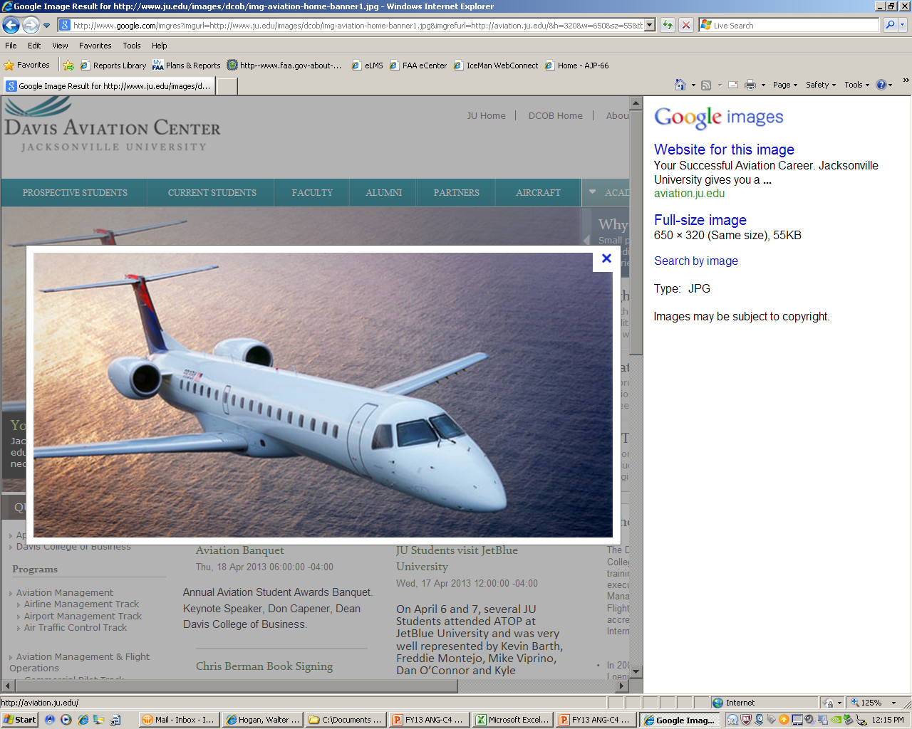

Optimized Route Capability (ORC)
Description:
The addition of many new PBN routes and playbook options significantly increases complexity of optimal route selection and coordination
ORC researches tools and procedures to assist ATM with assessment, coordination, selection, and implementation of these new options in order to optimize the benefits
Partnerships:
MITRE
NASA
Accomplishments:
Initial ORC Concept of Use: Automation Support and Procedures (Mar 2015)
ORC Procedural Mapping (Jul 2015)
ORC Concept of Operations v2.0 (Sep 2015)
ORC Site Analysis: Houston (Nov 2015)
Preliminary Quantified Shortfall Analysis Report for Optimized Route Capability (Jun 2016)
Funding:
FY13 | FY14 | FY15
$1,096,698 | - | -
6
Notes:
UPDATE: Jun 2016 product (ORC shortfall analysis)
The shortfall analysis:
Identified and quantified 12 NAS shortfalls that could potentially be mitigated through the ORC concept
Monetized costs associated with 3 shortfalls
Excess Traffic Volume is Managed by Adding Delay
Merging Pre-Departure Traffic is challenging
Inefficient Delay Management Tools
Costs associated with these 3 shortfalls were estimated to be $200M per year
Fulfills the FAAs final deliverable to NASA to support the transition of ORC to NASA for integration into the ATD-3 platform
___________
PM: Phil Bassett
NextGen has promoted the development of a more efficient performance based route system. As these new routes and procedures multiply it has driven the need to assist air traffic managers in the assessment, selection and coordination of these new routes and procedures. The ORC (Optimized Route Capability) fulfills this need. ORC has been TECH TRANSFERRED To NASA for integraton and validation in the joint FAA/NASA ATD-3 demonstration (Air Traffic Demonstration-3).
The Performance-Based Trajectory Allocation (PBTA) program will leverage the ORC algorithm being developed in collaboration with NASA. PBTA extends functionality of the ORC algorithm to take further advantage of optimized PBN routing options and intelligent PBN transitions from enroute to the terminal environment. Initially the program will focus on benefits associated with PBTA and also support further development and maturation of the tool.
FY18 funded products will include
Initial investigation of integration issues associated with the integration of RNAV/OPD arrivals and Time Based Flow Management (TBFM)
Initial optimal arrival/departure routing options and implementation strategies for PBN Route Optimization
In Summary
The proliferation of these multiple PBN routes and procedures is beyond the ability of traffic managers to sort and assign.....the numbers of these routes continues to grow
We are supporting the maturation of the algorithm with NASA (ATD-3)

Slide 7
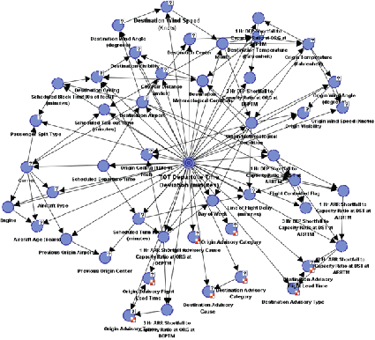
Statistical Methods for Departure Predictability (SMDP)
Description:
SMDP research will develop a probabilistic directed acyclic graphical model for improving departure time predictions by developing a Bayesian Belief Network (BBN) model.
BBN model will utilize historical data to improve the reliability of departure time predictions for real-time traffic flow management.
Partnerships:
FAA Mission Support (AJV)
Accomplishments:
  Obtain TFMS Historical Database (Feb 2016)
  Complete merge of all data sets to train BBN model (May 2016)
  Conduct ATC expert interviews at 6 facilities (Jul 2016)
Plans:
SMDP Single Airport Phase 2 Model (Aug 2016)
SMDP Core 30 Phase 2 Model (Apr 2017)
Funding:
FY13 | FY14 | FY15
- | $695,000* | -
  * FY15 PLA
7
Notes:
Update:
Data compilation:
Additional data sets were added to the Phase 1 baseline. The new data sets include the addition of TFMS (command center) and CCFP (convective weather) to NTML and ASPM/BTS data sets.
The additional data sets are expected to improve model prediction performance.
ATC Interviews:
The interviews were conducted for model refinement. ATC SME’s provided input on key factors affecting departure delay. They also participated in model variable selection and discretization that can be unique to the individual facility.
Visits were made to Las Vegas TRACON, SoCal TRACON, Lindbergh Tower (San Diego), Tampa TRACON, Orlando TRACON and Denver Tower, TRACON and ARTCC.
________
Program Manger: Steve Oshel
TFMS uses proposed departure times for scheduled air carriers to create demand projections for NAS elements (airports, sectors, fixes, etc). When aircraft do not depart at their scheduled time, our demand predictions end up being incorrect. This can lead to inefficient TMIs, GDPs, etc, and either over- or under- delivery of aircraft to arrival sectors & airports.
SMDP uses machine-learning to analyze historical flight data and create sophisticated algorithms that can predict departure times with much better accuracy.
Improved accuracy of departure-time predictions in TFMS will enable more efficient NAS planning, better use of TMIs, and improved management of NAS resources.

Slide 8
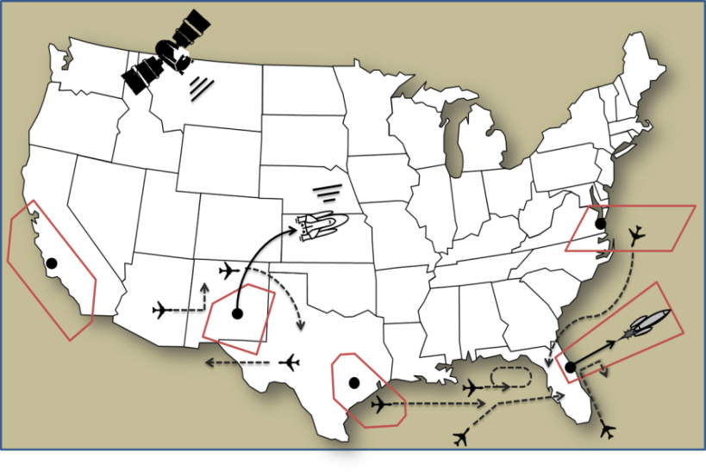
Space Vehicle Operations (SVO)
Description:
SVO research facilitates synchronization of FAA’s NextGen, Commercial Space, and Air Traffic Organization offices with the Center of Excellence for Commercial Space Transportation (COE CST) and industry stakeholders to develop a concept that will enable integration of air and space traffic management in the NextGen timeframe.
Partnerships:
FAA Commercial Space Transportation (AST)
Air Traffic Organization Space Operations
Stanford University
William J. Hughes Technical Center
ACTA
Volpe Center
Mosaic ATM
MITRE
Accomplishments:
  Final Requirements Document for Second Additional Type of SVO (Oct 2015)
Define SVO Data Requirements Definitions (Jul 2016)
Plans:
Initial data elements for FIXM (Nov 2016)
4D Trajectory Concept for SVO (Mar 2017)
Debris Mitigation Failure Mode Analysis Report (Jun 2017)
Funding:
FY13 | FY14 | FY15
$1,090,272 | $1,270,000* | -
  * FY14 PLA: $800,000; FY15 PLA: $470,000
8
Notes:
UPDATE: Jul 2016 Deliverable (Data Requirements Definitions)
The SVO Data Requirements task provides a detailed assessment of NAS architecture and the NAS infrastructure data exchange and processing requirements for handling of space vehicle operations (SVO).
It provides the basis for the upcoming analysis of current and future systems and operational platforms that will potentially require (or be subject to) SVO data requirements.
_____________
Program Manager: Jason Coon (replaced Kevin Hatton)
The SVO Program has produced a Level 3 NAS ConOps that articulates the vision for space launch and reentry operations in the NAS for 2025 and beyond. The SVO ConOps has been vetted and approved by all primary agency stakeholders (AST, AJV, AJR).
Current work supports the ConOps by providing tools or capabilities necessary to implement the ConOps.
“Define Data Requirements for SVO” was requested by the Chief Scientist, and will provide a scenario-based view of all data exchange necessary for SVO, including actors, systems, and new capabilities.
Initial Data Elements for FIXM” has been coordinated with AJV-7 (Maureen Keegan), and will provide the operational input to the FIXM Change Control Board necessary for incorporating SVO data elements into FIXM and AIXM.
4D Trajectory Concept for SVO is research being performed by Stanford University under the Center of Excellence for Commercial Space Transportation, and is developing advanced dynamic debris hazard areas that are smaller than current airspace closures and have shorter durations, creating less NAS impact.
The Debris Mitigation Failure Mode Analysis will include analysis of multiple space vehicles, launch locations, and failure modes to assess NAS impact of the debris hazard volumes that result from each type of failure.

Slide 9
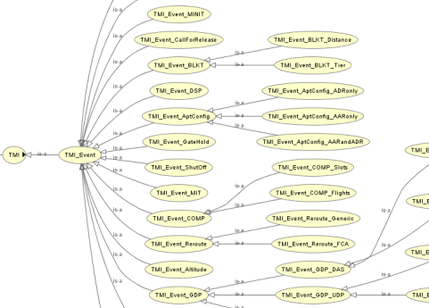
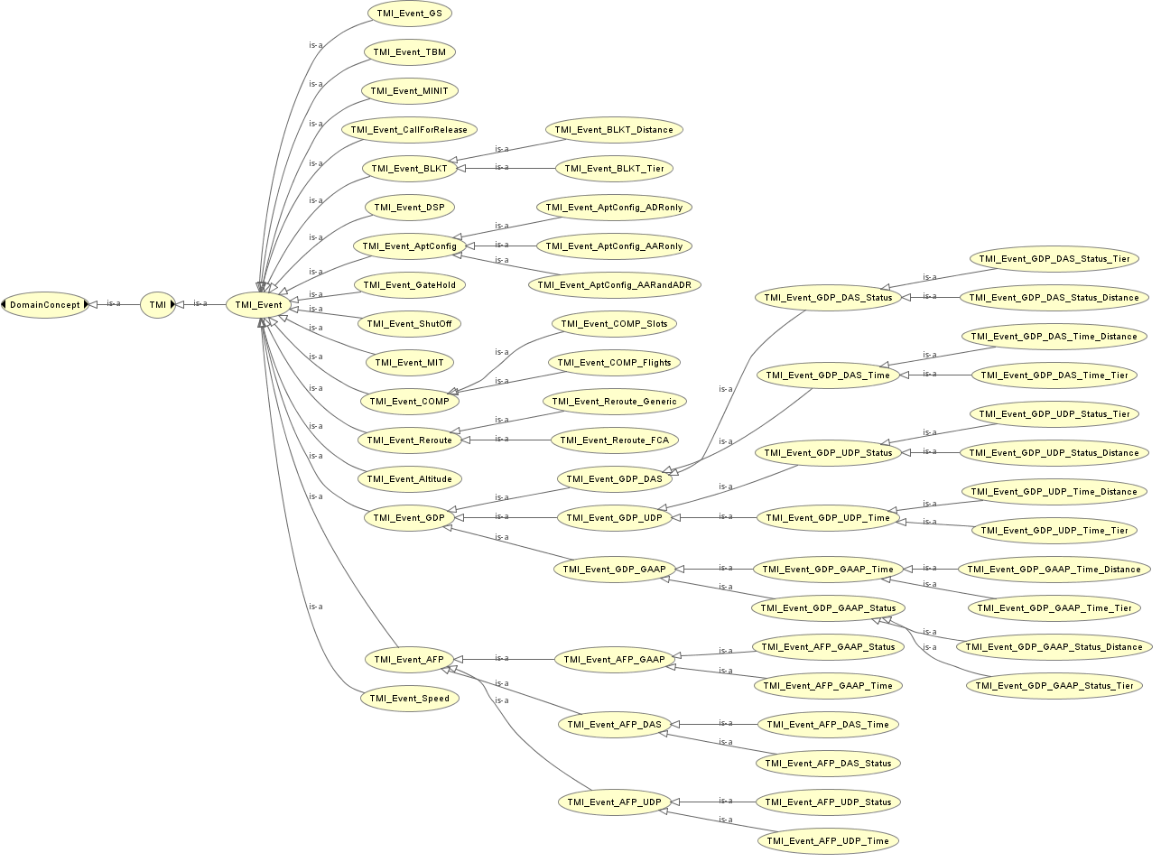
TMI Attribute Standardization (TAS)
Description:
TAS research utilizes historical and current Traffic Management Initiative (TMI) data to define a system model in which TMI attributes are categorized in a manner that will facilitate real-time TMI information and feedback to NAS users, unified TMI modeling, post-event analysis, and continuous flight day evaluation.
This research will also result in standardized TMI entry, parsing, & tracking, by enhancing functionality currently provided by NTML.
Partnerships:
Volpe Center
Mosaic ATM
FAA Mission Support (AJV)
Accomplishments:
  TMI Attribute Standardization Report (Jun 2014)
  Update TAS Ontology (Jun 2016)
Plans:
  Initial Requirements (Dec 2016)
  Coordinate with AJV Advanced Methods (May 2017)
TAS Standardization Requirements (May 2017)
Funding:
FY13 | FY14 | FY15
- | $290,000* | -
  * FY15 PLA
9
Notes:
Update:
TAS Ontology Update:
The ontology has been updated to account for modification to TFMS since Phase 1 was completed.
Major revisions included the addition, deletion or replacement of more than 30 elements of the original ontology.
________
Program Manger: Steve Oshel (formerly Kevin Hatton)
TAS has developed an ontology for Traffic Management Initiatives. The ontology will enable standardized entry and tracking of TMIs across different automation platforms. This will prevent the problems that exist today with attempting to detect and parse TMIs that are often recorded in non-standard formats or free text.
Bradford and Liang were briefed on the initial results and they asked for TAS to be implemented in TFMS as soon as practical.
This work will include documentation of Initial Requirements for TAS in TFMS (to be handed off to AJV-7).

Slide 10
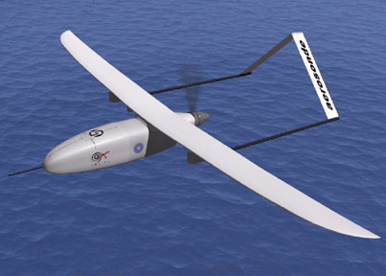
UAS Integration into the NAS
Description:
Mature a ConOps for UAS integration into the NAS:
  Ensure NextGen systems and capabilities are prepared for increased numbers of UAS operations
  Develop and describe operating concepts outside the scope of the UAS ConOps to enable nearer term operations
  Develop concept and system requirements for a Flight Information Management System low altitude, small UAS operations (planned)
NextGen Operational Analysis of UAS Operations in Class A&B Airspace (Sep 2015)
UAS Low Altitude Operating Concepts Paper (Modified IFR) (Apr 2016)
Partnerships/Stakeholders
Accomplishments:
AJV-7
AFS-80
ANG-C2
AIR-130
AFS-400
Funding
FY13 | FY14 | FY15
$500,000 | $360,500 | -
10
Notes:
Update: UAS Low Altitude Operating Concepts Paper
Developed to address the predicted demand in small UAS operating at low altitudes – which was not covered in the FAA’s UAS ConOps 2.0.
Based on scenarios reviewed and vetted by the FAA by the UAS Steering Group, comprised of cross line of business Directors (AVS, ATO, and ANG) and those working UAS concept and requirements development.
The paper describes potential means by which UAS access could be expanded – visual line of sight, extended visual line of sight, and beyond visual line of sight – through the use of airspace constructs, notification in lieu of a flight plan to convey flight intent, and a clear delineation of roles and responsibilities among the UAS operator, Air Navigation Service Provider, and manned aircraft.
__________
PM: Sherri Magyarits
The Advanced Concepts Branch (ANG-C54) has been supporting the development and maturation of UAS concepts and requirements for expanded access to the NAS since 2011.
Most recently, in 2015, we
Completed analyses to map UAS operational requirements, in Class A and B airspace, to NextGen systems and capabilities to ensure we are prepared for increased numbers of UAS operations.
Notes:
If they ask why Class A and B – that’s where most NextGen investments reside.
If they ask about results, we feel we either already are or will be prepared from the requirements we’ve identified, given the numbers and nature of the types of forecasted operations in these airspace classes).
Developed UAS operating concepts and scenarios for potential near-term application – primarily focusing on low altitude (under 1200 ft AGL) operations. This work highlighted key elements that could enable these operations, including notifying of flight intent, use of airspace constructs (segregated concepts) to contain UAS given shortfalls of the UAS and/or NAS infrastructure
Future plans include performing a functional analysis and developing system requirements to work towards implementing a notification system for UAS operating in primarily uncontrolled airspace. The project is called Common Support Services – Notification System for sUAS. This need is derived from the FAA requirement to be cognizant to at least some degree of all UAS operations occurring in the NAS, including airspace where ATC may not be involved. This work is still being scoped out, but should be initiated in FY17.

Slide 11

(SEPMAN Portfolio)
Vertical Conformance Verification (VCV)
Description:
Misjudgment of aircraft rate of climb and descent during Converging/Opposite Direction operations is among the top 5 risks to the NAS (FAA Safety Office)
VCV researches the impact of new technologies on primary surveillance parameters, and how to mitigate the effects on ATC ability to leverage historical methods to mentally calculate vertical rate
Providing near real time VR information will aid ATC in assessing conformance and promote more efficient airspace utilization
SEPMAN: Separation Management
Partnerships:
Boeing
Accomplishments:
Research Management Plan (Jan 2016)
  Recommendations for Interim solutions prior to ADS-B (May 2016)
Plans:
  Identify NAS automation and ATC procedural needs for improved vertical airspace management (Aug 2016)
  Feasibility Analysis of interim vertical solutions prior to ADS-B implementation (Mar 2017)
  VCV Concept of Operations (Mar 2017)
Funding:
FY13 | FY14 | FY15
- | $490,000* | -
  * FY15 PLA
11
Notes:
UPDATE: May 2016 product (VCV Interim Solutions)
The VCV concept provides a more efficient means for radar controllers to obtain and monitor real-time vertical rate (climb and descent) for flights from top of descent to touchdown and from departure to top of climb,
Will result in better airspace optimization and procedures and more efficient operations
The product identified three recommended solutions for obtaining vertical rate information prior to full-scale deployment of ADS-B.
ERAM Vertical Rate Indicator,
the Aeronautical Telecommunications Network Baseline 2 data communication standard, and
Mode S Transponder capabilities.
The document outlines a strategy for maturing the VCV concept and validating the recommended solutions for efficiently presenting vertical rate information to air traffic controllers.
______________________________
PM: Phil Bassett
The way vertical airspace is managed during descent today results in the loss of utilization of large volumes of airspace.
Even though aircraft are required to descend or climb at an established rate, this can vary substantially due to variations in airframe, equipage, flight deck workload, and user fleet preferences.
ATC can verify vertical conformance only after the aircraft has passed the required fix/altitude which is performed verbally.
The VCV concept identifies the procedures, technologies, and tools that will enable controllers the ability to verify vertical rate, and monitor the aircraft’s conformance to a defined trajectory.
Enabling more precise vertical control will allow large volumes of previously unavailable airspace to be utilized for other traffic. This will be extremely beneficial in areas of high volume and congestion (e.g., the Northeastern United States).
Additional benefits beyond increased airspace efficiency include the ability to leverage emerging aircraft design and technologies, to leverage this new information within NAS automation (eg conflict alert), and the development of vertical designed technologies (4DT, OPD, OPC)

Slide 12
Questions

Slide 13
FY15 Accomplishments
SVO
  Integrated NAS/SVO Simulation Model (Oct 2014)
  Draft Requirements Document for Second Additional Type of SVO (May 2015)
VCV
  VCV Operational Improvement Assessment (Oct 2014)
  VCV Concept Assessment Report (Dec 2014)
ORC
  ORC Initial Concept of Use: Automation Support and Procedures (Mar 2015)
  ORC Procedural Mapping (Jul 2015)
  ORC Concept of Operations v2.0 (Sep 2015)
  ORC Site-Specific Analysis (Nov 2015)
UAS
  Draft Concept Reports for Class A&B Airspace (Sep 2015)
  NextGen Operational Analysis of UAS Operations in Class A&B Airspace (Sep 2015)
13

