Slide 1
REDAC / NAS Ops
Operations Concept Development & Infrastructure (ATDP)
BLI Number: 1A01C
Rob Hunt, AJV-73
August 9, 2016

Slide 2
Operations Concept
Development & Infrastructure - ATDP
Overview
The FAA is proceeding with NAS modernization based on the NextGen Operational Concept and the FAA’s Future of the NAS. Concept development and validation is necessary to investigate specific concept elements, and to drive out operational and technical requirements and implications for human factors, training and procedures. This program assesses the interaction of changing roles and responsibilities of NAS service providers and pilots, airspace changes, procedural changes and new mechanized systems for distributing weather, traffic and other flight related information. It tests the assumptions behind common situational awareness and distributed information processing. It also contributes to the FAA’s support for the RTCA, a non-profit association that develops standards based on manufactures, government, and aviation operator inputs.
The program uses analysis and associated white papers to validate whether future system requirements meet NextGen goals, including the flight data processing evolution in En Route Automation Modernization (ERAM), data communications, the future voice switch, changes in surveillance requirements and associated procedures, establishment of new roles and responsibilities to support increased productivity, etc. It will develop methods, metrics, and models to demonstrate that the modernized system can handle anticipated growth in traffic demand according to the Terminal Area Forecasts (TAF) for incremental years. This supports the goal of continued US leadership internationally and helps ensure the global harmonization through continued support for the ICAO Global ATM operational concept, the development of global requirements, and the definition of an air transportation performance framework.

Slide 3
Operations Concept Development & Infrastructure – ATDP / BLI Number: 1A01C Overview Capabilities
  People:
  Program Manager: Rob Hunt
  Subject Matter Experts: Traffic Managers, ATC, Discipline Experts, Airspace User Community
  Research Partners: ANG, NASA, Mitre, Lincoln Labs, Volpe, Academia
  Laboratories:
  MITRE
  Tech Center
  DAB Test Bed
  NASA
  Volpe

Slide 4
FY16/17 Activities
PBN Optimization
  Objective: Expand the efficient use of PBN procedures in the NAS, leveraging the new PBN Strategy
  Activities: Collaborate with industry via the NAC PBN Time/Speed/Spacing Tools Tasking and obtain feedback on the evolution of tactical flow management to enable PBN operations; Tasking Report, which is due in October 2016, may influence future concept engineering activities
4

Slide 5
FY16/17 Activities (cont)
PBN Optimization (cont)
5

Slide 6
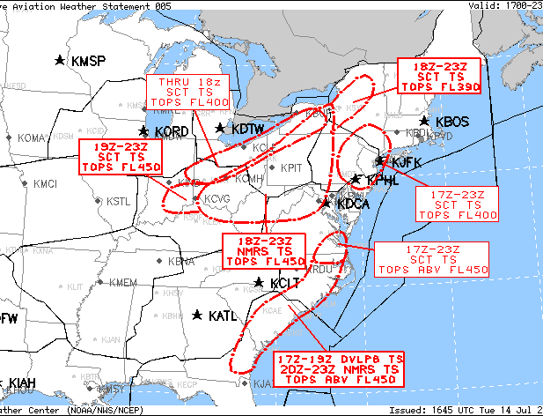
FY16/17 Activities (cont)
Weather Integration
Objective: Evaluate collaborative, event-driven weather-relevant ATM decision making
Activities: In collaboration with the CSG WET, support field evaluations of the collaborative aviation weather statement (CAWS) concept; update preliminary conops and requirements documentation and determine next steps
Collaborative Aviation Weather Statement 005
NWS Aviation Weather Center Kansas City MO
1645 UTC Tue 14 Jul 2015
Weather: Thunderstorms
Valid: 1700-2300Z
ARTCCs affected: ZBW, ZDC, ZID, ZJX, ZNY, ZOB
Terminals affected: KDCA, KEWR, KIAD, KJFK, KLGA, KPHL
SUMMARY: Thunderstorms over the Ohio Valley through Northeast and over VA through southeastern GA this afternoon.
DISCUSSION: This updates and replaces CAWS003. Thunderstorms over western NY throught southeastern IN will increase to become numerous through 23z. Tops FL450.
Further north...scattered thunderstorms probable over northeastern through central NY. Tops FL390.
Scattered thunderstorms expected over NY metros through 23z.
Afternoon thunderstorms over sern VA through sern GA coast through 23z. Tops FL450 and above.
17Z CCFP does not reflect this detail or tops expected.
6

Slide 7
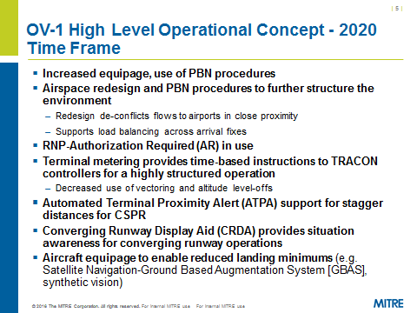
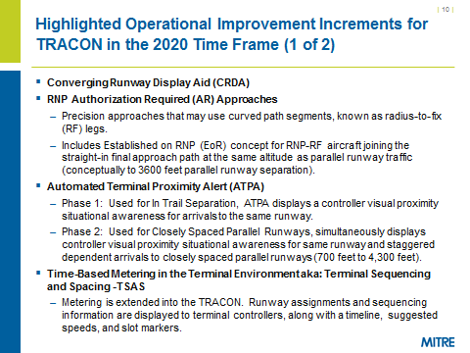
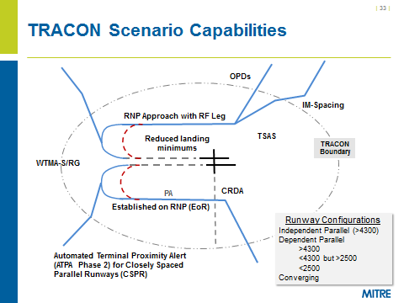
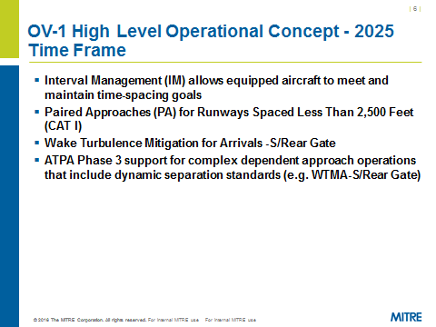
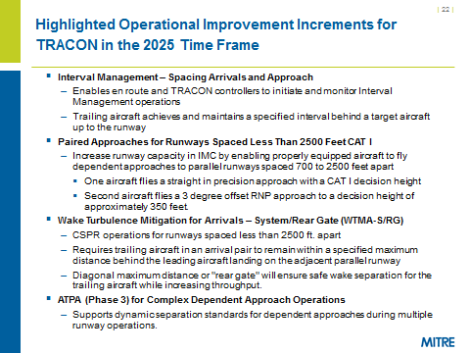
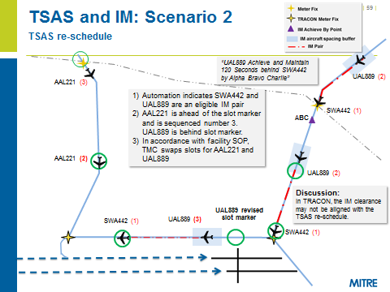
FY16/17 Activities (cont)
Operational Integration Analysis
  Objective: Continue to examine possible operational integration issues as emerging concepts evolve and new concepts are planned between now and 2025
  Activities: Scenario development/update/execution with operational SMEs—scenarios include all operational domains (e.g. TFM, en route, terminal, etc); generate mitigation recommendations (e.g. further research, reqs)
7

Slide 8
Emerging FY18 Focal Areas
Trajectory-Based Operations
  Objective: Mature Trajectory-Based Operations (TBO) concept
  Potential Activities: Continue collaboration with research community, e.g. NASA, Mitre, to:
  Mature and integrate advanced rerouting and time-based metering operations
  Conduct an evaluation of proposed Trajectory-Based Operations, assessing potential ground and/or flight deck solutions to meet system-level requirements
  Develop requirements for and initiate NAS changes to execute mature TBO elements
Operational Integration Analysis
  Objective: Continue to examine possible operational integration issues as emerging concepts evolve and new concepts are planned for the future
  Potential Activities: Scenario development/update/execution with operational SMEs, generate mitigation recommendations (e.g. further research, requirements)
RTCA Support
  Continued support of international standards and public/private collaboration
8

Slide 9
Questions?

