Slide 1
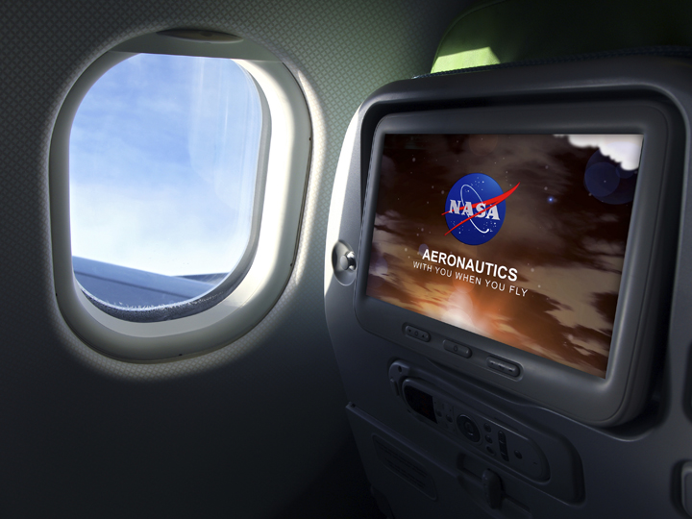
ATD-1: Overview
August 9, 2016

Slide 2
Outline
ATD-1 Overview
TSAS Activities
FIM Activities
Conclusion

Slide 3
ATD-1 at a Glance
The first of a series of NASA ATM Technology Demonstration (ATD) projects to provide benefits to the commercial aviation community through the development of new technologies
Integrated Arrival Solution
Terminal Sequencing and Spacing (TSAS) + Interval Management (IM)
Key Steps
Finish research on TSAS and IM that began in years prior
Build prototype systems
Demonstrate prototype systems
Transfer technologies to Industry and FAA
IM prototype and flight test team: NASA, The Boeing Company, Honeywell, United Airlines, and FAA
Accelerate NextGen and reduce time to market by addressing tech transfer challenges between research, development and implementation for key capabilities

Slide 4
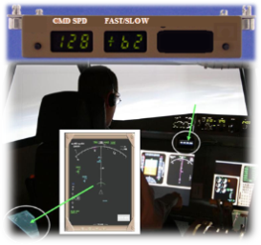
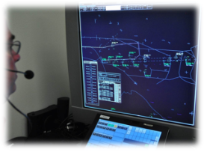
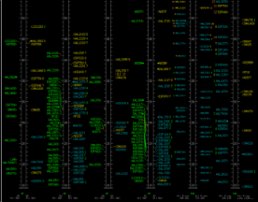
Operational Context
NOTE: Nominal +/- spacing precision
Is indicated in parentheses.
Trajectory-based Operations
Reduced excess separation
Efficient Descents
Flight Deck-based
Spacing Aids
(~5 sec)
Ground-based
Spacing Aids
(~15 sec)
FIM
Increasing level of efficiency
Terminal
Metering
TSAS
En Route
Metering
(~60 sec)
TMA-TM
Terminal vectoring
Excess separation
Step-down Descents
TMA
Independent Scheduling
Integrated Scheduling and Spacing
Increasing level of automation, accuracy, maturity…

Slide 5
ATD-1 Formulation
In 2010
Elements of NASA terminal ATM research progressed to high-fidelity human-in-the-loop (HITL) simulations. Stakeholder input and feedback was positive; the research aligned with FAA priorities
In 2011
Office of Management and Budget and Congress requested NASA to:
Accelerate ATM technology transition, including ADS-B In
Conduct more relevant flight research emphasizing enhancing aviation safety and airspace efficiency
ATD-1 initiated as part of the Systems Analysis, Integration, and Evaluation Project within NASA’s Airspace Systems Program
In 2012
The ADS-B In Aviation Rulemaking Committee and FAA Reauthorization Act of 2012 both identified the need to demonstrate promising ADS-B In applications to help the community understand the benefits of ADS-B In

Slide 6
ATD-1 Objectives
Demonstrate increased, more consistent use of Performance-Based Navigation (PBN)
RNAV/RNP arrival procedures from cruise to touchdown
Optimized Profile Descents (OPD) using speed control
Simultaneous high throughput and fuel-efficient terminal ops
Demonstrate ADS-B In Spacing Application
NASA ADS-B In merging and spacing algorithm (ASTAR)
Accelerate transfer of NASA scheduling and spacing technologies for inclusion in NAS/NextGen
Terminal metering based upon Traffic Management Advisor research
Airborne spacing application based upon Interval Management research
Controller spacing tools based upon Controller Managed Spacing research

Slide 7
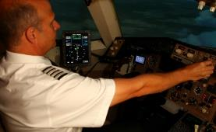
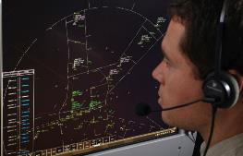
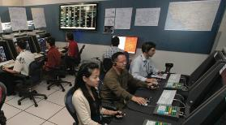
ATD-1: Integrated Arrival Solution
FIM
Flight Deck Interval Management
for Arrival Operations
CMS
Controller-Managed Spacing
in Terminal Airspace
NASA Technologies plus
ADS-B Infrastructure Area Navigation (RNAV)
Arrivals Required Navigation Performance (RNP)
Optimized Profile Descents (OPD)
TMA-TM
Traffic Management Advisor
with Terminal Metering

Slide 8
Operational Scenario
Time-based scheduling provides runway arrival times and fix crossing times for arriving aircraft.
En route speed and path assignments correctly space aircraft for descents on RNAV/RNP OPDs to assigned runways.
250+ NM
Aircraft are delivered to meter fixes according to schedule, but with small spacing errors that need to be reduced to maximize throughput and avoid spacing violations.
Meter Fix
Most flight crews use FMS to fly OPDs along RNAV/RNP routes – largely without controller intervention.
50 NM
Merge Point
Meter Fix
Some flight crews use onboard speed guidance to achieve and maintain precise traffic spacing.
Terminal controllers correct residual spacing errors and cope with disturbances and off-nominal events using tools and display enhancements based on 4-D trajectories.

Slide 9
ATD-1 HITL Simulations (FY)
REACT w/FAA+ MITRE
Enable RNP-AR procedures using ATD-1 tools in DAL airspace
NASA TMA-TM + CMS
FIAT-1
Initial ATD-1 integration of TM algorithms into RTMA –TM 3.12 + CMS + ASTAR11 in LAX airspace
FIAT-2
Validate RTMA 3.12 w/TSS + ASTAR11 in PHX airspace
FIAT 3
Integration of RTMA 3.12 w/TSS and STARS ELITE w/TSS in PHX airspace
CMS Flight Deck #1 & #2
Examine crew workload & strategies when flying schedule-based OPDs using CMS in LAX airspace
Evaluate crew response to “nominal” CMS speed clearances using RTMA-TM 3.12 + CMS in PHX airspace
TSS-1 w/FAA+MITRE
Evaluate ATD-1 tools using advanced PBN procedures with mixed-equipage in LAX airspace
NASA TMA-TM + CMS
TSS-2 w/FAA+MITRE
Evaluate PBN arrival procedures under robust wind and heavy traffic conditions in PHX airspace
RTMA 3.12 w/TSS
FIAT-4
Validate ASTAR12 performance in PHX airspace
RTMA 3.12 w/TSS and STARS ELITE w/TSS + ASTAR12
Ops Int @ Tech Center
Identify changes for GIM-S/TSS integrated operations; Recommend AT procedures & training for TSS operational use
TBFM 4.2.3 w/TSS & GIM-S and STARS SCOUT R2 w/TSS in PHX airspace
2012
2013
2014
2015
CA-1, CA-2, CA-3
Initial ATD-1 system integration of NASA TMA-TM + CMS + ASTAR11 in DFW airspace
Controller evaluation of tools, workload, proposed phraseology
CA-4, CA-4.1
ATD-1 system integration of RTMA-TM 3.12 + CMS + ASTAR11 in PHX airspace
Corrected RUC truth winds & forecast winds
CA-5.1, CA-5.2
Compare baseline & TSS performance measures using PHX West & East Flow operations using RTMA 3.12 w/TSS
CA-5.3
Compare ATD-1 performance measures using PHX West & East Flow operations using RTMA 3.12 w/TSS + ASTAR12
GIM-S
Evaluate MFX delivery ops
TSS/ATPA/ RECAT
Evaluate TAMR CHI integration
IM-NOVA
Assess acceptability of ATD-1 ConOps crew procedures
ASTAR11 + NASA TMA-TM + CMS in DFW airspace
ISIM
Assess FIM HMI Options
ASTAR11 + NASA TMA-TM + CMS in PHX airspace
RAPTOR
Assess if ASTAR12 satisfies the ATD-1 requirements for FIM
ASTAR12 + RTMA 3.12 w/TSS in PHX airspace
FIAT-5 & ORM
Validate TBFM 4.2.x w/TSS & STARS SCOUT R2 w/TSS in PHX airspace
Pre-Ops Int prep
IMAC
Validate IM procedure, algorithm, phraseology for new clearance types; Evaluate IM display elements
ASTAR13 + TBFM 4.2.x in DEN airspace
Notes:
Updated 2/23/15: ATD-1 HITLs
-- Updated TBFM version in OIA, ATPA boxes
-- Per MM: Animation order and color by sim grouping (FIAT, CA, FIM, FAA, FY15); Arranged by FY; FY15 pop up together
-- NASA ATC TSS: REACT (Mar 2012), CMS Flt Deck 1 (Mar/Apr 2012), TSS-1 (Sep 2012), FIAT-1 (Oct 2012), FIAT-2 (Mar 2013), TSS-2 (Apr 2013), FIAT-3 (Aug 2013), CMS Flt Deck 2 (Nov/Dec 2013), FIAT-4 (Feb 2014), FIAT-5 (Dec 2014), OIA Risk Mitigation (ORM) Ops Int Prep (Mar 2015)
-- NASA AOL TSS: CA-1 (Jan 2012), CA-2 (Apr 2012), CA-3 (Jun 2012), CA-4 (Dec 2012), CA-4.1 (Mar 2013), CA-5.1 (Jul 2013), CA-5.2 (Sep 2013), CA-5.3 (Apr 2014), GIM-S Performance Eval for OIA (Apr 2015), TSS/ATPA/RECAT (May 2015), Research Platform for ZAB/ZDV/ZNY (3Q-4QFY15)
-- NASA FIM: IM-NOVA (Aug/Sep 2012), ISIM (Apr 2013), ASTAR Batch 1 (Jul 2013), RAPTOR (Jan/Feb 2014), ASTAR Batch 2 (Sep/Oct 2014), ASTAR Batch 3 (Apr 2015), IMAC (Jul 2015)
-- Ops Int @ TC (May 2015)
-- 1st ASTOR build with ASTAR12 is 9/5/2013 (per TSmith)

Slide 10
Outline
ATD-1 Overview
TSAS Activities
FIM Activities
Conclusion

Slide 11
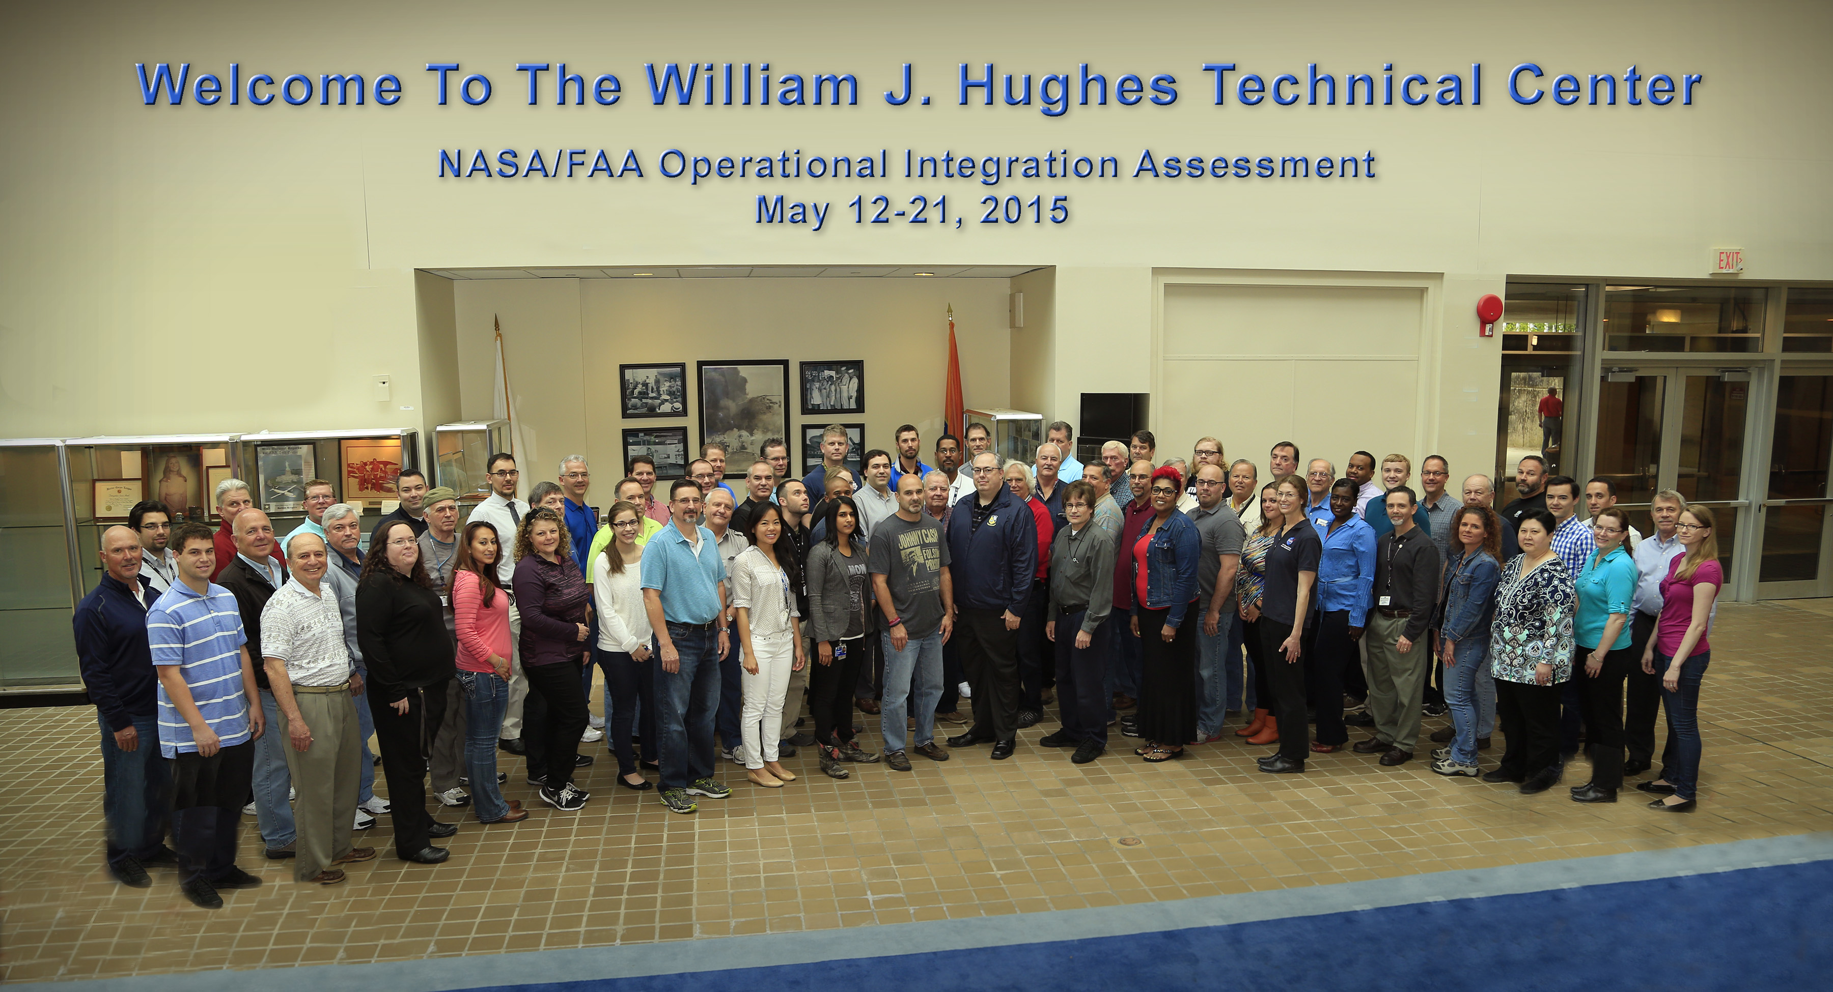
NASA/FAA OIA Team

Slide 12
TSAS Activities
Operational Integration Assessment (OIA)
May 2015: OIA conducted at FAA Tech Center
July: Provided briefings of some preliminary results to the FAA
Sept: Final Report drafted
Nov: Additional results briefed during Tech Transfer 4 TIM at FAA HQ
Final Report being updated to reflect additional results and stakeholder comments
Jan 2016: Final Report with all updates will be delivered to the FAA
Mar 2016: OIA Data Package will be prepared and delivered to the FAA
Provides the FAA with additional materials to support implementation of TSAS

Slide 13
Outline
ATD-1 Overview
TSAS Activities
FIM Activities
Conclusion

Slide 14
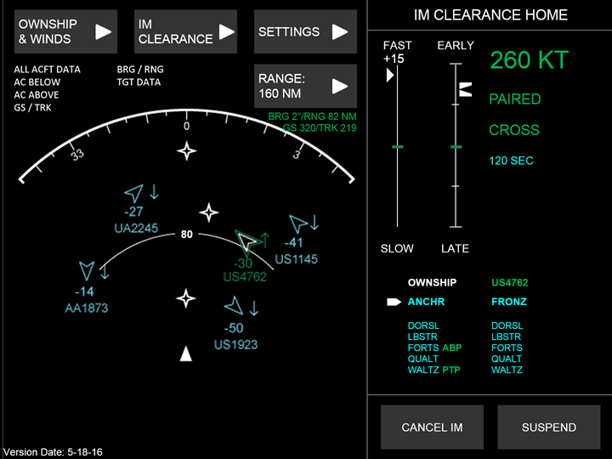
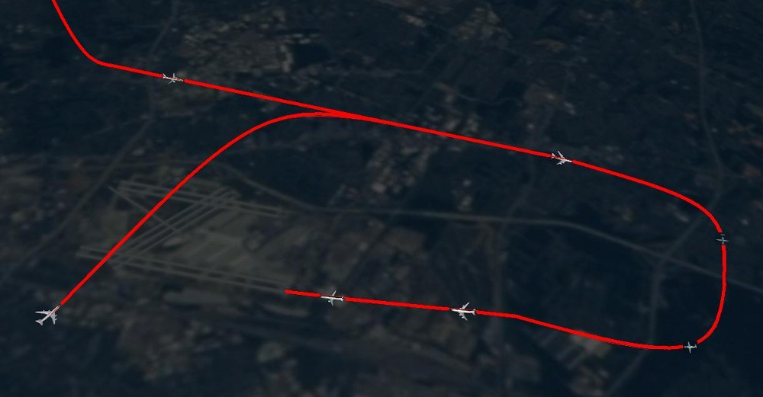
Flight-deck Interval Management (FIM)
Flight deck automation that provides air speeds to pilots allowing them to more accurately space their aircraft behind another aircraft based on an operationally desired spacing goal prescribed by Air Traffic Control (ATC)
Includes ground automation enhancements
Target/Lead Aircraft
FIM Aircraft
14

Slide 15
FIM Activities - Prototyping
Objectives:
Demonstrate ADS-B In Application
Address ADS-B In ARC Final Report: ADS-B In demonstrations needed
Address FAA Reauthorization Act of 2012: ADS-B In demonstrations needed
Accelerate transfer of NASA scheduling and spacing technologies/accelerate key NextGen capability
Avionics Phase 1
Feasibility and Trade Studies on Hardware/Software for FIM using ASTAR
ASTAR Flight Test
Proof of Concept flight test for operational risk reduction
Avionics Phase 2
Build, test, fly and report on FIM system based on ASTAR
Transfer prototypes to FAA

Slide 16
Avionics Phase 1
Prototyping Initiated in 2012
Phase 1:
Feasibility and trade studies performed by the Boeing Company
NASA Airborne Spacing for Terminal Arrival Routes (ASTAR) FIM algorithm was demonstrated in flight test cabs at Boeing facilities using ACSS system in Feb 2013
Several members of FAA attended
All deliverables included in ATD-1 Tech Transfer package

Slide 17
ASTAR Flight Test
Proof-of-concept ADS-B In application flight test in December 2014
Purpose:
Assess risks associated with ADS-B In application flight trials
Get an initial look at NASA FIM application performance in flight
FIM application on board Boeing EcoDemonstrator 787
Arrivals into Moses Lake, WA
Boeing also provided second aircraft as ADS-B Out source
NASA and Boeing staff monitored operations from ZSE and MWH
Conducted successfully and results were positive
Presented to US Congress during NASA Technology Day on the Hill
Media
http://www.nasa.gov/press/2014/december/nasa-tests-software-that-may-help-increase-flight-efficiency-decrease-aircraft/
http://www.ainonline.com/aviation-news/air-transport/2014-12-18/boeing-concludes-latest-round-ecodemonstrator-trials

Slide 18
NASA Testing on the Boeing EcoDemonstrator 787

Slide 19
Avionics Development/ Flight Test Scope
Build, test, and fly a prototype FIM Avionics System in air transport category aircraft
System and Hardware Development
FIM application Software Development
Hardware/Software Integration and Testing
Avionics System and FIM Application Documentation
Ground and Flight Tests
Six Working Groups managed by Boeing with participation by NASA, Boeing, Honeywell, United Airlines, and FAA
Requirements WG: baseline final requirements to align with RTCA FIM MOPS
Human/Machine Interface WG: baseline final pilot interface for FIM avionics system
Control Law WG: baseline final ASTAR FIM algorithm implementation in FIM avionics system
Flight Test WG: develop flight test plans
Data Gathering/Analysis WG: develop data collection plans
Hardware/Aircraft WG: baseline hardware and aircraft configurations for all aircraft
Conduct analyses of results and report out

Slide 20
Flight Test Operational Environment
Operational environment
Seattle Center and Grant County International Airport (MWH) in Washington State
Arrival operations performed at MWH with some in cruise
Custom arrival procedures designed for state-of-the-art NAS development
3 Aircraft available
Honeywell Dassault Falcon as DO-260B ADS-B Out lead
Honeywell B757-200 as DO-260B ADS-B In/Out FIM aircraft
United Airlines B737-900ER as DO-260B ADS-B In/Out FIM aircraft
Voice comm for clearances
38 Test Conditions – 82 Flight Hours+Transit
Observers embedded in local FAA facilities
Flight Crew procedures defined by HMI design and SMEs
ATC procedures defined by the FAA Facilities

Slide 21
Schedule at a Glance
Award June 2015
Kickoff July 2015
PDR September 2015
CDR May 2016
SAR December 2016
Pilot Orientation December 2016
FRR January 2017
Flight Test January/February 2017
Analysis Complete May 2017
Closeout June 2017

Slide 22
Outline
ATD-1 Overview
TSAS Activities
FIM Activities
Conclusion

Slide 23
Concluding Remarks
NASA is working with key stakeholders to improve high density terminal arrival operations by developing new concepts and prototypes, and providing expertise to accelerate a key ADS-B In Application and sequencing and spacing tools for NextGen
TSAS technologies have already been transferred to the FAA for a 2018 IOC
IM concepts and technologies are being developed for a flight test and subsequent transfer to the FAA and OEMs for further development and testing as needed

