Slide 1
Weather PPT Portfolio Review
Weather Program, A11.k
By: Randy Bass
Date: August 10, 2016

Slide 2
  Program Overview
  AVS Weather Portfolio
  Core Weather Program
  Offshore Precipitation Capability (OPC)
  Research Technology Transition
2

Slide 3
Program Overview
  Why is this program necessary?
  Weather has been identified as a causal factor for 53 percent of delays in 2015 (derived from FAA OPSNET data from the Bureau of Transportation Statistics) and 20 percent of accidents as cited in “The Mission Need Statement (MNS) for Aviation Weather (#339)”.
    Shortfalls identified in the areas of weather detection and forecasting as well as product creation and dissemination
  Supports NextGen Implementation Plan Weather Operational Improvements
  Supports FAA Strategic Goals related to efficiency, capacity, safety, and environmental impacts
  Facilitate transition of legacy weather requirements and products to meet emerging NextGen needs
  Weather frequently cited as primary or secondary cause in accidents and injuries (per NTSB, turbulence is leading cause of inflight injuries in Part 121 operations)
  GA fatality rate in weather related accidents, on average is 35% (GA accounts for 75% of weather related accidents)
  Supports the need to provide high quality weather analyses and forecasts to ATM, dispatchers and pilots to proactively select safe and optimal routes
3

Slide 4
Program Overview (cont.)
  What is this program?
  Purpose
    Applied research to minimize the impact of weather on the NAS
      Specific initiatives to support NextGen weather Operational Improvements contained in the NextGen Implementation Plan
      Collaborative, complimentary initiatives with NWS to transition legacy capabilities to meet NextGen requirements
      Focused initiatives to help mitigate safety and/or efficiency issues associated with well documented weather problems
  Benefits
    Increased NAS capacity/efficiency and safety and reduced environmental impacts
Funding
FY16 | FY17
$13,860,000 (final contract $) | $16,850,000 (total budget proposed)
4

Slide 5
AVS Wx Portfolio
AVS sponsored and prioritized research initiatives to address select safety concerns in the short and mid-term time horizon, but consistent with current and future requirements
Develop Terminal Area Icing Weather Information for NextGen Improved icing weather information including Supercooled Large Drops (SLD) in terminal area in response to new SLD certification rule
Mitigate the Ice Crystal Weather Threat to Aircraft Turbine Engines High Ice Water Content (HIWC) ice crystal data set sufficient for assessment of certification envelopes, development of test facilities, and diagnosis and forecasting for avoidance
Convectively Induced Turbulence - Extent/Severity/Impact on Aviation Conduct assessment of CIT impacts on NAS - results will enhance NAS capacity/safety with a primary focus on GA pilots through tool development for use in GA cockpit
Safety-Driven Wx Requirements for Wake Mitigation Predict system safety for NG OIs that incorporate real-time wake mitigation; and establish the specific relationship of system safety to the accuracy and update rate of the wx obs used to support these OIs
Validation of Advanced Airborne Radar Weather Hazards Detection Evaluation of capability of enhanced current generation and new generation airborne radar to detect potentially hazardous engine icing conditions
5

Slide 6
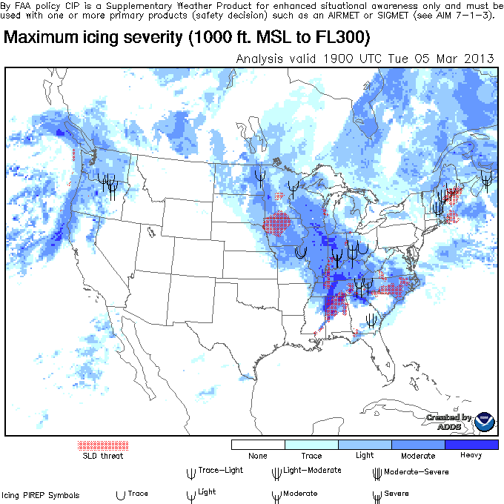
Hazardous Weather Mitigation
Description
Need: More accurate, relevant weather information to address efficiency and safety shortfalls in commercial and GA operations
Concept: Improve quality and applicability of weather information used for decision support in air carrier (emphasis on efficiency) and GA (emphasis on safety) operations
Recent Accomplishments
Transferred display upgrades for high resolution inflight icing diagnosis (CIP) and forecast (FIP) to NWS for operational implementation on aviationweather.gov
Turbulence display modifications (display of EDR, displays for different weight classes (light, medium, heavy)" implemented on aviationweather.gov
Improved prototype of oceanic probabilistic convective guidance; tested integration of other international weather forecast models into prototype, expanded domain worldwide between 60N and 60S
Future Plans
Complete transition Alaska In-Flight Icing Forecast and Diagnosis capability to NWS
Complete development of World Area Forecast System (WAFS) deterministic turbulence forecast capability
Develop recommended guidelines for implementing airport ramp procedures during lightning events to enhance NAS safety and efficiency
Collaborative research activities with NWS to integrate C&V improvements into the HEMS tool, TAFs, and TRACON area forecasts
Integrate GOES-R satellite data into the Offshore Precipitation Capability
6

Slide 7
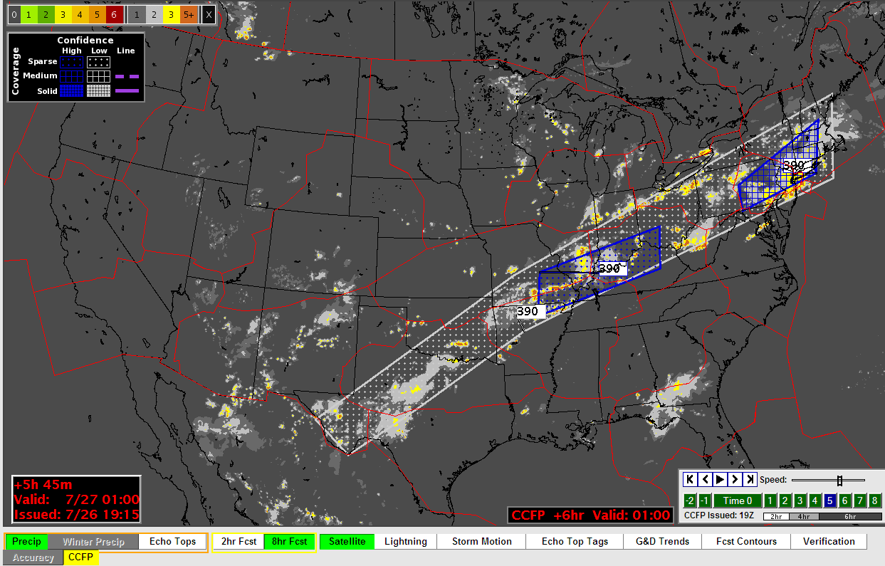
Evolving Current Capabilities
Description
Need: Weather information as required today in many legacy capabilities must evolve significantly to meet emerging NextGen Decision Support Tool (DST)/Decision Support Process (DSP) needs
Concept: FAA Weather requirements today, often levied on the National Weather Service, will evolve and change as NextGen concepts emerge. AWRP research, often in collaboration with NWS, will explore ways to derive legacy weather information from the highly automated weather paradigm likely in the future
Recent Accomplishments
Developed experimental technique for estimating visibility utilizing data from FAA AK weather cameras
Future Plans
Complete quality assessment and user evaluation of global ensemble thunderstorm forecast system
Improvements to the 0-2 hour LAMP C&V
Derive SIGMETs from grids in collaboration with NWS
Improve and enhance modeling and simulation techniques to validate performance requirements for both direct and indirect weather dependencies
7

Slide 8
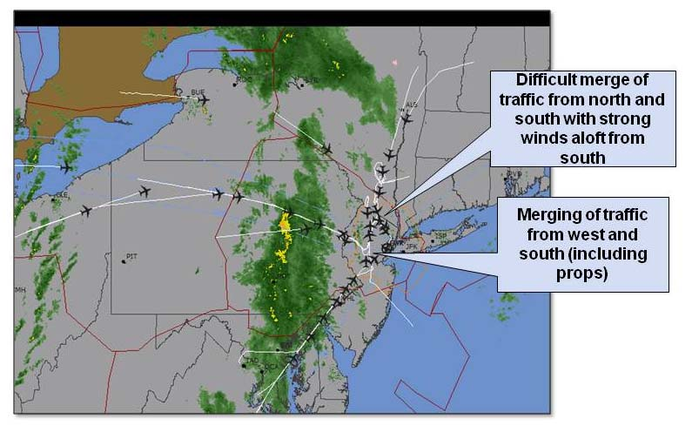
Direct linkage to NextGen Implementation Plans
Description
Need: Research to meet specific NextGen weather Operational Improvements as called out in NextGen Implementation Plans
Concept: Emerging DSTs/DSPs will require high fidelity, high resolution weather information, but many research questions must be asked:
How “good” the weather information is today?
What gaps exist in today’s available weather information?
What fundamental weather research needs to be done to actually support the performance of the new DSTs/DSPs?
Recent Accomplishments
Developed model to evaluate the amount of weather impact that is "avoidable" for aviation operational decisions. Initial model represents C&V events at PHL and convective weather at ATL
Initiated new study on how much weather impact constraints / mitigation risks vary among collaborative decision-makers, and what it means in terms of needed weather forecast uncertainty information
Future Plans
Verify model results estimate amount of weather that is "avoidable" for aviation operational decisions through scenario deep-dives
Identify model shortfalls for improvement
Develop and execute a methodology to deconstruct weather-TFM decision processes during convective weather events, and construct a functional analysis of convective weather – TFM decisions
Produce a detailed, and data-driven repository for most in-depth analysis to date of TFM challenges with weather uncertainty
8

Slide 9
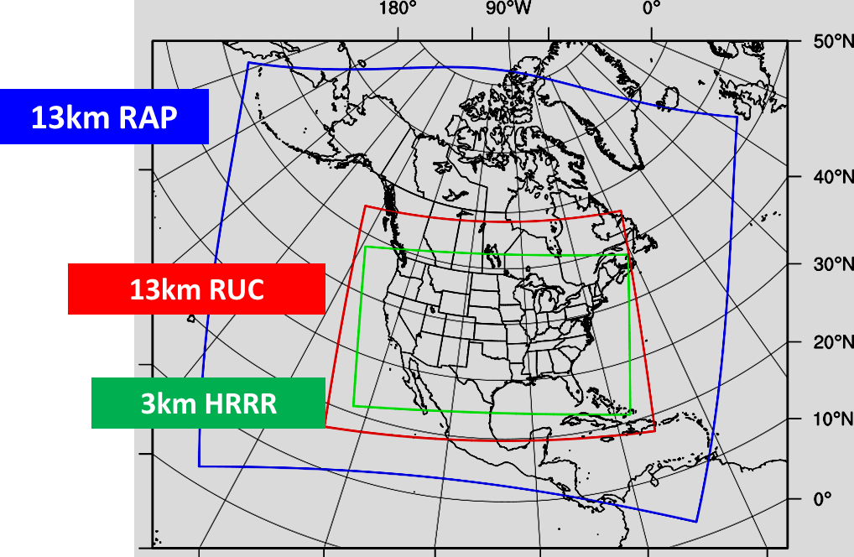
Weather Modeling and Sensing
Description
Need: NextGen will rely on improvements and updates to atmospheric numerical models and weather sensing techniques to meet the emerging requirements of new DST/DSPs and other advances to ATM applications.
Concept: Enhance numerical weather prediction models and data assimilation (inputs and techniques) to improve aviation weather hazard forecast and nowcast accuracy and resolution. Multi-Radar/Multi-Sensor (MRMS) research to improve real-time detection of in-flight hazards using high-resolution, high quality, three-dimensional (3D) weather radar data analysis from national and international radar networks. This MRMS capability will also function as a validation tool for high-resolution forecasts and decision support tools.
Recent Accomplishments
Developed higher resolution rapid refresh model with larger domains and longer lead times to support aviation forecasts
Transferred RAP and HRRR enhancements to NWS (improvement of wind, temperature, cloud and convective forecasts)
Implementation of real-time data feeds from Cayman Islands, Bahamas and Jamaica into the MRMS R&D system in Norman, OK
Developed 3D aviation-specific hydrometeor classification in MRMS
Implemented radar icing algorithms into MRMS
Future Plans
Implement regional ensemble data assimilation supporting improved hazard forecasts especially convection
Develop 0-24 hour HRRR ensembles to support probabilistic forecast products
Implement additional international radars including Martinique, St. Martins, Barbados and Cuba into MRMS
9

Slide 10
Ensuring Effective Research
Description
Need: To insure the relevancy of weather research, strict processes with regard to prioritization, quality assurance, and operational evaluation are adhered to.
Concept: All AWRP projects are subject to:
Prioritization with respect to operational needs
Quality assessment for scientific goodliness
Evaluation and demonstration for operation relevancy
Receiver operating characteristic (ROC) curves for GTG3 (red) and GTG2.5 (blue) for the 0.1(a) and 0.2(b) EDR thresholds
Future Plans
Auto-CCFP quality assessment
IPA diagnosis quality assessment
Conduct initial assessment of Volcanic Ash Forecast Capability
Global Turbulence capability quality assessment
Conduct the Collaborative Aviation Weather Statement (CAWS) Operational Evaluation
Recent Accomplishments
Completed reassessment of Icing Product Alaska (IPA)
Completed Offshore Precipitation Capability (OPC) quality assessment
Completed Turbulence (mountain-wave, low-levels) quality assessment
Completed User Assessment of Offshore Precipitation Capability
10

Slide 11
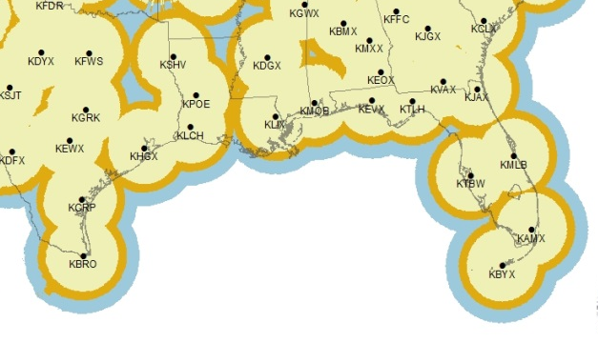
Offshore Precipitation Capability (OPC)
Problem Identification
Air Traffic Safety Action Program (ATSAP) Corrective Action Report (CAR) CAR-2011-023 was received from ZMA
  Lack of weather radar in Caribbean sectors presents unsafe condition
Current NEXRAD Coverage Map
Not unique to ZMA: Affects 9 ARTCC’s, 2 CERAPS, and over 22M square miles of offshore airspace
Impacts Gulf Q & Atlantic Routes (ARs)
Safety & efficiency concern

Slide 12
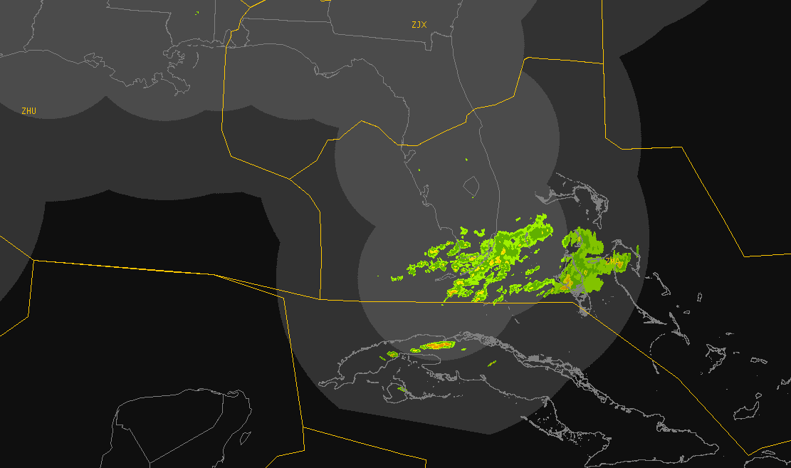
OPC - Current State
ZJX
ZHU
ZNY Non-Radar
Degraded NEXRAD
ZMA
ADS-B Challenges
International Coordination

Slide 13
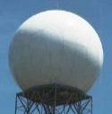
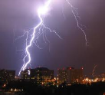
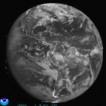
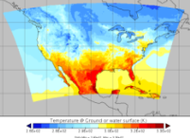
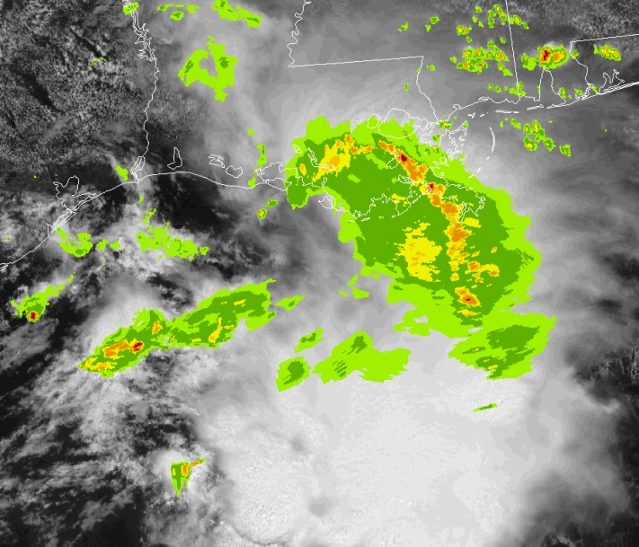
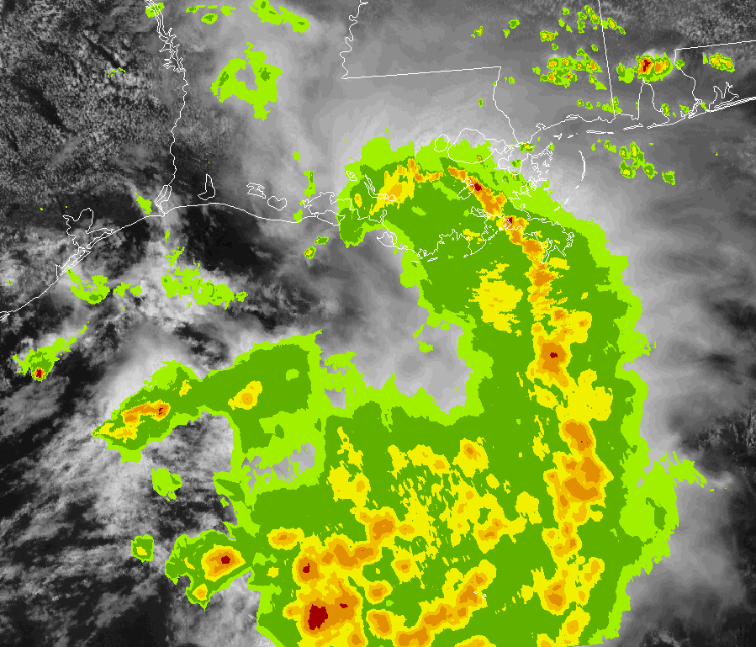
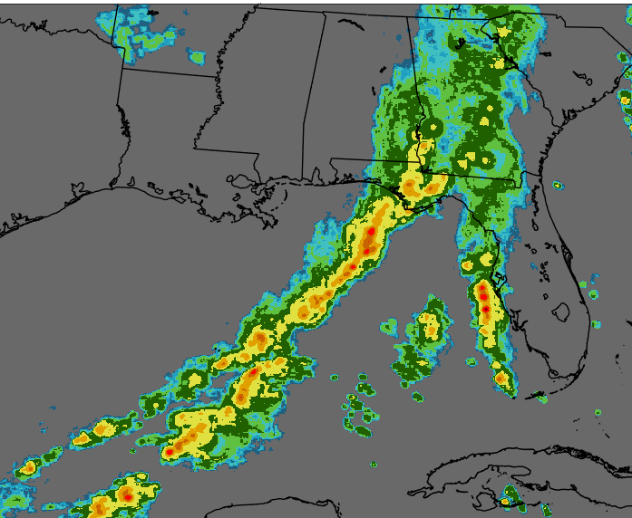
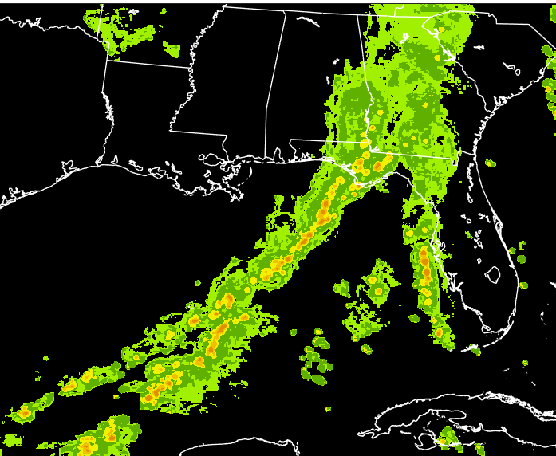
OPC - Overview
Offshore Precipitation Capability (OPC)
Multi-Sensor Data Collection
Weather Radar
Lightning
Satellite
Numerical Model
Machine Learning
No Radar
Offshore Storm Height and Precipitation Intensity
Goal: Provide a “virtual radar” in regions outside NEXRAD coverage
High spatial resolution
Accuracy of location
Fast updating
Storm Height Analysis (kft)
6-Level Precipitation Intensity

Slide 14
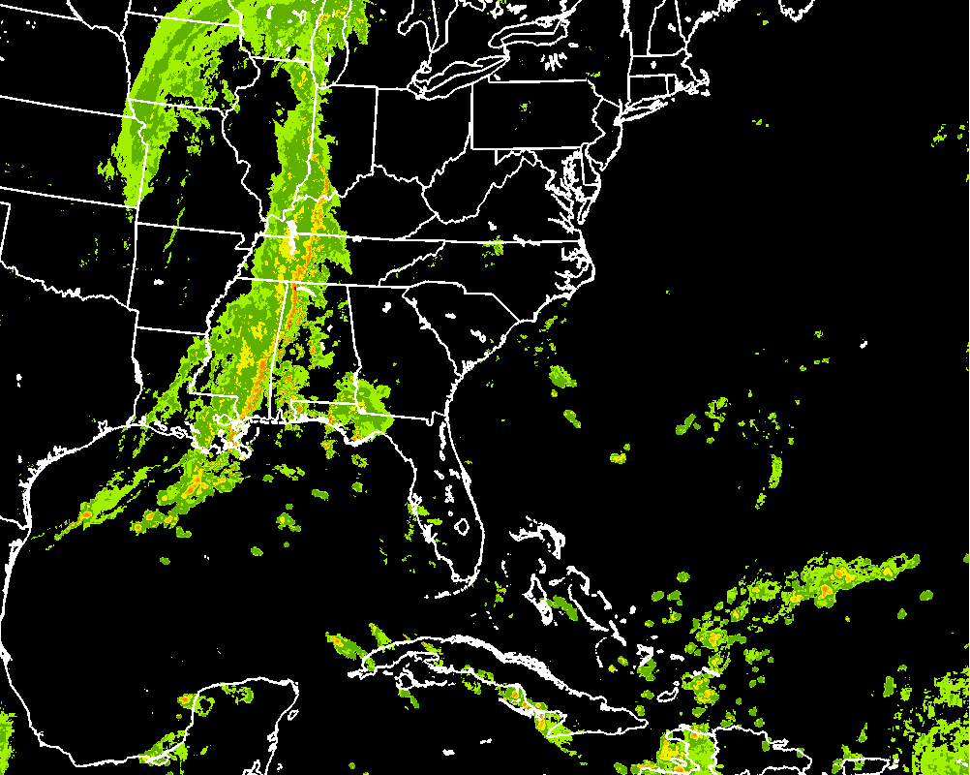
OPC Loop
Hurricane Gonzalo
10-14-2014 UTC
NEXRAD and OPC merged

Slide 15
OPC - Notes
Excellent teamwork between ANG-C6, AJV-7, AJM-33 and others
  Team formed in 2013 to come up with a solution to answer the CAR
  Good collaboration between divisions still occurring today
Independent quality assessment conducted by NOAA’s Earth Systems Research Lab in the fall of 2015
  Initial OPC accuracy slightly less than radar but overall scored well
  Sets baseline for future improvements
Onsite user evaluation of OPC completed at ZMA & ZHU this past spring by ANG’s Aviation Weather Demonstration & Evaluation (AWDE) group
  Tabletop exercise of scenarios involving Controllers, FLM, and TMU personnel
  Overwhelming positive response with ratings above 9 on 10 point scale for safety, efficiency in sector operations, efficiency in use of airspace, operational suitability, situational awareness and information presentation
60 day Limited Operational User Evaluation just completed at ZHU & ZMA
  120 day evaluation continues at the Command Center until 23 Sep
  Goal: Validate that OPC provides an operational benefit to traffic management where NEXRAD coverage is absent or degraded

Slide 16
OPC - Activity Schedule
Concept Maturity and Technology Development (CMTD) Activities | Duration (By Month) | Targeted Date
Phase I – CMTD Total | 28 | 08/2016
Finalize SOW and Contract | 2 | 04/2014
Status update | 0 | 12/2014
Delivery of initial prototype | 13 | 05/2015
Independent meteorological Quality Assessment (QA) on algorithm | 6 | 12/2015
User Evaluation | 9 | 09/2016
Preliminary Safety Assessment | 6 | 02/2017
CMTD to IA Transition Plan | 3 | 12/2016
Additional refinements to Algorithm | 26 | 09/2017
Meteorological QA on Refined OPC Algorithm | 3 | 12/2017
Phase 2 – Investment Activities | 18 | 2/2017
Phase 3 – Initial implementation at ZMA and ZHU | 3 | TBD
Phase 3 – Transition to NWP (Work Package 2) | TBD | 2020-2022
Phase 3 – Transition to NWS | TBD | TBD

Slide 17
OPC - Challenges
Expansion of OPC geographically and to other facilities
  Calibration of output; training of users
Transition to operations
  National Weather Service and others have expressed interest in capability
  Scheduled for NextGen Weather Processor Work Package 2, 2021-2022
  Will FAA use NWS product or run our own version?
  AJV responsibility, working with ANG-C6, AJM, NWS, etc.
Controllers and planners expressing desire in getting access before NWP
  Where would it be displayed?
  Who would run it and be responsible for production?
  ROE for using output in decision making?

Slide 18
Research Technology Transition (RTT)
Developed a framework for disciplined, but agile, RTT process focusing on:
  Product Maturity
  Line of Sight (Requirements to Implementation)
  Roles & Responsibilities
RTT developed for National Ceiling and Visibility (C&V)
  National C&V Capability
    Sponsored by FAA
    R&D conducted by NOAA
    Planned for NOAA implementation
  Joint NOAA NWS - FAA draft RTT plan completed
Next steps
  With NWS agree on next candidate capabilities

