Slide 1
REDAC / NAS Ops
Review of FY 2019 Proposed Portfolio
Runway Incursion Reduction Program (RIRP)
Ben Marple, ANG-C5
August 10, 2016

Slide 2
Runway Incursion Reduction Program (RIRP)
Benefits to the FAA:
FAA Strategic Priority 1 – Make Aviation Safer and Smarter
FAA Performance Metric 4 – Reduce Category A & B (most serious) runway incursions to a rate of no more than 0.395 per million operation and maintain or improve through FY 2018
RIRP is the FAA Response to NTSB Recommendation A-00-66:
“Require, at all airports with scheduled passenger service, a ground movement safety system that will prevent runway incursions; the system should provide a direct warning capability to flight crews. In addition, demonstrate through computer simulations or other means that the system will, in fact, prevent incursions.”

Slide 3
RIRP Overview Capabilities
People:
Program Managers: Ben Marple
Support Contractors: GEMS Inc., Veracity Eng.
Laboratories:
MIT/LL:
Safety Logic and Technology Development
System Requirements Development
Volpe:
Research / Data Mining
MITRE:
Benefit Estimation Methodology
Research / Data Mining
Human Factors

Slide 4
Anticipated Research in FY17 and FY18
Planned Research Activities
Runway Incursion Prevention Shortfall Analysis (RIPSA) candidate airport site surveys & ongoing evaluation of new technologies for inclusion within the RIRP Portfolio (2015 FAA Runway Safety Call to Action)
Initiate research on Surface Taxi Conformance and Monitoring for RI prevention (2015 FAA Runway Safety Call to Action)
Potential integration of SASS with runway safety logic and annunciators
Expected research Products
RIPSA Site Assessment Report & Program Plan for “Right-site-Right-size” technologies at candidate airports
Shortfall analysis report identifying RIs that may be prevented by various surface taxi conformance monitoring concepts at controlled airports
SASS surveillance capability report

Slide 5
Emerging FY19 Focal Areas
Site Implementation and systems installation of localized/airport-wide surveillance and annunciation technologies at RIPSA Candidate Airports following the right-site, right-size model
Research and refine existing near and far-term capabilities needed to digitize taxi route instructions.
Operational test evaluation of SASS as a sensor to drive the activation of direct to pilot alerting safety logic

Slide 6
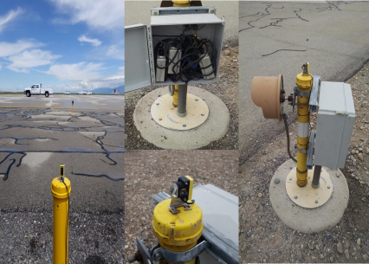
Runway Safety Assessment (RSA)
Research Requirement
Outputs/Outcomes
Develop Program Requirements for potential technologies at candidate airports as identified in the RIPSA report.
Sponsor: Runway Safety Group (AJI-14) POC: James Fee, Manager, Runway Safety, AJI-141
Products:
RIPSA “Right-Site-Right-Size” Assessment Report
Program Plan for feasible technologies at candidate airports.
FY 16 Accomplishment / Issues
Out Year Funding Requirements
Completed Runway Incursion Prevention Shortfall Analysis (RIPSA) report documenting RI causal factors and identifying small-medium airports that need RI prevention technologies.
Completed summary briefing on technical evaluation of feasible RI prevention technologies.
Initiated candidate airport site assessments.
FY17 | FY18 | FY19
$ 1.25M | $ 2M | $ 2.5M

Slide 7
Surface Taxi Conformance Monitoring (STCM)
Research Requirement
Outputs/Outcomes
New: Conduct research to refine concept and develop tools for tower-based and cockpit-based taxi conformance monitoring
Sponsor: Runway Safety Group (AJI-14) POC: James Fee, Manager, Runway Safety, AJI-141
Products:
Shortfall analysis report to identify Runway Incursions that may be prevented by various taxi conformance
monitoring concepts at controlled airports
Expected impact estimate of taxi conformance monitoring capabilities on Runway Incursions at controlled airports
FY 16 Accomplishment / Issues
Out Year Funding Requirements
N/A
FY17 | FY18 | FY19
$ 750K | $ 1.5M | $ 1.5M

Slide 8
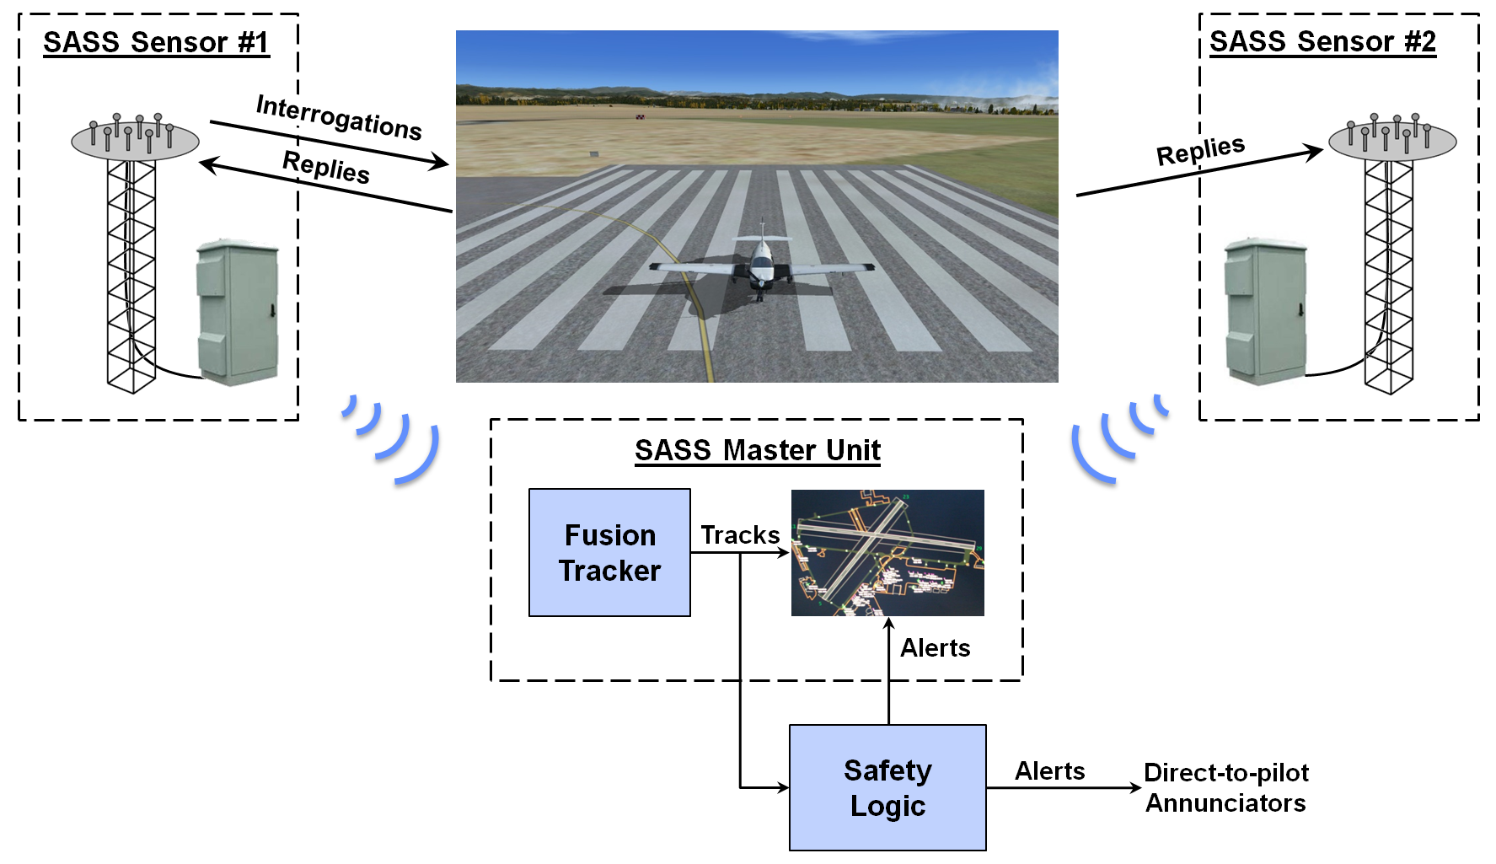
Small Airport Surveillance Sensor (SASS)
Research Requirement
Outputs/Outcomes
Develop Low Cost Surface Surveillance Sensor
Sponsor: Runway Safety Group (AJI-14) POC: James Fee, Manager, Runway Safety, AJI-141
Products:
SASS system
FY 16 Accomplishment / Issues
Out Year Funding Requirements
Conducted preliminary ground surveillance (passive) data collection at Hanscom Field (KBED) using SASS units – Sep/Oct 2015
Demonstrated real time passive Mode S surface surveillance capability – Feb 2016
Demonstrated real time passive Mode S airborne surveillance capability – July 2016
FY17 | FY18 | FY19
$ 1M | $ 1.5M | $ 2M

