Slide 1
Airspace Operations and Safety Program
(AOSP)
Airspace Technology Demonstrations (ATD) Project
Leighton Quon
Project Manager
Airspace Technology Demonstrations (ATD) Project

Slide 2






ATD Domains
ATD-3
Applied TFM
ATD-2
Integrated Metroplex Traffic Management
ATD-1
Terminal Sequencing and Spacing (TSAS) and Flight deck Interval Management (FIM)
TOC
TOD
OUT
IN
OFF
ON
Notes:
Filtered stakeholder issues through the ‘gate to gate metering’ lens
What can affect the variability in that segment

Slide 3
Outline
ATD-2 Overview
ATD-3 Overview
Notes:
NOTES for June 16 mtg: Al to brief this section.

Slide 4
The Journey Thus Far
Early 2014 NASA begins ATD-2 planning for IADS Traffic Management for the Metroplex to improve predictability and efficiency while maintaining or improving throughput
Oct 17 FAA and NAC† deliver “NextGen Priorities Joint Implementation Plan” to Congress
Oct – Mar FAA and NASA explore collaboration as ATD-2 undergoes formulation
Mar 31 FAA informs NAC† of intent to collaborate with NASA on ATD-2 to evaluate the integration of departure metering that reflects the FAA’s Surface CDM ConOps
April NASA and FAA jointly assess sites for ATD-2 demonstration
May 12 FAA announces Charlotte Douglas International Airport (CLT) as ATD-2 demonstration site
May 22 Kickoff for FAA-to-NASA Surface CDM tech transfer
Jun 22 FAA/NASA executive deep dive at NTX
Jul 16 VIP Kickoff at CLT
Jul 29 FAA/NASA executive deep dive at ARC
Aug 18-19 Stakeholder summit at CLT
Sep 16-17 Stakeholder deep dive at NTX
Sep 21-15 Initial ATD-2 airspace HITL
2015
FAA/NASA Collaboration Notes
† FAA NextGen Advisory Committee
FAA AA for NextGen (ANG-1) events
Sep 2016 ATD-2 system installation at CLT
Sep 2017 ATD-2 demonstration commences
Notes:
NOTES for June 16 mtg: Consider making two slides and restore some of the items I dropped
Use color to highlight key items.
Using this slide to remind some folks and educate other folks on how we got here
Updated timeline events to highlight our efforts to communicate the ATD-2 plan in various venues

Slide 5
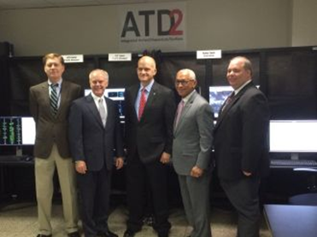
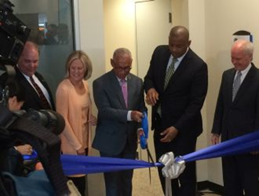
The Journey Thus Far (cont.)
Oct 15 Initial engagement with Surface CDM Team
Nov 17 ATD-2 Formulation Review before FAA/NASA Independent Review Board
Dec 2-3 ZDC site visit informs ATD-2 strategy for TBFM/IDAC components
Dec 9 IADS RTT plan for ATD-2 signed by NASA and FAA
Jan 13 ATD-2 plans briefed to industry
Feb 8-9 ATD-2 plans briefed to NIWG Surface Team and CDM Stakeholders Group (CSG)
Apr 18-20 NASA and AAL (lead carrier) engage with stakeholders at CDM spring meeting
Apr 25 NASA presents revised strategy for TBFM/IDAC components to FAA/AJM-22
Apr 25-29 Initial ATD-2 surface HITL
May 3-4 ATD-2 plans vetted with Field Demonstration Partners
Jun 16 NASA and FAA meet to discuss of TBFM/IDAC collaboration
Jun 24 CLT Lab VIP ribbon cutting with DOT Secretary and NASA Administrator
Jun 28 ATD-2 MOPs and ConUse briefed to Surface CDM Team
Jul 12-14 Initial shadow evaluation session with CLT ATCT personnel at CLT Lab
2016
Notes:
NOTES for June 16 mtg: Consider making two slides and restore some of the items I dropped
Use color to highlight key items.
Using this slide to remind some folks and educate other folks on how we got here
Updated timeline events to highlight our efforts to communicate the ATD-2 plan in various venues

Slide 6




Operational Environment for the ATD-2 Concept
Downstream demand/capacity imbalance
Overhead stream insertion
Center boundary
Departure meter points
Departure meter points
Center airspace
Arrival meter point
Arrival meter point
Terminal airspace
Terminal airspace
OFF
Less-equipped
airports
OFF
OFF
Queue
Well-equipped
airport
Spot
Gate
Departure Metering
Notes:
I will spend some time to introduce the ATD-2 operational environment because it is key to understanding what follows
Use animation to walk audience through
Base layer
upper portion of the figure depicts en route airspace
dashed line represents the boundary between the Home Center and one or more adjacent Centers.
cylinders in the lower portion of the figure represent terminal or TRACON airspace.
The larger cylinder represents the Home terminal airspace for the ATD-2 concept.
Three airports are shown in the Home terminal airspace. One well-equipped airport and two less-equipped airport
Control points layer
The colored ovals illustrate some of the points (i.e. meter points) at which control is applied. Red dots are arrival meter points. Blue dots are departure meter points. Yellow dots are surface meter points.
Constraints layer
The funnel located at the top right of the image represents a downstream demand/capacity imbalance that results in departure restrictions on the Home terminal airspace.
The thundercloud on the terminal boundary represents a typical dynamic weather event that may close one or more departure fixes, putting additional demand on fixes that remain open.
Overhead stream represents another type of constraint where departures must be inserted into stream
Trajectories layer
Blue arrows in the figure depict trajectories for flights departing the Home terminal airspace.
Departures from multiple airports must be coordinated at control points
Red arrows show trajectories for flights arriving to the Home terminal airspace.
Final trajectory is a departure that becomes an arrival subject to arrival metering constraints at their destination, even prior to takeoff

Slide 7
ATD-2 Goal, Objectives and Outcomes
GOAL ATD-2 will improve the predictability and the operational efficiency of the air traffic system in metroplex environments through the enhancement, development and integration of the nation’s most advanced and sophisticated arrival, departure and surface prediction, scheduling and management systems.
Predictability: Reduce the variability of aircraft movement times
Efficiency: Manage and schedule operations to reduce aircraft movement times and fuel burn by leveraging enhanced predictability
Throughput: Maintain or improve metroplex airspace throughput
OBJECTIVES
Demonstrate improved aircraft arrival, departure and surface movement predictability and efficiency by integrating evolving collaborative decision-making capabilities with state-of-the-art air traffic management scheduling technologies.
Enable effective use of collaborative decision making by demonstrating efficiency gains through enhanced two-way sharing of prediction and scheduling information.
Demonstrate Integrated Arrival/Departure/Surface (IADS) traffic management for metroplex environments.
OUTCOMES
Demonstrate the ATD-2 technologies in an operationally relevant environment
Quantify the benefits, performance, acceptability, and limitations of the ATD-2 technology
Transfer an integrated set of technology to the FAA and airlines, airports, and suppliers.
Notes:
Goal: Paraphrase. ATD-2 will improve PREDICTABILITY (point) and EFFICIENCY (point) of metroplex IADS operations while maintaining THROUGHPUT by enhancing and integrating A/D/S prediction and scheduling systems
Objectives: Mention each. Need to paraphrase.
Outcomes: Mention each.

Slide 8
Contributing Technologies
2010
2011
2012
2013
2014
2015
2016
2017
SARDA ATC Tower
SARDA Ramp Tower
Chart focuses on buildup to initial 2017 demo. ATD-2 continues through 2020
PDRC
PDRC++
ATD-2
Surface CDM ConOps
Surface CDM P3
TFDM pre-acquisition and early implementation
RFP
EFD
acquisition
TBFM
IDAC
TFMS
Release 13
FAA DSS
R&D
Tech Transfer
Notes:
Use animation to step through
Leveraging the ATD-1/TSAS investment. When talking about tech transfers be sure to note that not all of them are shown on this chart. EDA/3D-PAM not shown. ATD-1/TSAS not shown. ATD-2 will leverage all earlier NASA tech transfers as they become available in TBFM due to the fact that we build on FAA TBFM system.
Slide change notes:
20151112 – revised TFDM arrow to add EFD tech transfer

Slide 9
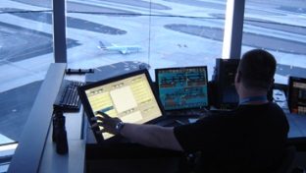
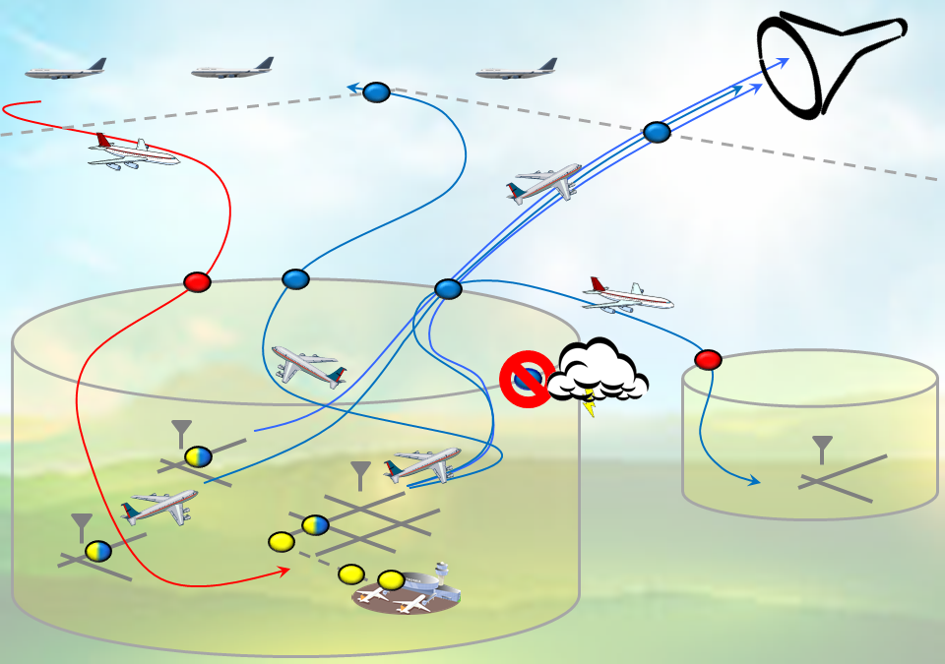
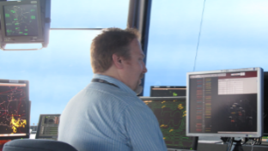
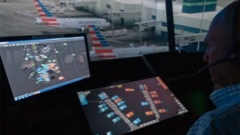
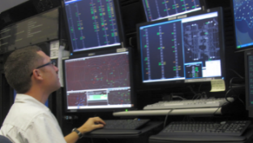
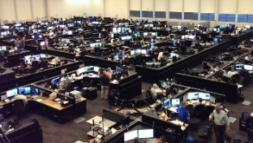
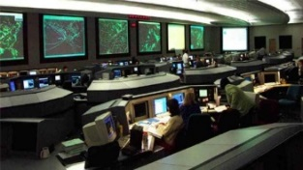
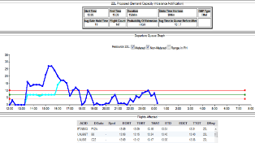

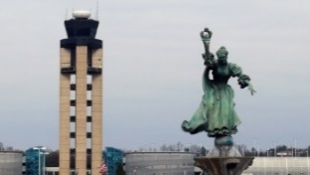
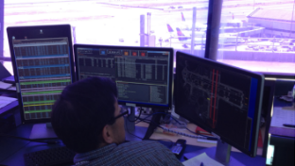
ATD-2 Overview
Operational Concept Graphic (OV-1)
ATCT Control
ATCT TMU
TFDM EFD is controller interface to ATD-2 scheduling and metering
Better predictability improves TMI compliance
Tactical departure scheduling builds on IDAC and PDRC
Manage traffic to satisfy TMIs and departure metering
Ramp Control
ARTCC
Tactical pushback advisories build on SARDA research
Manage ramp traffic and meet strategic TMATs
Ramp and gate status and intent information
Integrate TBFM/IDAC with ATD-2 surface system
Improve TBFM departure trajectory predictions
Departures into overhead and metered arrival streams
Surface CDM
Airline Ops
ATCSCC
Earliest off block times
Airline priorities via CDM
Flight data
Strategic TMIs
Surface delays
Multi-center coordination
TRACON
Builds on Surface CDM concept engineering effort
Identify need to meter and compute ration-by-schedule strategic TMATs
Accommodate airline priorities
Local TMIs and demand predictions for all airports
Metroplex coordination and planning functions
Explore departure controller advisory requirements
Airport Ops
Industry Apps
Airport conditions
Additional flight operators
Information exchange with commercial applications
Surface Components
External interfaces via SWIM and SWIM extensions
Airspace Components
Notes:
Now moving from a system-oriented view to a user-oriented view
Use animation to step through
Here is the familiar operational environment diagram
Start at the top with the airspace components (blue box)
Briefly point to each user and connect to the environment figure
Next surface components
Next external components

Slide 10




Field Demonstration Partners
Federal Aviation Administration (FAA) multiple organizations led by NextGen (ANG)
Interagency partnership coordinated via IADS RTT provides for:
  Participation by and routine access to SMEs at participating facilities
  Data (flight plan, surveillance, TMI, SWIM, etc.) for all participating facilities
  Decision support system (e.g. TBFM, TFMS, etc.) s/w and information
  Surface CDM departure metering prototype s/w and information
  ATD-2 user interfaces in operational areas at all participating facilities
  TFDM EFD system interfaced to ATD-2 at participating Towers
American Airlines (AAL)
FAA-designated lead carrier for ATD-2
Nonreimbursable Space Act Agreement (originally with US Airways) provides for:
  Participation by and routine access to SMEs at participating facilities
  Data for all participating facilities
  ATD-2 user interfaces in operational areas at all participating facilities
Charlotte Douglas International Airport (CLT)
Nonreimbursable Space Act Agreement (under development) provides for:
  Dedicated ATD-2 computer laboratory space
  Airport information and data feeds
  Communications and logistics support
National Air Traffic Controllers Association (NATCA)
FAA/NATCA agreement provides for designated NATCA representatives to serve in a collaborative and expert capacity in the planning, development, and testing of all air traffic control modernization projects including ATD-2
Statements of support and the cooperation of NATCA Leadership
Notes:
20 years of field work at NTX has taught me that partnerships are absolutely essential
Introducing partnerships here because they are key element of the technical plan
More details on partnership strategy will be provided in a later section.
Slide change notes:
20151112 – Fixed typo in title and revised NATCA wording and adjusted spacing

Slide 11
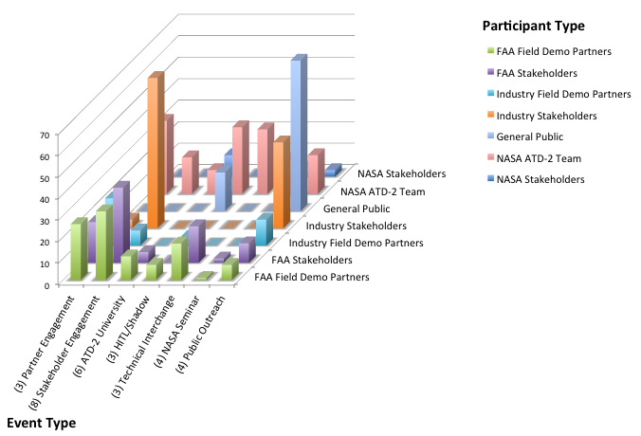
Stakeholder Engagement
336
Phase 1 Concept of Use
Addressed 577 comments over 4 review rounds
Notes:
Note since Aug 2015

Slide 12
Technology Transfer Strategy
Intentional approach to technology transfer
  Technology transfer is a Level 1 requirement
  ATD-2 system architecture is designed to facilitate tech transfer
    Uses FAA TBFM/IDAC (v4.7) system with minimal enhancements
    Leverages FAA TFDM system requirements and interface specifications
    Uses Surface Data Elements delivered via FAA TFMS (Release 13)
    Follows FAA SWIM model for data feeds and external communication
  Follows ATD-1 model for development of system requirements and design documents to facilitate technology transfer
NASA to FAA technology transfer
  NASA will engage with FAA AJV and AJM organizations via IADS RTT to ensure that timing and content of technology transfers are aligned with FAA needs
  Enhancements to FAA Decision Support Systems tools (i.e. 3Ts) and SWIM will fully documented as deltas to reference versions known to the FAA
NASA to industry technology transfer
  Regular engagement with industry
  ATD industry day conducted 2QFY16
  System architecture designed to enable industry engagement and solutions
International collaborations
  Germany: work with DLR on integrating ground and flight deck tools using CLT environment
  Korea: work with KAIA/KARI/IIAC on application of tactical surface tools to ICN environment
Notes:
From Day 1 successful tech transfer has been a primary focus
Reflected in ATD-2 system architecture
Slide change notes:
20151112 – revised wording in several sub bullets under first bullet
20151115 – added international collaborations bullet

Slide 13
IADS Research Transition Team
IADS RTT background
  established in 2008
  Co-leads from NASA and FAA NextGen (ANG) organization plus representation from
    FAA ATO Program Management Operations (AJM-22)
    FAA ATO System Operations Services (AJR-1200)
    FAA ATO Mission Support Services (AJV-7)
  Successfully transitioned two Research Transition Products
    June 2013: Precision Departure Release Capability (PDRC)
    May 2015: Airport Runway Management – Metroplex Capability
FY15 activities
  June: IADS RTT begins coordinating on ATD-2
  July: FAA ANG-1 and NASA ARMD agree to coordinate ATD-2 via IADS RTT
  July: commence weekly telecons
  September: begin development of IADS RTT plan
FY16 plans
  Complete IADS RTT Plan
  Continue weekly telecons
  Develop Joint Project Management Plan (JPMP) for ATD-2
Notes:
Walk through bullets
Note that prior to ATD-2 assignment I was IADS RTT co-lead
Slide change notes:
20151112 – revised names and ordering of FAA orgs

Slide 14
Outline
ATD-2 Overview
ATD-3 Overview
Notes:
NOTES for June 16 mtg: Al to brief this section.

Slide 15

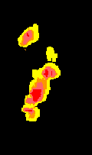
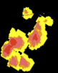
ATD-3 Integrated Concept
MFCR
Pre-flight route
Delay recovery from stale TMIs – automated search for efficient high value common reroutes for multiple flights
~90 min to MF
Common reroute
TASAR
Airborne automated continuous searching for efficient reroutes
Dep
~60 min to MF
DRAW
Route corrections to maintain metering and avoid weather
Air-ground integration for dynamic reroutes
Freeze Horizon
ORC
Ground
station
Efficient reroutes for meter fix load-balancing
(20 min to MF)
(FOC or ANSP)
Dest
Notes:
Need: Distance from MF to airport? Freeze horizon from MF or airport? With that, talk w/Kapil and look at DFW TFs to edit bottom-left of diagram.

Slide 16
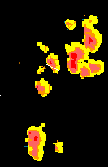
Multi-Flight Common Route (MFCR)
Problem
Weather changes as flights progress, avoidance routes become stale
Common Dynamic Route Correction
Solution
Continuous automatic search finds common, high value, ATC acceptable route corrections for multiple flights, MFCR preferred by ATC users
Return Capture Fix
Moving Weather
Auxiliary Waypoint(s)
Maneuver Start Points
Nominal Flight Plans
Congested Sectors
Metrics
Flight time and fuel savings
ATC acceptability
Reduced operator workload
Notes:
Pick snap to with minimum delay relative to FRD solution, still avoids weather
Savings decrease some depending on eligible snap to fixes
Sometimes can't find snap-to solution with 5 min or more savings
Later have some data to quantify this difference

Slide 17
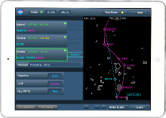
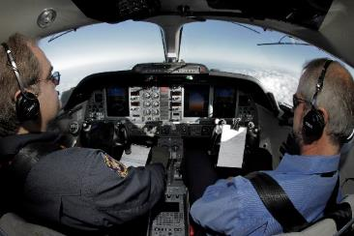
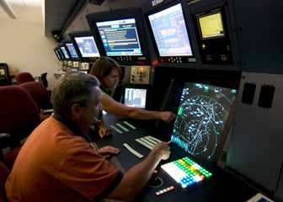
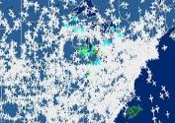

Traffic Aware Strategic Aircrew Request (TASAR)
Pilot uses onboard automation tool to optimize an aircraft’s trajectory
Greater flight efficiency
en route
NASA Technology
Navigation Database
Operational
Outcomes
Pilot Interface
Optimization Engine
Aircraft Performance
Real-time
Aircraft Data
Crew Request
ATC Response
Internally sourced data
Traffic
Weather
Airspace
Dispatch
Increased ATC approval
of requests
Externally sourced data
Tool leverages networked connectivity to real-time operational data

Slide 18
Dynamic Re-routes for Arrivals in Weather (DRAW)
AC5
Current scheduled times of arrival do not reflect the need to deviate for weather
AC4
AC5
AC3
AC4
AC4
+2
AC2
AC3
-1
1
Meter Fix 1
AC2
1
AC1
Dynamic Arrival Route Corrections
AC1
AC2
AC2
Meter Fix 2
Current Flight Plan
Freeze Horizon
MF1
MF2
Adjusted times of arrival and metering impact

Slide 19
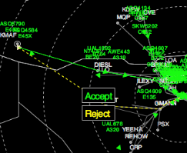
Optimized Route Capability (ORC)
Capability
  Intelligent off-loading of over-loaded meter fixes
  Data-driven processes to predict when capacity limits will be exceeded
  Ability to identify optimal path routing options to balance capacity
Benefits
  Improving overall system efficiency by utilizing data-driven traffic flow management decisions to optimize route configurations
  Reducing delay and fuel consumption by minimizing the need for holding and tactical maneuvering (i.e., vectoring)
  Enhanced utilization of Performance-Based Navigation (PBN) routing and other NextGen capabilities
  Augments today’s metering capabilities
Without intervention, demand exceeds capacity at NW arrival gate and results in holding
1. ORC identifies excess demand
2. ORC alerts TMC/STMC
3. ORC identifies candidate reroute
4. TMC/STMC accepts solution
Notes:
“other NextGen capabilities” – OPDs, RNP…

Slide 20
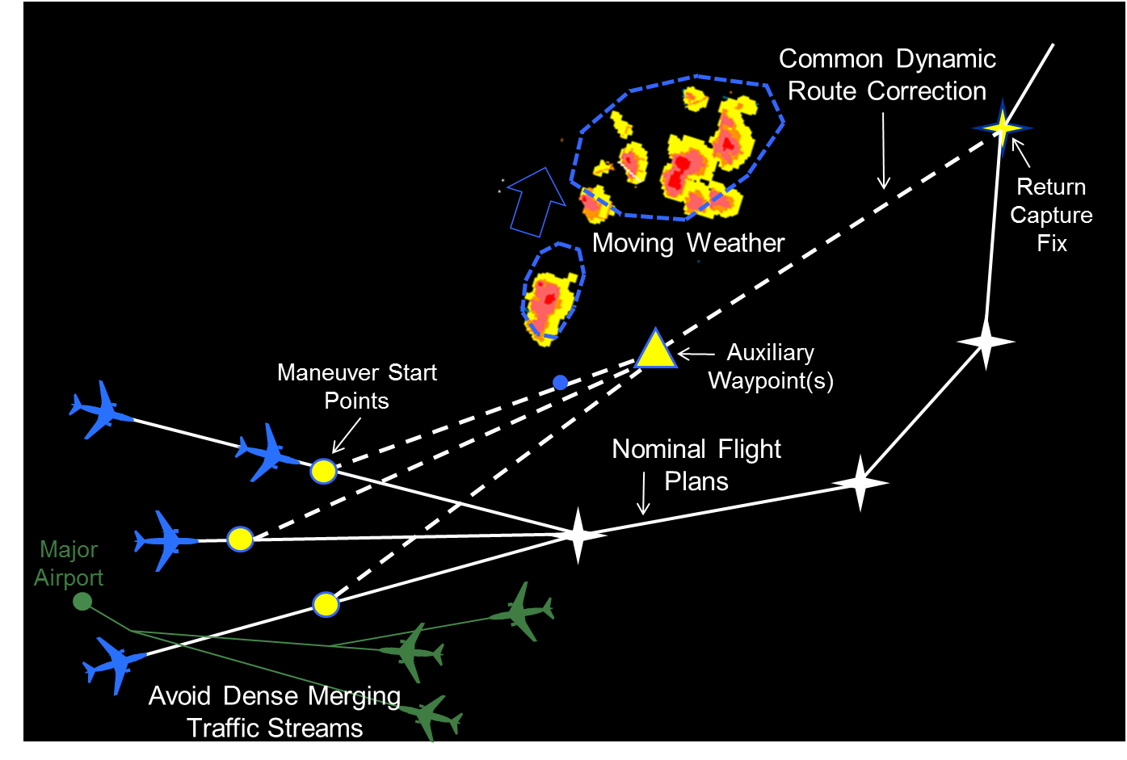
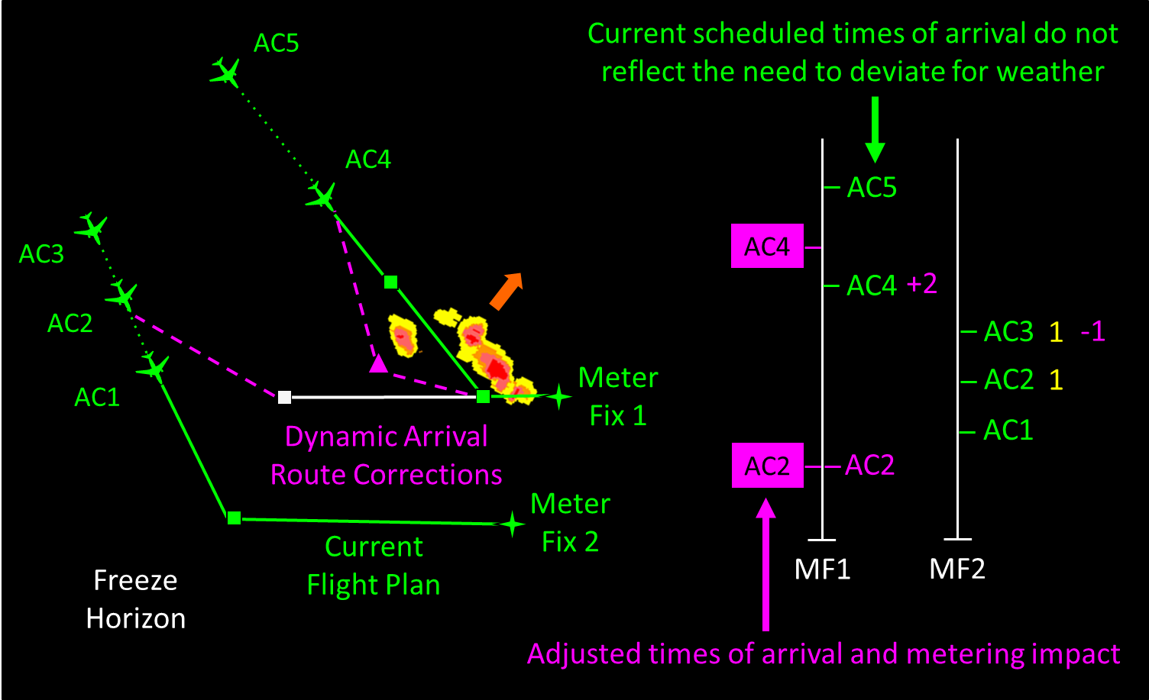
ATD-3 – Technical Highlights
      ATFM RTT Tech Transfer – DWR (July/August 2016)
        Delivering: Requirements, ConOps, software, user guide, publications
        Tech Transfer TIM (Sept/Oct 2016) - NASA-led meeting with broad FAA community at FAA HQ describing the DWR technology, and reviewing deliverable materials
    Under SAA with American, installing NASCENT tool in IOC July/Aug 2016
      NASA-developed FACET-based tool to run DWR at all 20 ARTCCs simultaneously
      Utilizes airline data sources, will enable transition away from NASA-dependence on data for DWR operation
      Also enables potential air/ground partnership per recent TASAR interest from airline
    MFCR Status
      NRA to be awarded in FY16 for MFCR benefits case
      Development continues leveraging input received from stakeholder/SME interactions
      Initial three-day SME Evaluation activity planned for Oct, and HITL simulation in January
      MFCR is an RTT tech transfer product, delivering requirements, ConOps, etc, in Mar/Apr 2017
    DRAW/ORC Status
      Development continues leveraging input received from stakeholder/SME interactions
      Meter-fix balancing functionality of ORC concept being added as additional DRAW functionality
      DRAW Workshop – Aug 10 – bringing in former (and possibly current) Traffic Managers, arrival-sector controllers
      Five DRAW HITLs planned through FY19 in preparation for integration with TBFM and culminating ARC HITL
      Two RTT tech transfers scheduled – Q2FY18 and Q2FY20
Notes:
Capt. Brian Will participated in our first TASAR flight trial (FT-1) in Nov 2013. He was interested in TASAR back then, but we didn’t have it running with the iPad. Now that we do, he has asked to reengage and “continue the discussions.” So I’m not sure exactly what he has in mind, but my plan is to give him a demo and a briefing on where we currently are with TASAR, and then see what he is thinking. I’ll also talk air/ground integration with him, since obviously AAL is doing DWR and would make a natural partner for ATD3.

Slide 21
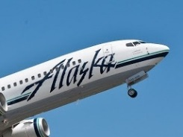

ATD-3 Technical Highlights (cont’d)
Airline SAA collaborations continue toward initiating operational trials in FY17
  Alaska Airlines
    Data agreement with Boeing to receive 737NG performance data for TASAR trials
    UTAS activity underway to achieve EFB wiring certifications needed for Alaska implementation
    Procurements in progress to acquire weather data feeds from WSI
  Virgin America
    Kickoff meeting held, June 9th, to organize upcoming activities to integrate TASAR into a Virgin America aircraft for operational trials as part of the NASA/Virgin America Space Act Agreement.
    Attendees included NASA, Virgin America (Flight Ops, Flight Tech Engineering, FOQA, Dispatch and Training), Engility Corp., Astronautics (EFB provider), Honeywell (ADS-B and wx radar provider), ViaSat (potential internet connectivity provider), Schneider Electric (Wx data provided)
  TASAR and Potential ATD-3 Collaboration with American Airlines
    American Airlines asked for an update on the TASAR project and to discuss options for future collaboration. ATD3 objectives of air/ground integration were discussed as an area of potential common interest. A follow-up meeting at AAL is currently scheduled for August 31st.
Traffic Aware Planner (TAP) Awarded 2016 NASA Software of the Year Award
Notes:
Capt. Brian Will participated in our first TASAR flight trial (FT-1) in Nov 2013. He was interested in TASAR back then, but we didn’t have it running with the iPad. Now that we do, he has asked to reengage and “continue the discussions.” So I’m not sure exactly what he has in mind, but my plan is to give him a demo and a briefing on where we currently are with TASAR, and then see what he is thinking. I’ll also talk air/ground integration with him, since obviously AAL is doing DWR and would make a natural partner for ATD3.

Slide 22
ATD-3 Partnerships
Government
NASA/FAA ATFM Research Transition Team (RTT)
  RTT Plan developed, should be signed off by July 31
  ATD-3 NASA/FAA TIM held January 2016
  JPMP draft underway, estimate October completion and sign-off
  DWR first tech transfer under RTT - July/August 2016
Participation in MITRE SFMA Mini-HITL #5 – June 21-23, 2016
FAA/NASA TASAR/SWIM Integration meeting February 2016
Industry/Operators
Under SAA with American, installing NASCENT tool in IOC July/Aug 2016
Under SAA with Alaska Airlines and Virgin America, installing TASAR on aircraft for data collection
Notes:
Capt. Brian Will participated in our first TASAR flight trial (FT-1) in Nov 2013. He was interested in TASAR back then, but we didn’t have it running with the iPad. Now that we do, he has asked to reengage and “continue the discussions.” So I’m not sure exactly what he has in mind, but my plan is to give him a demo and a briefing on where we currently are with TASAR, and then see what he is thinking. I’ll also talk air/ground integration with him, since obviously AAL is doing DWR and would make a natural partner for ATD3.

Slide 23
Key Upcoming Events
July 21 | FAA Quarterly Meeting @ ARC
August 15 | Tech Transfer of DWR to FAA via ATFM RTT
August 10 | DRAW Workshop
October | MFCR SME Evaluation
January 2017 | MFCR HITL
Oct-Dec, 2016 | TC3 - Anticipated initial TASAR deployment on Alaska Airlines aircraft

Slide 24
Summary
ATD-2 heavy engagement Stakeholders
  FAA orgs involved in weekly RTT telecons
  Industry Partners active in shadow evaluations
ATD-3 engaged with Stakeholders
  FAA orgs involved in bi weekly RTT telecons
  FAA orgs also active in TIMs for input and refined definition
  Industry collaborating through Space Act Agreements for multiply flight and ground activities
Notes:
NOTES for June 16 mtg: Al to brief this section.

