Slide 1
Unmanned Aerial Systems Traffic Management (UTM)
Safely Enabling UAS Operations in Low-Altitude Airspace
NASA
Moffett Field, CA
Parimal.H.Kopardekar@nasa.gov
http://www.utm.arc.nasa.gov

Slide 2
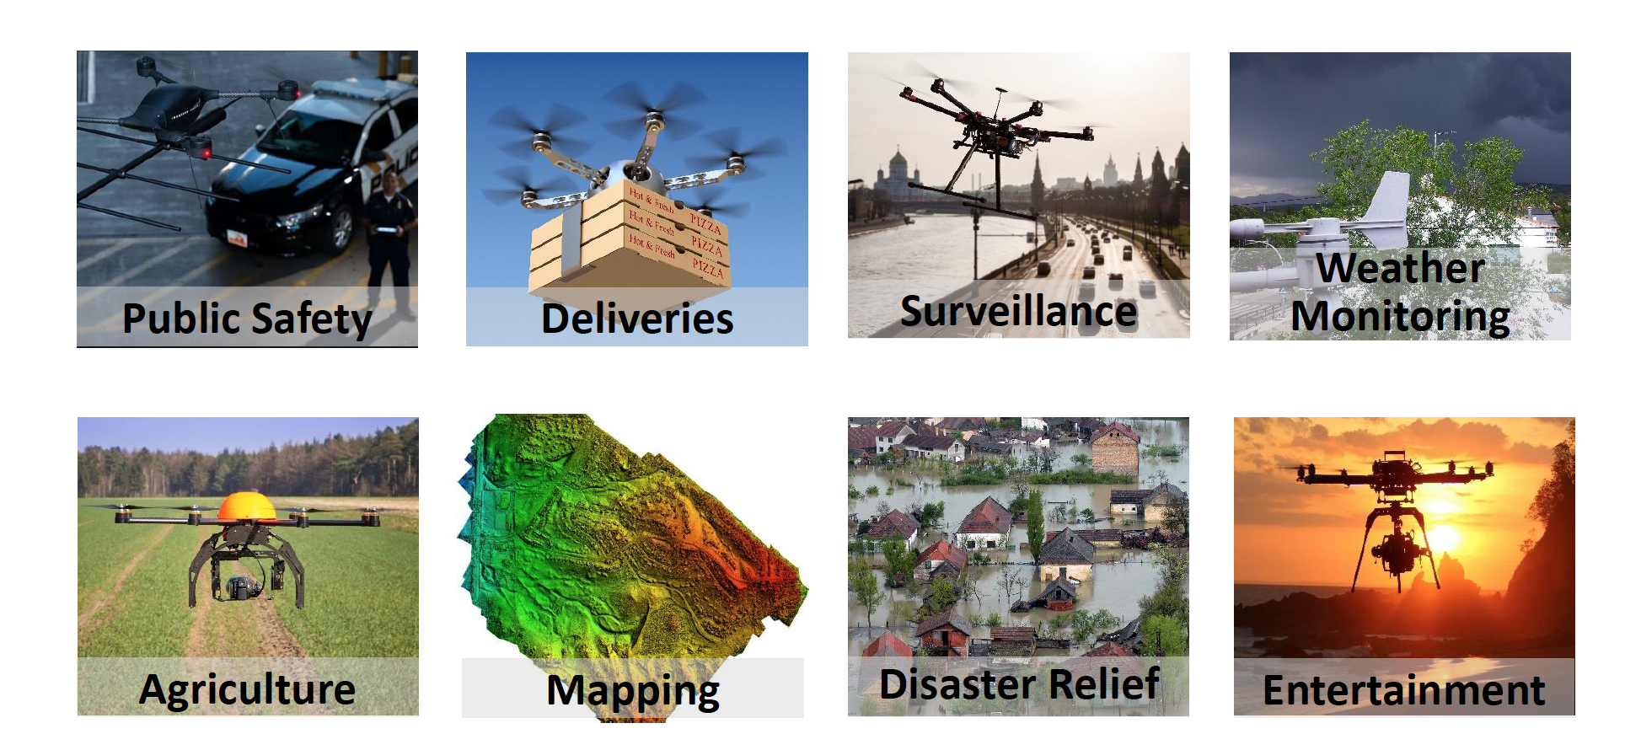
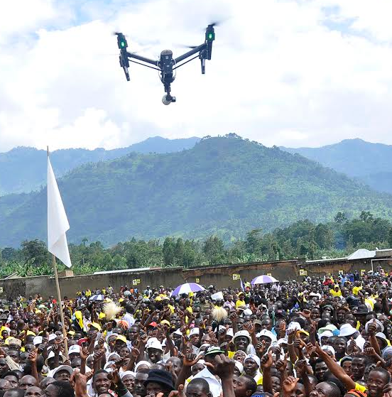
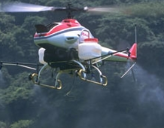
Applications of Unmanned Aerial Systems
Aerial Instruments
Cargo
Aerial Instruments
Aerial Instruments
Aerial Instruments
News Gathering
Aerial Instruments
Aerial Instruments
Aerial Instruments
Aerial Instruments
Aerial Dispersal
Spraying/Seeding
Notes:
Spraying/seeding appears to be missing (agriculture is a surveillance drone?).
News-gathering should be mentioned if all of these others are mentioned.
Combining this, rationalizing them, into some types of categories may be very helpful and should be discussed.

Slide 3
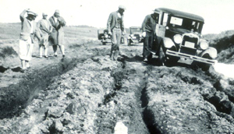
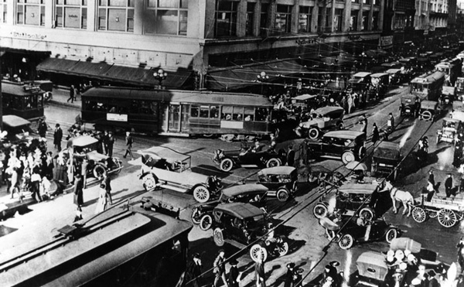
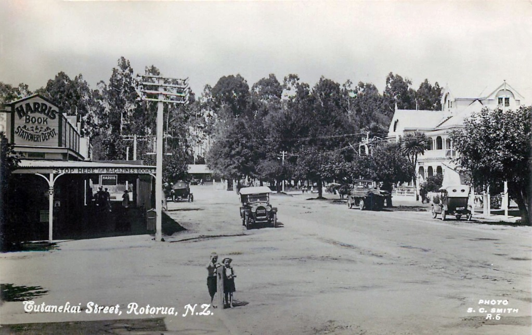
Stages of Traffic Management: Requirements are Different
http://www.kcet.org/updaily/socal_focus/history/la-as-subject/7th-and-broadway.html
1920, Photo Collection, Los Angeles Public Library

Slide 4
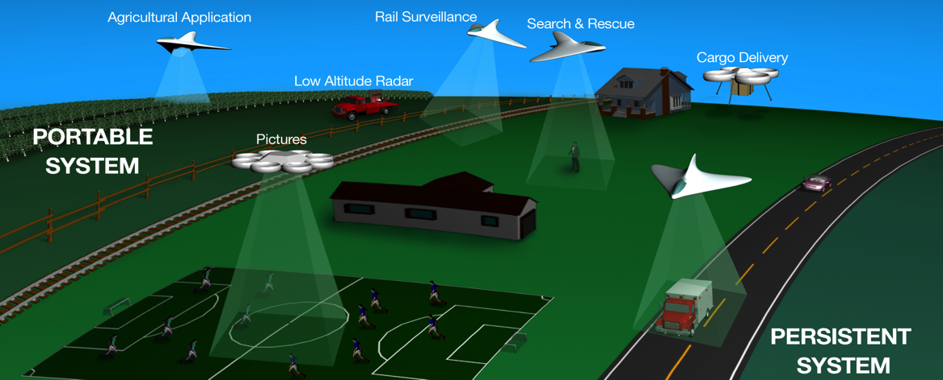
Low-Altitude Unmanned Aerial System Operations
Goal: Ensure safe and efficient operations
Notes:
Flexibility where possible, and structure where necessary
Consider the needs of national security, safe airspace operations, economic opportunities, and emerging technologies
Risk-based approach based on population density, assets on the ground, density of operations, etc.
Digital, virtual, dynamic, and as needed
UTM services to manage operations

Slide 5
Balancing Multiple Needs
National and Regional Security
Protecting key assets
Safe Airspace Integration
Mantra 1: Flexibility where possible and structure where needed
Mantra 2: Risk based- Geographical needs, application, and performance-based airspace operations
Scalable Operations for Economic Growth
Ever-increasing applications of UAS: Commercial, Agricultural, and Personal

Slide 6
Low Altitude UAS operations
Small UAS forecast – 7M total, 2.6M commercial by 2020
Need a way to manage beyond visual line of sight UAS
Vehicles are autonomous and airspace integration is necessary
Operators want flexibility for operations
Regulators need a way to put structures as needed

Slide 7
What is UAS Traffic Management (UTM)?
Research Platform that
Gives situational awareness of all airspace constraints and info about other operations to UAS operators, support service suppliers, and regulators
Allows to exchange data among UAS operators as well as regulator
Allows UAS operators to submit flight plans to execute a specific mission in low-altitude airspace, and
Determines how to safely enable such single or multiple UAS operations either within visual line of sight or beyond visual line of sight
Integrates airspace and vehicle operations
Product: Validated airspace operations requirements: roles/responsibilities; federated, networked, and interoperable data exchange; information architecture; and air/ground integrated concept of operation
Airspace configuration (static and dynamic geo-fencing)
Weather and wind (actual and predicted)
Demand/capacity imbalance management
3D maps
Track and locate (cell, ADS-B, satellite, psudo-lites)
Conflict (V2V, sense and avoid) and hazard avoidance
Last and first 50 feet operation
Contingency management
Notes:
Allows requester to create and submit one or more trajectories
Shows all airspace constraints (dynamic and static geo-fences)
Supports connection to external subsystems (e.g., 3D maps, weather data, etc.) through standardized interface protocols
Assesses and advises for trajectory interference or constraint violations
Provides multiple trajectories for the same UAS with rank ordering to seek the best available trajectory in presence of other operations and constraints
Tracks vehicle position

Slide 8
Value Proposition of UTM
(Agreed upon by stakeholders and FAA as discussed at OSTP panel)
Unmanned vehicle operations coordination through agreed upon data/information exchanges about each others operations and with FAA systems
Exceptions handling – entry into controlled airspace
Beyond Part 107 operations– 450 feet
Beyond visual light of sight
Manned and unmanned vehicle operations coordination
Higher density operations
Longer-term: Changing the paradigm of airspace operations

Slide 9
UTM Research Goals and Characteristics
Conduct research, development and testing to identify airspace operations requirements to enable large-scale visual and beyond visual line of sight UAS operations in the low-altitude airspace
Use build-a-little-test-a-little strategy – remote areas to urban areas
  Low density: No traffic management required but understanding of airspace constraints
  Cooperative traffic management – Understanding of airspace constraints and other operations
  Manned and unmanned traffic management – Scalable and heterogeneous operations
UTM construct consistent with FAA’s risk-based strategy
UTM research platform is used for simulations and tests
UTM offers path towards scalability

Slide 10
Principles and Services for Safe Integration
Principles
  Authenticated users and UAS are allowed to operate in the airspace
  UAS stay clear of each other
  UAS and manned aircraft stay clear of each other
  UAS operator has complete awareness of airspace and other constraints and stay clear of them
  Public safety UAS have priority over other UAS
Key UAS related services
  Authentication
  Airspace configuration and static and dynamic geo-fence definitions
  Weather and wind prediction and sensing
  Conflict avoidance (e.g., airspace notification, V2V)
  Demand/capacity management
  Large-scale contingency management – GPS outage, cell outage, etc.
Research platform is cloud-based
UTM research identifies roles and responsibilities of operator, air navigation service provider, and UAS support service providers

Slide 11
Defining UAS Operator and ANSP/UTM Roles
UAS Operator
Work with Original equipment manufacturer
Communication, Navigation, and Surveillance (CNS)
Register
Train/qualify to operate
Avoid other aircraft, terrain and obstacles
Respect airspace constraints
Avoid incompatible weather
Through
Performance-based regulation where practical
Limited categories of operator types, matched
to regulations
Air Navigation Service Provider (ANSP)
→ UAS Traffic Management (UTM)
Define airspace constraints
Foster collaboration among UAS operators to deconflict their operations
Where demand warrants, provide air traffic control
Through
Near real-time airspace control
Where it is needed, air traffic control integrated with manned aircraft traffic control
Third-party entities may provide support services
but are not separately categorized or regulated.

Slide 12
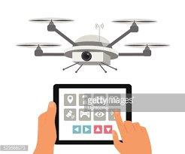
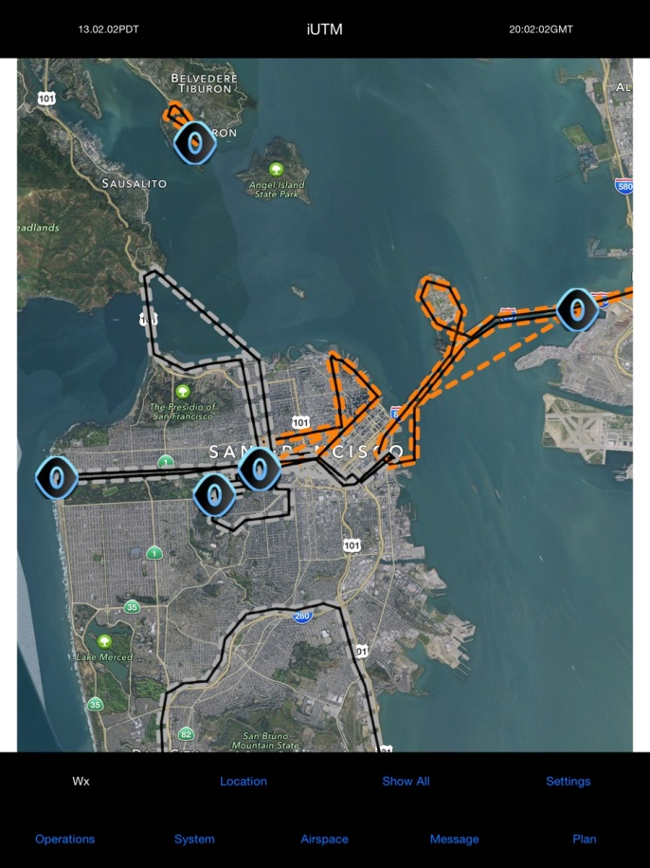
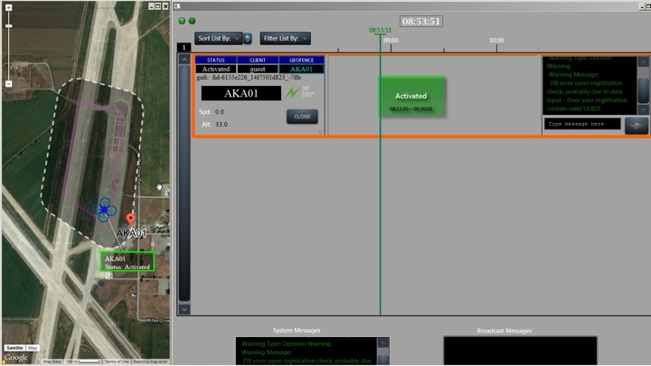

UAS Operator/UTM Functions
UTM: AIRSPACE Management
Notifications accessible to UAS operators and public
Static (like TFR) and dynamic (like security or public health scenario)
UAS Operator
Broadcast identity (and possibly intent)
Operations accessible by all
No anonymous flying

Slide 13
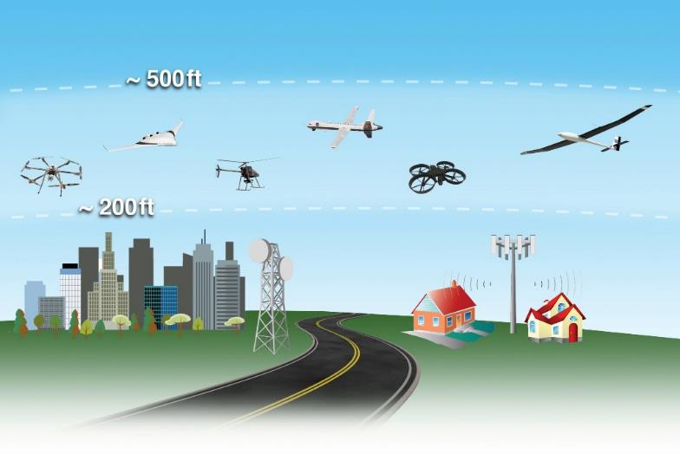
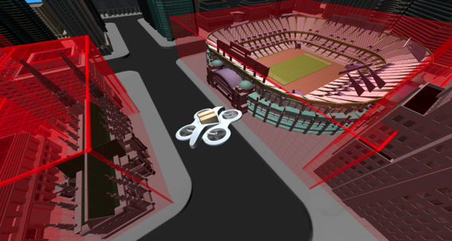
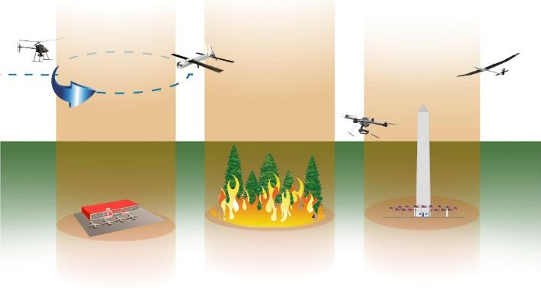
UAS Operator/UTM Functions
UTM Example Airspace Management
Consider other traffic and underlying environment
Can be keep-out or keep-in requirement
May be static or dynamic (near-real time)
UAS Operator:
Operator can comply through geofences or operational control

Slide 14
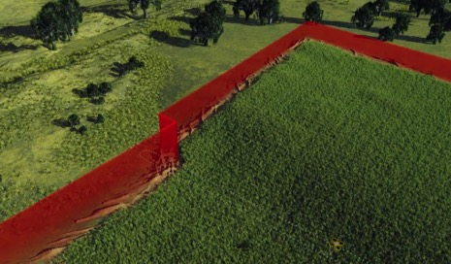
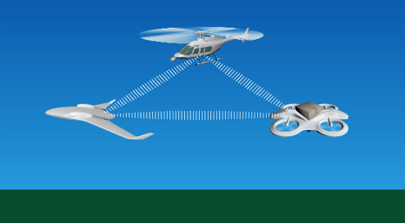

UAS Operator/UTM Functions
UAS Operator: Traffic Avoidance
Detect Sense And Avoid (DSAA) to manned aircraft predicated on right of way
Status and intent exchange in accordance with standards
Collaborative decision making
Contingency planning and response (system outages, unreported weather, etc.)
UTM: Enable Collaborative Exchange
Standards for publish and access
If needed, provision of data repository

Slide 15
UTM Functions
Route Structure
Only where needed for safety or efficiency of flight
Procedural rules-of-road (corridors, altitudes, etc).
Flow Control
Only where needed for safety or efficiency of flight
Manage access into areas of operation, not particular operation
Air Traffic Control
Integrated with manned air traffic control, where positive UAS control is required for safety or efficiency of flight
Static or dynamic application (e.g., ability to respond in crisis situation where sustained mixed operations are required)
Mantra 1:
Flexibility where possible and structure where needed
Mantra 2:
Risk based- Geographical needs, application, and performance-based airspace operations

Slide 16
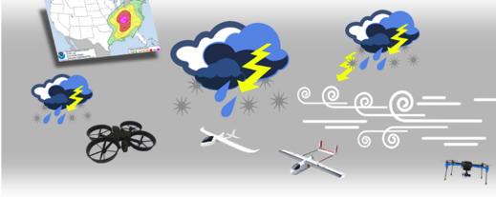
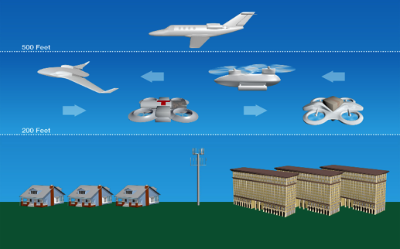
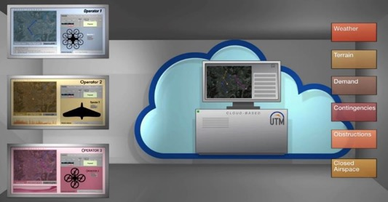
Supporting Functions
Wind & Weather Integration
Operator responsibility, may be provided by third party
Actual and predicted winds/weather
No unique approval required

Slide 17
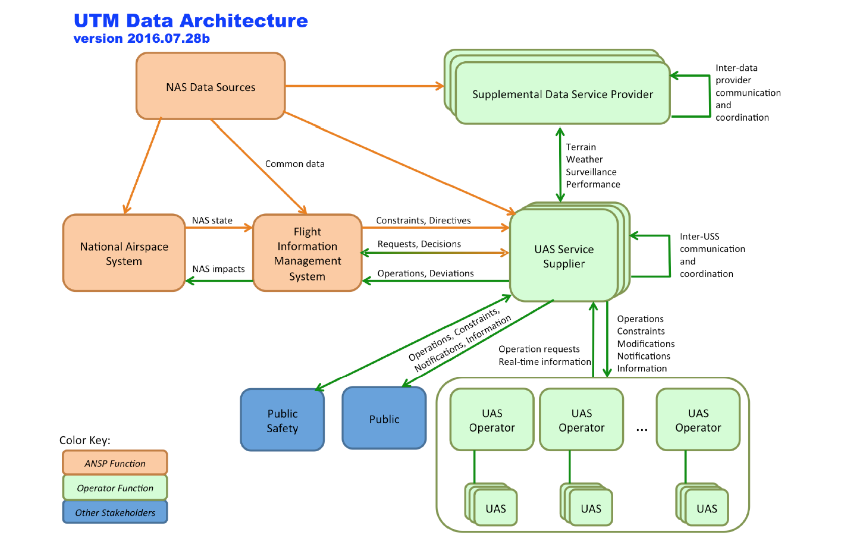
Architecture

Slide 18








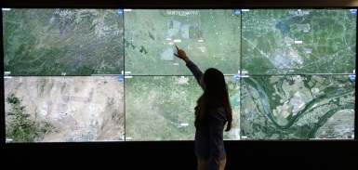










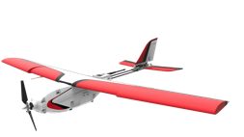
Terrain Maps
User Credentials
Public Safety Data
Surveillance Data
Obstacle Data
Airspace Data
Vehicle Registration
Air Traffic
Controllers
Air Traffic
Managers
Weather Data
NOTAM Data
Vehicle Performance
Data Service Providers
Other Stakeholders
DATA API
PUBLIC SAFETY API
Regulatory Agencies
Law Enforcement
Air Traffic
Systems
ATM API
UAS Traffic Management
UTM
PUBLIC ACCESS API
Traffic Management
Systems
Public Access
ATC System
Command Center
Community Groups
Airport
Tower
CNS API
UAS Service Suppliers
ATM Systems
General
Public
UAS
Controllers
UTM
Clients
Hobbyists
ANSP function
UAS
UAS Operations
UAS Operator function
Public Safety
Deliveries
UAS Control
Precision Agriculture
Science Missions
Notes:
Cloud-based architecture
UAS operations will be safer if a UTM system is available to support the functions associated with
Airspace management and geofencing
Weather and severe wind integration
Predict and manage congestion
Terrain and man-made objects database and avoidance
Maintain safe separation
Allow only authenticated operations
Analogy: Self-driving or person driving a car does not eliminate roads, traffic lights, and rules
Missing: Infrastructure to support operations at lower altitudes

Slide 19
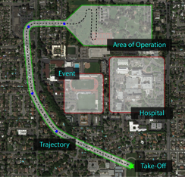
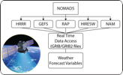




Information
Flow
Dynamic Constraints
Weather
Conflict Detection
Feasibility
Vehicle
Performance
Database
Model-Based Trajectory Constraint Check
UTM Vehicles Registration
Check dynamic constraints
Check static constraints
UAS Traffic Management UTM
Check if UVIN
is registered
3
4
5
Share information
UAS Support Services
2
Schedule
delivery to …
6
Contingency Management
  Geo-fence breach
  Loss of C2
  Emergency responder
Operator submits operation (waypoints; vehicle info; operator data)
7
1
Operation completed
UAS Operator function
ANSP function

Slide 20
UTM Research Technical Capability Level
Each capability is targeted to type of application, geographical area and uses risk-based approach
Capability 1
  Reservation of airspace volume
  Over unpopulated land or water
  Minimal general aviation traffic in area
  Contingencies handled by UAS pilot
  Enable agriculture, firefighting, infrastructure monitoring
Capability 3
  Beyond visual line of sight
  Over moderately populated land
  Some interaction with manned aircraft
  Tracking, V2V, V2UTM and internet connected
  Public safety, limited package delivery
Capability 2
  Beyond visual line-of-sight
  Tracking and low density operations
  Sparsely populated areas
  Procedures and “rules-of-the road”
  Longer range applications
Capability 4
  Beyond visual line of sight
  Urban environments, higher density
  Autonomous V2V, internet connected
  Large-scale contingencies mitigation
  News gathering, deliveries, personal use

Slide 21
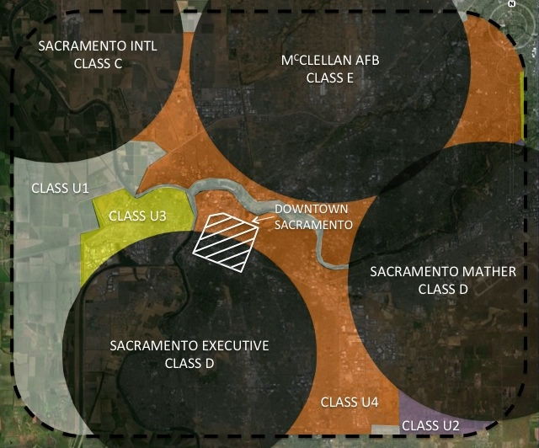
Notional UTM Airspace
Multiple providers could offer some UTM services
Tailoring operational services based on geographical area needs
Vehicle performance could be different
Notes:
Not every geographical area needs same UTM build - can be tailored based on the needs of use case, density, etc..
Based upon four risk-based criteria
Density of people on the ground
Number of structures on the ground
Likelihood of manned operations in close proximity
Number of UAS operations in close proximity
Each build enables certain types of missions and provides certain services
Each build supports the missions and services of the previous build
Builds are intended to be developmental milestones, as well as, self-contained systems

Slide 22






Potential Users of UTM
Air Traffic
Controllers
UTM Services
Can use UTM information services for safety
Hobbyists
Manned
Aircraft Pilot
Reviews UAS operations prior to take off, maintains situation awareness for safety
General
Public
Can use UTM information services for safety, privacy, and security concerns
UTM
Manager
Makes strategic decisions to ensure safety, efficiency and equity of the UTM Airspace
UAS
Controllers
Responsibly for the safe conduct of UAS vehicle(s)
UAS
Operators
Legal entity that requests access to UTM airspace and manages UAS operations

Slide 23
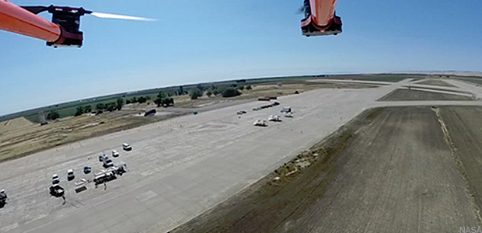
TCL 1 Demonstration
What: Demonstrated concept for management of airspace in lower risk environments and multiple UAS operations
Where: Crows Landing, CA
Who: NASA and several flying, weather, surveillance partners
When: Aug 2015
UTM
GCS #2
GCS #1
Collected state data for operations, weather conditions, communications with UTM System, sound readings
Built foundation for future demonstrations with proposed increased capabilities
Showed that operations that could represent many business cases are already enabled with the initial concept

Slide 24
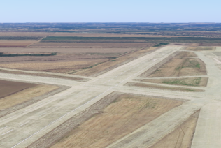
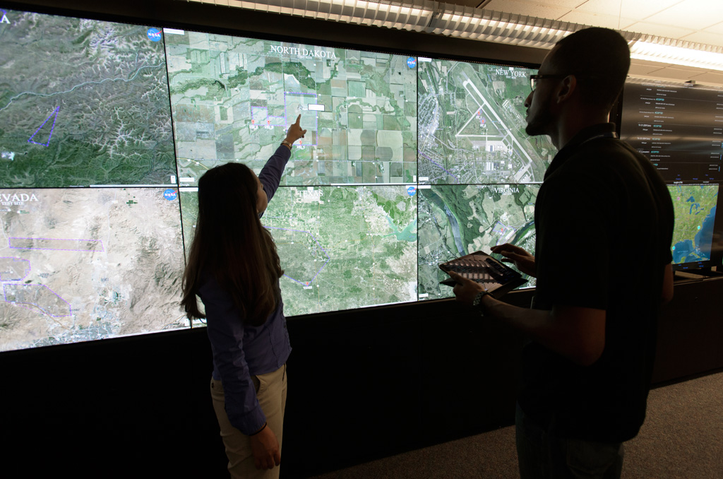

NASA UTM Simulation Capabilities
UTM API
  Validation and Verification of UTM research prototype functions
  Develop, demonstrate, and evaluate advanced UTM services and operations
  Develop tools and procedures to manage UTM ops
  Accelerate and increase value of field tests and provide live virtual constructive (LVC) environments
  Simulate complex operations that cannot be done in the field (e.g. urban ops, 911 type scenarios)
UTM
Simulation Viewer
(e.g. Google Earth)
Simulation Viewer
(e.g. Google Earth)
UTM client
Ground Control Station
UAS Operator/ Controller
UAS Operator/ Controller

Slide 25
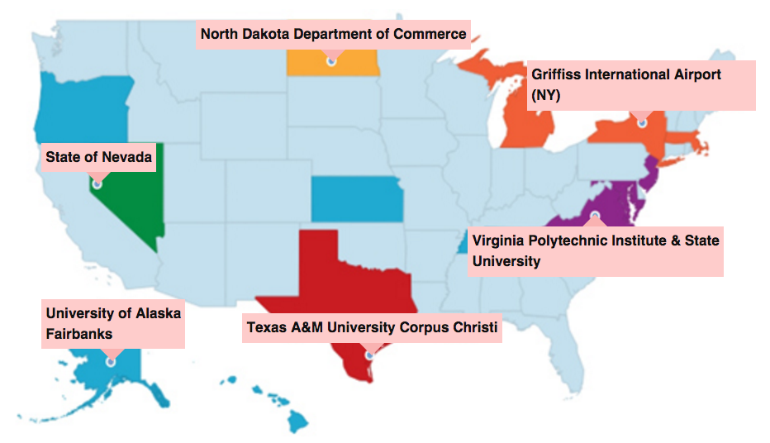

National Safe UAS Integration Campaign
What: Demonstrated management of geographically diverse operations, 4 vehicles from each site flown simultaneously under UTM
Where: All 6 FAA UAS Test Sites
Who: NASA, Test Sites, support contractors
When: 19 April 2016
24 live vehicles, over 100 live plus simulated flights under UTM in one hour –Highly successful
Received positive feedback from the FAA Test Sites on the UTM concepts, technologies and operations
API based model worked well – enabled operator flexibility, exchanged information, and maintained safe operations

Slide 26
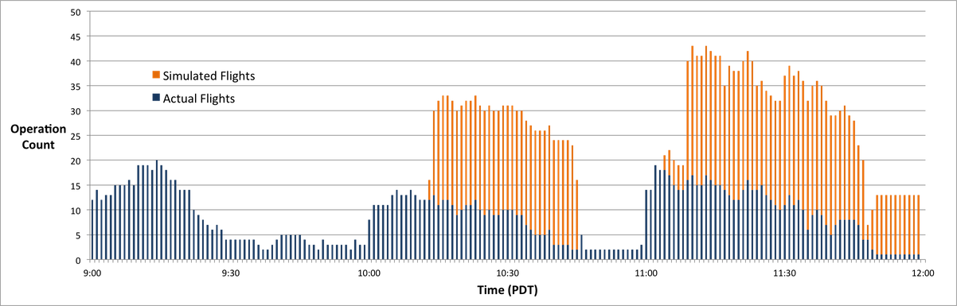
Safe UAS Integration National Campaign
National Campaign Statistics:
4 types of vehicles at each site
3 Hours
102 real, distinct flights
67 simulated operations injected
About 31 hours of flight time
281.8 nmi flown

Slide 27
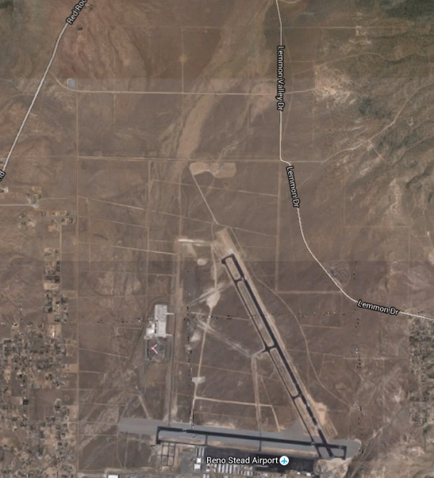
TCL 2 Demonstration
What: Extension of TCL 1 to BVLOS. Will exercise handling of off-nominal scenarios, altitude stratification, initial wx integration, surveillance data, and other services.
Where: Likely Reno-Stead, NV
Who: NASA and several flying, weather, surveillance partners
When: Oct 2016
TCL 2 Operation area
Demonstrate efficient airspace use through multi-segmented plans, altitude stratification, and other procedures
Incorporate input from surveillance systems to share awareness with all stakeholders within UTM
Fly BVLOS with multiple vehicles procedurally separated supported by data from the UTM System
Reno Stead Airport

Slide 28
NASA-FAA RTT and Working Groups
NASA and FAA have established an RTT
FAA extension language – NASA and FAA to work together on a plan and UTM pilot project
Working groups
  Data definition
  Information architecture
  Concept of operations and use cases
  Communications and spectrum (with FCC and FAA)
  Weather (with NCAR, NOAA, and FAA)
  Separation (sense and avoid and V2V)
  Performance requirements

Slide 30
UTM
Supports:
  Multiple UAS operations and FAA ATM interoperability
  Exploring pathfinder use including security – verifying authorized/authenticated users
  DOD use cases
    MTR and SUA information exchange with UAS operator and vice-a-versa
    Protecting key sites – UTM to verify authorized users in the airspace
  DHS use cases
    Border patrol operations planning, scheduling, and monitoring (Air Marine Operations Center)
    Protection of VIP personnel
  FAA Reauthorization Requirements (Section 2208- UTM and 2209 – dynamically restricting operations)
International interest: JAXA, S. Korea, France, UK, New Zealand, Australia, Sweden, Italy, Canada, and others
Global UTM Association is formed

Slide 31
NuSTAR: Performance Benchmarking for sUAS
Performance benchmarking: responsible, credible, collaborative (move towards self-certification)
National UAS Standardized Testing and Rating (NuSTAR)
Parallel: Underwriter’s Laboratory, Consumer Reports, JD Powers, Which?
Credible test bed and scenarios
  Drop tests
  Urban, rural, atmospheric conditions (e.g., fog, smog, rain)
  Simulated pets
  Failure modes
  Sub-system level performance: engine/propulsion, networking, battery, sensor systems, software systems
  Cyber-security, GPS denied conditions, etc.
Support UAS manufacturers, consumers, insurance companies, and public at large through objective assessments for self-certification to meet FAA requirements
Forensics analysis: Re-creation of incidents and accidents

Slide 32
Beyond NextGen
UTM is a small step towards safely enabling UAS operations
Construct of operator, service supplier, and regulator is defining the infrastructure – allows to accelerate innovation and scalability
Research: Will the UTM kind of construct migrate to entire airspace operations?

Slide 33
Summary
Research Transition Team with FAA, DHS, NOAA, DOI, and DoD
200+ industry and academia collaborators and increasing
Initial UTM Concept of Operations: Industry, academia, and government
Technical Capability Level 1 with 12 partners completed
Technical Capability Level 2 in October 2016
National Campaign with FAA Test Sites successful completed on April 19 2016
UTM Weather Workshop in July 2016
Established several working groups to help develop the concept
International interest

Slide 34
Back UP

Slide 35
Balancing Multiple Needs
National and Regional Security
Protecting key assets
Safe Airspace Integration
Mantra 1: Flexibility where possible and structure where needed
Mantra 2: Risk based- Geographical needs, application, and performance-based airspace operations
Scalable Operations for Economic Growth
Ever-increasing applications of UAS: Commercial, Agricultural, and Personal

Slide 36
NASA Deliverables
Airspace Operations Performance
  Concept of operations
  Information architecture
    Data and information needs (e.g., constraints)
    Data exchanges among operators
    Data exchanges with ATM
    Interfaces
  Roles and responsibilities among UAS operator, UAS Service Suppliers (USS), and Regulator
  Performance requirements

Slide 37
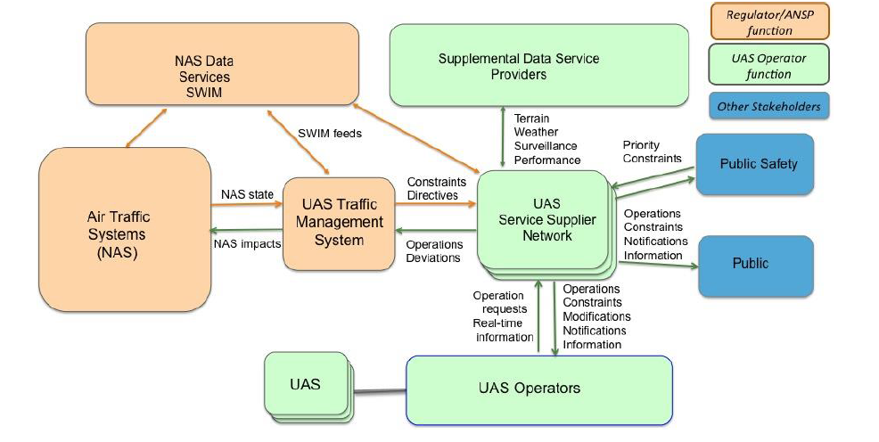
UAS Traffic Management
In close collaboration with the FAA, industry, and academia
2.6M commercial small UAS are expected by 2020: Need a way to manage beyond visual line of sight UAS operations in the low-altitude airspace
UTM is an instantiation of air/ground integrated increasingly autonomous system – in lower and/or uncontrolled airspace
Cloud-based, connected, federated system
  Flexibility where possible, structure where necessary
  Risk and performance based
Defined roles/responsibilities: UAS operator, UAS support service supplier, and regulator (implications on who pays)

