Slide 1
UNMANNED AIRCRAFT SYSTEM (UAS) TRAFFIC MANAGEMENT (UTM) PROJECT
Presented to: REDAC - NAS Operations Subcommittee
Presented by:
Steve Bradford, FAA Chief Scientist - Architecture and NextGen Development
Sherri Magyarits, FAA Technology Development & Prototyping Division, ANG-C5
March 21, 2017

Slide 2
What is UTM?
UTM is an “traffic management” ecosystem for uncontrolled operations
UTM is separate, but complementary system to the Air Traffic Management (ATM) system
UTM utilizes industry’s ability to supply services under FAA’s regulatory authority where these services do not exist
UTM development will ultimately identify services, roles/responsibilities, information architecture, data exchange protocols, software functions, infrastructure, and performance requirements for enabling the management of low-altitude uncontrolled UAS operations
How to enable multiple BVLOS operations in low-altitude airspace?
UTM addresses critical gaps associated with lack of support for uncontrolled operations
2

Slide 3
UTM Principles & Services for Safe Integration
Principles
Users operate in airspace volumes as specified in authorizations
UAS stay clear of each other
UAS and manned aircraft stay clear of each other
UAS operator has complete awareness of airspace and other constraints
Public safety UAS have priority over other UAS
Key UAS-related services
Authentication
Airspace configuration and static and dynamic geo-fence definitions
Weather and wind prediction and sensing
Conflict avoidance (e.g., airspace notification)
Demand/capacity management
Large-scale contingency management (e.g., GPS or cell outage)
Authorizations are issued based on type of operation & operator/vehicle performance
3

Slide 4
Value of UTM
Higher density UAS operations
Beyond visual light of sight (BVLOS) UAS operations
Manned and unmanned vehicle operations coordination
Unmanned vehicle operations coordination through agreed upon data/information exchanges about each others’ operations and with FAA NAS systems
Exceptions handling
Beyond Part 107 operations– e.g, entry into controlled airspace
4

Slide 5
UTM Research Transition Team (RTT)
UTM FAA & NASA Research Transition Team (RTT) formed March 2016
RTTs
Ensure that research and development needed for Next Generation Air Transportation System (NextGen) implementation is identified, conducted, and effectively transferred to the implementing agency
Provide a structured forum for researchers and implementers to constructively work together on a continuing basis
Ensure that research results will be fully utilized, and will be sufficient to enable implementation of NextGen air navigation services concepts
Include key NASA and FAA stakeholders who are responsible for planning, conducting, receiving, and utilizing the research conducted by the RTT
5

Slide 6
UTM RTT Overview
Overarching Goals
Explore concepts, develop prototypes, and demonstrate a possible future UTM system to enable large-scale low altitude UAS operations
Define the operational concept, services, roles/responsibilities, information architecture, data exchange protocols, software functions, infrastructure, and performance requirements for low altitude UAS operations
Execution
March 2016 – December 2020
Aligns with NASA UTM Project timeframe
Results of this project are expected to be transitioned to the FAA for further testing and implementation
6

Slide 7
UTM RTT Objectives
Conduct research, development, and testing to identify airspace operations requirements that enable large-scale visual and beyond visual line of sight UAS operations in the low-altitude airspace
Collaborate across government agencies
Collaborate with industry, leverage capabilities and insights – more so than any other RTT
Use UTM research platform for simulations and tests
Partner with FAA UAS test ranges
Use build-a-little-test-a-little strategy – remote areas to urban areas
Low density - No traffic management required but understanding of airspace constraints
Cooperative traffic management - Understanding of airspace constraints and other operations
Manned and unmanned traffic management - Scalable and heterogeneous operations
Ensure UTM RTT approach offers path towards scalability
7

Slide 8
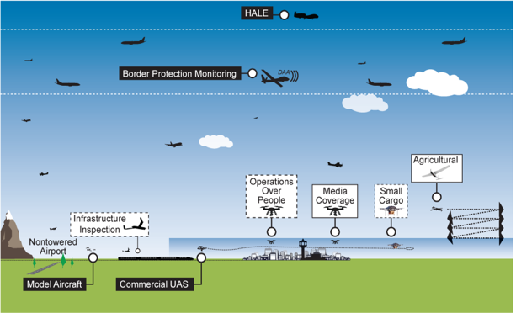
UTM RTT Scope
UTM focuses on a self-managed environment:
Uncontrolled airspace & uncontrolled operations inside controlled airspace
Entry point - small UAS (Part 107 < 55lbs) – although weight is not a factor for UTM
Beyond visual line of sight (BVLOS) of the operator - expanded operations
Airspace where the FAA does not interact directly (e.g., no controller clearances to each vehicle)
Low altitudes – initial focus is at or below 400 ft AGL – potentially scales to other airspace
All airspace classes (B, C, D, E, & G) except Class A - initial focus is Class G, uncontrolled airspace
ATM
Established policies & procedures
UTM
Cooperative interaction
8

Slide 9
UTM RTT Approach
Concepts &
Use Cases
Data Exchange & Information Architecture
Communications & Navigation
Sense & Avoid
UTM RTT
Working Groups
9

Slide 10
Alignment with UTM Project Technical Capability Levels (TCLs)
CAPABILITY 1: DEMONSTRATED HOW TO ENABLE MULTIPLE OPERATIONS UNDER CONSTRAINTS
Notification of area of operation
Over unpopulated land or water
Minimal general aviation traffic in area
Contingencies handled by UAS pilot
Product: Overall con ops, architecture, and roles
CAPABILITY 3: FOCUSES ON HOW TO ENABLE MULTIPLE HETEROGENEOUS OPERATIONS
Beyond visual line of sight/expanded
Over moderately populated land
Some interaction with manned aircraft
Tracking, V2V, V2UTM and internet connected
Product: Requirements for heterogeneous operations
CAPABILITY 2: DEMONSTRATED HOW TO ENABLE EXPANDED MULTIPLE OPERATIONS
Beyond visual line-of-sight
Tracking and low density operations
Sparsely populated areas
Procedures and “rules-of-the road”
Longer range applications
Product: Requirements for multiple BVLOS operations
CAPABILITY 4: FOCUSES ON ENABLING MULTIPLE HETEROGENEOUS HIGH DENSITY URBAN OPERATIONS
Beyond visual line of sight
Urban environments, higher density
Autonomous V2V, internet connected
Large-scale contingencies mitigation
Urban use cases
Product: Requirements to manage contingencies in high density, heterogeneous, and constrained operations
10

Slide 11
UTM RTT Focus Areas
Objectives
Develop and establish consensus on operational concepts
Airspace framework to guide RTT development
Operating principles & assumptions
Use cases
Allocation of responsibilities to operators and FAA
Provide input to RTT working groups and ensure consistency in scope and integrity of UTM concept
Identify joint validation/demonstration opportunities
Expected Outcomes
Agreed upon concept for UTM, including roles & responsibilities associated with entities interacting with UTM, and operational requirements for UTM operations
Concepts &
Use Cases
11

Slide 12
UTM RTT Focus Areas (cont'd)
Objectives
Identify and collaboratively develop standards for the data/information needed across stakeholders to support safe and efficient UAS operations
Operator - Operator
Operator - NAS/ATM systems
Explore information architecture options that meet FAA needs to access information when needed – or make information available to UTM operators
Expected Outcomes
Data exchange standards
Information architecture requirements
Data Exchange & Information Architecture
12

Slide 13
UTM RTT Focus Areas (cont'd)
Objectives
Explore operator solutions to ensure that UA are under operational control of the pilot (to the degree appropriate to the operation) and remain within a defined area
Address Command & Control, Navigation/Positioning, Compliance & Data Collection
Expected Outcomes
Guidance to industry on performance and test methodologies for maintaining operational control and remaining in designated areas or routes
Best practices for collecting and aggregating navigation and communication performance data
Communications & Navigation
13

Slide 14
UTM RTT Focus Areas (cont'd)
Objectives
Explore operator solutions to ensure that UA do not collide with other aircraft (UA or manned aircraft).
Address Operational Coordination (sharing of intent information and sense & avoid capabilities), Compliance & Data Collection
Expected Outcomes
Guidance to industry for
Assuring collision avoidance in dense drone environments
Determining minimum separation standards for various technology solutions
System performance for avoiding manned aircraft
Best practices for collecting and aggregating sense & avoid data
Sense & Avoid
14

Slide 15
UTM RTT Collaboration
FAA
Subject matter expertise
Concept of operations
Information requirements
Roles/responsibilities definition
Integration & interoperability needs
Engagement on potential solutions
NASA
Concept of operations
Overall UTM information architecture and data exchange definition
UTM research platform, flight test planning and execution
Performance requirements for operations including planning, scheduling, track/locate, sense & avoid
Industry
Use cases and operational needs
Readiness of technologies (e.g., sense & avoid)
Validation of the concept of operations
Participation in flight tests and demonstration
Technology options for vehicle
15
Notes:
Allows requester to create and submit one or more trajectories
Shows all airspace constraints (dynamic and static geo-fences)
Supports connection to external subsystems (e.g., 3D maps, weather data, etc.) through standardized interface protocols
Assesses and advises for trajectory interference or constraint violations
Provides multiple trajectories for the same UAS with rank ordering to seek the best available trajectory in presence of other operations and constraints
Tracks vehicle position

Slide 16
UTM RTT Tech Transfer Outputs
Tech transfer - to FAA and industry
Required data exchange and supporting information architecture, with emphasis on
Requirements for multiple, coordinated BVLOS operations
Concepts and initial requirements for multiple, coordinated BVLOS operations - operating with other UAS and manned aircraft
Tech transfer - to FAA
Flight Information Management System prototype
Joint FAA-NASA UTM Pilot Program
16

Slide 17
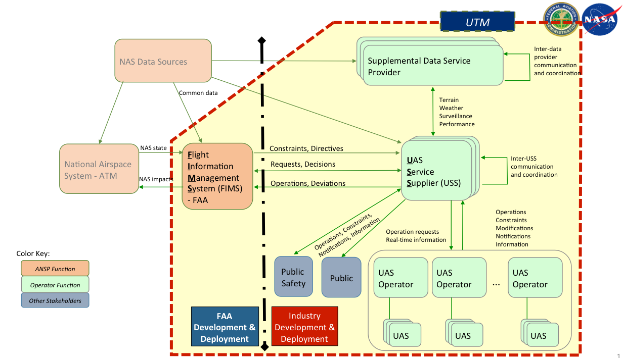
Notional UTM Architecture
17

Slide 18
Reauthorization Actions/Deliverable Updates
UTM Research Plan
Identified research outcomes sought
Ensured consistency with existing regulatory and operational frameworks and considered potential future frameworks
Assessing interoperability of proposed UTM system with existing and potential future air traffic management systems and processes
UTM RTT Research Plan v1.0 finalized with updates to comments from the FAA Aviation Safety’s (AVS) UAS Integration Office (AUS), Office of the Chief Counsel (AGC), and Government & Industry Affairs (AGI) organizations.
Status: Memo signed and ready to be delivered
The FAA Extension, Safety, and Security Act of 2016 calls for the “development of a Research Plan for UTM development and deployment”
Within 60 days after enactment (September 13, 2016): initiate research plan development
Within 180 days after enactment (January 11, 2017): complete research plan, post to FAA website, and submit to Congress
18

Slide 19
Reauthorization Actions/Deliverable Updates
UTM Pilot Program
Develop and demonstrate an infrastructure supporting UTM operations - that will be used for sharing of intent information between FAA airspace and UTM operational airspace
Provide an understanding for level of investment required for UTM operations
Support the tech transfer of the Flight Information Management System (FIMS) to the FAA and information requirements to the operators/suppliers
Conclude in 2019 with an infrastructure left behind to support the investment plan for implementation
Status: Planning on track for April 2017 definition
The FAA Extension, Safety, and Security Act of 2016 calls for the “establishment of the UTM System Pilot Program” within 90 days after completion of research plan (April 11, 2017)
Within 180 days of establishment of pilot program: submit update on status and progress (October 8, 2017)
Conclude pilot program not later than two years after establishment
19

Slide 20
Reauthorization Actions/Deliverable Updates
UTM Pilot Program (cont’d)
Demonstration Areas | Responsibility
UAS Service Supplier (USS) | Industry / NASA
UAS Operator | Industry
FIMS Prototype | NASA / FAA (ANG/PMO)
Procedures/Rules for Applicable Airspaces | Industry / FAA (ATO/AFS)
Backup Communications - Procedural | Industry / FAA (AIR)
Backup Surveillance – Human Observers for Expanded Operations (BVLOS) | Industry / FAA (AUS)
20
Notes:
Allows requester to create and submit one or more trajectories
Shows all airspace constraints (dynamic and static geo-fences)
Supports connection to external subsystems (e.g., 3D maps, weather data, etc.) through standardized interface protocols
Assesses and advises for trajectory interference or constraint violations
Provides multiple trajectories for the same UAS with rank ordering to seek the best available trajectory in presence of other operations and constraints
Tracks vehicle position

Slide 22
Backup

Slide 23
Critical Technology Enablers
Hobbyist, VLOS
(Part 101-E)
Commercial Small UAS, VLOS (Part 107 and Ops over People Rule)
BVLOS / Extended Operations
(Part 107.xx)
Integrated
(Part xx)
Pathfinder 3 BVLOS
Dynamic Spectrum Allocations for Command & Control
Pathfinder 2 EVLOS
Ground Based Sense & Avoid
Increasing Operational Risk, Complexity & Cost Drivers
Pathfinder 1 VLOS Over People
Low Altitude Automation and Scheduling
(UTM)
ATM System Integration
Automated
Airspace Notification & Authorization
Tools
Online Airspace Authorization
Registration
Website
Geo-fencing Technologies
Airborne Detect & Avoid
Commercial BVLOS
Sectors Framework
Hobbyist
Commercial VLOS
Integrated
Public
23

