Slide 1
REDAC / NAS Ops
Review of FY 2019 Proposed Portfolio
Runway Incursion Reduction Program (RIRP)
Ben Marple, ANG-C5
March 21, 2017

Slide 2
Runway Incursion Reduction Program (RIRP)
Benefits to the FAA:
FAA Strategic Priority 1 – Make Aviation Safer and Smarter
FAA Performance Metric 4 – Reduce Category A & B (most serious) runway incursions to a rate of no more than 0.395 per million operation and maintain or improve through FY 2018
RIRP is the FAA Response to NTSB Recommendation A-00-66:
“Require, at all airports with scheduled passenger service, a ground movement safety system that will prevent runway incursions; the system should provide a direct warning capability to flight crews. In addition, demonstrate through computer simulations or other means that the system will, in fact, prevent incursions.”

Slide 3
RIRP Overview Capabilities
People:
Program Managers: Ben Marple
Support Contractors: GEMS Inc., Veracity Eng.
Laboratories:
MIT/LL:
Safety Logic and Technology Development
System Requirements Development
Volpe:
Research / Data Mining
MITRE:
Benefit Estimation Methodology
Research / Data Mining
Human Factors

Slide 4
Anticipated Research in FY18 and FY19
Planned Research Activities
Advanced RI prevention technology procurement for Runway Incursion Prevention Shortfall Analysis (RIPSA)
Site Implementation and systems installation of localized surveillance and annunciation technologies at RIPSA Candidate Airports following the right-site, right-size model
Small Airport Surveillance Sensor (SASS) shadow operations testing at MIT Lincoln Lab
SASS Technology Transfer to Industry
Initiate research on Surface Taxi Conformance Monitoring (STCM) for RI prevention
Research capabilities needed to digitize taxi route instructions to support STCM

Slide 5
Anticipated Research in FY18 and FY19
Expected Research Products
RIPSA Program Plan for “Right-site-Right-size” technologies at candidate airports
SASS surveillance capability report
Shortfall analysis report identifying RIs that may be prevented by various STCM concepts at controlled airports

Slide 6
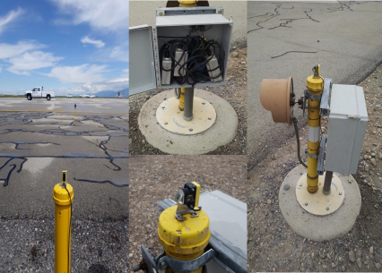
Runway Incursion Prevention Shortfall Analysis (RIPSA)
Research Requirement
Outputs/Outcomes
Develop Program Requirements, prototype, test and evaluate potential technologies at candidate airports as identified in the RIPSA report.
Sponsor: Runway Safety Group (AJI-14) POC: James Fee, Manager, Runway Safety, AJI-141
Products:
RIPSA “Right-Site-Right-Size” Assessment Report
Program Plan for feasible technologies at candidate airports.
FY 16/17 Accomplishment / Issues
Out Year Funding Requirements
Completed Runway Incursion Prevention Shortfall Analysis (RIPSA) report documenting RI causal factors and identifying small-medium airports that need RI prevention technologies.
Completed summary briefing on technical evaluation of feasible RI prevention technologies.
Completed candidate airport site assessments.
Completed draft candidate airport site assessments report.
FY18 | FY19
$ 3M | $ 3M

Slide 7
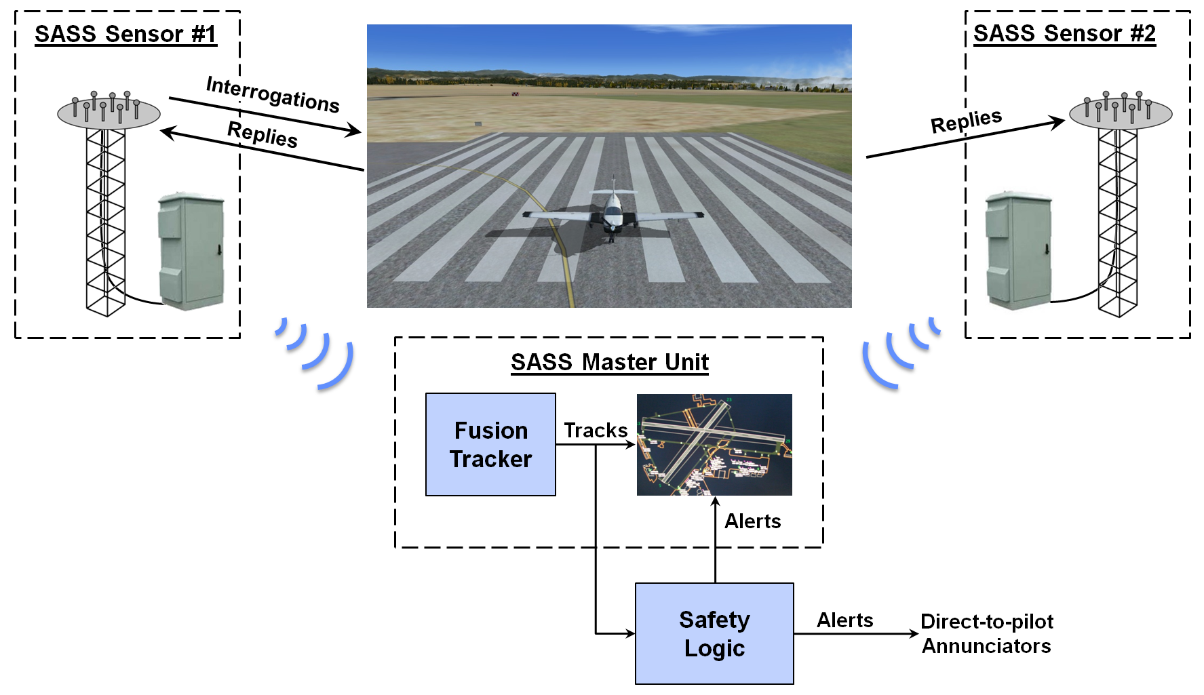
Small Airport Surveillance Sensor (SASS)
Research Requirement
Outputs/Outcomes
Develop Low Cost Surface Surveillance Sensor
Sponsor: Runway Safety Group (AJI-14) POC: James Fee, Manager, Runway Safety, AJI-141
Products:
SASS system
FY 16/17 Accomplishment / Issues
Out Year Funding Requirements
Demonstrated real time passive Mode S surface and airborne surveillance capability – Sep 2016
SASS awarded an R&D 100 award at the 2016 R&D 100 conference – Nov 2016
Conducted Technical Interchange Meeting (TIM) with MIT Lincoln Lab – Dec 2016
FY18 | FY19
$ 2M | $ 2M

Slide 8
Surface Taxi Conformance Monitoring (STCM)
Research Requirement
Outputs/Outcomes
New: Conduct research to refine concept and develop tools for tower-based and cockpit-based taxi conformance monitoring
Sponsor: Runway Safety Group (AJI-14) POC: James Fee, Manager, Runway Safety, AJI-141
Products:
Shortfall analysis report to identify Runway Incursions that may be prevented by various taxi conformance monitoring concepts at controlled airports
Expected impact estimate of taxi conformance monitoring capabilities on Runway Incursions at controlled airports
FY 16/17 Accomplishment / Issues
Out Year Funding Requirements
N/A
FY18 | FY19
$ 0.5M | $ 1.0M

