Slide 1
Runway Safety Metric (RSM)
RSM Stakeholders
Firdu Bati, AJI-3
March, 2017

Slide 2
Background
The primary goal of safety metrics is to gauge the safety performance of the National Airspace System (NAS), at the system and facility levels.
Existing runway safety metrics focus solely on runway incursion type counts, not accidents and excursions.
RSM Goal: Develop a runway safety metric that includes accident, Runway Excursion (RE), Runway Incursion (RI), and Surface Incident (SI) data.

Slide 3
Approach
Collect applicable accident and incident data.
National Transportation Safety Board (NTSB), RI-SI, and RE data sources
Use modeling to assign risk weights to all kinds of outcomes.
Weighted outcomes include injuries, damage, incursion types, surface incidents, and excursions
Weights are based on outcomes’ “proximities” to fatality and are ordered based on SME input [Injury → Damage → Incident]
For accidents, weighting gives some credit for saving lives and minimally-damaged aircraft
Aggregate all event weights for each fiscal year to get a FY score.

Slide 4
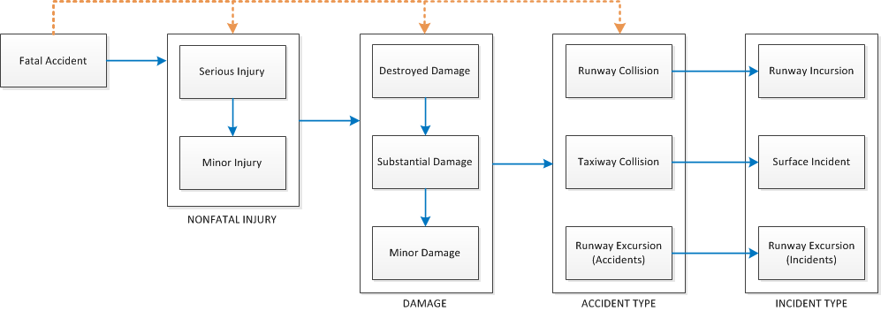
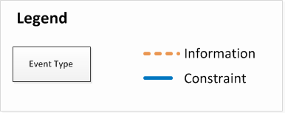
Weighting Schematic

Slide 5
Combined Risk & Event Count
*Risk decreased, incident increased, accident relatively constant over time

Slide 6
Commercial Risk & Event Count
*Risk decreased, incident increased, accident relatively constant over time

Slide 7
Non-Commercial Risk & Event Count
*Risk decreased, incident increased, accident relatively constant over time

Slide 8
Commercial Risk & Ops (Per Million)
*Risk decreased, Ops slightly decreased over time

Slide 9
Non-Commercial Risk & Ops (Per Million)
*Risk increased and started decreasing, Ops decreased over time

Slide 10
Conclusion
Systematic approach followed to develop Runway Safety metric
Inclusive of all relevant datasets
Quantitative technique to assign severity weights
Baseline/target is in development
Expected deployment date: FY 19

Slide 11
Backup Slides

Slide 12
Technical Approach
Prepare National Transportation Safety Board (NTSB), RI-SI Database, and RE Database data.
Assume the worst possible accident involves fatal injury.
Assign weights to accidents and incidents based on relative “distance” to fatality.

Slide 13
Data Pre-Processing
NTSB data selection
Reports without phase codes relevant to the runway environment were removed
Remaining data classified as runway collision, taxiway collision, runway excursion by training a text mining model and validating results
Data merging
RE and RI-SI data have already been reviewed by domain expects and categorized
Some overlap between RE and NTSB datasets; duplicates were removed (NTSB records retained)

Slide 14
FY16 Dataset
NTSB (FY81 – FY16)
RI-SI (FY98 – FY16)
RE (FY12 – FY16)
 | Runway Collision | Taxiway Collision | Runway Excursions
# of Events | 237 | 302 | 9,653
 | A | B | C | D | E | SI
# of Events | 235 | 319 | 5,472 | 7,967 | 12 | 8,936
 | Runway Excursions
# of Events | 1,276

Slide 15
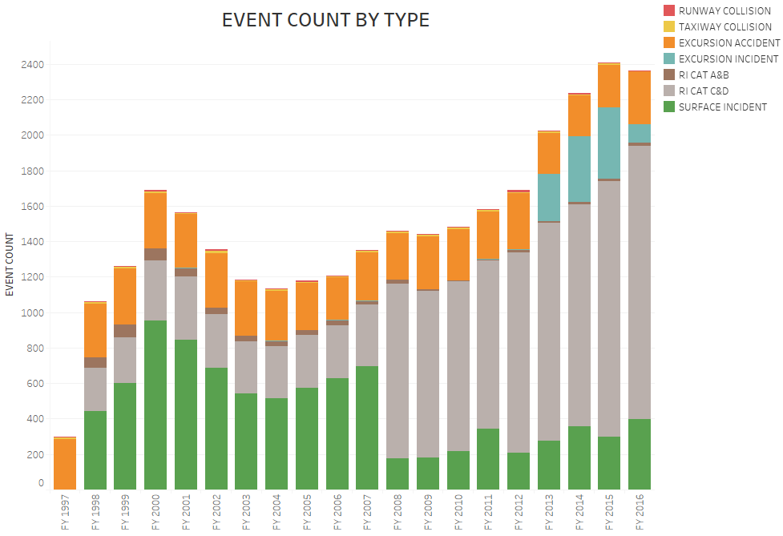
Event Count

Slide 16
Three Step Weighting Process
Weights are assigned to types of accidents based on proximity to a fatal accident.
Appropriate domain expert assumptions are used to reorder the weights:
Injury
Damage
Incident without injury/damage
Incidents are assigned weights based on their corresponding accident types.

Slide 17
Information Gain as a Measure of Uncertainty
$$H\left(FA\right)=−\sum_{x∈X}{P\left(x\right)\log_{2}P, }$$
$$H\left(FA | Acc\right)= \sum_{i}{P\left({FA}_{i}\right)H({FA}_{i}|{Acc}_{i})}$$
$$I\left(FA, Acc\right)=H\left(Acc\right)−H(FA|Acc)$$
$$I\left(FA, Acc\right)= \sum_{fa∈FA}{\sum_{acc∈Acc}{p(fa, acc)\log_{2}}}\frac{p(fa, acc)}{p\left(fa\right)p(acc)}$$

Slide 18
Information Gain as a Measure of Uncertainty
Bayesian Network employed
Accounts for correlation between different outcomes
Computes information gain

Slide 19
SME-Based Reordering Logic
Model output ranks some damage higher than injury.
Domain experts provided qualitative direction resulting in reordering.
Injury
Damage
Incident

Slide 20
SME-Based Reordering Logic
Compute information gain (model output)
Compute relative significance of highest gain
Normalize it so the relative gain sums to 1
Order gain using cumulative significance
Compute relative significance to new highest gain
Shift significance by maximum gain to compute relative significance to fatality

Slide 21
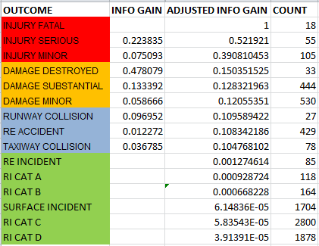
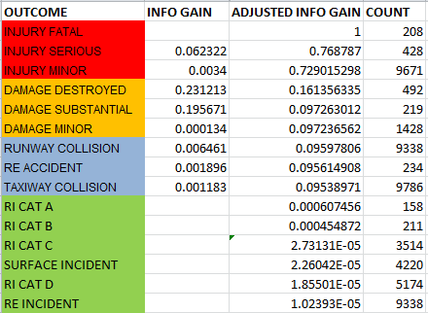
Entropy-Based Relative Weight
Commercial
Non-Commercial

Slide 22
Weights – Penalty & Credit
Injuries
Penalty and credit terms for injured and non-injured, respectively
Damage
Penalty and credit terms for damaged and non-damaged, respectively
Incidents
Ratio of the weight of the corresponding accident type to frequency of incident
$$w_{I}=\left(InjCnt− \frac{NonInjuryCnt}{TotalOnboard}\right)∗w_{i}$$
$$w_{D}=\left(DmgCnt− \frac{NonDmgCnt}{NumberOfAircraft}\right)∗w_{d}$$
$$w_{Inc}=\frac{w_{Acc}}{n_{Inc}}$$
$Where, W_{Acc}{: W}_{RC}|W_{RI, }W_{TC}$| $W_{SI}$, $W_{RE_Acc}$| $W_{RE_Inc}$

Slide 23
Credit – Penalty Correction Term
Example Two accidents
A: 5/5 injured
B: 5/200 injured
Without credit term,
Both A & B: 5 * .75 = 3.75
With credit,
A: (5*.75) = 3.75
B; (5*.75) – (.975*.75) = 3.02

Slide 24
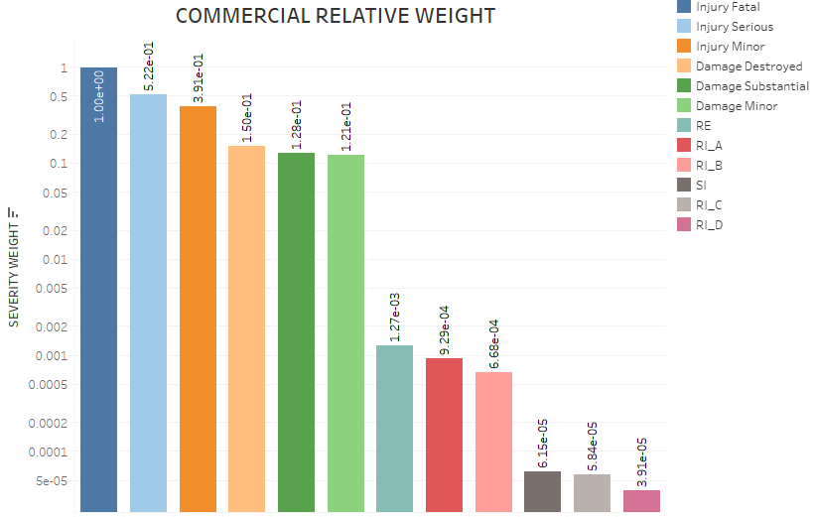
Relative Weights – Commercial
Note: Y-Axis uses Logarithmic scale

Slide 25
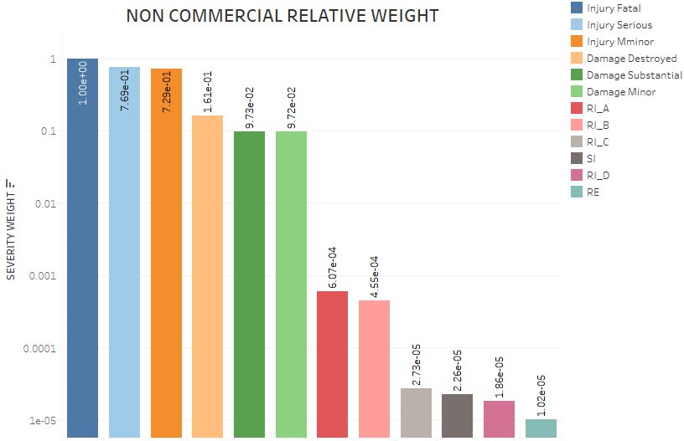
Relative Weights – Non-Commercial
Note: Y-Axis uses Logarithmic scale

Slide 26
Application of Weights
Two potential applications:
Aggregation: sum of all undesired outcome weights
Worst-outcome: weight of the worst outcome
*The choice makes little difference in the relative risk profile primarily due to the limiting effect of the worst-outcome [adding small numbers to a large number]

Slide 27
Combined Risk & Event Count
*Risk decreased, incident increased, accident relatively constant over time

Slide 28
Commercial Risk & Event Count
*Risk decreased, incident increased, accident relatively constant over time

Slide 29
Non-Commercial Risk & Event Count
*Risk decreased, incident increased, accident relatively constant over time

Slide 30
Commercial Risk & Ops (Per Million)
*Risk decreased, Ops slightly decreased over time

Slide 31
Non-Commercial Risk & Ops (Per Million)
*Risk increased and started decreasing, Ops decreased over time

Slide 32
Assumptions
Assumed the following hierarchy of accident/incident severity based on domain expert input: fatality, injury, aircraft damage, incidents.
Incident to accident mapping assumption
RIs ➔ Runway Collision
SIs ➔ Taxiway Collision
RE Incidents ➔ RE Accident
Assumed the following criteria should be used to split the dataset by Commercial and Non-Commercial
Part 121, 129, 135: Commercial
Others: General Aviation / Non-Commercial
Incident data are only available starting in 1997; however, the model used accident data since 1982.
This is more conservative

Slide 33
Conclusion
Systematic approach followed to develop Runway Safety metric
Inclusive of all relevant datasets
Quantitative technique to assign severity weights
Baseline/target is in development

