Slide 1
TSAS Benefit Summary

Slide 2
TSAS
Terminal Sequencing and Spacing (TSAS) is part of Time-Based Flow Management (TBFM) Work Package 3 (WP3) which received its final investment decision (FID) in April 2015
TSAS is formerly known as TSS

Slide 3
Benefits Development Methodology
Identify Potential Benefits
Initial concept development targets an operational shortfall (e.g., need for improved sequencing and spacing in Terminal area)
Feedback during variety of concept validation exercises
Exercises include “table-top” as well as part-task or full-task simulations
Subject Matter Experts (SMEs) asked to identify what helped and why, and what could augment the current concept
Measure Benefits
Conduct balanced Human-in-the-Loop (HITL) simulation using SMEs that compare use with and without proposed tool
HITL design should provide comparison data on identified potential benefits
Results based on objective and subjective data
Project how HITL results can be extrapolated to other facilities and/or across the NAS
Data Analysis
Fast-time simulations

Slide 4
TSAS Benefit Areas
Types of Benefit | Benefit | Source
Trajectory Efficiency | Decrease in delays through reduced flight time | TSS2 HITL, 2013
 | Savings due to greater use of optimal trajectories and reduced ground tracks | TSS2 HITL, 2013
Throughput* | Increase throughput due to the ability to realize more efficient arrival spacing | TSS2 HITL, 2013; TBFM WP3 Shortfalls, 2013
Safety | Decreased probability of loss of separation due to TSAS spacing assurance | SME input based on reduced route deviations
 | Reduced controller workload due to improved capability to maintain the queuing flights on their published routes & STA with less control actions | Various HITLs 2013-2014
 | Decreased deviations from published routes | Application of ASIAS study, 2012
Environmental | Reduction in CO₂ emissions and noise level | TSS2 HITL, 2013
TBFM Schedule Improvements | Improved scheduling allows better merging of flows to the runways allowing En Route and TRACON controllers to work toward common plan that includes appropriate spacing at all merge points | SME input based on HITL experience
* Not part of economic analysis
ASIAS: Aviation Safety Information Analysis and Sharing
STA: Schedule Time of Arrival
Source: derived from TBFM WP3 BBOE

Slide 5
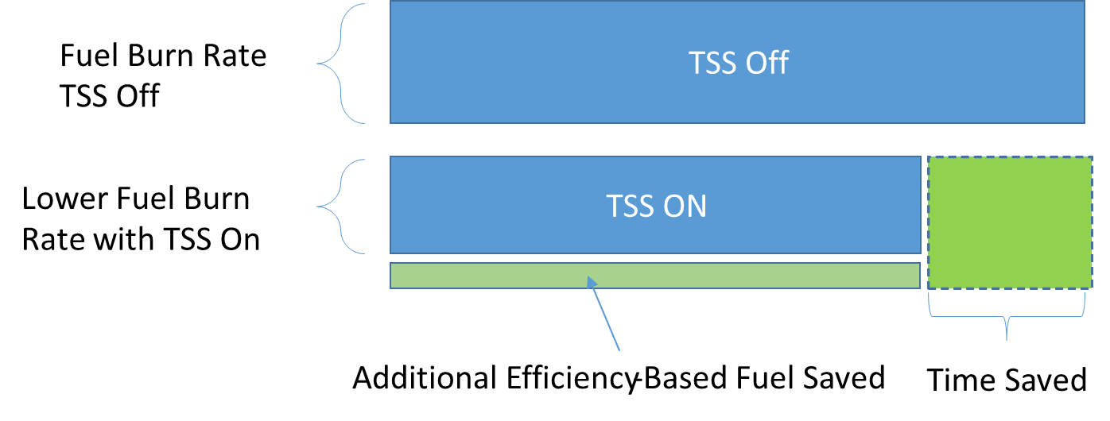
Reduced Flight Time and Fuel Burn
TSAS shortens flying time in TRACON
More RNP approaches with RF-leg (curved)
Less vectoring
TSAS promotes more efficient trajectories in TRACON
Source: TBFM WP3 BBOE

Slide 6
TSS2 HITL Results
Source: TSS2 HITL, April 2013

Slide 7
TSS2 HITL Results
More flights fly RNP approach in mixed environment
RF-Leg flown 100%
More efficient routes for all flights
Source: TSS2 HITL, April 2013

Slide 8
TSAS Benefit Numbers
 | Risk-Adjust FY14$M
Airline Direct Operating Costs | $477.82
Passenger Value of Time | $541.31
Total | $1019.13
 | Risk-Adjust PV$M
Airline Direct Operating Costs | $156.60
Passenger Value of Time | $177.40
Total | $334.00
Lifecycle: 2020-2039

