Slide 1
REDAC / NAS Ops
Review of FY 2019 Proposed Portfolio
Air Traffic Control / Technical Operations Human Factors
BLI Number: 8BA000 (Core Program)
Jason Demagalski, AJI-155, ATO Human Factors R&D Requirements Roundtable Chair Dan Herschler, ANG-C1, R&D Budget Line Program Manager
March 22, 2017

Slide 2
ATC / Tech Ops Human Factors – Core Program Overview
Purpose:
To provide technical sponsors with timely and appropriate R&D products and consultation services, as identified by the ATO Human Factors R&D Roundtable and ANG-C management, that improve safety and efficiency of complex ATC systems
Provide support to Human Factors efforts for FAA acquisition programs through In-Service Review (ISR) Checklist human factors approval responsibility, and Acquisition Management System (AMS) Policy updates
Methods used:
Measuring individual and team performance of air traffic controllers and technical operations specialists.
Recommending and testing improvements to design, procedures, training, selection and placement; and mitigations to address human performance shortfalls.

Slide 3
ATC / Tech Ops Human Factors Benefits
What are the benefits to the FAA:
Improving the safety and efficiency of complex ATC systems by application of R&D to address factors affecting human performance in air traffic control operations and ATC system maintenance.
Recommending and testing improvements to design, procedures, training, selection and placement; and mitigations to address human performance shortfalls.
What determines program success:
R&D Sponsors and Stakeholders in the ATO are able to make important workforce policy and acquisition decisions based on the results of thorough, timely, and focused R&D efforts.
When programs embrace human factors processes and requirements during system acquisition, they reduce human factors risks. This increases the likelihood for successful system implementation and operation, while reducing the likelihood for system design and engineering rework.

Slide 4
ATC / Tech Ops Human Factors – Core Program Team
ATO Sponsors:
AJG – Management Services (also supports AHF-02, Deputy Director HR Services)
AJI – Safety and Technical Training - includes AJI-155 HF Core R&D Roundtable (also supports AMA-1 FAA Academy Superintendent)
AJM – Program Management Office
AJT – Air Traffic Services
AJW – Technical Operations Services
ANG-C1 Program Management:
BLI PM – Dan Herschler
N90 OJTI Training – Stephanie Kreseen
FAA Research Performers:
FAA Civil Aerospace Medical Institute (CAMI)
Aerospace Human Factors Research Division (AAM-500)
AAM-520 – Carol Manning, Manager
FAA William J. Hughes Technical Center
Aviation Research Division (ANG-E2), Human Factors Branch
ANG-E25 – Kenneth Allendoerfer, Manager

Slide 5
ATC / Tech Ops Human Factors Focus Areas
The program addresses R&D needs within five focus areas:
Human Factors Standards
Workforce Optimization – Human Factors Efforts
Improved Safety – Human Factors Efforts
Human Factors in NAS Technology Integration
Human Performance Enhancement
The program also supports Human Factors efforts for FAA acquisition programs through ISR Checklist human factors approval responsibility, and AMS Policy updates

Slide 6
Anticipated Research in FY17 and FY18
Planned Research Activities
ATC and Tech Ops Display Design Standards & Guidance – FY17-FY20
Tech Ops Workforce Transition Job Analysis Efforts – FY17-FY18
Identify NAS ATC Capability and Equipment Utilization, HF Issues – FY16-FY18
ATCS Selection, Placement, Training and Performance Evaluation R&D – FY17-FY20
Runway Safety Analysis and Training Research to Develop Best Practices – FY16 – FY19
Expected Research Products
Technical Operations Graphical User Interface (GUI) Style Guide for New ATO Equipment – Part 1 FY18, Part 2 FY19, Part 3 FY20
ATC Display Color Standard with Color Palette that Accommodates Color Vision Deficient Users – FY18
Controller Performance Standards for Field Facility and Academy Training – FY18
Technical Operations Pre-Hire Selection Tool – FY20
Recommendation to Technical Training (AJI-2) on Policy Decision for use of Radar Vectoring Aptitude Test (RVAT) as a Job Placement Method – FY18
Recommended Interventions to Mitigate Non-Task Factors Impacting ATCS Training Success – FY18
Recommended Training Methods for Improving ATCS Scanning Techniques – FY18

Slide 7
8BA000 Funding and Staffing Status as of January 31, 2017
Organization | *FY2017$ | FY2016$ | FY2015$ | Total
ANG-C1 | 238,723 | 554,752 | 49,303 | 842,778
ANG-E25 | 1,256,251 | 32,653 | 232,612 | 1,521,516
AAM-520 | 1,460,644 | 132,695 | 141,257 | 1,734,596
Total | 2,955,618 | 720,100 | 423,172 | 4,098,890
FY2016 Roundtable Unexpended Funds |  |  | 373,869
FY2017 Roundtable Recommended Funds |  |  |  | 775,000 (5,597)
FY2017 Roundtable Unfunded Requirements |  |  |  | 760,656
Org | FTP Allowance | Onboard as of 1/21/17 | FY17 Allowance | FY17 Cost | Remaining
ANG | 16 | 14 FTE | $2,589,956 | $2,343,244 | $246,712
AVS | 20 | 15 FTE + 1 PT (intern) | $2,566,135 | $2,088,773 | $477,362
* FY2017 – PC&B, no Contracts; FY2016 and FY2015 – carryover PCB&T converted to Contracts
7

Slide 8
FY2017 Roundtable Requirements
No. | Title | Technical Performer | Funding (FY15/16) | Acquisition Status
HF17-AJG-1 | Determine if attachment of job jeopardy to performance in the Common Principles (FAA 43078001) is supported by content validation | CAMI | $0 | FY2017 CAMI PD under development
HF17-AJG-2 | Update and maintain an ATCS longitudinal training and performance database to support evaluation of proposed strategies, tests, or interventions in training, placement, and/or promotion of ATCSs | CAMI | $100,000 | FY2017 CAMI PD under development
HF17-AJG-3 | Conduct strategic job analysis for NAS Security and Enterprise Operations (NASEO) Directorate | CAMI | $150,000 | FY2017 CAMI PD under development
HF17-AJG-4 | Develop recommendations for increasing the likelihood that controller trainees will succeed in field training to ensure that trainees are not lost due to factors other than their ability to control air traffic | CAMI | $0 | FY2017 CAMI PD under development
HF17-AJG-5 | Technical Operations Talent Acquisition Process: Development of field ATSS (FV-2101) structured pre-employment interview | CAMI | $0 | FY2017 CAMI PD under development
 | AJG Total |  | $250,000
HF17-AJI1-1 | Conduct research to support Runway Safety Call to Action Implementation Plan activities - Literature Review for Human Factors in Wrong Surface Landings (R&D requirement withdrawn) |  | $0 | AJI-155 Technical Sponsor withdrew R&D requirement
HF17-AJI1-2 | Visual Scanning Techniques Research Study | CAMI | $50,000 | FY2017 CAMI PD under development
HF17-AJI1-3 | Human Factors for NextGen Remote Towers | Not Core Funded | ANG-A NG F&E | Roundtable: $256K needed ANG-A funded $400K
HF17-AJI2-1 | Assess the Radar Vectoring Aptitude Test (RVAT) as a measure of vectoring aptitude and assist in determining its predictive validity, utility, and fairness use in the placement of newly hired air traffic developmental controller | CAMI | $0 | FY2017 CAMI PD under development
HF17-AJI2-2 | Conduct research to provide data and targeted analyses to support data-driven decision-making at the FAA Academy Air Traffic Division, including documenting and improving the reliability of the raters who evaluate ATC student performance at the end of their initial courses. | CAMI | $0 | FY2017 CAMI PD under development
HF17-AJI2-3 | Evaluate AT-CTI Program effectiveness (R&D requirement pending) | CAMI | $0 | Requirement deferred for FY2017 per AJI-155
 | AJI Total |  | $100,000

Slide 9
FY2017 Roundtable Requirements (cont.)
No. | Title | Technical Performer | Funding (FY15/16) | Acquisition Status
HF17-AJT-1 | Supplemental Review of Visual Air Traffic Terminal Services | ANG-E25 | $50,000 | FY2017 ANG-E25 LOEA under development
 | AJT Total |  | $50,000
HF17-AJM-1 | Optimizing Air Traffic Control Information Presentation | ANG-E25 | $175,000 | FY2017 ANG-E25 LOEA under development
HF17-AJM-2 | Color palette development and deployment | CAMI | $100,000 | FY2017 CAMI PD under development
HF17-AJM-3 | NAS Capability Utilization Analysis | ANG-E25 | $100,000 | FY2017 ANG-E25 LOEA under development
HF17-AJM-4 | Standardized Scenario Development | CAMI | $0 | FY2017 CAMI PD under development
 | AJM Total |  | $375,000
HF17-AJW-1 | Revising HF Style Guide for New ATO Equipment | ANG-E25 | $50,000 | FY2017 ANG-E25 LOEA under development
 | AJW Total |  | $50,000
 | FY2017 ATO Roundtable Total |  | $775,000
 | Funds currently available ($49,352 – FY15; $714,729 – FY16) |  | $769,403
 | Shortfall |  | -$5,597

Slide 10
Emerging FY19 Focal Areas
Research to Support Controller Selection, Placement, and Training Performance Evaluation
Develop new approaches to aptitude testing for future controllers.
Assess the Radar Vectoring Aptitude Test (RVAT) as a selection procedure. Support research to determine its predictive validity, utility, and fairness in the placement of newly hired controllers.
Evaluate 2014, 2015, 2016 controller hiring processes and recommend improvements for better applicant/job fit.
Develop measures of controller on-position core technical job performance and identify training environment performance obstacles.
Assess use of alternative training technologies and practices to improve field training efficiency and reduce the time for developmental controllers to reach full certification.
Air Traffic Control Safety Research
Recommend improvements to controller visual scanning techniques to reduce runway incursions and loss of standard separation at tower-controlled airports.

Slide 11
Emerging FY19 Focal Areas (continued)
Research to Support Selection, Placement, and Training Performance Evaluation of Technical Operations Personnel
Engineering Services strategic job analysis
Future SSC 2101 strategic job analysis
Future ATSS Automated Crediting Plan
Future ATSS Technical Electronics Knowledge & Skill Assessment
Develop guidance for ATO sponsors on Technical Operations workforce optimization for specific workforce elements.

Slide 12
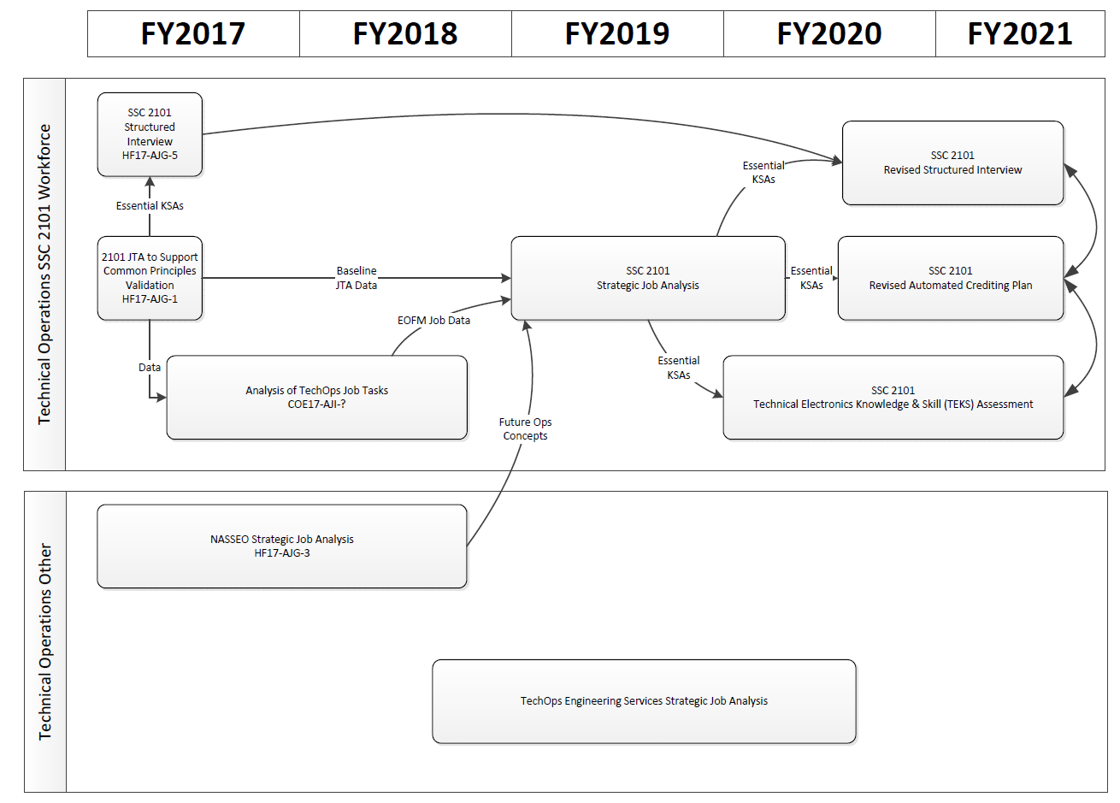
Research to Support Selection, Placement, and Training Performance Evaluation of Technical Operations Personnel

Slide 13
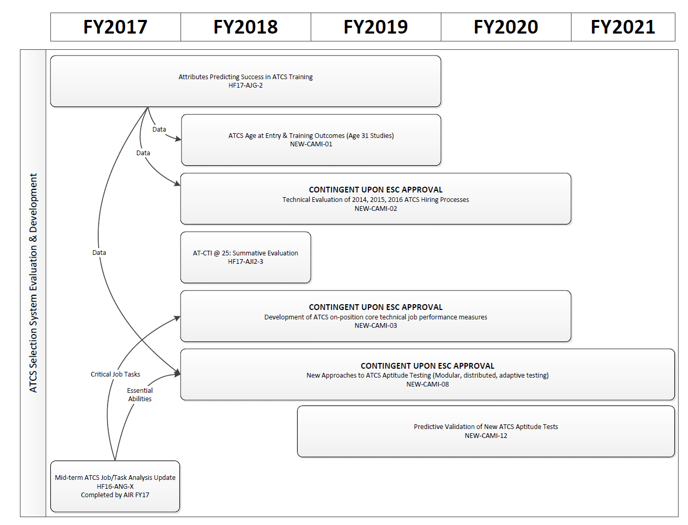
Research to Support Controller Selection, Placement, and Training Performance Evaluation of Air Traffic Control Specialists

Slide 14
Air Traffic Control/Technical Operations Human Factors, Base Program (RE&D)
FAA Strategic Initiatives
Research Goals
Priority 1: Make Aviation Safer and Smarter
Priority 2: Deliver benefits through Technology and Infrastructure
Priority 4: Empower and innovate with the FAA’s people
Standards - Implement human factors standards for design requirements for new and modified air traffic control systems
Workforce Optimization – Provide research results to ATO and FAA Academy sponsors on policies affecting controller and technician recruitment, selection, placement, staffing, and performance evaluation
Improved Safety – provide recommendations to improve procedures and operating practices for ATC and Technical Operations personnel
Human Factors in NAS Technology Integration - Provide methods and tools to support air traffic control system acquisition programs as they address human factors during concept development, including prototyping and scenario evaluations
Human Performance Enhancement - Identify minimum qualification standards of performance of ATC and Technical Operations personnel (e.g., initial training)
Need
The ATC/TO Human Factors research program supports FAA strategic goals for increased safety and greater capacity by developing research products and promoting the use of those products to meet the future demands of the aviation system.
FY 2019 Accomplishments
Out Year Funding Requirements
Assess use of alternative training technologies and practices to improve field training efficiency and reduce the time for developmental controllers to reach full certification.
Develop guidance for ATO sponsors on Technical Operations workforce optimization for specific workforce elements.
Recommend improvements to controller visual scanning techniques to reduce runway incursions and loss of standard separation at tower-controlled airports.
Provide recommendations to ATO facility managers to address training environment challenges that adversely affect performance of developmental and CPC-IT controllers during field training.
 | FY 2019 | FY 2020 | FY 2021 | FY 2022 | FY 2023
Funding Target | $241K | $242K | $247K | $252K | $257K
Notes:
This is the slide that was briefed to the Research Executive Board (REB) (by the NAS OPS Program Planning Team)
The funding profile is for contracts funding, but in practice, there are no funds designated on this BLI for contracts. The program currently funds the work of 30 federal employees; only unused PCB&T funds that are carried over are available for R&D procurement purposes.
14

Slide 15
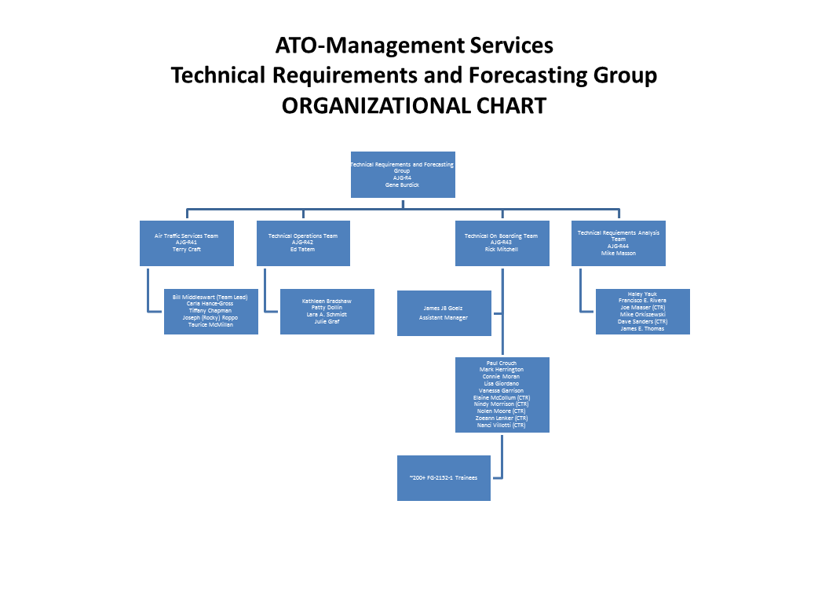
Human Factors Analyses Drive Personnel Decisions: From Research to Reality
AJG Identifies
Research Need
(2013)
ANG-C1 Coordinates CAMI Research
(2014 – 2017)
AJG uses analytical results for programmatic decision-making. Results influence policies in ATC training and placement:
AT Basics pass score
Standards for ATC trainee retention recommendations
ATC trainee facility type and level placement
Organizational Users
AJG P2 is responsible for Technical Workforce Planning, Prioritization & Hiring Plan Development for Air Traffic and Tech Ops. They report on the technical workforce, conduct staff studies, and validate positions.
Human factors analytical support was requested to inform data-driven-decisions in the design of placement, training, and promotion programs for air traffic controllers.
AJG identifies research questions of interest in the placement, training, and promotion of air traffic controllers. CAMI analyzes data in the longitudinal database and provides feedback to AJG.
Assessments
ATC Basics to Initial
Course Outcomes
NEST-VP Agreement
on Developmental Retention & Placement
ATC Approach to
Placement
Training Outcomes:
ERAM Course Trainees
Transfer Lowers
AJG Uses Research Results
(2015+)
AJG uses our analyses to inform decisions in planning, prioritizing, and developing a hiring plan and implementing recruitment activities and initiatives in air traffic control.
Mission: To provide accurate and timely recommendations with regard to placement and future needs for the ATO Technical workforce from a global perspective.
Future Activities
Track the relationship between analyses and policy and SOP development.
Continuously improve the longitudinal database to increase responsiveness based on identified research needs.

Slide 16
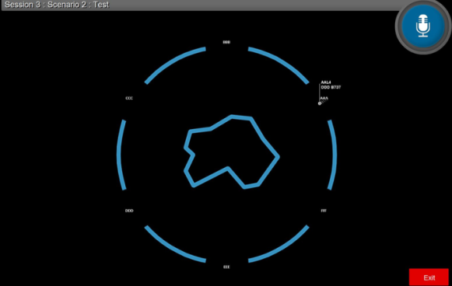
ATC Trainee Pipeline Placement and Performance Evaluation: From Research to Reality
AJI Identifies
Research Need
(2015)
ANG-C1 Coordinates CAMI Research
(2016 – 2017)
Recommendations for improvements will be provided to AJI.
Results can influence policies in ATC training and placement:
Implementation of periodic reliability training for evaluators at the Academy
Use of the RVAT tool to place newly hired trainees into the appropriate ATC specialty.
Organizational Users
AJI-2000 is the organizational element responsible for Technical Training within the ATO.
Human factors research support was needed to enhance data-driven-decisions in two key areas.
First, the Radar Vectoring Aptitude Test (RVAT) tool that AJI and MITRE developed must be evaluated for use as a potential ATC specialty placement tool. Second, AJI and the Academy are looking for ways to improve performance evaluations of students during their initial training courses.
AJI identified research questions concerning the placement and training of ATC trainees. CAMI will collect and analyze data to evaluate the utility of the RVAT as a proposed placement tool, as well as measure the current reliability of evaluators who rate students in the ATC initial course performance.
AJI Uses Research Results
(2016+)
AJI will use this research to inform decisions in evaluating and improving ATC placement and training programs. Coordination with ATO groups that are responsible for new hire placements will provide an opportunity to expand application of the results. The intent is to reduce trainee attrition.
RVAT Image
Future Activities
If positive results are obtained, further expansion of recommended improvements to other AJI training programs could be considered. Additionally, if found useful, the RVAT could be implemented as a placement tool to increase the likelihood of trainee success.

Slide 17
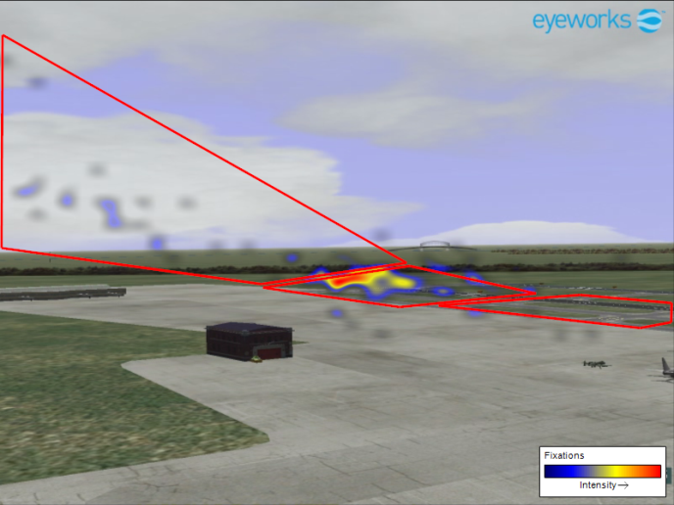
Understanding Visual Scanning Performance of Tower Controllers: From Research to Reality
AJI Identifies
Research Need
(2016)
ANG-C1 Sponsors Research Program
(2016)
AJI will incorporate human factors research results into briefing that provides guidance on effective scanning and will disseminate the briefing to field controllers via a PFS teleconference on or before September 30th, 2016.
Tower Controllers in the Field
ANG-C1 sponsored a human factors project to:
Conduct literature review regarding scanning and how it is taught to air traffic controllers
Participate in work group to identify characteristics of a good scan
Conduct human-in-the-loop experiments to characterize controller scanning
Attempt to test the performance impact of the scanning characteristics identified by the work group.
AJI Uses Research Results
(2016)
Number 4 on ATO’s FY 2016 Top 5 Safety issues list was “Tower Visual Scanning: Air Traffic Control scanning technique did not provide situational awareness.” Scanning arose as a Top 5 Safety issue when deficits in visual scanning were found to have contributed to 42 traffic incidents, most of which were runway incursions. It was proposed that human factors research could provide valuable input into the identification of a mitigation strategy.
Tower controllers learn something from the briefing that they can use to enhance their scanning performance.
Identified scanning best practices are introduced into tower controller training.
Future Activities
Validate the findings using current tower controllers, higher fidelity simulations of real airports, and think aloud & shadowing protocols in the field.

Slide 18
Job Analysis Information Database: From Research to Reality
AJI & ANG Identify
Research Need
(2012)
ANG-C1 Coordinates CAMI Research
(2012 – 2017)
JAIdB provides single point of access to ATCS (FV-2152), Tech Ops ATSS (FV-2101), & AVS Operations Research Analyst (ORA; FV-1515) job/task analysis data for ANG/HF research community and AJI & other training development community
Organizational Users
Multiple job/task analyses were generated for ATCS occupation in recent years, including the Human Solutions, Inc. En Route cognitive task analysis (2011) and the American Institutes for Research (AIR®) 2007 and 2011 job analysis. No single repository/point-of-access exists for the JTA data for human factors engineering (ANG) and training (AJI). Need identified for web-based repository for JTA data.
Prototype web-based Job Analysis Information Database (JAIdB) developed, hosted by contractor (AIR®), populated initially with 2007 ATCS job analysis data for ATCT, TRACON, & ARTCC.
Training community (AJI) identified additional functional requirements for JAIdB, leading to version 2.0 in 2014-2015.
JAIdB version 2.0 to be published on FAA Cloud service in late 2016 (depending on support contract).
ANG, AJI Uses Research Results
(2017+)
JTA data can be used by ATO, Academy, and human resources to:
• Develop training
• Validate training course content
• Support development of methods and messaging for new hire candidate recruitment
• Develop and validate selection instruments
• Develop methods for determining best fit and job placement for new hires in areas of specialization and level of complexity
• Establish performance metrics and standards
• Identify the impact of planned NAS changes
Future Activities
Develop methods/tools within JAIdB for comparison of job/task analyses for single occupation to identify changes
Populate JAIdB with additional JTAs, such as most recent APTMetrics ATCS job analysis (2016) and other occupations
Develop access protocols for HF researchers outside FAA cloud

Slide 19
Tech Ops Common Principles Validation: From Research to Reality
AJW Identifies
Research Need
(2014)
ANG-C1 Coordinates CAMI Research
(2012 – 2017)
Analysis results will provide justification to AHR, AGC, and PASS to attach (or not) job jeopardy to performance in Common Principles course.
Organizational Users
Tech Ops re-instituted the Common Principles course in 2011 to ensure that ATSS had basic electronics knowledge & skills when reporting for duty. Tech Ops managers Identified the need to attach job jeopardy to performance in the course.
Attachment of job jeopardy makes Common Principles a selection procedure within scope of 29 CFR § 1607, requiring validation.
CAMI developed a program to validate Common Principles for job jeopardy:
* Conducted baseline job analysis
* Identified important job duties/tasks & KSAOs required overall.
* Currently linking specific duties/tasks to specific KSAOs to identify KSAOs essential to successful job performance.
* Will compare essential KSAOs and Common Principles content to establish the degree of content validity.
AJW Uses Research Results
(2017+)
AJW uses Common Principles to screen out new hires without level of technical electronics knowledge and skill required at SSCs.
Common Principles to be used on interim basis while ATSS selection process is re-engineered.
Future Activities
Re-engineer ATSS selection process (including on-line application/crediting plan, assessment of knowledge & skills, and interview) to be adaptable to specific position requirements

Slide 20
Risks
Funding Limitations Leading to Technical Risk
8BA000 budget line continues to be funded at a level that only covers federal employee PC&B and travel.
It is only through use of very limited prior-year carryover of PC&B funds (from unfilled federal positions and unused travel funding) that we can afford to hire external contract support to supplement research conducted by FAA principal investigators using only current year PC&B core BLI funds.
Lack of contracts funding presents a challenge for execution of studies that require contract services and paid participants. (Available carryover funding averages less than $50K per project.)
20

