Slide 1
Unmanned Aircraft Systems Traffic Management (UTM) Safely Enabling UAS Operations in Low-Altitude Airspace
Dr. Thomas Prevot, Dr. Marcus Johnson, Dr. Joseph Rios and Dr. Parimal Kopardekar
NASA Ames Research Center
Moffett Field, CA
March 2017

Slide 2
Outline
Overview
Architecture
Approach and schedule
FAA-NASA Research Transition Team deliverables
Technical Capability Level 1 (TCL1) Demonstration overview and results
TCL 2 Demonstration overview and results
Next Steps

Slide 3
Overview

Slide 4
Low Altitude UAS Operations
Small UAS forecast – 7M total, 2.6M commercial by 2020
Vehicles are automated and airspace integration is necessary
New entrants desire access and flexibility for operations
Current users want to ensure safety and continued access
Regulators need a way to put structures as needed
Operational concept being developed to address beyond visual line of sight UAS operations under 400 ft AGL in uncontrolled airspace using UTM construct

Slide 5
What is UTM?
UTM is an “air traffic management” ecosystem for uncontrolled airspace
UTM is a separate, but complementary system to the Air Traffic Management (ATM) system
UTM utilizes industry’s ability to supply services under FAA’s regulatory authority where these services do not exist
UTM development will ultimately identify services, roles/responsibilities, information architecture, data exchange protocols, software functions, infrastructure, and performance requirements for enabling the management of low-altitude uncontrolled UAS operations
How to enable multiple BVLOS operations in low-altitude airspace?
UTM addresses critical gaps associated with lack of support for uncontrolled operations

Slide 6
Key Operational Assumptions
FAA maintains regulatory AND operational authority for airspace and traffic operations
UTM is used by FAA to issue directives, constraints, and airspace configurations
Air traffic controllers are not required to actively “control” every UAS in uncontrolled airspace or uncontrolled operations inside controlled airspace
FAA has on-demand access to airspace users and can maintain situation awareness through UTM
UTM roles/responsibilities: Regulator, UAS Operator, and UAS Service Supplier (USS)
FAA Air Traffic can institute operational constraints for safety reasons anytime
Key principle is safely integrate UAS in uncontrolled airspace without burdening current ATM

Slide 7
UTM Principles and Services
Principles
Users operate in airspace volumes as specified in authorizations
Authorizations are issued based on type of operation and operator/vehicle performance
UAS stay clear of each other
UAS and manned aircraft stay clear of each other
UAS operator has complete awareness of airspace and other constraints
Public safety UAS have priority over other UAS
Key UAS-related services
Authentication
Airspace configuration and static and dynamic geo-fence definitions
Track and locate
Communications and control (spectrum)
Weather and wind prediction and sensing
Conflict avoidance (e.g., airspace notification)
Demand/capacity management
Large-scale contingency management (e.g., GPS or cell outage)

Slide 8
Value of UTM
Higher density UAS operations
Beyond visual light of sight (BVLOS) UAS operations
Manned and unmanned vehicle operations coordination
Unmanned vehicle operations coordination through agreed upon data/information exchanges about each others’ operations and with FAA NAS systems
Exceptions handling
Beyond Part 107 operations– e.g. entry into controlled airspace

Slide 9
Roles and Responsibilities and Architecture

Slide 10
Defining Operator and Regulator/ANSP Roles
UAS Operator
Assure communication, navigation, and surveillance (CNS) for vehicle
Register
Train/qualify to operate
Avoid other aircraft, terrain, and obstacles
Comply with airspace constraints
Avoid incompatible weather
Regulator/Air Navigation Service Provider
Define and inform airspace constraints
Facilitate collaboration among UAS operators for de-confliction
If future demand warrants, provide air traffic management
Through near real-time airspace control
Through air traffic control integrated with manned aircraft traffic control, where needed
Third-party entities may provide support services but are not separately categorized or regulated

Slide 11
UTM Architecture
UTM
Supplemental Data Service Provider
Inter-data provider communication and coordination
Supplemental Data Service Provider
NAS Data Sources
Supplemental Data Service Provider
Common data
Terrain
Weather
Surveillance
Performance
NAS state
Flight Information Management System (FIMS) - FAA
Constraints, Directives
UAS
Service
Supplier (USS)
Inter-USS communication and coordination
UAS Service Supplier
National Airspace System - ATM
Requests, Decisions
UAS Service Supplier
NAS impacts
Operations, Deviations
Operations
Constraints
Modifications
Notifications
Information
Operations, Constraints,
Notifications, Information
Operation requests
Real-time information
Color Key:
ANSP Function
Public Safety
UAS Operator
UAS Operator
UAS Operator
Public
…
Operator Function
Other Stakeholders
FAA
Development &
Deployment
Industry
Development &
Deployment
UAS
UAS
UAS
UAS
UAS
UAS
UAS
UAS
UAS

Slide 12
UTM Approach and Schedule

Slide 13
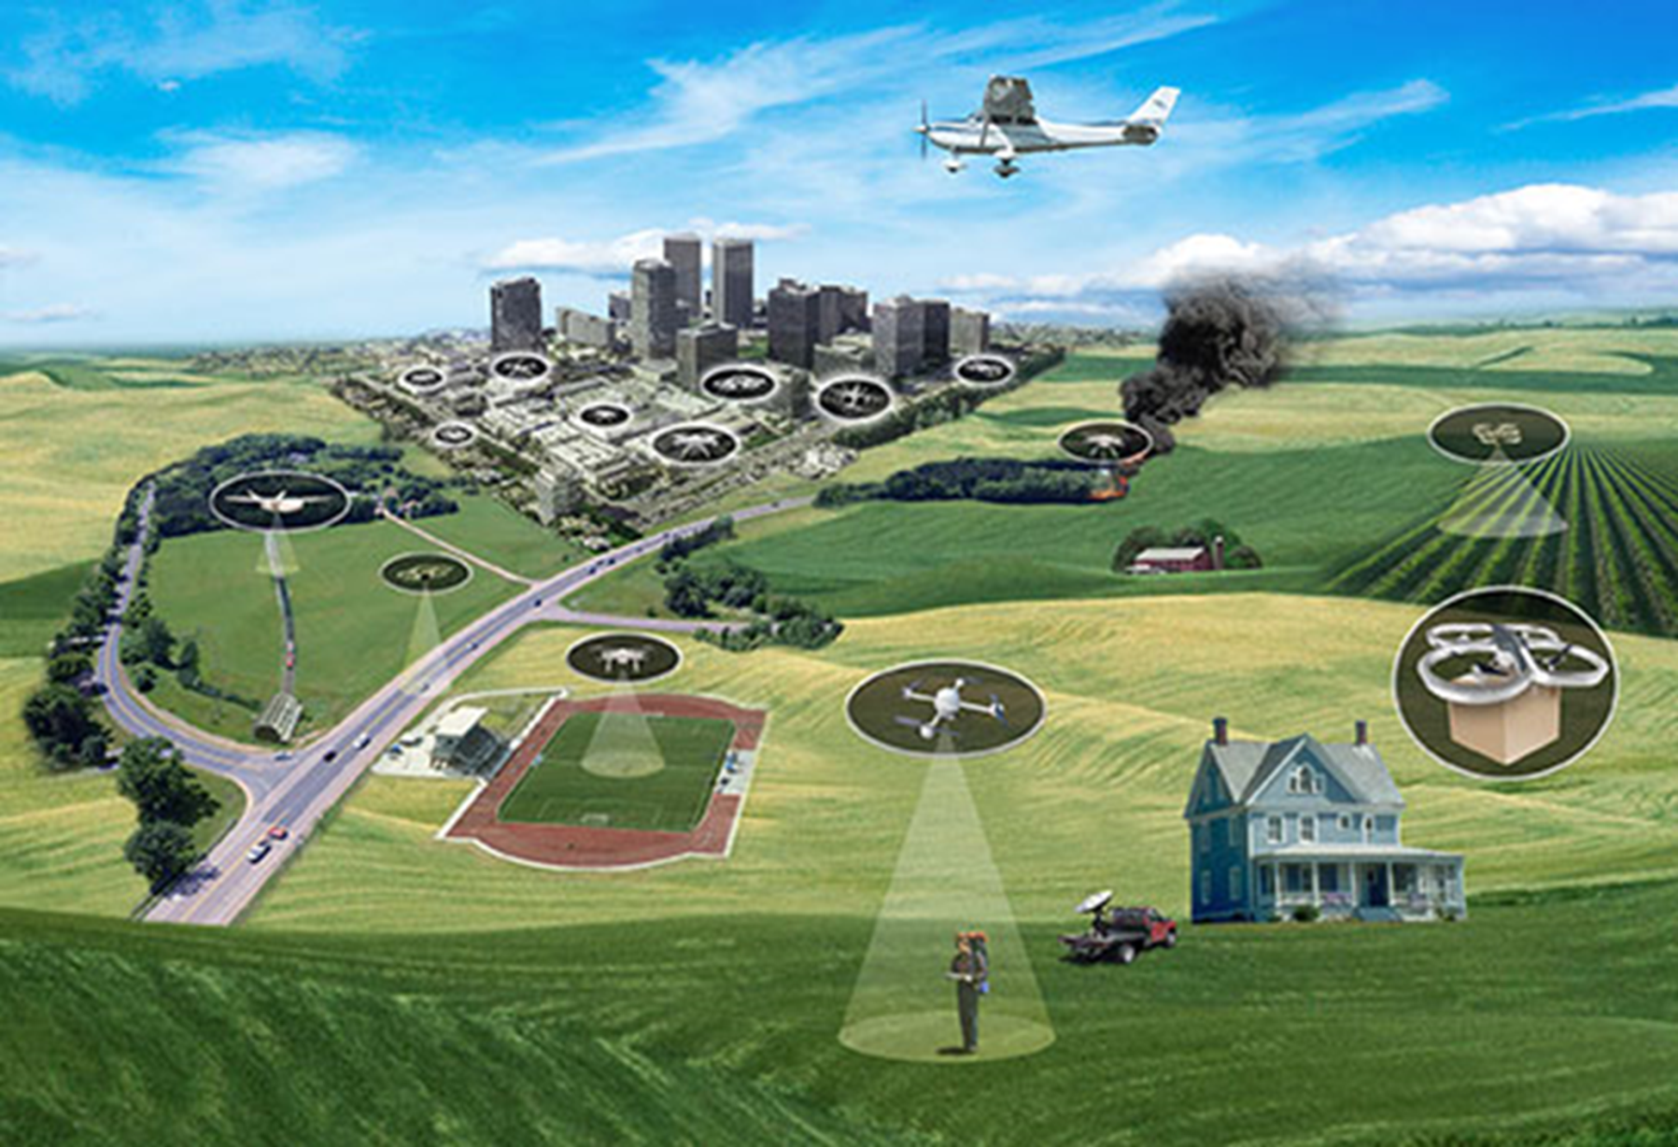
UTM Progression
Goal:
Safely enabling large scale visual and beyond visual line of sight operations in the low altitude airspace
Risk-based approach along four distinct Technical Capability Levels (TCL)

Slide 14
UTM Progression
TCL1: multiple VLOS
API-based networked ops
Info sharing

Slide 15
UTM Progression
TCL1: multiple VLOS
API-based networked ops
Info sharing
TCL2: multiple BVLOS, rural
Initial BVLOS
Intent sharing
Geo-fenced ops

Slide 16
UTM Progression
TCL1: multiple VLOS
API-based networked ops
Info sharing
TCL2: multiple BVLOS, rural
Initial BVLOS
Intent sharing
Geo-fenced ops
TCL3: multiple BVLOS, near airports, suburban
Routine BVLOS
Airborne DAA, V2V
Avoid static obstacles

Slide 17
UTM Progression
TCL1: multiple VLOS
API-based networked ops
Info sharing
TCL2: multiple BVLOS, rural
Initial BVLOS
Intent sharing
Geo-fenced ops
TCL3: multiple BVLOS, near airports, suburban
Routine BVLOS
Airborne DAA, V2V
Avoid static obstacles
TCL4: complex urban BVLOS
BVLOS to doorstep
Track and locate
Avoid dynamic obstacles
Large scale contingencies

Slide 18
UTM Technical Capability Levels (TCLs)
Capability 1: Demonstrated how to enable multiple Operations Under Constraints
Notification of area of operation
Over unpopulated land or water
Minimal general aviation traffic in area
Contingencies handled by UAS pilot
Product: Overall con ops, architecture, and roles
Capability 3: Focuses on how to Enable Multiple Heterogeneous Operations
Beyond visual line of sight/expanded
Over moderately populated land
Some interaction with manned aircraft
Tracking, V2V, V2UTM and internet connected
Product: Requirements for heterogeneous operations
Capability 2: Demonstrated How to Enable Expanded Multiple Operations
Beyond visual line-of-sight
Tracking and low density operations
Sparsely populated areas
Procedures and “rules-of-the road”
Longer range applications
Product: Requirements for multiple BVLOS operations including off-nominal dynamic changes
Capability 4: Focuses on Enabling Multiple Heterogeneous High Density Urban Operations
Beyond visual line of sight
Urban environments, higher density
Autonomous V2V, internet connected
Large-scale contingencies mitigation
Urban use cases
Product: Requirements to manage contingencies in high density, heterogeneous, and constrained operations
Risk-based approach: depends on application and geography

Slide 19
FAA-NASA Research Transition Team (RTT) Deliverables

Slide 20
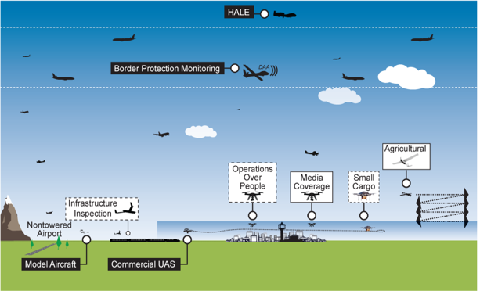
UTM RTT Scope
UTM focuses on a self-managed environment:
Uncontrolled airspace & uncontrolled operations inside controlled airspace
Entry point - small UAS (Part 107 < 55lbs) – although weight is not a factor for UTM
Beyond visual line of sight (BVLOS) of the operator - expanded operations
Airspace where the FAA does not interact directly (e.g., no controller clearances to each vehicle)
Low altitudes – initial focus is at or below 400 ft AGL – potentially scales to other airspace
All airspace classes (B, C, D, E, & G) except Class A - initial focus is Class G, uncontrolled airspace
ATM
Established policies & procedures
UTM
Cooperative interaction
20

Slide 21
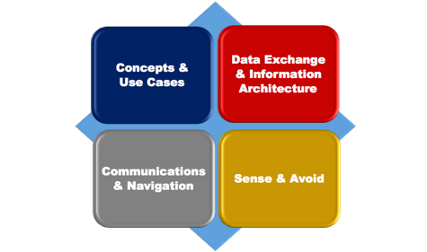
RTT Plan & Key Deliverables
Near-term priorities
Joint UTM Project Plan (JUMP) – December 2016 (Completed)
RTT Research plan – January 2017
UTM Pilot project – April 2017-2019
Execution
March 2016 – December 2020
Key RTT Deliverables (FAA needs)
Tech transfer - to FAA and industry
Concepts and requirements for data exchange and architecture, communication/navigation and detect/sense and avoid
Cloud-based architecture and Conops
Multiple, coordinated UAS BVLOS operations
Multiple BVLOS UAS and manned operations
Multiple operations in urban airspace
Tech transfer to FAA
Flight Information Management System prototype (software prototype, application protocol interface description, algorithms, functional requirements)
FAA-NASA Key RTT Deliverable
Joint FAA-NASA UTM Pilot Program
RTT will culminate into key technical transfers to FAA and joint pilot program plan and execution

Slide 22
Contributions to FAA Decision-Making Process
FAA Decision-Making
UTM R&D Contributions
(In collaboration with FAA)
Establish appropriate regulations, infrastructure, and operational procedures to begin enabling UAS operations in existing airspace classes shared with manned aircraft
Requirements to operate within UTM environment
Requirements to operate within ATM environment (UAS in the NAS project)
Some vehicles will operate in both environments (Tweener)
Expanded Operations
UAS over people
Part 107
Section 333
Non-Segregated Operations
Establish and implement an operational and regulatory framework for UAS operations which expands on Part 107 and enables UAS operations under a wider range of circumstances
Multiple BVLOS operations – requirements
TCL2 flight test findings (e.g., wx, contingencies management)
Concept/use case work group
Data exchange standards through working group and simulations
Airspace scheduling through UTM
Navigation performance (geo-fence) through working group
Heterogeneous manned/unmanned multiple operations requirements
TCL3 test findings and all of the above
DAA readiness assessment for small UAS through working group and tests
Complex urban operations requirements
TCL4 test findings and All of the above
Contingency management (no GPS, cell, etc)
Enable operations for small UAS operating over people not directly participating in the operation of the UAS
Enable operations for small UAS operating over people not directly participating in the operation of the UAS
Implement an operational and regulatory framework which facilitates operations of small civil UAS for commercial and non-commercial/non-profit purposes
Implement an operational and regulatory framework which facilitates operations of small civil UAS for commercial and non-commercial/non-profit purposes
Case-by-case exemptions granted to existing regulations to enable non-recreational UAS operations before Part 107 rulemaking was final
Allowable Exceptions to Part 107 (above 400 ft, < 5 nm from airport) through data exchange and information architecture
Highlighted boxes show NASA contributions

Slide 24
Partnerships and Collaboration Approach
FAA and NASA are actively and closely collaborating
Over 200 collaborators: Gov’t, industry, academia, FAA test sites, and FAA COE
Industry is settling down: main players in commercial small UAS operators are emerging
FAA and NASA will continue to collaborate to ensure agility and safety needs are balanced
Other working groups
Information security group being formed
Weather group getting focused
Spectrum working group collaborating with CTIA

Slide 25
TCL 2 Demo and Preliminary Results

Slide 26
UTM TCL 1 and TCL 2 Demonstration Objectives
TCL1
Evaluate the feasibility of multiple VLOS operations using scheduling and planning through an API connection to the UTM research platform
TCL 2
Evaluate the feasibility of multiple BVLOS operations using a UTM research platform

Slide 27
TCL 1: Multiple VLOS Operations

Slide 28
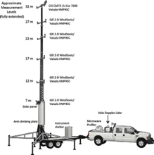
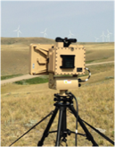
TCL1
UAS Range
August 2015
Elevation: 166 feet MSL
Flat Agricultural Farmland
Operations at 2 Locations
Crows Landing, CA
Acoustic Sensors
Weather Sensors
SRHawk Radar
100 ft Weather Tower
Radiosonde Weather Balloon
Remote Automated Weather Station
Used to detect small UAS
Notes:
Add Dates

Slide 29
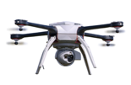
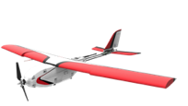
UTM TCL 1 Demonstration Highlights
Days of Flight
8
11
Partner Organizations
2
Simultaneous VLOS Operations
10
UAS Platforms
4
108
18
Test Conditions
Flights
Flight Hours

Slide 30
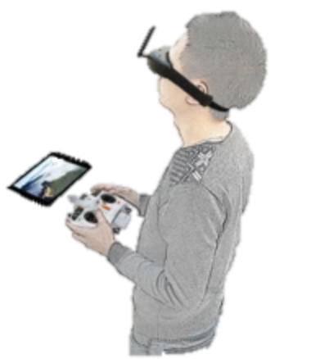
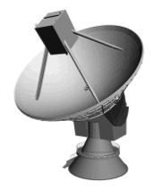
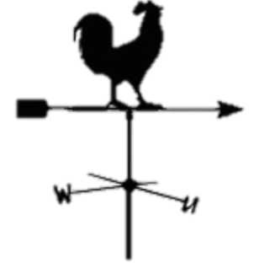
TCL 1 Demonstration Objectives
Objective 5: Collect Data on
Noise Signature of UAS Vehicles
Objective 2: Collect Data on
UAS Navigation Performance Error
Objective 3: Collect Data on
Aircraft Tracking Performance
Objective 1: Demonstrate UTM Prototype Features
Objective 4: Collect Weather
Observations for Forecasting Models

Slide 31
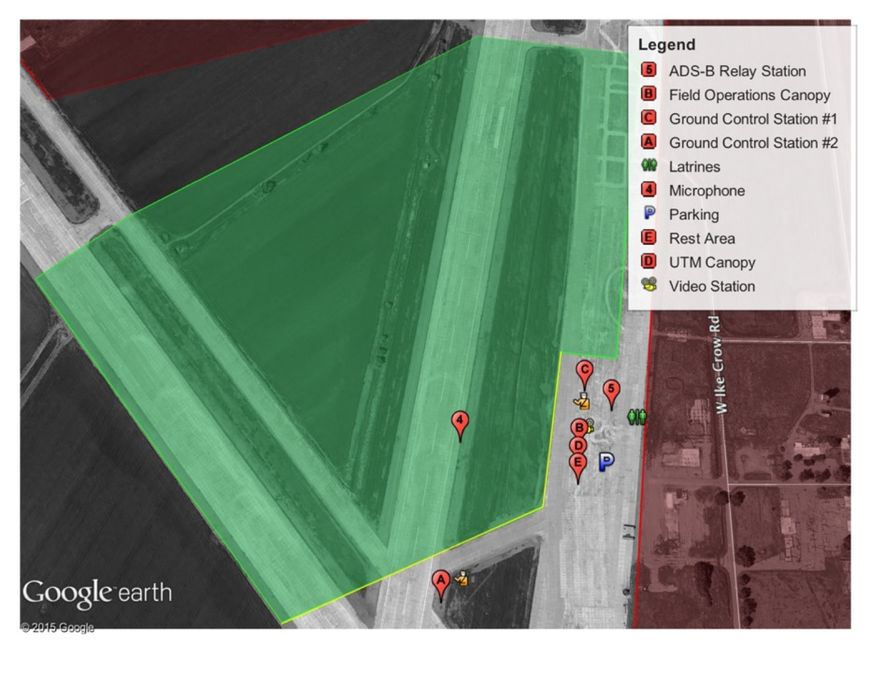
Flight Profiles:
Free Flight
Horizontal Trajectory Conformance
Vertical Trajectory Conformance
Sound Recording
System Identification Maneuvers
Operation Area 1
Operation Area 2
Altitude: up to 400 ft AGL
Duration: 8-30 minutes
Simultaneous Aircraft: 2

Slide 32
TCL 1 Safety-related Observations

Slide 33
Observations:
1
Ground equipment degraded performance and failed under high temperatures
High temperatures caused failures in ground control stations, routers, UTM computers, and Ethernet wiring.
2
Spectrum interference from unknown sources causes lost link conditions
Lost link conditions were invoked due to spectrum interference. Local farming equipment was hypothesized to have contributed to the incidents.
3
GPS degradation caused initiation of contingency management system
Inefficient satellites received during operations caused an aircraft to initiate a contingency management procedure and grounded another vehicle.
UAS and ground equipment should be rated for use based on the operational environment

Slide 34
Observations:
4
Atmospheric conditions on the ground were not indicative of conditions aloft
Despite flat terrain, wind and turbulence conditions varied on the ground as compared with 200—400 ft AGL.
5
Line of sight was often difficult to maintain when flying multiple aircraft
In the presence of other nearby operations, and raptors maintaining visual on aircraft was challenging for observers of the test.
6
Tracking information for UAS was provided at rate that was insufficient
The test used 5 second update rates for telemetry information which did not account for the dynamic changes in aircraft states, dropouts, quality of service connectivity, and human factors aspect of the displays. (Changed for TCL 2: 1 Hz or faster)
7
Lack of airspace and operations information caused conflicting planned operations
Flight crews had no airspace displays to allow them to de-conflict operations and this caused frequent operations that were in conflict.
All airspace users should have a common picture of the operating environment

Slide 35
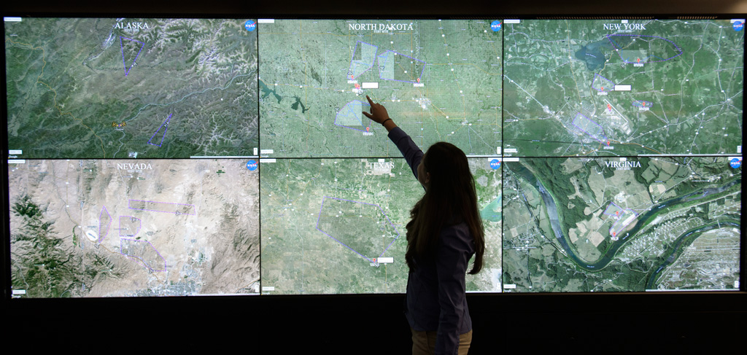
TCL-1 National Safe UAS Integration Campaign
What: Demonstrated management of geographically diverse operations, 4 vehicles from each site flown simultaneously under UTM
Where: All 6 FAA UAS Test Sites
Who: NASA, Test Sites, support contractors
When: 19 April 2016
24 live vehicles, over 100 live plus simulated flights under UTM in one hour –Highly successful
Received positive feedback from the FAA Test Sites on the UTM concepts, technologies and operations
API based model worked well – enabled operator flexibility, exchanged information, and maintained safe operations

Slide 36
TCL-1 National Safe UAS Integration Campaign
National Campaign Statistics:
3 Hours
102 real, distinct flights
67 simulated operations injected
About 31 hours of flight time
281.8 nmi flown

Slide 37
TCL 2: Multiple BVLOS Operations

Slide 38
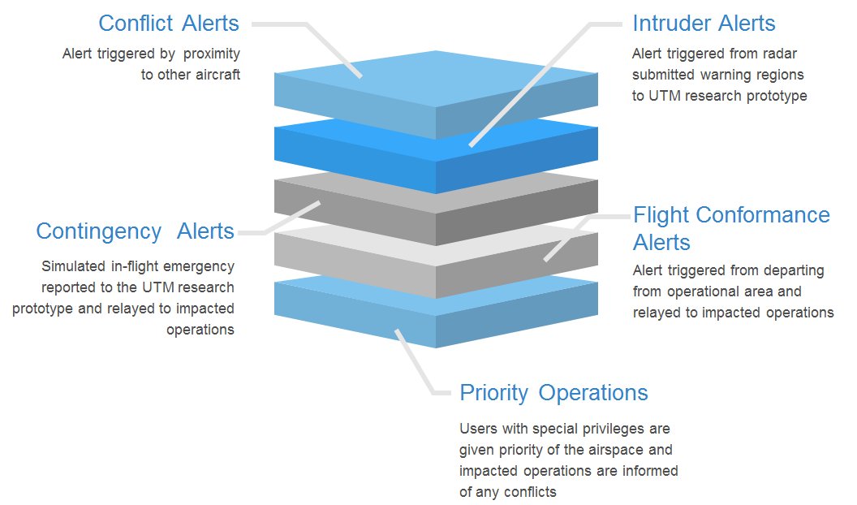

Slide 39
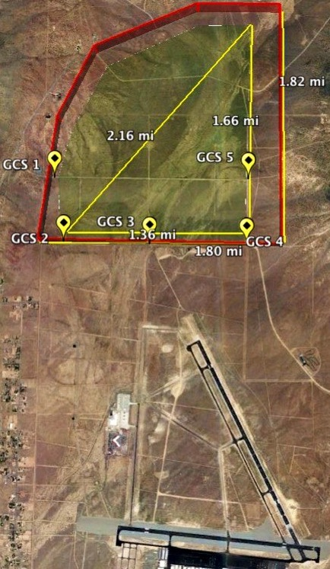
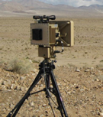
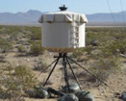
TCL 2
Test Range
October 2016
Operational Area
State of Nevada Test Site
UAS Range
Elevation: 5050 feet
Desert Terrain
Missions up to 500 ft
Operations at 5 Locations
Reno
SRHawk Radar
Used to detect small UAS
Weather Equipment
30 ft weather tower, sodar and lidar are used to measure atmospheric boundary layer
Reno-Stead Airport
LSTAR Radar
Used to detect manned aircraft
Notes:
Add Dates

Slide 40
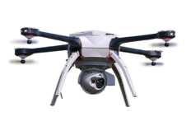
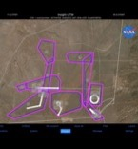
UTM TCL 2 Demonstration Flight Operations
Live-Virtual Constructive Environment
Altitude Stratified Operations
Situation Awareness Displays
Critical alerts, operational plan information and map displays
Cras justo, dapibus ac facilisis in, egestas eget quam.
2
3
5
Expanded
Visual Line of Sight
Simultaneous Operations
Flights up to 1.5 miles away from the pilot in command
Hypothetical missions based on industry use cases

Slide 41
ScEnario
Scenario
Scenario
Scenario
1
2
3
4
Agriculture
Lost Hiker
Ocean
Earthquake
BVLOS
Multiple BVLOS
Altitude Stratified VLOS
Altitude Stratified BVLOS
Intruder Aircraft Tracking
Intruder Aircraft Conflict Alerts
Rogue Aircraft ConFlict Alerts
Dynamic Re-Routing
Contingency Management Conflict Alerts
Public Safety Priority Operation
Simulated Virtual Aircraft

Slide 42
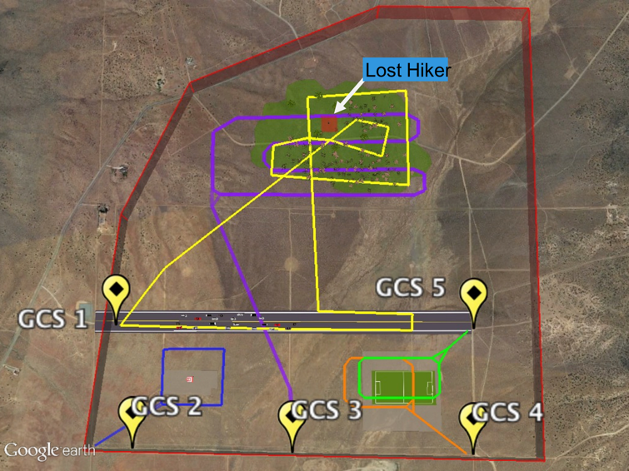
Scenario 2: Lost Hiker
Critical Events (in approximate order):
GCS1 ( submits all plans while logged in as special user
GCS3 sends message to RC “Reporting a lost hiker in area…” (once all GCS have launched)
ALL GCS receive message from RC “Simulated lost hiker in area…” (once all GCS have launched)
GCS1 submits 2nd plan with special permissions *logged in as special user (after 2 minute hover & lost hiker message)
GCS3 receives UTM system message “first responder in proximity...” and ABORTS (after GCS1’s 2 min hover & lost hiker message)
GCS5 submits 2nd plan – REJECTED for special permissions operation – does not launch (after landing plan 1, while GCS1 is still flying)

Slide 43
UTM TCL 2 Demonstration Highlights
Days of Flight
5
14
Partner Organizations
2
Simultaneous Altitude Stratified Expanded Operations
11
UAS Platforms
30
Minutes per scenario
4
74
13.5
Scenarios
Flights
Flight Hours
Notes:
Add a slide that list the organizations: add some names to this slide

Slide 44
UTM Research Platform
UTM concept and research platform supported BVLOS
UTM Core Principles and Guiding Tenet | Tested Feature
UAS should avoid each other | Scheduling and Planning Conformance Alerting Proximity Alerting Segregation in Space and Time (e.g. Geo-fencing)
UAS should avoid manned aircraft | Intruder Alerting Notification to manned (e.g. NOTAM)
UAS operators should have complete awareness of all constraints in the airspace | UTM Mobile Application Contingency Management Alerts
Public safety UAS have priority within the airspace | Priority Operations
Flexibility where possible and structure where necessary | Altitude Stratification Dynamic Re-routing 4D Segmented Flight Plans
Notes:
Make two slides…

Slide 45
TCL 2 Safety-related Observations

Slide 46
Impact of Weather
Nominal Aircraft Endurance
Multi-Rotors: 20-40 minutes
Fixed-Wing: 45-200+ minutes
Reno-Stead Elevation: 5,050 ft
Cool Temperatures
Density Altitude: 4,000 ft
Winds: 5-35 knots
Aircraft encountered thermals, microbursts and high winds which resulted in reduced endurance and degraded flight plan conformance
Warm Temperatures
Density Altitude: 9,000+ ft
Winds: 5-15 knots
Aircraft experienced substantially shorter endurance
UAS should be tested and rated against different operational environments
Notes:
Change Font Sizes (increase) and lower battery size
Main message for each slide…

Slide 47
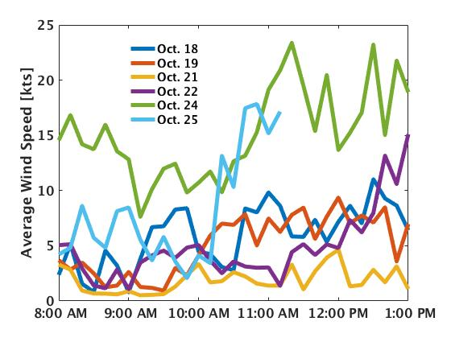
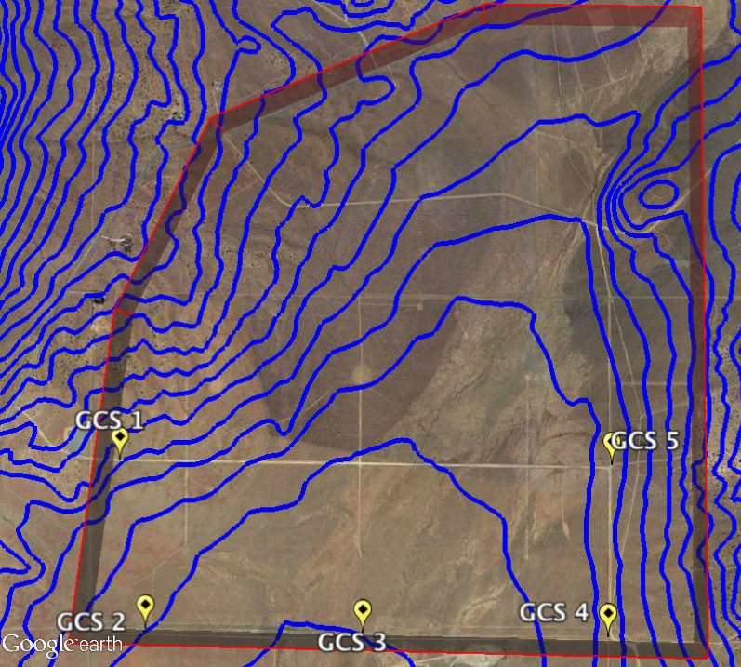
Impact of Weather
Basin and range topography yielded local micro-climates with observably different wind conditions
5160
Operation Limit
5200
5120
5240
5080
Local weather and national forecasts not indicative of observed conditions on site
Ground reports were not indicative of conditions UAS experienced aloft
Ground reports local to GCS location was not indicative of conditions UAS experience while BVLOS
5040
30 ft Weather Tower
Improvements in weather products are needed to support BVLOS
Notes:
Chose not to fly…
Add punchline...

Slide 48
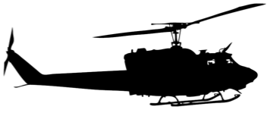
Inconsistent Altitude Reporting
Increased risk of controlled flight into terrain and airborne collision hazard
Variety of Altitude Reporting
MSL Altitude
Height above Terrain
Height above Take-off Location
Altitude Reporting should be consistent or translatable across airspace users
Notes:
Make two slides…

Slide 49
Use of the UTM Research Platform
Awareness of proximity to nearby operations
Notifications and Alerts
Operation plan violation alerts need to be clear and informative
No Awareness
Full Awareness
Levels of alerting and severity should be included in messages and displays
Medium Awareness
Areas for improvement:
Spectrum Usage
Contingency Management Actions
User reported information (e.g. UREP)
Integrated Airspace Display
Procedures are needed for returning to normalcy from an operational plan violation
UTM improved awareness, however additional information should be shared between operators
Notes:
Add text… to awareness scale
Additional information would be useful...(list a few examples)
Most cases info was not integrated into single display
Take out black text...focus on key takewaways...

Slide 50
Key Findings using UTM to support Expanded Operations
1
Information sharing provided situation awareness of airspace constraints
UTM clearly raised situation awareness and shifted flight crew’s perspective of safety from a self-centered view to an airspace view.
2
Informative weather products are lacking
The test used numerous weather sensing equipment and weather products for forecasting, however the differences in local conditions and when the aircraft was aloft were dramatic.
3
User reported information enhanced safety
When users had the ability to communicate conflicts, like RF interference or weather conditions, it improved the safety and confidence in conducting operations. This was especially true in aggressive weather conditions.
4
Alerting is useful but alerting criteria is needed
Operators benefited from raised situation awareness due to notifications and alerts, but the frequency and severity diluted the usefulness for some operators.
A common awareness of all airspace constraints and hazards is essential for safe BVLOS operations
Notes:
Break into four slides…
- Information sharing enhance sharing...(comparison between google maps and waze..)

Slide 51
Key Findings using UTM to support Expanded Operations
5
Minimum set of GCS information is required
Mixed operations require additional information to maintain situation awareness. A minimum set of required display information and common units are needed to ensure each operator has a common dialect to communicate hazards in the airspace.
6
Differences reporting in altitude pose a hazard
A common altitude measure for information sharing and reporting, common units of measure, and an acceptable error tolerance for each measurement are needed.
7
Reliable and Redundant C2 Links
Even in favorable radio line of sight conditions lost link conditions occur and when operating in close proximity of other operations interference when aloft is an issue.
8
Vehicle performance should be rated by environment
Several vehicles greatly underperformed from what was listed by the manufacturers due to the environmental conditions. More uniformity and transparency as to how UAS are tested and at what conditions, is needed.
Industry standardization can reduce risk for BVLOS Operations
Notes:
Break into four slides…
- Information sharing enhance sharing...(comparison between google maps and waze..)

Slide 52
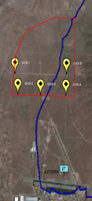
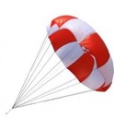
Key Findings using UTM to support Expanded Operations
9
Surveillance enhanced situation awareness
Surveillance may not be a requirement in all TCL 2 environments, however for areas with increased manned air traffic, surveillance provided increased situation awareness and should be required.
Lancaster 5
Piper Cub
500 ft AGL
300 ft AGL
LSTAR Radar
Bramor RTK
Manned Aircraft Test Range Incursion on 10/22/2016
GCS 3
GCS 5

Slide 53
Preliminary Recommendations for Initial Multiple BVLOS Operations
01
Operators need to display airspace information and have access to other operator’s operational intent and contingency actions in off-nominal conditions
02
In the absence of acceptable weather products, atmospheric conditions should be self-reported from GCS and UAS
03
Initial BVLOS should avoid altitude stratification, until altitude standard, V2V
04
Altitude reporting should be standardized and consistent/translatable to current airspace users
05
Operator training, UTM information integrated with GCS, displaying airspace constraints, and procedural guidance are needed to support separation provision
Notes:
Airspace management is key… bold few words...
Break up the last rec
In the abesence of better forecasting in measurement....information sharing

Slide 54
Next Steps

Slide 55
Next Planned Evaluations
Additional TCL2 multiple BVLOS tests at all FAA test sites in May/June 2017
Task orders to all test sites issued last week. Strong industry participation (many operators, multiple USS, many use cases)
Focus Areas:
UAS Service Supplier technologies and procedures
Geofencing technologies/conformance monitoring,
Ground-based surveillance/sense and avoid,
Airborne sense and avoid
Communication, navigation, surveillance
Human factors related to UTM data creation and display
TCL3 preparations ongoing, testing period end FY17/FY18

Slide 56
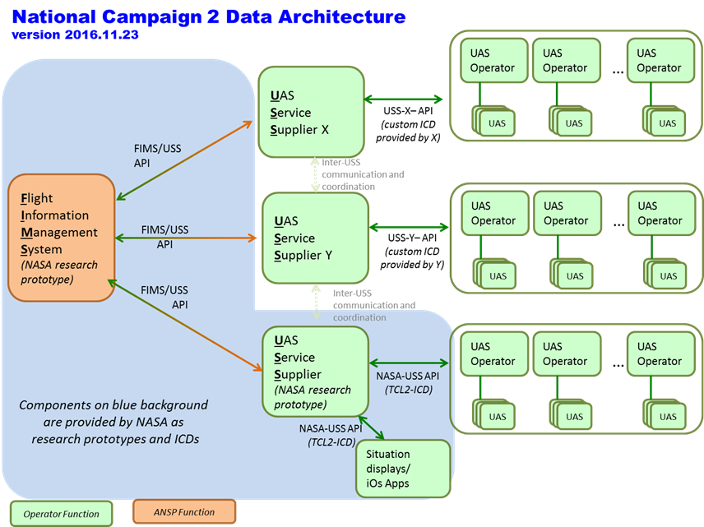
TCL 2 National Safe UAS Integration Campaign
What: Demonstrate and evaluate critical elements of diverse multiple BVLOS operations, 4 different vehicles from each site flown under UTM
Demonstrate architecture with multiple Operators, UAS Service Suppliers and Flight Information Management System (FIMS)
Where: 6 FAA UAS Test Sites
Who: NASA, Test Sites, partners
When: 15 May – 9 June 2017
Test Site | USS Tech | Geofence Tech | Ground-based SAA | Airborne SAA | CNS | Human Factors
Alaska |  | X |  |  | X
Nevada | X | X | X | X | X | X
New York | X | X |  |  | X
North Dakota | X | X | X |  | X | X
Texas |  |  |  | X
Virginia | X |  |  | X
The UTM concept and research platform is exercised by all industry and FAA test sites

Slide 57
QUESTIONS?
Embracing innovation in aviation while respecting its safety tradition

