Slide 1
FAA Pathfinder Focus Area 2

Slide 2
Background and Purpose
Early in 2013 the UAS Executive WG considered novel approaches to permit civil UAS operations beyond those envisioned in the small UAS rule
Approach would preclude reliance on rulemaking, major acquisitions or technical solution to onboard sense and avoid
In August 2014 three broad regimes (pathfinders) were identified:
Pathfinder Focus Area 1: Visual Line of Sight (VLOS) over populations
Pathfinder Focus Area 2: Extended Visual Line of Sight (EVLOS) and in fixed, well-defined, limited area
Pathfinder Focus Area 3: Beyond Visual Line of Sight (BVLOS)
In March 2015, PrecisionHawk Inc., approached the FAA to be the Pathfinder 2 industry partner
A Cooperative Research and Development Agreement (CRDA) with the FAA and PrecisionHawk was signed on June 12, 2015

Slide 3
What is Extended Visual Line of Sight (EVLOS)?
Visual Line of sight (VLOS)
Extended Visual Line of sight (EVLOS)
Beyond Visual Line of sight (BVLOS)
Extended Visual Line of Sight (EVLOS) is an Unmanned Aircraft System (UAS) operation whereby the Pilot in Command (PIC) and/or the observer maintains an uninterrupted visual situational awareness of the airspace in which the UAS operation is being conducted, for encroaching aircraft. The Aircraft may be operated out of sight of the PIC and observer, but must be kept in a defined area of operation, with control authority being maintained by the PIC at all times.
Notes:
Extended Visual Line of Sight (EVLOS) is an Unmanned Aircraft System (UAS) operation whereby the Pilot in Command (PIC) and/or the observer maintains an uninterrupted visual situational awareness of the airspace in which the UAS operation is being conducted, for encroaching aircraft. The Aircraft may be operated out of sight of the PIC and observer, but must be kept in a defined area of operation, with control authority being maintained by the PIC at all times.

Slide 4
Benefits of Expanded Operational Envelope
Ability to operate outside of the pilot’s immediate line of sight expands a wide range of commercial uses
Agricultural applications
Infrastructure inspections
Emergency response applications

Slide 5
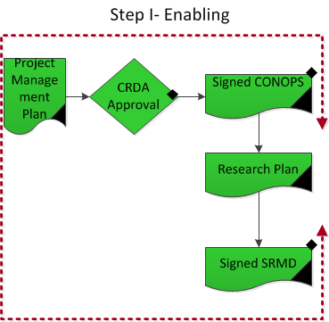
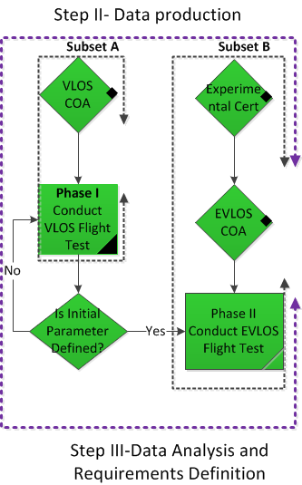
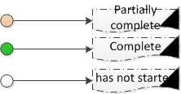
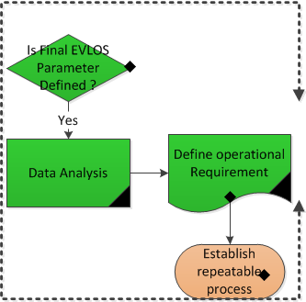
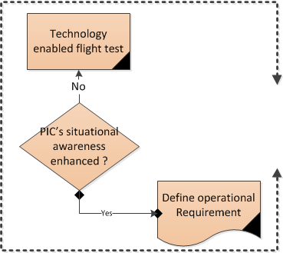

Slide 6
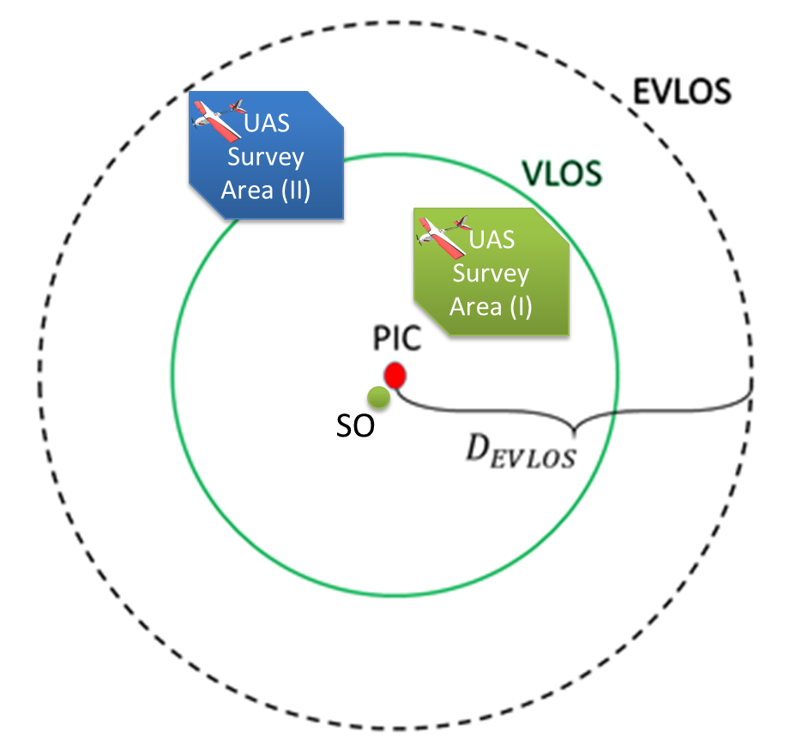
Phase I & II Overview
Phase I
Research focused on identifying the range where an intruder aircraft could be visually identified.
Phase II
Research focused on the PIC ability to react to an intruder aircraft within the EVLOS range.
7

Slide 7
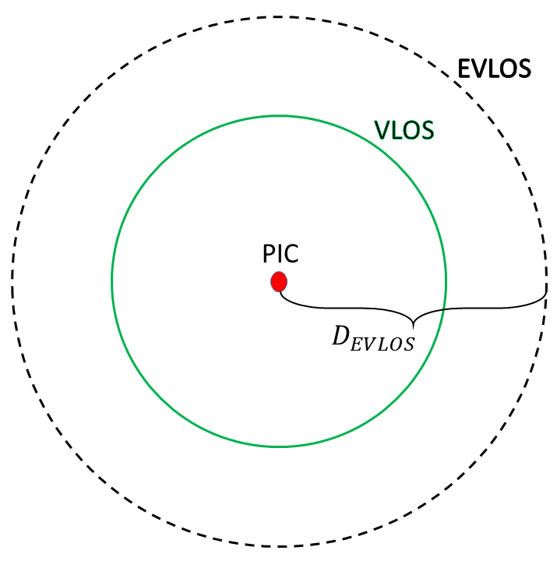
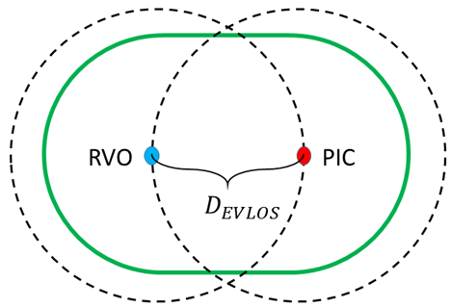
Extended Visual Line of Sight
Sun Position: Altitude of sun > 45º above the horizon
VFR meteorological conditions
Visual angle < 5 degrees in quadrant centered on UA location
PIC location free of significant noise pollution (i.e. generators, farm equipment, trucks)
PIC qualifications:
Meets all Part 107 requirements
15-20 hours VLOS flight time in desired operating environment on the specific UAS (both aircraft and GCS).
In-field flight training in EVLOS operation from an EVLOS-experienced operator (~2 or 3 short sorties and 2 or 3 longer ones is enough to establish the appropriate strategies necessary for EVLOS flight)
8

Slide 8
Data utilization
Enable more operation through issuance of a waiver
Develop a standard
Inform the rulemaking initiative

Slide 9
Gaps
Collected data remain underutilized for purposes of informing future Advisory circular, policies, and rules
Repeatable process yet to be established.
Communication between Policy Offices needs improvement to be effective

Slide 10
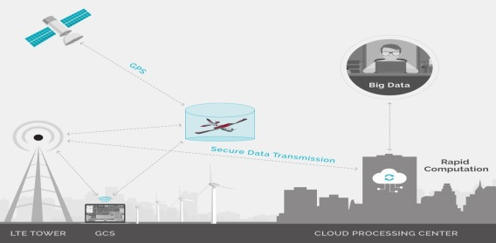
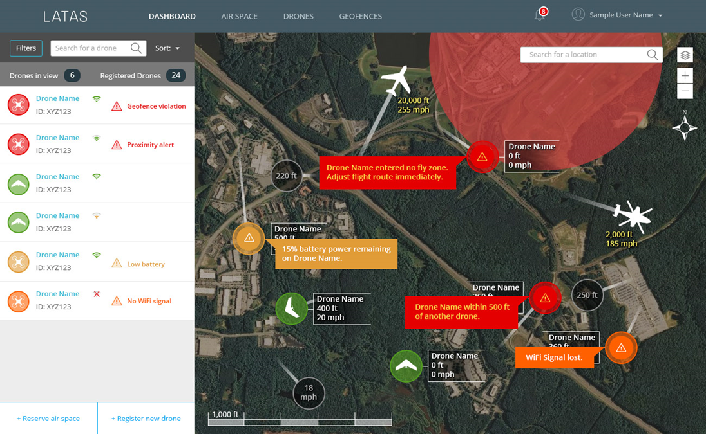
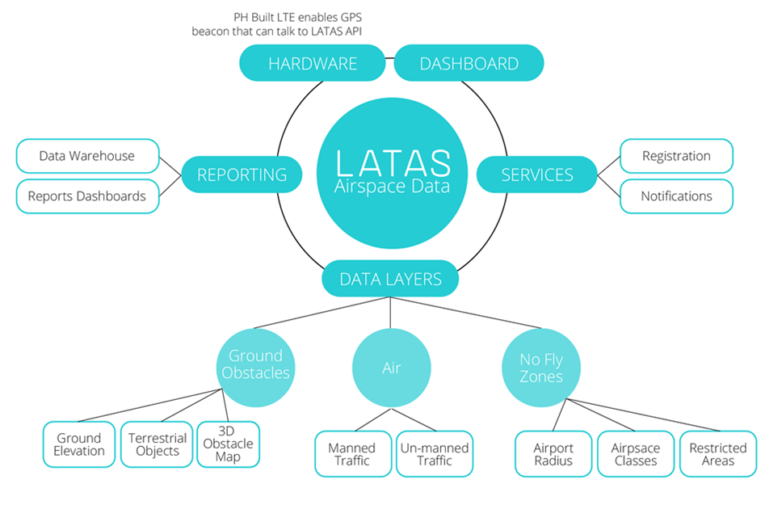
Phase III concept maturation
Phase III research Plan
Purpose: Evaluate the impact of assistive technology on operational risk associated with flight of sUAS in BVLOS applications in the NAS
Test Technological capabilities
LATAS
LTE
GPS
others
Localized BVLOS
Technology based Localized BVLOS operation enabled.

Slide 11
Operational risk assessment
Inherent Risks
Technological malfunctions
Improper utilization of technology ( Human factor)
Operational environment complexity

Slide 12
Locations for Research
Raleigh, NC
PrecisionHawk Flight operations
Salina, KS
Kansas State University flight operation
Starkville, MS
Mississippi State flight operation
McLean, VA
MITRE human in the loop display simulation testing
Online simulation for pilots in the many locations

Slide 13
Phase III Milestones timeline
Flight test in complete Raleigh
MS, KS and VA
flight test & simulations , starts in May
Flight tests and simulations complete by September 31st
Data analysis complete by, October 31^{st,}
Final Report by, December 30th

