Slide 1
FAA Pathfinder Focus Area 1
REDAC/NAS Operations Subcommittee
Rob Pappas, FAA Pathfinder Program Manager
September 12, 2017

Slide 2
Concept of Operations (CONOPS)
CNN exploring how UAS might be safely used for newsgathering in populated areas
Production Value-Added-Documentaries/Historical Events
Planned Event
Documentaries
Long Planning and Coordination Timeline (months/weeks)
Enhances Storytelling
Example East Coast Hurricane Coverage
Breaking News-Accidents, Public Events, etc.
Breaking event
Short Notice
Very Limited Planning and Coordination Time (hours)

Slide 3
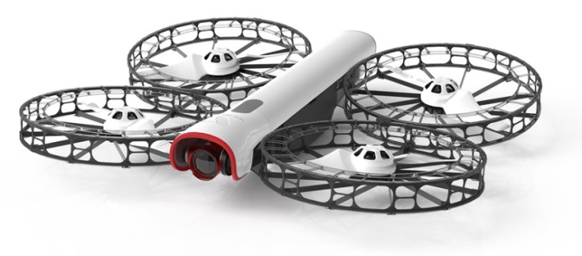
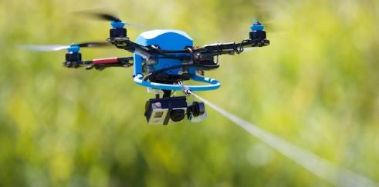
Key Applicable Regulation- Part 107.39 Operation Over People
§ 107.39 Operation over human beings
No person may operate a small unmanned aircraft over a human being unless that human being is:
(a) Directly participating in the operation of the small unmanned aircraft; or
(b) Located under a covered structure or inside a stationary vehicle that can provide reasonable protection from a falling small unmanned aircraft
Goals
Waiver approval for Operations Over People
Develop a repeatable FAA process for waiver application
Develop a viable technical approach for the validation of safety risk testing and mitigation that can be shared externally
Fotokite Tethered
Vantage Robotics Snap

Slide 4
Operational Windows That Are Expanding
§ 107.39 Operation over human beings
Goal to expand the Operations over People operating Envelope based on a reasonable approach to safety mitigation of identified risks
Incorporate Lessons Learned from CNN Fotokite Waiver Process
Focused Waiver Team
Defined Waiver Package (CONOPS, Ops Manual, etc.)
Ops Over People Compatible Vehicle
Light weight vehicle (1.37 lbs.)
Shrouded propellers
No protruding points
Advanced software capabilities
Energy dissipating component design (“MagConnect”)

Slide 5
Milestones
CNN’s Fotokite Pro vehicle received approval of waiver to Part 107.39…Waiver 0001 (August 29, 2016)….with altitude restrictions

Slide 6
Milestones
FAA Part 107.39 Waiver Process Team developed a repeatable FAA process for waiver review and disposition
FAA Form 7711-2 Like Application
Concept of Operations
Operational Risk Assessment
Operations Manual
Vehicle Description
Other Documentation
CNN developed a viable technical approach for Part 107.39 waivers
Developed Draft PART 107.39 Waiver for Vantage Robotic Snap Free Flight Multirotor (Currently Under Review)

Slide 7
Pathfinder One Engagement Team Members
Sabrina Saunders-Hodge, FAA, AUS Focus Area One Champion
Jeff Breunig, MITRE, Focus Area One Program Manager
Michelle Retman, FAA, AUS Focus Area One Technical Lead
Laine D’Augustine, MITRE, Focus Area One Technical Team
David Vigilante, CNN, Senior VP Legal
Greg Agvent, CNN, Senior Director News Operations
Emily Avant, CNN, Program Manager
Lisa Ellman, Hogan Lovell, Consulting Support to CNN
Matt Clark, Hogan Lovell, Consulting Support to CNN
Tobin Fisher, CEO, Vantage Robotics

