Slide 1
REDAC / UAS Wx
Gap Analysis
Weather Program
BLI Number: A11.k
Starr McGettigan, ANG-C6
September 12, 2017

Slide 2
Program Overview
  Purpose
    Applied research focused on weather information and capabilities needed for safe and efficient UAS operations
      Specific initiatives to explore enhancement of current weather capabilities or development of new capabilities necessary for UAS operations
      Collaborative initiatives with FAA UAS organizations to align weather research with the FAA UAS ConOps and Implementation Plan
Funding
FY16 (Enacted) | FY17 (Enacted) | FY18 (Request) | FY19 (Target)
$300K | $0* Delays in contract award moved FY16 work into FY17 | $300K | $300K

Slide 3
Background
Prior to initial effort, there was little understanding about weather information most beneficial to support safe and efficient UAS operations
The goals of this research were to provide a better understanding of:
  Weather information and capabilities that would be most beneficial for UAS operations
  Research needed to refine existing weather products for UAS operations
  New weather capabilities needed for UAS operations
Initial focus on UAS operators not FAA air traffic management

Slide 4
FY16 - 17 Accomplishments
Identified UAS weather stakeholders (Feb 2016)
Catalog of UAS types, mission types, and weather considerations (Mar 2016)
Analysis on weather impacts and preliminary user needs (Sep 2016)
  Use cases developed for different mission types (examples on upcoming slides)
Analysis on UAS weather information gaps (Feb 2017)
  12 gaps identified (listed on upcoming slides)
  Driven by current operational environment and prioritized by MIT/LL
Preliminary research roadmap to address UAS weather information gaps (Feb 2017)

Slide 5
FY16 - 17 Accomplishments (cont.)
Briefing of initial research findings to FAA UAS community
  FAA Headquarters – March 8, 2017
    Representatives from AUS, ANG, ACE, AFS, AIR, AJV, & AVS invited
  FAA William J Hughes Technical Center – April 12, 2017
  Ongoing collaboration/communication with FAA UAS organizations
  ANG-C2 PMRs
  AUS Research Roundtable
  FAA Technical Center Coordination Team
  Flight Standards (AFS)

Slide 6
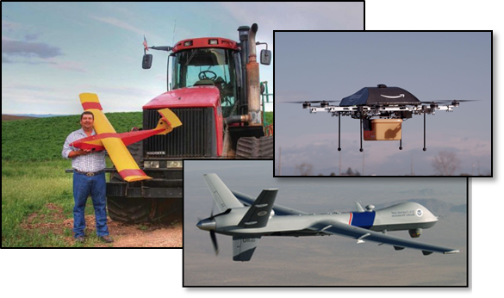
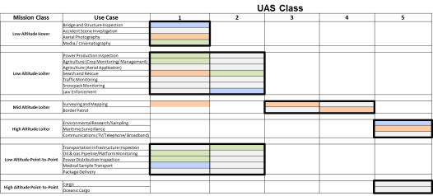
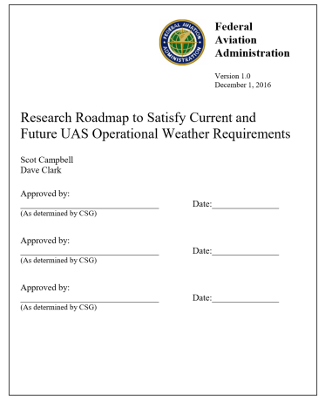
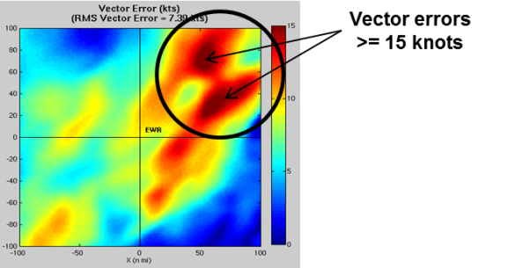
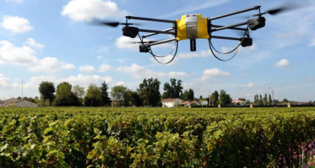
Initial Research Approach
Investigate weather information requirements for UAS operations
90 surveys collected from UAS community (commercial and government operators)
Classify broad range of UAS missions and vehicle types by commonly reported weather needs
Prioritize use cases and investigate ability of current weather products to meet operator needs
Provide preliminary roadmap to describe potential weather research needed to address current and future UAS operations

Slide 7
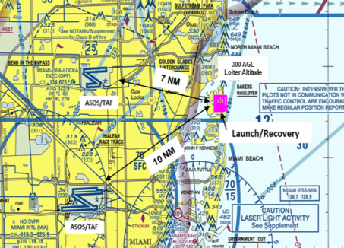
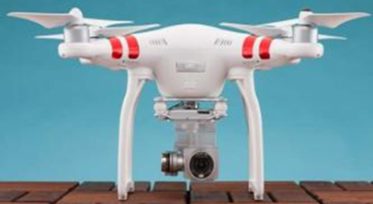
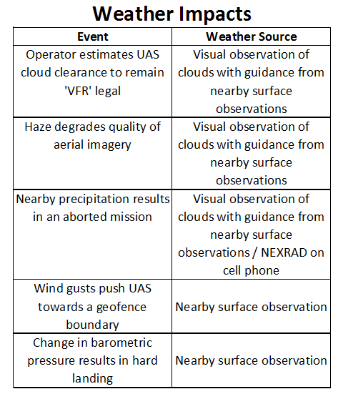
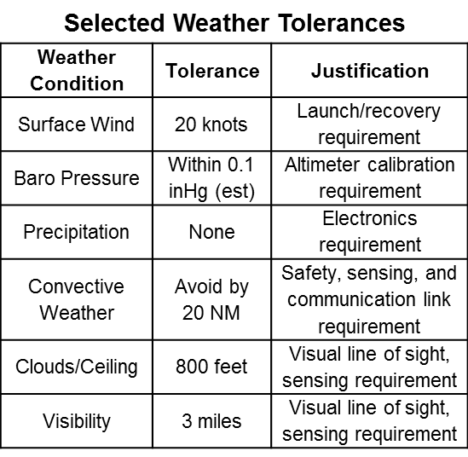
Use Case – Survey & Mapping
DJI Phantom III

Slide 8
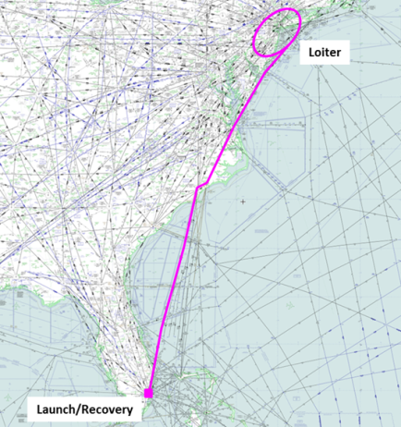
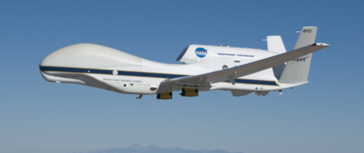
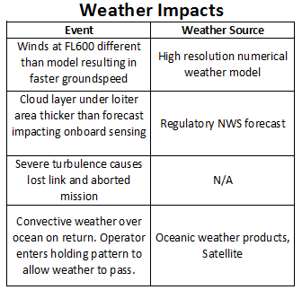
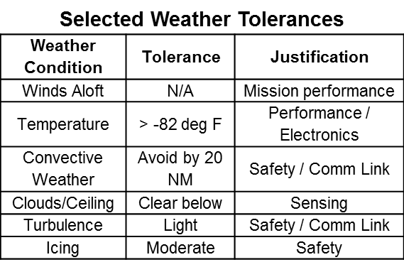
Use Case – Maritime Surveillance
Global Hawk

Slide 9
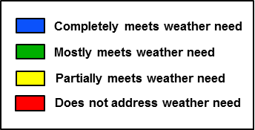
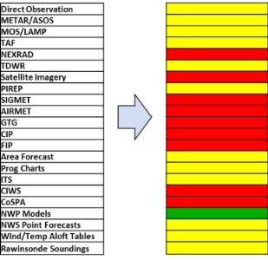

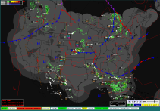
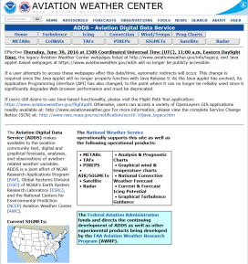

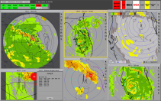
Weather Information Gap Process
Mission Classification
UAS Weather Gaps
Similar Missions
Recommendations for deeper quantitative analysis and development
List of Wx Products
Ability to meet need
Dependent on mission class
Safety
Airspace management
Mission efficiency
Mission urgency
UAS Weather Needs
Operator Surveys and Interviews
Current Weather Products
FAA ConOps and Vision for Integration
Strategies for Airspace Management

Slide 10
Weather Information Gaps Overview
Based on prioritization from MIT/LL
Focus on operations, not air traffic management
Driven by current operational environment
  Survey feedback reflective of weather needs for current operations (small UAS VLOS operations)
  BVLOS operations identified through interviews with FAA Pathfinder program and inferring operational needs from FAA UAS ConOps

Slide 11
Weather Information Gaps
1 | Numerical Weather Prediction model performance uncertain, especially where there is a large variation in terrain.
2 | No mechanism to alert operators to rapid changes in winds (e.g., due to microburst outflows, gust fronts and sharp synoptic fronts).
3 | Off-airport weather observations (visibility, ceiling, wind) are sparse.
4 | Tactical convective weather products are susceptible to latency. Short term convective forecasts not readily available.
5 | Winds aloft forecasts lack precision. Winds aloft observations are sparse for off-airport locations in the low and super high altitudes.
6 | Strategic convective weather forecast horizons do not support select BVLOS mission durations (e.g. 12-24 hour forecasts). Forecast uncertainty is not sufficiently conveyed to manage risk in lost link contingency planning.
7 | Wind products are not sufficient for missions in dense urban environments.
8 | Lack of validated very high-altitude (stratospheric) and low-altitude turbulence information.
9 | Icing and turbulence forecast uncertainty is not sufficiently conveyed to support lost link contingency planning.
10 | Icing models do not account for ‘cold soak’ effect.
11 | Turbulence and Icing models not do not provide sufficient information for small UAS operations.
12 | Weather impact translation models do not exist for UAS and UTM.

Slide 12
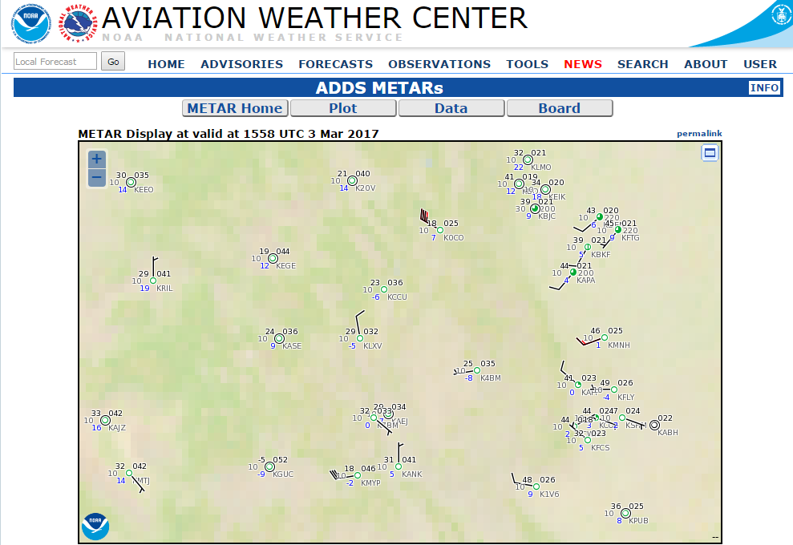
Weather Information Gaps
  Gap 3
  Off-airport weather observations (visibility, ceiling, wind) are sparse.
Aviation Digital Data Service (ADDS) Regional METAR Plot
  Impacted Operation
  All UAS missions that operate off-airport, especially in the low-altitude domain and VLOS operations (Part 107)
  Current Weather Capability & Limitations
  Rural and terrain areas most impacted
  Leveraging non certified observations, road cameras, etc.
  Improved analysis fields (e.g. RTMA)

Slide 13
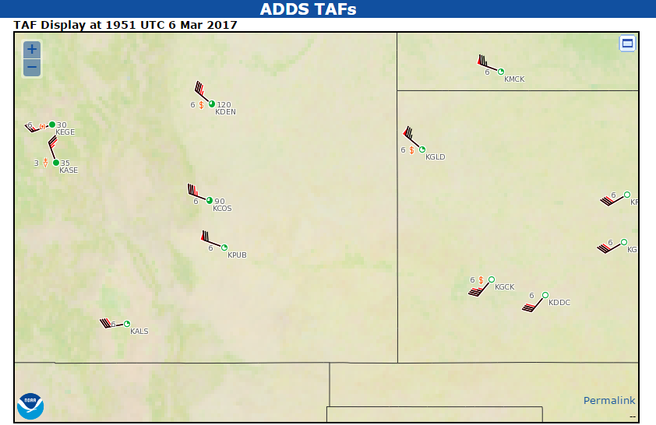
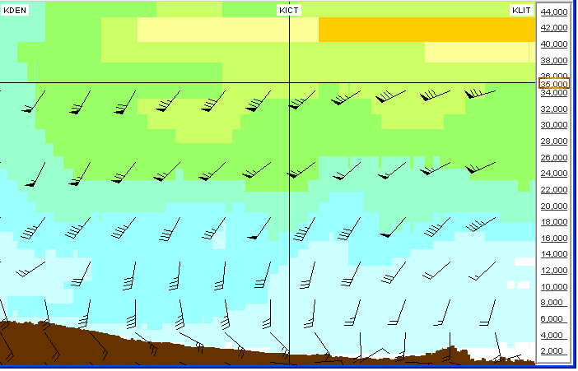
Weather Information Gaps (cont.)
  Gap 5
  Winds aloft forecasts lack precision.
  Winds aloft observations are sparse for off-airport locations in the low and super high altitudes.
Left: Aviation Digital Data Service (ADDS) Regional TAF Plot
Right: Cross section of winds along flight path from KDEN to KLIT
  Impacted Operation
Primarily BVLOS mission planning, especially for time-based operations
  Current Weather Capability & Limitations
  Many more PIREPs and airborne observations available at standard flight altitudes
  High resolution model improvements benefitting wind forecasts

Slide 14
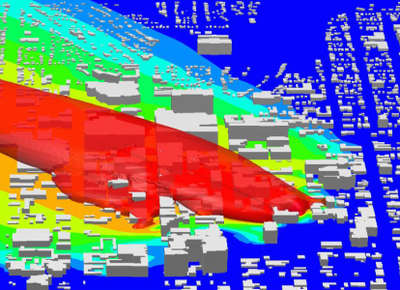
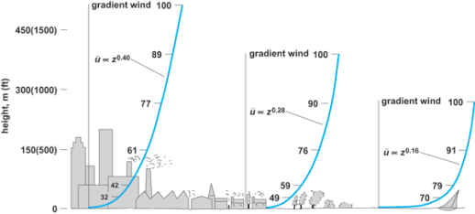
Weather Information Gaps (cont.)
  Gap 7
  Wind products are not sufficient for missions in dense urban environments.
Left: Wind model illustrating flow patterns that form in an urban setting
Right: Effect of terrain & urban structures on the shape of the boundary layer
  Impacted Operation
All UAS missions in an urban environment
  Current Weather Capability & Limitations
  High resolution wind models indeed improving, but do not take into effect local terrain or wind tunnel effects

Slide 15
Potential Research in FY18/19
Improve analysis accuracy between surface observations by leveraging and extending current work addressing similar manned aircraft issues
  Sparse off-airport weather observations (Gap 3)
Improve low level wind accuracy through modeling
  Low-level winds aloft (Gap 5)
  Urban wind modeling (Gap 7)

Slide 16
Next Steps
Prioritize gaps to align weather research with FAA UAS Implementation Plan and ConOps
Continue collaboration with FAA UAS community to refine current gaps or define new gaps.
Increase communication and collaboration with NASA UTM to begin to understand traffic management needs.

Slide 17
Back-up Slides

Slide 18
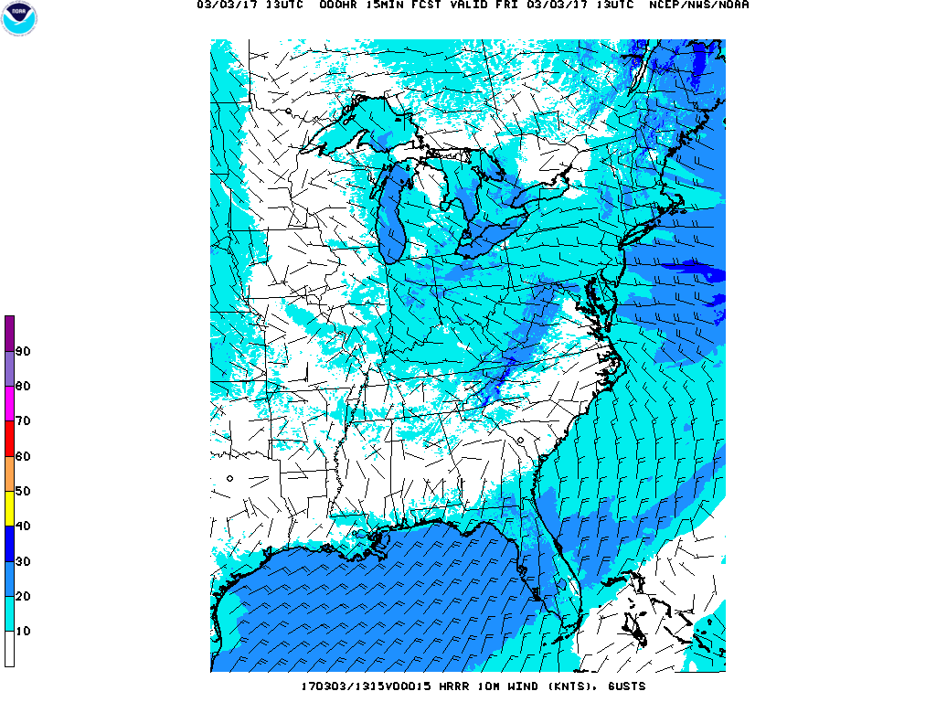
Weather Information Gaps (cont.)
  Gap 1
  Numerical Weather Prediction model performance uncertain, especially where there is a large variation in terrain.
High Resolution Rapid Refresh (HRRR) 10m Wind Gusts
  Impacted Operation
  All UAS missions that operate off-airport, especially in the low-altitude domain and VLOS operations (Part 107)
  Current Weather Capability & Limitations
Though NWS operational model resolution has improved down to 3km resolution, forecast accuracy questionable for some missions
Costs and justifications needed to operate higher resolution models

Slide 19
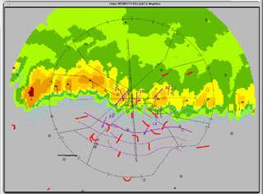
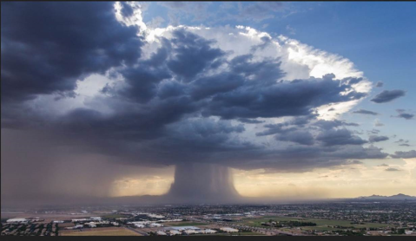
Weather Information Gaps (cont.)
  Gap 2
  No mechanism to alert operators to rapid changes in winds (e.g., due to microburst outflows, gust fronts and sharp synoptic fronts)
Left: Integrated Terminal Weather System (ITWS)
Right: Microburst
  Impacted Operation
All UAS operations, though different level of alerts/notifications needed
  Current Weather Capability & Limitations
  Industry providers do have GA notification capability
  Wide variety of operational platforms make uniform notifications challenging

Slide 20
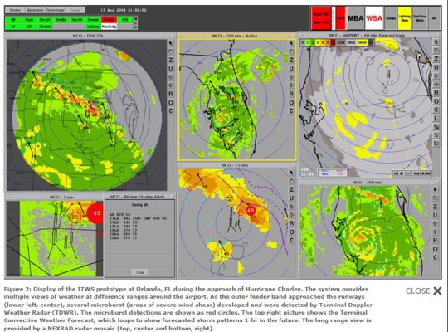
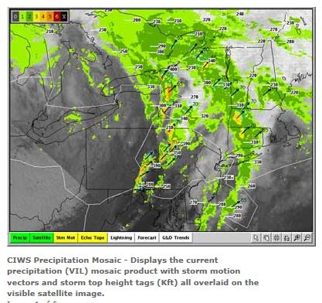
Weather Information Gaps (cont.)
  Gap 4
  Tactical convective weather products are susceptible to latency.
  Short term convective forecasts not readily available.
Left: Integrated Terminal Weather System (ITWS)
Right: Corridor Integrated Weather System (CIWS)
  Impacted Operation
Primarily BVLOS missions for UAS without onboard weather radar
  Current Weather Capability & Limitations
  NEXRAD products have inherent latency leading to tactical decision errors in rapidly moving or developing weather
  FAA products like ITWS/CIWS not available publically

Slide 21
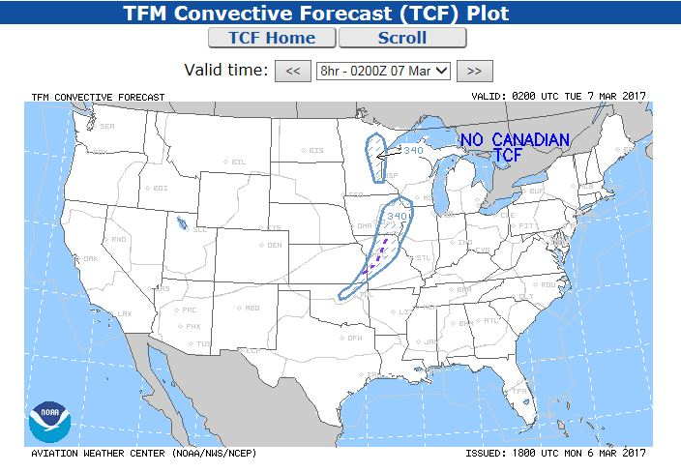
Weather Information Gaps (cont.)
  Gap 6
  Strategic convective weather forecast horizons do not support select BVLOS mission durations (e.g. 12-24 hour forecasts).
  Forecast uncertainty is not sufficiently conveyed to manage risk in lost link contingency planning.
TFM Convective Forecast (TCF)
  Impacted Operation
Primarily BVLOS missions with longer durations
  Current Weather Capability & Limitations
  Forecasts used for ATM strategic planning 8 hours or less (TCM, CoSPA)
  Forecasts relaying uncertainty valuable for strategic planning, but may not be accurate or relevant enough for UAS decisions

Slide 22
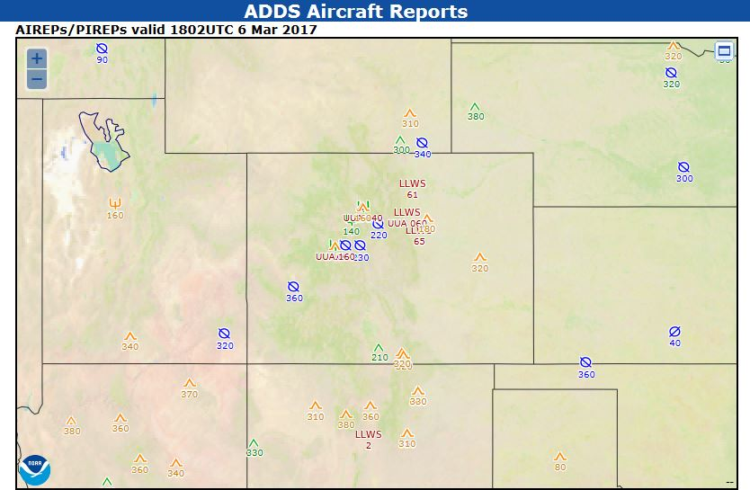
Weather Information Gaps (cont.)
  Gap 8
  Lack of validated very high-altitude (stratospheric) and low-altitude turbulence information.
PIREP (pilot report) of actual weather conditions encountered by aircrafts
  Impacted Operation
Very high-altitude missions / low-altitude missions in the boundary layer
  Current Weather Capability & Limitations
  Pilot reports, both automated and manually produced, are much less frequent outside of standard commercial aviation cruise altitude levels
  Widely believed that automated UAS reports of sensible weather valuable in future weather models

Slide 23
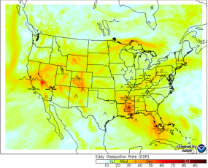
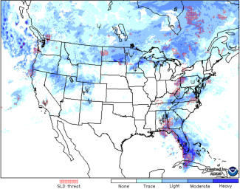
Weather Information Gaps (cont.)
  Gap 9
  Icing and turbulence forecast uncertainty is not sufficiently conveyed to support lost link contingency planning.
Left: Graphical Turbulence Guidance (GTG)
Right: Forecast Icing Product (FIP)
  Impacted Operation
Primarily BVLOS missions
  Current Weather Capability & Limitations
  While improvements to icing and turbulence forecasts have been realized, science limitations still exist including:
    Accuracy
    Uncertainty attributes

Slide 24

Weather Information Gaps (cont.)
  Gap 10
  Icing models do not account for ‘cold soak*’ effect.
  *The wings of an aircraft are considered “cold-soaked” when they contain very cold fuel as a result of just landing after a flight at a high altitude. When precipitation falls on a cold-soaked aircraft, icing may occur regardless of ground temperature.
Frozen precipitation on aircraft wing
  Impacted Operation
High-altitude BVLOS missions
  Current Weather Capability & Limitations
  Wing temperature information not readily available to weather models

Slide 25
Weather Information Gaps (cont.)
  Gap 11
  Turbulence and Icing models do not provide sufficient information for small UAS operations.
Left: Graphical Turbulence Guidance (GTG)
Right: Forecast Icing Product (FIP)
  Impacted Operation
Primarily BVLOS missions with small UAS
  Current Weather Capability & Limitations
  While improvements to icing and turbulence forecasts have been realized, science limitations still exist including:
    Accuracy
    Uncertainty attributes

Slide 26
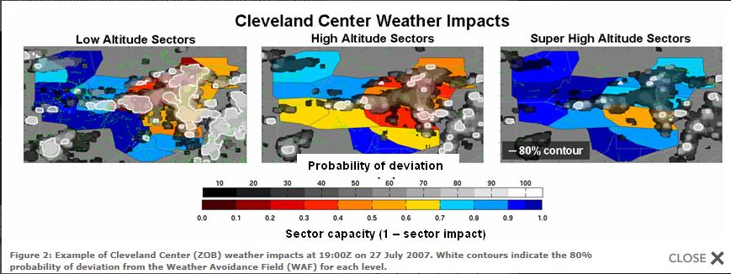
Weather Information Gaps (cont.)
  Gap 12
  Weather impact translation models do not exist for UAS and UTM.
Weather Avoidance Field (WAF)
  Impacted Operation
Airspace management, including geofences, airspace capacity balancing, time-based ops
  Current Weather Capability & Limitations
  Wide range of weather impacts based on UAS types and capabilities
  Still working these issues in 121 and GA operations

