Slide 1
Commercial Space Transportation RE&D
Program
REDAC NAS Ops Subcommittee
Di Reimold
Director of Strategic Operations, AST
August 2017

Slide 2
Agenda
Progress since last update
Pillars of AST’s Research and Development Program
Research Areas and Selected Projects
  Select Highlights/Accomplishments
Major Milestones in Next Few Years

Slide 3
Progress
Recognition that commercial space transportation research not well understood—internally or externally
Disadvantaged by not having a CST strategic plan
Developed/updated AST Strategic Plan
Validated AST Research Priorities
Aligned priorities to resources

Slide 4
LEVELS OF R&D GOALS
ORGANIZATIONAL GOALS | R&D GOALS
DOT Strategic Goals Safety State of Good Repair Economic Competitiveness Quality of Life in Communities Environmental Sustainability | MAP-21 Goals
FAA/AST Strategic Initiatives Enhance global leadership Make aerospace safer & smarter Deliver benefits through technology and infrastructure Empower & innovate with FAA’s people | FAA National Aerospace Research Plan 3 Outcomes 5 Goals 19 Objectives
AST 2017 Priorities Keep pace with industry Streamline the CST regulatory framework Continuously improve HSF safety Develop and implement a civil STM system Enable new and non-traditional CST Safely integrate CST into the NAS | Safety and promotional goals in each of the four research areas.
White House & Congress
FAA
AST
DOT

Slide 5



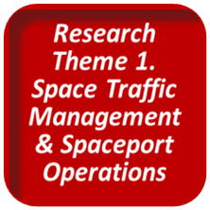
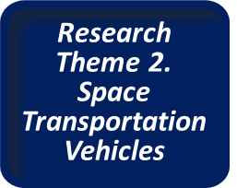
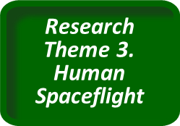
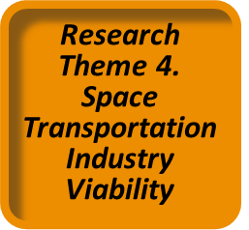
Pillars of CST R&D
Operators
are fully capable and
responsible to safely perform
all aspects of commercial space transportation.
Operations Domain
Vision:
Qualify, File & Fly
Engineering Domain
Vision:
Type
Approval
Based on Standards
Human Sciences Domain
Vision:
No Harmful Effects
Social Sciences Domain
Vision:
Long-Term Industry Growth
Technical and Administrative Interactions

Slide 6
Research Area 1. Management of Space and Spaceport Operations
BIG QUESTION: What criteria, tools, and documents can optimize public safety and maintain commercial aviation safety and efficiency as CST is integrated into the NAS? GOALS Safe integration of air & space traffic Improved analytical methods to evaluate safety of public and property Safe and equitable sharing of the NAS by air and space operators, with minimal disruption caused by commercial space traffic (outbound and inbound) Improved spaceport interoperability and spaceport industry infrastructure resources. | PROJECTS: (Current R&D) Separation Concepts and Architectures Dynamic Allocation of Special Use Airspace Vehicle Separation Standards Dynamic Airspace Response and Decision-Making Automated Air Traffic Data Handling Analyses of Risk to People on Aircraft Dynamic Population Cluster Analysis Equipage-Communication Requirements Probabilistic Tools/Methods Spaceport Research Launch and Landing Requirements Noise Models and Data Flight Corridor/Risk Analysis Vehicle Tracking and Monitoring

Slide 7
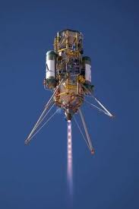
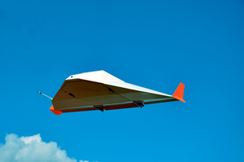
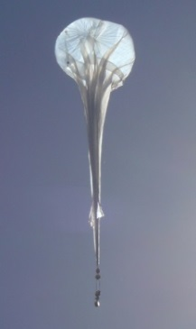
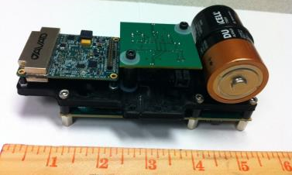
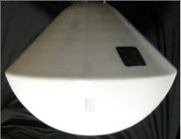
Select Highlights/Accomplishments for RA #1
Demonstrated advanced ADS-B tracking capabilities
  Hosted on a variety of rocket powered vehicles, stratospheric balloons, and an RV prototype with various trajectories
  Advanced prototype ADS-B does function at> 4G, 60Kft, 1000kts (unlike aircraft ADS-B); flew to 70+ miles altitude
  Showed ADS-B meets most applicable requirements for tracking sources used by range safety (RCC-324-01, Appendix A)
Near Space Corp High Altitude
Shuttle System (HASS) -Winged RLV surrogate
Near Space Corp. Balloon
Masten Space Systems
Xombie RLV
Terminal Velocity Aerospace
Prototype commercial RV
And REBR
UBR-ERAU Advanced
ADS-B Transmitter
UpAerospace SpaceLoft
"Sounding Rocket" like RLV

Slide 8
Research Area 1. Management of Space and Spaceport Operations (Continued)
BIG QUESTION: What advanced technologies and analysis techniques can optimize public safety and efficiency during CST and on-orbit? GOALS Situational awareness and understanding of risk posed by resident space objects Concept evaluation for Civil Space Traffic Management System (CSTM) | PROJECTS: (Current R&D) Research CSTM architectures, methods, data gathering Debris Monitoring, Tracking, & Identification Database Development Debris Forecasting Atmospheric and Debris Environment Modeling Probabilistic Orbit Characterization Collision Avoidance Analysis Methods

Slide 9
Research Area 2. Space Transportation Vehicles (and Analysis)
BIG QUESTION: What methods can optimize public safety, manufacturing and operating costs of CST vehicles? GOALS Improve vehicle safety and risk analyses and management Knowledge of safety-critical components and systems of the space vehicles and their operations Improve the manufacturability, assembly, and operational efficiencies of space transportation vehicles, systems, and subsystems | PROJECTS: (Current R&D) Vehicle Safety Analyses Vehicle Probabilities of Failure Vehicle Breakup Analyses Vehicle Safety Systems and Technologies Pressure, Gas Sensors Flight Safety Systems Safety Critical Systems/Safety Enabling Tech Material and Structure Characterization Vehicle Operations Safety Voluntary Reporting of Safety Data

Slide 10
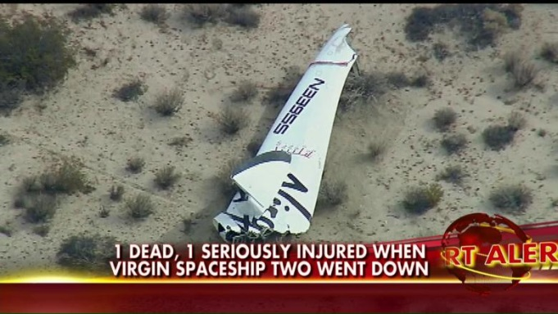
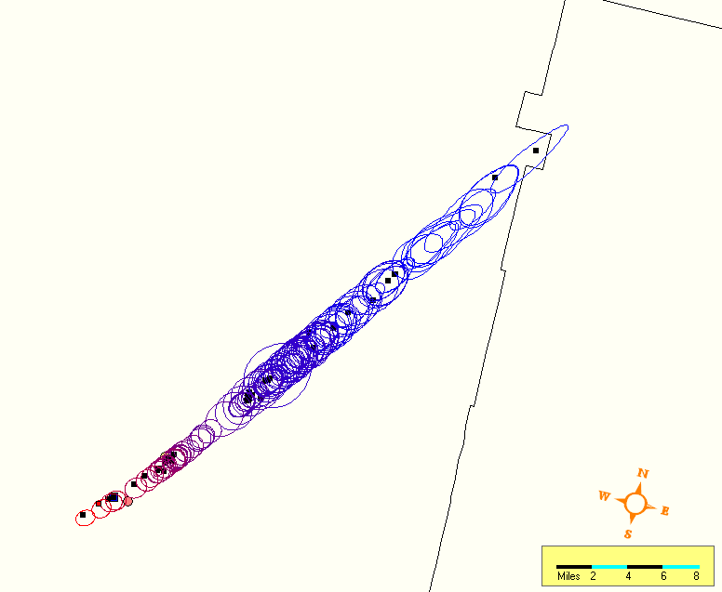
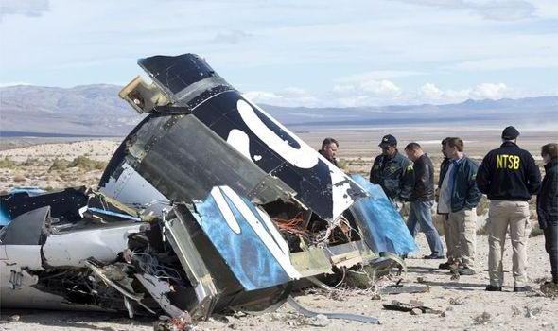
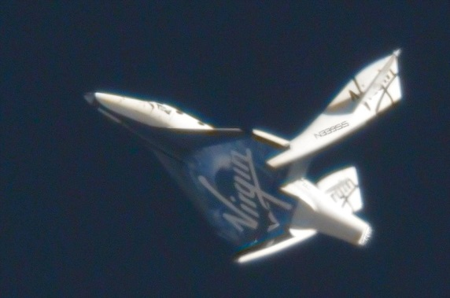
Select Highlights/Accomplishments for RA #2
Met first NARP milestone (2016)
  Compared debris predictions to empirical evidence from recent mishaps to identify potential areas for improvement in public safety assessments
Showed small adjustments to SS2 debris list (for high beta frags) produces RRAT results that match PF04 actual debris impacts
Computed debris footprint using RRAT (95% confidence ellipses) and best available input data matches well with recorded debris impact locations

Slide 11
Research Area 3. Human Spaceflight
BIG QUESTION: What criteria, tools, and documents can facilitate the continuous improvement of occupant safety for CST? GOALS Facilitate continuous improvement of operational safety of human-carrying vehicles (during both launch and reentry) and spaceports Protecting crew health and safety Identification and reduction of avoidable risks of human spaceflight | PROJECTS: (Current R&D) Aerospace Physiology & Medicine Effects of Suborbital Spaceflight Habitability & Human Factors Human Rating Perceived Risk of Spaceflight

Slide 12


Select Highlights for RA #3
  CU, UTMB, and FIT have joined forces to conduct human spaceflight research collaboratively.
  Together, the universities will
    Assist with verifications for the FAA/AST Human Space Flight Recommended Practices
      The next step for this document.
    Publish ‘Design Implementation Considerations for Human Space Flight Occupant Safety,’ an all-in-one document that will cover the vehicle/human/interface topic.
  Collaboration funded starting in FY17

Slide 13
Research Area 4. Space Transportation Industry Viability
BIG QUESTION: What can improve and sustain the evolving CST industry? GOALS Develop improved criteria for evaluating public safety Encourage growth of evolving space industry sectors through relevant economic, legal, legislative, regulatory, and market analyses & modeling Support effective policy decision-making Provide a better understanding of the relationship of governmental policy, innovation adoption, and industry growth | PROJECTS: (Current R&D) Regulatory Parametric Research Property Protection/MPL Regulations for Reuse Software Safety Requirements Ground Safety (Facility/Transient) Ground Crew Rest Location Review Amateur Rocket Definition Industry Analyses International, Multidisciplinary Studies

Slide 14
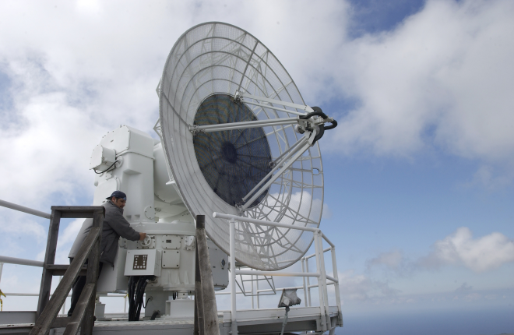
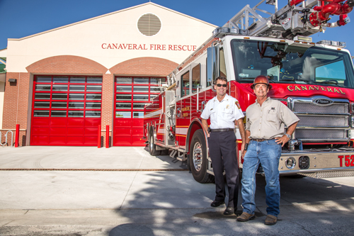
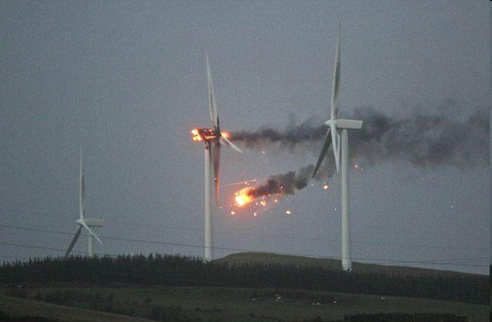
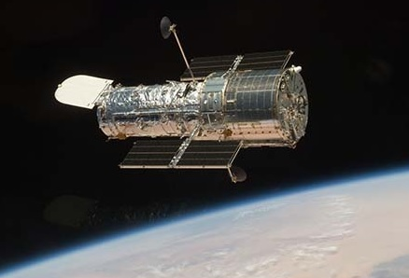
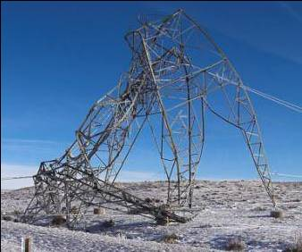
Select Highlights/Accomplishments for RA #4
Drafted property protection criteria
  Six types of property accounted for
    Utility infrastructure
    Transportation & other infrastructure
    Emergency response facilities
    Hazardous facilities (i.e. potential secondary effects)
    Range critical assets
    Significant cultural, historical, environmental site
    Satellites

Slide 15
Major Milestones for 2017 and 2018
2017 - Review available data and analyses to identify priority areas of concern for repetitive use considerations of high utilization reusable spaceflight vehicles
2018 - Assessment of screening and training requirements for pilots with repeated exposures to sustained high acceleration
2018 - Identify and assess algorithm improvements for launch collision avoidance, with initial formulation of improved trajectory and uncertainty input data requirements
2018 - Identify candidate approaches to characterize dynamic population clusters in public safety analysis methods and evaluate potential mitigation measures

Slide 16
Major Milestones 2019 and 2020
2019 - Identify draft recommended practices for crew human factors for suborbital winged commercial spaceflight vehicles
2019 - Identify improved methods for assessing a proposed launch or reentry site location for its impact on the public, to include airspace and airport operations, other transportation modes, population centers, and critical national assets
2020 - Identify draft recommended practices for autonomous flight safety systems
2020 - Complete Whole Atmosphere Model implementation coupling ionosphere and magnetospheric forcing and assimilate high-resolution data
2020 - Develop and assess separation standards for improved airspace management of launch/reentry vehicles, such as hybrids and manned stratospheric balloons, during non-explosive phases of flight
2020 - Develop refined approaches to estimate failure probabilities for RLVs

