Slide 1
REDAC / NAS Ops
Operations Concept Development & Infrastructure (ATDP)
BLI Number: 1A01C
Maureen Keegan, AJV-73
September 2017

Slide 2
Operations Concept
Development & Infrastructure - ATDP
Why is this program necessary?
The FAA is proceeding with NAS modernization based on the NextGen Operational Concept for 2025. Concept development and validation is necessary to investigate specific concept elements, and to drive out operational and technical requirements and implications for human factors, training and procedures. This program assesses the interaction of changing roles and responsibilities of NAS service providers and pilots, airspace changes, procedural changes and new mechanized systems for distributing weather, traffic and other flight related information. It tests the assumptions behind common situational awareness and distributed information processing.
The program uses analyses and associated white papers to validate whether future system requirements meet NextGen goals, including the flight data processing evolution in En Route Automation Modernization (ERAM), data communications, the future voice switch, changes in surveillance requirements and associated procedures, establishment of new roles and responsibilities to support increased productivity, etc. It will develop methods, metrics, and models to demonstrate that the modernized system can handle anticipated growth in traffic demand according to the Terminal Area Forecasts (TAF) for incremental years. This supports the goal of continued US leadership internationally and helps ensure the global harmonization through continued support for the ICAO Global ATM operational concept, the development of global requirements, and the definition of an air transportation performance framework.

Slide 3
Operations Concept
Development & Infrastructure - ATDP
What are the benefits to the FAA
The activity supports the FAA’s Strategic Initiatives by delivering benefits through technology and infrastructure; Concept validation supports development, analysis, and simulation of new concepts to assess requirements and to evaluate the impact of the concept on system capacity, efficiency, safety and human performance. Evaluation criteria include the following:
Impact/Improvement to Air Traffic Service Providers, airspace users, and automation that could increase capacity,
Impact/Improvement on airspace structure which may increase productivity and hence capacity,
Impact/Improvement on communication, navigation, and surveillance (CNS) requirements to support the FAA's efforts to reducing cost, increasing capacity and efficiency and;
Impact/Improvement on automation, display, and facility configuration elements to increase productivity and hence capacity.
What determines program success
Success is measured by the completion of the goals identified in multi-year plans developed for each activity. Initiatives that successfully complete all the project goals identified are then presented as candidates for acquisition.

Slide 4
Operations Concept Development & Infrastructure – ATDP / BLI Number: 1A01C Overview Capabilities
  People:
  Program Manager: Maureen Keegan
  Subject Matter Experts: Traffic Managers, ATC, Discipline Experts, Airspace User Community
  Research Partners: ANG, NASA, Mitre, Lincoln Labs, Volpe, Academia
  Laboratories:
  MITRE
  Tech Center
  DAB Test Bed
  NASA
  Volpe

Slide 5
Research Focus Areas
PBN and Time, Speed, Spacing Tools Optimization
  Objectives: Expand the efficient use of PBN procedures in the NAS (leveraging the PBN NAV Strategy) and apply time, speed, spacing tools to achieve operational goals
  Potential Activities: Concept engineering activities (to include ATDs) designed to mature the tools necessary to enable the PBN NAV Strategy and achieve throughput, flight efficiency, safety, and other enterprise-level benefits
Graphic Not to Scale
Freeze Horizon Distances are notional and will vary by location
* Indicates capability is fielded
550 NM
Scheduling Freeze Horizon
PBN Procedures: Optimizes design of airspace and STAR procedures to enable more efficient arrival operations.
300-280 NM
Datacomm when/where available
XMP
Top of
Descent
160-140 NM
CMP
Meter
Point
Extended Metering: Greater range for distribution of delay (expands solution horizon) for arrivals
Merge Point
40 NM
XMP
near FAF
Extended Metering*
Arrival Metering*
Terminal Metering
Coupled Scheduling*
TSAS Tools
Speed Advisories* (GIM-S)
Time of Arrival Control (RTA)
TRACON Boundary
IM En Route and Terminal Operations
Terminal Sequence and Spacing Tools: Metering in the TRACON and provides Controller Managed Spacing tools.
Path Stretch
Path Stretch: Closed-Loop lateral maneuver to absorb delays
Delay Countdown Timer*
Ground Interval Management:
Speed advisories to achieve meet-time at meter fixes.
Ground-based
Flight Deck-based

Slide 6
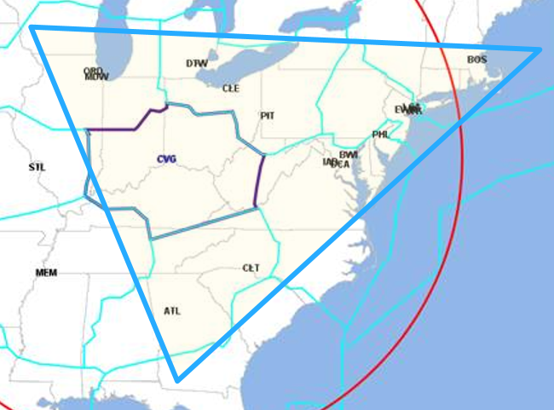

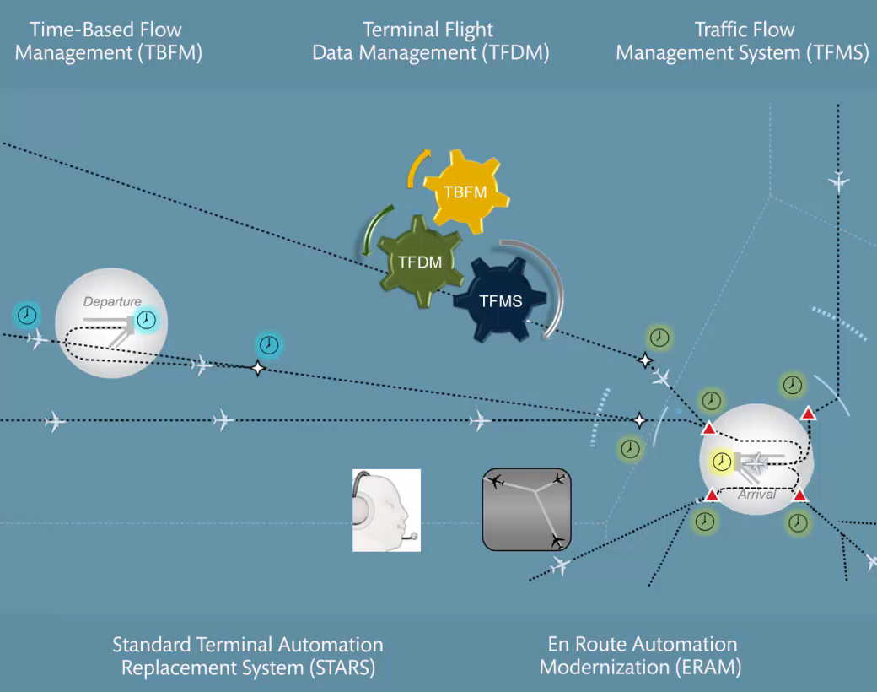






Research Focus Areas
Cross-Capability Integration Analysis
  Objective: Continued examination of possible cross-capability integration issues as emerging concepts evolve and new concepts are planned for the mid-term
  Potential Activities: Scenario development/update/execution, mitigation recommendations (e.g. further research, reqs)
*RTCA Support
  Continued support of international standards and public/private collaboration
CTOP
Data Comm
Airborne Reroutes
Adjacent Center
Metering
Speed Control
RNAV / RNP
Extended
Metering
OAPM
TSAS
IDAC
CRDA
ATPA
Wake
CSPO
Pre-Departure Reroutes
Coupled
Scheduling
Departure Scheduling
6

Slide 7
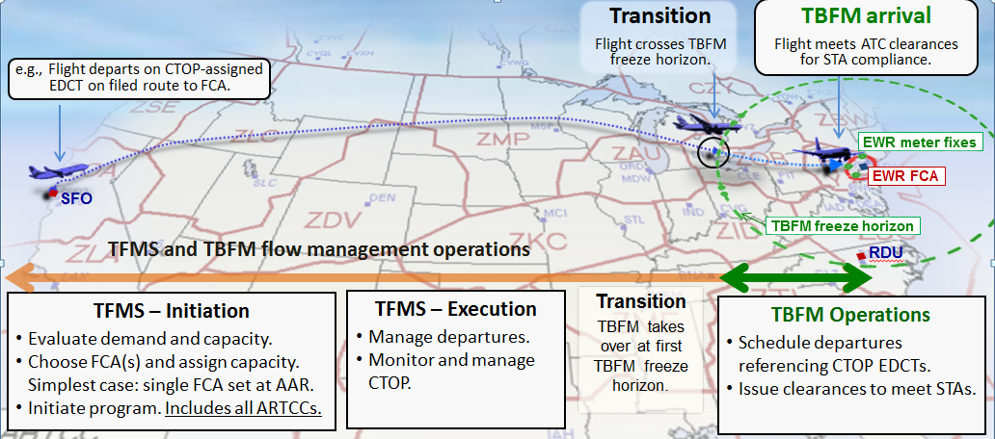
Research Focus Area
Improved TBFM/TFMS Data Integration
  Objective: Explore the use of the TFMS toolset to strategically pre-condition demand into TBFM
  Leverages on-going research by NASA

Slide 8
Research Area
Improved TBFM/TFMS Data Integration
Status:
  Initial technical exchange meeting with NASA to discuss their simulation and findings for initial concept
  Assessment on-going to identify potential TMIs for strategic pre-conditioning of TBFM
  Initial concept targeted for early 2018

Slide 9
Space Integration Enhancements Strategy
Goal: Leverage work to date to develop ATO capabilities, services, systems and procedures to integrate space operations into the NAS
  Support the acquisition process by addressing shortfalls from preliminary Shortfall Analysis Report (pSAR) 2015 and Validation
  Phased investment approach integrating various stakeholders, current capability efforts, and future identified capabilities
  Leverage extensive efforts/research conducted by NextGen (ANG), System Operations (AJR) and the Office of Commercial Space Transportation (AST)
  Prioritize operational capabilities for Space Integration Enhancements Work Packages

Slide 10
Space Integration Enhancements Planning
CY2017 | 2018 | 2019 | 2020 | 2021 | 2022 | 2023 | 2024 | 2025 | 2026
Pre-Capability
IARD
IID
FID
New Capabilities
Space Integration Enhancements WP1
Space Int. Enhance. WP2
FID
Space Data Integrator
Space Int. Enhance. WP3
Other Prototype Capabilities
Aircraft Hazard Area Generator (RRAT) Hazard Risk Assessment & Management
Core Infrastructure
Traffic Flow Management/Collaborative Air Traffic Management Technologies
ERAM Enhancements and Tech Refresh
Terminal Systems Enhancements
Policy & Procedures
Work Group for Development of Policy/Procedure Items

Slide 11
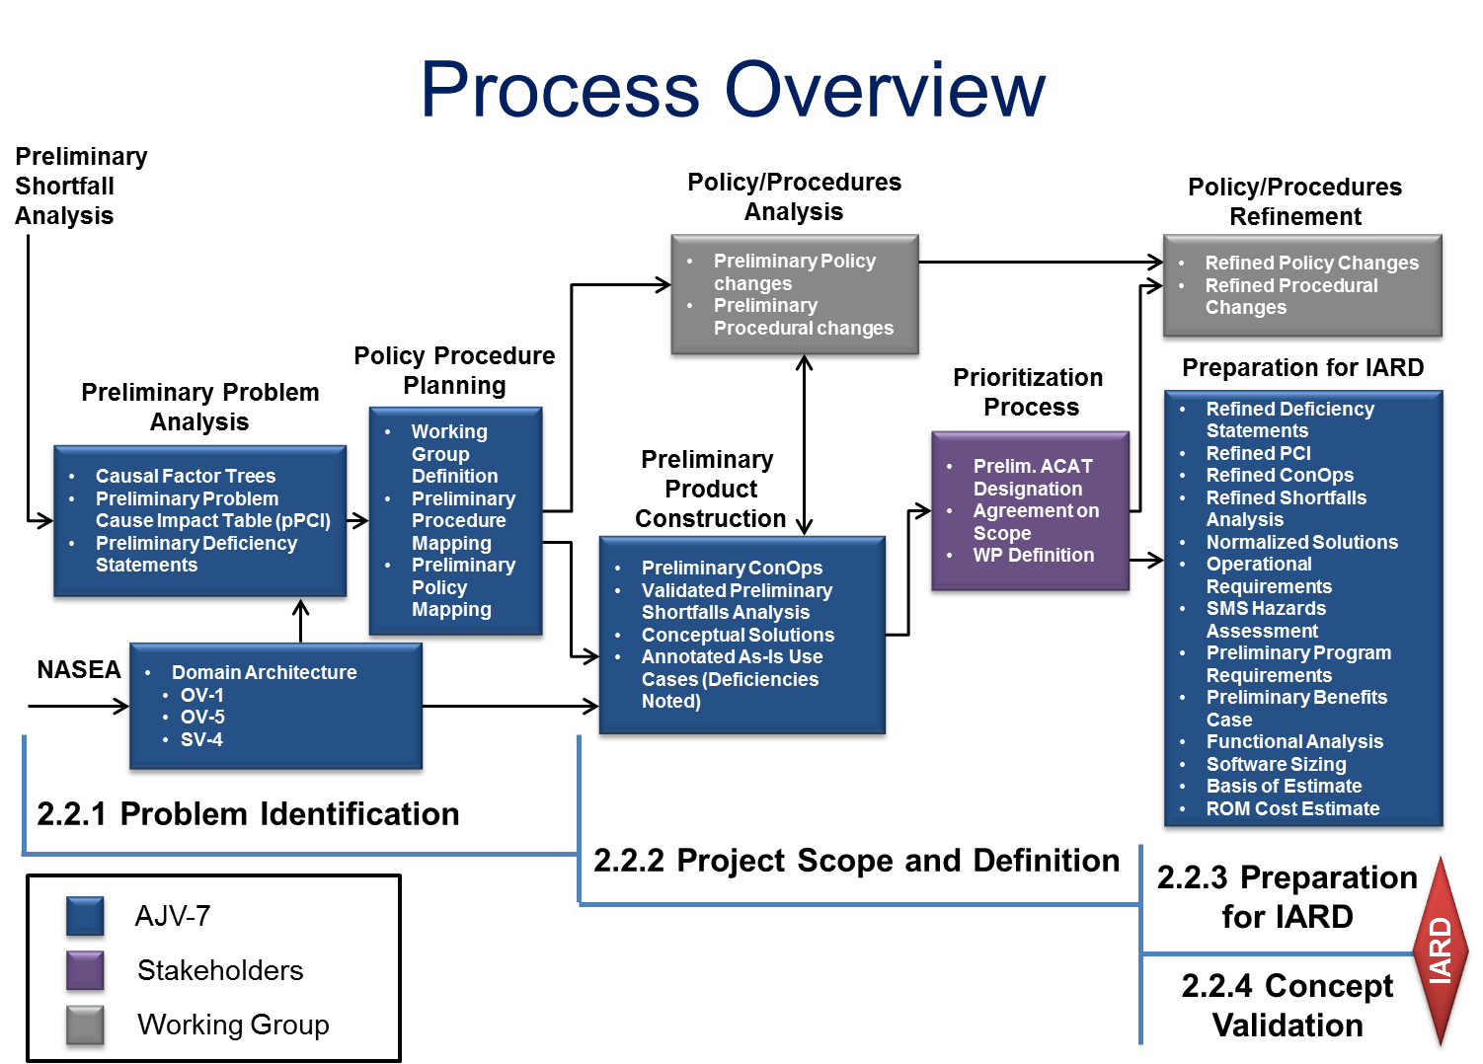
Space Integration Enhancements Process

Slide 12
Quantifying the Shortfall Space
Phase: Real-time
Flight Efficiency
Metrics
Phase: Real-time
Monetized Shortfall
$$
PCI Table
Problems
Impacts
Analysis
Enroute Controller Workload
Metrics
Phases: Planning & Post Operation
Workload*, Workflow*
Metrics
*Awaiting publication of OV-6c diagram

Slide 13
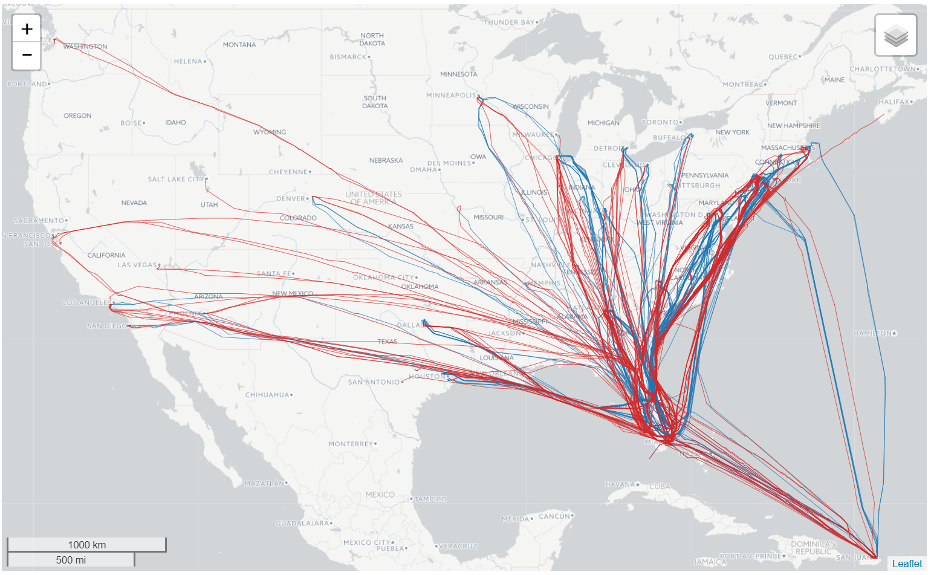
Quantifying the Shortfall Space
Phase: Real-time
Flight Efficiency
Real-time: During a L/R operation, some routes are closed and aircraft are rerouted to avoid the AHA
Flights’ reroute distance depends on AHA geometry and aircraft trajectory
The amount of time airspace is cleared before and after AHAs varies
(PCI Table RT1, RT2, RT3, RT4)
Flight Efficiency
Metrics
Notional Example: FLL, MCO, MIA, PBI, RSW, SJU, TPA
Phase: Real-time
Monetized Shortfall
$$
PCI Table
Problems
Impacts
Analysis
Enroute Controller Workload
Metrics
Phases: Planning & Post Operation
Workload*, Workflow*
Metrics
Example Findings*:
Approx. 8,200 nm
Approx. 1,500 mins.
Approx. 10 nm (2 mins.) per flight
*Assuming 100 L/R events per year
*Awaiting publication of OV-6c diagram

Slide 14
Quantifying the Shortfall Space
Phase: Real-time
Flight Efficiency
Metrics
Enroute Controller Workload
Real-time: During a L/R operation, changes to “regular” operations impact sector workload
This change can lead to congestion and excess workload in some sectors, de-combining sectors, opening new positions, etc.
(PCI Table RT1, RT2, RT3, RT4)
Phase: Real-time
Monetized Shortfall
$$
PCI Table
Problems
Impacts
Analysis
Enroute Controller Workload
Metrics
Phases: Planning & Post Operation
Workload*, Workflow*
Metrics
*Awaiting publication of OV-6c diagram

Slide 15
Quantifying the Shortfall Space
Phase: Real-time
Flight Efficiency
Metrics
Phase: Real-time
Monetized Shortfall
$$
PCI Table
Problems
Impacts
Analysis
Enroute Controller Workload
Metrics
Phases: Planning & Post Operation
Workload, Workflow
Planning & Post Operation: Outdated means of communications, coordination and information exchange between Stakeholders can result in increased workload
(PL1, PL2, PL3, PL4, PL5, PL6, PO1, PO2)
Workload*, Workflow*
Metrics
*Awaiting publication of OV-6c diagram

Slide 16
Space Integration Enhancements Next Steps
2016
Jan 1
Apr 1
Jul 1
Oct 1
Jan 1
Apr 1
Jul 1
Oct 1
Jan 1
Apr 1
Jul 1
Oct 1
Jan 1
Apr 1
Jul 1
Oct 1
Jan 1
Apr 1
Jul 1
Oct 1
2020
Program Activities:
Complete conceptual solutions/ capability identification effort
Prioritize with stakeholders conceptual solutions/capabilities
  AJM, AJR, AJT, AJV, ANG, AST, NATCA, others
Initiate CONOPs development/validation
  leveraging ANG Space Vehicle Operations concept work
Update Enterprise Architecture artifacts
Collaboration/Outreach Activities:
Finalize resource needs and source(s)
Continue stakeholder engagement
245 days
Today
06/01/16 - 01/31/17
485 days
01/31/17 - 05/30/18
366 days
06/01/18 - 06/01/19
367 days
06/01/19 - 06/01/20
366 days
01/01/18 - 01/01/19
366 days
01/01/19 - 01/01/20
153 days
01/01/20 - 06/01/20
366 days
01/01/19 - 01/01/20
153 days
01/01/20 - 06/01/20
366 days
01/01/19 - 01/01/20
153 days
01/01/20 - 06/01/20
153 days
01/01/20 - 06/01/20
214 days
01/31/17 - 09/01/17
731 days
09/01/17 - 09/01/19
731 days
09/01/17 - 09/01/19
365 days
07/01/16 - 06/30/17
365 days
07/01/17 - 06/30/18
365 days
07/01/18 - 06/30/19

Slide 17
Questions?

