Slide 1
REDAC / NAS Ops
Review of FY 2019 Proposed Portfolio
Runway Incursion Reduction Program (RIRP)
Ben Marple, ANG-C5
James Fee, AJI-14
Sep 12, 2017

Slide 2
Program Overview
The RIRP’s objective is to continually discover, research, implement, maintain and innovate technologies that will detect the incorrect presence of an object in the Runway Safety Area at every airport and deliver a directive cue to the individual who can take corrective action.
To-date, the RIRP has been involved in the creation of successful runway safety baseline program technologies such as
Airport Surface Detection Equipment (ASDE-X)
Runway Status Lights (RWSL).
Consistent with standing National Transportation Safety Board recommendations, research emphasis will remain on technologies that provide for direct safety indications and alerts to pilots and aircrews at large airports as well as those that can be applied cost effectively at small to medium airports.
When appropriate, investment analyses will be performed to support acquisition and implementation of selected solutions.
Notes:
The Program should reference the CIT Guide to populate this slide

Slide 3
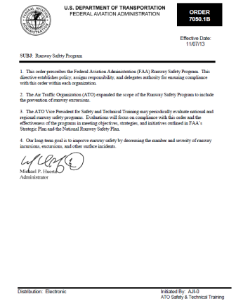
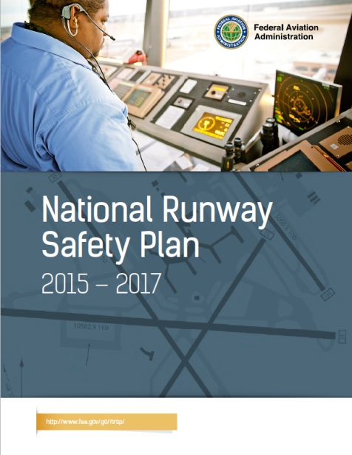
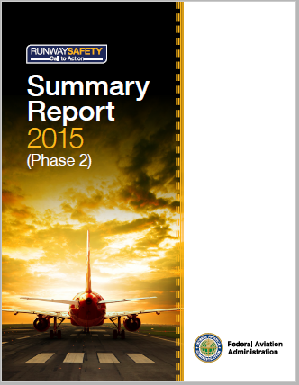
RIRP supports critical FAA Runway Safety Requirements
FAA Runway Safety Program Order
This order prescribes the Federal Aviation Administration (FAA) Runway Safety Program.
This directive establishes policy, assigns responsibility, and delegates authority for ensuring compliance with this order within each organization.
The Air Traffic Organization (ATO) expanded the scope of the Runway Safety Program to include the prevention of runway excursions.
The ATO Vice President for Safety and Technical Training may periodically evaluate national and regional runway safety programs. Evaluations will focus on compliance with this order and the effectiveness of the programs in meeting objectives, strategies, and initiatives outlined in FAA’s Strategic Plan and the National Runway Safety Plan.
Our long-term goal is to improve runway safety by decreasing the number and severity of runway incursions, excursions, and other surface incidents.
FAA National Runway Safety Plan
The National Runway Safety Plan is a living document that incorporates these objectives and outlines the FAA’s medium-term runway safety strategic vision.
The 2015-2017 National Runway Safety Plan (referred to herein as the “Plan”) directly supports the Administrator’s Strategic Priorities, including the initiatives to make aviation safer and smarter in the nation’s airports by moving to risk-based decision making; enabling the safe and efficient integration of the Next Generation Air Transportation System; and demonstrating glob-al leadership in improving air traffic safety and efficiency through data-driven solutions that shape international standards.
FAA Call to Action
The Runway Safety Call to Action (C2A) convened on June 24, 2015, with 108 representatives from industry, labor, and government.
The “Call” was summoned by the FAA Administrator and was a follow-up to the 2007 Call to Action Safety Summit. Here, the Summit established a five-point, short-term Call to Action Plan that was completed, while the mid- and long-term Call to Action Plans involving technology improvements are either complete or are now in their final stages of deployment.
Notes:
Describe exactly what your team does:
-Serves as the focal point for all FAA runway safety efforts and as the agency’s primary representative to industry, national, and international aviation bodies on runway safety.
As prescribed by FAA Order 7050.1B – Runway Safety Program:
Runway Safety Group (Runway Safety).
a. Works with other FAA organizations and the aviation community to improve runway safety.
b. Develops policy on the proper classification and risk assessment of surface events, maintains appropriate metrics, and collects and classifies official data on surface events for the FAA.
c. Determines whether surface events are runway incursions, runway excursions, or surface incidents, and classifies the severity of runway incursions.
d. Conducts periodic reviews of the Runway Incursion Assessment Team results.
e. Conducts analysis of individual surface events and overall runway incursion and excursion statistics and documents and publishes information on trends, risk factors, and lessons learned.
f. Identifies runway incursion and excursion risks and influences their reduction.
g. Researches, develops, and distributes products associated with safe surface operations on runways and taxiways.
h. Collects and publishes information on runway safety best practices for airport operators, pilots, and air traffic controllers.
i. Periodically reviews the effectiveness and impact of procedures, policies, and practices on surface safety.
j. Determines locations for regional and special focus RSAT meetings in cooperation with the Service Area Runway Safety Team Manager, the RRSPM and the RRST(s).
k. Establishes and maintains standard procedures for regional and special focus RSATs.
l. Provides recommended standards and practices for the conduct of local RSATs.
m.Provides at least one member of the Airport Construction Advisory Council.
n. Participates in the Regional Runway Safety Governance Council.
o. Ensures that Service Area Runway Safety Teams are executing national priorities and initiatives, and that a level of standardization across service areas and regions is maintained.
p. Ensures that the Runway Safety Web page is updated with current information and that any links are valid.
q. Develops and maintains a Runway Safety Maturity Model (RSMM) in collaboration with appropriate FAA lines of business and aviation industry partners, as appropriate.
r. Coordinates requests for data on surface events from person(s), operator(s), certificate holder(s), or any related organization(s) which may be the subject of an investigation surrounding the surface event with the organization that has investigative authority for the subject event. Refrains from contacting such personnel directly unless the investigative authority grants permission for direct contact.
Service Area Runway Safety Team Managers.
a. Manages and allocates all ATO resources as required to execute the Runway Safety Program in the service area.
b. Provides a single point of contact for the Runway Safety Program for ATO organizations within the service area.
c. Ensures that Runway Safety initiatives involving ATO organizations are common throughout the regions comprising the service area.
d. Identifies key initiatives included in the National Runway Safety Plan for possible inclusion into the Regional Runway Safety Plans within the service area.
e. Reviews and approves Regional Runway Safety Plans and submits them to the Runway Safety Group Manager for final approval.
f. Manages the process of determining whether events reported as Mandatory Occurrence Reports (MOR) are determined to be runway incursions, runway excursions, or surface incidents, and supports entry of the incursion data into the national database.
g. Represents the Runway Safety Group in all matters involving surface safety at the service area level.
h. Monitors and participates in the National and Regional Runway Safety Governance Councils.
i. Analyzes individual surface events and identifies and forwards appropriate follow up actions to the appropriate FAA line of business.
j. Analyzes data on surface events to identify service area and regional runway safety trends and issues, best practices, and lessons learned.
k. Works with RRSPMs within the service area to determine appropriate locations for regional and special focus RSATs.
l. Provides support for local RSATs whenever possible.
m. Identifies, coordinates, and initiates activities to improve runway safety that involve ATO organizations.
n. Tracks the status of action items assigned in RSAP for all airports within the Service Area.
o. Supports the execution of the Surface Risk Assessment Program and the Air Traffic Safety Action Program in the ATO Safety and Technical Training Service Area Office.
p. Informs the Runway Safety Group Manager of all matters involving systemic surface safety issues occurring within the service area.
Regional Runway Safety Program Managers (RRSPM).
a. Represents the Runway Safety Group in activities within the region.
b. Coordinates all runway safety activities, issues, and objectives with the Regional Administrator and regional Line of Business (LOB) team members.
c. Leads the RRST. (Note: The RRSPMleads those key members assigned to the team on a collateral basis only when they are performing runway safety duties.)
d. Develops and implements the Regional Runway Safety Plan to support the surface event reduction initiatives and strategies in the NRSP.
e. Initiates and implements runway safety outreach programs and activities, and conducts and participates in activities such as:
(1) Pilot seminars, flight instructor refresher clinics (FIRC), flight schools, and Aviation College programs.
(2) Air shows and fly-ins.
(3) Meetings with the aviation community.
(4) RSAT meetings.
(5) Aviation Maintenance Technician Workshops (AMTs) and Certified Flight Instructor/Designated Pilot Examiners Workshops/Conferences (CFIs/DPEs).
(6) State aviation conferences.
(7) Regional airport conferences and safety expos.
(8) Outreach visits to airports, ATCTs, and other locations.
f. Works with the RRST to submit proposed regional RSAT locations to the Runway Safety Service Area Team Manager.
g. Schedules and accomplishes regional RSATs at airports within and occasionally outside the region.
h. Participates in and/or supports local RSAT meetings.
i. Determines whether RSAPs meet the requirements of this order, provides feedback to RSAT chairpersons on compliance, and accepts all RSAPs within their region.
j. Approves RSAPs for regional RSATs.
k. Identifies, coordinates, and initiates activities to improve runway safety, including those that cross the responsibilities of two or more FAA organizations within the region.
l. Measures the effectiveness of implemented recommendations (primarily resulting from RSAP) intended to reduce surface events. 11/07/13 7050.1B 7
m. Participates in Safety Risk Management (SRM) panels when possible and reviews Safety Risk Management Documents (SRMD) for surface movement risks. Support requests from SRM panels for data or input when participation is not possible.
n. Collects data on surface events when necessary to support severity classification and/or analysis of individual events or trends.
o. Participates in the Regional Runway Safety Governance Council (if applicable).

Slide 4
RIRP Response to REDAC recommendations
The RIRP’s primary mission is to research, prototype, test and conduct operational evaluations of potential runway incursion reduction technologies to assess their technical capability and operational feasibility.
If the systems meet the technical requirements and prove to be feasible, only then, in accordance with the FAA’s AMS process, does the RIRP proceed with activities pertaining to cost and benefits estimation. The lessons learned during the test and evaluation of the technologies determine what potential “benefits pool” the system can claim, and are used to build a potential business case for an acquisition decision by the FAA.
The RIRP, and the program sponsor, the Office of Runway Safety (AJI-14) presented a briefing on the FAA's Runway Safety Metric at the Spring 2017 REDAC NAS Ops sub-committee meeting in order to address the committee’s Fall 2015 recommendation to the RIRP, viz. to estimate the benefits pool for Runway Incursion prevention technologies.

Slide 5
RIRP Response to recommendations
This Runway Safety Metric (RSM), being developed by the FAA’s Office of Safety & Technical Training (AJI) focuses on quantifying the reduction of risk, as opposed to valuing a theoretical loss of life; which was the metric previously used to calculate available benefit pool estimates.
This metric has been developed specifically for runway safety related programs, since fatal aviation accident avoidance benefits have been exhausted by previous activities for all technology programs.
Runway Incursions in the NAS have increased significantly since the previous accident avoidance technology programs were acquired by the FAA. Since Runway Incursions are pre-cursors to runway accidents, the increase has contributed to an increased runway safety risk in the NAS.
The RSM will serve as the cornerstone to quantify the benefits of all future runway safety systems, included those being investigated by the RIRP.
The RIRP and the Office of Runway Safety would like to continue to brief the REDAC NAS Ops sub-committee on the development of safety benefits based on the RSM, as the Metric is formally adopted by the FAA in FY2019.

Slide 6
RIRP Overview Capabilities
People:
Program Managers: Ben Marple
Support Contractors: GEMS Inc., Veracity Eng.
Laboratories:
MIT/LL:
Safety Logic and Technology Development
System Requirements Development
MITRE:
Benefit Estimation Methodology
Research / Data Mining
Human Factors

Slide 7
Anticipated Research in FY18 and FY19
Planned Research Activities
Advanced RI prevention technology procurement for Runway Incursion Prevention Shortfall Analysis (RIPSA)
Site Implementation and systems installation of localized surveillance and annunciation technologies at RIPSA Candidate Airports following the right-site, right-size model
Small Airport Surveillance Sensor (SASS) surveillance capability development and testing at MIT Lincoln Lab
SASS Technology Transfer to Industry
Initiate research on Surface Taxi Conformance Monitoring (STCM) for RI prevention
Research capabilities needed to digitize taxi route instructions to support STCM
Develop airport surface database requirements to support taxi conformance monitoring

Slide 8
Anticipated Research in FY18 and FY19
Expected Research Products
RIPSA Program Plan for “Right-site-Right-size” technologies at candidate airports
Localized surveillance and annunciation technology test systems installed at RIPSA Candidate Airports
SASS surveillance capability report
Shortfall analysis report identifying RIs that may be prevented by various STCM concepts at controlled airports
Preliminary airport surface database requirements to support taxi conformance monitoring

Slide 9
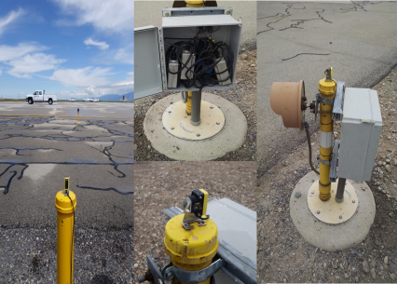
Runway Incursion Prevention Shortfall Analysis (RIPSA)
Research Requirement
Outputs/Outcomes
Develop Program Requirements, prototype, test and evaluate potential technologies at candidate airports as identified in the RIPSA report.
Sponsor: Runway Safety Group (AJI-14) POC: James Fee, Manager, Runway Safety, AJI-141
Products:
RIPSA “Right-Site-Right-Size” Assessment Report
Program Plan for feasible technologies at candidate airports.
Localized surveillance and annunciation technology test systems at candidate airports.
FY 16/17 Accomplishment / Issues
Out Year Funding Requirements
Completed Runway Incursion Prevention Shortfall Analysis (RIPSA) report documenting RI causal factors and identifying small-medium airports that need RI prevention technologies.
Completed summary briefing on technical evaluation of feasible RI prevention technologies.
Completed candidate airport site assessments.
Completed draft candidate airport site assessments report.
FY18 | FY19
$ 750K | $ 1.5M

Slide 10
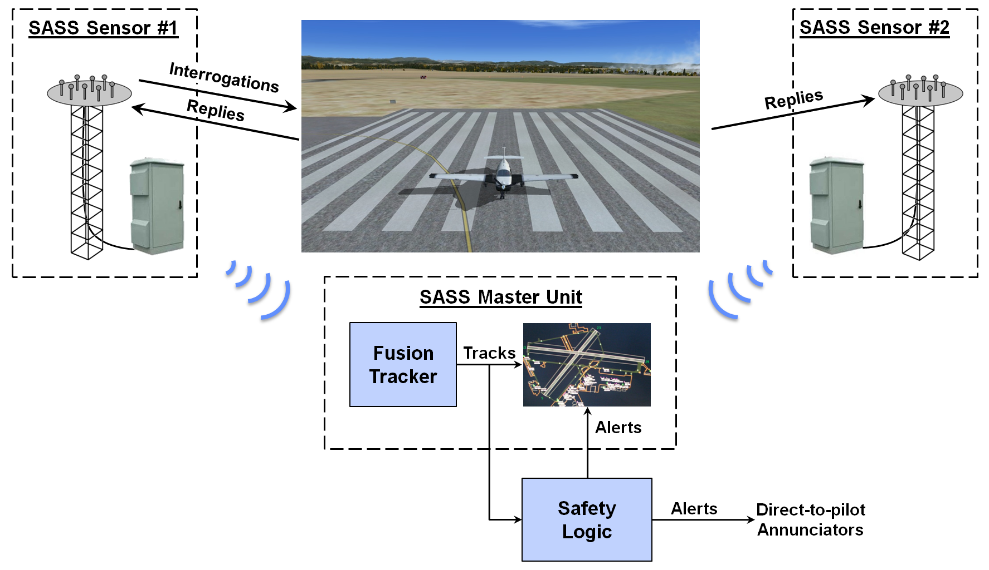
Small Airport Surveillance Sensor (SASS)
Research Requirement
Outputs/Outcomes
Develop Low Cost Surface Surveillance Sensor
Sponsor: Runway Safety Group (AJI-14) POC: James Fee, Manager, Runway Safety, AJI-141
Products:
SASS system
FY 16/17 Accomplishment / Issues
Out Year Funding Requirements
Demonstrated real time passive Mode S surface and airborne surveillance capability – Sep 2016
SASS awarded an R&D 100 award at the 2016 R&D 100 conference – Nov 2016
Conducted Technical Interchange Meeting (TIM) with MIT Lincoln Lab – Dec 2016
Developed Active Mode S surface surveillance capability – July 2017
FY18 | FY19
$ 750K | $ 500K

Slide 11
Surface Taxi Conformance Monitoring (STCM)
Research Requirement
Outputs/Outcomes
New: Conduct research to refine concept and develop tools for tower-based and cockpit-based taxi conformance monitoring
Sponsor: Runway Safety Group (AJI-14) POC: James Fee, Manager, Runway Safety, AJI-141
Products:
Shortfall analysis report to identify Runway Incursions that may be prevented by various taxi conformance monitoring concepts at controlled airports
Expected impact estimate of taxi conformance monitoring capabilities on Runway Incursions at controlled airports
FY 16/17 Accomplishment / Issues
Out Year Funding Requirements
N/A
FY18 | FY19
$ 500K | $ 1.0M

Slide 12
BACKUP

Slide 13
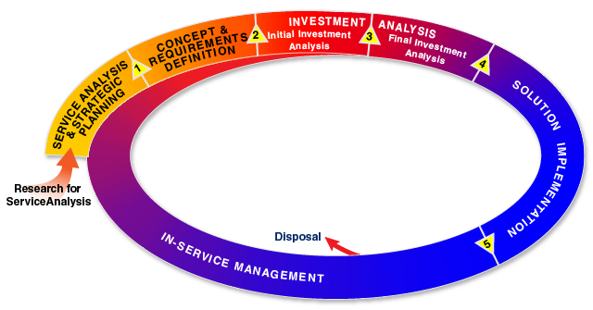
FAA AMS Lifecycle
2.1.2 Evolutionary Product Development Revised 4/2013
The FAA employs evolutionary product development to limit the design challenge for any one product development cycle by deferring risky technology and immature requirements to later updates. The objective is to minimize risk and facilitate the achievement of cost, schedule, and performance goals. Product development and implementation are appropriate when risk is low, requirements are known and stable, and resources are available.
Evolutionary product development begins during research for service analysis when the FAA develops and evaluates new concepts and technology for possible application to the aviation service environment. Only the best new concepts validated to be technically, operationally, strategically, and financially mature and beneficial enter into the NAS Concept of Operations as candidates for investment and deployment.
During concept and requirements definition, service teams conduct a final assessment of the maturity of marketplace technology and customer requirements. Only low-risk, high-value investment increments proceed to investment analysis and solution implementation. Higher risk concepts are deferred, terminated, or designated for additional research or technology development.
AMS Policy: http://fast.faa.gov/docs/acquisitionManagementPolicy/AcquisitionManagementPolicy_2.pdf

