Slide 1
REDAC / NAS Ops
FY2017 Accomplishments
A11.i Air Traffic Control / Technical Operations Human Factors
BLI Number: 8BA000 (Core Program)
Dan Herschler, ANG-C1, R&D Budget Line Program Manager
September 13, 2017

Slide 2
Contents
ATC /Tech Ops Human Factors R&D Core Program
Overview
Benefits
Program team
Focus areas
FY 2017 Accomplishments by Focus Area
Supplemental slides
FY2017 research requirements
Risks
Additional reading
Research to Reality slides
Anticipated research in FY18 and beyond
Emerging FY19 focal areas
Research Requirement Evolution (AJG)

Slide 3
ATC / Tech Ops Human Factors – Core Program Overview
Purpose:
To provide technical sponsors with timely and appropriate R&D products and consultation services, as identified by the ATO Human Factors R&D Roundtable and ANG-C management, that improve safety and efficiency of complex ATC systems
Provide support to Human Factors efforts for FAA acquisition programs through In-Service Review (ISR) Checklist human factors approval responsibility, and Acquisition Management System (AMS) Policy updates
Methods used:
Measuring individual and team performance of air traffic controllers and technical operations specialists.
Recommending and testing improvements to design, procedures, training, selection and placement; and mitigations to address human performance shortfalls.

Slide 4
ATC / Tech Ops Human Factors Benefits
What are the benefits to the FAA:
Improving the safety and efficiency of complex ATC systems by application of R&D to address factors affecting human performance in air traffic control operations and ATC system maintenance.
Recommending and testing improvements to design, procedures, training, selection and placement; and mitigations to address human performance shortfalls.
What determines program success:
R&D Sponsors and Stakeholders in the ATO are able to make important workforce policy and acquisition decisions based on the results of thorough, timely, and focused R&D efforts.
When programs embrace human factors processes and requirements during system acquisition, they reduce human factors risks. This increases the likelihood for successful system implementation and operation, while reducing the likelihood for system design and engineering rework.

Slide 5
ATC / Tech Ops Human Factors – Core Program Team
ATO Sponsors:
AJG – Management Services (also supports AHF-02, Deputy Director HR Services)
AJI – Safety and Technical Training - includes AJI-155 Human Performance team and AJI-213 Training Curriculum Team (also supports AMA-1 FAA Academy)
AJM – Program Management Office
AJW – Technical Operations Services
ANG-C1 Program Management:
BLI PM – Dan Herschler
OJTI Training Standards – Stephanie Kreseen
FAA Research Performers:
FAA Civil Aerospace Medical Institute (CAMI)
Aerospace Human Factors Research Division (AAM-500)
AAM-520 – Carol Manning, Manager
FAA William J. Hughes Technical Center
Aviation Research Division (ANG-E2), Human Factors Branch
ANG-E25 – Kenneth Allendoerfer, Manager

Slide 6
ATC / Tech Ops Human Factors Focus Areas
The program addresses R&D needs within five focus areas:
Human Factors Standards
Workforce Optimization – Human Factors Efforts
Improved Safety – Human Factors Efforts
Human Factors in NAS Technology Integration
Human Performance Enhancement
The program also supports Human Factors efforts for FAA acquisition programs through ISR Checklist human factors approval responsibility, and AMS Policy updates

Slide 7
HF.1 Human Factors Standards
Develop and update human factors standards that convey:
Human factors design requirements for new and modified air traffic control systems.
Human factors practices and requirements for contractors who plan and execute human factors efforts to meet air traffic control acquisition program requirements.
Update AMS Policy and Guidance that PMO human factors specialists will reference and apply on FAA acquisition programs.

Slide 8
HF.1 Human Factors Standards
FY2017 Accomplishments
HF-STD-001B – UPDATED Human Factors Design Standard (December 30, 2016)
This is the main source of human engineering design requirements for new and modified systems.
The updated standard guides the PMO in defining human factors design requirements for air traffic control system acquisitions.
HF-STD-010 (DRAFT) – ATC Display Color Standard – This new standard replaces HF-STD-002 “Baseline requirements for color use in air traffic control displays” (April 2007).
The ATO sponsor (AJM-352) needs a standard that addresses display requirements in detail to ensure that the perceptual limitations of Color Vision Deficient (CVD) air traffic controllers will not adversely affect their job performance.
CAMI is developing a color palette to ensure that ATC display colors are recognizable, discriminable, and legible for normal color vision (NCV) and CVD air traffic controllers.
The new standard should be completed in early FY18.
HF-STD-009 – Technical Operations Graphical User Interface Standard (January 19, 2017)
Provides graphical user interface design requirements for new and modified ATC systems maintenance workstations, published in 2015
Updated in 2017 to identify and appropriately credit use of ASTM F 1166 copyrighted material in over 40% of its content.
Initiated project on Technical Operations Graphical User Interface Style Guide

Slide 9
HF.2 Human Factors in Workforce Optimization
Develop recommendations and guidance for ATO sponsors (and FAA Academy stakeholders) who are responsible for policies affecting controller and technician recruitment, training, placement, staffing, and performance evaluation.
Maintain reliable and valid job/task analysis data that support application of FAA policies, and that will withstand potential legal challenges.
Upon sponsor request, conduct research to identify and recommend alternative approaches where current policies and methods result in adverse impact for employee selection, as required by EEOC Uniform Guidelines in 29 Code of Federal Regulations.

Slide 10
HF.2 Human Factors in Workforce Optimization
FY2017 Accomplishments
Developed and implemented On-the-Job Training (OJT) certification standards (Program Manager: Stephanie Kreseen)
Completed development of training standards
ATO took over validation of the training standards
OJT instructors (OJTIs) and Front Line Managers (FLMs) received skill enhancement and best practices training
Developmentals received learning styles and study skills training
FAA Academy ATC On the job training instructor (OJTI) course
Provided guidance and input to contribute to improvements to OJTI initial Training at the FAA Academy
Updating the supplemental resource, The Air Traffic Instructor’s Handbook, for use in OJTI courses and for use by OJTIs and FLMs at ATC field facilities
Began a review of ATC Collegiate Training Initiative (CTI) program benefits
25 years since the CTI program was initiated

Slide 11
HF.3 Human Factors in Improved Safety
Identify and characterize safety-related aspects of human capabilities and limitations that impact performance of air traffic control and technical operations personnel in the NAS
Through analysis and research, support major FAA safety initiatives such as the Runway Safety Call to Action, by developing human factors recommendations and guidance that will improve procedures and training in operational domains where air traffic controllers and pilots interact

Slide 12
HF.3 Human Factors in Improved Safety
FY2017 Accomplishments
Improved visual scanning by tower controllers
Follow-on to prior work on development of recommendations for visual scanning using low-fidelity simulation research and the output from a workgroup meeting
Developing a high fidelity tower simulation capability for future studies to develop guidance for controllers scanning practices.
Results will support development of methods to train tower controllers in FAA Academy and recurrent field training to scan for traffic and hazards in the airport environment.
Improved en route radar display visual scanning
Supporting Oklahoma University research (funded in the AJI Operations account) to improve methods for training en route developmental controllers to scan an en route radar display
Recommendations will be proposed for FAA Academy and field training.

Slide 13
HF.4 Human Factors in NAS Technology Integration
Develop methods and tools to support air traffic control system acquisition program efforts to address human factors during concept development, including prototyping and scenario evaluations.
Improve human factors laboratory capabilities using state-of-the-art human performance and human factors measurement techniques, to support studies that more robustly evaluate and predict human performance with future NAS technologies and procedures.

Slide 14
HF.4 Human Factors in NAS Technology Integration
FY2017 Accomplishments
Identify and mitigate human factors challenges in air traffic controller tools
Applied data mining method to calculate frequency of use, effectiveness, number of errors, novel uses of capabilities, for selected ATC system functions.
Identifying Ground-based Interval Management-Spacing (GIM-S) operational challenges, including controller use and disuse of the capability
Developing recommendations to encourage more frequent or more effective use of new ATC system features and provide feedback to programs on systems / procedures that pose problems for users.
Tech Center data stores:
CASSIE (Computing and Analytics Shared Services Integrated Environment)
NER (NAS Enterprise Repository)
Assess design decisions represented in the design of the air traffic controller’s computer-human interface from a human factors perspective.
CHI development. Assessed the integrated work environment for controllers to identify relative risks and initiate development of potential mitigation strategies
Provide Air Traffic, Safety and Program Managers with an initial risk assessment and recommended risk mitigations.
Provide recommendations with scientific data supporting the need to make changes to the controller's work environment. Addressing new technologies; NAS change requirements from the field; and external requirements from organizations such as ICAO.

Slide 15
HF.5 Human Performance Enhancement
Develop methods of measurement and assessment criteria supporting evaluation of air traffic controller and technician performance and application in workforce improvement policies.
Conduct focused research to identify minimum qualifications for specific air traffic control and technical operations jobs and performance in initial training.

Slide 16
HF.5 Human Performance Enhancement
FY2017 Accomplishments
Recommended Use of Common Principles Course in ATSS Employment Decisions
Completed content validation of the Common Principles Course
Briefed Vice President for Technical Operations (AJW-0) with findings and recommendations
Advise ATO Management Services (AJG) about why air traffic control specialists (ATCSs) fail field qualification training
Assessed trainees who came to the Academy to retrain in the tower option after failing field training at en route and higher level TRACON facilities using the Controller Transfer Questionnaire (CTQ)
Supported ATO data-driven decision-making on ATC selection and training, for controllers who were unsuccessful in training at their first assigned facility and were allowed to transfer to a lower-level ATC facility.
Improving FAA Academy instructor rater reliability
Assessed feasibility of using recordings of student performance as stimuli for evaluation of inter-rater agreement.
Provided expertise and training on the psychological biases and errors that can impact performance ratings. Incorporated best practices in this area.

Slide 17
Supplemental Slides
FY2017 Research Requirements
Risks

Slide 18
FY2017 Research Requirements
No. | Title | Technical Performer | Acquisition Status
HF17-AJG-1 | Determine if attachment of job jeopardy to performance in the Common Principles (FAA 43078001) is supported by content validation | CAMI | FY2017 CAMI PD Task 5
HF17-AJG-2 | Update and maintain an ATCS longitudinal training and performance database to support evaluation of proposed strategies, tests, or interventions in training, placement, and/or promotion of ATCSs | CAMI | FY2017 CAMI PD Task 4
HF17-AJG-3 | Conduct strategic job analysis for NAS Security and Enterprise Operations (NASEO) Directorate | CAMI | FY2017 CAMI PD Task 10
HF17-AJG-4 | Develop recommendations for increasing the likelihood that controller trainees will succeed in field training to ensure that trainees are not lost due to factors other than their ability to control air traffic | CAMI | FY2017 CAMI PD Task 6
HF17-AJG-5 | Technical Operations Talent Acquisition Process: Development of field ATSS (FV-2101) structured pre-employment interview | CAMI | Requirement Withdrawn
 | AJG Total = 4 projects
HF17-AJI1-1 | Conduct research to support Runway Safety Call to Action Implementation Plan activities - Literature Review for Human Factors in Wrong Surface Landings |  | Requirement Withdrawn (AJI Used Ops Account to fund this)
HF17-AJI1-2 | Visual Scanning Techniques Research Study | CAMI | FY2017 CAMI PD Task 3
 | Air Traffic On-the-Job Training Instructor (OJT-I) Support and Instructor’s Handbook | CAMI | FY2017 CAMI PD Task 1
HF17-AJI2-1 | Assess the Radar Vectoring Aptitude Test (RVAT) as a measure of vectoring aptitude and assist in determining its predictive validity, utility, and fairness use in the placement of newly hired air traffic developmental controller | CAMI | FY2017 CAMI PD Task 8
HF17-AJI2-2 | Conduct research to provide data and targeted analyses to support data-driven decision-making at the FAA Academy Air Traffic Division, including documenting and improving the reliability of the raters who evaluate ATC student performance at the end of their initial courses. | CAMI | FY2017 CAMI PD Task 9
HF17-AJI2-3 | Evaluate AT-CTI Program effectiveness | CAMI | FY2017 CAMI PD Task 11
 | AJI Total = 5 projects

Slide 19
FY2017 Research Requirements (cont.)
No. | Title | Technical Performer | Acquisition Status
HF17-AJT-1 | Supplemental Review of Visual Air Traffic Terminal Services | ANG-E25 | Requirement Withdrawn
 | AJT Total = 0 projects
HF17-AJM-1 | Optimizing Air Traffic Control Information Presentation | ANG-E25 | FY2017 ANG-E25 LOEA under development
HF17-AJM-2 | Color palette development and deployment | CAMI | FY2017 CAMI PD Task 7
HF17-AJM-3 | NAS Capability Utilization Analysis | ANG-E25 | FY2017 ANG-E25 LOEA under development
HF17-AJM-4 | Standardized Scenario Development | CAMI | FY2017 CAMI PD Task 2
 | AJM Total = 4 projects
HF17-AJW-1 | Revising HF Style Guide for New ATO Equipment | ANG-E25 | FY2017 ANG-E25 LOEA
 | AJW Total = 1 project
 | Host the DoD HFE TAG | ANG-E25 | FY2017 ANG-E25 LOEA
 | FY2017 Total = 15 projects

Slide 20
Risks
Research Requirements Process Transition
Prior to FY16, the Human Factors Division (ANG-C1) polled ATO stakeholders for R&D needs and built the research program slate
In FY16 and FY17 the new AJI-155 Human Performance Team hosted the new R&D requirements Roundtable, including representatives from AJI-1 and AJI-2, AJW, AJG, and AJM.
Jason Demagalski (AJI-155 manager) sent a widely addressed email on June 26, 2017 stating that they were not adequately resourced to continue to host the R&D requirements Roundtable.
ANG-C1 is working with others within the ATO to formalize the R&D requirements process and identify an Executive level sponsor for this important function, on a permanent basis, beginning in FY18.
20

Slide 21
Additional Reading
Research to Reality Slides
Anticipated research in FY18 and beyond
Emerging FY19 focal areas
Research Requirement Evolution (AJG)

Slide 22
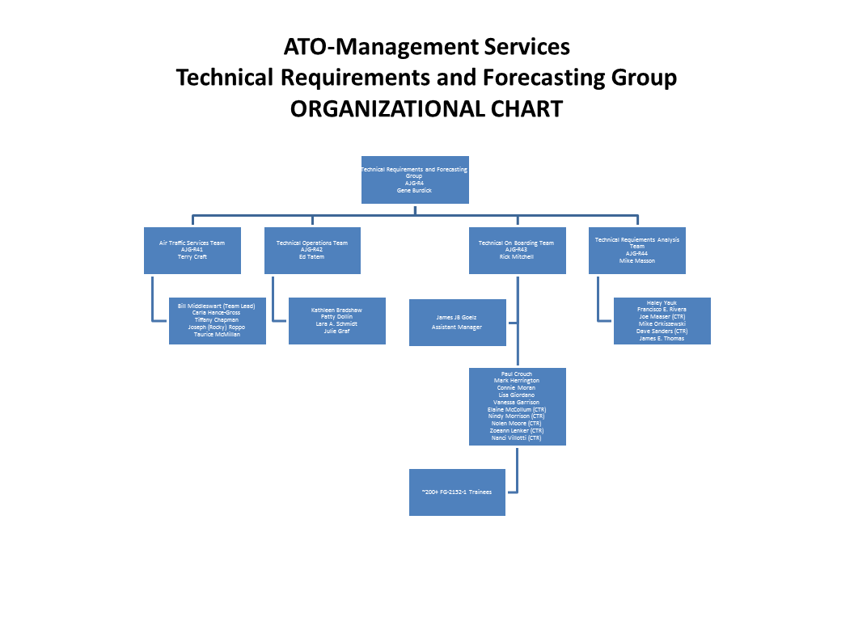
Human Factors Analyses Drive Personnel Decisions: From Research to Reality
AJG Identifies
Research Need
(2013)
ANG-C1 Coordinates CAMI Research
(2014 – 2017)
AJG uses analytical results for programmatic decision-making. Results influence policies in ATC training and placement:
AT Basics pass score
Standards for ATC trainee retention recommendations
ATC trainee facility type and level placement
Organizational Users
AJG P2 is responsible for Technical Workforce Planning, Prioritization & Hiring Plan Development for Air Traffic and Tech Ops. They report on the technical workforce, conduct staff studies, and validate positions.
Human factors analytical support was requested to inform data-driven-decisions in the design of placement, training, and promotion programs for air traffic controllers.
AJG identifies research questions of interest in the placement, training, and promotion of air traffic controllers. CAMI analyzes data in the longitudinal database and provides feedback to AJG.
Assessments
ATC Basics to Initial
Course Outcomes
NEST-VP Agreement
on Developmental Retention & Placement
ATC Approach to
Placement
Training Outcomes:
ERAM Course Trainees
Transfer Lowers
AJG Uses Research Results
(2015+)
AJG uses our analyses to inform decisions in planning, prioritizing, and developing a hiring plan and implementing recruitment activities and initiatives in air traffic control.
Mission: To provide accurate and timely recommendations with regard to placement and future needs for the ATO Technical workforce from a global perspective.
Future Activities
Track the relationship between analyses and policy and SOP development.
Continuously improve the longitudinal database to increase responsiveness based on identified research needs.

Slide 23
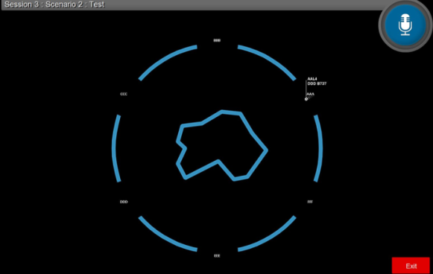
ATC Trainee Pipeline Placement and Performance Evaluation: From Research to Reality
AJI Identifies
Research Need
(2015)
ANG-C1 Coordinates CAMI Research
(2016 – 2017)
Recommendations for improvements will be provided to AJI.
Results can influence policies in ATC training and placement:
Implementation of periodic reliability training for evaluators at the Academy
Use of the RVAT tool to place newly hired trainees into the appropriate ATC specialty.
Organizational Users
AJI-2000 is the organizational element responsible for Technical Training within the ATO.
Human factors research support was needed to enhance data-driven-decisions in two key areas.
First, the Radar Vectoring Aptitude Test (RVAT) tool that AJI and MITRE developed must be evaluated for use as a potential ATC specialty placement tool. Second, AJI and the Academy are looking for ways to improve performance evaluations of students during their initial training courses.
AJI identified research questions concerning the placement and training of ATC trainees. CAMI will collect and analyze data to evaluate the utility of the RVAT as a proposed placement tool, as well as measure the current reliability of evaluators who rate students in the ATC initial course performance.
AJI Uses Research Results
(2016+)
AJI will use this research to inform decisions in evaluating and improving ATC placement and training programs. Coordination with ATO groups that are responsible for new hire placements will provide an opportunity to expand application of the results. The intent is to reduce trainee attrition.
RVAT Image
Future Activities
If positive results are obtained, further expansion of recommended improvements to other AJI training programs could be considered. Additionally, if found useful, the RVAT could be implemented as a placement tool to increase the likelihood of trainee success.

Slide 24
From Research to Reality: Air Traffic Instructor’s Handbook
AJI Identifies Research Need (2013)
ANG-C1 Coordinates CAMI Research (2013-2016)
AJI Uses Research Results (2016+)
Organizational Users
Formal course revision for the OJTI Initial Training course was recommended.
The OJTI Work group responsible for development identified the need for a supplemental OJTI handbook or ‘tool box’ for OJTIs to use once training was complete.
The supplemental resource should also be available for FLMs working with OJTIs.
In support of formal OJTI training, research was conducted to develop supplemental HF, psychological, and educational resources for use by OJTIs in training controllers and FLMs in developing OJTIs.
Outputs: Air Traffic Instructor’s Handbook provides supplemental information for Academy and field training:
human behavior
the learning process
effective communication
the teaching process
assessment
planning instructional activities
risk management, and
additional resources available
Clearance with NATCA review
Clearance with SUPCOM
2017 AJI-2 review and Revisions
Link on AJI Website (pending)
Provided to supplement OJTI training (pending)
Provided to SUPCOM (pending)
Basis for SUPCOM training development (pending)
Using Handbook For:
Field OJTI Training Supplement
Field Classroom trainers
OJTI Supplemental Workshop
OJTI Basic Techniques Course
OJTI Cadre Workshop
SUPCOM FLMs
Identify Needs for Additional Guidance to be Included in Future Handbook Editions

Slide 25
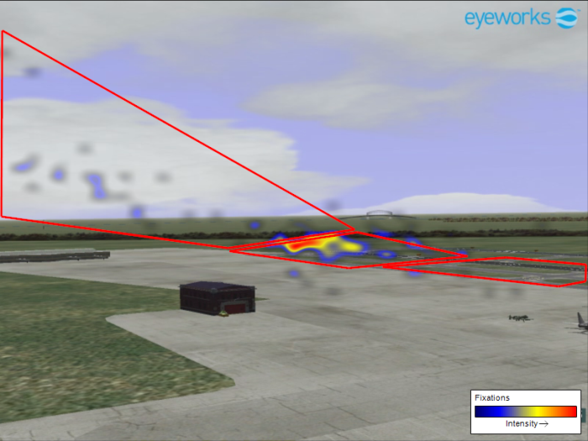
Understanding Visual Scanning Performance of Tower Controllers: From Research to Reality
AJI Identifies
Research Need
(2016)
ANG-C1 Sponsors Research Program
(2016)
AJI will incorporate human factors research results into briefing that provides guidance on effective scanning and will disseminate the briefing to field controllers via a PFS teleconference on or before September 30th, 2016.
Tower Controllers in the Field
ANG-C1 sponsored a human factors project to:
Conduct literature review regarding scanning and how it is taught to air traffic controllers
Participate in work group to identify characteristics of a good scan
Conduct human-in-the-loop experiments to characterize controller scanning
Attempt to test the performance impact of the scanning characteristics identified by the work group.
AJI Uses Research Results
(2016)
Number 4 on ATO’s FY 2016 Top 5 Safety issues list was “Tower Visual Scanning: Air Traffic Control scanning technique did not provide situational awareness.” Scanning arose as a Top 5 Safety issue when deficits in visual scanning were found to have contributed to 42 traffic incidents, most of which were runway incursions. It was proposed that human factors research could provide valuable input into the identification of a mitigation strategy.
Tower controllers learn something from the briefing that they can use to enhance their scanning performance.
Identified scanning best practices are introduced into tower controller training.
Future Activities
Validate the findings using current tower controllers, higher fidelity simulations of real airports, and think aloud & shadowing protocols in the field.

Slide 26
Job Analysis Information Database: From Research to Reality
AJI & ANG Identify
Research Need
(2012)
ANG-C1 Coordinates CAMI Research
(2012 – 2017)
JAIdB provides single point of access to ATCS (FV-2152), Tech Ops ATSS (FV-2101), & AVS Operations Research Analyst (ORA; FV-1515) job/task analysis data for ANG/HF research community and AJI & other training development community
Organizational Users
Multiple job/task analyses were generated for ATCS occupation in recent years, including the Human Solutions, Inc. En Route cognitive task analysis (2011) and the American Institutes for Research (AIR®) 2007 and 2011 job analysis. No single repository/point-of-access exists for the JTA data for human factors engineering (ANG) and training (AJI). Need identified for web-based repository for JTA data.
Prototype web-based Job Analysis Information Database (JAIdB) developed, hosted by contractor (AIR®), populated initially with 2007 ATCS job analysis data for ATCT, TRACON, & ARTCC.
Training community (AJI) identified additional functional requirements for JAIdB, leading to version 2.0 in 2014-2015.
JAIdB version 2.0 to be published on FAA Cloud service in late 2016 (depending on support contract).
ANG, AJI Uses Research Results
(2017+)
JTA data can be used by ATO, Academy, and human resources to:
• Develop training
• Validate training course content
• Support development of methods and messaging for new hire candidate recruitment
• Develop and validate selection instruments
• Develop methods for determining best fit and job placement for new hires in areas of specialization and level of complexity
• Establish performance metrics and standards
• Identify the impact of planned NAS changes
Future Activities
Develop methods/tools within JAIdB for comparison of job/task analyses for single occupation to identify changes
Populate JAIdB with additional JTAs, such as most recent APTMetrics ATCS job analysis (2016) and other occupations
Develop access protocols for HF researchers outside FAA cloud

Slide 27
Tech Ops Common Principles Validation: From Research to Reality
AJW Identifies
Research Need
(2014)
ANG-C1 Coordinates CAMI Research
(2012 – 2017)
Analysis results will provide justification to AHR, AGC, and PASS to attach (or not) job jeopardy to performance in Common Principles course.
Organizational Users
Tech Ops re-instituted the Common Principles course in 2011 to ensure that ATSS had basic electronics knowledge & skills when reporting for duty. Tech Ops managers Identified the need to attach job jeopardy to performance in the course.
Attachment of job jeopardy makes Common Principles a selection procedure within scope of 29 CFR § 1607, requiring validation.
CAMI developed a program to validate Common Principles for job jeopardy:
* Conducted baseline job analysis
* Identified important job duties/tasks & KSAOs required overall.
* Currently linking specific duties/tasks to specific KSAOs to identify KSAOs essential to successful job performance.
* Will compare essential KSAOs and Common Principles content to establish the degree of content validity.
AJW Uses Research Results
(2017+)
AJW uses Common Principles to screen out new hires without level of technical electronics knowledge and skill required at SSCs.
Common Principles to be used on interim basis while ATSS selection process is re-engineered.
Future Activities
Re-engineer ATSS selection process (including on-line application/crediting plan, assessment of knowledge & skills, and interview) to be adaptable to specific position requirements

Slide 28
ATC / Tech Ops Human Factors – Core Program Future Plans
FY2018 – 2020 research plans

Slide 29
Anticipated Research in FY18 and beyond
Planned Research Activities
ATC and Tech Ops Display Design Standards & Guidance – Started FY17, ends FY20
Tech Ops Workforce Transition Job Analysis Efforts – Started FY17, ends FY18
NAS ATC Capability and Equipment Utilization HF Issues – Started FY16, ends FY18
ATCS Selection, Placement, Training and Performance Evaluation R&D – Started FY17, Ends FY20
Runway Safety Analysis and Training Research to Develop Best Practices – Started FY16, Ends FY19
Expected Research Products
Technical Operations Graphical User Interface (GUI) Style Guide for New ATO Equipment – Part 1 FY18, Part 2 FY19, Part 3 FY20
ATC Display Color Standard with Color Palette that Accommodates Color Vision Deficient Users – FY18
Technical Operations Pre-Hire Selection Tool – FY20
Recommendation from MITRE to Technical Training (AJI-2) on Policy Decision for use of Radar Vectoring Aptitude Test (RVAT) as a Job Placement Method – FY18
Recommended Interventions to Mitigate Non-Task Factors Impacting ATCS Training Success – FY18
Recommended Training Methods for Improving ATCS Scanning Techniques – FY18

Slide 30
Emerging FY19 Focal Areas
Research to Support Controller Selection, Placement, and Training Performance Evaluation
Develop new approaches to aptitude testing for future controllers.
Support MITRE’s assessment of the Radar Vectoring Aptitude Test (RVAT) as a selection procedure. Support research to determine its predictive validity, utility, and fairness in the selection of newly hired controllers. [subject to HR concurrence]
Evaluate 2014, 2015, 2016 controller hiring processes and recommend improvements for better applicant/job fit.
Develop measures of controller on-position core technical job performance and identify training environment performance obstacles.
Assess use of alternative training technologies and practices to improve field training efficiency and reduce the time for developmental controllers to reach full certification.
Air Traffic Control Safety Research
Recommend improvements to controller visual scanning techniques to reduce runway incursions and loss of standard separation at tower-controlled airports.

Slide 31
Emerging FY19 Focal Areas (continued)
Research to Support Selection, Placement, and Training Performance Evaluation of Technical Operations Personnel
Engineering Services strategic job analysis
Future SSC 2101 strategic job analysis
Future ATSS Automated Crediting Plan
Future ATSS Technical Electronics Knowledge & Skill Assessment
Develop guidance for ATO sponsors on Technical Operations workforce optimization for specific workforce elements.

Slide 32
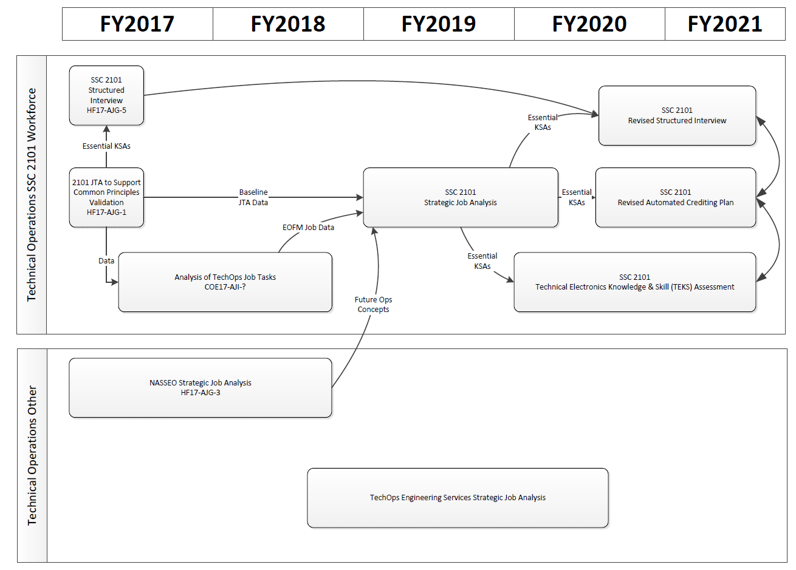
Research Requirement Evolution to Support Selection, Placement, and Training Performance Evaluation of Technical Operations Personnel

Slide 33
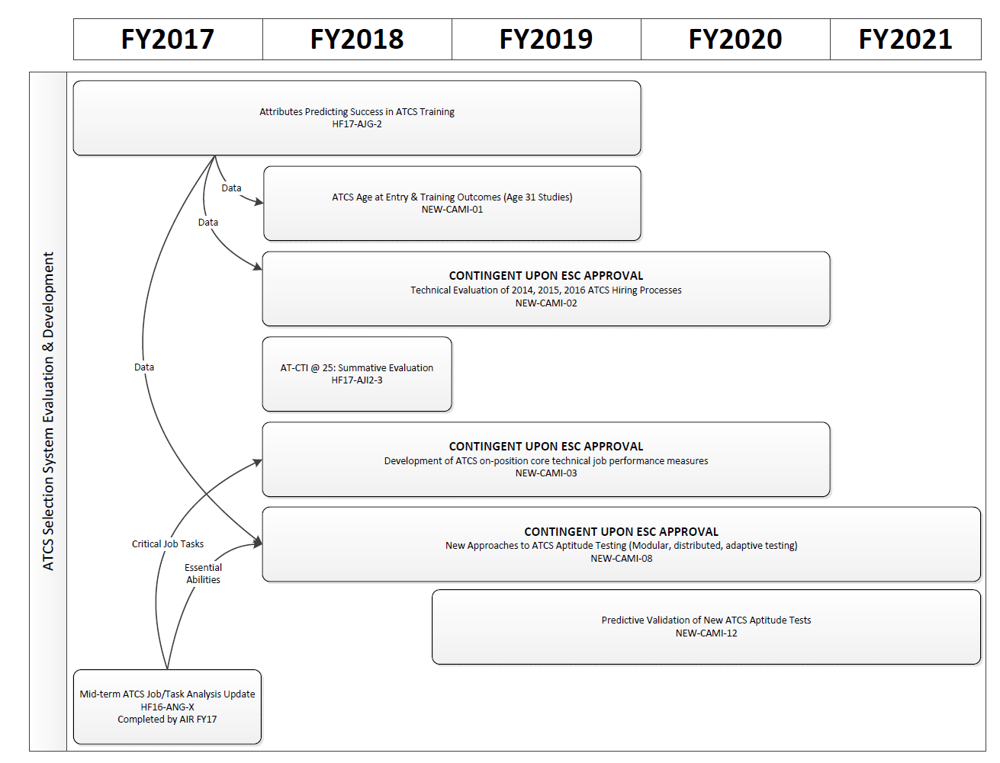
Research Requirement Evolution to Support Controller Selection, Placement, and Training Performance Evaluation of Air Traffic Control Specialists

