Slide 1


FAA Cybersecurity R&D Plan
  To: NAS Ops Subcommittee
  By: John Lapointe, ANG-E2
  Chuck Agava, ANG-E271
  Date: September 13, 2017

Slide 2






Today’s Objective
Provide update on the FAA Cybersecurity R&D Plan
Approach
Requirements
Funding Profile
Gaps
For Your
Review

Slide 3
FAA Extension, Safety, and Security Act of 2016
Section 2111 Aviation Cybersecurity (1)
Section 2111
  (a)- Comprehensive and Strategic Aviation Framework
    Strategic framework of principles and policies to reduce cybersecurity risks to the national airspace system, civil aviation, and agency information systems that takes into consideration the interactions and interdependence of different components of aircraft systems and the national airspace system. (Due: within 240 days of enactment)
  (b)- Update on Cybersecurity Implementation Progress
    Provide to Congress an update on progress made toward the implementation of section 2111. (Due: within 90 days of enactment)
  (c)- Cybersecurity Threat Model
    Assess and research the potential cost and timetable of developing and maintaining an agency-wide cybersecurity threat model. (Due: within 1 year of enactment)
  (d)- National Institute of Standards and Technology Information Security Standards
    Provide to Congress an update on progress made toward the implementation of NIST latest revisions to FAA information and information systems. (Due: within 180 days of enactment)

Slide 4
FAA Extension, Safety, and Security Act of 2016
Section 2111 Aviation Cybersecurity (2)
Section 2111
(e) of the FAA Extension, Safety and Security Act of 2016, “…the Administrator, … shall establish a cybersecurity research and development plan for the national airspace system…”
  Cooperation with international partners
  Risks of cabin communications and cabin information technology
  Objectives, proposed tasks, milestones, and a 5-year budgetary profile
  One year after the date of enactment of the Act (7/15/2016)
Notes:
CYBERSECURITY RESEARCH AND DEVELOPMENT.—Not later
than 1 year after the date of enactment of this Act, the Administrator,
in consultation with other agencies as appropriate, shall
establish a cybersecurity research and development plan for the
national airspace system, including—
(1) any proposal for research and development cooperation
with international partners;
(2) an evaluation and determination of research and
development needs to determine any cybersecurity risks of
cabin communications and cabin information technology systems
on board in the passenger domain; and
(3) objectives, proposed tasks, milestones, and a 5-year
budgetary profile.

Slide 5

Timeline
7/15/16
9/15/16
11/15/16
1/15/17
3/15/17
5/15/17
7/15/17
PL 114-90
Signed
Milestones
2/24/17 ANG-E initiated action
4/7/17 First draft released (Internal to ANG-E)
4/21/17 Version 0.5 released for comments
4/24 – 5/26 Comments ( ~100) received and adjudicated
5/26/17 Version 0.6 sent submitted for editing
6/2/17 Current Version 0.7 released
6/16/17 Version 0.8 released to CSC
6/21/17 Briefed CSC
6/30/17 Comments due from all
7/03/17 Concurrence from CSC
7/11/17 Briefed ANG-E Staff
7/14/17 Released Version 1.0
Plan
Established

Slide 6



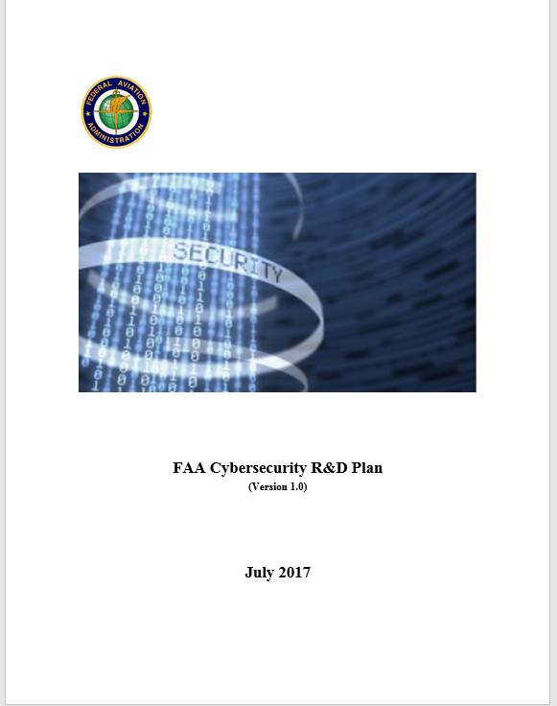
FAA Cybersecurity R&D Plan - Development
Assessment
Discovery
Comments / Concurrence
Output
  Cybersecurity Strategy 2017-2022
  National Aviation Research Plan
  FAA Budget Narratives
  FY 2019 Budget Estimates
  FAA Research Leads
FAA (CSTAs and SMEs)
FAA Organizations
Aviation Safety
NextGen
Air Traffic Organization
Finance & Management
Security & Hazardous Materials Safety
ICCT

Slide 7
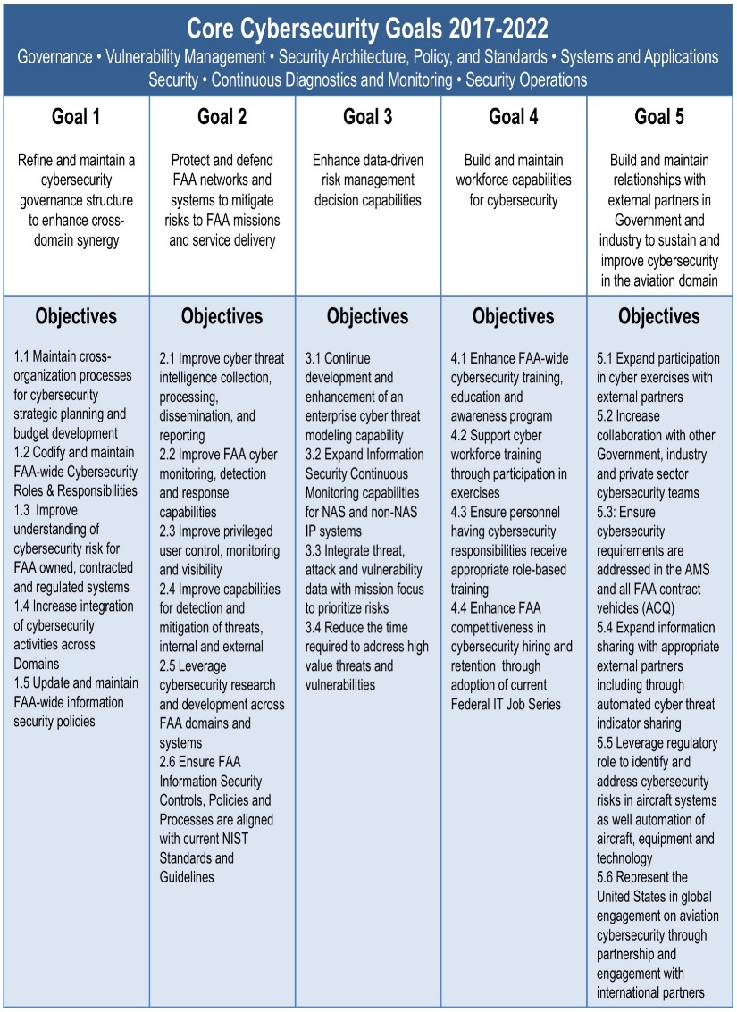
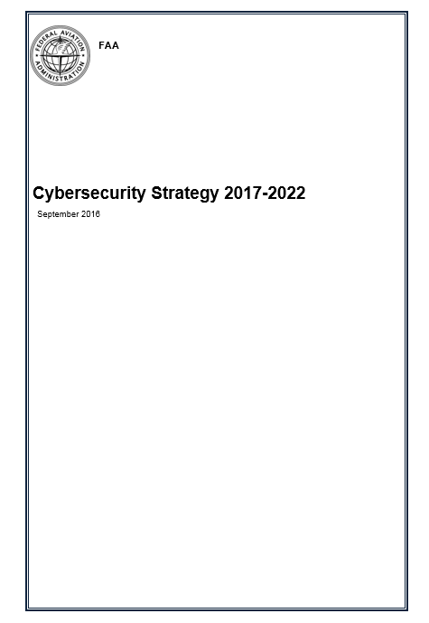
Alignment to CSC Strategic Plan: 2017 - 2022
CSC Steering Committee
FAA Chief Information Security Officer
Aviation Safety
Security & Hazardous Materials Safety
Air Traffic Organization
NextGen
DOT Chief Information Security Officer

Slide 8




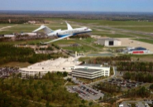





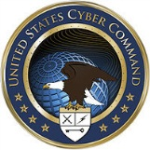

Cybersecurity R&D Plan - Partnerships
Aviation Safety
CRDAs
Security & Hazardous Materials
SC-216
Finance and Management
SC-222
Industry &
Academia
Air Traffic Organization
SC-223
SC-228
NextGen
International
Government Agencies
DHS
NASA
Cybercom
DOD
SC-216 - Aeronautical Systems Security SC-222 - Minimum Aviation Performance Standards
SC-223 - Internet Protocol Suite (IPS) and AeroMACS SC-228 – Minimum Performance Standards- UAS

Slide 9
Cybersecurity R&D Plan - Definitions
FAA Goals
Research Areas
FAA Domains
Goal 1- Refine and maintain a cybersecurity governance structure to enhance cross domain synergy
Goal 2- Protect and defend FAA networks and systems to mitigate risks to FAA missions and service delivery
Goal 3-Enhance data-driven risk management decision capabilities
Goal 4-Build and maintain workforce capabilities for cybersecurity
Goal 5-Build and maintain relationships with external partners in government and industry to sustain and improve cybersecurity in the aviation domain
Security and Resiliency - Develop methods to enhance FAA’s ability to prevent, detect, and respond to cyber attacks
Data Analytics - Develop analytical capabilities for aggregating and correlating current data with the intent of understanding, predicting, and responding to cyber attacks.
Human Behavior/Human Factors - Develop and validate human-in-the-loop policies, training, and procedures to detect and respond to cyber attacks
System-Wide Safety Assurance - Develop real time, continuous, safety analysis and assurance tools and capabilities to prevent/mitigate the impact of cyber attacks.
NAS- Automation, Communication, Navigation, Surveillance and Weather
Mission Support- Administrative, NAS support applications, Aircraft certification/Regulatory services, Airports and Commercial space
R&D- Air space management, New technologies for aerospace vehicles, Infrastructure durability and resiliency; Human component of the system, Integrated modeling capabilities and system-wide analysis

Slide 10
Cybersecurity R&D Plan- Framework
FAA Cybersecurity Goals
FAA Goal 2
FAA Goal 3
FAA Goal 4
Research
Areas
Security and Resiliency
Data Analytics
System-wide Safety Assurance
Human Behavior & Human Factors
FAA Domains
Aircraft Systems Information Security Protection (ASISP)
UAS C2 Link Security Protection
Cybersecurity Risks of Cabin Communications and Information Systems
Flight Deck Data Exchange
NextGen Information Security
IAM Interoperability
UAS C2 Link Security Protection Capability
CyTF Virtualization
ASISP Response and Recovery
Situational Awareness Visualization & Threat Assessment
NAS
Requirements
Mission
Support
R&D

Slide 11
Cybersecurity R&D Plan – Research Requirements
Research Area: Security and Resiliency Develop methods to enhance FAA’s ability to prevent, detect, and respond to cyber attacks
  Aircraft Systems Information Security Protection (ASISP)
  Cybersecurity Risks of Cabin Communications and Cabin IT Systems
  Unmanned Aircraft Systems Networked Command and Control (C2) Link Security Protection
Funding Profile | FY18 | FY19 | FY20 | FY21 | FY22
 | $2,310K | $4,430K | $4,950K | $4,200K | $4,000K

Slide 12
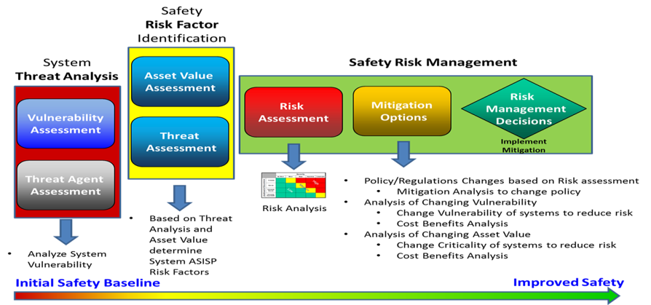
ASISP Research Requirement
Problem Statement
Assess/analyze wired and wireless connectivity to aircraft systems to identify information-security-protection vulnerabilities and risks that could adversely affect the safety of an aircraft.
Research Output
ASISP safety risk assessment and risk mitigation processes.
Technical data for use in the development of aircraft systems information security-protection-related rulemaking, policy development, and guidance for best practices.

Slide 13
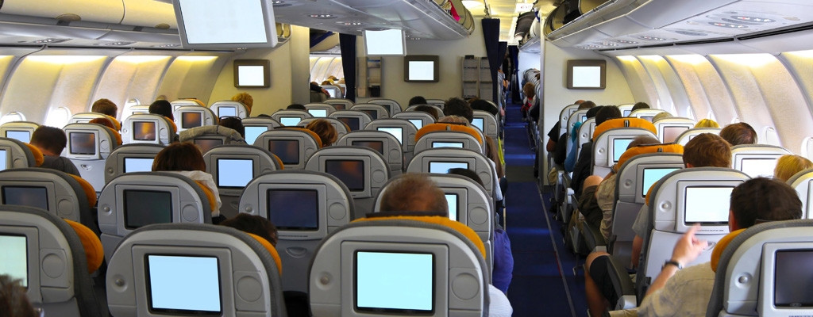
Cybersecurity Risks of Cabin Communications
Problem Statement
Conduct an evaluation and determination of research and development needs to determine any cybersecurity risks of cabin communications and cabin information technology systems on board in the passenger domain.
Research Output
Technical data on the identification and assessment of any safety risks as well as the identification of discovered vulnerabilities.
The technical would provide a basis for developing rulemaking, policy, guidance, standards, training, and tools for security.

Slide 14
Cybersecurity R&D Plan – Research Requirements
Research Area: Data Analytics Develop analytical capabilities for aggregating and correlating current data with the intent of understanding, predicting, and responding to cyber attacks
  Flight Deck Data Exchange
  Identify and Authorization Management Interoperability
  NextGen Information Security
Funding Profile | FY18 | FY19 | FY20 | FY21 | FY22
 | $1,000K | $6,250K | $6,350K | $6,200K | $4,200K

Slide 15
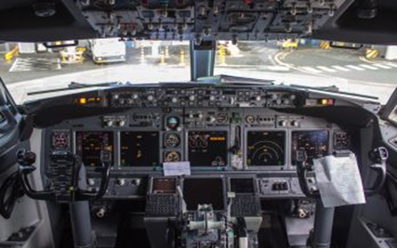

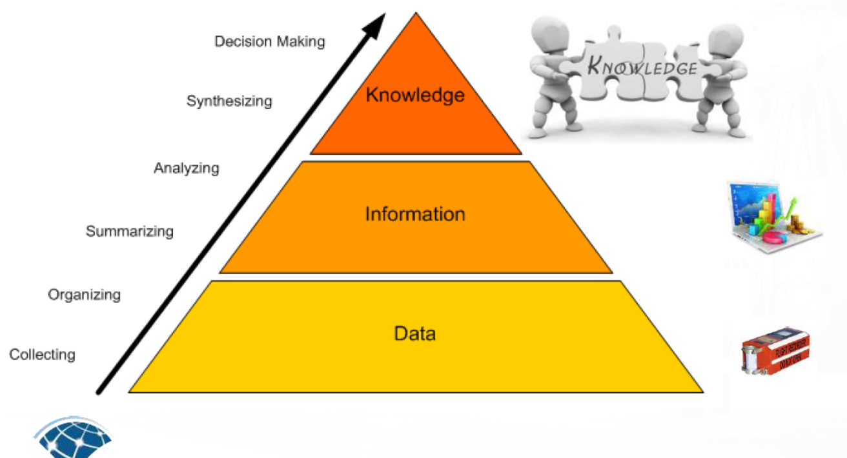
Flight Deck Data Exchange
Problem Statement
Evaluate the security requirements to enable safe data exchange between certified and non-certified systems, the performance standards required to enable operational information exchange, and the data-exchange protocols to enable seamless integration between airborne and ground systems.
Research Output
Technical data on recommended flight-deck data-exchange requirements and performance standards.
It is envisioned that flight operators will be able to operate at their optimal performance envelopes while reducing the need for air traffic control intervention and restrictions by enabling reduced and delegated separation management.

Slide 16
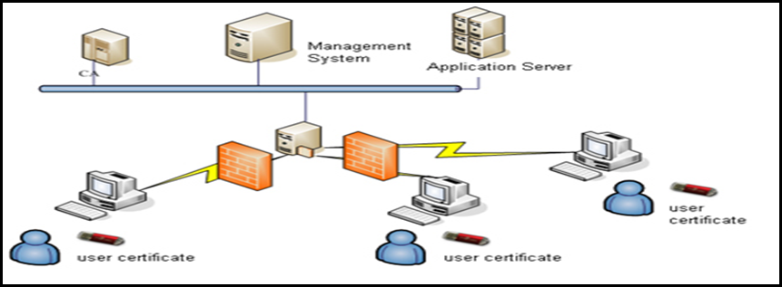
IAM Interoperability
Problem Statement
Assess and analyze the expansion of identity and authorization management (IAM) with domestic and international public key infrastructure (PKI) systems, and to explore and recommend solutions for interoperability, capacity, and architectural issues that arise with the industry, domestic, and international aviation partners.
Research Output
Methodology for expanding IAM trust framework, algorithmic interoperability, and internal use cases, including collaboration with the expanded, heterogeneous IAM user community.
Technical data for use in the development of standards, policies, and governance to support the unified global Operational Concept for IAM.

Slide 17
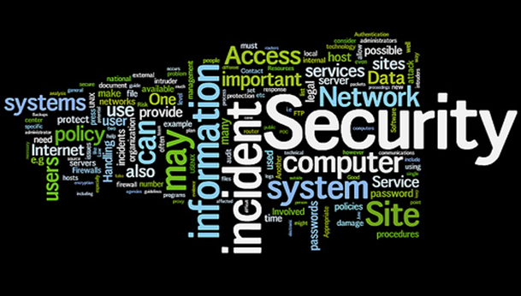
NextGen Information Security
Problem Statement
Conduct research on big data methodologies addressing cyber security parameters such as data volume, data rates, behavioral data, and a variety of other parameters to help prevent disruptive cyber incidents that may impact Operational data which includes the NAS, mission support and R&D domains.
Research Output
Advanced big data analytics approaches to detect and respond to advanced persistent and insider threats.
Big analytical capabilities for aggregating and correlating current behavioral and operational data with the intent of understanding, predicting and responding to cyber events.
The intent is to provide the necessary protections of the ATC services and associated functions from potential disruptive cyber events.

Slide 18
Cybersecurity R&D Plan – Research Requirements
Research Area: Human Behavior/Human Factors Develop and validate human-in-the-loop policies, training, and procedures to detect and respond to cyber attacks
  Situational Awareness Visualization
  ASISP Response and Recovery
Funding Profile | FY18 | FY19 | FY20 | FY21 | FY22
 | $0 | $1,000K | $3,000K | $3,000K | $2,000K

Slide 19
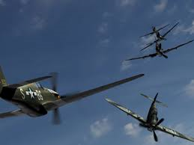
Situational Awareness Visualization
Problem Statement
Identify and assess products that can assist the FAA in the detection, protection, behavior analysis, and visualization of insider threats, and to support the requirement for Information Security Continuous Monitoring.
Research Output
Assessment of candidate situational awareness visualization, real-time threat assessment and compliance tools, and threat intelligence tools in the R&D domain.
Recommendations for implementation of situational awareness visualizations and threat compliance, threat assessment, and threat intelligence within the FAA..

Slide 20
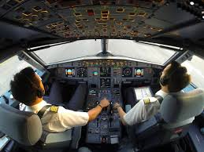
ASISP Response and Recovery
Problem Statement
To determine whether aircraft pilots will recognize that a cyber-attack is occurring and, if so, respond appropriately.
Research Output
Technical data derived from specific cyber-attack scenarios to understand pilot behavior, i.e., understand the human-factors implications of an information security attack.
The technical would provide a basis for developing rulemaking, policy, guidance, standards, training, and tools for security.

Slide 21
Cybersecurity R&D Plan – Research Requirements
Research Area: System-Wide Safety Assurance Develop real time, continuous, safety analysis and assurance tools and capabilities to prevent/mitigate the impact of cyber attacks
  UAS C2 Link Systems Security Capability
  FAA Cybersecurity Test Facility
Funding Profile | FY18 | FY19 | FY20 | FY21 | FY22
 | $400K | $2,100K | $2,100K | $1,000K | $1,000K

Slide 22
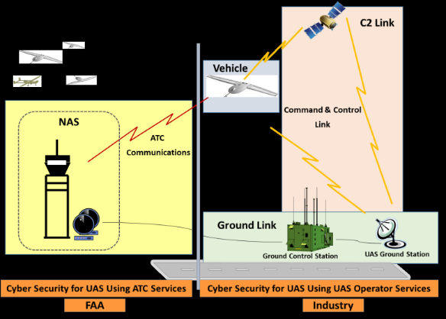
UAS C2 Link Systems Security Capability
Problem Statement
Assess efficient and effective mitigation against security threats of terrestrial, SatCom, and network terrestrial and SatCom C2 data-link systems with a high level of sophistication.
Research Output
Avionic systems-design and airworthiness-approval requirements for the UAS C2 non-payload communication data links.
Technical derived from the research will be used in the development of FAA new advisory circulars for security protection of new and unique C2 terrestrial, SatCom, and networked systems, FAA Path Finder certification activities, publication of operational guidance materials, and other related activities.

Slide 23

FAA Cybersecurity Test Facility
Problem Statement
Identify, evaluate, and provide recommendations for candidate systems and tools that should be virtualized for use within the Cybersecurity Test Facility (CyTF) for the purpose of assessing cybersecurity vulnerabilities in the R&D domain, and recommend mitigation strategies.
Research Output
Identification of additional candidate FAA capabilities for inclusion into the CyTF
Improvement and enhancement of the CyTF capabilities, and enable comprehensive, realistic, and complex cybersecurity exercises, product evaluations, and other R&D activities.

Slide 24

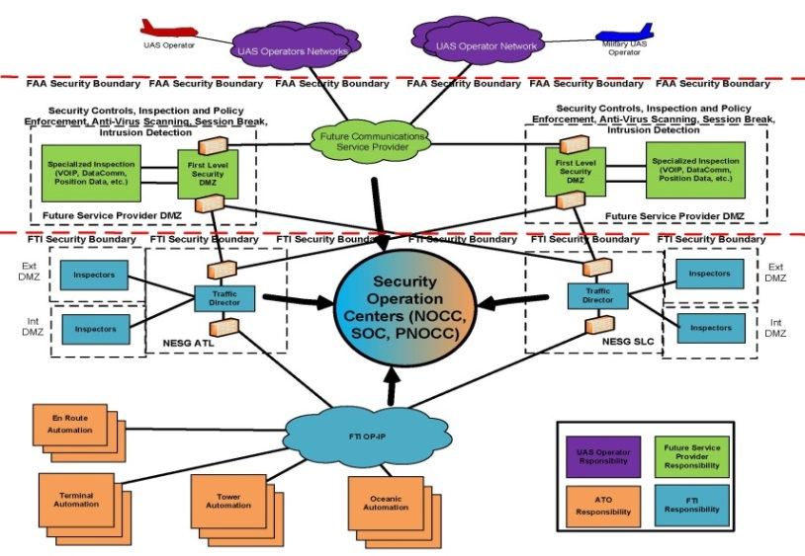
Research Needs: UAS Cybersecurity
Four UAS-cybersecurity requirements that address a research gap.
Initial draft version of requirements are pending additional review and acceptance.
Cost estimates need to be vetted.
Information Security Protection research supports information security concerns associated with:
UAS pilot to/from NAS- Data Communications
UAS pilot to/from NAS- Voice Communications
UAS Flight Plans
UAS Departure Clearances
    Unmanned Aircraft Control Station Ground-to-Ground Communication with NAS Air Traffic Control research supports shall identify the safety issues associated with the use of UAS Gateways that provide the capability for multiple Pilots-in-Command (PICs) to communicate with Air Traffic Control via dynamically built voice bridges.
UAS Risk Management Framework research supports the development of comprehensive UAS cybersecurity risk management processes and guidelines to be used in the development of new FAA regulations, policy, standards, guidance, and training
Development of Cybersecurity UAS Integration Model research supports a virtual representation of the existing NAS and FAA Telecommunications Infrastructure (FTI) systems and helps the FAA prepare for full UAS integration into the NAS, along with procedures, threat and vulnerability analysis and related documentation.
.

Slide 25
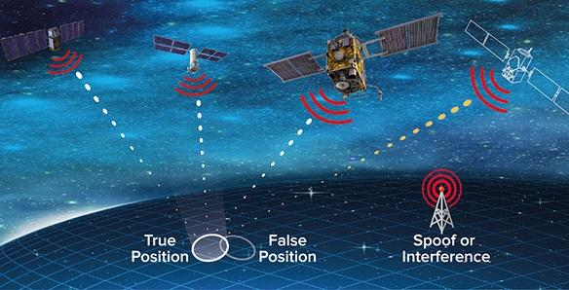
Cyber Positioning, Navigation, and Timing
Research Need
FAA is working with DHS to access the vulnerabilities of GPS equipment, including timing systems used in NAS infrastructure.
Tasks, milestones, research outcomes and resources required have not been fully defined.
The Space-based Positioning, Navigation, and Timing (PNT) research need focuses on enabling technologies for NextGen capabilities and identifying the critical failure mechanisms for essential elements of the national airspace infrastructure and external supporting infrastructure sectors.
Where possible, these activities will be conducted jointly with DHS and other agency partners.

Slide 26
Mapping of Requirements to FAA Domains
 |  | Primary Domain
Requirement | Research Area | NAS | R&D | Mission Support
Aircraft Systems Information Security Protection (ASISP) | Security & Resiliency |  |  | Regulatory Service
UAS C2 Link Security Protection | Security & Resiliency |  |  | Regulatory Service
Cybersecurity Risks of Cabin Communications and Cabin Information Technology Systems | Security & Resiliency |  |  | Regulatory Service
Flight Deck Data Exchange | Data Analytics | X
NextGen Information Security | Data Analytics | X
IAM Interoperability | Data Analytics |  | X
UAS C2 Link Security Protection Capability | System-Wide Safety Performance |  | X
CyTF Virtualization | System-Wide Safety Performance |  | X
ASISP Response and Recovery | Human Behavior/Human Factors |  |  | Regulatory Service
Situational Awareness Visualization and Threat Assessment | Human Behavior/Human Factors | X

Slide 27
Cybersecurity R&D Plan-Funding Summary
Funding Type | 2018 Requested | 2019 Planned | 2020 Out-Year | 2021 Out-Year | 2022 Out-Year | Total
Total | $3,710K | $13,780K | $16,400K | $14,400K | $11,200K | $59,490K
Requested/ Planned/ | $3,710K | $8,030K | TBD | TBD | TBD
Shortfall | $0 | $5,750K | TBD | TBD | TBD

Slide 28
Cybersecurity R&D Requirements – Mapped to the NARP
Requirement | FAA Goals | Draft NARP Goal | Draft NARP Objective | Research Output(s) | Research Outcome
NextGen-Information Security | Enhance data-driven risk management decision capabilities | Improve integrated modeling capabilities & system-wide analysis | Primary: Data Engineering Secondary: System Performance | Data analytics, methods, and tools | Protection of ATC services from disruptive cyber attacks
Flight Deck Data Exchange | Protect FAA Networks | Improve airport operations, air traffic & air space management capabilities | Separation Management | Data exchange protocols and performance standards | Optimal performance envelopes in the NAS
Aircraft Systems Information Security Protection | Enhance data-driven risk management decision capabilities | Increase Infrastructure durability and resiliency | Cybersecurity - Aviation Ecosystem | Safety risk management framework & processes | Policy, guidance, training & tools
Cybersecurity Risks of Cabin Communications and Cabin Information Technology Systems | Enhance data-driven risk management decision capabilities | Increase Infrastructure durability and resiliency | Cybersecurity - Aviation Ecosystem | Vulnerability discoveries and risk assessment | Policy, guidance, training & tools
Aircraft Systems Information Security Protection Response and Recovery | Enhance data-driven risk management decision capabilities | Improve the operation of the human component of the system | Human Performance | Results of simulation of cyber attack scenarios. Research studies with pilots | Policy, guidance, training & tools

Slide 29
Cybersecurity R&D Requirements – Mapped to the NARP
Requirement | FAA Goals | Draft NARP Goal | Draft NARP Objective | Research Output(s) | Research Outcome
UAS Networked C2 Link Systems Security Protection | Cyber Workforce Capability / Protect FAA Networks | Increase Infrastructure durability and resiliency | Cybersecurity - Aviation Ecosystem | Technical data for the development of standards, policies and governance | Policy, guidance, training & tools
UAS Security Control Capability | Cyber Workforce Capability / Protect FAA Networks | Increase Infrastructure durability and resiliency | Cybersecurity - Aviation Ecosystem | Technical data for the development of standards, policies and governance | Policy, guidance, training & tools
CyTF Virtualization | Cyber Workforce Capability / Protect FAA Networks | Increase Infrastructure durability and resiliency | Cybersecurity - Aviation Ecosystem | Results of simulation of cyber attack scenarios. Evaluation of tools | Protection of ATC services from disruptive cyber attacks
IAM Interoperability | Cyber Workforce Capability / Protect FAA Networks | Increase Infrastructure durability and resiliency | Cybersecurity - Aviation Ecosystem | Technical data for the development of standards, policies and governance | Policy, guidance, training & tools
Situational Awareness Visualization, Threat Assessment and Compliance | Cyber Workforce Capability | Increase Infrastructure durability and resiliency | Cybersecurity - Aviation Ecosystem | Technical data for the development of standards, policies and governance | Policy, guidance, training & tools

Slide 30


