Slide 1

FAA UAS Update
Strategic Initiatives and Activities
Presented by: Bill Crozier, Deputy Director,
FAA UAS Integration Office
Date:
May 31, 2017

Slide 2
Overview
2017 Accomplishments
  Registration continues to grow – over 835,000
  Pilot certificates – 47,000
  Extended and beyond line-of-sight waivers
  UAS facility maps
LAANC and UTM
UAS Integrated Gateway
ARCs – UAS ID and Tracking, UAS in Controlled Airspace
DAC and UAST progress
Budget support in appropriations bill
Legislative Activities

Slide 3
UAS by the Numbers
Airspace Waiver/Authorization Requests
Top 5 Waiver Requests
0% 10% 20% 30% 40% 50% 60% 70%
Night Operations
Total: 17,141
Class E 2,118
Class B 2,771
66%
36%
20% 10% 10%
Operations over People
BVLOS Operations
Class C 3,905
Operations from a Moving Vehicle
Class D 8,347
Operational Limitation: Altitude
UAS Registrations
Airspace Waivers/Authorizations Approved – 4,336
Class B | 602
Class C | 941
Class D | 2,368
Class E | 425
Online Commercial 64,808
Paper 6,727
Total: 835,879
Online Hobby 764,344

Slide 4






Meeting the Challenge
Volume
+ Pace
Performance-based regulations
Shared commitment to safety

Slide 5
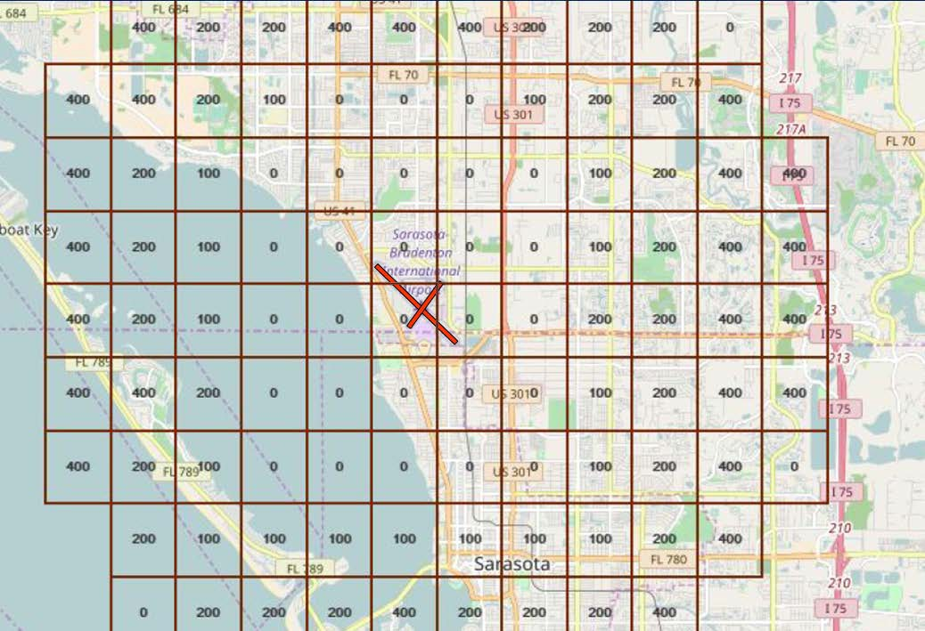
UAS Facility Maps (UASFM)

Slide 6
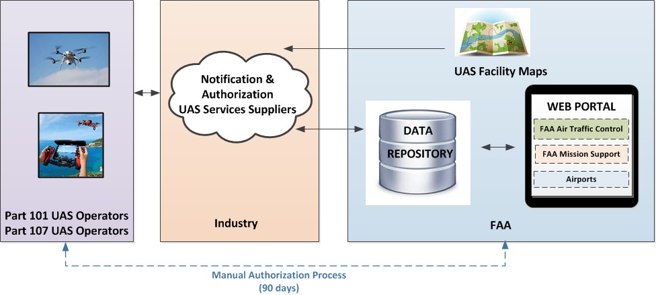
UAS Low Altitude Authorization & Notification Capability (LAANC)

Slide 7
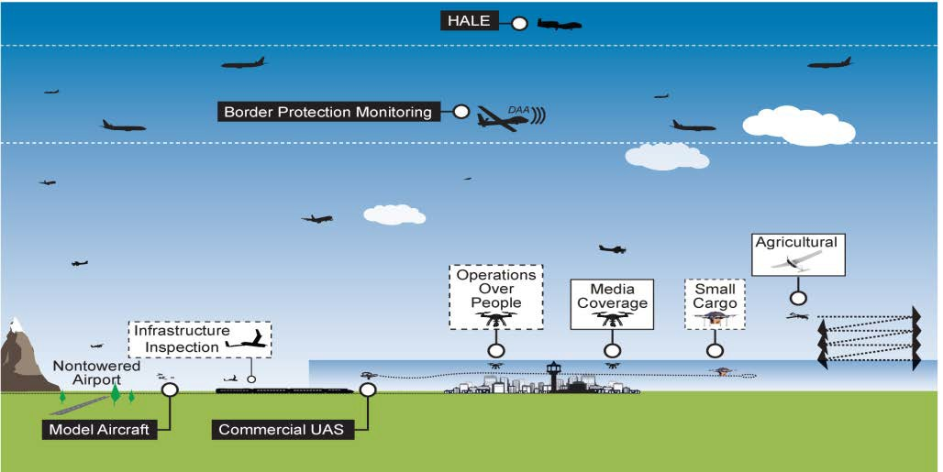
Managing Airspace Access – UTM
Air Traffic Management System
Established policies & procedures
UAS Traffic Management System
Cooperative interaction
HALE = High Altitude Long Endurance

Slide 8




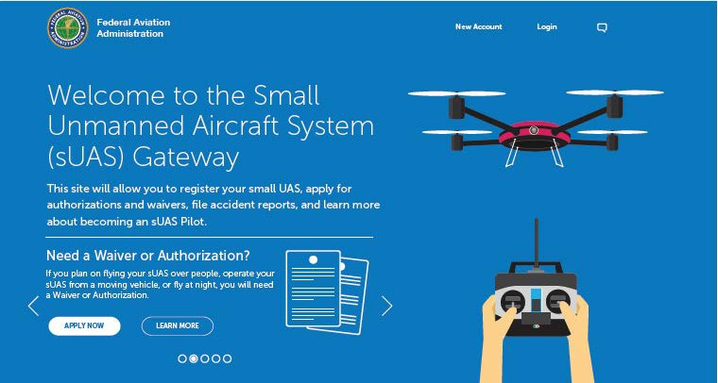






UAS Integrated Gateway
FAA User
• FAA AUS – Performance Reports
• FAA AFS – Waiver/Accidents
• FAA ATO - Authorizations
• FAA ASH – Registry Lookup
• FAA AOC – Alerts and Notifications
FAA User
Performance Reports
Waivers/Accidents
Authorizations
Registry Lookup
Alerts and Notifications
FAA ATC
)
Service a
as
Data
^{Layer} Enterprise Data
^{UAS} through
d
provide
be
To (
FAA Air Traffic Control
UAS Reporting
LAANC ATC
Application
LAANC
Application for Air Traffic
UAS Data Layer (FAA IT)
Registry db
Waiver db
LAANC 3rd Party Partner Providing Authorizations
LAANC 3rd
Party Partner Application
Accident db
• Registration
• Waivers – Request/Status
• Authorizations – Request/Status
• Accident Reporting
• Education / Training
• UAS Operator Communication
UAS Registration
Part 107 waivers & authorizations (requests and status lookup)
Accident Reporting
Education & Training
Alerts and Communications
Authorizations and Notifications db
UAS Operator
UAS Operator

Slide 9















UAS Identification and Tracking
Identification & Tracking ARC
DFO-Earl Lawrence
Existing and Emerging Technologies Group (WG1)
Law Enforcement and Security Group (WG2)
Implementation Group (WG3)
Domestic/ International Technology
Industry
Chiefs of Police
Domestic/ International Technology
Industry
Sheriffs Associations
FFRDCs (MITRE, MIT/LL,VOLPE,
Aerospace Corp, etc.)
Standards Bodies
Govt Security Partners
Operators
NIST
Manufacturers
NASA

Slide 10
UAS in Controlled Airspace ARC
Recommend scenarios encompassing most desired operations
Identify gaps in R&D to inform integration
Recommend prioritized changes/additions to policies and capabilities to achieve integration
Submit recommendations to the FAA within 12 months

Slide 11


Stakeholder Collaboration
Drone Advisory Committee
(DAC)
Purpose: help prioritize the FAA’s UAS integration activities
Chaired by Intel CEO Brian Krzanich
35 members
– UAS manufacturers and operators, traditional manned aviation, labor organizations, radio and navigation equipment manufacturers, airport operators, state and local officials
Subcommittee + 3 Task Groups
  Roles and Responsibilities
  Access to Airspace
  UAS Funding
Unmanned Aircraft Safety Team
(UAST)
Purpose: gather and analyze data to enhance safety and operations of drones in the nation’s airspace
Co-chaired by AirMap CEO Ben Marcus
48 members
– Primarily UAS manufacturers, operators, and data service providers, as well as traditional manned aviation groups
3 Working Groups
  UAS Survey
  UAS Data Management
  UAS Communications

Slide 12
Legislative Activities
FAA Extension, Safety and Security Act – Public Law 114-190
  Section 2202 – Remote ID Standards
  Section 2206 – Airport Safety and Airspace Hazard Mitigation Pilot Program
  Section 2208 – UTM Research Plan
  Section 2209 – Restrictions over Fixed Site Facilities
  Section 2211 – UAS Research Roadmap
  Section 2212 – UAS Collision Research
  Section 2213 – Probabilistic Risk Assessments

