Slide 1
by: Shelley Yak REDAC Designated Federal Official
FAA Research and Development
National Aviation Research Plan Redesign
Presented to: Full REDAC
REDAC Chair: John Hansman

Slide 2
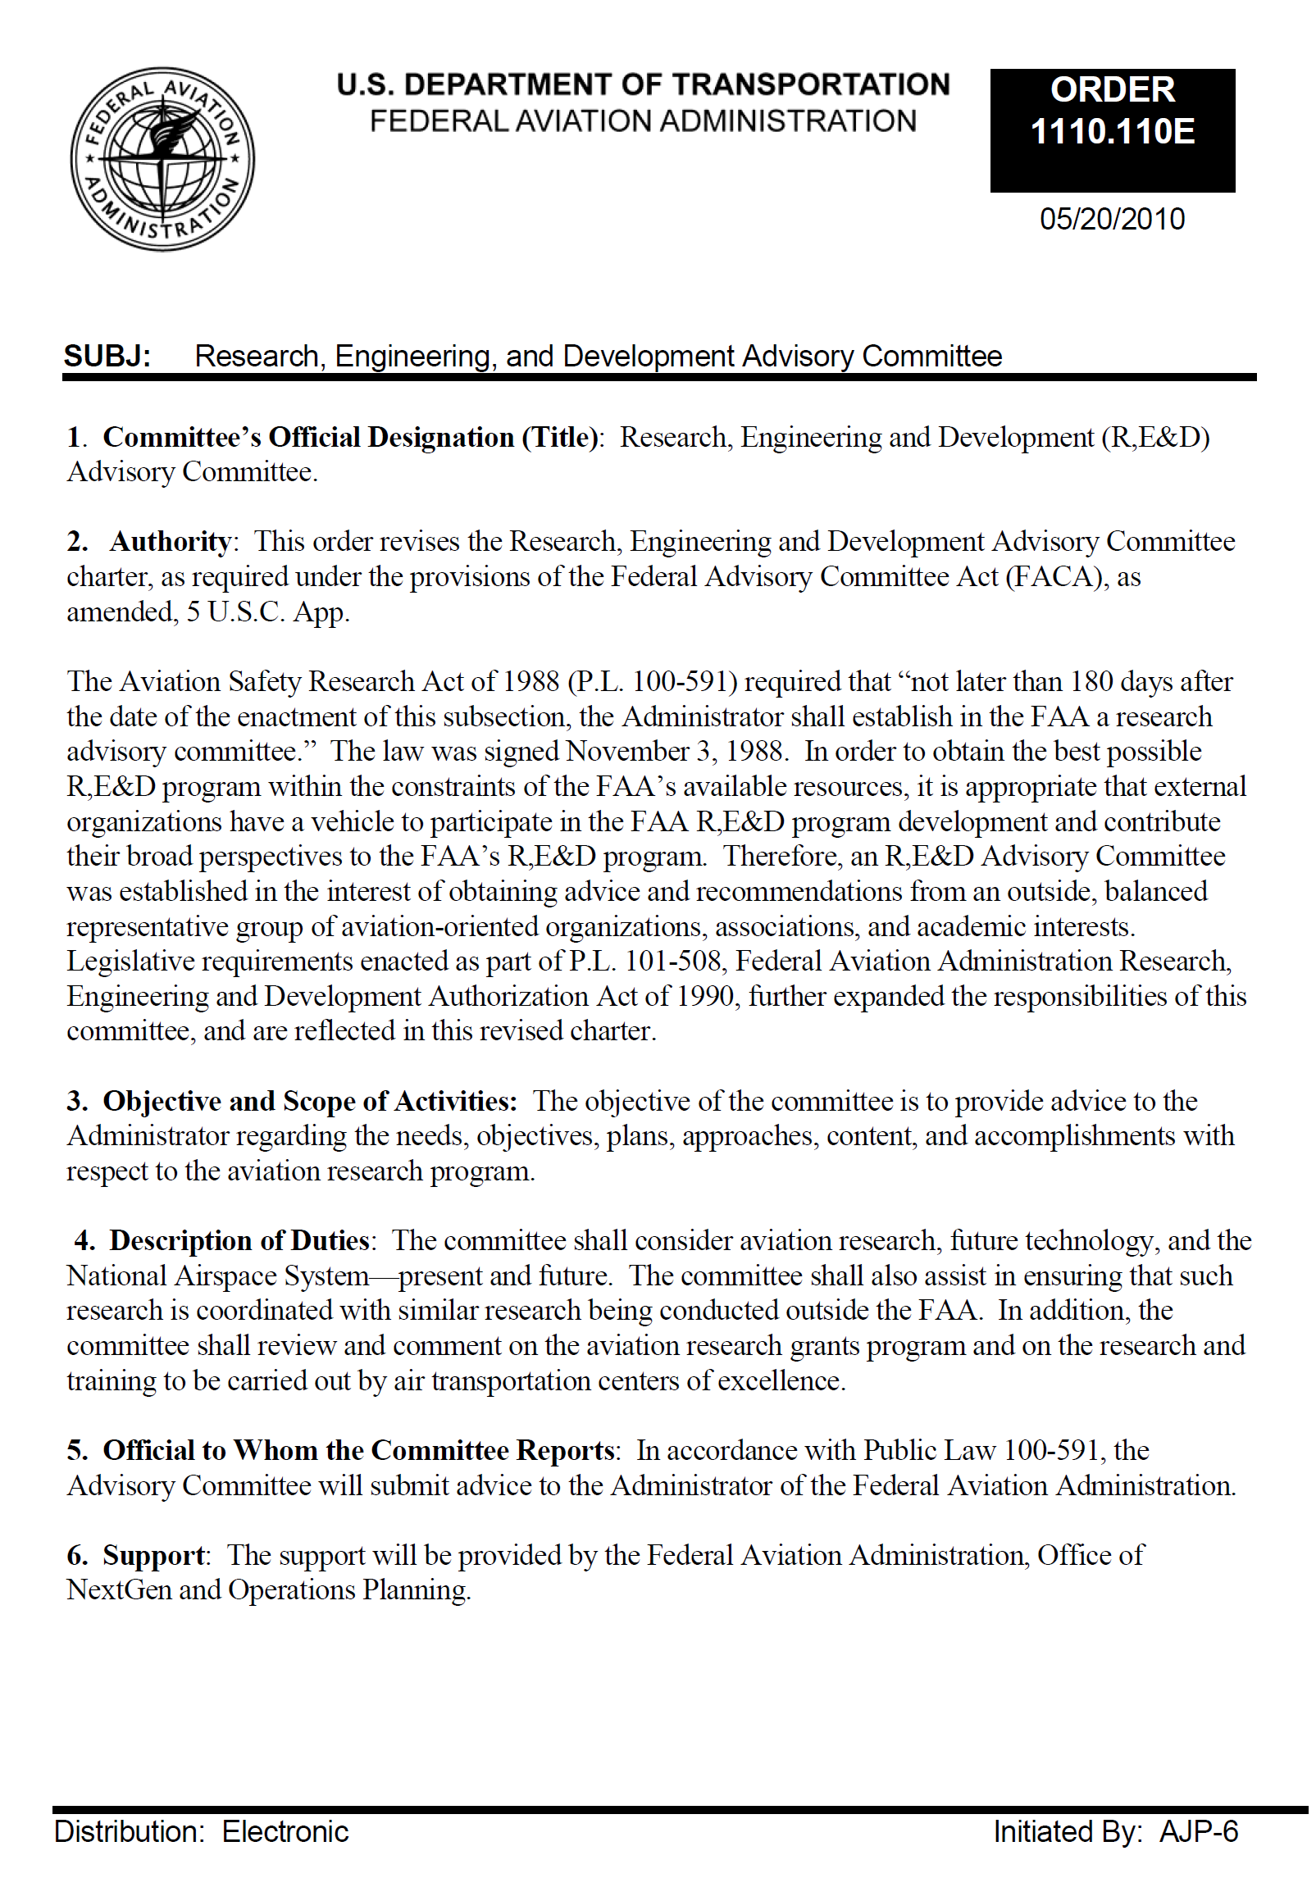
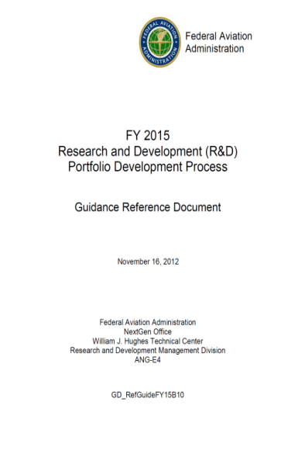
Briefing Purpose/Agenda
Discuss REDAC’s NARP Redesign Feedback and review plans
Summary: Redesign Effort
Feedback
Goals/Objectives
Research Planning
Notes:
Narrowing the focus to the R,E&D Account: i.e. No longer discussing the larger R&D program described in the NARP (which includes F&E/AIP)
The R,E&D appropriation is the smallest of FAA’s capital accounts (about 1% of FAA’s total budget authority) and the only one dedicated exclusively to R&D.
Like the F&E appropriation, it is a multiyear account with funds remaining available for obligation for three years; thus during any execution year we operate with three active accounts.
Unlike the F&E appropriation, each budgeted line item within the R,E&D appropriation provides for both the federal staff and the contracted resources supporting the program.
Another distinctive characteristic of the R,E&D portfolio is that it largely supports research aimed at informing regulatory activity (i.e. issuance of rules and guidance materials) as opposed to developing new technology – a key thrust of R&D funded through the F&E account.
Through FY2016 … the R,E&D portfolio consisted of 21 separately funded line items across 4 activities; a 22nd program is proposed with the FY2017 budget to conduct Cybersecurity R&D to address emerging and continuing security threats against our aviation infrastructure

Slide 3
NARP Redesign Drivers
April 2016: Research Executive
“Observation from attending REDAC Subcommittee Meetings is that the NARP in its current form seems to be of limited value in communicating a holistic FAA R&D story”
May 2016: Research Eng. & Development Advisory Committee (REDAC)
“The REDAC also identified the need for a high level research strategy and plan which coordinates research across the research areas of the agency. We strongly support the plan to develop such a strategy and offer any assistance which would be effective.”
April 2017: Government Accountability Office
FAA Could Improve How It Develops Its Portfolio and Reports Its Activities. Recommendations:
Identify long-term R&D research priorities
Disclose how projects are selected
Ensure that the NARP and R&D Annual Reviews meet statutory requirements for content.
Notes:
Research Executive – NARP does not seem to be used, barely mentioned at REDAC meetings, limited value communicating holistic FAA R&D story
Advisory Committee (REDAC)
May, 2016: REDAC chair’s letter to Administrator Huerta
“REDAC Questions:
What is FAA’s Research and Development Strategy?
Is there a strategic context for the agency’s R&D investments?
How is research aligned with FAA’s mission and operational outcomes?
What are Interagency, Industry, and Centers of Excellence work activities?
Government Accountability Office
Review of FAA’S Research and Development (Feb. 2017)
Preliminary general observations:
Need for forward looking outlook – aware of NARP redesign
Need for transparent prioritization process
Areas for improvement in fulfilling statutory requirement

Slide 4
NARP Redesign
Research Executive Board (REB)
Agreed to redesign NARP:
Communicate driving forces for research (Vision)
Communicate big picture (Strategy)
Prioritize research that is results focused and properly positions the FAA
Communicate Costs and align investments
Include in-house/other resources (i.e. agencies, COEs, etc.)
Communicate strategy for leveraging other resources
Communicate impacts/mitigations/alternatives of budget decisions on research
Request REDAC input/feedback on work to date
Feb/Mar 2017 subcommittee meetings

Slide 5
Reminder: Research Plan Framework and Terminology
Outcomes
Improve Aviation Safety
Improve Operational Efficiency
Reduce Environmental Impact
Goals
Goal 1
Goal 2
Goal 3
Goal 4
Objectives
Objective
Objective
Objective
Objective
Outputs
Output*
Output
Output
*Key outputs within a 5 year horizon
Notes:
Outcomes
Principles: “Why”
Goals
Pursuit: “Where”
Objectives
Domain: “What/Who/Why”
Outputs
Deliverable: “What”

Slide 6
Research Engineering & Development Advisory Committee (REDAC) Feedback
Thank You
Specific wording changes
Design
Collaborating with industry & others (too FAA focused)
Applying Measurements/Metrics
Aligning research to results
Reoccurring update NARP goals/objectives
Achieving a balanced research portfolio

Slide 7
NARP Redesign Addressing Feedback
April - May: Research Executive Board Meetings
Meeting 1
Reviewed suggested wording changes
Updated Goals/Objectives
Reviewed comments and design input
Meeting 2
Continued refining Goals/Objectives
Began reconciling design input
Established plan/approach for aligning outputs to Goals/Objectives
Meeting 3
“Finalized” Draft Goals/Objectives
Reconciled design input - NARP Redesign Roadmap
Shared experiences to date regarding aligning outputs
Notes:
Advisory Committee (REDAC)
May, 2016: REDAC chair’s letter to Administrator Huerta
“The REDAC also identified the need for a high level research strategy and plan which coordinates research across the research areas of the agency. We strongly support the plan to develop such a strategy and offer any assistance which would be effective.”
REDAC Questions:
What is FAA’s Research and Development Strategy?
Is there a strategic context for the agency’s R&D investments?
How is research aligned with FAA’s mission and operational outcomes?
What are Interagency, Industry, and Centers of Excellence work activities?
Government Accountability Office
Review of FAA’S Research and Development (Feb. 2017)
Preliminary general observations:
Need for forward looking outlook – aware of NARP redesign
Need for transparent prioritization process
Areas for improvement in fulfilling statutory requirement

Slide 8
NARP Redesign Roadmap
2017
2018
2019..
Set Direction and
Build
Review
and
Improve
Manage
and
Improve
Requirements
Meet Legislative/DOT
Clarify FAA’s strategy: Goals: from 25 to 5
Provide linkage across LOB research areas
Align goals, objectives and outputs
Considerations
Gap analysis
Collaboration/Partners
Measurement
Results focused
Timeframe (Short/Long)
Processes
Research Portfolio
Balance Strategy/Plan
Plan Short/Long term research needs
Prioritize investments
Communicate results
Challenge: Communicating a coherent long-range research strategy while meeting highly prescriptive statutory requirement

Slide 9
REDAC Design Feedback/Resolution
Include Collaboration/Partnerships
Complete included “Identify” in objectives (i.e. partnerships)
Agree identify/align applicable work being performed by other agencies/industry. Draft in 2018 and finalize in 2019
Apply Measurements/Metrics
Review Consider during the 2018 review
Align Research to Results
Agree 2018 Annual Performance Report will be results focused and conform with US Code 31-1116 – Agency performance reporting
Update NARP Goals/Objectives Periodically
Agree Update Research Executive Board process to annually review/update goals and objectives
Achieve a Balanced Research Portfolio
Review Assess in 2019

Slide 10
Strategic context for agency R&D investments
Outcomes:
Improve Aviation Safety
Improve Operational Efficiency
Reduce Environmental Impact
Goals
Improve airport operations, air traffic and air space management capabilities
Accelerate use of new technologies for aerospace vehicles, airports and spaceports
Increase infrastructure durability and resiliency
Optimize operations through human performance
Improve integrated modeling capabilities and system-wide analysis
10

Slide 11
Handout: Updated Goals/Objectives
11

Slide 12
Research Goals/Objectives at a Glance
Improve airport operations, air traffic and air space management capabilities
Separation Management
Air/Surface Traffic Management
Integrated Weather Information
Collaborative Decision Making
Airport/Spaceport Systems
Aerospace Vehicle Operation
Noise and Emission Management
Accelerate use of new technologies for aerospace vehicles, airports and spaceports
Applied Innovation
Certification/Licensing
Alternative Fuels
Data Analysis
DRAFT
12

Slide 13
Research Goals/Objectives at a Glance
Increase infrastructure durability and resiliency
Durability – NAS, Airport & Spaceport Infrastructure
Resiliency – NAS, Airport & Spaceport Infrastructure
Cybersecurity – Aviation Ecosystem
Improve the operation of the human component of the system
Human Performance
Aeromedical Factors
Improve integrated modeling capabilities and system-wide analysis
Aerospace System
Data Engineering
System Performance
DRAFT
13
Notes:
Aviation Ecosystem - Aircraft, Airlines, Airports, Aviation Operators, & Actors

Slide 14
NARP Redesign Plan
Activity | Schedule
Draft Goals and Objectives | COMPLETE
Develop NARP Outline | Jan-May, 2017
Draft NARP content | Feb-Aug, 2017
Socialize & Finalize Goals/Objectives | Apr-Jun, 2017
Develop Budget Narratives | May-Jun, 2017
Align outputs to objectives (FAA, MITRE/CAASD, COE, NASA) | May-Jun, 2017
Finalize NARP content | Aug, 2017
Reviews:
Research Executive Board/LOB | Sep-Oct, 2017
OMB/OST (Informal) | Nov-Dec, 2017
FAA, OMB, OST (FINAL) | Jan, 2018
DELIVER 2018 NARP | Feb, 2018
Finalize NARP redesign for 2019 publication | Apr, 2018-Jan, 2019

Slide 15
NARP Redesign
Communication/Feedback Plan
Activity | Schedule
REB/LOB Design Off-sites | Ongoing
Brief Deputy Administrator | COMPLETE
REDAC Feedback/Dialog (Feb-Apr, 2017) | COMPLETE
REB members update FAA Executives | COMPLETE
Brief FAA Administrator/Executives | Jun, 2017
Review Approach with MITRE/CAASD & NASA | May-Jun, 2017
Review Approach with OMB/OST | Jun, 2017
REDAC Feedback/Dialog | Aug-Sep, 2017
PUBLISH 2018 NARP | Feb, 2018
REDAC Feedback/Dialog on 2018 NARP | Feb-Apr, 2018 Aug-Sep, 2018

Slide 16
Research Planning Advisory Committee (REDAC)
October, 2016: REDAC chair’s letter to Administrator Huerta
The REDAC has long struggled to have a comprehensive view of the FAA research portfolio. If successful, the enhanced NARP provides a great mechanism to communicate the FAA research strategy to the community and will also be a strong tool to manage and coordinate research across the FAA and it's collaborating research partners.”
Better position REDAC to
Review and advise on planned R&D
Share insights on research activities occurring within industry/academia
Identify future/long-term R&D requirements, emerging technologies, and knowledge gaps

Slide 17
Questions?

Slide 18
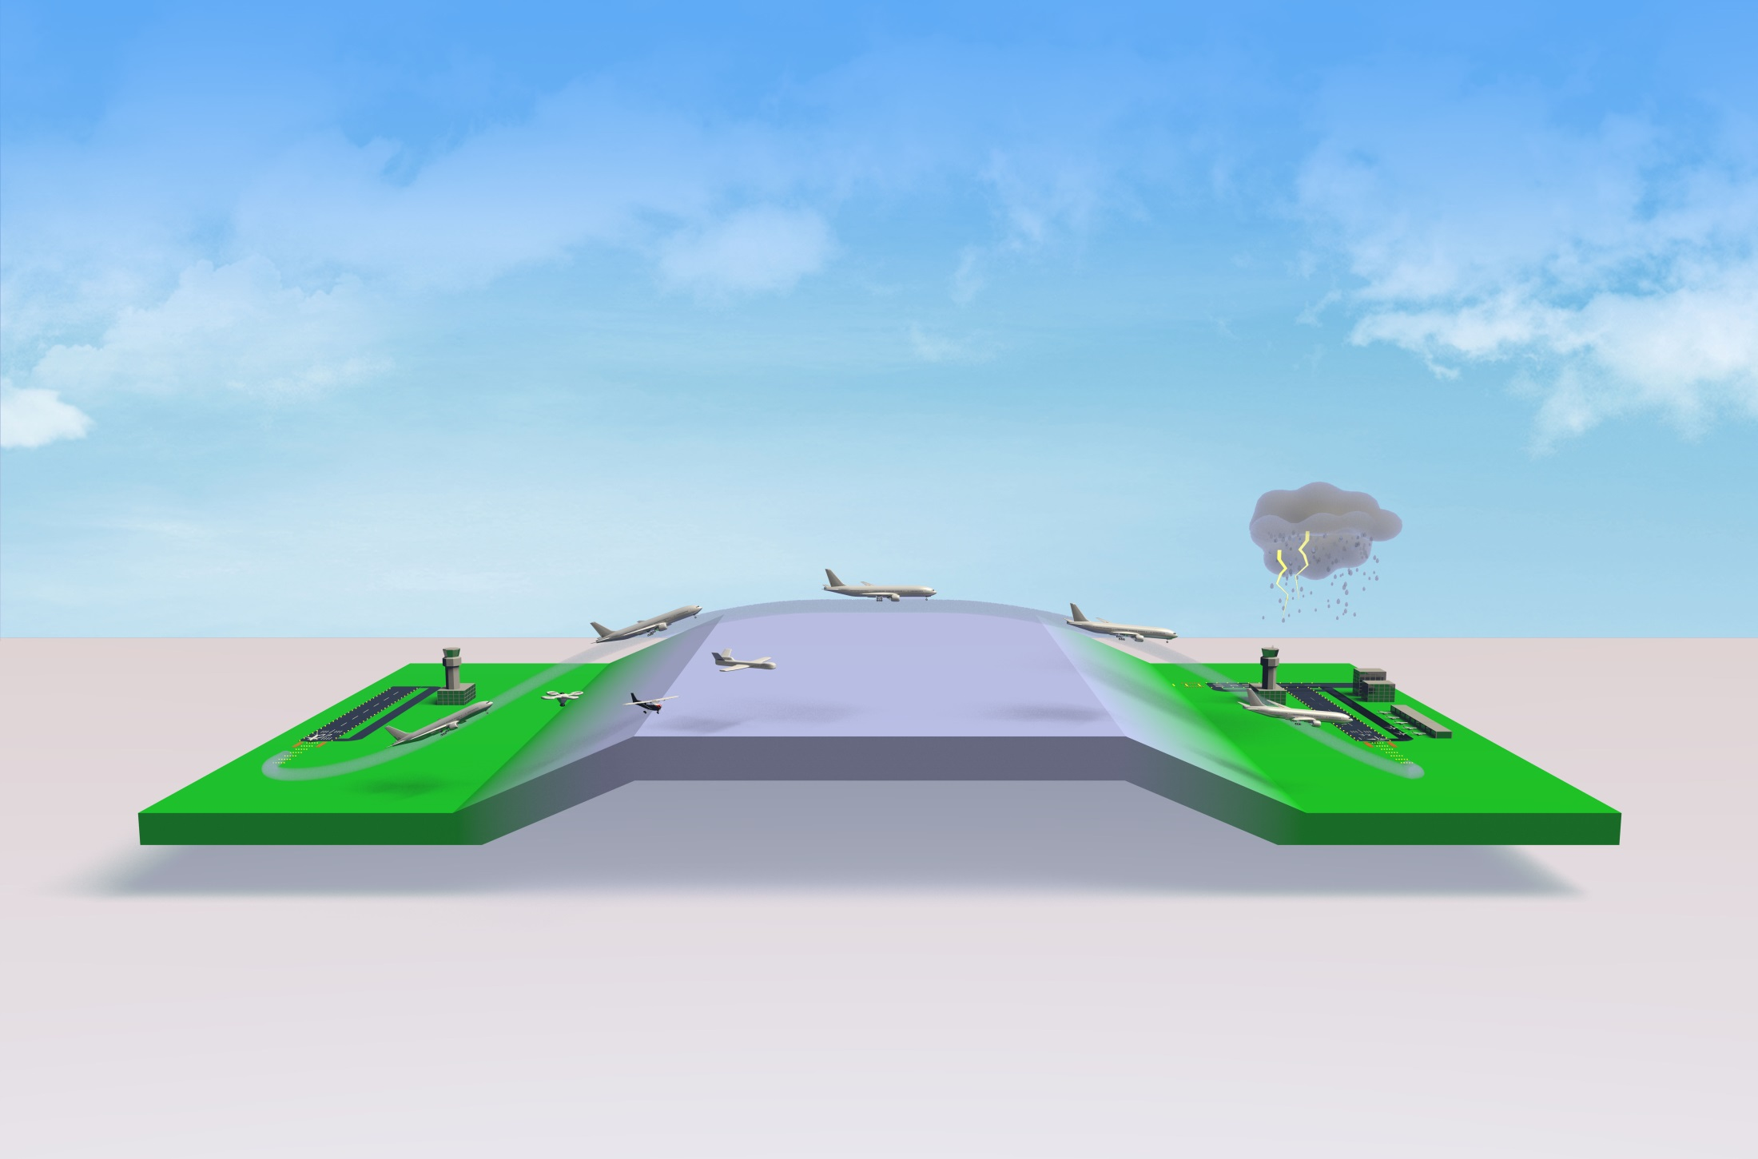
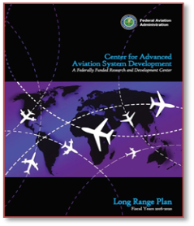
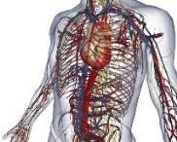
FAA Research & Development at a Glance
Commercial Space
Air Traffic Management
Fire Safety
Propulsion and Fuel systems
Aircraft
Structures
Digital Systems
Airport and Terminal
UAS
Weather
Pavement
Icing
Mission Support
Aeromedical & Human Performance
Cyber Security
System Safety
Management
Environment
and Energy/Fuels

