Slide 1
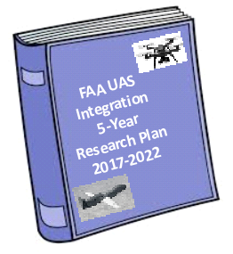
UAS Integration Research Planning

Slide 2
The Path to Full Integration
Large UAS / high energy output
Airspace Access
Full UAS Integration
NAS System Integration
Small Cargo / Passenger Operations
Aeronautical Information Infrastructure for UAS
Non-Segregated Operations
Expanded Operations
Low Altitude Authorization & Notification Capability (LAANC)
Rulemaking to Address Security Concerns
Online Registration
UAS Operations Over People
Part 107 Operations
Operations by Exemption
Low-risk, Isolated
Small UAS / low energy output
Regulatory Framework
Within VLOS / isolated operating area
Beyond VLOS / populated operating area
Notes:
Rulemaking for operations vs. the airspace infrastructure needed to support
Few other folks may recognize part of this graph
New element is that security piece in the middle – we’re working with our interagency partners to figure out next steps

Slide 3
UAS Integration Steps to Operational Capabilities
Maturing of Operational Capabilities
Ops Over People
Expanded Ops
Non-Segregated Operations
sUAS Package Delivery
Routine/ Scheduled Ops
Large Cargo Carrier Ops
Passenger Ops
Initial Operational Capabilities (IOC)
UAS Low Altitude Authorization & Notification Capability (LAANC)
Low Altitude UAS Traffic Management
Advanced Automation UAS Operational
Requirements & Repeatable Approval Process
DAA & BVLOS
Performance Requirements
Identification
& Tracking
Capability
Key Enablers to address Market Needs
Notes:
FAR
Part 101- Unmanned Free Balloons
Part 107 – sUAS rule
Part 121 – Scheduled commercial domestic operators
Part 125 – Corporate/Business GA
Part 129 – Foreign air carriers
Part 133 – Rotorcraft operations (Helicopter)
Part 135 – GA/Air Taxi/commuter
Part 136 - Commercial air tours
Part 137 – Agriculture
Q: will sUAS ever be permitted to fly in controlled airspace??

Slide 4
Functional & Cross-Cutting Domains for UAS Integration Research Planning
Key Functional Domains

Slide 5
FAA UAS Internal Research Partnerships

Slide 6
FAA UAS External Research Partnerships
International Standards Groups (ANSI,ASTM, EASA, ICAO, JARUS)
NASA
(UTM and UAS in the NAS)
Federally Funded Research and Development Centers (FFRDC)
WJHTC
CAMI
Domestic Standards Groups (RTCA)
FAA
UAS Research Needs
Test Sites and Pathfinders
Volpe
FAA
LOBs
UAS EXCOM
(Science and Research Panel)
Industry
UAS Center of Excellence (ASSURE)

Slide 7
Operations Over People
IOC Characteristics | Limitations/ Restrictions | IOC Date**
sUAS to operate over people not directly participating in the operation Includes Identification & Tracking capabilities Continuation of Part 107 Considerations: population density, ops over moving vehicles | sUAS only | Q4 2017
No environmental impact expected from sUAS operations | Noise considerations through manufacturer provided “ranking” | Q4 2017
New market opportunities, change in growth trajectory of Part 107 registration/forecast Considerations: detect and report to tower facilities (e.g., Florida airport ECP) |  | Q4 2017
Considerations should include: The conspicuity of the operation The proficiency of the pilot Control modes employed by the pilot
Part 107 operations May include night No Air Traffic Services expected or modifications to NAS automation systems. | Small UAS only << 55 lb << 400 ft | Q4 2017
** IOC=Initial Operational Capability; may be a single operation of this kind; may include testing.
Full Operational Capability in 2023+ timeframe

Slide 8
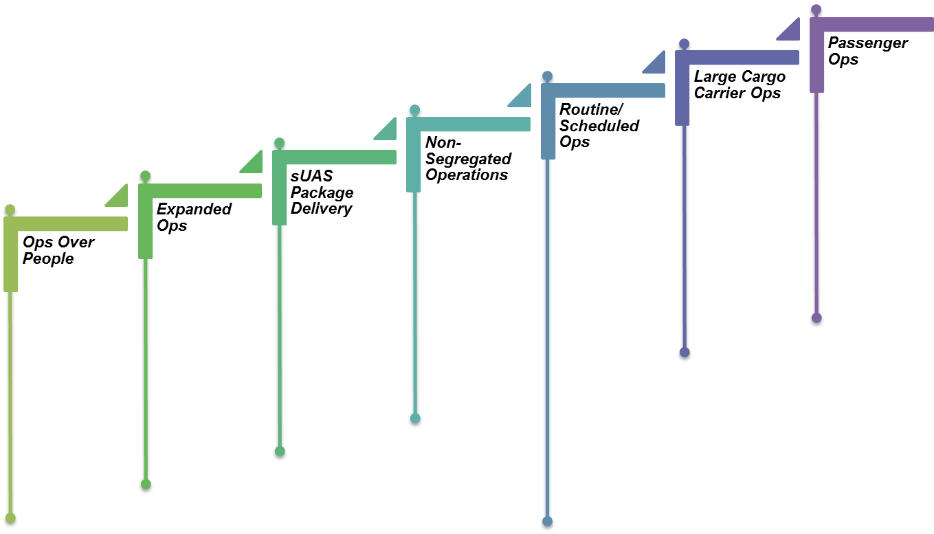
UAS Needs Identified by LOBs
DRAFT
Operations Over People
Assess environmental (NEPA) and noise impacts
Develop approved methods to “noise rank” sUAS for use by the manufacturers
Develop noise level database
Market opportunities
Dense corridor vs. sparse communities
Growth trajectory
Moving vehicles, road network and possible safety implications
Safety & liability implications of colliding UAS
Create conspicuity recommendations
Establish pilot proficiency requirements
Research effects of control modes on safety
Assumptions:
Part 107 Operation
LAANC Authorization / Notification in Class B, C, D, E
No ATC Services
No Transponder/ or ADS-B equipage

Slide 9
Routine / Scheduled Operations
Characteristics | Limitations/ Restrictions | IOC Date**
Enables regularly scheduled UAS arrivals and departures at Class C and D (??) airports Enables BVLOS/EVLOS operations with less restrictions Enables UAS to operate in controlled airspace on IFR flight plans (does not include VFR operations) | Limited to Class C/D CONUS flights? No VFR | 2021
Includes noise certification requirement for UAS larger than determined weight. Required noise standards TBD Includes Part 34 engine emissions airworthiness certification requirements for UAS powered by conventional-fueled engines
Integration of IFR UAS flights into ATM
Include on-airport applications if we approach these operations as being routine or 'as needed' | Class B operations would need to be allowed for on-airport applications and also allow for VFR conditions
Enables regularly scheduled UAS arrivals and departures. Enables BVLOS operations with less restrictions. Enables UAS to operate in controlled airspace on IFR flight plan DAA behavior for delegated separation will be required to achieve capacity and efficiency of NAS operations. CPDLC and Voice Communications (e.g. NVS) requirements must be completed, allocated, validated and implemented into NAS Automation. Traffic flow management system modifications To achieve IOC through the Acquisition Management System by 2025 would require maturity to CRDRD by 4Q 2019: Highly unlikely. | IFR | Q4 2025+
** IOC=Initial Operational Capability; may be a single operation of this kind; may include testing.
Full Operational Capability in 2023+ timeframe

Slide 10
UAS Needs Identified by LOBs
DRAFT
Routine / Scheduled Operations
Assess environmental (NEPA), emissions, and noise impacts
Identify noise certification requirement and its limit
Develop noise level databases
Assess applicability of exhaust emissions airworthiness certification requirement
IFR submission into present ATM and clearance
Types of network and interactions with manned air
Weather events and delay program for example: ground delay, MIT, for IFR UAS
Priority, equity, fair treatment
Types of regulations
UAS Operations within the Airport:
Develop standards for operation of UAS for pavement inspection
Develop standards for operation of UAS for perimeter security applications
Develop standards for tethered operations of UAS during airfield emergency events
Develop standards for operation of UAS for wildlife management and mitigation
DAA behavior for delegated separation
CPDLC/Voice Comm allocation
Traffic Flow Management
Wake Vortex In-Trail Separation
Assumptions:
Instrument Flight Rules
Approved DAA equipment
Type Design and Airworthiness Approval
High availability, low latency C2 link
Commercial C2 service provision
Transponder/ and ADS-B equipage mandatory
Existing ATC separation standards apply

Slide 11
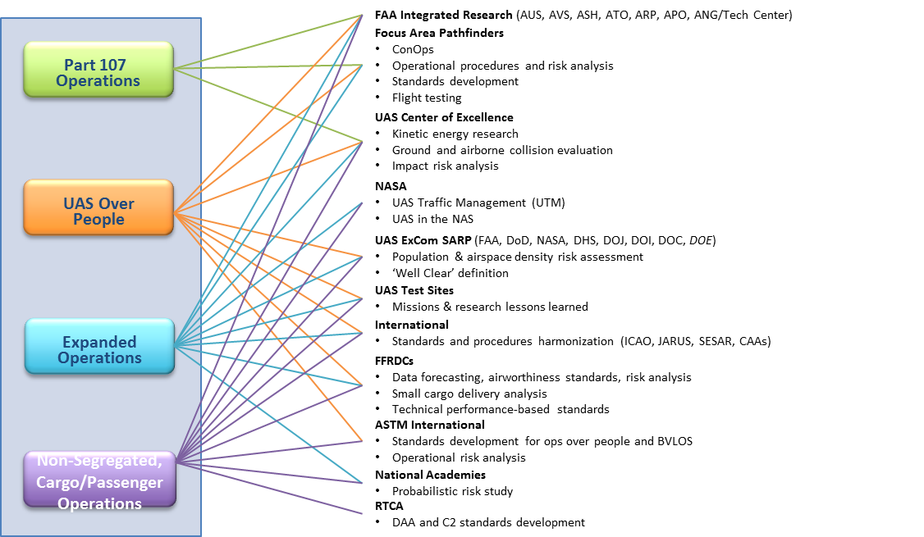
Mapping of Key Research Activities

Slide 12
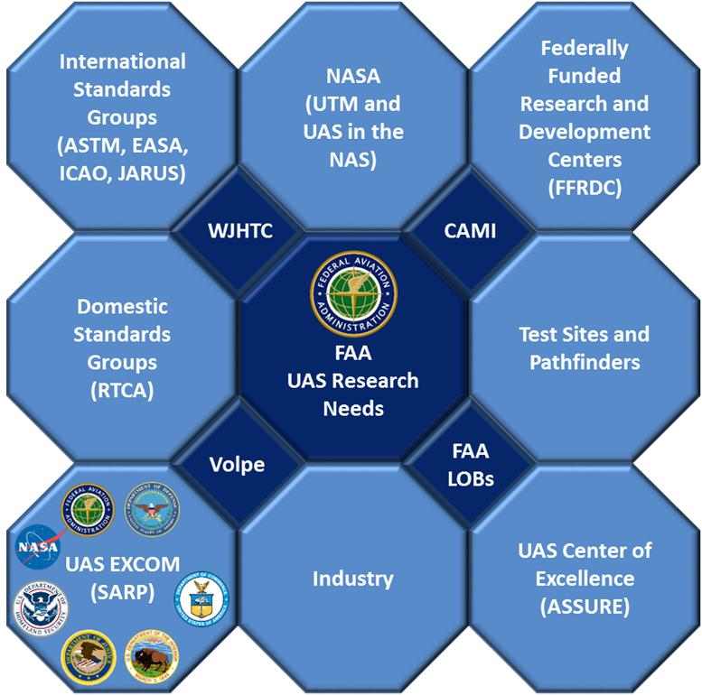
UAS Research Plan Development Schedule
Today
Kick Off Mtg. (Jan. 31)
Round Table (Mar 2)
Round Table
Round Table
Round Table
Round Table
Internal Coordination
Meet with Individual LOBs to integrate research needs
External Coordination
Meet with external partners to integrate research needs
Analysis
Analysis of Dependencies
Initial Outline
Deliverable for 2016 FAA Reauthorization, Section 2211
Research Plan Development
Graphic design
Initial Draft
Final Draft
Milestones
Initial Outline
Finalization Functional Areas
Draft for AUS-300 Review
Draft for FAA LOB Review
Final Draft
Notes:
Project Reviews with Sponsor
Product Due Dates

