Slide 1
FAA Cybersecurity R&D Plan
To: REDAC
By: John Lapointe, ANG-E2
Chuck Agava, ANG-E271
Date: October 11, 2017

Slide 2
Today’s Objective
Provide update on the FAA Cybersecurity R&D Plan
Approach
Requirements
Funding Profile
Gaps
For Your
Review

Slide 3
FAA Extension, Safety, and Security Act of 2016
Section 2111 Aviation Cybersecurity (1)
Section 2111
(a)- Comprehensive and Strategic Aviation Framework
Strategic framework of principles and policies to reduce cybersecurity risks to the national airspace system, civil aviation, and agency information systems that takes into consideration the interactions and interdependence of different components of aircraft systems and the national airspace system. (Due: within 240 days of enactment. Status –met.)
(b)- Update on Cybersecurity Implementation Progress
Provide to Congress an update on progress made toward the implementation of section 2111. (Due: within 90 days of enactment . Status –met.)
(c)- Cybersecurity Threat Model
Assess and research the potential cost and timetable of developing and maintaining an agency-wide cybersecurity threat model. (Due: within 1 year of enactment . Status –met.)
(d)- National Institute of Standards and Technology Information Security Standards
Provide to Congress an update on progress made toward the implementation of NIST latest revisions to FAA information and information systems. (Due: within 180 days of enactment . Status –met.)

Slide 4
FAA Extension, Safety, and Security Act of 2016
Section 2111 Aviation Cybersecurity (2)
Section 2111
(e) of the FAA Extension, Safety and Security Act of 2016, “…the Administrator, … shall establish a cybersecurity research and development plan for the national airspace system…”
Cooperation with international partners
Risks of cabin communications and cabin information technology
Objectives, proposed tasks, milestones, and a 5-year budgetary profile
One year after the date of enactment of the Act (7/15/2016)
Notes:
CYBERSECURITY RESEARCH AND DEVELOPMENT.—Not later
than 1 year after the date of enactment of this Act, the Administrator,
in consultation with other agencies as appropriate, shall
establish a cybersecurity research and development plan for the
national airspace system, including—
(1) any proposal for research and development cooperation
with international partners;
(2) an evaluation and determination of research and
development needs to determine any cybersecurity risks of
cabin communications and cabin information technology systems
on board in the passenger domain; and
(3) objectives, proposed tasks, milestones, and a 5-year
budgetary profile.

Slide 5
Timeline
7/15/16
9/15/16
11/15/16
1/15/17
3/15/17
5/15/17
7/15/17
PL 114-90
Signed
Milestones
2/24/17 ANG-E initiated action
4/7/17 First draft released (Internal to ANG-E)
4/21/17 Version 0.5 released for comments
4/24 – 5/26 Comments ( ~100) received and adjudicated
6/16/17 Version 0.8 released to CSC
6/21/17 Briefed CSC
7/03/17 Concurrence from CSC
7/11/17 Briefed ANG-1 Staff
7/14/17 Released Version 1.0
8/14/17 Briefed DOT IG
8/17/17 Briefed ICCT
8/29 – 9/14 Briefed various REDAC Subcommittees
9/15 – 10/2 Comments ( ~100) received and adjudicated
10/11/17 Brief REDAC
Plan
Established

Slide 6
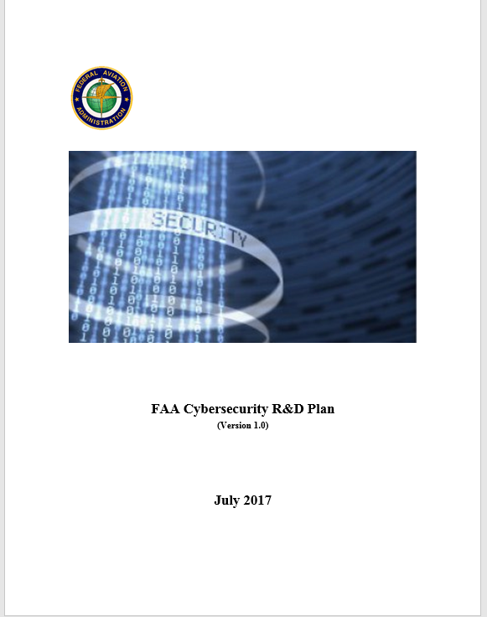
FAA Cybersecurity R&D Plan – Version 1.0 Development
Assessment
Discovery
Comments / Concurrence
Output
Cybersecurity Strategy 2017-2022
National Aviation Research Plan
FAA Budget Narratives
FY 2019 Budget Estimates
FAA Research Leads
FAA (CSTAs and SMEs)
FAA Organizations
Aviation Safety
NextGen
Air Traffic Organization
Finance & Management
Security & Hazardous Materials Safety
FAA CSC
ICCT

Slide 7
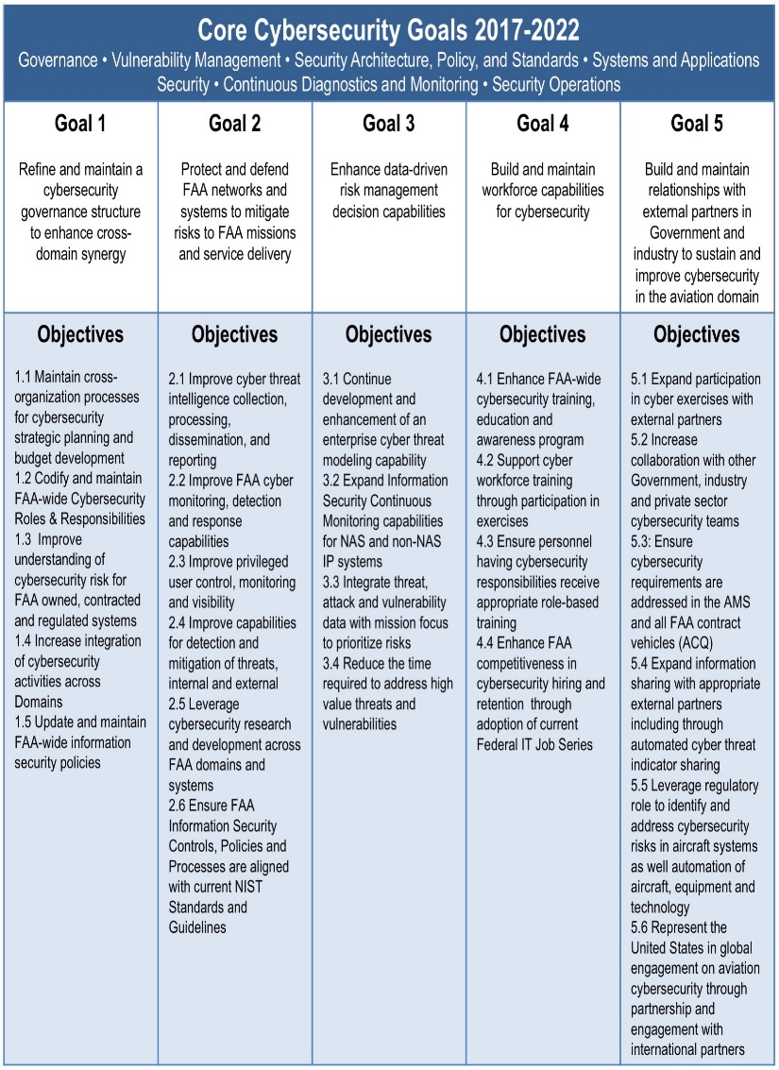
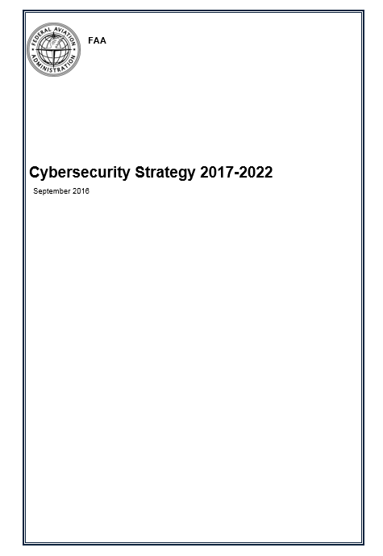
Alignment to CSC Strategic Plan: 2017 - 2022
CSC Steering Committee
FAA Chief Information Security Officer
Aviation Safety
Security & Hazardous Materials Safety
Air Traffic Organization
NextGen
DOT Chief Information Security Officer

Slide 8
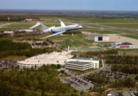
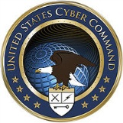
Cybersecurity R&D Plan - Partnerships
Aviation Safety
Security & Hazardous Materials
SC-216
MIT-LL
Finance and Management
SC-222
Industry &
Academia
Air Traffic Organization
SC-223
SC-228
NextGen
DOT
International
Government Agencies
DOT
DHS
NASA
Cybercom
DOD
SC-216 - Aeronautical Systems Security SC-222 - Minimum Aviation Performance Standards
SC-223 - Internet Protocol Suite (IPS) and AeroMACS SC-228 – Minimum Performance Standards- UAS

Slide 9
Cybersecurity R&D Plan - Definitions
FAA Goals
FAA Domains
Research Areas
Goal 1- Refine and maintain a cybersecurity governance structure to enhance cross domain synergy
Goal 2- Protect and defend FAA networks and systems to mitigate risks to FAA missions and service delivery
Goal 3-Enhance data-driven risk management decision capabilities
Goal 4-Build and maintain workforce capabilities for cybersecurity
Goal 5-Build and maintain relationships with external partners in government and industry to sustain and improve cybersecurity in the aviation domain
NAS- Automation, Communication, Navigation, Surveillance and Weather
Mission Support- Administrative, NAS support applications, Aircraft certification/Regulatory services, Airports and Commercial space
R&D- Air space management, New technologies for aerospace vehicles, Infrastructure durability and resiliency; Human component of the system, Integrated modeling capabilities and system-wide analysis
Security and Resiliency - Develop methods to enhance FAA’s ability to prevent, detect, and respond to cyber attacks
Data Analytics - Develop analytical capabilities for aggregating and correlating current data with the intent of understanding, predicting, and responding to cyber attacks.
Human Behavior/Human Factors - Develop and validate human-in-the-loop policies, training, and procedures to detect and respond to cyber attacks
System-Wide Safety Assurance - Develop real time, continuous, safety analysis and assurance tools and capabilities to prevent/mitigate the impact of cyber attacks.

Slide 10
Cybersecurity R&D Plan- Framework
FAA Cybersecurity Goals
FAA Goal 2
FAA Goal 3
FAA Goal 4
Research
Areas
Security and Resiliency
Data Analytics
System-wide Safety Assurance
Human Behavior & Human Factors
FAA Domains
Aircraft Systems Information Security Protection (ASISP)
UAS C2 Link Security Protection
Cybersecurity Risks of Cabin Communications and Information Systems
Flight Deck Data Exchange
NextGen Information Security
IAM Interoperability
UAS C2 Link Security Protection Capability
CyTF Virtualization
ASISP Response and Recovery
Situational Awareness Visualization & Threat Assessment
NAS
Requirements
Mission
Support
R&D

Slide 11
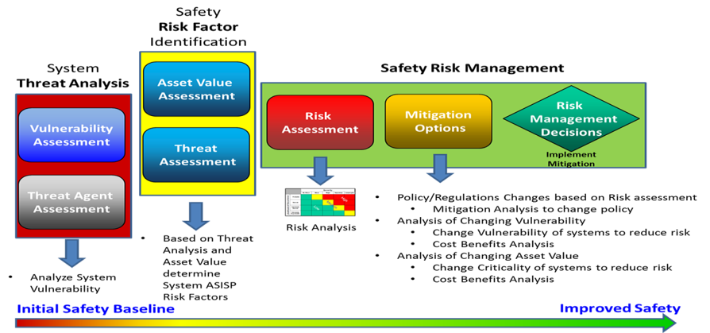
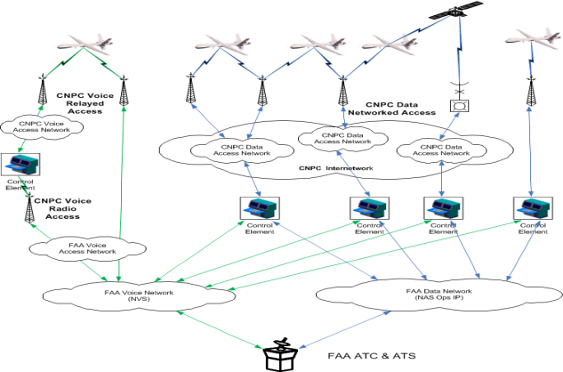
Cybersecurity R&D Plan – Research Requirements
Research Area: Security and Resiliency Develop methods to enhance FAA’s ability to prevent, detect, and respond to cyber attacks
The ASISP research will assess/analyze wired and wireless connectivity to aircraft systems to identify information-security-protection vulnerabilities and risks that could adversely affect the safety of an aircraft
The Cabin Communications research will provide insights into information-security-protection vulnerabilities of, and risks to, cabin communication and information technology systems, associated components/networks
UAS C2 Link Systems Security Protection research directly supports the development of FAA new TSO requirements and AC guidance for UAS new, unique and safety critical C2 Beyond Line of Sight (BLOS) networked terrestrial and satellite Link Systems security control.
Funding Profile | FY18 | FY19 | FY20 | FY21 | FY22
 | $2,310K | $4,430K | $4,950K | $4,200K | $4,000K

Slide 12
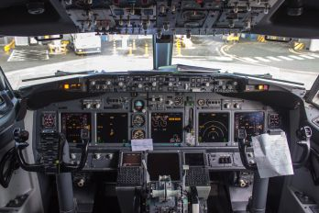
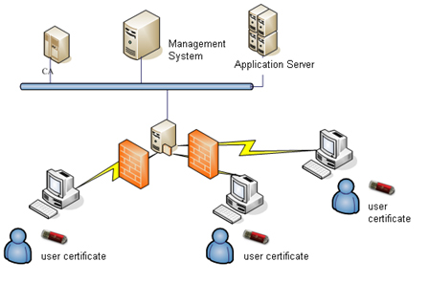
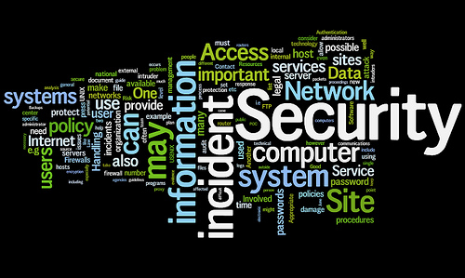
Cybersecurity R&D Plan – Research Requirements
Research Area: Data Analytics Develop analytical capabilities for aggregating and correlating current data with the intent of understanding, predicting, and responding to cyber attacks
The Identify and Authorization Management (IAM) research will assess, and analyze the expansion of IAM with domestic and international Public Key Infrastructure (PKI) systems, and recommend solutions for interoperability, capacity, and architectural issues that arise with domestic, and international aviation partners.
The NextGen Information Security research supports the FAA’s overall cyber security posture through development of advanced tools, techniques and processes that can be adapted for use in the NAS.
The Flight Deck Data Exchange research supports enhanced data exchange between onboard avionics systems and ground systems to enable Trajectory Based Operations (TBO)
Funding Profile | FY18 | FY19 | FY20 | FY21 | FY22
 | $1,000K | $6,250K | $6,350K | $6,200K | $4,200K

Slide 13
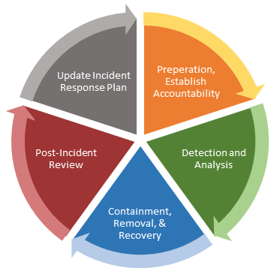
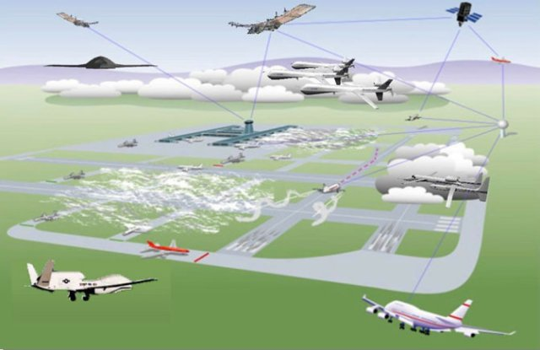
Cybersecurity R&D Plan – Research Requirements
Research Area: Human Behavior/Human Factors Develop and validate human-in-the-loop policies, training, and procedures to detect and respond to cyber attacks
The Situational Awareness Visualization research will identify, integrate, evaluate, and provide recommendations for products that enhance the situational awareness visualizations available to operators and maintainers of NAS
The ASISP Response and Recovery research will provide human factors data and context to study pilot responses to cyber-attacks
Funding Profile | FY18 | FY19 | FY20 | FY21 | FY22
 | $0K | $1,000K | $3,000K | $3,000K | $2,000K

Slide 14
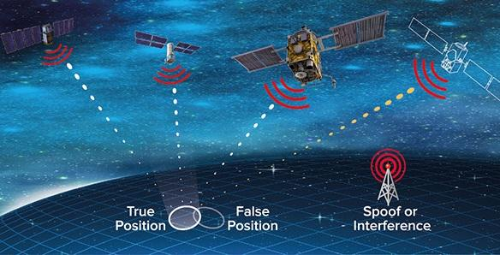
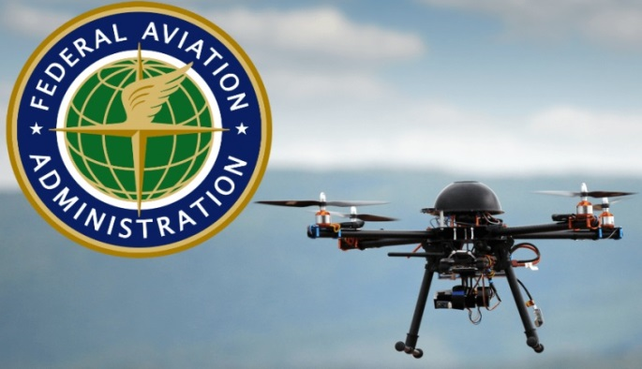
Cybersecurity R&D Plan – Research Requirements
Research Area: System-Wide Safety Assurance Develop real time, continuous, safety analysis and assurance tools and capabilities to prevent/mitigate the impact of cyber attacks
The Space-based Positioning, Navigation, and Timing (PNT) research need focuses on enabling technologies for NextGen capabilities and identifying the critical failure mechanisms for essential elements of the national airspace infrastructure and external supporting infrastructure sectors. (Currently identified as a research need.)
UAS C2 Link Systems Security Capability research will conduct in-house testing to assess efficient and effective mitigation against security threats of terrestrial, SatCom, and network terrestrial and SatCom C2 data link systems with a high level of sophistication.
The FAA CyTF research supports evolution of CyTF to provide more comprehensive and complex cybersecurity exercises, product evaluations, cybersecurity risk testing, and other R&D activities
Funding Profile | FY18 | FY19 | FY20 | FY21 | FY22
 | $400K | $2,100K | $2,100K | $1,000K | $1,000K

Slide 15
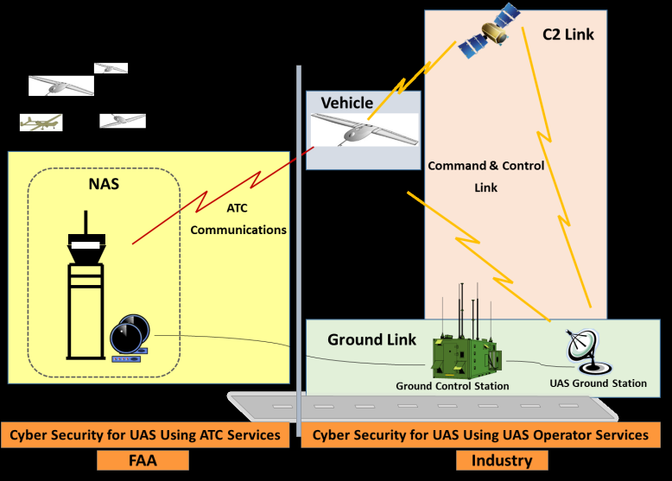
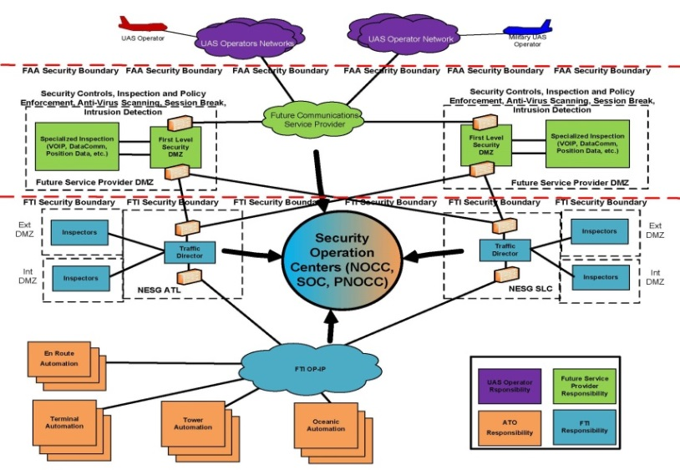
Research Needs: UAS Cybersecurity
Four UAS-cybersecurity requirements that address a research gap.
Initial draft version of requirements are pending additional review and acceptance.
Cost estimates need to be vetted.
Information Security Protection research supports information security concerns associated with:
UAS pilot to/from NAS- Data Communications
UAS pilot to/from NAS- Voice Communications
UAS Flight Plans
UAS Departure Clearances
Unmanned Aircraft Control Station Ground-to-Ground Communication with NAS Air Traffic Control research supports shall identify the safety issues associated with the use of UAS Gateways that provide the capability for multiple Pilots-in-Command (PICs) to communicate with Air Traffic Control via dynamically built voice bridges.
UAS Risk Management Framework research supports the development of comprehensive UAS cybersecurity risk management processes and guidelines to be used in the development of new FAA regulations, policy, standards, guidance, and training
Development of Cybersecurity UAS Integration Model research supports a virtual representation of the existing NAS and FAA Telecommunications Infrastructure (FTI) systems and helps the FAA prepare for full UAS integration into the NAS, along with procedures, threat and vulnerability analysis and related documentation.
.

Slide 16
FY17 Accomplishments
Aircraft Systems Information Security Protection (ASISP)
Conducted research and collaborated with Lincoln Labs, John Hopkins, and Astronautics to produce a process/methodology for Safety Risk Assessment (SRA) for ASISP.
Conducted SRA of Aircraft Communication Addressing and Reporting System (ACARS), including identification of potential risk scenarios, vulnerabilities and aircraft access points (apertures).
NextGen Information Security
Developed a program plan containing research initiatives to support the FAA Cybersecurity Strategic Plan.
Formulated research activities to support national aviation system priority needs set forth by the FAA Cybersecurity Steering Committee.
CyTF Virtualization
Conducted a Cybersecurity Incident Response Process (IRP) exercise that brought together cyber incident stakeholders from the Office of Information and Technology (AIT), NextGen (ANG), the Air Traffic Organization (ATO), and Security and Hazardous Materials Safety (ASH).
Validate current cyber security incident response procedures
Not funded with R&D dollars

Slide 17
Cybersecurity R&D Plan-Funding Summary
Funding Type | 2018 Requested | 2019 Planned | 2020 Out-Year | 2021 Out-Year | 2022 Out-Year | Total
Total | $3,710K | $13,780K | $16,400K | $14,400K | $11,200K | $59,490K
Requested/ Planned/ | $3,710K | $8,030K | TBD | TBD | TBD
Shortfall | $0 | $5,750K | TBD | TBD | TBD

Slide 18
Summary of REDAC Comments- Example
ASISP
Risk Framework, Industry Collaboration, Safety Risk Assessment
Cabin Communications Cybersecurity Risks
Penetration Testing- Industry Collaboration, Scope
Commercial Space (Gap- No requirement)
PNT/GPS, Information Security Risk
System Design- Human Factors
Proactive vs Reactive
NextGen Information Security- AI, Machine Learning
Big Data Analytics Tools and Techniques
Cybersecurity Test Facility- Joint Cyber Exercises
Partnerships with DOD, DHS etc.

Slide 19
Adjudication of REDAC Comments- Example

Slide 20
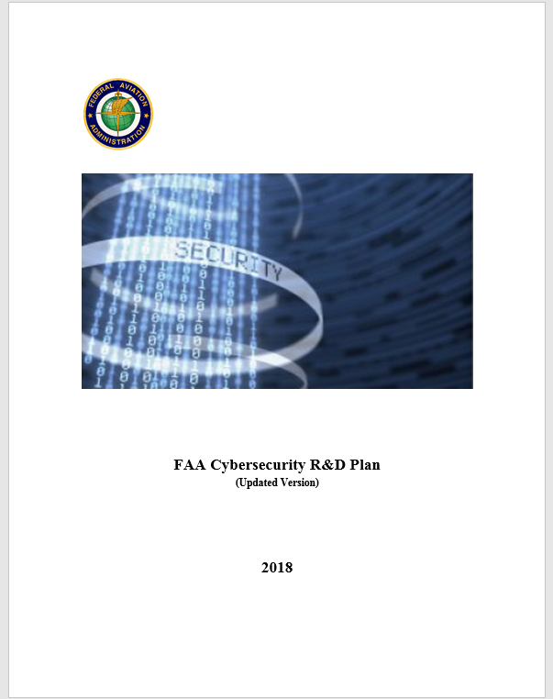
Next Steps
Continue discussions internally and externally (DHS, NSF, DoD, Industry, etc.) on collaborative efforts.
Update the Cybersecurity R&D Plan
Seeking a December 2017 interim update
Scrub the tasks to minimize redundancy
Identify opportunities for leveraging
Develop a framework for continually monitoring and providing updates on ongoing research.
Hopefully, a minimum of two more cybersecurity requirements will commence in FY18 (subject to available funding)
Includes briefing updates
Ensure consistency with the FAA LOBs work plans pertinent to cybersecurity

Slide 22
Optional Charts

Slide 23
Mapping of Requirements to FAA Domains
 |  | Primary Domain
Requirement | Research Area | NAS | R&D | Mission Support
Aircraft Systems Information Security Protection (ASISP) | Security & Resiliency |  |  | Regulatory Service
UAS C2 Link Security Protection | Security & Resiliency |  |  | Regulatory Service
Cybersecurity Risks of Cabin Communications and Cabin Information Technology Systems | Security & Resiliency |  |  | Regulatory Service
Flight Deck Data Exchange | Data Analytics | X
NextGen Information Security | Data Analytics | X
IAM Interoperability | Data Analytics |  | X
UAS C2 Link Security Protection Capability | System-Wide Safety Performance |  | X
CyTF Virtualization | System-Wide Safety Performance |  | X
ASISP Response and Recovery | Human Behavior/Human Factors |  |  | Regulatory Service
Situational Awareness Visualization and Threat Assessment | Human Behavior/Human Factors | X

Slide 24
Cybersecurity R&D Requirements – Mapped to the NARP
Requirement | FAA Goals | Draft NARP Goal | Draft NARP Objective | Research Output(s) | Research Outcome
NextGen-Information Security | Enhance data-driven risk management decision capabilities | Improve integrated modeling capabilities & system-wide analysis | Primary: Data Engineering Secondary: System Performance | Data analytics, methods, and tools | Protection of ATC services from disruptive cyber attacks
Flight Deck Data Exchange | Protect FAA Networks | Improve airport operations, air traffic & air space management capabilities | Separation Management | Data exchange protocols and performance standards | Optimal performance envelopes in the NAS
Aircraft Systems Information Security Protection | Enhance data-driven risk management decision capabilities | Increase Infrastructure durability and resiliency | Cybersecurity - Aviation Ecosystem | Safety risk management framework & processes | Policy, guidance, training & tools
Cybersecurity Risks of Cabin Communications and Cabin Information Technology Systems | Enhance data-driven risk management decision capabilities | Increase Infrastructure durability and resiliency | Cybersecurity - Aviation Ecosystem | Vulnerability discoveries and risk assessment | Policy, guidance, training & tools
Aircraft Systems Information Security Protection Response and Recovery | Enhance data-driven risk management decision capabilities | Improve the operation of the human component of the system | Human Performance | Results of simulation of cyber attack scenarios. Research studies with pilots | Policy, guidance, training & tools

Slide 25
Cybersecurity R&D Requirements – Mapped to the NARP
Requirement | FAA Goals | Draft NARP Goal | Draft NARP Objective | Research Output(s) | Research Outcome
UAS Networked C2 Link Systems Security Protection | Cyber Workforce Capability / Protect FAA Networks | Increase Infrastructure durability and resiliency | Cybersecurity - Aviation Ecosystem | Technical data for the development of standards, policies and governance | Policy, guidance, training & tools
UAS Security Control Capability | Cyber Workforce Capability / Protect FAA Networks | Increase Infrastructure durability and resiliency | Cybersecurity - Aviation Ecosystem | Technical data for the development of standards, policies and governance | Policy, guidance, training & tools
CyTF Virtualization | Cyber Workforce Capability / Protect FAA Networks | Increase Infrastructure durability and resiliency | Cybersecurity - Aviation Ecosystem | Results of simulation of cyber attack scenarios. Evaluation of tools | Protection of ATC services from disruptive cyber attacks
IAM Interoperability | Cyber Workforce Capability / Protect FAA Networks | Increase Infrastructure durability and resiliency | Cybersecurity - Aviation Ecosystem | Technical data for the development of standards, policies and governance | Policy, guidance, training & tools
Situational Awareness Visualization, Threat Assessment and Compliance | Cyber Workforce Capability | Increase Infrastructure durability and resiliency | Cybersecurity - Aviation Ecosystem | Technical data for the development of standards, policies and governance | Policy, guidance, training & tools

Slide 26
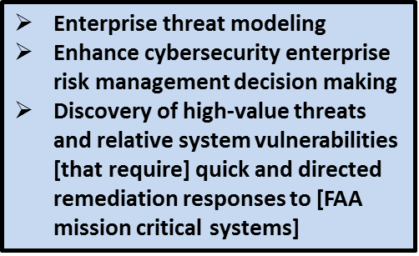
Cybersecurity Strategy: 2017 - 2022 Extracts
Goal 2
Goal 3
Goal 4
Protection and defense of FAA networks and systems
Collection and internal sharing… of classified cyber threat… ensuring proper handing
Cyber monitoring, detection and response capabilities
Improved identity and access management standards, systems and processes
Identify cybersecurity vulnerabilities
Proactively remediate vulnerabilities in information systems
Improving and maintaining the cybersecurity capabilities
Practical cybersecurity exercises enhance knowledge of employees
Support the cybersecurity professionals’ education needs
Building and maintaining the FAA cybersecurity workforce
Goal 5
Establishing a framework to cooperate with other government agencies
Requires collaboration in the R&D efforts…to identify cyber risks

