Slide 1
FAA UAS Integration Research Plan
2017-2022
Update

Slide 2
  Section 2211: Unmanned Aircraft Systems Research and Development Roadmap
2016 Reauthorization Requirement
  Summary: FAA, NASA, and stakeholders in industry and academia shall develop a roadmap of the cost estimates, planned schedules, and benchmarks, including specific tasks, milestones, and timelines for integrating UAS into the NAS. The roadmap shall include how to use research and development, assessments of abilities to integrate the UAS, and update on the advancement of various technologies.
Full Text: https://www.congress.gov/bill/114th-congress/house-bill/636/text/pl

Slide 3
FAA UAS Integration Research Plan
Major Sections of the Plan
  Alignment to FAA’s Strategic Priorities
  FAA’s Applied Research Approach
  UAS Integration Landscape
  UAS Research Collaboration & Partnerships
  UAS Research Functional Areas
  UAS Research Domains
  Operational Capabilities Towards Full UAS Integration
    Timelines reflecting Completed, In Process, Planned and Needed UAS Research
  Conclusion

Slide 4
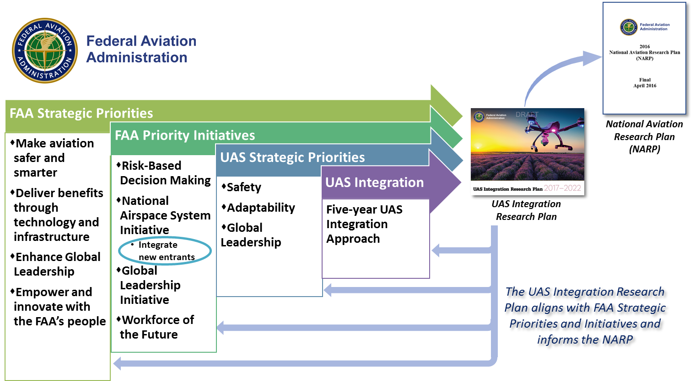
  Alignment to FAA’s Strategic Priorities
Five-year UAS Integration Approach

Slide 5
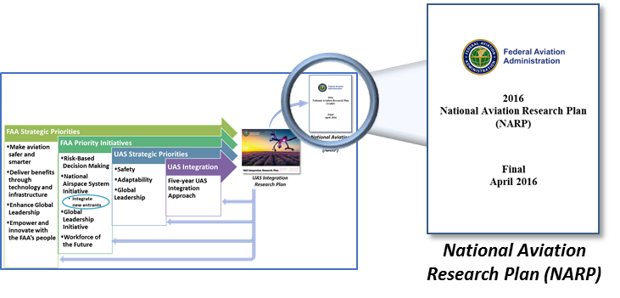
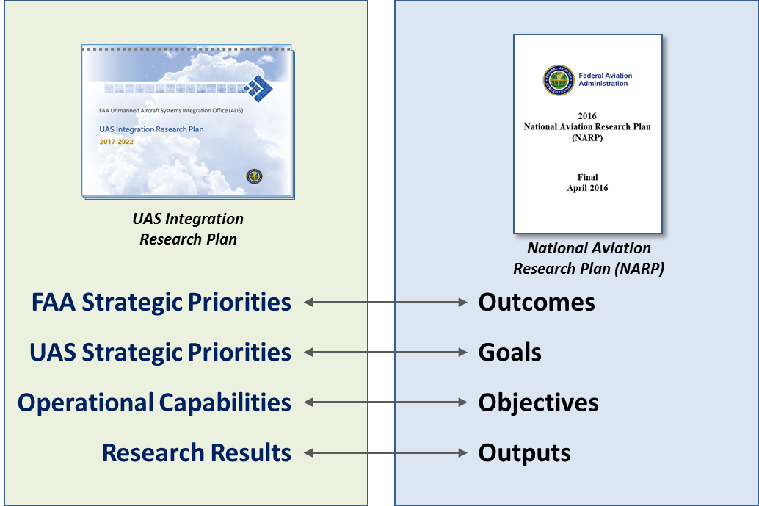
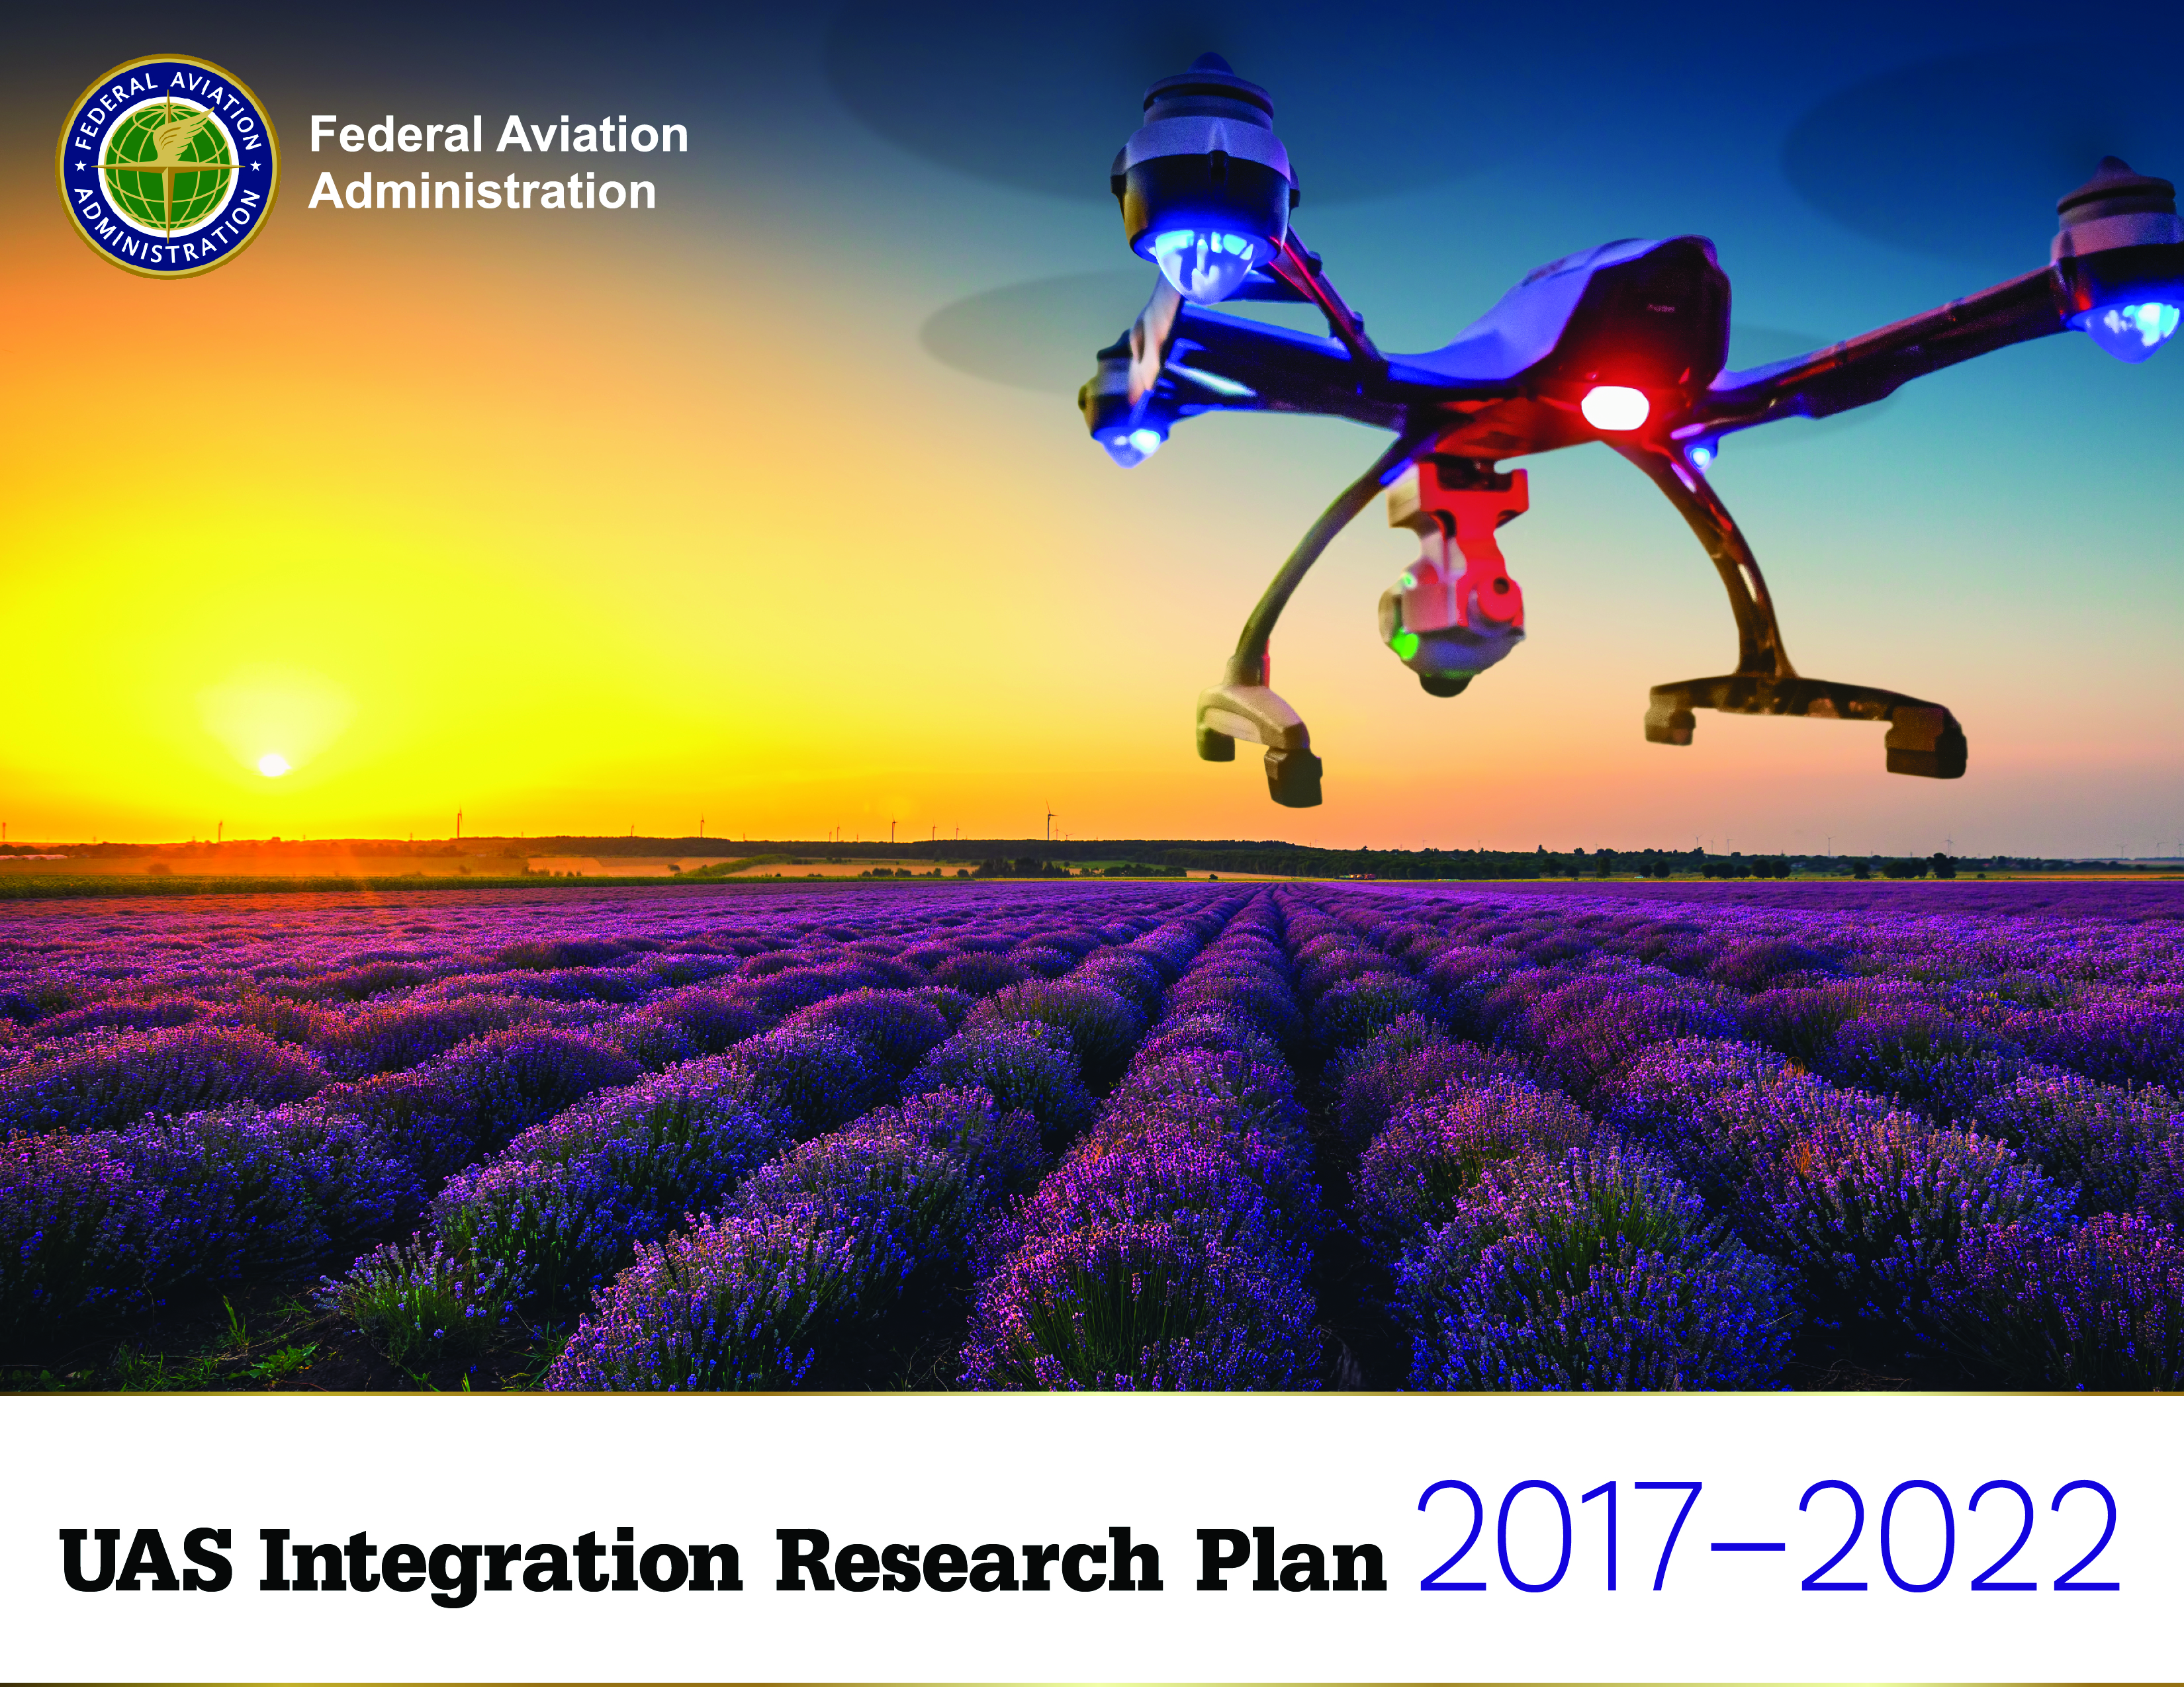
National Aviation Research Plan: Alignment of Research Planning Framework and Terminology
FAA Strategic Priorities
Operational Capabilities
Research Activities/Needs
Research Results
Outcomes
Goals
Objectives
Outputs

Slide 6
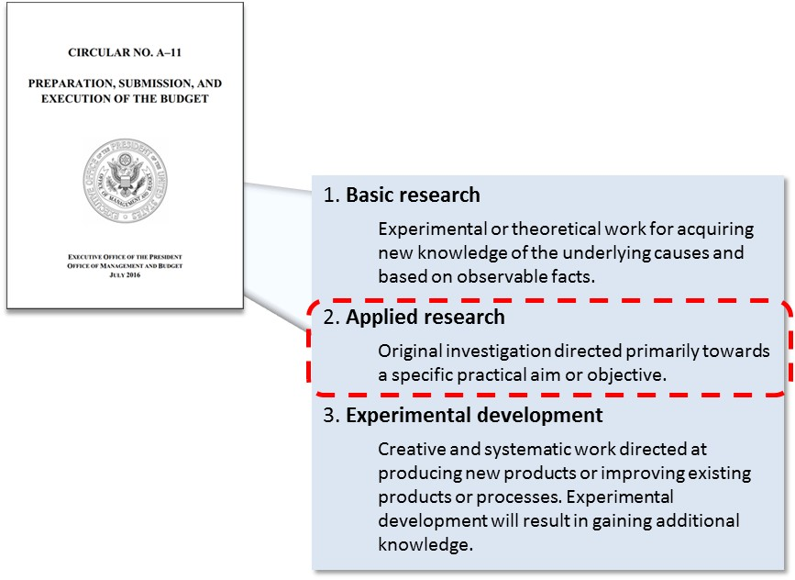
  FAA’s Research Approach
OMB Circular A-11, Section 84.2

Slide 7
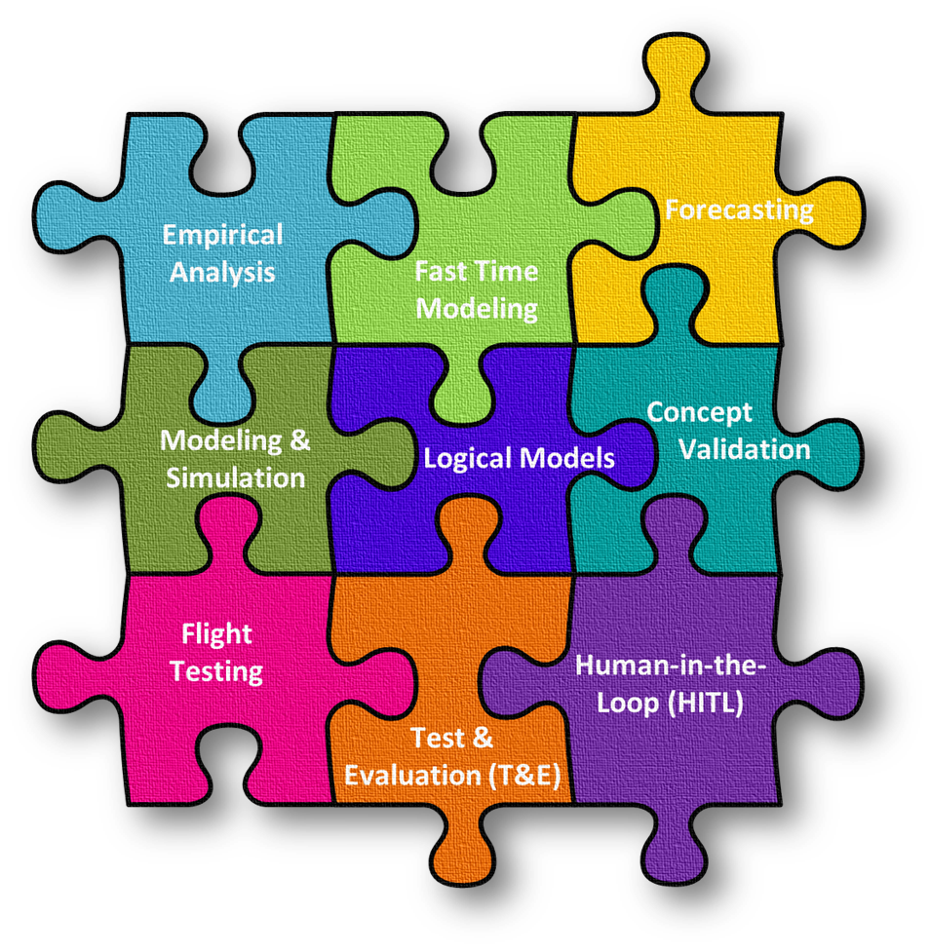
  FAA’s Applied Research Methods
What is applied research?
Applied research is directed towards a specific practical aim or objective.

Slide 8
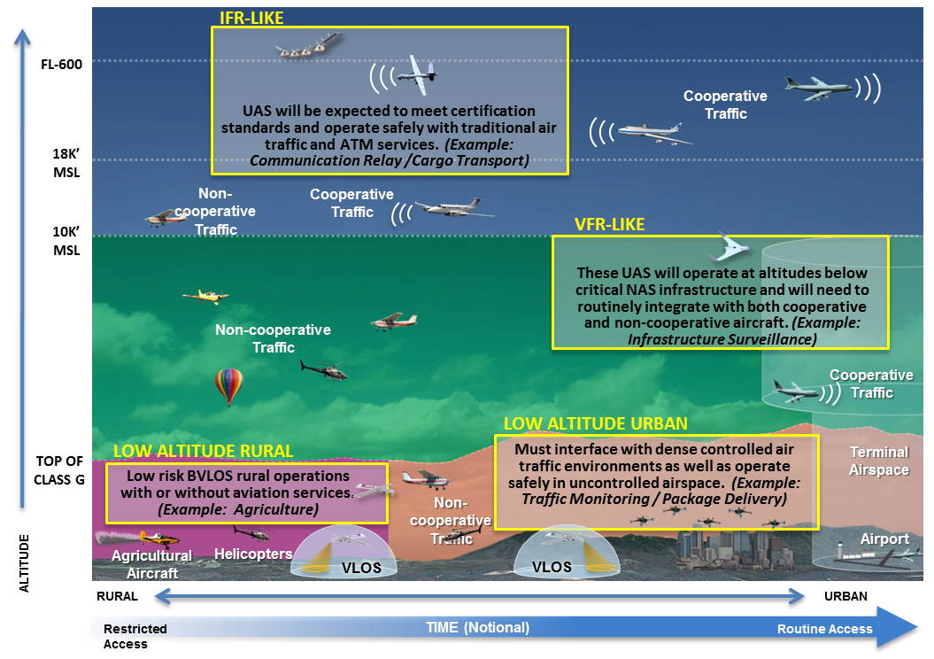
UAS Integration Landscape
Ed Waggoner, Director
Integrated Aviation Systems Program
NASA, Aeronautics Research Mission Directorate

Slide 9
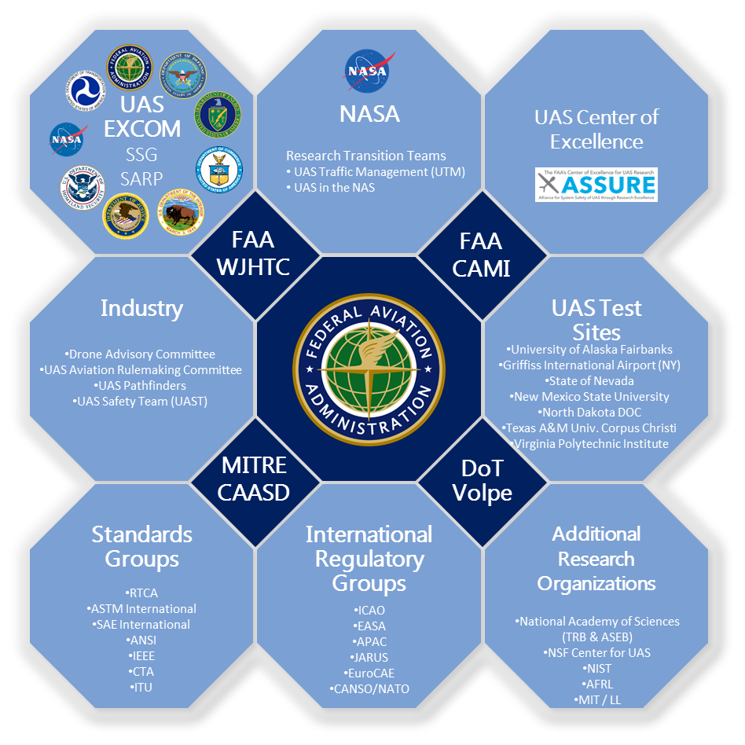
  UAS Research Collaboration & Partnerships
AFRL: Air Force Research Lab
ANSI: American National Standards Institute
ASEB: Aeronautics and Space Engineering Board
ASSURE: Alliance for System Safety of UAS through Research Excellence CANSO: Civil Air Navigation Services Organization
CTA: Consumer Technology Association
EASA: European Aviation Safety Agency
EuroCAE: European Organisation for Civil Aviation Equipment
EXCOM SSG SARP: Executive Committee – Senior Steering Group –
Science And Research Panel
FAA CAMI: Civil Aerospace Medical Institute
FAA WJHTC: William J. Hughes Technical Center
ICAO: International Civil Aviation Organization
IEEE: Institute of Electrical and Electronics Engineers
ITU: International Telecommunications Union
JARUS: Joint Authorities for Rulemaking on Unmanned Systems
MIT / LL: Massachusetts Institute of Technology Lincoln Laboratory
MITRE CAASD: Center for Advanced Aviation Systems Development
NATO: North Atlantic Treaty Organization
NSF: National Science Foundation
NIST: National Institute of Standards and Technology
SAE: Society of Automotive Engineers
TRB: Transportation Research Board

Slide 10
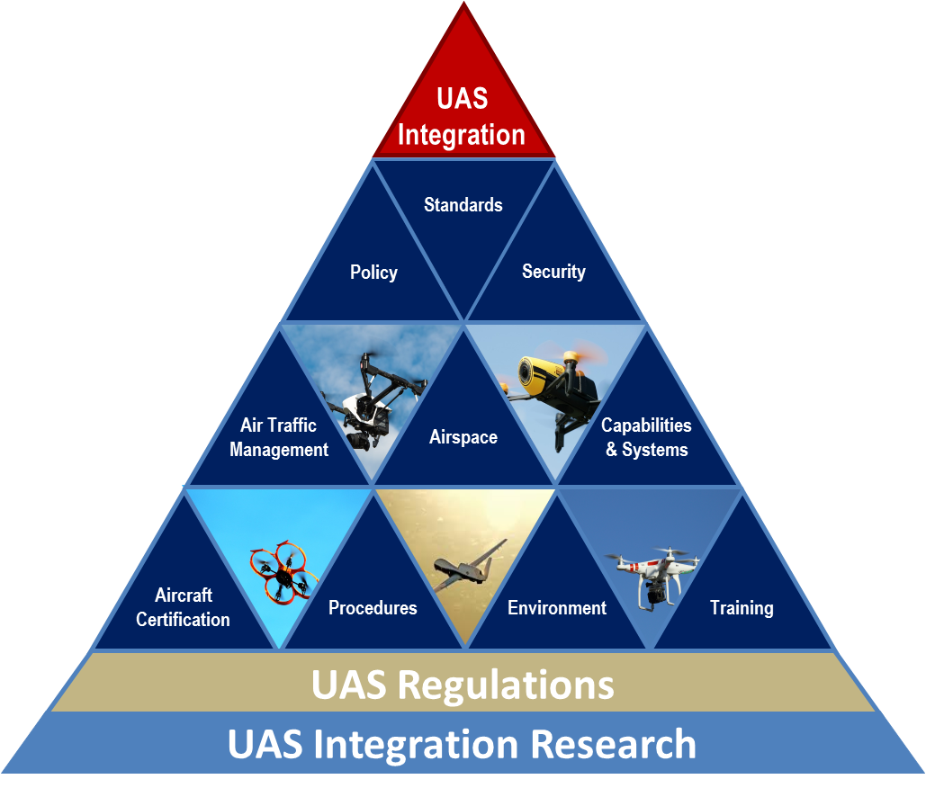
  UAS Research Functional Areas
UAS Integration Research
Functional Framework
UAS integration research supports key FAA mission functions to publish regulations, policy, procedures, and guidance material to support safe and efficient UAS operations in the NAS.
Ongoing and planned research activities inform these functional areas.

Slide 11
  UAS Research Domains
UAS Research Domains represent key challenge areas for the safe and effective integration of UAS operations in the NAS
Within each domain there are research initiatives that address these challenges to help solve the technology issues to support UAS integration.
  Detect-and-Avoid
  Command and Control
  Human Factors
  Surveillance
  Navigation
  Forecasting
  Safety
  Data
  Reliability

Slide 12
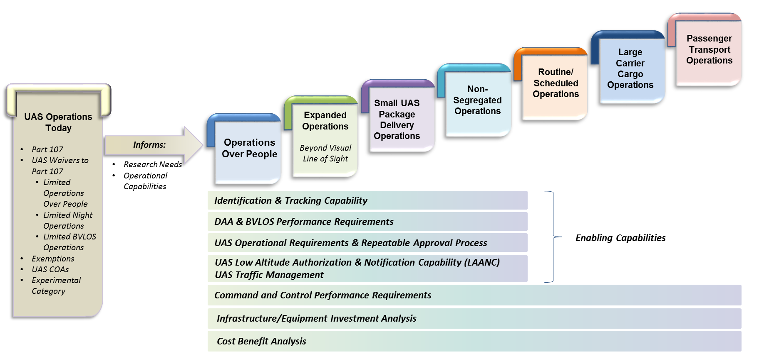
  Operational Capabilities Towards Full UAS Integration

Slide 13
UAS Research Timelines - Overview
Timelines are broken out by operational capability
Research includes activities captured from research planning documentation including LOB discussions, Roundtable Meetings, and Partnerships
Each research activity is mapped to functional areas and research domains
Research is classified by:

Slide 14
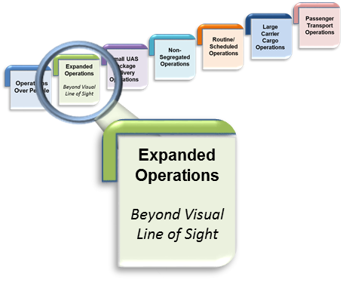

Expanded Operations Research Summary
Summary of Ongoing Research Areas for Expanded Operations
Develop low altitude UAS traffic management
Streamline low altitude access and approval
Evaluate cybersecurity requirements
Evaluate detect and avoid requirements and hazard avoidance capabilities
Determine requirements for swarm operations
Develop methods of detection of UAS
Determine effects of turbulence and weather on sUAS
Develop UAS safety needs and requirements for nighttime operations
Perform outreach to develop the workforce for the future
Summary of Identified Needs for Expanded Operations
Determine operational classifications of UAS
Develop ground collision impact mitigation strategies
Determine detect and avoid hardware requirements
Evaluate UAS safety containment capabilities
Determine cybersecurity requirements

Slide 17
Conclusion
FAA UAS research planning cycle begins 2+ years before year of execution
Needs summarized in this plan were realized post planning cycle and result from
  Completed or ongoing activities: R&D may yield additional questions or follow-on phases
  Updates to the FAA UAS integration pathway
    Evolution of UAS technology and business cases and increasing demand for expanded operations result in dynamically changing UAS integration plans
Original estimates of level of effort are not always sufficient to address research gaps
FAA will continuously re-evaluate its UAS research program to determine the required level of effort and to account for unanticipated changes

