Slide 1

AeroSPACE medical research
EMERGING Aviation safety medical issues
3-23-2016
REDAC SAS
Estrella M. Forster, Ph.D.
FAA CAMI AAM-600 OKC

Slide 2

AGENDA
Aeromedical TCRG Requirements
Aeromedical Research Contribution
Emerging Aeromedical Issues

Slide 3
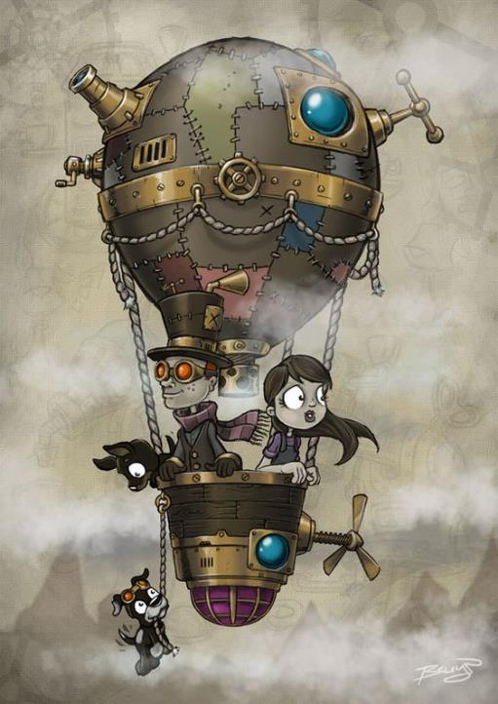
Aeromedical (AM)
Technical Community Representative Group (TCRG) Requirements

Slide 4
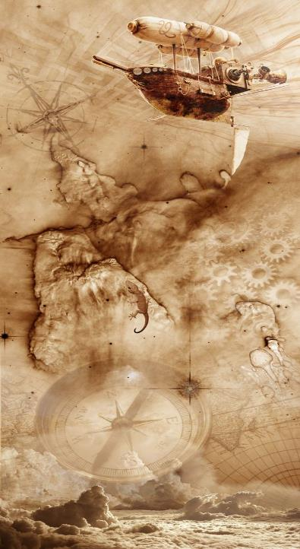
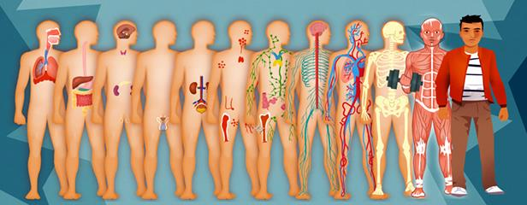

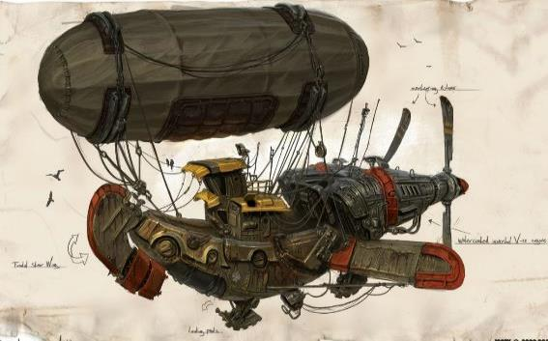
HUMAN
ENVIRONMENT
TECHNOLOGY

Slide 5
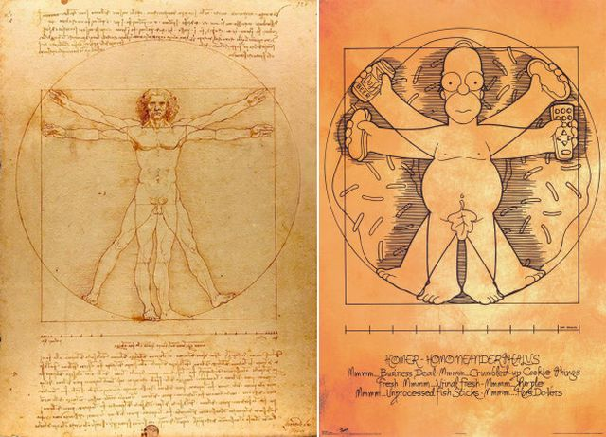
THE MOST IMPORTANT ASPECT OF THE National Airspace System (NAS)

Slide 6
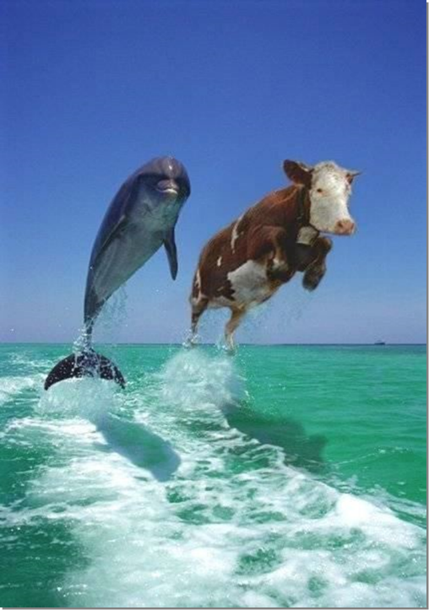

Understanding the Environment
A
B

Slide 7

Understanding the Technology
A
B

Slide 8
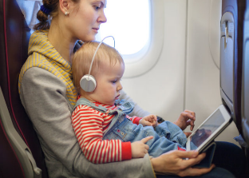

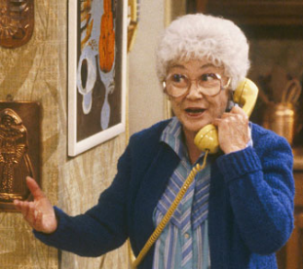

Understanding Human Safety: Pax and Pilot
A
B

Slide 9

AM-1 Aerospace Medical Systems Analysis
AM-2 Accident Prevention & Investigation
TECHNOLOGY
HUMAN
AM-3 Human Protection & Survival
ENVIRONMENT

Slide 10
AM-1
Analyze medical certification, accident, and other biological data to derive methods, recommendations, and/or tools to enhance aircrew health, medical certification decision-making processes, and education programs.
Evaluate trends in physiological, human factors, clinical, and forensic findings from civil aviation aircraft accidents and incidents to support accident investigation processes and develop strategies to mitigate aeromedical risks.
Investigate the effects of ionizing and non-ionizing radiation on living systems.
Develop and maintain comprehensive aeromedical research databases to support epidemiological studies and probabilistic risk analyses methodologies towards the realization of aeromedical safety management systems.
Investigate current and anticipated aeromedical issues and technology that may impact human safety in aerospace operations, particularly in the fields of bioinformatics, medicine, epidemiology, and radiobiology.
Serve as an advisory resource in areas relating to aeromedical factors affecting or expected to affect aerospace safety.
Aerospace Medical Systems Analysis
Addressed by 92 tasks described as continuous research activities (n= 64) and research projects (n= 28).

Slide 11
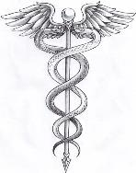

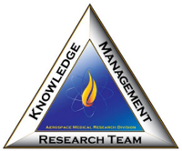
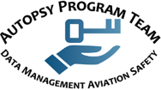
Aerospace Medical Systems Analysis
AM-1 TCRG
15 GOV and 3 CTR in-house FTEs
Medical Research Team
Numerical Sciences Research Team
Knowledge Management Research Team
Autopsy Program Team

Slide 12
AM-2
Develop advanced toxicological and biochemistry methodologies to detect and analyze human biological samples for emerging drugs, toxins, and other substances that may impact pilot performance or assist in determining accident causality.
Develop gene expression (biomarker) methodologies to detect and quantify impairment from alcohol, drugs, fatigue, hypoxia, and other environmental or aeromedical stressors (e.g., disease or impairment) relative to human safety and performance in aerospace operations.
Investigate current and anticipated aeromedical issues and technology that may impact human safety in aerospace operations, particularly in the fields of biochemistry, toxicology, and genomics.
Serve as an advisory resource in areas relating to aeromedical factors affecting or expected to affect aerospace safety.
Accident Prevention & Investigation
Addressed by 99 tasks described as continuous research activities (n= 73) and research projects (n= 26).

Slide 13



Aeromedical Accident Prevention and Investigation
AM-2 TCRG
18 GOV and 4 CTR in-house FTEs
Forensic Toxicology Research Team
Biochemistry Research Team
Functional Genomics Research Team

Slide 14
AM-3
Develop design and certification test methods and criteria to ensure occupant survival at maximum airframe impact tolerance.
Develop and validate mathematical models to simulate, facilitate, and improve item A above.
Provide recommendations for the development of industry-wide standards and coordinate/participate in these standardization efforts through professional associations and workshops.
Develop safety and emergency equipment standards, procedures, and criteria to ensure evacuation capability for all aircraft occupants from all aircraft incidents and survivable aircraft accidents.
Investigate environmental factors that influence human physiology and performance in aerospace environments.
Serve as an advisory resource in areas relating to biodynamics, altitude physiology, and cabin safety issues affecting or expected to affect aerospace safety.
Human Protection & Survival
Addressed by 88 tasks described as continuous research activities (n= 53) and research projects (n= 35).

Slide 15
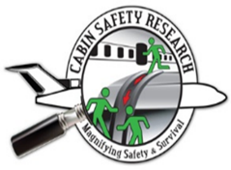
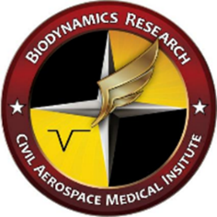

Human Protection & Survival
AM-3 TCRG
17 GOV and 1 CTR in-house FTEs
Cabin Safety Research Team
Biodynamics Research Team
Physiology Research Team

Slide 16
Book Chapter – publication of a book or book chapter
Manuscript – publication in the open, peer-reviewed literature
Technical Report – government document, such as technical report published by CAMI
Regulatory – language for a regulatory document or industry standard
Abstract or Presentation – publication in conference proceedings and presentations
Other Document – other publication, internal or external to the FAA
Other Service – serve as a subject matter expert (SME)
Software – delivery of software and its code
Case – delivery of FOIA documents or case reports (Toxicology, Aeromedical Review)
Mentoring and Teaching – providing training and guidance to Aviation Medical Examiners (AMEs), Accident Investigators, and Residents of Aerospace Medicine (RAMs).
Awards and Honors – recognition
Maintenance of Certifications and Licenses
AM TCRG
FY15
RESULTS

Slide 17

AEROMEDICAL
RESEARCH
CONTRIBUTION
TO
AVIATION
SAFETY

Slide 18

Continued Operational Safety
Results of research maximize the strengths of the human link in the NAS and minimize inherent human weakness to prevent accidents and improve safety through evidence-based medicine.

Slide 19
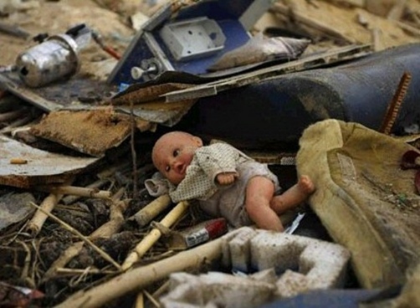
Standards & policy
Investigation and analysis of injury and death patterns in civilian flight accidents and incidents results in the development of preventive strategies including language for proposed standards, regulations, educational materials, and policies.

Slide 20
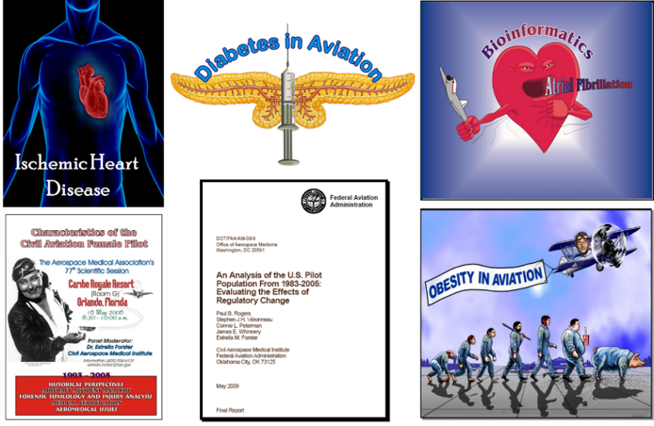
Risk management
Support accident investigation and medical certification processes to identify hazards and augment safety information systems towards an Aeromedical Safety Management System.

Slide 21
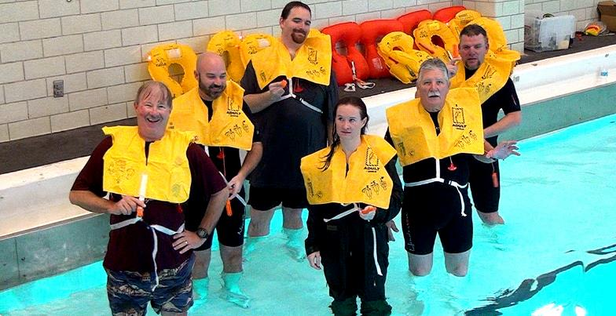
certification
Provides criteria concerning equipment, technology, and procedures for human protection and survival from stressful environments/emergency events.

Slide 22
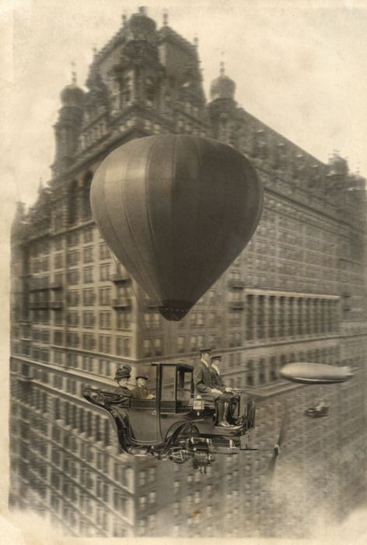
EMERGING
AVIATION SAFETY
AEROMEDICAL ISSUES
SAS 2014

Slide 23
2016 - 2018
CAMI has a methodology in place to track technological advances in bio‐engineering and medicine.
This process involves regular conversations with technology experts as well as study of newsletters/reports that identify and describe technological advances (nationally & internationally).
CAMI personnel assess the implications from both a positive and a safety and risk management perspective of these technological advances and identify the potential practical impacts of these technologies upon the users of civil aviation transportation systems.
CAMI has identified a research strategy to address advanced medical technologies that can potentially affect aviation safety, in line with the FAA Administrator’s Initiatives, and viable to pursue within the current research funding constraints.
Identification of pathology risk
High performance computing and visualization technology
Emergent medications and medical devices

Slide 24
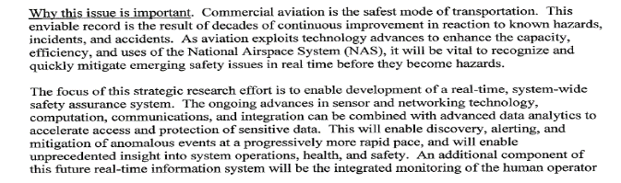
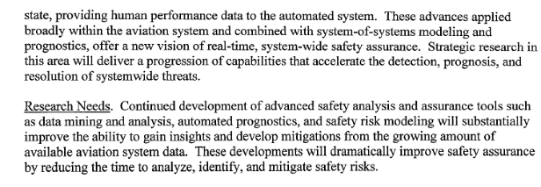
Real-Time System-Wide Safety Assurance
AM-1
AM-3

Slide 25
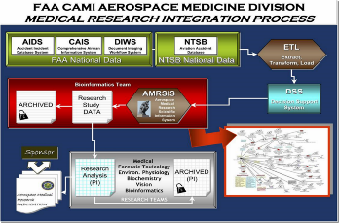
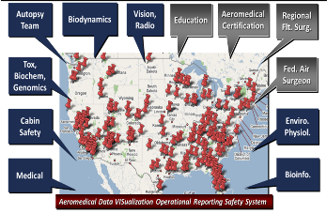
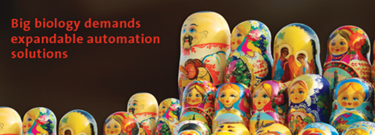
AM-1
Identification of pathology risk through dedicated data bases
  Medical Analysis and Tracking System(MANTRA)
  Scientific Information System (SIS)
  Aerospace Accident Injury and Autopsy Data System (AA-IADS)
High Performance Computing (HPC) and visualization technology
  Friedberg Numerical Sciences Laboratory (HPC)
  AA-IADS
  Aeromedical Data Visualization Operational Reporting Safety System (ADVISORS²)
Emergent Medical Devices – Advanced Prosthetics
AM-3
Physiologic Measures

Slide 26
Commercial Space Integration in NAS
AM-1, AM-2, AM-3

Slide 27
AM-1
Office of Science and Technology (OSTP) Space Weather Action Plan – Advisory Resource to ANG
NTSB Accident Investigation, Space Ship 2 – Aeromedical Review of Accident
Developing Medical Standards – Collaboration with AAM
NASA 2015 Draft Technology Roadmaps – Advisory Resource
Invited participant in workgroup: “Nowcast of radiation storms (proton events) at energy levels that could create a radiation hazard for aircrew and passengers“ as part of the NASA Living With A Star Institutes program – Copeland
AST Safety Portfolio – Advisory Resource
  Exploring advanced commercial human space flight data sharing and mining capabilities to inform safety assessments and identify emerging safety issues.
  Research projects within Human Spaceflight and Physiological Safety Factors: Identifying best practice considerations for crew human factors for small winged commercial spaceflight vehicles
AM-2
Development of Forensic Toxicology Process for Commercial Space Transportation Accidents – Collaboration with NASA and Industry
AM-3
Evaluation of Space Suit – Research Opportunity with U. North Dakota
Served on two NASA Expert Panels reviewing occupant protection research plans and standards for spacecraft

Slide 28
Certification of Advanced Materials and Structural Technologies
AM-3

Slide 29
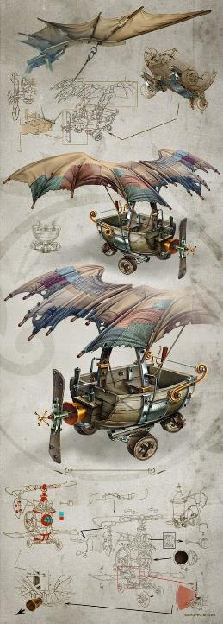
General Aviation’s Role in Safety Systems Development
AM-3

Slide 30
Identification and Funding of Strategic Research and Development
AM-1, AM-2, AM-3

Slide 31
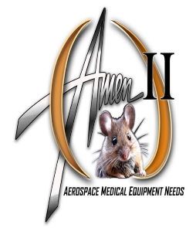

Data mining – Identification of Risks:
  AM-1: Exploiting aeromedical review of accidents data base (MANTRA) and other information systems (ADVISORS², SIS).
  AM-2: Discovering aviation-stressor related biomarkers
  AM-3: Working with other stakeholders
Replacement of old and obsolete R&D Facilities and Equipment through the Aerospace Medical Equipment Needs (AMEN) and the Wind & Wave Evacuation & Survival (WiWAVES) programs.
Contributing to R&D Process Improvements – “Process Evolution”

Slide 32
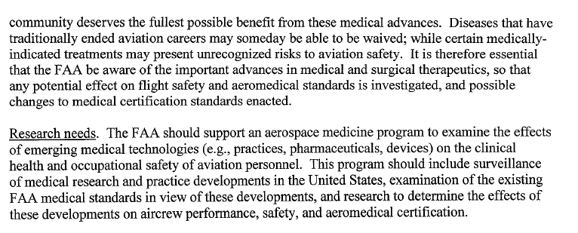
Effect of Breakthrough Medical Technologies on FAA Medical Certification Standards
AM-1, AM-2, AM-3

Slide 33
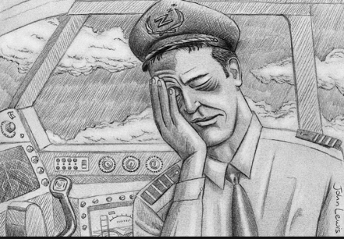
AM-1
Medical Certification Strategies in Response to Emergent Prosthetic Technology Development
AM-2
Designer Drugs
Analytical Method Development For THC (Marihuana ingested vs. smoked) and Associated Analogs
Quantification of Fatigue – Gene Expression
Sleep Deprivation – Gene Expression
Comparison of Hypoxic Environments – Gene Expression
AM-3
Inflatable Emergency Equipment
Virtual ATDs
Protective Devices
Seat Configurations

Slide 34
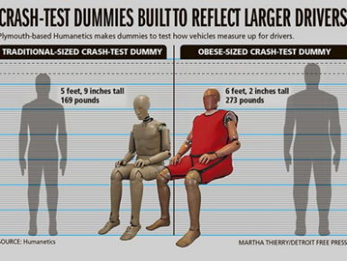

Still MUCH MORE to DO!
SAS 2014

Slide 35
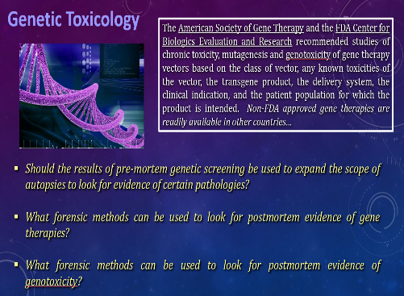
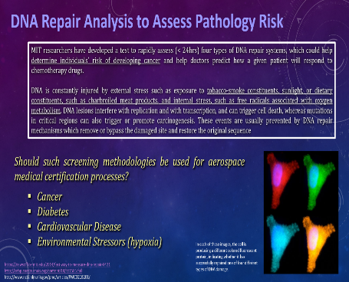
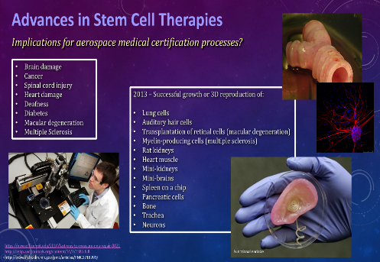
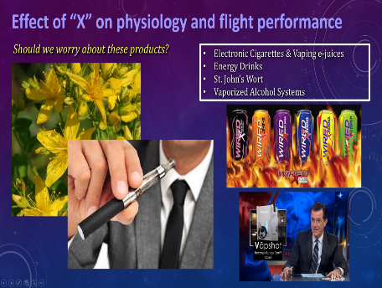

Slide 36
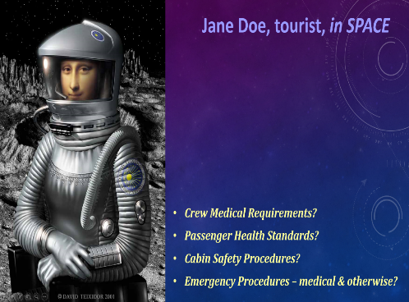
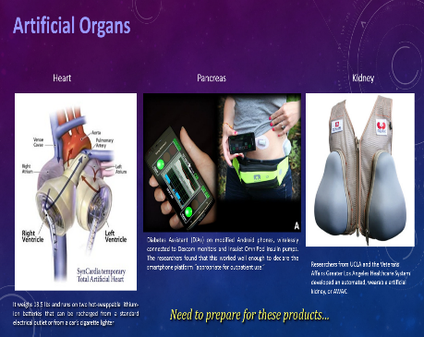
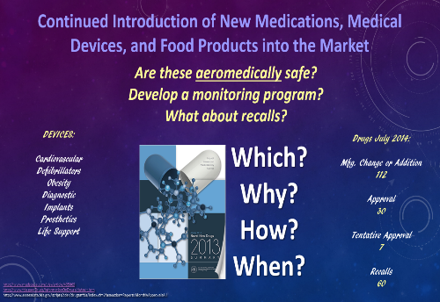
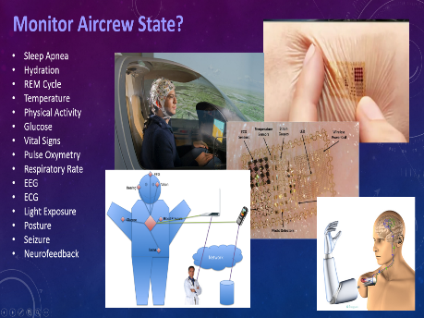

Slide 37
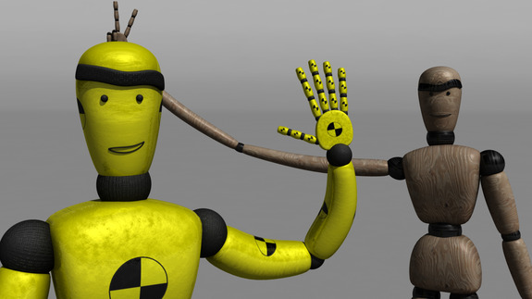
THANK You
Estrella Forster, Ph.D.
405-954-6131
Estrella.Forster@faa.gov

