Slide 1
FY18 AVS RE&D Portfolio
Overview
Subcommittee on Aircraft Safety
Mark S. Orr
23 March 2016

Slide 2
Order of the Presentation
SAS Recommendation
Program drill-down
Outcome grouping
Emerging Issues/Future Opportunities
Specific topic areas

Slide 3
Recommendation
FAA should create a comprehensive program description for safety research that clearly identifies and communicates the higher level research objectives, by topic, (icing, fire safety, structural technologies, etc.) as well as provides connectivity to the comprehensive set of specific targeted research objectives in each area. This description needs to clearly communicate how individual research supports the overall objectives. The description should be designed and easily updateable so that it primarily adds FAA management value as well as supports the SAS Committee objectives.

Slide 4
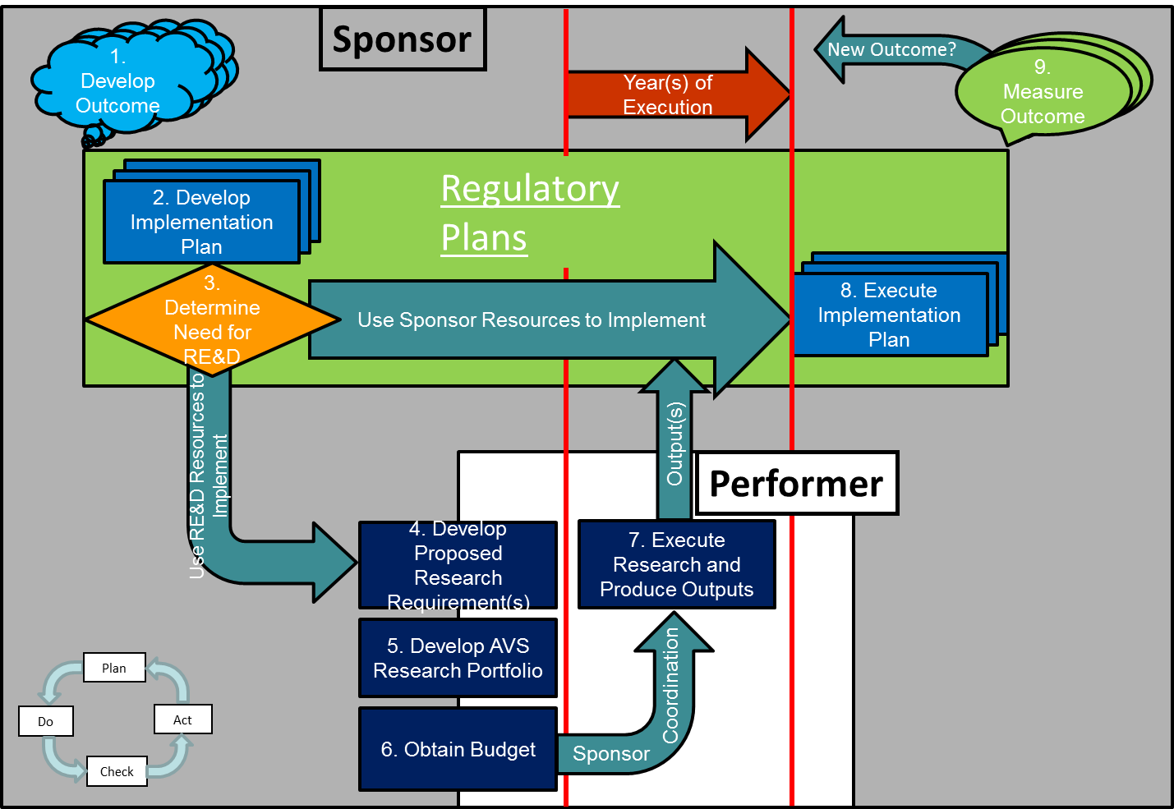
AVS R&D Life-cycle Model

Slide 5
AVS R&D Process Definitions
Budget Line Item (BLI) – Officially designated lines in the congressional budget historically arranged in different areas of responsibility.
Control Account # – The AVS R&D program reference number that stays the same from year-to-year throughout the life of an individual research project. (format = BLI.TCRG.seq# )
Outcome – The future state desired by the sponsoring organization in a given area under their responsibility. Per the process life-cycle model, this is stated in terms of the desired safety effect (i.e. improvement or mitigation) in the future that the sponsor hopes to achieve after executing the implementation plans using the outputs from the research. In practical terms, there is not always a direct cause and effect relationship between the sponsors actions and the safety effect because of variables outside the FAA. The life-cycle recognizes that the outcomes need to be measured and new outcomes developed based on the these measurements in an improvement cycle.
Output – The results of the research, usually in the form of a final FAA report; the deliverables supplied at the completion of a set of research tasks.
Research Project – The organized collection of tasks, milestones, and phases intended to satisfy the research requirement. There is one research project for each research requirement. Outputs from the research project are applied by the sponsor to the execution of the implementation plan. (ed. The Control Account # was introduced in FY15.)
Research Requirement – The term used to describe an area of inquiry that supports the needs of a sponsor.
Task – A specific step in the process of conducting the research project that leads to an output.
Technical Community Representative Group (TCRG) – Groups of subject matter experts representing AVS sponsors and ANG performers in designated areas (i.e. metallics, electrical, software, UAS, etc.) that work together to develop research requirements.

Slide 6

R&D Documentation (Running List)
Requirement Write-Up
Research Execution Plan (REP)
Provider Research Execution Plan (PREP)
Cost Estimate
Monthly/Quarterly/Yearly Status Reports
Briefing Matrix
Rosetta Stone
RE&D Appropriation Status Report
NARP
Annual Review
Budget Narrative
Quad Charts (SAS)
Quad Charts (REB)
AVS Strategic Guidance
Process supplement
AVS Kickoff Training
  FAA Business Plan
  Milestone Implementation Charts (prototype)
  Waterfall Outcome Charts (prototype)
  Budget Line Snapshot (prototype)
  Implementation Plans and Roadmaps
  Business Plans (multiple levels)

Slide 7
R&D Document Elements

Slide 8
Future
Working toward future where we have:
  Single source for baseline information
  Traceability up & down the information chain
  Better change management documentation
  More holistic view across time & project domains

Slide 9
AVS R&D Program Drill-down
Organizational
Bookkeeping
FAA R&D Principle
Improve Aviation Safety
BLI
A11A, A11B, A11C, A11D
Continued Airworthiness (A11E)
A11F, A11G, A11H, A11J, A11K, A11L, A11M, A12B
Flight Controls – Mechanical Systems
TCRG
ES,
M&I
SIM
R&D Outcomes
Reduction in loss of control accidents resulting from stall departure (GA & 121)
Achieve accident reductions by 10%
Tire failure and burst models that can be used by industry and authorities
Research & Implementation Milestones

Slide 10
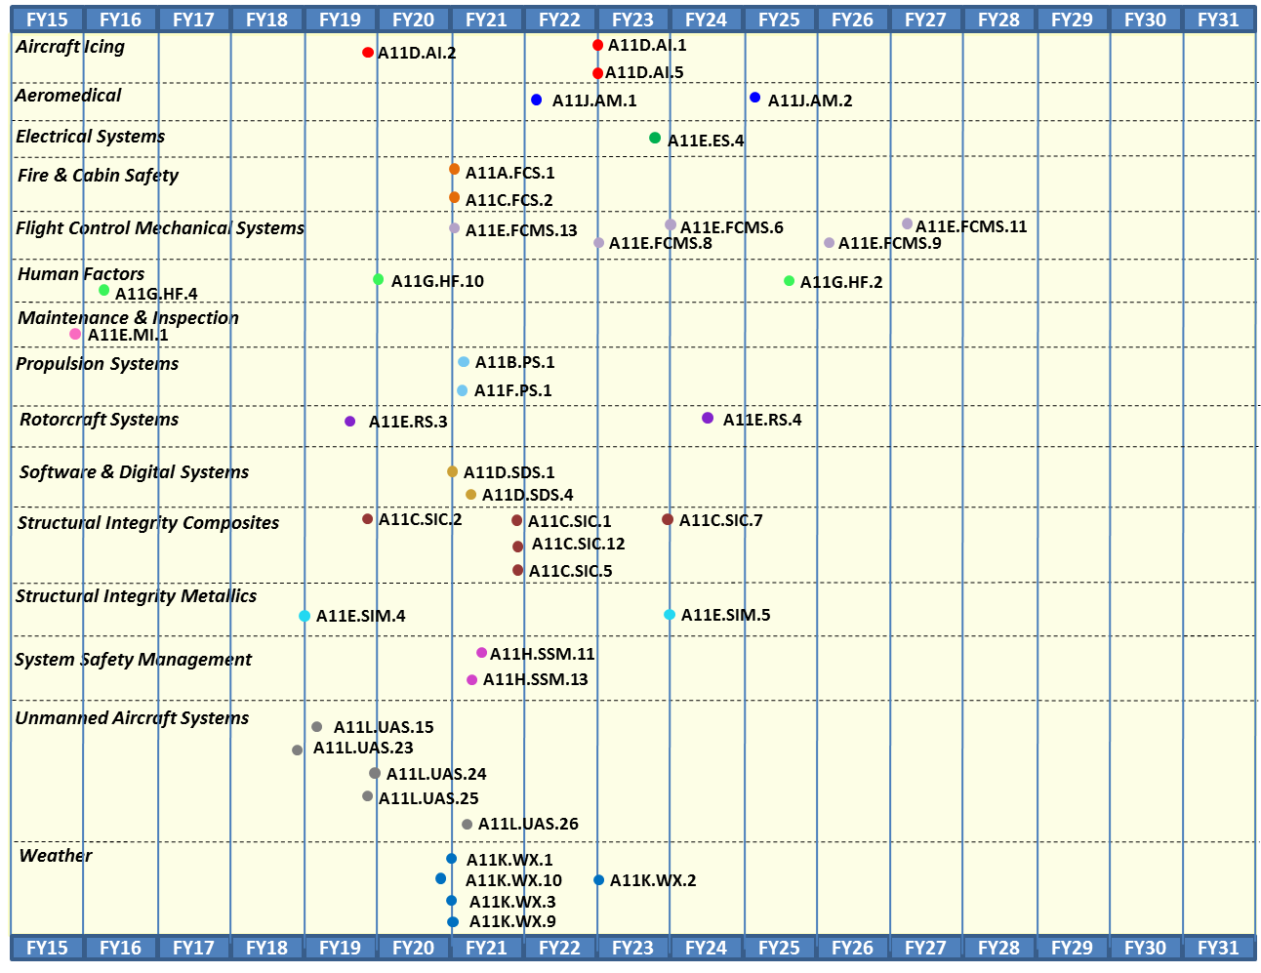
FY18 Outcomes by TCRG

Slide 11
FY18 Outcomes by TCRG

Slide 12
Initial Requirement Mapping to SAS Emerging Issues & Future Opportunities
AVS R&D Team undertook an effort to “map” FY18 proposed requirements (those above the Mendoza line) to Emerging Issues/Future Opportunities from fall FY14 SAS report
  Reviewed by:
    AVS R&D Team
    AVS RED Group
  First order review of common wording
    Review based on requirement write-ups
  Some requirements cover multiple emerging issues/opportunities
  Programmed funding level identified
    This does not imply that total funding amount will be used to support emerging issue identified

Slide 13
FY18 AVS R&D Requirements 1st cut Alignment to SAS Emerging Issues and Future Opportunities – by BLI
(Requirements above Mendoza line)
SAS Emerging Issues & Future BLI | SAS/Emerging - Real Time System-Wide Safety Assurance | SAS/Emerging - Dependability of Increasingly Complex Systems | SAS/Emerging - Certification of Advanced Materials and Structural technologies | SAS/Emerging - High Density Energy Storage, Management and Use | SAS/Future - Commercial Space Integration with the NAS | SAS/Future - General Aviation’s Role in Safety Systems Development | SAS/Future - Effects of Breakthrough Medical Technologies on FAA Medical Certification Standards | SAS/Future - Identification and Funding of Strategic Research and Development
A11.a | A11a.FCS.1 |  | A11a.FCS.1 | A11a.FCS.1
A11.b | A11b.PS.1 |  | A11b.PS.1
A11.c | A11c.FCS.2 |  | A11c.FCS.1, A11c.SIC.1, 2, 5, 12
A11.d | A11d.AI.1, 2, 5 | A11d.SDS.1, 4 | A11d.AI.1
A11.e | A11e.FCMS.6, 7, 11, 13 |  | A11e.FCMS.8, 13 | A11e.ES.4 |  | A11e.FCMS.8, 13
A11.f | A11f.PS.1 |  | A11f.PS.1
A11.g |  | A11g.HF.4 |  |  |  | A11e.RS.4, A11g.HF.10
A11.h |  | A11h.SSM.11, 13
A11.j | A11j.AM.1, 3 |  | A11j.AM.3 |  |  | A11j.AM.3 | A11j.AM.1, 2, 3 | A11j.AM.1, 2, 3
A11.k | A11k.WX.1, 2, 3, 10
A11.l | A11l.UAS.25 | A11l.UAS.24
Total | 18 | 5 | 12 | 2 | 0 | 5 | 3 | 3
Different Line of Business not under AVS Purview

Slide 14
FY18 By the Numbers
Requirements submitted = 98 (77 in FY17)
  28 New requirements
FY18 Contract Fund Target = $38,832K (38 req)
  FY17 Target = $39,242K (49 req)
  FY16 Target = $42,640K (57 req)
Continuing vs. New
  34 requirements
  4 New
Notes:
Main Points:
98 requirements is the most we have had submitted in a year over the past 4 years. While there is no restriction on the number that can be submitted, ALL members of the AVS RED Group stated that 98 was a lot to get through.
The Weather and NextGen funded requirements ALL get prioritized, but are not part of the Top-60 list because they are funded through different processes.
A11K.WX.1, Safety-Driven Weather Requirements for Wake Mitigation initially done in FY14 & FY15, but not submitted in FY16 & FY17
A12B.UASNG.1, Minimum Detect and Avoid (DAA) Display and Flight Path Information originally proposed in FY17 as A11L.UAS requirement that wasn’t funded
28 new requirements were proposed with half of them making it into the top-60. This means that 70 have been submitted before, but not that all of them have been funded in the past.
12 of the 98 requirements were submitted were contained incomplete information. During the Phase I meeting, the primary fields used to vote are the criteria justification fields and one requirement had a blank justification that affected their ranking. The AVS RED Group members committed to getting the Sponsor POCs to provide the complete information before the January Phase II meeting.
Historically, only about 50 requirements can be funded each year on average, so some years ago, the process was changed to only ask for cost estimates for the top-60 to limit the workload on the performers.
The Future of the program:
Even though 70 of these were submitted in previous years, the current process asks for a new write-up each year. Much of the information in these is copied and pasted into the new write-up, but there are some changes made. We review each requirement each year and prioritize it. We are working to improve the process to allow for multi-year submissions that are voted in the beginning and managed over multiple years.

Slide 15
Appropriated Budget Context
FY 2015 |  |  |  |  |  | FY 2016*
BLI (A11) | Contract Request $(K) | Contract Enacted $(K) | Contract Delta $(K) | Contract Delta % |  | BLI (A11) | Contract Request $(K) | Contract Enacted $(K) | Contract Delta $(K) | Contract Delta %
A | $ 3,214 | $ 2,835 | $ (379) | -11.79% |  | A | $ 3,000 | $ 2,190 | $ (810) | -27.00%
B | $ 1,595 | $ 1,182 | $ (413) | -25.90% |  | B | $ 2,350 | $ 1,557 | $ (793) | -33.74%
C | $ 1,939 | $ 1,839 | $ (100) | -5.16% |  | C | $ 2,738 | $ 6,469 | $ 3,731
D | $ 3,888 | $ 3,299 | $ (589) | -15.15% |  | D | $ 5,028 | $ 3,404 | $ (1,624) | -32.30%
E | $ 6,546 | $ 6,496 | $ (50) | -0.76% |  | E | $ 6,385 | $ 5,891 | $ (494) | -7.74%
F | $ 1,188 | $ 1,121 | $ (67) | -5.64% |  | F | $ 1,100 | $ 1,055 | $ (45) | -4.09%
G | $ 6,023 | $ 2,126 | $ (3,897) | -64.70% |  | G | $ 6,090 | $ 967 | $ (5,123) | -84.12%
H | $ 5,421 | $ 5,221 | $ (200) | -3.69% |  | H | $ 3,750 | $ 3,411 | $ (339) | -9.04%
J | $ 2,723 | $ 2,104 | $ (619) | -22.73% |  | J | $ 4,049 | $ 2,539 | $ (1,510) | -37.29%
L | $ 7,210 | $ 13,210 | $ 6,000 |  |  | L | $ 8,150 | $ 16,022 | $ 7,872
Total - | $ 39,747 | $ 39,433 | $ (314) |  |  | Total - | $ 42,640 | $ 43,505 | $ 865
Average of 19.4% moved from 9/10 BLIs and added to A11L
Average of 33.8% moved from 8/10 BLIs and added to A11C & A11L
*NOTE: FY16 BLI allocations are under review and not yet final.

Slide 16

Questions on the presentation?

