Slide 1

NASA Aeronautics FY 2017 Budget Request
Investing in our Future
Briefing to REDAC Subcommittee on Aircraft Safety
John Cavolowsky, Director, Airspace Operations and Safety Program
March 24, 2016

Slide 2

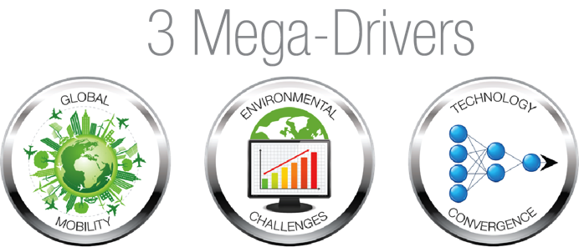
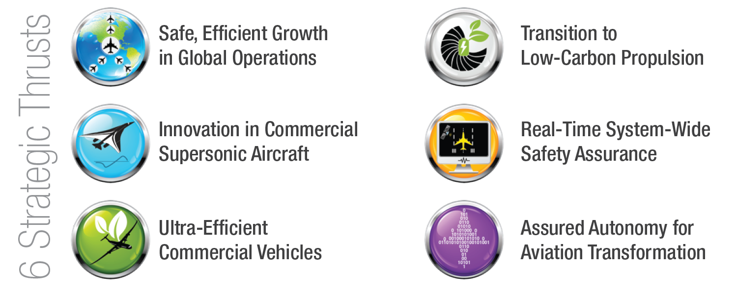
NASA Aeronautics
NASA Aeronautics Vision for Aviation in the 21st Century
U.S. leadership for a new era of flight

Slide 3
FY 2017 Budget
$ Millions | FY 2015 | Enacted FY 2016 | FY 2017 | FY 2018 | FY 2019 | FY 2020 | FY 2021 | FY 2022 | FY 2023 | FY 2024 | FY 2025 | FY 2026
Aeronautics | $642.0 | $640.0 | $790.4 | $846.4 | $1,060.1 | $1,173.3 | $1,286.9 | $1,294.2 | $1,307.6 | $1,218.1 | $829.7 | $839.5
Airspace Operations and Safety | 154.0 |  | 159.4 | 159.2 | 176.2 | 189.1 | 221.5 | 198.7 | 200.9 | 193.2 | 175.5 | 167.8
Advanced Air Vehicles | 240.6 |  | 298.6 | 277.4 | 308.8 | 311.6 | 312.6 | 321.3 | 315.0 | 318.9 | 317.7 | 326.7
Integrated Aviation Systems | 150.0 |  | 210.0 | 255.4 | 381.4 | 493.0 | 556.7 | 591.5 | 612.2 | 525.0 | 203.8 | 210.6
Transformative Aeronautics Concepts | 97.4 |  | 122.3 | 154.4 | 193.8 | 179.7 | 196.2 | 182.8 | 179.4 | 181.0 | 132.7 | 134.4
Aeronautics budget includes paid-for 10-year mandatory funding from the Administration’s 21st Century Clean Transportation Plan. See appendix for additional detail.
Mandatory Budget Authority $ Millions | FY 2017 | FY 2018 | FY 2019 | FY 2020 | FY 2021 | Outyears
21st Century Clean Transportation Plan | 100 | 200 | 400 | 500 | 600 | 1900
Airspace Operations and Safety | 18 | 20 | 35 | 45 | 75 | 170
Advanced Air Vehicles | 30 | 41 | 79 | 80 | 65 | 305
Integrated Aviation Systems | 37 | 84 | 196 | 300 | 370 | 1170
Transformative Aeronautics Concepts | 15 | 55 | 90 | 75 | 90 | 255
Low Boom Flight Demonstrator | 56
Integrated Aviation Systems | 56

Slide 4

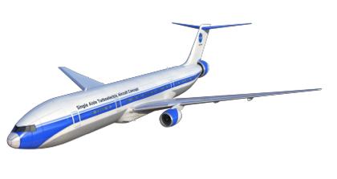


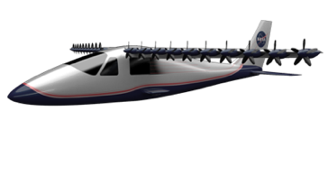
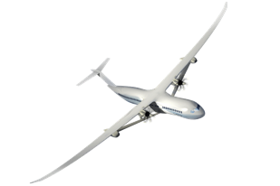
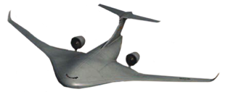



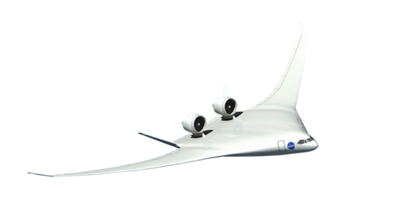
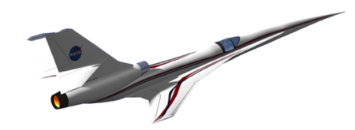

New Aviation Horizons Flight Demo Plan
Hybrid Electric Propulsion Demonstrators
DP
Transport Scale
Preliminary
Design
Total Demonstration Cost ROM: $700M
Ground Test Risk Reduction
Small Scale “Build, Fly, Learn”
Design & Build
Flight Test
Validated HEP Concepts, Technologies
And Integration for U.S. Industry to Lead the Clean Propulsion Revolution
Design & Build
Flight Test
Design & Build
Flight Test
DP
Life Cycle Cost ROM: $400-500M
Ground Test
Risk Reduction
Preliminary
Design
Design & Build
Flight Test
Images Credit: Lockheed Martin
Potential
Candidates
DP
Life Cycle Cost ROM: $400-500M
Ground Test
Risk Reduction
Preliminary
Design
Validated ability for U.S. Industry to Build Transformative Aircraft that use 50% less energy and produce over 40dB (cumulative) less noise
“Purpose-Built” UEST Demonstrators
Design & Build
Flight Test
DP
Life Cycle Early Cost Est: $850M
Preliminary
Design
Design & Build
Flight Test
Fully integrated UEST Demonstrator
DP
Life Cycle Cost Est: $430M
Design & Build
Flight Test
Enables Low Boom Regulatory Standard and validated ability for industry to produce and operate commercial low noise supersonic aircraft
FY17
FY18
FY19
FY20
FY21
FY22
FY23
FY24
FY25
FY26

Slide 5
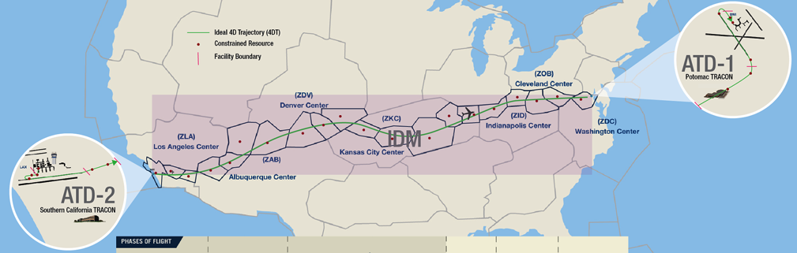

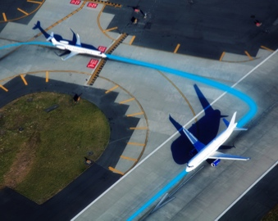
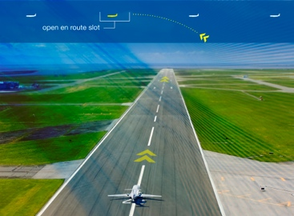
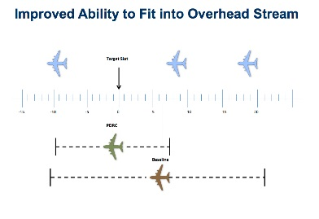
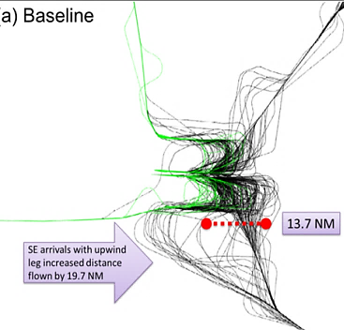
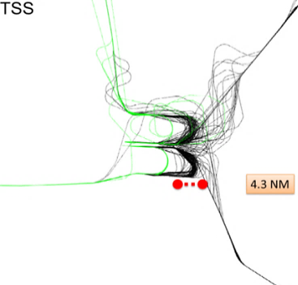
Trajectory Based Operations: Concept to Demo
Next Step in NASA Research and NextGen Development
Develop and Demonstrate NextGen Capabilities:
Reducing fuel use and flight delays
Concept Validation
Technology Maturation
Demo
Gate-to-Gate
Optimization
Gate-to-Gate 4DT TBO: Complete gate-to-gate flight optimization incorporating
system constraints and user request.
Architectural
Definition
Tech Gap
Assessment
Gate-to-Gate
Trajectory
Based
Operations
Enables airlines to operate increasingly efficient 4D “gate-to-gate” trajectories
Fast-time
Simulation
Human In The Loop
Simulation
Integrated
Field Demo
RTT
deliverable
Initial
Integrated
Demand
Management
Concept Validation
Technology Maturation
IDM TBO: Integrates departure, en route, and descent flight operations for greater optimization
Initial Concept Demo
Fully Integrated Field Demo
ATD-2
RTT deliverable
ATD-2: Coordinated preflight, taxi, takeoff, and departure paths for all outbound flights at an airport
Complex
Terminal Area Trajectory
Management
Enables airlines to optimize efficient operations into and out of busy airports and terminal area airspace
Ground Side
Demo
Flight Side
Demo
ATD-1
RTT deliverable
ATD-1: Efficient descent, approach, and landing for all flights inbound to an airport
2015
2017
2020
2025

Slide 6

ARMD Outcomes, Benefits and Capabilities
Strategic Thrust 5: Real-time System-Wide Safety Assurance
2015 2025 2035
Outcomes | Doman Specific (Real-time) Safety Monitoring and Alerting Tools | Integrated Predictive Technologies with Domain Level Application | Adaptive Real-time Safety Threat Management
Benefits | Expanded system awareness through increased access to safety relevant data and integrated analysis capability; improved safety through initial real-time detection and alerting of hazards at the domain level and decision support for limited operations | NAS-wide availability of real-time detection and alerting with initial assured decision support for mitigation response selection | Integrated detection, alerting and decision support tools; adaptive human-automation teaming for optimum threat management
Capabilities/ NASA Outputs | Safe/normal operation baseline Initial continuous real-time monitoring Real-time anomaly and precursor identification Real-time alerting of safety hazards Mitigation response capability for selected applications | Integrated system-level continuous monitoring in system-wide architecture Assured access and analysis of secure data Trustworthy decision support tools Proactive safety assurance under uncertainty | Real-time intelligent safety monitoring In-time integrated threat detection, prediction and mitigation process in a high dynamic environment Predictive safety-case for highly-automated and evolving aviation systems

Slide 7

ARMD Outcomes, Benefits and Capabilities
Strategic Thrust 6: Assured Autonomy for Aviation Transformation
2015 2025 2035
Outcomes | Introduction of aviation systems with bounded autonomy, capable of carrying out function-level goals | Introduction of aviation systems with flexible autonomy based on earned levels of trust, capable of carrying out mission-level goals | Introduction of distributed collaborative aviation systems with assured autonomy, capable of carrying out policy-level goals
Benefits | Efficiency and NAS capacity Increased robustness and resilience in operations Enhanced vehicle performance Initial UAS applications benefits | Increased NASA system flexibility, efficiency and capacity Prognostic safety New vehicles designed to leverage autonomy Reduced costs at all levels Multi-vehicle UAS applications benefits | Extreme flexibility and adaptability for large-scale systems, with extreme levels of reliability and recovery from disturbances Advanced prognostic safety Further reduced costs at all levels
Capabilities/ NASA Outputs | Advanced prescribed automation and initial goal-directed and adaptive automation Initial world views from local sensors and limited data exchange Applied to aviation system components and small-scale systems. Predominantly human-supervised; higher levels of machine independence under carefully controlled conditions | Mission-level goal-directed adaptive automation Large-scale detailed world views using advanced sensors and networks Applied to large-scale integrated systems Human/machine teams with many levels of control, depending on specific situations; extensive machine-based learning | Campaign-level goal-directed adaptive automation, embedded within all system elements Adaptive collaboration based on extensive shared world views Highly distributed large-scale collaborative systems that constitute integral parts of larger systems they support Human/machine teams, with humans primarily specifying strategic goals; many stems self-protect and self-heal

Slide 8

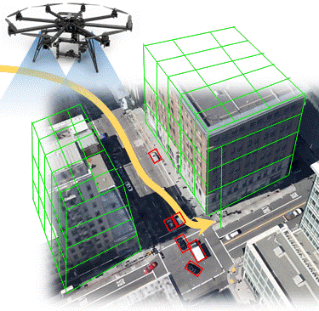
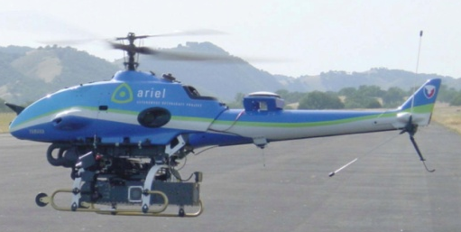
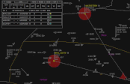
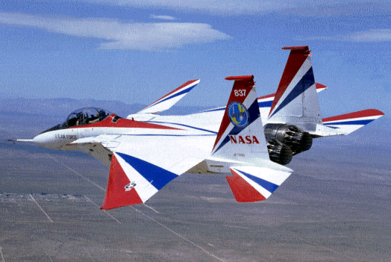
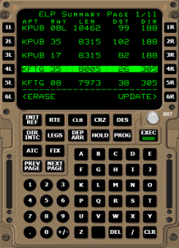
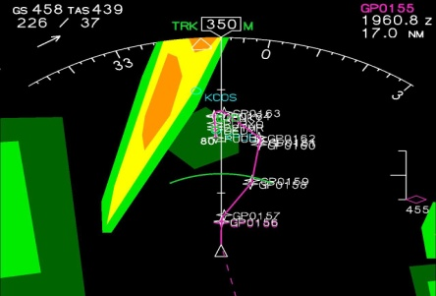

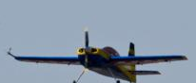
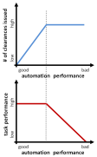
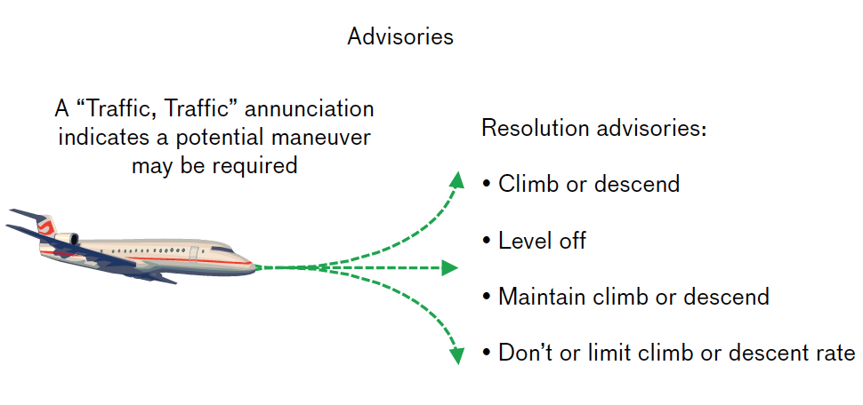
Autonomy for Aeronautics
15.6.1
2004 Autonomous Rotorcraft
Automated reasoning in the context of autonomous rotorcraft operations.
2012 Function Allocation
Automated ground-based separation assurance across increasing levels of autonomy
2015 sUAS Autonomy
Fully Autonomous urban deployment of sUAS—Vehicle Technologies and Airspace Management
4.5.1
4.1.2
15.5.1
4.5.1
2013 Prediction
Uncertainty
Operators compensating for imperfect autonomy
1999 Neural Net Learning
Dynamic Cell Structure
NN based learning for adaptive control
4.5.2
2010 Emergency Landing Planner
Decision support to the pilot of a damaged commercial transport aircraft
2011 Real-Time
Prognostics
Predict remaining useful battery life

Slide 9
Current Autonomy Pursuits
    Unmanned Aerial Systems
      UAS Integration in the NAS
      UAS Traffic Management
    Crew-Autonomy Teaming
      Partnering with DoD, cargo carrier
    Ab Initio Autonomous Architectures
      Exploratory efforts to examine far-term, clean-sheet airspace structures and controls

Slide 10
UAS Integration in the NAS Project

Slide 11
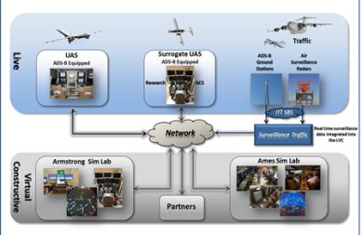
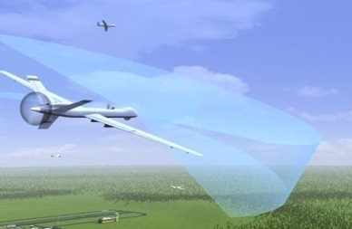
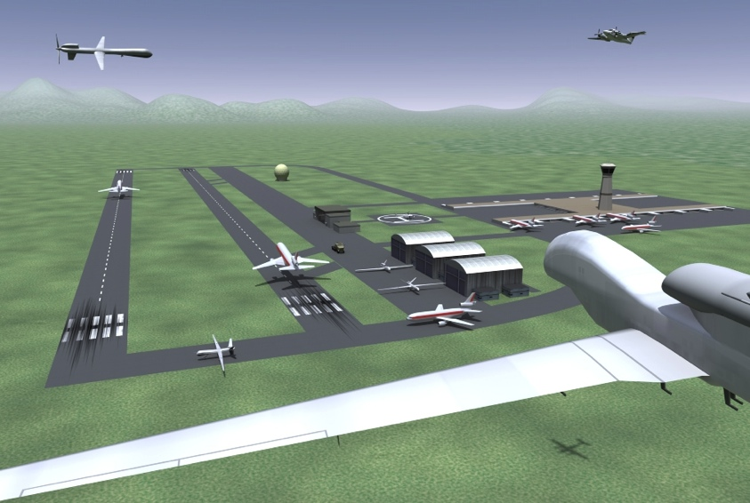

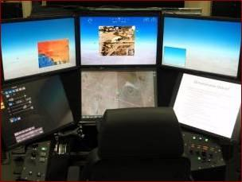
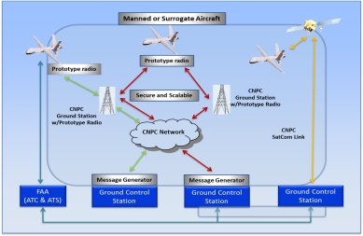
Project Goal, Research Themes, & Technical Challenges
Goal: Provide research findings to reduce technical barriers associated with integrating Unmanned Aircraft Systems into the National Airspace System utilizing integrated system level tests in a relevant environment
  Research Theme 1: UAS Integration - Airspace integration procedures and performance standards to enable UAS integration in the air transportation system
Research Theme 2: Test Infrastructure - Test infrastructure to enable development and validation of airspace integration procedures and performance standards
TC-SAA:
Sense and Avoid Performance Standards
TC-ITE: Integrated
Test & Evaluation
TC-C2:
Command & Control Performance Standards
TC-HSI: Human
Systems Integration

Slide 12
IT&E Integrated Test Flow
FY14
FY15
FY16
Preliminary MOPS Development
MOPS Verification & Validation
Integrated Human in the Loop Development
Preliminary
MOPS Inputs
Aug 2014
Preliminary
MOPS Inputs
Jan 2015
RTCA SC-228 Preliminary MOPS
July 2015
Final MOPS Inputs
Oct 2015
Final MOPS Inputs
May 2016
RTCA SC-228
Final MOPS
July 2016
Rqmts
Peer Reviews
(9/11-12, 16)
∆SRR
(11/6-7)
SWRR
(12/19)
∆FDR
(3/4-5)
TRR
(5/30)
FY13 APG
LVC Charac. Report
(9/30/13)
FY14 APG
IHITL Report
Scenario
Build-up
Component
Testing
V&V
IHITL Sim Complete
(8 /8)
Trial Planning
Development
SAA Initial Flight Tests
Ikhana FCFs
(10/22 – 10/31)
∆FRR
(9/5)
Ikhana
SAA Initital Flight Tests Complete
(1 /15)
SAA Initial Flight Tests Start
11/3/14
PDR
(4/25)
CDR
(6/3)
Ikhana
Mods
SAA Initital FT
(11/1 ~ 1/15)
Ikhana
Deployment
(6/15 – 8/14)
Tech Brief/
AFSRB
(10/21)
Partner Intruder Flts
Flight Test Series 3 Development
∆SRR (FT3/FT4)
(9/11)
SWRR
(10/24)
∆FDR
(2/17)
Tech Brief
(6/10)
FT3 Report
(10/15)
FT3
Start
7/28/14
Obj/Req
Component
Testing and
Scenario Build-up
Integration
and V&V
CST
5/21
FT3 Complete
(8/14)
Flight Test Series 4 Development
(& Capstone Demo)
Level 1 Milestone
Reviews
Annual Performance Goal/Indicator
Development Milestones
Tech Brief
(2/16)
∆FDR
(10/13)
Capstone
Doc.
FT4 Report
(5/20)
Component
Testing and
Scenario Build-up
CST
1/27
FT4 Complete
(4/14)
FT4
Start
8/27/15
Capstone
Complete
(4/29)

Slide 13
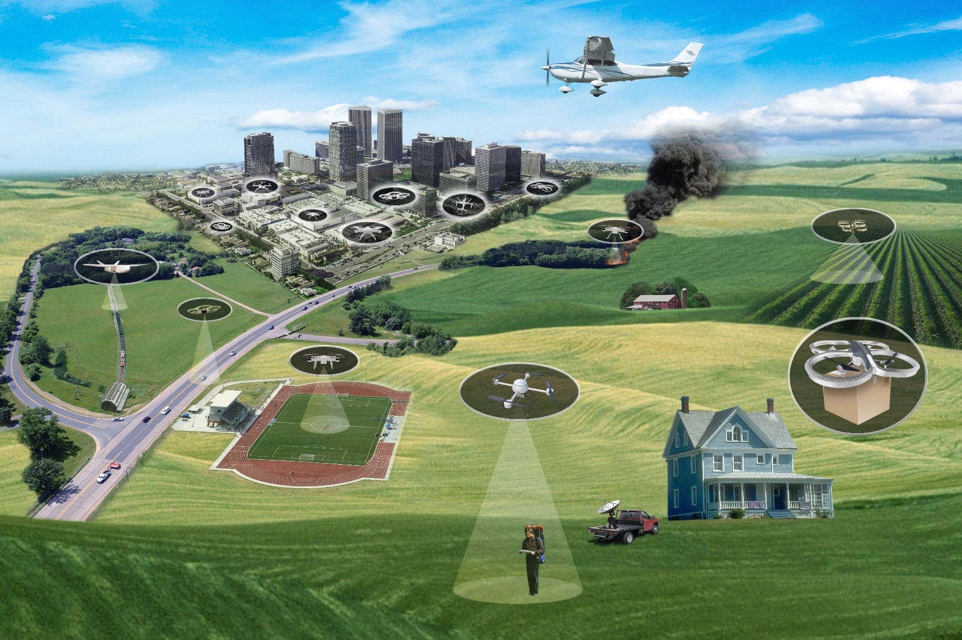
UAS Traffic Management (UTM)
Near-term goal: Safely enable initial low-altitude UAS operations as early as possible
Long-term goal: Accommodate increased demand with highest safety, efficiency, and capacity.
Notes:
Flexibility where possible, and structure where necessary
Consider the needs of national security, safe airspace operations, economic opportunities, and emerging technologies
Risk-based approach based on population density, assets on the ground, density of operations, etc.
Digital, virtual, dynamic, and as needed
UTM services to manage operations

Slide 14
UTM: Balancing Multiple Needs
National and Regional Security
Protecting key assets
Safe Airspace Integration
Flexibility where possible, and structure where needed
Applications to incorporate geographical constraints, and performance-based airspace operations
Scalable Operations for Economic Growth
Support ever-increasing applications of UAS: Commercial, Agricultural, and Personal

Slide 15
What is UTM?
Research software application prototype that (1) allows UAS operators to submit flight plans to execute a specific mission in low-altitude airspace, and (2) determines how to safely enable such single or multiple UAS operations either within visual line-of-sight or beyond visual line-of-sight
  Allows requester to create and submit one or more trajectories
  Shows all airspace constraints (dynamic and static geo-fences)
  Supports connection to external subsystems (e.g., 3D maps, weather data, etc) through standardized interface protocols
  Assesses and advises for trajectory interference or constraint violations
  Provides multiple trajectories for the same UAS with rank ordering to seek the best available trajectory in presence of other operations and constraints
  Tracks vehicle position and adjusts as needed
Airspace Manager and UAS operators are primary users
Cloud-based user access

Slide 16
UTM Technical Capabilities
Each level is incremental upon the capabilities of the prior level
Capability 1 (August 2015)
  Within visual line-of-sight
  Reservation of airspace volume
  Over unpopulated land or water
  Minimal general aviation traffic in area
  Contingencies handled by UAS pilot
  Enable agriculture, firefighting, infrastructure monitoring
Capability 3 (January 2018)
  Beyond visual line of sight
  Over moderately populated land
  Some interaction with manned aircraft
  Tracking, V2V, V2UTM and internet connected
  Public safety, limited package delivery
Capability 2 (October 2016)
  Beyond visual line-of-sight
  Tracking and low density operations
  Sparsely populated areas
  Procedures and “rules-of-the road”
  Longer range applications
Capability 4 (March 2019)
  Beyond visual line of sight
  Urban environments, higher density
  Autonomous V2V, internet connected
  Large-scale contingencies mitigation
  News gathering, deliveries, personal use

Slide 17
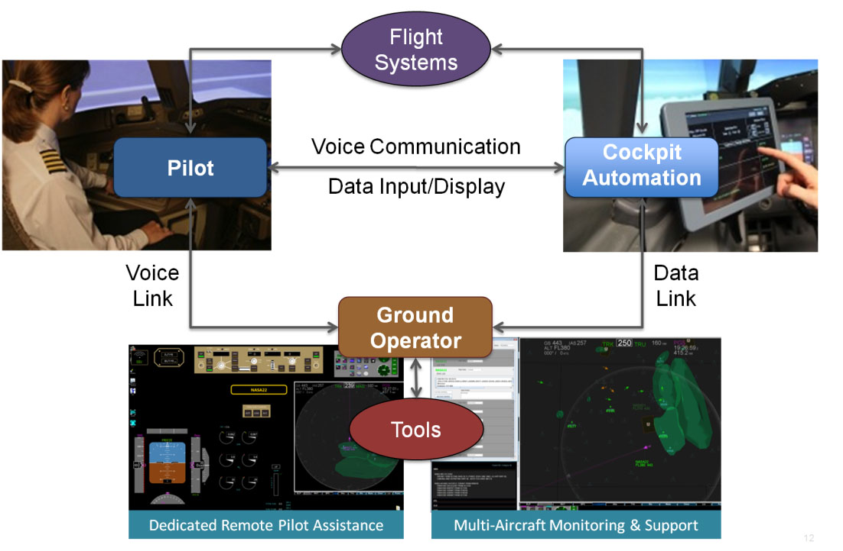
Crew-Autonomy Teaming
Increasingly Autonomous Systems
  Automated Procedures and
  Checklist Interactions
  Aircraft Monitoring & Assessment
  Predictive a/c state and clearance
  compliance monitoring
  Detecting, diagnosing and
  responding to non-normal conditions
  Autonomous Flight Planning
Human/Autonomy Teaming (HAT)
  Function Allocation (FA) and Crew Resource Management
    Adjustable, adaptive, and/or mixed initiative autonomy
  Collaboration tablet (shared documents, text & video chat, voice interface)
  Human-Machine Interfaces (HMI)
    Transparent and collaborative autonomy; Multi-modal interaction
  Futuristic Flight Deck and/or Ground Station Technologies
    Flight, Automation, and Information Management (FAIM) system
    Simplified Autoflight Testbed (SAT)

Slide 18
V&V of Uncertainty
ACAS X:
the next generation onboard collision avoidance system, to replace TCAS
PROBLEM: Software for autonomy is designed to deal with uncertainty and is hard to verify. For example, ACAS X is based on models that capture pilot or intruder behavior and state estimation probabilistically.
ACHIEVEMENTS: 1) VeriCA – tool for design and verification of probabilistic systems. 2) RLES – tool for automatic generation of high probability aircraft scenarios that trigger undesirable behavior in ACAS X.
IMPACT: Both tools applied to ACAS X, and transferred to the FAA. VeriCA identified a design problem of an early ACAS X prototype. RLES is used by ACAS X team to generate scenarios leading to Near Mid Air Collision.

Slide 19
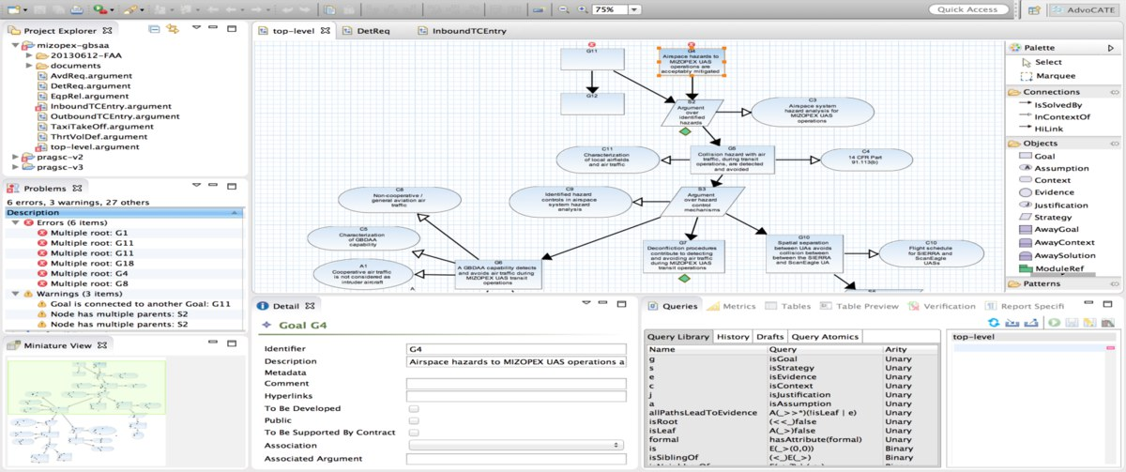
Safety Cases for Autonomy
PROBLEM: FAA’s safety case requirement for ‘non-standard’ UAS operations presents very high bar for entry to the NAS.
ACHIEVEMENTS: AdvoCATE tool facilitates development of safety cases through semi-automated generation, reducing barrier to autonomous missions and supporting eventual certification.
IMPACT: NASA Ames used AdvoCATE to create the first operational safety case accepted by the FAA for a Ground-based Sense and Avoid (GBSAA) mission. This was also the first safety case for civilian UAS in the NAS.

Slide 20

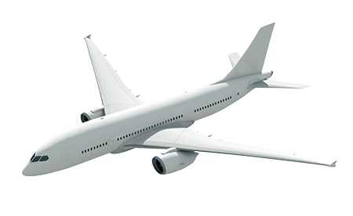
Back-Up

Slide 21
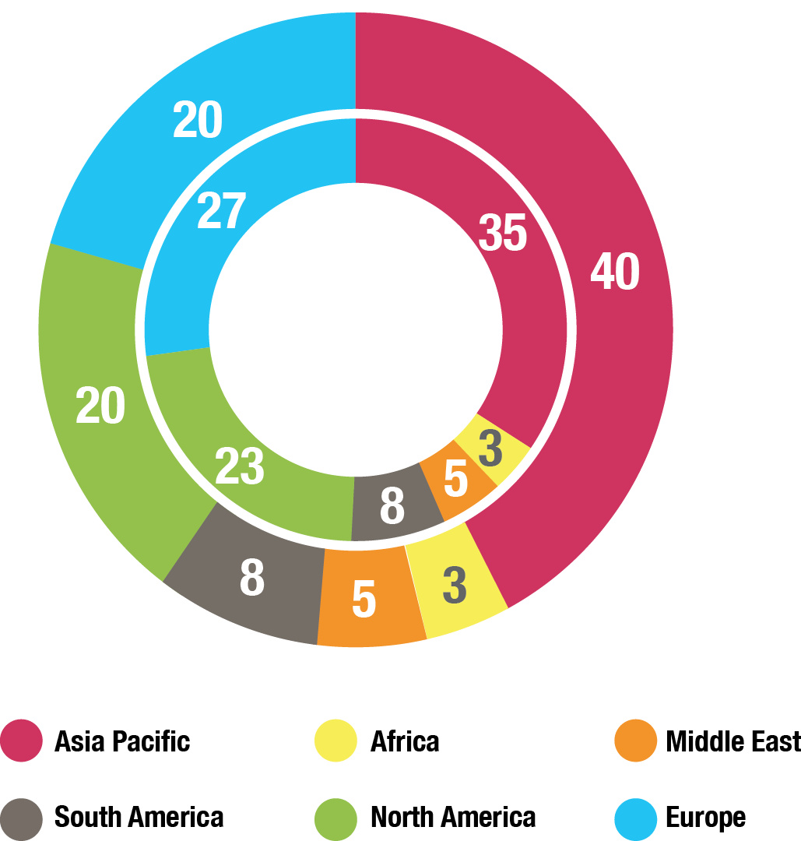
Global Growth in Aviation: Opportunities and Challenges
Global Air Passengers by Region (% of Total)
2014
Global Aviation
Industry
3.3B Passenger Trips
North America and Europe combined is half of all Passenger Trips
58M Jobs
$2.4T GDP
2034
Global Aviation
Industry, est.
7B Passenger Trips
Asia-Pacific Passenger
Trips equal to
North America and
Europe combined
105M Jobs
$6T GDP
Over 36,000 New Aircraft required (replacement and growth) over the
20 year period
($4-$5T value)
Sources: International Air Transport Association, Air Transport Action Group, Boeing
Major Opportunities / Growing Challenges
Competitiveness—New state backed entrants, e.g., COMAC (China); Growing global R&D
Environment—Very ambitious industry sustainability goals; Large technology advances needed
Mobility—More speed to connect the worlds’ major cities; Opportunity for commercial supersonic flight
U.S. Technological Leadership Required!

Slide 22


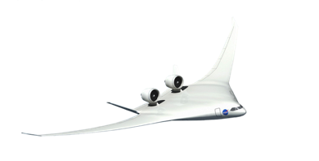



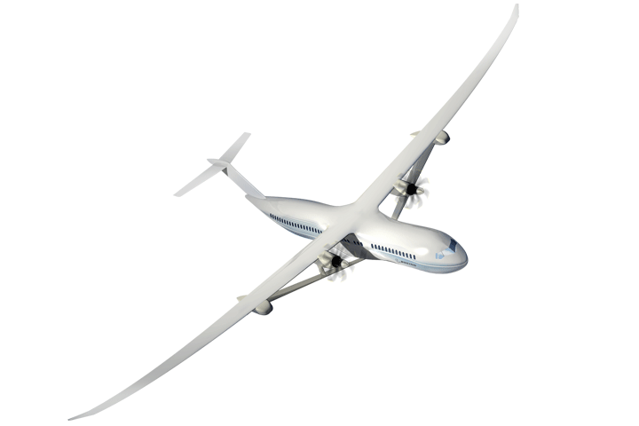
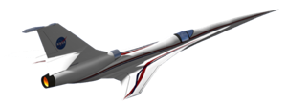


NASA Aeronautics Ready for Flight
Accomplishments and Planning
NASA Aero Vision and Strategy Established
Roadmaps Completed
2008-2013
2014/15
2016/17
2018-2026
N+3 Subsonic & Supersonic Concept/Technology Studies
Ground Testing of N+3 configurations and technologies
LBFD PDR
Completed
UEST PDR
Completed
N+2 Environmentally Responsible Aviation (ERA) Project Initiated
8 Integrated Tech Demos Completed, Tech transitioned to industry. HWB ready for Flight Dem/Val.
Ready for X-Plane Integration & Demonstration
NASA FAA NextGen Research Transition Teams (RTTs) Initiated
Technology Transitions to FAA: MSP, EDA, PDRC, TSAS
ATD-1 Completed and transferred to FAA
ATD-2, 3 Completed
& Transferred to FAA
Ready for NextGen TBO Integration & Demonstration

Slide 23

Ten Year Investment Plan—FY 2017 Budget Accelerates Key Components of NASA Aeronautics Plan
Fund the Next Major Steps to Efficient, Clean and Fast Air Transportation Mobility
New Aviation Horizons
Enabling Tools & Technologies
Revolutionizing
Operational Efficiency
Fostering Advanced Concepts & Future Workforce
UAS
Major series of ground experiments to ready key technologies for flight
Research and ground demonstration for an advanced small engine core for very high bypass engines and as a hybrid-electric propulsion enabler
Development of next generation physics-based models needed to design advanced configurations
Accelerate demonstration of full gate-to-gate Trajectory Based Operations
Strong continued research leadership in enabling UAS integration into the National Airspace. Extending the UAS in the NAS project for an additional 4 years
Start a continuing series of experimental aircraft to demonstrate and validate high impact concepts and technologies. Five major demonstrations over the next 10+ years in the areas of
Ultra-Efficiency,
Hybrid-Electric Propulsion, and Low Noise Supersonic Flight
Increased investment in new innovation through the NASA workforce and Universities
Leverage
Non-Traditional Technology Advances
Hypersonics
Pursue challenge prizes in areas such as energy storage, high power electric motors, advanced networking and autonomy
Increased investment to ensure a strong National fundamental research capability
Major New Initiative within IASP
Increases to AAVP and TACP
Increase to AOSP
Increase to TACP
Increases to IASP and AAVP
Build off of major current developments and accomplishments
Continue to incentivize
new innovation

Slide 24


