Slide 1
Draft FAA Responses to SAS F&R
Presented to: REDAC Subcommittee on Aircraft Safety (SAS)
Date: September 14, 2016

Slide 2
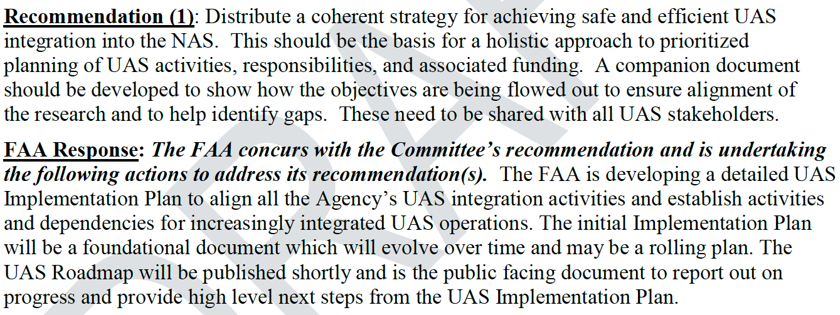
UAS Leadership & Strategic Planning

Slide 3
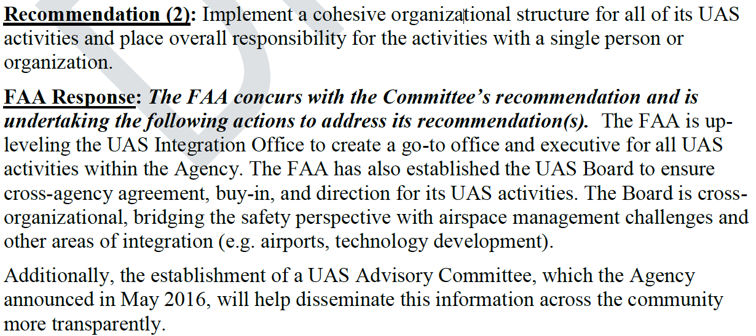
UAS Leadership & Strategic Planning

Slide 4
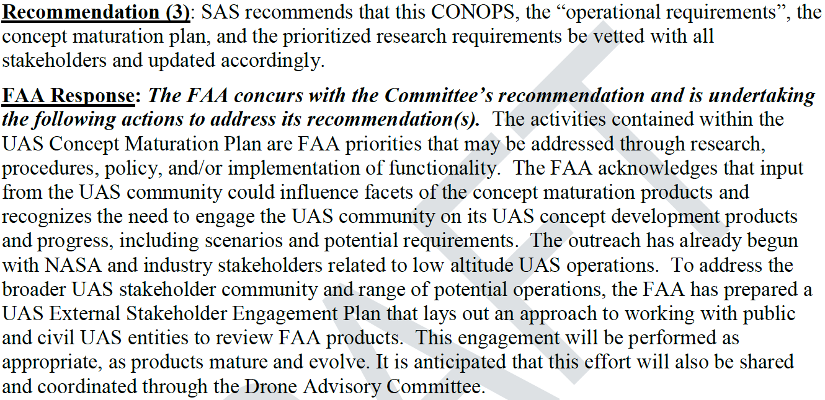
UAS ConOps & Concept Maturation Plan

Slide 5
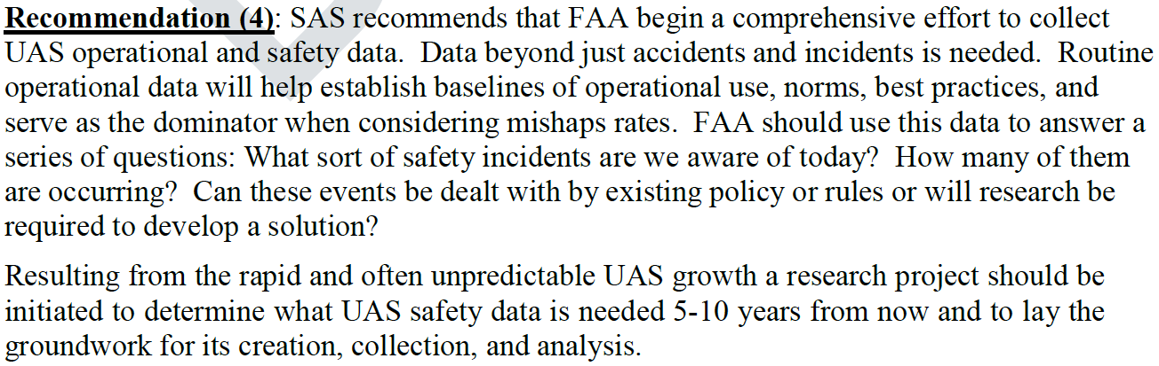
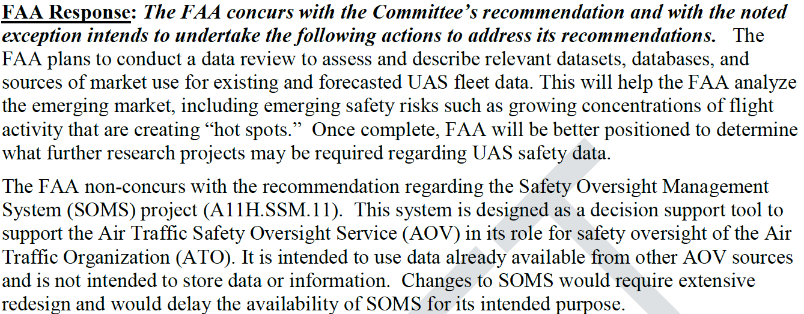
UAS ConOps & Concept Maturation Plan

Slide 6
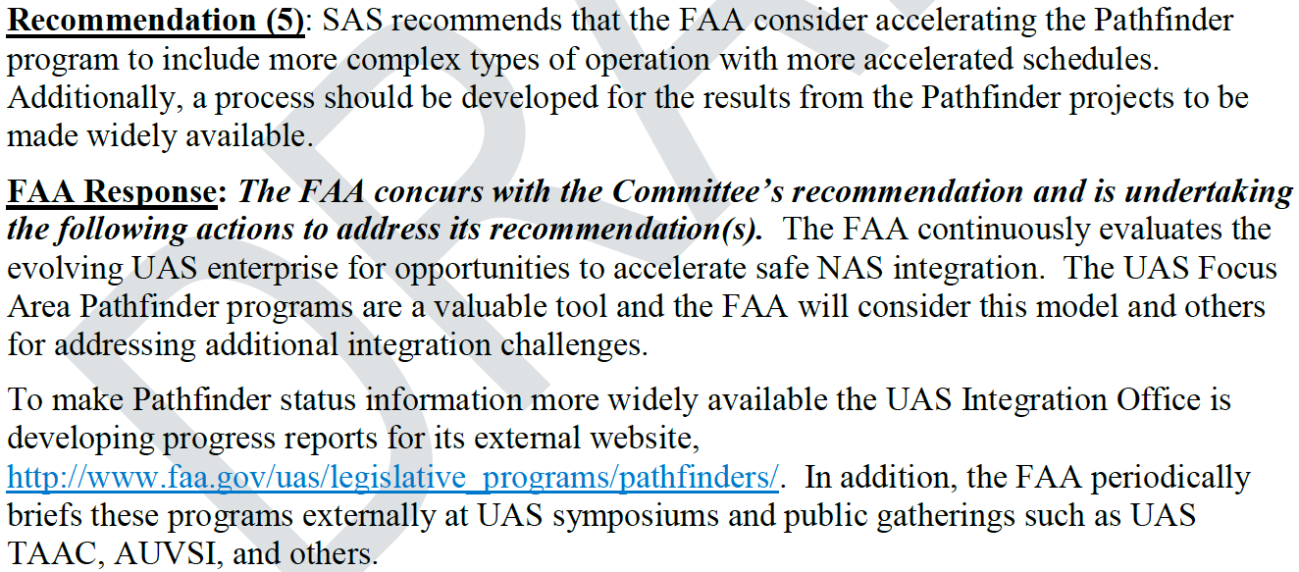
UAS ConOps & Concept Maturation Plan

Slide 7
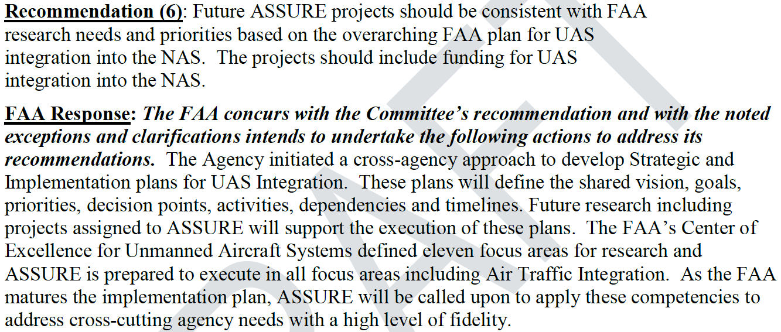
UAS Center of Excellence (ASSURE)

Slide 8
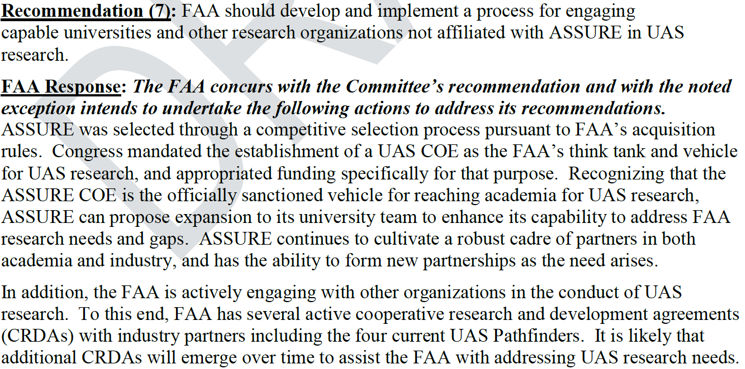
UAS Center of Excellence (ASSURE)

Slide 9
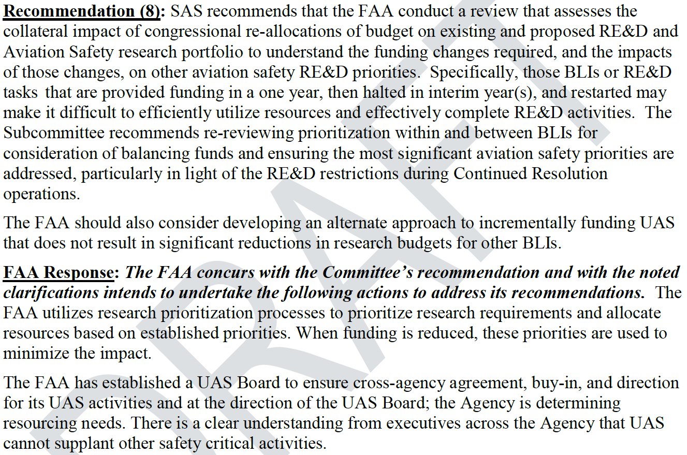
FAA Funding Impact on Other Safety Research Portfolio Items

Slide 10
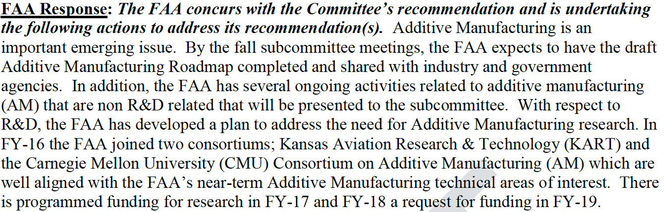
Additive Manufacturing (AM)

Slide 11
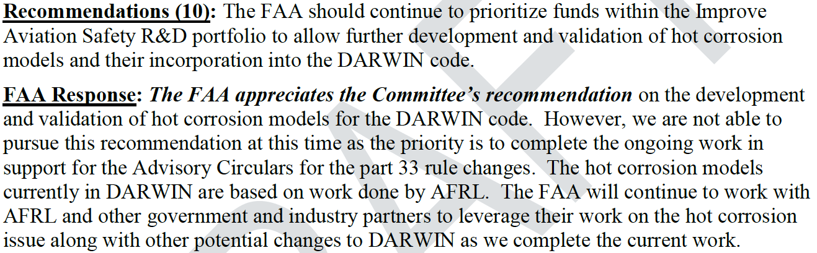
Advanced Materials Research – Supportive of SAS Emerging Issues

Slide 12
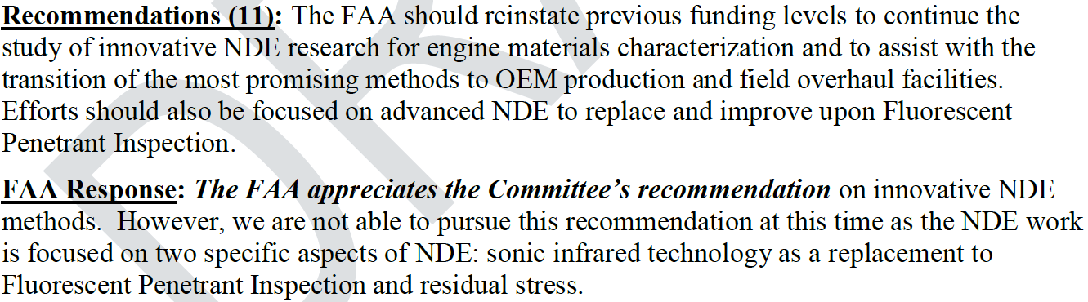
Advanced Materials Research – Supportive of SAS Emerging Issues

Slide 13
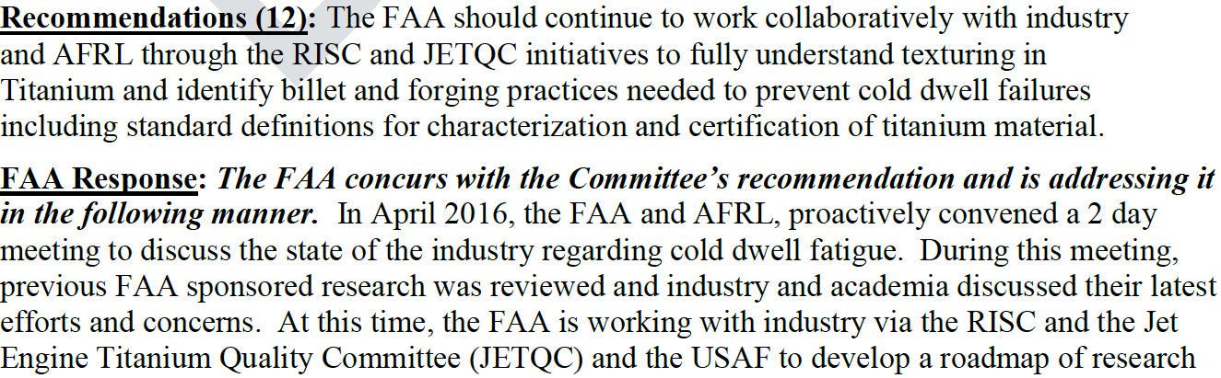
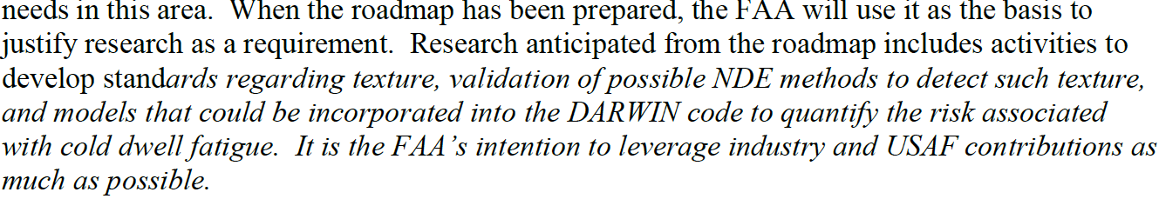
Advanced Materials Research – Supportive of SAS Emerging Issues

Slide 14
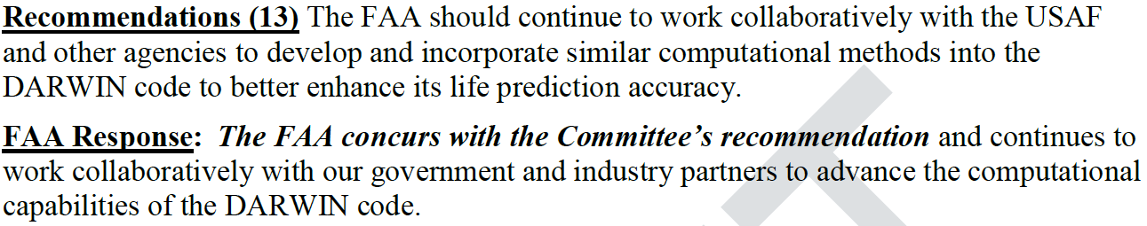
Advanced Materials Research – Supportive of SAS Emerging Issues

Slide 15
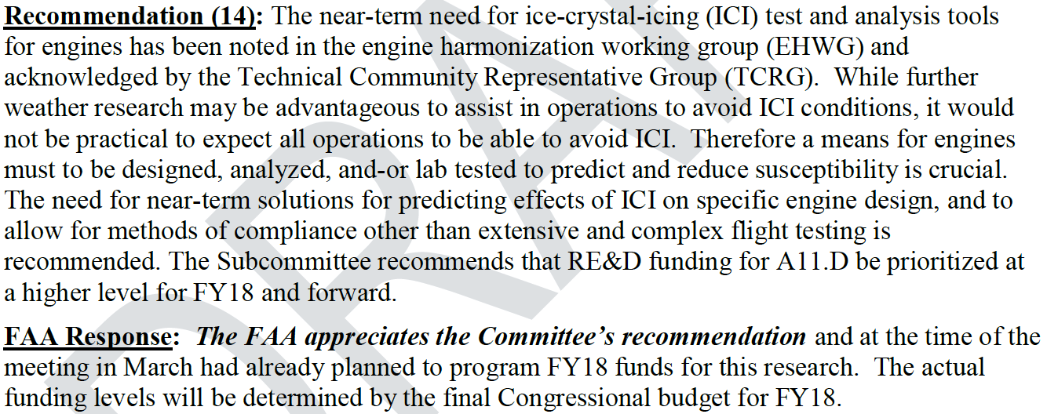
Research to Mitigate the effects of Ice Crystal Icing – engine test and analysis capabilities

