Slide 1
AVS Sponsored Research
FAA Supporting Organizations
REDAC - SAS
Mark S. Orr, AVS R&D Manager
3/8/2017

Slide 2
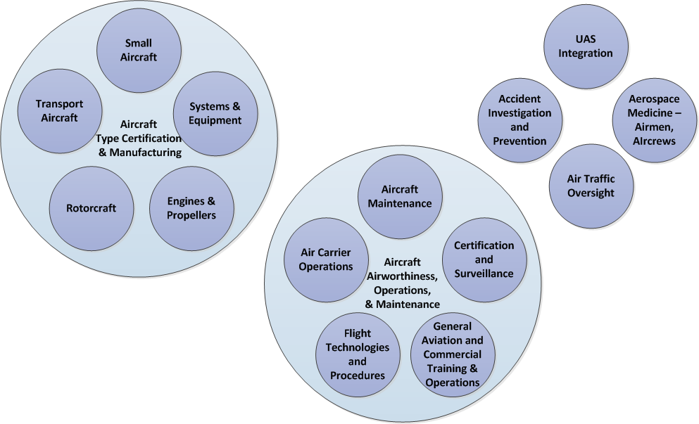
AVS Sponsors

Slide 3
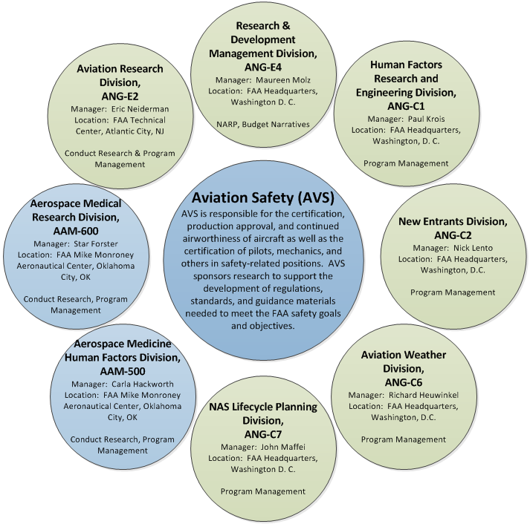
Research Support Organizations

