Slide 1
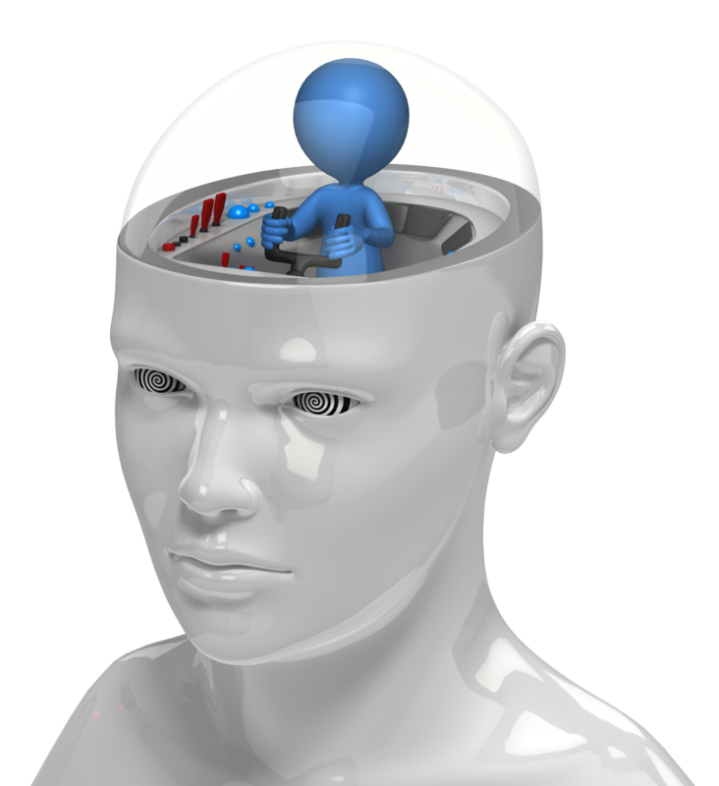
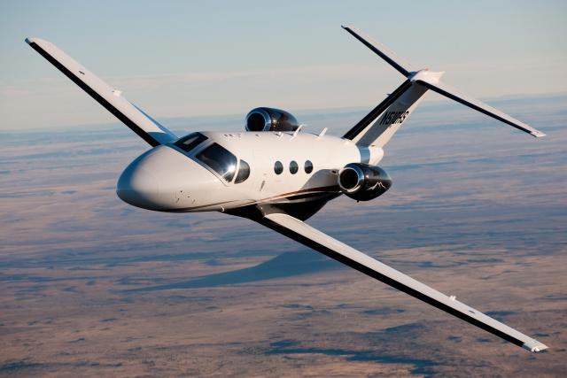
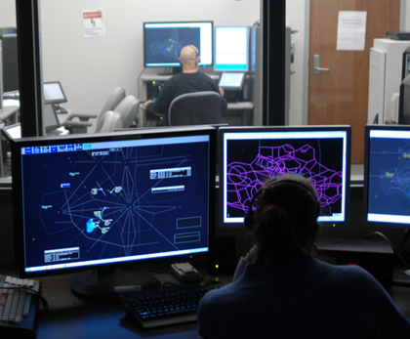
Human Factors Research Division (AAM-500)
  Flight Deck Human Factors Research Branch (AAM-510)
  NAS Human Factors Safety Research Branch (AAM-520)

Slide 2

Human Factors within FAA
  Multi-disciplinary field (combines psychology, engineering, physiology, and other areas) to generate and apply human performance information to acquire safe, efficient, and effective operational systems
    Design and optimization of work environments
    Consider human capabilities and limitations
      Human performance, fatigue, attention, user interface, human error
      Understand human psychological, social, physical and biological characteristics

Slide 3
Human Performance “Focuses on all job-related factors at the individual, group and organisational level”
TOPICS
Human Factors “Discipline applying scientific knowledge to optimise well-being and system performance”
Well-being (Fatigue)
Equipment & Tools (decision support tools)
Procedures
Teamwork
Training
Selection
Leadership
HP Assurance
Change Management
Roles & Responsibilities

Slide 4
Aerospace Human Factors Research Division
Organized into two branches
  NAS Human Factors Safety Research (AAM-520)
  Flight Deck Human Factors Research (AAM-510)
Conduct field and laboratory research
  Pilots, air traffic controllers, technical operations, mechanics, dispatchers, avionics technicians, flight attendants, and ramp workers
Research Drivers
  AVS RE&D Requirements Process for Flight Deck
  ATO Requirements Process for Air Traffic
  Research is primarily conducted under Program Directive/Level of Effort Agree­ments between the Federal Aviation Administration Human Factors Division (ANG-C1) and the Aerospace Human Factors Research Division (AAM-500) of the Civil Aerospace Medical Institute.
Emphasis on sponsor-driven research
  provides support and research results to sponsors so that they may develop rulemaking, provide policy guidance, inform certification requirements and offer mitigation/solutions
Our research includes
  Design and optimization of work environments
  Considering human capabilities and limitations
  Human performance, fatigue, attention, user interface, human error
  Understanding how human psychological, social, and biological characteristics affect job performance in aerospace occupations
Notes:
Expertise: Fatigue Management, Color Vision, Survey Methodology and Organizational Research, Data Analysis and Risk assessment

Slide 5
Flight Deck Human Factors Research Laboratory (AAM-510)
  Determine the effects of stressors on human performance, identify human factors involved in accidents and incidents, and quantify the effects of advanced NextGen displays, procedures, and task design on pilot performance.
Staff
  PhD-level manager
  10 PhD-level Research and Engineering Research Psychologist positions
    2-30 years experience
  3 MA/MS-level Psychological Technician positions
    6 years experience
  ~ 22 AAM-510/520 Student Volunteers
    2012 - 2017
Notes:
Vacancies =3

Slide 6
Flight Deck Human Factors
  Simulation Research Capabilities (Very Light Jet, Unmanned, Rotorcraft, Legacy General Aviation)
        Interchangeable displays and systems to identify information requirements and evaluate new technologies (e.g., advanced vision systems, avionics, and advanced control systems)
        Conduct HITL simulations of current/future technologies
        Assess effects of automation on performance
        Utilize HUD, HWD, and HDD technologies
  Biophysiological Research
        Colorvision Research Lab
        Fatigue Research Lab
  Human and Organizational Assessment
        Surveys, Training Assessments, and System Safety Reviews

Slide 7
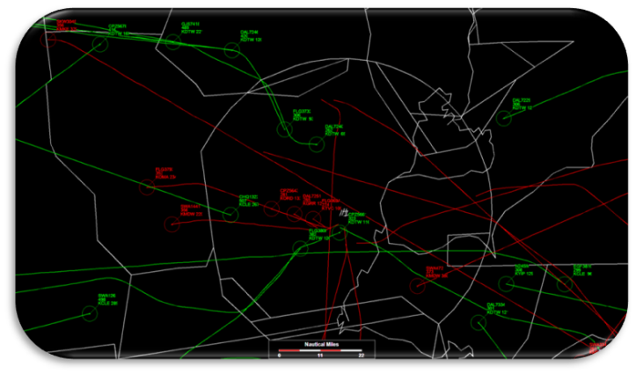
NAS Human Factors Safety Research Laboratory (AAM-520)
  Research focuses on the relationship of factors
  affecting individuals, teams, and organizations in the work environment. Examines improved person-job fit through training and changes to technology.
Staff
  PhD-level manager
  8 PhD-level Personnel Research and Engineering Research Psychologist positions
    10-30 years experience
  8 BS/MS-level Psychological Technician & Statistician positions
    New-15 years experience
HQ program & budget management provided by ANG-C1
Notes:
Vacancies N=5

Slide 8
AAM-520 Facilities/Capabilities
Air Traffic Simulators for Enroute, TRACON, and Tower Environments
        Identify information requirements and evaluate new technologies
        Conduct HITL simulations of current/future ATC environments
        Assess effects of automation on performance
Two labs with 54 workstations for mass computerized testing
ATCS longitudinal database matching aptitude test, experimental test scores, Academy test scores, FPPS (Federal Payroll and Personnel System) data, and field training data

Slide 9
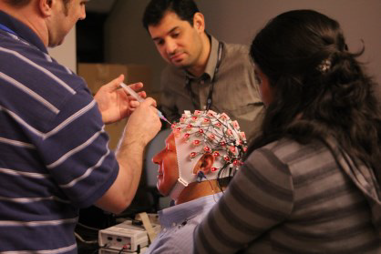
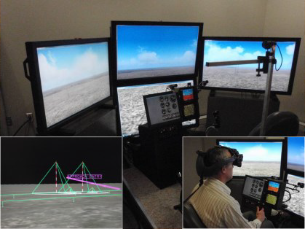
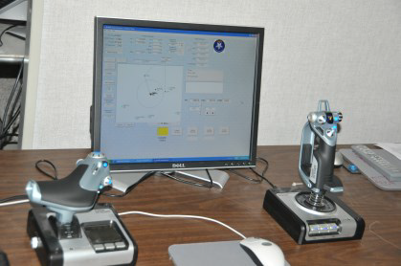
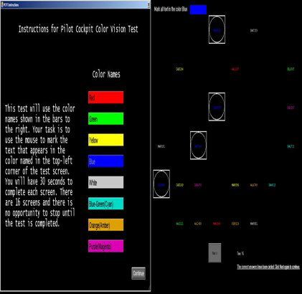
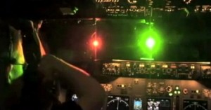
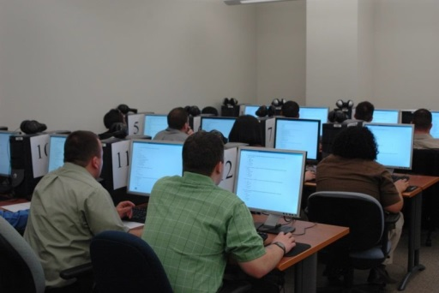
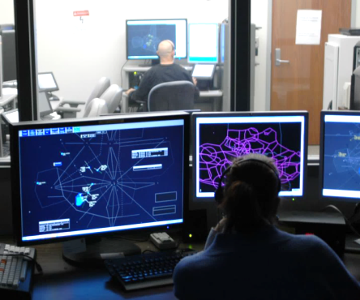
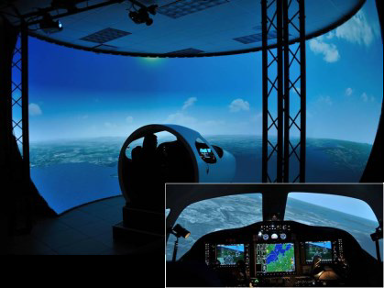
Capabilities
Notes:
Simulation
Flight Deck
GA, UAS & Rotorcraft
Angle of attack, enhanced flight vision systems, combined vision systems
Air Traffic
En Route, TRACON, Tower
Identify information requirements and evaluate new technologies
Assess trust in automation
Biophysiological Research
Fatigue Risk Management
LED Lighting
Color Vision Requirements
Human and Organizational Assessment
Surveys, Training Assessments and System Safety Reviews
Training and Performance
Conduct job analyses, develop individual and group performance metrics
Evaluate training programs
Maintain ATCS database; conduct analyses that respond to sponsors’ research

Slide 10
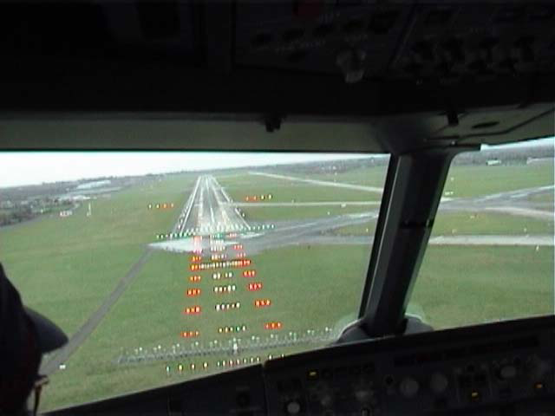
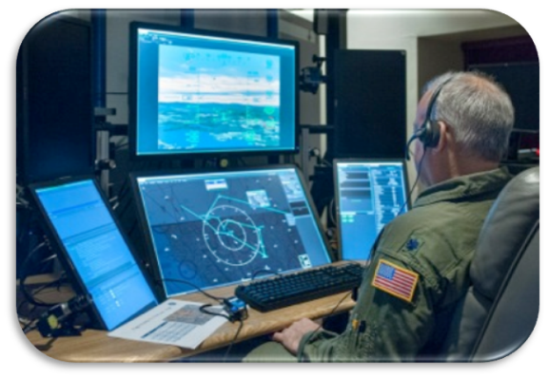
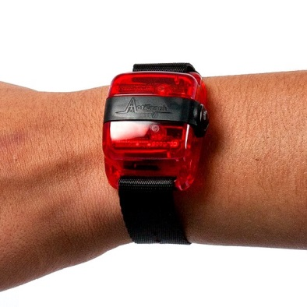
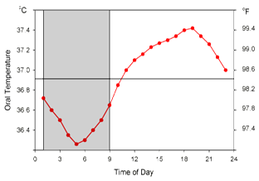
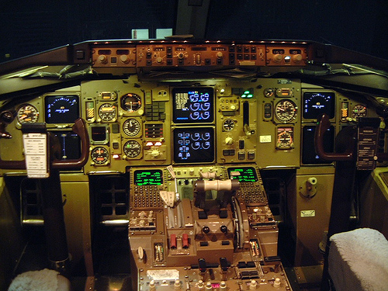
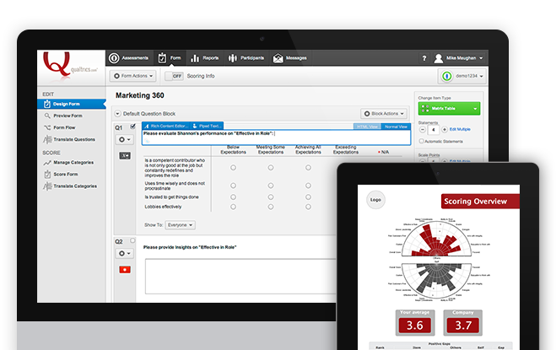
Capabilities (cont.)
Notes:
Simulation
Flight Deck
GA, UAS & Rotorcraft
Angle of attack, enhanced flight vision systems, combined vision systems
Air Traffic
En Route, TRACON, Tower
Identify information requirements and evaluate new technologies
Assess trust in automation
Biophysiological Research
Fatigue Risk Management
LED Lighting
Color Vision Requirements
Human and Organizational Assessment
Surveys, Training Assessments and System Safety Reviews
Training and Performance
Conduct job analyses, develop individual and group performance metrics
Evaluate training programs
Maintain ATCS database; conduct analyses that respond to sponsors’ research

Slide 11
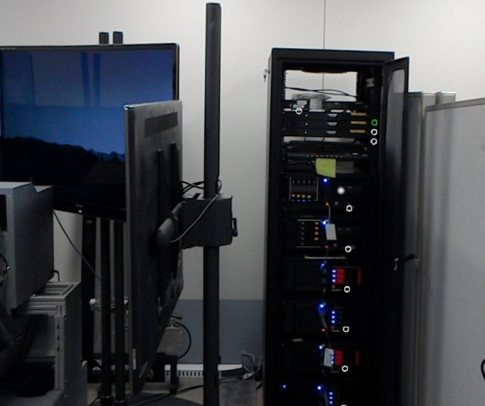
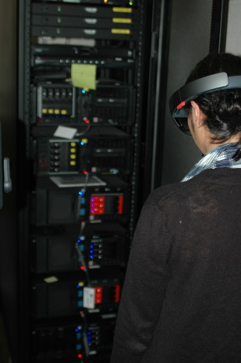
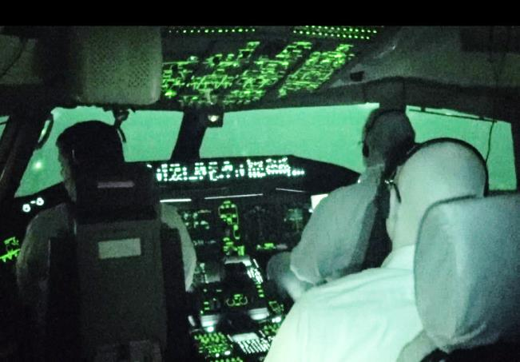
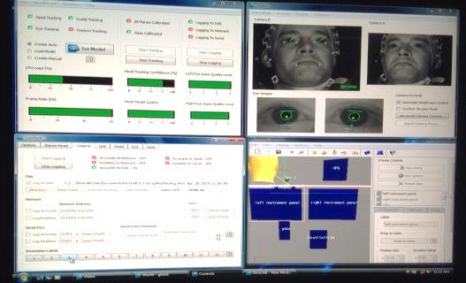
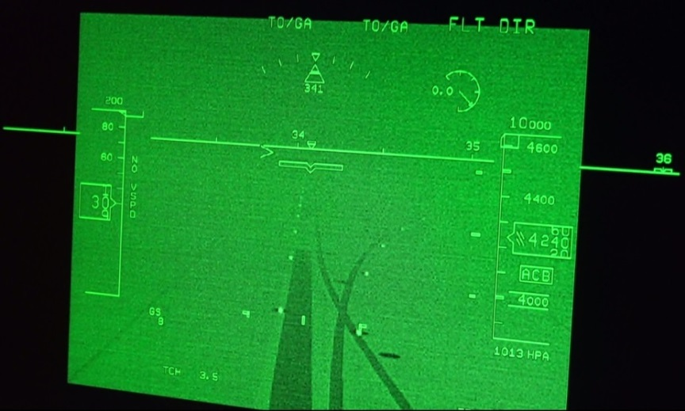
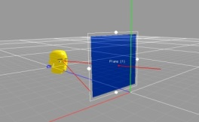
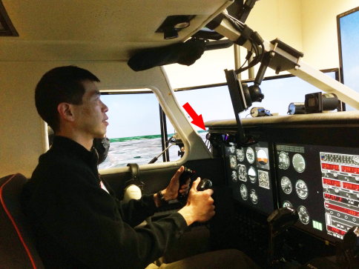
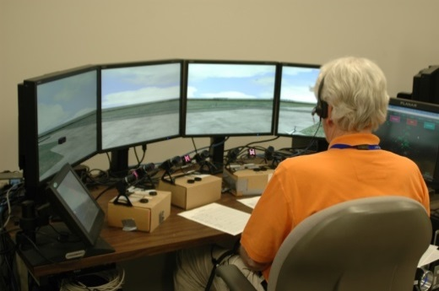

Capabilities (cont.)
Notes:
Simulation
Flight Deck
GA, UAS & Rotorcraft
Angle of attack, enhanced flight vision systems, combined vision systems
Air Traffic
En Route, TRACON, Tower
Identify information requirements and evaluate new technologies
Assess trust in automation
Biophysiological Research
Fatigue Risk Management
LED Lighting
Color Vision Requirements
Human and Organizational Assessment
Surveys, Training Assessments and System Safety Reviews
Training and Performance
Conduct job analyses, develop individual and group performance metrics
Evaluate training programs
Maintain ATCS database; conduct analyses that respond to sponsors’ research

Slide 12
These organizations sponsor our research:
Human Factors Division,
ANG-C1
Flight Standards Service,
AFS-1
Aircraft Maintenance Division,
AFS-301A
UAS Integration Office,
AFS-80
Federal Air Surgeon, Office of Aerospace Medicine,
AAM-1
Management Services,
AJG-0
Safety Analysis Branch,
AAI-220
ATO Safety and Technical Training,
AJI-0
Transport
Airplane Directorate,
ANM-111
ATO Program Management Organization,
AJM-0
Aircraft Certification Service,
ACE-114
Flight Standards Service – Air Transportation Division,
AFS-200
FAA Academy,
AMA-1
Chief Scientific and Technical Advisors,
AIR-100

Slide 13

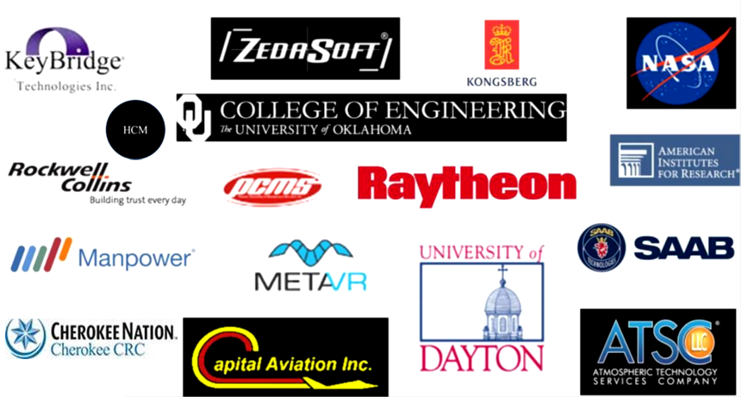



We partner with several other organizations to accomplish our research:
Flight Technologies and
Procedures Division
AFS-400

Slide 14
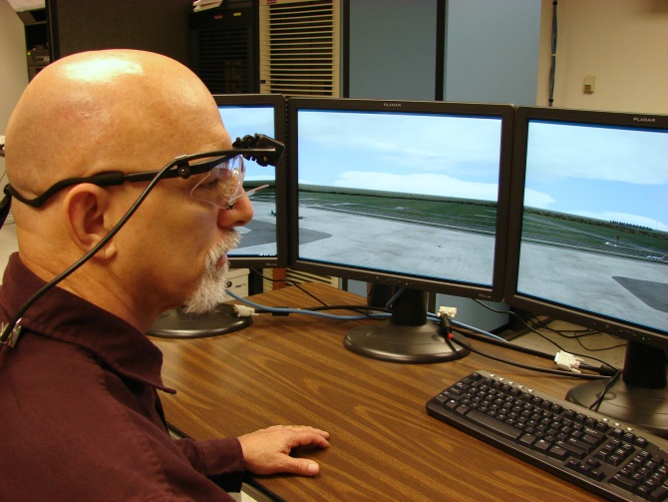
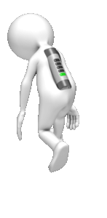
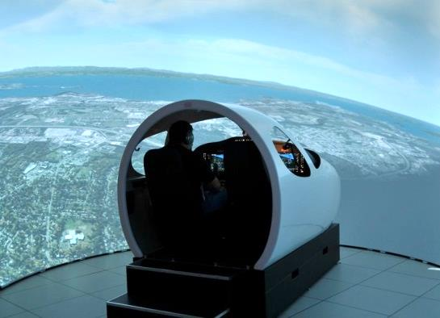
  Current Human Performance Research Areas
  FLIGHT DECK
  UAS Detect and Avoid
  Avionics Certification and Approval Criteria
  Advanced Vision Systems (EFVS, EVS, CVS, HUD, HMD, etc.)
  Fatigue Mitigation in Flight Operations
  Maintenance Risk Management
  Rotorcraft Safety
  General Aviation Angle of Attack
  LaserEye Protection
  Training for Complex Technologies and Automation
  AIR TRAFFIC
  Visual Scanning Techniques
  Tech Ops Strategic Job Analysis
  Longitudinal Training & Performance Database Evaluation of Radar
  Vector Aptitude Test Reasons for Field Training Failures Standardized
  Color Palette for ATC
Notes:
Integrate DAA display into UAS simulations using the Tech Center’s Unmanned Aircraft Traffic Display (UATD)
Update UATD by integrating NASA autoresolver algorithm information

