Slide 1
Update on NASA COTS and CCDev Programs
Presented to COMSTAC Reusable Launch Vehicle Working Group (RLVWG)
Brett Alexander, RLVWG Chair
May 10, 2011

Slide 2
Commercial Orbital Transportation Services (COTS) Update

Slide 3
Program Status
The COTS FY11 augmentation budget has been approved. $128M is allocated for each partner.
  SEC. 401. COMMERCIAL CARGO DEVELOPMENT PROGRAM. The Administrator shall continue to support the existing Commercial Orbital Transportation Services program, aimed at enabling the commercial space industry in support of NASA to develop reliable means of launching cargo and supplies to the ISS throughout the duration of the facility’s operation. The Administrator may apply funds towards the reduction of risk to the timely start of these services, specifically— (1) efforts to conduct a flight test; (2) accelerate development; and (3) develop the ground infrastructure needed for commercial cargo capability.
Associated new milestones for Orbital and first and second quarter’s for SpaceX have been negotiated. Final SpaceX mod is under review (contents will be presented).

Slide 4
Summary of the Augmentation
  Milestones that reduce risks associated with the remaining development and timely demonstration of cargo space transportation capabilities. The additional Milestones improve the chance of mission success by (1) augmenting ground and flight testing; (2) accelerating development of enhanced cargo capabilities; or (3) further developing the ground infrastructure needed for commercial cargo capabilities.
SpaceX
  Pressurized Cargo Environment Modal Test
  LIDAR Sensors 6 Degree of Freedom Testing
  Solar Array Deployment Tests
  Thermal Vacuum System Test
  Infrastructure Enhancements (Launch, Test and Production sites)
  Acoustic and EMI Tests, Second Flight-Like HTIL
  Enhanced Powered Cargo accommodations
Orbital
  Addition of Taurus II Maiden Flight
  Processor in the Loop (PITL) Simulators
  PROX FEU Test Unit Simulators

Slide 5
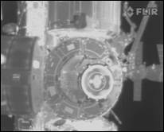
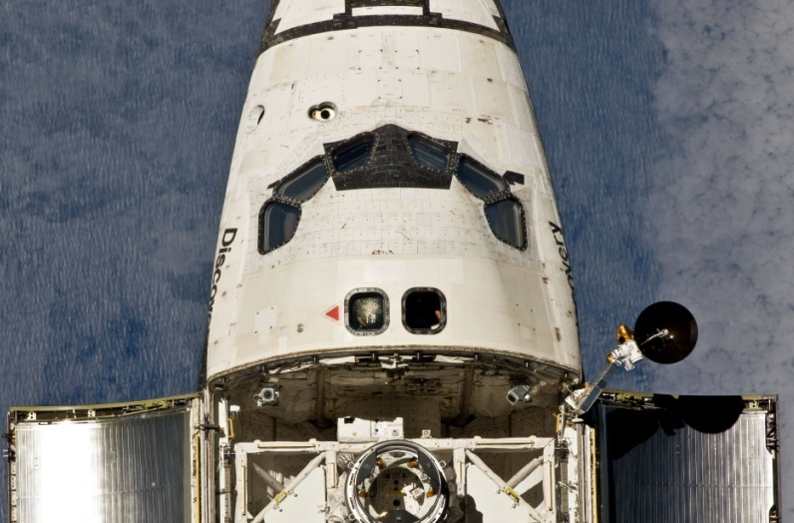
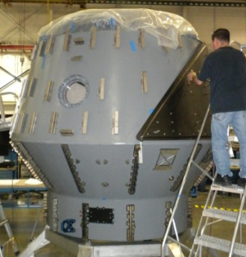
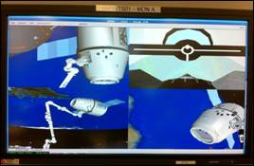
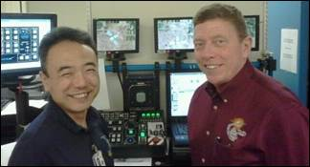
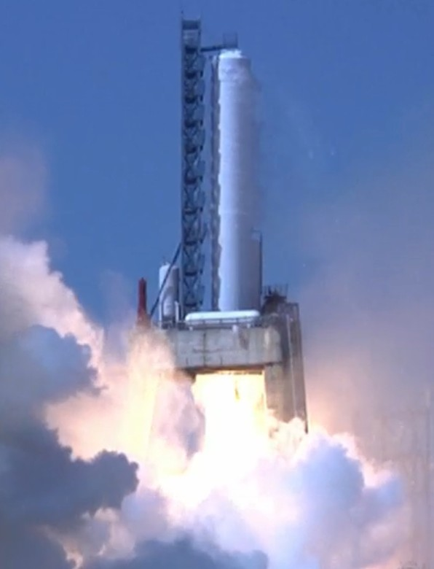
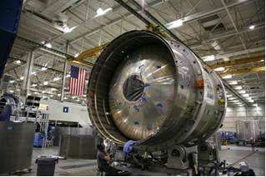
SpaceX Recent Progress
23 of 29 Milestones completed for a total of $283M NASA payments
  Evaluating proposal for accelerating C3 mission objectives on C2 flight
  DragonEye II launched on STS-133
    Preliminary LIDAR and Thermal Imager data collection was successful
  Performed mission sim with future ISS crew manipulating the Robotic Work Station – Dragon successfully berthed
C2 F9 First Stage in Texas, completed static fires
Second Stage delayed due to weld defects
C2 Dragon in final assembly
  Final Augmentation mod under review
    Complete TVAC, EMI, Acoustic test
    Complete infrastructure enhancements
    Powered Cargo improvement
DragonEye II Thermal Imager
DragonEye II on STS-133
C2 Dragon capsule in assy
Dragon berthing sim with future ISS Crew
C2 F9-003 1st Stage Static Fire
C2 F9-003 Second Stage

Slide 6
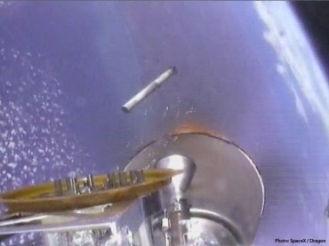
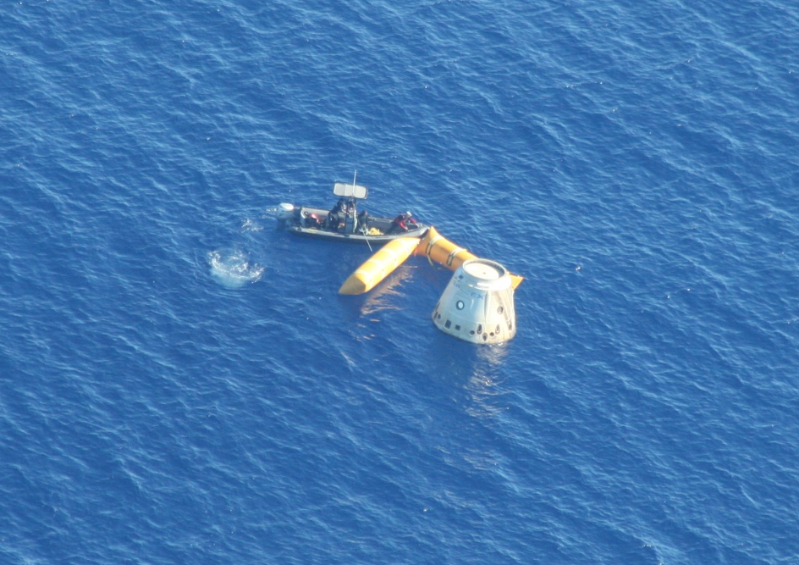
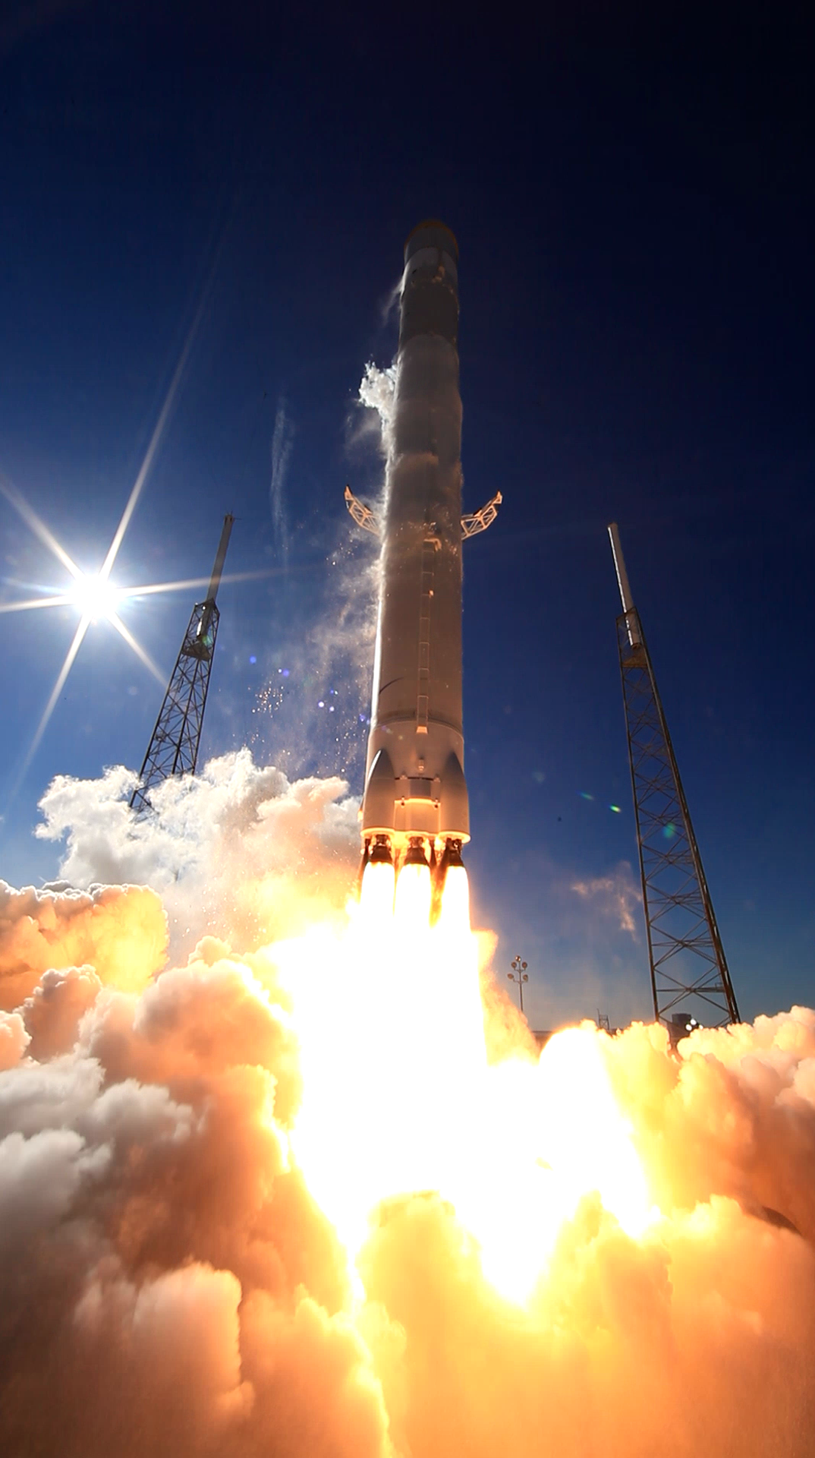
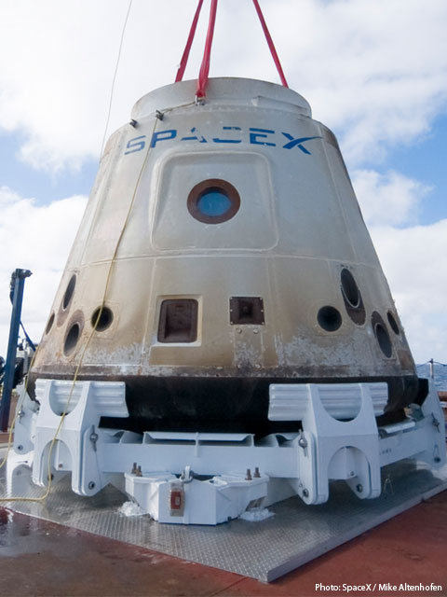
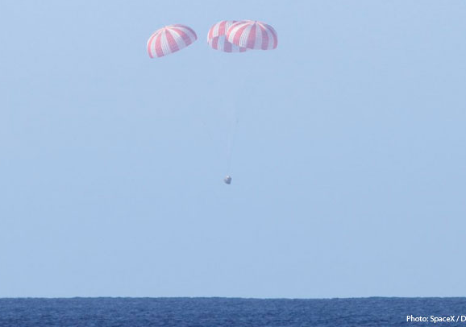
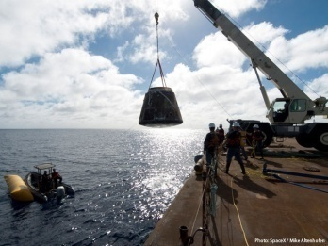
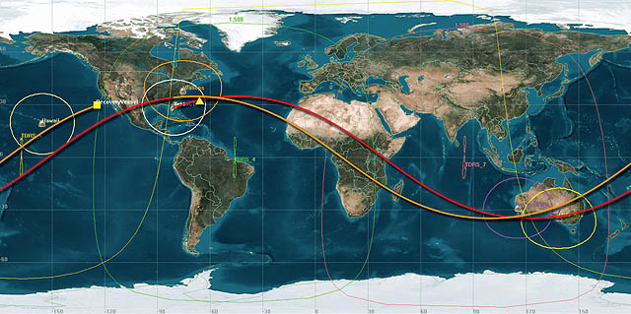
SpaceX C1 Demo Mission, Dec. 8, 2010
Moments after stage sep
Dragon Recovery of C1 Demo Flight
Dragon Approaching Splashdown
Dragon Recover Ops
C1 Demo Mission launching from KSC on Dec 8, 2010
Demo C1 Mission Orbital Path

Slide 7
SpaceX COTS Milestones
 |  | $M | $M | 2006 |  | 2007 |  |  |  | 2008 |  |  |  | 2009 |  |  |  | 2010 |  |  |  | 2011 |  |  |  | 2012
 | Milestones |  | Total | Q3 | Q4 | Q1 | Q2 | Q3 | Q4 | Q1 | Q2 | Q3 | Q4 | Q1 | Q2 | Q3 | Q4 | Q1 | Q2 | Q3 | Q4 | Q1 | Q2 | Q3 | Q4 | Q1 | Q2 | Q3 | Q4
 |  | 278.0
1 | Project Mgmt Plan | 23.1 | 23.1
2 | Demo 1 SRR | 5.0 | 28.1
3 | Demo 1 PDR | 18.1 | 46.2
4 | Financing Round 1 | 10.0 | 56.2
5 | Demo 2 SRR | 31.1 | 87.4
6 | Demo 1 CDR | 8.1 | 95.5
7 | Demo 3 SRR | 22.3 | 117.8
8 | Demo 2 PDR | 21.1 | 139.0
9 | Draco Init. Hot fire | 6.0 | 145.0
10 | Financing Round 2 | 10.0 | 155.0
11 | Demo 3 PDR | 22.0 | 177.0
12 | Multi-Engine Test | 22.0 | 199.0
13 | Demo 2/3 CDR | 25.0 | 224.0
14 | Financing Round 3 | 10.0 | 234.0
15 | Demo 1 RR | 5.0 | 239.0
16 | CUCU Flight Unit | 9.0 | 248.0
17 | Demo 1 Mission | 5.0 | 253.0
18 | Demo 2 RR | 5.0
19 | Demo 2 Mission | 5.0
20 | Cargo Int. Demo | 5.0 | 258.0
21 | Demo 3 RR | 5.0
22 | Demo 3 Mission | 5.0
Sep 15
Nov 29
Feb 8
Mar 1
Mar 15
Aug 22
Oct 29
Dec 19
Mar 21
Mar 21
Apr
Jun 27
Aug 4
Sep
Dec 18
Jan
Feb 8
Mar
Feb
Mar
Jun 8
May
Jul 23
Sep
Jun
Dec 15
Dec
Sep
Sep
Jun
Nov
Nov
Dec 18
Jan
Jul
Jan
Dec
Sep
Mar
Jan
Current Plan
Initial SAA Plan
Actual Completion Date
Projected
04-08-11

Slide 8
SpaceX Augmented COTS Milestones
 |  | $M | $M | 2007 |  |  |  | 2008 |  |  |  | 2009 |  |  |  | 2010 |  |  |  | 2011 |  |  |  | 2012
 | Milestones |  | Total | Q1 | Q2 | Q3 | Q4 | Q1 | Q2 | Q3 | Q4 | Q1 | Q2 | Q3 | Q4 | Q1 | Q2 | Q3 | Q4 | Q1 | Q2 | Q3 | Q4 | Q1 | Q2 | Q3 | Q4
 |  | 40.0
23 | Modal Test Plan | 5.0 | 5.0
24 | Modal Test | 5.0 | 10.0
25 | LIDAR Test (open loop) | 5.0 | 15.0
26 | Solar Array Deploy Test | 5.0 | 20.0
27 | LIDAR Test Plan (closed loop) | 5.0 | 25.0
28 | Thermal Vacuum Test Plan | 5.0
29 | Infrastructure Plan | 10.0
 | SAA Total | 318.0 | 278.0
Dec 16
Dec 16
Dec 16
Dec 16
Mar 31
Mar
Apr
Mar
Apr
Current Plan
Initial SAA Plan
Actual Completion Date
Projected
04-19-11

Slide 9
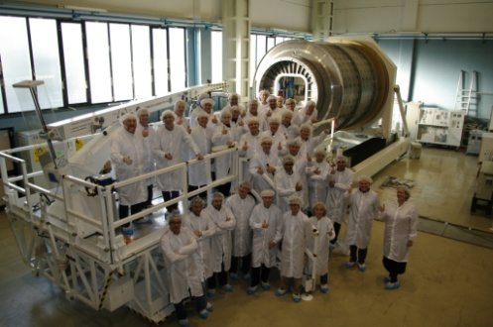
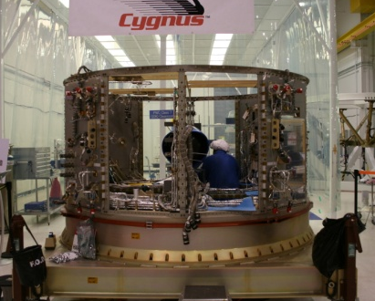
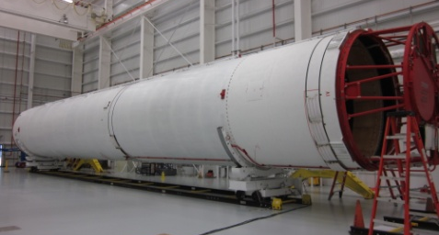
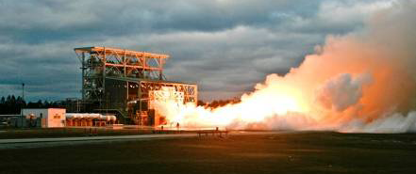
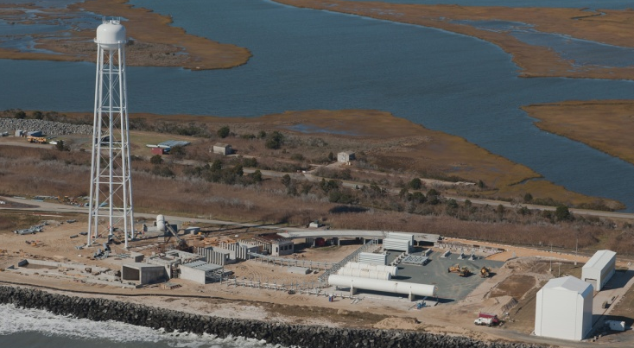
Orbital Recent Progress
18 of 29 total Milestones completed for a total of $197.5M NASA payments
  All Design reviews complete
  Spacecraft & launch vehicle hardware being integrated & tested
  ISS Phase II Safety Review Panel Complete
SAA renegotiated to augment scope of SAA to include Taurus II Test Launch and other risk reduction activities with associated additional funding commitments from NASA & OSC
Cygnus Spacecraft in assembly, integration & testing phase
  PCM nearing completion & prepping for shipment from Italy
  SM initiated system level integration & testing at OSC Dulles
Taurus II hardware making major progress toward test launch & demo
  2 – 1st stage Cores delivered to WFF from Ukraine
  3 AJ-26s successfully tested at SSC & 2 delivered to WFF
Wallops Flight Facility & MARS launch & integration facilities under construction
Cygnus PCM
Cargo Integration
Team
3rd AJ-26 Test Firing at SSC
Cygnus SM
Integration
T2 Test Launch
Core at WFF
Launch pad under
construction at WFF

Slide 10
Orbital COTS Milestones
 |  | $M | $M | 2008 |  |  |  | 2009 |  |  |  | 2010 |  |  |  | 2011 |  |  |  | 2012
 | Milestones |  | Total | Q1 | Q2 | Q3 | Q4 | Q1 | Q2 | Q3 | Q4 | Q1 | Q2 | Q3 | Q4 | Q1 | Q2 | Q3 | Q4 | Q1 | Q2 | Q3 | Q4
 |  | 170.0
1 | Program Plan Review | 10.0 | 10.0
2 | Demo Mission SRR | 20.0 | 30.0
3 | UCM PDR | 10.0 | 40.0
4 | DELETED
5 | COTS Int/Ops Facility | 10.0 | 50.0
6 | PCM PDR | 10.0 | 60.0
7 | DELETED
8 | IP&CL Submission | 10.0 | 70.0
9 | ISS Phase 1 SRP | 10.0 | 80.0
10 | COTS System PDR | 20.0 | 100.0
11 | PCM CDR | 10.0 | 110.0
12 | Cygnus Avionics Test | 10.0 | 120.0
13 | ISS Phase 2 SRP | 10.0 | 130.0
14 | COTS System CDR | 10.0 | 140.0
15 | SM Core Assembly Complete | 7.5 | 147.5
16 | SM Test Readines Review | 7.5 | 155.0
17 | SM Initial CPT | 5.0
18 | LV Stage I Assy. Complete | 2.5
19 | Cargo Int. Demo | 2.5 | 157.5
20 | Mission Readiness Review | 2.5
21 | System Demo Flight | 2.5
Mar 31
Jun
Jul 17
Jul
Aug 14
Sep 22
Oct
Oct 9
Nov
Feb 18
Mar 27
Sep
Apr
May 22
Jul 31
Jun
Aug 13
Aug
Nov 6
Mar
Sep
Mar 23
Oct
Dec
Aug 30
Jan
Apr
Nov 17
May
Jun
Sep
Sep
Dec 6
Oct
Oct
Dec
Dec
Current Plan
Initial SAA Plan
Actual Completion Date
Projected
03-30-11

Slide 11
Orbital Augmented COTS Milestones
 |  | $M | $M | 2008 |  |  |  | 2009 |  |  |  | 2010 |  |  |  | 2011 |  |  |  | 2012
 | Milestones |  | Total | Q1 | Q2 | Q3 | Q4 | Q1 | Q2 | Q3 | Q4 | Q1 | Q2 | Q3 | Q4 | Q1 | Q2 | Q3 | Q4 | Q1 | Q2 | Q3 | Q4
 |  | 118.0
22 | TII Test Flight Mission Review | 20.0 | 20.0
23 | TII Test Flight Mission Analys. | 10.0 | 30.0
24 | Cygnus Mass Sim. (CMS) DR | 10.0 | 40.0
25 | Install Add’l PITL Simulators | 5.0
26 | PROX FEU Test Unit | 5.0
27 | TII Maiden Flt Stg 1 Core Del. | 24.0
28 | TII Maiden Flt Uppr Stage Del. | 20.0
29 | TII Maiden Flt CMS Delivered | 10.0
30 | TII Maiden Flt Stage 1 Assy. | 10.0
31 | TII Maiden Flight | 4.0
 | SAA Total | 288.0 | 197.5
Dec 15
Feb 23
Mar 03
Apr
May
Apr
Jun
Jun
Jul
Oct
Current Plan
Initial SAA Plan
Actual Completion Date
Projected
03-30-11

Slide 12
Commercial Crew Program Update

Slide 13

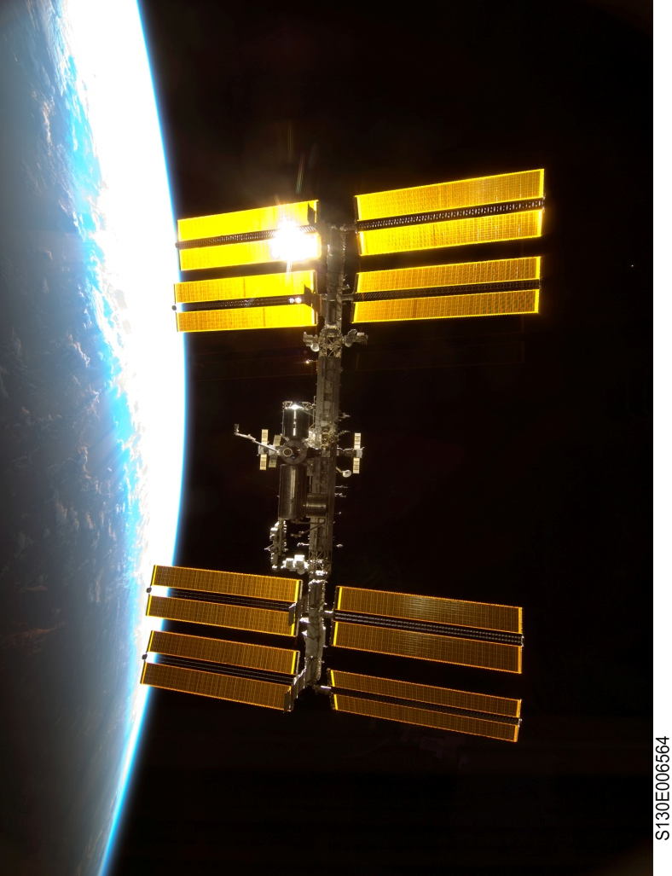
Program Approach
Fiscal Year
2011 | 2012 | 2013 | 2014 | 2015 | 2016 | 2017 | 2018 | 2019 | 2020
Demo/Test Flights
Commercial Crew
Initial Design
Critical Design
Certification
Missions
The 2010 NASA Authorization Act established commercial crew as the primary means for ISS crew transportation.
The program objective is to facilitate the development of a U.S. commercial crew space transportation capability for achieving safe, reliable, and cost effective access to and from LEO and the International Space Station (ISS) by late 2016.
  Use a non-traditional acquisition and partnering approach
  Competition is a fundamental aspect of the strategy
  NASA could purchase commercial services to meet its ISS crew transportation needs

Slide 14
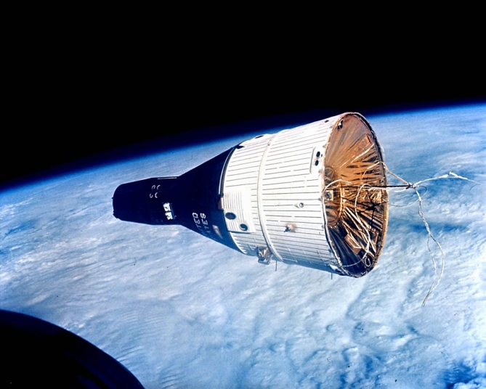
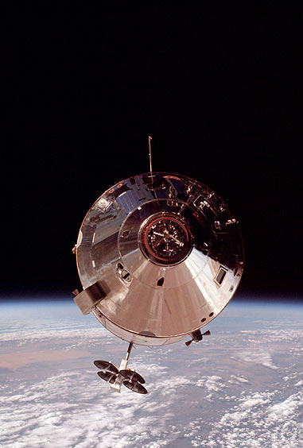
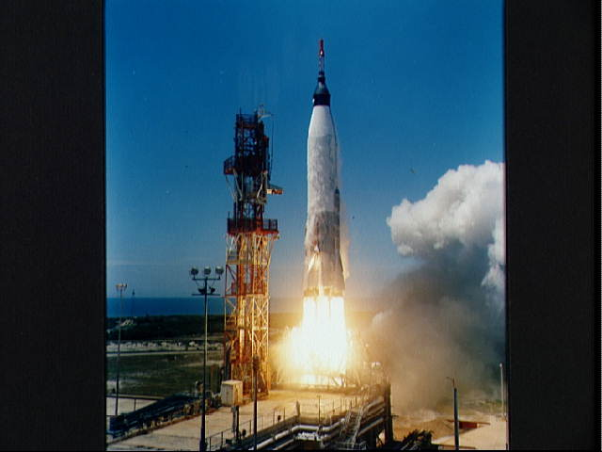
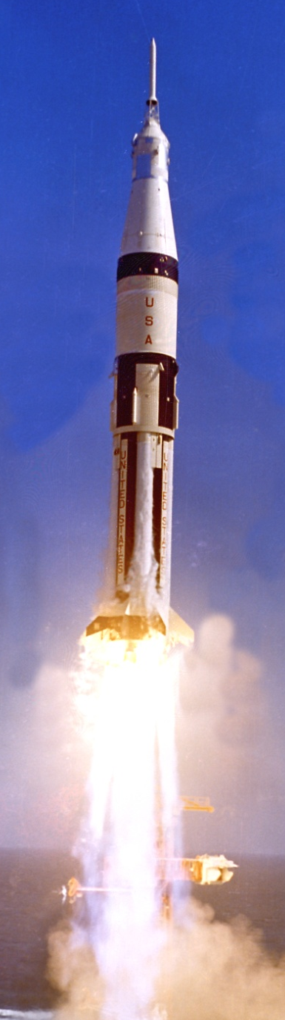
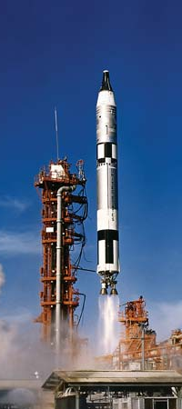
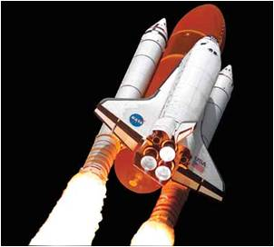
Commercial Crew Program (CCP)
CCP is leading NASA’s efforts to develop an American-made commercial capability for crew transportation and rescue services to the station following this year's retirement of the space shuttle fleet.
  Program Manager will reside at KSC
  Deputy Program Manager located at JSC
Program Mission
  Manage the investment in the development of commercial end-to-end transportation systems
  Manage the CTS (Crew Transportation System) certification process
  Lead the technical and programmatic partner integration and approval functions

Slide 15
Commercial Crew Program Organizational Structure
Human Exploration & Operations Directorate
C3PO Program
Commercial Crew Program
FAA
ISS Program
Technical Authority
LSP Program
Systems Engineering & Requirements
Systems
Launch Vehicle
Spacecraft
Launch & Recovery Systems
Mission Planning & Integration
Partner Integration
Program Control & Integration
Partner Team
Partner Team
Partner Team
Partner Team

Slide 16
NASA’s CCP Program Boards
CCP Program Control Board (PCB)
  Establish and manage changes to NASA’s Program baseline
  Specific tasks for CCDev2 include:
    NASA Budget resource allocations
    Assess progress of Commercial Partners at Milestone Reviews
    Manage investment risk and determine success or actions required
    Approve Milestone Evaluation Reports
    Authorize Milestone Payments
    NASA schedule
    NASA Program Risk Management
CCP Technical Review Board (TRB)
  Supports PCB with technical management, systems engineering and integration for Program requirements and assessments of safety or technical risk issues
  Integration and resolution of NASA technical issues
  Recommends independent assessments based on Partner Integration Team request/input or as determined by TRB

Slide 17
NASA Commercial Crew Requirements Documents

Slide 18
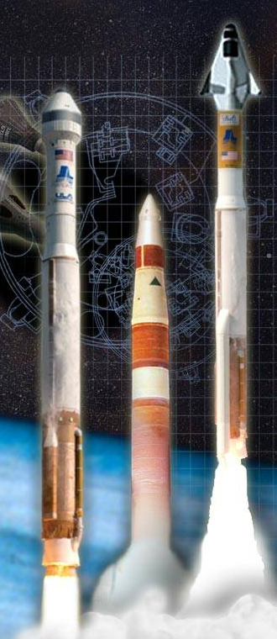

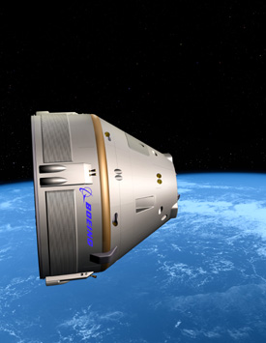

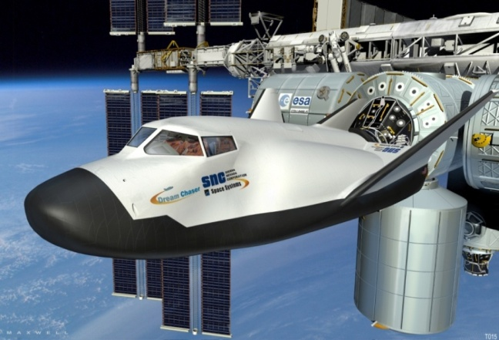


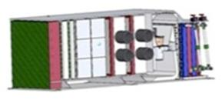
Commercial Crew Development
Phase 1 Initial Design Concepts

Slide 19

Commercial Crew Development Round 2
CCDev2

Slide 20
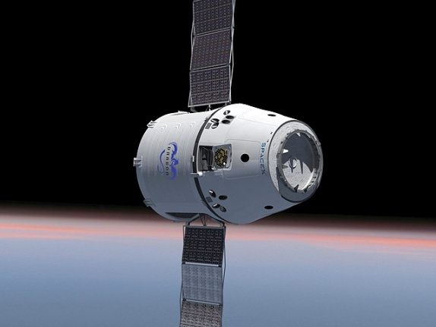
Commercial Crew Development
Phase 2 Maturing Design Elements

Slide 21
CCDev 2 Summary
Participant Name | Work Summary | NASA Funding
Blue Origin | Space Vehicle design to SRR, pusher escape ground and flight testing, and engine pump and thrust chamber testing | $22,005,000
Boeing | CST-100 design maturation to PDR and launch vehicle integration | $92,300,000
Sierra Nevada Corporation | Dream Chaser crew transportation system design maturation to PDR and component testing | $80,000,000
SpaceX | LAS engine design maturation and maturing design to a PDR including crew accommodation prototype | $75,000,000
 | Total Funding | $269,305,000

Slide 22
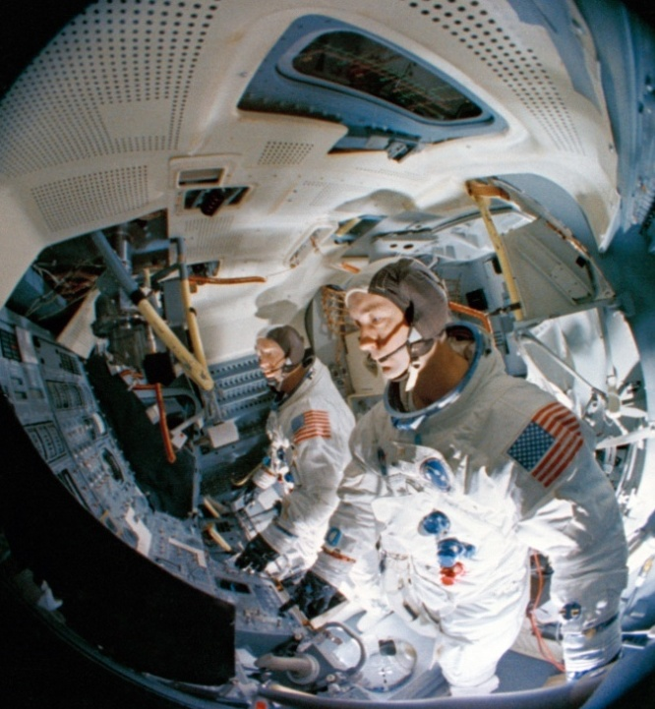
Partner Teams
NASA’s principal points of contact with Commercial Partners
Maintain insight into Commercial Partner’s program, status, issues, and operations
Manage NASA’s CPP technical engagement with Commercial Partners
Manage NASA participation in Partner system development reviews
Facilitate integration of Partner system with NASA systems
Objective determination of Partner completion of SAA performance Milestones
Protect Commercial Partner proprietary information

Slide 23
Partner Integration Team Structure
Partner Manager
Deputy Partner Manager
Technical Integration Lead
Systems Lead (s)
Dedicated Full Time
Members
Engineering
Flight Crew Office
Crew Health & Medical
Operations
Safety & Mission Assurance
CCP Matrix Staff
Participation As
Needed
  System & Discipline Specialists
    Struc, Mech,Guid, Nav, Control, Prop, Pwr, Therm, Comm,TPS, Aero, Crew Sys, ECLSS, etc.
  NESC
  NSC
External to CCP
Participation As
Needed

Slide 24

A successful Commercial Crew Program will:
  Transform human spaceflight for future generations
  Result in safe, reliable, cost effective crew transportation to LEO and for the ISS
  Reduce reliance on foreign systems
  Free NASA’s limited resources for beyond-LEO capabilities

