Slide 1
Commercial Crew Initiative Overview and Status
to the COMSTAC
Philip McAlister
NASA Exploration Systems Mission Directorate
October 7, 2010

Slide 2
Commercial Crew Outline
The Future State
Objectives and Approach
Framework
Insight / Oversight
ISS Program Goals
Concept of Operations
CCDev Round 2
Summary
All information contained in this briefing is for planning purposes only. NASA reserves the right to make any changes to these plans in the future.

Slide 3
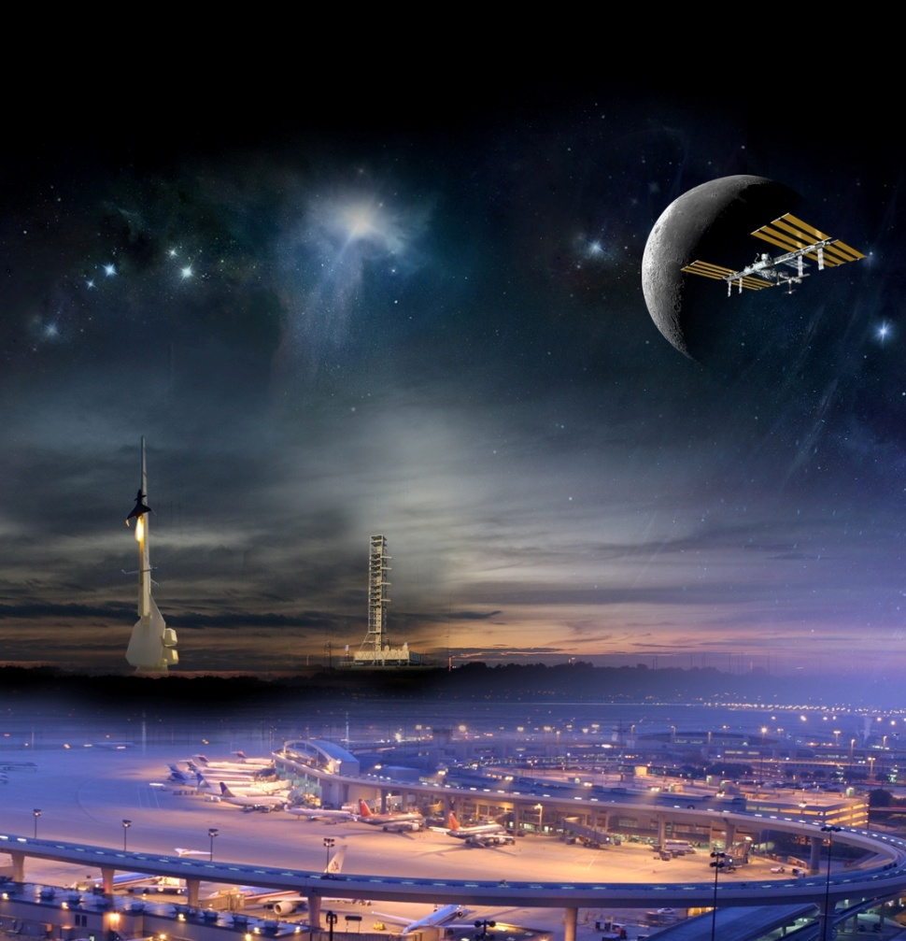
The Future State
The vision of commercial human spaceflight to Low Earth Orbit (LEO) is a robust, vibrant, profit-making commercial enterprise with many providers and a wide range of private and public users.
A successful human space transportation system will: strengthen the ISS Program, allow NASA to focus on beyond LEO exploration, potentially reduce the cost of human access to space, and significantly contribute to the National economy.
NASA’s commercial crew initiative will be the next, major step in making this vision a reality.
Notes:
The HRP is focused on the research required for human system risks that are poorly understood, and those which require new countermeasures or technologies to provide mitigation.
Results of HRP research support space flight medical and human performance standards with validation of acceptable level of risk
Results of HRP research enable the transition of mitigation or treatment strategies to spaceflight medical practice
The HRP risk approach does not change with FY 2011 budget plan
Removal of Constellation schedule constraints coupled with budget augmentation allows acceleration of risk mitigation, reduction in exploration risk posture, ability to address new priorities for target destinations, and breakthrough technology investments.
The program will capitalize on return to Earth benefits and strengthen contributions to Education and outreach

Slide 4
Objectives and Approach
The objective of the proposed commercial crew initiative is to facilitate the development of a U.S. commercial crew space transportation capability with the goal of achieving safe, reliable, and cost effective access to and from LEO and the ISS. Once the capability is matured and expected to be available to the Government and other customers, NASA could purchase commercial services to meet its ISS crew transportation needs.
Preliminary Approach:
Competition through pre-negotiated, milestone-based agreements that support the development, testing, and demonstration of multiple systems.
Support an end-to-end transportation solution that will encourage the development of a range of launch vehicle and spacecraft combinations.
Industry investment capital will be included as part of any agreement.
Clearly and promptly state NASA’s safety requirements and ensure that they are met.
Lead to the competitive selection of one or more commercial service providers with the goal of awarding firm fixed price contract(s).

Slide 5
Framework
The framework should be designed to achieve both program goals:
Safe transport of U.S. and U.S.-designated astronauts to and from ISS.
Support the development of non-NASA markets for commercial human transportation services to and from LEO.
Given this, the framework should:
Accommodate a diversity of people (e.g., astronauts, international partner personnel, scientists, spaceflight participants) for a variety of reasons (e.g., science, research, station operations, tourism), including NASA personnel as crew or participants.
Incorporate requirements and a concept of operations that are as high-level as possible, providing commercial providers with maximum flexibility to propose a variety of safe and cost effective system solutions.
Rely on NASA human spaceflight certification for ISS crew transportation missions.
Incorporate competition among multiple commercial partners: incentivizes performance, supports cost effectiveness, and does not leave NASA dependent on a single provider even if a provider drops out or is terminated.
Eventual state will be Federal Aviation Administration licensing with NASA human spaceflight certification and technical mission assurance oversight.

Slide 6
Insight / Oversight Tenets
There will be a stronger reliance on the commercial providers to develop a safe, reliable vehicle.
NASA will have in-depth insight of the vehicle design through NASA personnel who are embedded in the contractor’s facility.
A key facet of certifying the vehicle system will be through the use of requirements and standards. These will be imposed on all the providers and NASA will ensure that these are properly tailored.
NASA will not sign CPs procedures and non-conformances.
It will be the CPs’ Engineering Review Board.
The insight approach should be more efficient, more penetrating, provide more insight and can provide a more reliable system than an approach that embraces the review of contract deliverables and requirements accounting.
This approach has been highly effective in the past in ensuring reliable high-valued launch vehicle/payloads and robotic spacecraft.

Slide 7
ISS Program Goals
The requirements development process was guided by experience with core services provided by Soyuz, lessons learned from prior NASA development programs (such as the Constellation Program, Orbital Space Plane, and X-38), and feedback from industry during the Commercial Orbital Transportation Services (COTS) and Commercial Crew Development (CCDev) activities.
Key program requirements may include:
Safe transit for up to four ISS crewmembers
At least two flights per year
Targeted availability of 2015
Safe abort and crew recovery for all phases of launch and ascent, including pad escape
ISS visiting vehicle requirements
ISS physical and environmental interface definitions and requirements
NASA is currently evaluating the use of commercial vehicles for assured crew return capability
7

Slide 8
Concept of Operations
CP will provides end-to-end integration including: production, processing, launch operations, mission planning, flight operations, crew training, vehicle recovery, crew recovery, vehicle safing, and disposal.
Spacecraft
Spacecraft
CP Integration & Management
LEO & ISS Operations
Descent & Landing
Ground Operations
Launch & Ascent
Recovery
Spacecraft
Spacecraft
Integrated System
Spacecraft

Slide 9
CCDev Round 2
NASA recently announced its intention to have a CCDev Round 2 (CCDev 2) competition.
CCDev 2 is a continuation of NASA’s Commercial Crew Development (CCDev) initiatives started in FY2010.
CCDev 2 is intended to mature the design and development of elements of commercial crew space transportation systems such as launch vehicles and spacecraft.
Consideration will be given to NASA’s draft human certification requirements and standards or industry equivalent to those requirements and standards.
NASA plans on a new set of multiple SAAs to be awarded in March 2011 with terms of 12-14 months.
The Commercial Crew Office at KSC will lead the execution of the CCDev agreements with close support from JSC and other NASA Centers.

Slide 10
Summary
The commercial crew initiative is designed to meet the objectives of satisfying NASA’s ISS crew transportation needs and enable the growth of a commercial human space flight industry for use by NASA and other customers.
If approved by Congress, the commercial crew initiative will represent a new way of doing business in human spaceflight, and it will be well grounded by:
Knowledge gained from prior programs.
Thorough human spaceflight certification processes.
Building on the successes of Commercial Orbital Transportation Services (COTS), Commercial Resupply Services and Commercial Crew Development (CCDev) activities.
If successful, the commercial crew initiative will:
Transform human spaceflight for future generations.
Result in safe, reliable, cost effective crew transportation for the ISS.
Free NASA’s limited resources for beyond-LEO capabilities.
Reduce reliance on foreign systems.
Lower the cost of access to space, enhance the U.S. industrial base, and act as a catalyst for the development of other space markets.

