Slide 1
COMSTAC: EXPORT CONTROLS WORKING GROUP October 2010

Slide 2
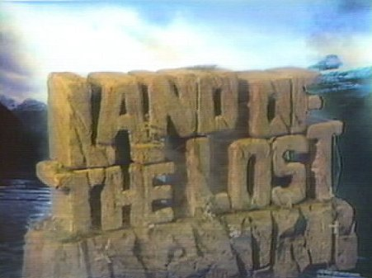
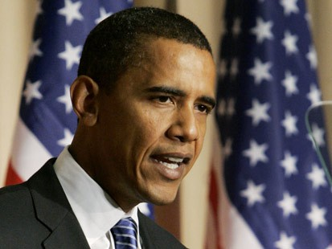
A Confusing State of Affairs

Slide 3
To the Rescue
Maureen Tucker- Senior Advisor to the Undersecretary of State for Arms Control and International Security (Ellen Tauscher)
Anthony Dearth- Space and Technology Division Chief, Office of Defense Trade Controls Licensing, U.S. Department of State
Thomas Moore- Senior Professional Staff Member, U.S. Senate Foreign Relations Committee

Slide 4
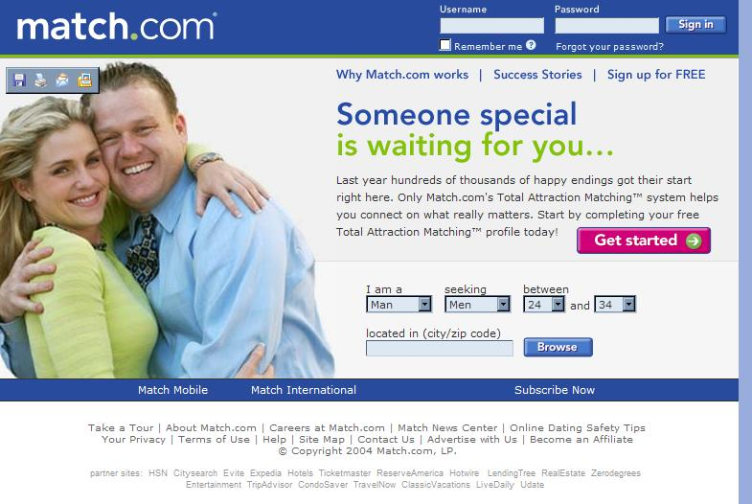
For Singles!
Single Control List
Single Primary Coordination Agency
Single IT System
Single Licensing Agency

Slide 5
‘Positive’ Lists
A list that describes controlled items using objective criteria (e.g., technical parameters such as horsepower or microns) rather than using broad, open-ended, subjective, catch-all, or design intent-based criteria.

Slide 6
Tiered Lists
Items that provide a critical military or intelligence advantage to the U.S. (License required for all destinations)
Items that provide a substantial military or intelligence advantage to the United States and are available almost exclusively from partners and allies (authorized for export to allies under exemption or general authorization)
Items that provide a significant military or intelligence advantage but are available more broadly (usually no license)

Slide 7
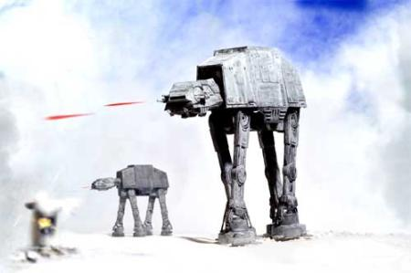
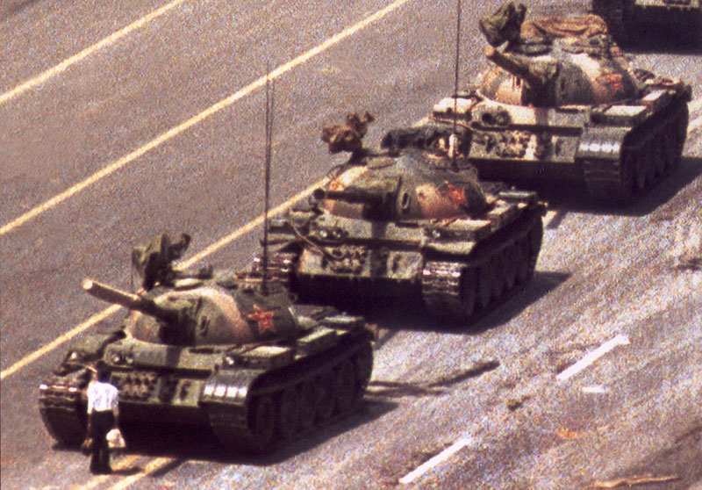
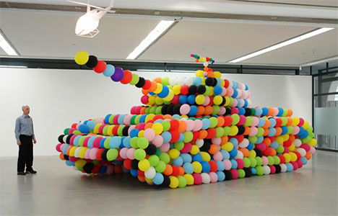
USML Category VII Tanks and Military Vehicles

Slide 8
Results
74 percent of the 12,000 items that were license last year in the category will be moved to the CCL or decontrolled entirely
32 percent decontrolled entirely
Of the 26 percent that remains on the munitions list, none were in the highest tier, 18 percent in the middle tier, and eight percent in the lowest tier

Slide 9
Tanks v. Firetruck

Slide 10
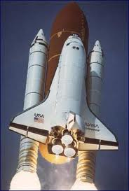
Title XV

Slide 11
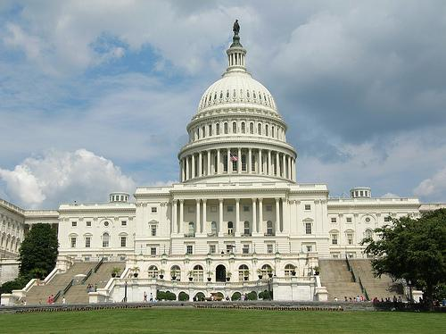
Congress?

