Slide 1
COMSTAC: EXPORT CONTROLS WORKING GROUP October 2009

Slide 2
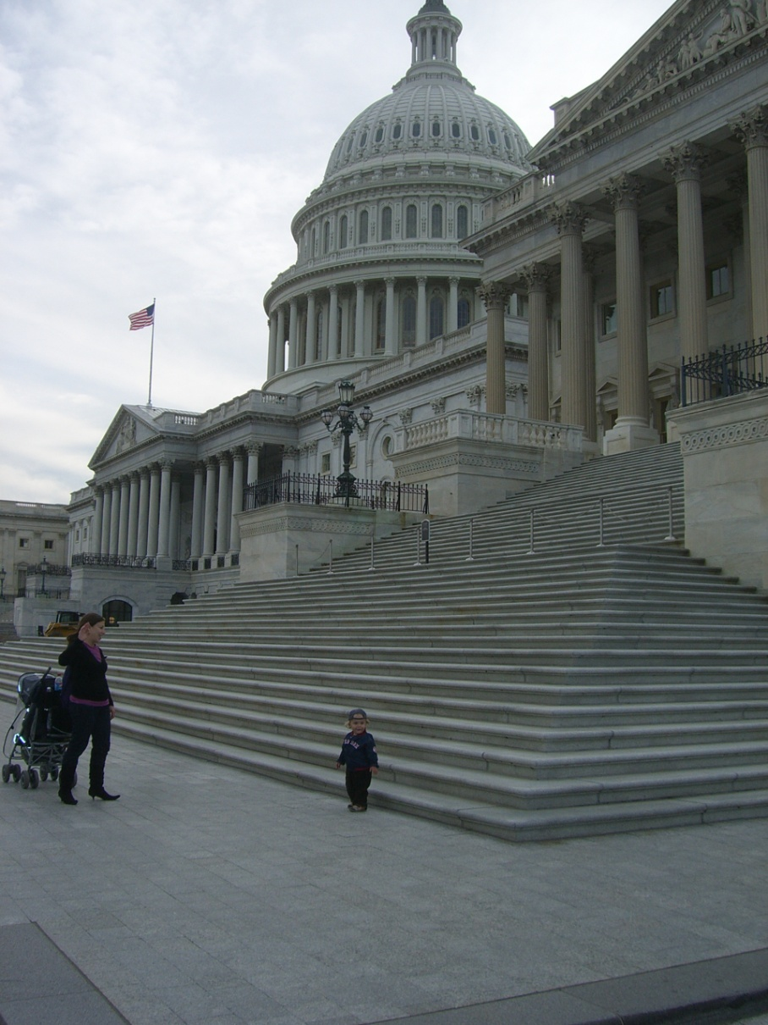
Recent Developments

Slide 3
H.R. 2410
To authorize appropriations for the Department of State and the Peace Corps for fiscal years 2010 and 2011, to modernize the Foreign Service, to authorize democratic, economic, and social development assistance for Pakistan, to authorize security assistance for Pakistan, and for other purposes
Title VIII- Export Control Reform and Security Assistance

Slide 4
H.R. 2410 Benefits
Full Review of the USML with at least 20 percent of the list examined every year for five years (at the end of which the process begins again)
The President is given the authority to remove satellites and related components from the USML (except for China)
Commodity Jurisdiction Request determinations will be publicly posted on the Internet

Slide 5
Senate Sitting On It

Slide 6
Uncertain Future

Slide 7
Executive Branch

Slide 8
Wiggle Room??
“The exportation or transfer of advanced communication satellites and related technologies from United States sources to foreign recipients should not increase the risks to the national security of the United States.”
-- Strom Thurmond National Defense Authorization Act for Fiscal Year 1999

Slide 9
Recommendation #1
The COMSTAC supports export control reform in general and the goals and objectives of H.R. 2410 in regard to, among others, reviewing and revising the USML. We urge the Senate to move as quickly as possible in taking up and passing comparable legislation.

Slide 10
Recommendation #2
Obtaining a broad array of industry input is vital for the U.S. Department of State and other federal entities to effectively implement positive changes to the nation’s export control regime. Therefore, future export control reform legislation in the Senate and House should encourage the Department of State to share significant planned rules and policy shifts with the Defense Trade Advisory Group (“DTAG”), the COMSTAC, and any other relevant Federal Advisory Committees that express a desire to become involved.

Slide 11
Recommendation #3
We support H.R. 2410’s call for the public disclosure of properly redacted Commodity Jurisdiction Request determinations via the Internet, and would encourage the Department of State to take such action immediately.

Slide 12
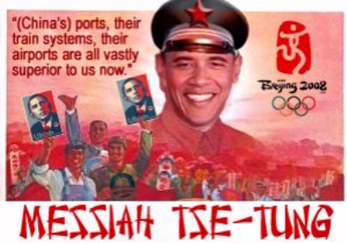
Unfair and Imbalanced

Slide 13
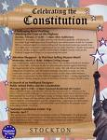
Unconstitutional ITAR
Prior Restraint on Free Speech
Too broad, not sufficiently narrowly tailored for its purpose
Does not protect a significant governmental interest
No hard deadlines
No expeditious judicial review

Slide 14
COMSTAC: EXPORT CONTROLS WORKING GROUP October 2009

