Slide 1
COMSTAC: EXPORT CONTROLS WORKING GROUP May 2011

Slide 3
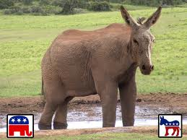
Bipartisan Discussion
David Fite, Senior Professional Staff Member for the House Foreign Affairs Committee
Tony DeTora, Legislative Assistant to Congressman Dana Rohrabacher (R-CA)

Slide 4
For Singles!
Single Control List
Single Primary Coordination Agency
Single IT System
Single Licensing Agency

Slide 5
Tiered Lists
Items that provide a critical military or intelligence advantage to the U.S. (License required for all destinations)
Items that provide a substantial military or intelligence advantage to the United States and are available almost exclusively from partners and allies (authorized for export to allies under exemption or general authorization)
Items that provide a significant military or intelligence advantage but are available more broadly (usually no license)

Slide 6
Results
74 percent of the 12,000 items that were license last year in the category will be moved to the CCL or decontrolled entirely
32 percent decontrolled entirely
Of the 26 percent that remains on the munitions list, none were in the highest tier, 18 percent in the middle tier, and eight percent in the lowest tier

Slide 7
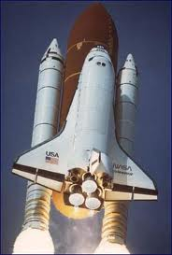
Title XV

Slide 8
Recommendation #1
The COMSTAC recommends that during interagency review the FAA communicate COMSTAC’s strong support of the export control reform effort to create a single, tiered list.

Slide 9
Recommendation #2
The COMSTAC endorses the current review of USML Category XV in particular and urges the FAA-AST to express the COMSTAC’s support for the Department of State’s efforts during the interagency process.

Slide 10
Recommendation #3
The COMSTAC recommends that the FAA express COMSTAC’s support for the public release of Commodity Jurisdiction requests and advisory opinions, to help enhance clarity, consistency, and transparency.

Slide 11
Finding #1
The COMSTAC finds that the deemed export rule under the ITAR is aggravating the aerospace industry’s already challenging problem of being able to hire and retain qualified engineers.

