Slide 1
Office of the Chief Technologist
Flight Opportunities Program
Laguduva Kubendran, PhD, MBA
Program Executive, NASA HQ
FAA COMSTAC Public Meeting
October 14, 2011
www.nasa.gov

Slide 2
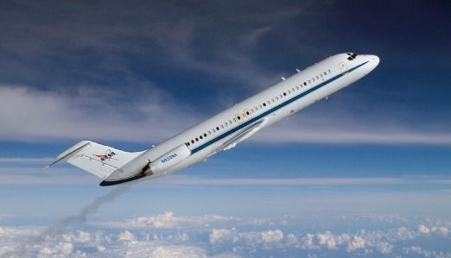
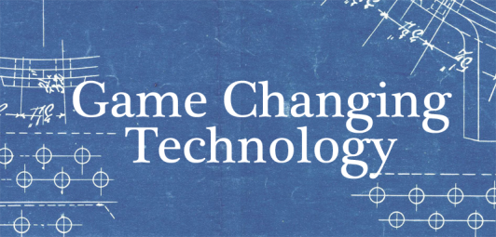
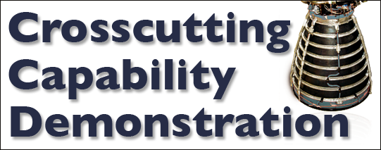
Space Technology Program – Overview
Space Tech Research Grants
NIAC
SBIR/STTR
Centennial Challenges
Center Innovation Fund
Possible
Solution
Technology
Demonstration Missions
Edison Small Sat Demonstration Missions
Flight Opportunities
Idea
Franklin Small Sat Subsystem Technology
Game Changing Development
Idea
Idea
Possible
Solution
Idea
Possible
Solution
Idea
Idea
Possible
Solution
Idea
Flight
Opportunities
Idea
Possible
Solution
Idea
Industry
Academia
Govt
1
2
3
4
5
6
7
Technology Readiness Level (TRL)

Slide 3
Flight Opportunities Program
Level II Program Office: DFRC
Objective: Provide flight opportunities in reduced-gravity and high-altitude environments toward maturation of technology for application in future space missions. Combines the FY 2010 FAST (parabolic) and CRuSR (suborbital) efforts previously managed by NASA’s Innovative Partnership Program. Goal of expanding program to other platforms and test environments in FY 2012.
Procure flight and payload integration services from suborbital reusable launch vehicle (sRLV) companies to provide 3-4 minutes of microgravity environment for tech development, scientific, and university research
Procure commercial parabolic flights to test technologies in environments that simulate microgravity and the reduced gravity environments of the Moon or Mars
Acquisition Strategy
Suborbital Flights – Commercial flight and payload integration services on operational and developmental suborbital platforms; IDIQ Contract Awards in August 2011 to Armadillo, Masten, Near Space Corp, Up Aerospace, Virgin Galactic, Whittinghill, and XCOR
Parabolic Flights – Utilize existing JSC/Reduced Gravity Office contract with Zero-G Corporation
Payloads - Open call to researchers to gain access to parabolic and suborbital flight opportunities to test technologies in a relevant space environment; Next Round to start in October 2011
Awards
Parabolic flights: Up to 4 flight weeks/year with ~10 payloads/flight week
Suborbital flights: Multiple flights and integration services purchased through seven vendors
Collaboration
Suppliers - Industry and emerging commercial suborbital platform providers supply flights to access simulated space environments
Users - Industry, Academia, Government researchers propose technology payloads to be flown on procured flights

Slide 4
Flight Opportunities Program Funding
$17M FY 2012 budget, based on FY 2012 President’s Budget Request
Flight Opportunities Program funds:
Flight Opportunities & Payload Integration
Development of Technology Payloads to “Prime the Pump” (Through GCD)
Vehicle Technology Enhancements (Through GCD)
Onboard Research Facilities (Through (GCD)
ESI
Announcement of Opportunities
STP
Payloads
Flight Opportunities
GCT
Other MD’s
(e.g., ROSES)
CCD
Other Govt. Entities
ESI: Early Stage Innovation GCT: Game Changing Technology CCD: Crosscutting Capability Demonstrations MD: Mission Directorates ROSES: Research Opportunities in Space and Earth Sciences

Slide 5
Acquisition Strategy for Flight & Payload Integration Services
Technology Needs for Space Relevant Environment drive OCT Platform Requirements
Technology development at a rapid pace requires frequent flights
Commercial service from Multiple Vendors
NASA one of several customers
Low cost access
Acquisition Strategy
Flight and Payload Integration services
Launch vehicles that fall under jurisdiction of FAA/AST shall be licensed
Standard commercial services
Firm, fixed-price contracts
Multiple awards
Subsequent solicitations, as required

Slide 6
Commercial sRLV RFP Requirements
Performance Area | Requirement
Vendor to provide flight and payload integration on qualified vehicles
Qualified Vehicle:
Commercial, Reusable | 80% reusable by mass, not incl. consumables
Frequent Flight | Payload 2x in 5 consecutive days
Min payload mass, volume | 1kg, 1U CubeSat
Successful flight | Return payload undamaged
Customer access to payload prior to launch and post launch | 3h prior to/post-hazardous op
System safety insight | Payload value
Number of successful flights at the required condition | 1
Basic Service Requirements
L3
Longer duration reduced
gravity applications
100km
(MSL)
L2
High altitude, Long duration,
Reduced Gravity Applications
altitude
~
20km
(MSL)
~
6km
(AGL)
L1
Approach and Precision
Landing Applications

Slide 7
Contract Awards (August 2011)
Flight Opportunities Program has selected Seven Companies to provide flight and payload integration services
Armadillo Aerospace, Heath, Texas
Near Space Corporation, Tillamook, Ore.
Masten Space Systems, Mojave, Calif.
Up Aerospace Inc., Highlands Ranch, Colo.
Virgin Galactic, Mojave, Calif.
Whittinghill Aerospace LLC, Camarillo, Calif.
XCOR, Mojave, Calif.
IDIQ Contracts with Two Year Period of Performance
Total Contract Value - $10M

Slide 8
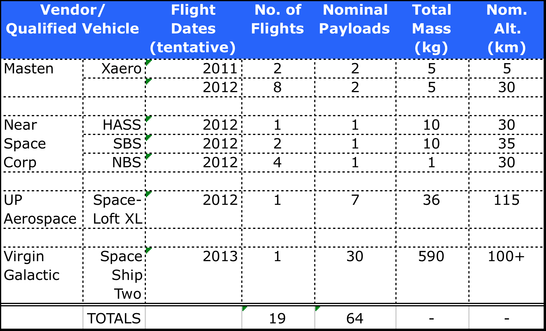
Suborbital Flight Schedule (tentative)

Slide 9
Summary
Current Program focus is Suborbital flight
Frequent
Commercial
Low Cost Access
Program Solicits & Flies Payloads in Relevant Environment
Payloads through Open Calls
Payloads from OCT pipeline
Payloads from NASA Mission Directorates
Payloads from Other Government Agencies

