Slide 1
Ten-Year Forecast of Markets and Launches for Reusable Suborbital Vehicles “Suborbital Forecast”
Brief to Systems Working Group, COMSTAC
May 11, 2012

Slide 2
Purpose and Agenda
This brief is for informational purposes. No action required for COMSTAC.
Agenda:
About the Project
Suborbital Markets
Approach
Report
Preliminary Findings

Slide 3
About the Project
10 year forecast of markets for launches of reusable suborbital vehicles
Effort is jointly funded by FAA and Space Florida
Builds on Spring 2011 Suborbital Market Characterization study and Fall 2011 FAA Suborbital Report
Those studies identified & characterized 7 market segments for suborbital vehicles and summarized suborbital suppliers
This study adds an 8th market, Satellite/UAV Deployment, which is for payloads launched or inserted from the suborbital vehicle
This study takes those markets and conducts demand-based forecasts for each market segment
Market forecasts are combined to develop a consolidated 10 year forecast and evaluated against the forecasted supply

Slide 4
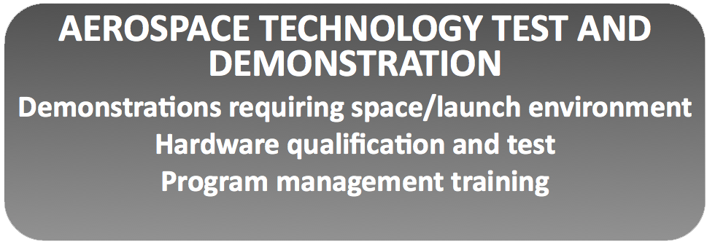
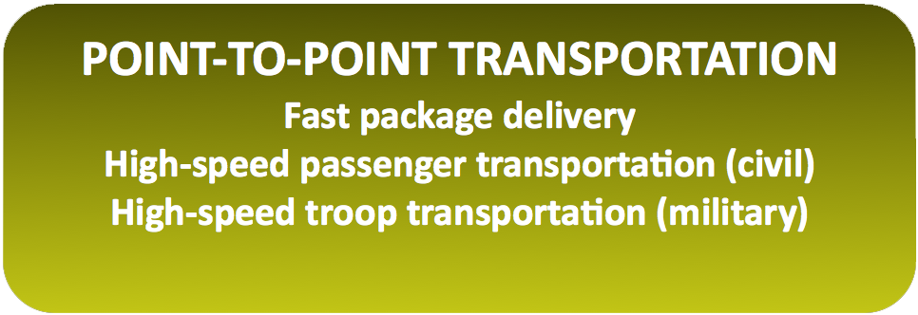
Suborbital Markets

Slide 5
Approach
Gathered all available information about each market area to reflect what is currently known in the industry, this included:
Examining all open source data related to each market
Evaluating the competitive offerings for each market
Conducting interviews: over 90 across all the markets, which included potential users, subject matter experts, government representatives, and vehicle providers
Surveying high net worth individuals with at least $5M in investable assets by an outside survey provider (the Harrison Group)--results will be available the third week in May
Conducting online survey from 2 suborbital researchers conferences: Next Generation Suborbital Researcher’s Conference and a space researcher’s conference in Japan
Evaluating Supply side: vehicle operators and spaceports
Final analysis will consider supply and demand for suborbital vehicles

Slide 6
Report
Profile each of the suborbital markets:
Who are the users?
What is the competition?
What are the market conditions/obstacles?
Where does the market stand now?
What will make it grow or contract (sensitivities)?
What are the uncertainties?
Are there actionable items that can positively influence growth in the market?
Develop a story and forecast for each market
Present the overall (aggregated) forecast
Overlay the demand and supply side to obtain a full picture

Slide 7
Sample of Preliminary Findings
Basic & Applied Research:
Promising near-term markets include meeting unsatisfied niche demand in astronomy and atmospheric sampling
With access to commercial spaceflight customers, scientists can gather valuable data for large population human research
Education of, and acceptance by, economic buyers (i.e., the ones who write the checks) seems to be a major near-term challenge
Education:
Interviews identified a lack of teacher awareness of the commercial spaceflight industry, yet a high demand among K-12 students for hands-on STEM projects
The challenge is any activity needs to prove it obtains measurable results
Remote Sensing: After conducting research and stakeholder interviews, have not identified a demand for using SRLVs as remote sensing platforms
Media and Public Relations:
For film and television, CGI is the practical first choice for filming space or microgravity scenes for movies and TV
There is a re-emerging interest in space-related advertising
Point-to-Point (P2P):
Operational P2P transportation is likely outside of the 10-year study timeframe
The report will identify key challenges and opportunities for P2P

