Slide 1
Report to COMSTAC of the Operations Working Group (formerly known as the Space Transportation Operations Working Group, STOWG)

Slide 2
Review of October 2011 Actions & Input to FAA/AST
Positive response from FAA/AST on STOWG Observations, Findings, Recommendations
Confirms that our topics and approach remain relevant
Completed survey of Commercial Spaceport Licensing approaches
Provided COMSTAC input to and participated in UN working groups on Long Term Sustainability of Space
Continued to monitor developments of DOD proposal to enhance commercial space launch cooperation

Slide 3
FAA/AST Priorities related to Operations
#1: On-Orbit Authority for FAA/AST
#3: Spaceport Licensing
Code of Conduct & Long Term Sustainability of Space
Global Regulations
Range Commercial Investment
Standards crafted by Human Spaceflight Industry

Slide 4
On-Orbit Authority discussion & questions posed for consideration
What is the problem we are trying to solve (use cases, examples of where regulatory authority appears to be “missing,” such as for on-orbit transportation)
What are the definitions to use
Which regulatory organization has primacy (is this FAA/AST)
What should the substance of this authority be

Slide 5
On-Orbit Authority Observation & Action
OBSERVATION: COMSTAC agrees that On-Orbit Authority is worthy of consideration and discussion, given the uncertainties surrounding jurisdiction and regulation questions of on-orbit operations involving space transportation.
ACTION: OWG task force of volunteers will explore the questions. Put on OWG telecon agenda.
Tim Hughes -- Oscar Garcia
Brett Alexander -- Brad Cheetham
Jeff Greason
Billie Reed
Chris Kunstadter

Slide 6
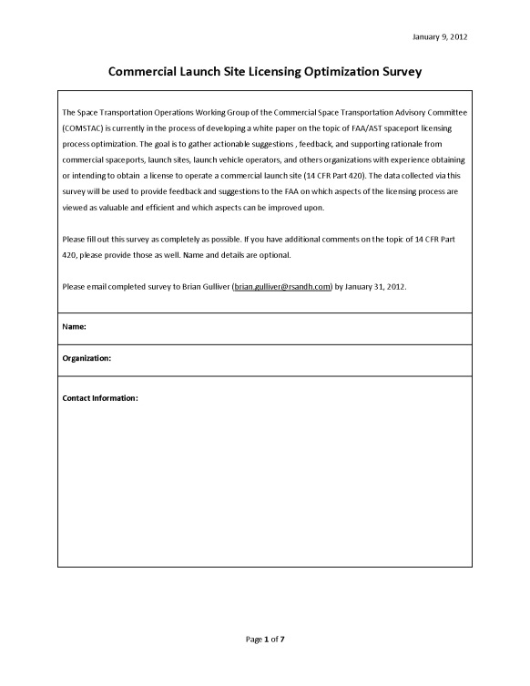
Spaceport Licensing White Paper and Survey
October 2011 - STOWG accepted task to develop a white paper to recommend changes to the regulations 14 CFR Part 420
STOWG developed an online survey
COMSTAC, Commercial Spaceflight Federation and FastForward Project notified its members of the survey
STOWG received a total of 28 responses
THANK YOU to: Brian Gulliver (RS&H), Oscar Garcia (Interflight Global), and Jeff Greason (XCOR) and all who responded

Slide 7
Summary of Survey Results
Difference in perspective of the relevance of launch site licensing requirements between spaceports and consultants
Spaceports- Express more change needed
Consultants- Express less change needed
The general consensus is that regulations are a better fit for vertical launch orbital launch sites than for horizontal suborbital launch sites
The latter can benefit from modular “right fit” approach
The least relevant requirements were identified as:
Propellant Handling
Lightning Protection
See full white paper for details

Slide 8
Recommended Next Steps
Discuss observations with COMSTAC STOWG and seek additional input to this report.
Review potential methods for re-aligning the regulations with the commercial spaceflight industry.
Option 1
Develop appendix to Part 420 or guidelines
Option 2
Modify Part 420 to be modular
Option 3
Start Over

Slide 9
Recommended Next Steps
Select a recommended approach and submit recommendations to COMSTAC to present to FAA/AST.
Form a STOWG subcommittee to further refine details on the final recommendations, in conjunction with FAA/AST. Report back in October 2012.

Slide 10
Spaceport Licensing Observation & Recommendation
OBSERVATION: The Spaceport Licensing survey has provided further insights to the diversity of issues involved with multiple types of vehicles and operations (e.g., vertical orbital, horizontal suborbital) and spaceport licensing. COMSTAC is encouraged that FAA/AST is conducting a broader review of Part 420.
RECOMMENDATION: COMSTAC recommends that FAA/AST accept the white paper and survey findings as input to this process and continue in an open dialogue with industry, through COMSTAC and OWG, to gather as much input as possible prior to any rule-making process.

Slide 11
International Developments in Space Operations
European Union's Proposed "Code of Conduct for Outer Space Activities:” Summary & Status
Frank Rose, Deputy Assistant Secretary for Space and Defense Policy, Bureau of Arms Control, Verification and Compliance, U.S. Department of State
Long-Term Sustainability of Space (A United Nations COPOUS Activity): Summary, Status & Opportunity for Industry Input
John Sloan, FAA/AST
Rachel Yates, COMSTAC (Group D)
Chris Kunstadter, COMSTAC (Group B)
COMSTAC provided coordinated input in January to the COPUOUS process. Now, updated inputs are due today. OWG reviewed COMSTAC responses to Group B and Group D input.

Slide 12
EASA update on regulating suborbital vehicles in Europe (relates to FAA/AST priority issues described earlier)
European Aviation Safety Agency Report – European Aviation Safety Plan 2012-2015 [undated; Fall 2011?] Excerpt from page 49:
EME1.6 Suborbital planes regulation. Regulate sub-orbital planes. EASA 2011-2015
“Pre-RIA and ToR drafted, submittal to SSCC put on hold due to a new
directive from the Commissioner’s Cabinet to investigate a lighter process,
similar to FAA-AST “Launch Licensing”. Sub-orbital Working Group (SoWG)
is subsequently currently drafting possible amendments to the BR to
accommodate for this lighter approach, however 3 European stakeholders
confirmed their demand for full certification (EADS, Booster, REL-Skylon).
To meet their application times and allow them to design according to the
rules, task MDM.098 should start during the third quarter of 2011 and
should end in 2014.”
[Notes: Pre-RIA-- Preliminary Regulatory Impact Assessment
SSCC -- The Safety Standards Consultative Committee BR-- Basic Regulation. ]
Source:
http://easa.europa.eu/sms/docs/European%20Aviation%20Safety%20Plan%20(EASp)%202012-2015%20-v1.0%20FINAL.pdf
EASA said in April 2012 this information is obsolete

Slide 13
Long-Term Sustainability of Space (LTSSA)
United Nations Committee on the Peaceful Uses of Outer Space (UN COPUOS)
Working group on long-term sustainability of space activities now underway
Expert group reviews of “best practice” guidelines in four areas:
Sustainable space utilization supporting sustainable development on Earth
Space debris, space operations and tools to support collaborative space situational awareness
Space weather
Regulatory regimes and guidance for actors in the space arena
LTSSA working group will guilds on ongoing work in existing international organizations and bodies, including:
Inter-Agency Space Debris Coordination Committee
Consultative Committee for Space Data Systems
International Organization for Standardization

Slide 14
Finding & Recommendation: International Code of Conduct and UN Long Term Sustainability of Space
Finding
Visibility into the International Code of Conduct is necessary.
The communication mechanisms being used by FAA/AST to keep industry informed and engaged are working well.
COMSTAC participation in the UN COPUOUS process on Group B and Group D is appreciated and welcome, and should continue.
Recommendation
FAA/AST continue to play this facilitation role and keep COMSTAC informed of key issues.

Slide 15
COMSTAC Immediate Action on LTSSA
COMSTAC submittals to State Dept on Group B and Group D will be submitted TODAY for the May 11 deadline (per request of Dick Buenneke, State Dept)
COMSTAC representatives will continue to stay involved
Next meetings in June in Vienna

Slide 16
DOD Proposal to Enhance Commercial Interactions at Federal Ranges
Tom Shearer, DOD Executive Agent for Space
The proposed FY12 NDAA addition of Section 2275 “Commercial Space Launch Cooperation” to “U.S.C. Title 10 Armed Forces” will:
Synchronize Title 10 with Title 15 (Commerce) and Title 49 (Transportation)
Enable DoD partnerships with states and commercial users to Increase capacity, Share resources, Combine resources, Enable commercial space augmentation
Legislative updates in process as of May 2012
Once through the Hill, DOD will engage with industry for further engagement

Slide 17
Finding: DoD Proposal to Enhance Commercial Interactions at Federal Ranges
Finding
It remains useful for COMSTAC and FAA/AST to remain apprised of this process. The communication process is working. When the time is right, COMSTAC remains the right place to engage in industry dialogue on next steps.

Slide 18
OWG Telecons Planned
Early July
Report back from UN meetings in June on LTSSA
On-orbit authority discussion
Commercial range update from DOD (if ready)
Late August / Early September
Global Regulations adopting U.s. regulatory process (update from FAA/AST)
Commercial standards (such as for insurance, including standardization of contracts, waivers, etc)
Further insight into FastForward Project (www.fastforwardproject.com)
Dates to be organized and will be communicated

Slide 19
STOWG Contact Send your email to get on the STOWG distribution list
Debra Facktor Lepore, Chair
President, DFL Space LLC
Industry Professor, Stevens Institute of Technology
debra@DFLspace.com
Sue Lender, FAA/AST
Susan.Lender@faa.gov
19
Notes:
19

