Slide 1
Launch Vehicle International Standards and Best Practices A Report on ISO Standards Proposals offered by China
Commercial Space Transportation Advisory Committee
Operations Working Group Meeting
9 October 2012
Frederick A. Slane
ISO TC20/SC14 US Head of US Delegation
Executive Director, Space Infrastructure Foundation

Slide 2
Inform and Discuss
Point of Discussion:
China has proposed at least three launch vehicle related international standards to ISO, for determining and communicating post deployment trajectories of multiple payloads deployed from the same launch vehicle. Others are close to approval for launch vehicle failure mode analysis and booster burnout state.
These are proposed by the China Advanced Launch Vehicles Technology Institute (CALT) through the Chinese Astronautics Standards Institute (CASI).

Slide 3
Background
Evolution of International Launch Vehicle International Standards and Best Practices
Arianne: Heavily influenced early spacecraft/launch vehicle interface standards through about 2002
ISO 14303 -- Spacecraft to launch vehicle interfaces
ISO 17401 – Spacecraft interface requirements document for launch services
ISO 15863 -- Spacecraft to launch vehicle interface control document
Soyuz: Russian emergent domination of launch vehicle market place from 2002 through 2011
ISO 26870 -- Launch pad and integration site operational documents
ISO 24917 -- General test requirements for launch vehicles
ISO 17400 -- Launch and integration site general test requirements
ISO 16159 -- Launch pad and integration site — Analysis of failures
ISO 15860 -- Gas contamination — Measurements methods for field tests
ISO 16694 -- Measured parameters at firing bench and flight tests of liquid rocket engines
ISO 17689 -- Interface control documents between ground technological equipment, launch site systems and launch vehicle with payload

Slide 4
The Issue Today
Evolution of International Launch Vehicle International Standards and Best Practices
Long March: China’s entry into launch vehicle market place is accompanied by new efforts in developing international standards from 1998 through today
ISO 15862 -- LV-SC flight environment requirements for telemetry data processing
ISO 16781 -- Simulation requirements for control system
ISO 16679 -- Relative motion analysis elements after LV/SC separation
ISO 18238 -- Closed loop problem solving management
ISO New Work Item Proposal -- Fault Diagnosis of Launch Vehicle (A group of technical specifications)
Chinese standardization efforts reflect a strategic combination of launch vehicle standards and manned spaceflight standards

Slide 5
Additional Important Facts
Evolution of International Manned Spaceflight International Standards and Best Practices
NASA STS and ISS:
NASA 3000 to ISO 17399 - Man-systems integration (being cancelled)
ISO: In 2007 Russia initiated manned spaceflight standards work within ISO TC20/SC14
ISO 17763 -- Human-life activity support systems and equipment integration in space flight
ISO 16157 -- Human-life activity support systems and equipment integration in space flight — Techno-medical requirements for space vehicle human habitation environments
ISO 16726 -- Human-life activity support systems and equipment integration in space flight – Techno-medical requirements for space vehicle human habitation environments – Requirements for the air quality affected by harmful chemical contaminants

Slide 6
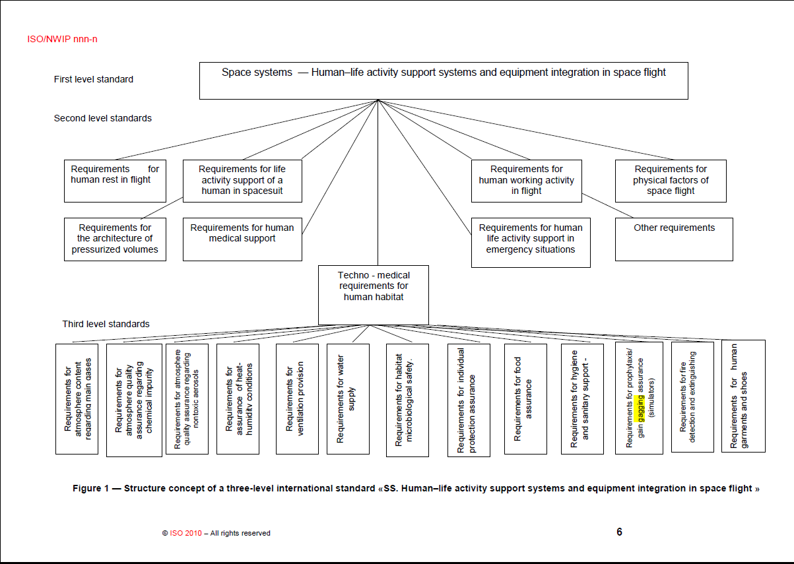

Slide 7
Formation of a Working Group
Determine COMSTAC member critical interests and positions on open standards development issues
Determine responses to Chinese space standardization initiatives

Slide 8
Backup Slides

Slide 9
Discussion of Role for COMSTAC and FAA/AST
Regulatory Guidance and Compliance
NTTAA
OMB Circular A-119
ITAR
Open standards (e.g., AIAA and ISO for space) are not regulated by the ITAR
US Government policy on attending meetings with certain foreign nationals

Slide 10
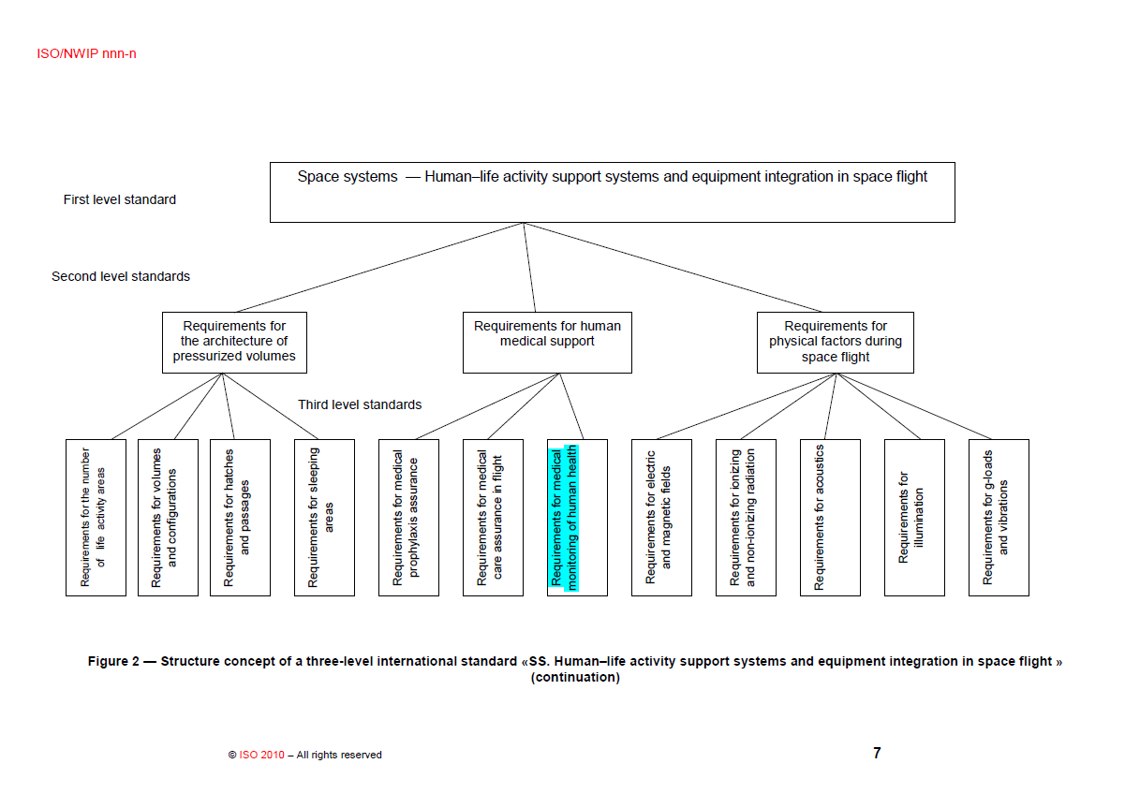

Slide 11
