Slide 1
Missile Technology Control Regime (MTCR)
Sean Monogue
Office of Missile, Biological, and Chemical Nonproliferation
Bureau of International Security & Nonproliferation
U.S. Department of State

Slide 2
Missile Technology Control Regime (MTCR)
Objective: To combat missile proliferation, in particular by controlling the transfer of equipment and technology that could contribute to missiles capable of delivering weapons of mass destruction (WMD).

Slide 3
Missile Technology Control Regime (MTCR)
Created in 1987.
Voluntary political arrangement; not a treaty.
34 partner countries.
Seeks to limit the proliferation of missiles capable of delivering WMD and related technology.
Controls virtually all equipment, software, and technology needed for missile development, production, and operation.

Slide 4
MTCR: How it works …
MTCR Partners (members) control a common list of items (MTCR Equipment, Software and Technology Annex, or the MTCR Annex) according to a common policy (MTCR Guidelines).
The MTCR restricts transfers of missiles, and equipment and technology related to missiles, capable of a range of at least 300 km.
A Category I or MTCR-class missile is capable of delivering a payload of at least 500 kg to a range of at least 300 km.
Transfers of Category I missiles are subject to a strong presumption of denial regardless of destination/purpose.

Slide 5
MTCR: How it works (continued) …
The MTCR Guidelines and Annex are open to all countries to implement.
MTCR controls are implemented by each country in accordance with its national laws and regulations.
MTCR export controls are not licensing bans.
They are regulatory efforts by individual Partners to prevent transfers of items that contribute to systems capable of WMD delivery.

Slide 6
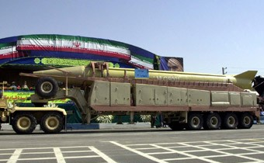
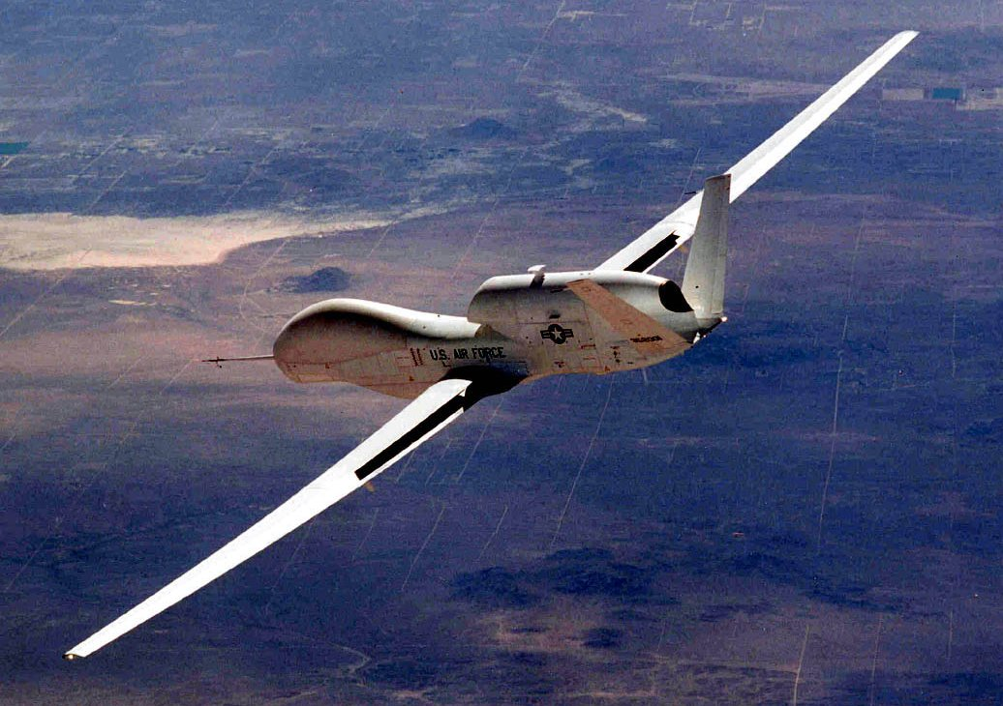
MTCR: Category I Items
Transfers of Category I items are subject to a strong presumption of denial regardless of the purpose of the export.
Category I items are licensed for export only on rare occasions.
The transfer of Category I production facilities is prohibited absolutely.

Slide 7
MTCR: Category I Items (continued)
Examples of Category I Items:
Ballistic and cruise missiles
Target drones
Sounding rockets
Space launch vehicles
Rocket motors/engines
Reentry vehicles
Guidance sets

Slide 8
MTCR: SLVs and Ballistic Missiles
MTCR controls do not distinguish between ballistic missiles and space launch vehicles (SLVs).
Any rocket capable of putting a satellite into orbit is inherently capable of delivering weapons of mass destruction.
Ballistic missiles and SLVs derive from nearly identical and virtually interchangeable technologies.
The main difference between SLVs and offensive ballistic missiles is their payload and intended use. With the addition of a weapons payload and different guidance algorithms, SLVs can be used as ballistic missiles.
Accordingly, all transfers of MTCR Category I items are subject to an unconditional strong presumption of denial regardless of purpose.

Slide 9
MTCR: Category II Items
Category II item transfers reviewed on a case-by-case basis
Propulsion components - motor cases
Propellants and constituents-fuel, oxidizer
Propellant production tech - mixers
Structural composites equipment - filament winding machines, tape-laying machines
Radiation Hardened microcircuits

Slide 10
MTCR Annex Category II Examples
Flight control systems
Flight instruments, inertial navigation equipment, software - gyroscopes
Avionics equipment - GPS receivers
Structural materials - composites
Launch/ground support equipment - telemetry, transporter-erector-launchers
Missile computers - ruggedized
Analog-to-digital converters - mil-spec
Test facilities and equipment - vibration sets
Software and related analog or hybrid computers - modeling software
Reduced observables, materials – stealth
Sub-Category I missiles and rocket motors/engines

Slide 11
Missile Technology Export Control Group (MTEC)
Reviews U.S. missile technology exports
Interagency, State-chaired.
One of many government agency reviews.
Reviews license applications administered by Department of
Commerce (dual use) and Directorate of Defense Trade
Controls (DDTC) (munitions).
Recommendation rarely overruled.
Meets weekly for nonproliferation policy review on about 90
cases (2 hours).
MTCR commitments; national policies; catch-all controls.

Slide 12
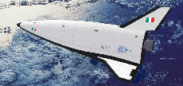
U.S. Export Control Policy
National nonproliferation policy since Sep ‘93
U.S. does not support the development or acquisition of MTCR Category I systems, including space launch vehicles, in non-MTCR countries
US will not encourage new (not supported pre -1987) space-launch vehicle programs in MTCR countries
Notes:
Italian Unmanned Space Vehicle
Indian GSLV
Chinese Shenzhou 5

Slide 13
Space Policy and Nonproliferation
National Security Space Strategy (January 2011)
Decisions on partnering will be consistent with U.S. policy
and international commitments and consider cost, protection
of sources and methods, and effects on the U.S. industrial
base.
National Space Policy (June 2010)
All actions undertaken … shall be … consistent with U.S. law and regulations, treaties and other agreements to which the United States is a party, other applicable international law, U.S. national and homeland security requirements, U.S. foreign policy, and national interests …
… departments and agencies should seek to enhance the competitiveness of the U.S. space industrial base while also addressing national security needs … The United States Government will consider the issuance of licenses for space-related exports on a case-by-case basis, pursuant to, and in accordance with, the International Traffic in Arms Regulations, the Export Administration Regulations, and other applicable laws, treaties, and regulations.

Slide 14
Off-Shore Procurement
U.S. off-shore procurement policy -- Recommend denial of imports of MTCR Annex items from Category I missile programs of proliferation concern (non-MTCR countries)
Presidential waiver required to overrule
Notes:
L40 strap-on for the GSLV

Slide 15
Conclusion
MTCR is the centerpiece of U.S. missile nonproliferation policy.
Export controls, licensing, interdictions, diplomatic exchanges, visa screening and sanctions are tools of implementation.

