Slide 1
Effects of Minimal Regulations on Commercial Human Spaceflight and Public Risk Acceptance
Results of Nov 2011 Public Opinion Poll
Presented to COMSTAC Business/Legal Working Group
Ed Springer
10 May 2012

Slide 2
Overview
Purpose
Background
Research Methodology
Results
Conclusions

Slide 3
Purpose
Report findings and results from a public opinion study relating to government regulation of commercial suborbital human spaceflight and public risk acceptance
Three primary focus areas addressed:
Does the general public feel the government should be more proactive to ensure human survivability during commercial suborbital space flight activities?
How much risk is the general public willing to accept to be a suborbital space traveler?
What are the effects of the current Part 460 requirements on industry? In particular, does the minimal regulation approach provide industry advantages that outweigh public interest in accepting risk in minimally regulated endeavors?

Slide 4
Background
In December 2006, The Federal Aviation Administration (FAA), Office of Commercial Space Transportation (AST), codified Human Space Flight Requirements (Code of Federal Regulations, Title 14, Chapter III, Part 460) to enable human space flight aboard commercial rockets as directed by the Commercial Space Launch Amendments Act (CSLAA) of 2004
While these requirements maintain public safety, they do very little to ensure the health, safety and survival of the crew and passengers
Part 460 regulations require “informed consent” agreements for all space flight participants
These agreements are intended to inform passengers of the dangers and risks of space flight thereby reliving the government and space flight operators from any liability in the event of a mishap, accident or fatality

Slide 5
Research Methodology - Survey
Online public opinion poll was conducted in November 2011
The representative public population was 300 survey invitees (176 males and 124 females)
Of the population, 111 people electronically submitted responses (return rate of 37%) - confidence interval (error) of 7.4% at the 95% confidence level
The intent of the survey was to collect respondent demographics, attitudes toward commercial human space flight, attitudes toward government roles and responsibilities, and attitudes towards entrepreneurial activities that are inherently risky
Survey participants were not provided with any background information pertaining to suborbital spaceflight and most likely had no familiarity with the current Part 460 Human Space Flight requirements

Slide 6
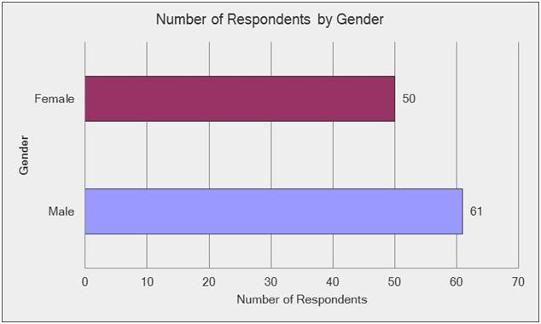
Number of Male and Female Respondents

Slide 7
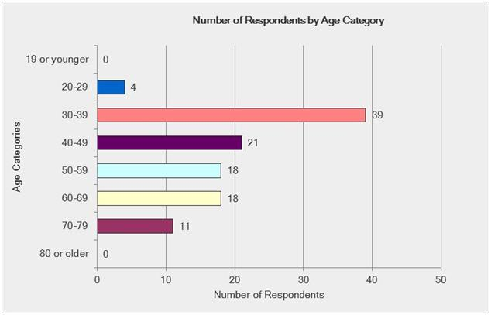
Number of Respondents by Age Category

Slide 8
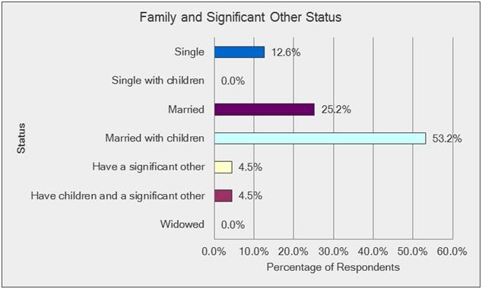
Respondent Family and Significant Other Status

Slide 9
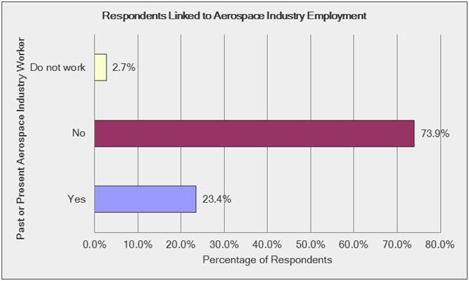
Respondents Linked to Past or Present Aerospace Industry Employment

Slide 10
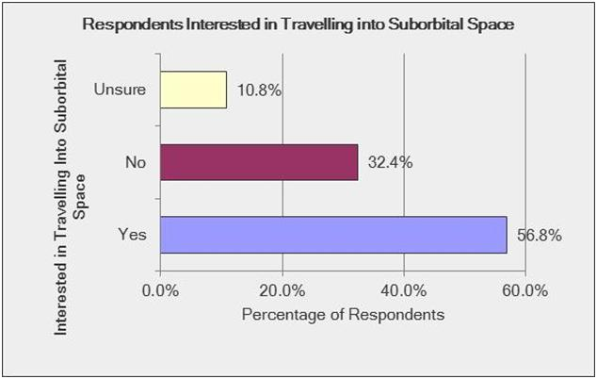
Respondents Personally Interested in Travelling into Suborbital Space

Slide 12
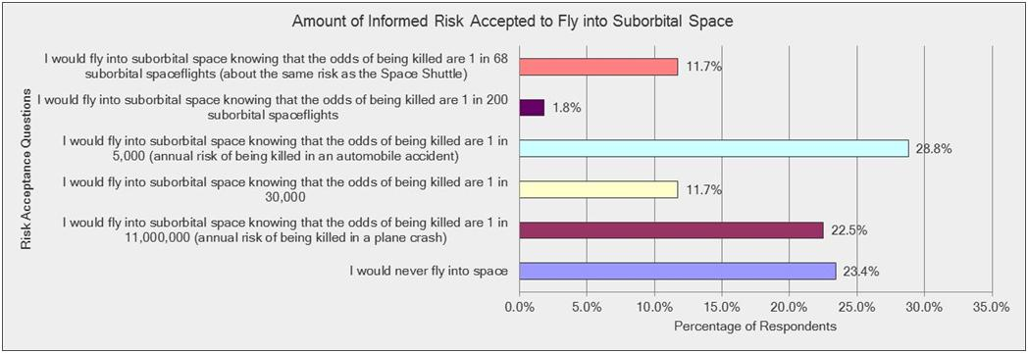
Respondent Informed Risk Acceptance for Suborbital Space Travel

Slide 13
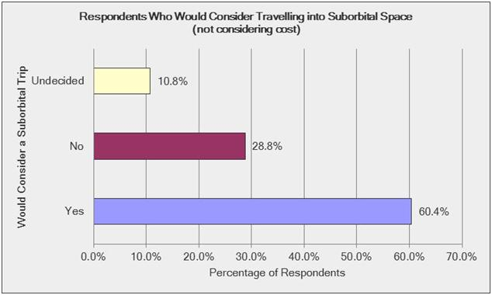
Respondents Who Would Consider Travelling into Suborbital Space without Cost Considerations

Slide 14
Respondents Who Would Consider Suborbital Space Travel by Category

Slide 15
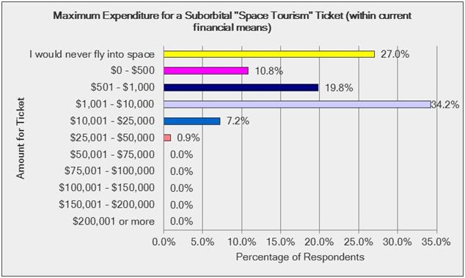
Maximum Expenditure for a Suborbital Tourism Ticket within Current Financial Means

Slide 16
Results
Single respondents were more inclined to travel into suborbital space than the married respondents (85.7% to 53.6% respectively)
Aerospace workers were more inclined to travel into suborbital space than the non-aerospace workers (80.8% to 54.1% respectively)
Under age 50 respondents were more likely to consider a trip into suborbital space than the age 50 and over respondents (73.4% to 42.6% respectively)
42.6% of age 50 and over respondents personally interested in suborbital space were willing to accept more risk to do so than the 73.4% of the younger respondents
The willing age 50 plus respondents were more inclined to accept automobile equivalent risk whereas the willing younger respondents leaned closer towards commercial airline risk acceptance (much safer than automobiles)

Slide 17
Conclusions
The general public believes the government should do more than what is currently captured in the FAA Part 460 regulations to protect crew and passengers during suborbital space flights
The general public is not willing to take more risk as a suborbital space flight passenger than they accept by driving or being a passenger in an automobile
The emerging suborbital space industry is technologically and financially unhindered by the current Part 460 requirements but may have a limited customer base due to minimal human survivability regulations and mandated notifications informing participants that the United States government has not certified the reusable launch vehicle as safe for carrying crew or space flight participants

