Slide 1
Space Export Controls Update
  Since Delivering the 1248 Report to Congress - April 2012
  Congress added language into the FY13 National Defense Authorization Act that gave the President the authority to transfer certain satellites and related items to the Commerce Control List (CCL)
  Prohibits export of CCL satellites and related items to China, North Korea, or any state sponsor of terrorism
  Future Tasks
  Late Spring 2013: Publish the proposed rules for satellite sections in USML (CAT XV) and CCL (ECCN 9x515) for public comment
  Fall 2013: Final rules for satellites and related items notified to Congress
  End calendar year 2013: Final rules published/in place

Slide 2
Summary of Proposed Controls
Cat XV Today
USML
CCL
Sats and Ground equip not in USML
Parts unique to military functions
Existing ECCNs
Other
Spec electronics
Spec optical sensors
Rad Hard ICs
Parts not on USML or other CCL
New sat related item or tech
GPS Rcvrs
New ECCN 9x515
Spec radar systems
Military Ground equip
Worldwide license, except CA.
25% de minimis except 0% for China and other ITAR 126.1 countries.
STA 36 eligible, except for certain software and tech
Controls for satellite items transferred from USML to be the same as for 9x515
Cat XV
Military Satellites
Services for USML and CCL satellites

Slide 3
16 Critical Technologies Remaining on USML
Certain specified antennas having particular capabilities
Certain space qualified optics with particular properties
Space qualified FPAs having particular peak response wavelength
Space qualified mechanical cryocooler
Space qualified active vibration suppression
Certain optical bench assemblies
Certain non-communication space qualified directed energy systems
Space-based kinetic or charged particle energy systems
Certain space qualified atomics clocks
High performance attitude determination and control systems
Certain Space based thermoionic converters or generators
Certain thrusters for orbit adjustment
Control moment gyroscopes
Certain space qualified MIMICs
Certain space qualified oscillators
Certain high performing star trackers

Slide 4
Items for Transfer to CCL
Satellites
  Commercial Communication Satellites
  Lower-Performance Remote Sensing Satellites
  Planetary Rovers
  Planetary and Interplanetary Probes
Including for the above:
  Ground control systems
  Training simulators
  Test, inspection, and production equipment
  Non-critical software for production, operation or maintenance
  Non-critical technology for the development, production, installation, operation and maintenance
Parts and components of satellite bus and payloads common to the above satellites
  Thousands of types of parts and subsystems
  Hundreds of thousands specific parts
  See next slide
Technology related to spaceflight passenger experience

Slide 5
Items Remaining on the USML
Satellites and spacecraft
  Unique military and intelligence functions, including nuclear detection, intelligence collection, missile tracking, anti-satellite or space-based weapons, classified operation or equipment, and navigation
  Certain remote sensing with military applications
  Man-rated habitats
Ground control equipment
  Performs a uniquely military function for one of satellites above
Parts & components
  Sixteen specific technologies critical to military functions
  Any payload that performs one of military functions listed above
  DoD funded payloads

Slide 6
Items Remaining on the USML (contd)
Satellite integration and launch services
  Provided by a U.S. person
  To a foreign launch integrator or launch vehicle provider
  Launch support considered a defense service, includes furnishing assistance or information for
  Integration of satellite to vehicle
  Launch failure analysis

Slide 7
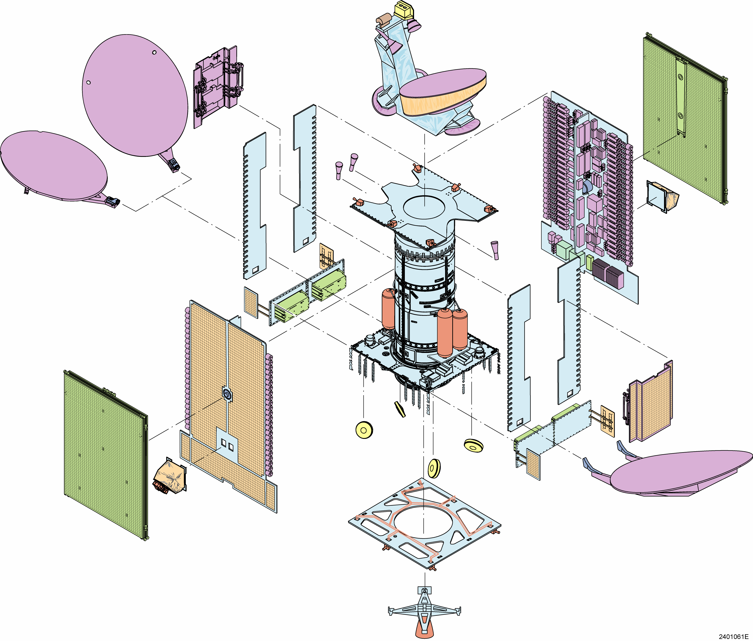
CCL Satellite-Related Parts and Components
SATELLITE BUS SYSTEMS INCLUDES:
Solar Array
Propulsion Tank
Optical Solar Reflector
Tower Structure
Stationary Plasma Thruster
Antenna Reflector
Antenna Subreflector
Comm Panel Electronics
Spacecraft Control Electronics
Thruster
Antenna Feed
Earth Sensor
Thermal Blanket
TWTA
Batteries
TT&C Antenna

Slide 8
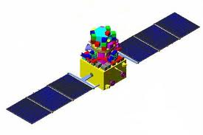
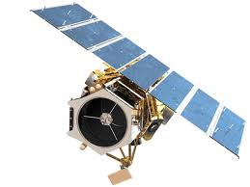
USML - Spacecraft
Proposed Category XV - Satellites
Nuclear Detection
Tracking – ground, airborne, missile using
imaging, infrared, radar, or laser
SIGINT
MSINT
Space-based logistics
Anti-satellite or anti-spacecraft
High Performance Remote Sensing
  Electro-optical VNIR or IR with < 40 spectral bands and an aperature >0.35 m
  Electro-optical Hyperspectral VNIR and SWIR with > 40 bands, with narrow spectral bandwidth of delta lamba < 20nmFWHM AND ground sample distance <200m
  Same as above but for MWIR
  Same as above but for LWIR
Radar remote sensing, including AESA, SAR, ISAR, ultra-wideband SAR EXCEPT for those with center frequency of 1GHz<x<10GHz and BW <300MHz
Position, Navigating, and Timing
Constellation of satellites that form a virtual satellite performing any function listed here
Man-rate sub-orbital, orbital, lunar, or inter-planetary
Man-rated habitat
Contained a classified system, subsystem or component
Ground control systems for TM, tracking, and control of any satellite listed here
Radiation hardened microelectronics
Illustrative list only

Slide 9

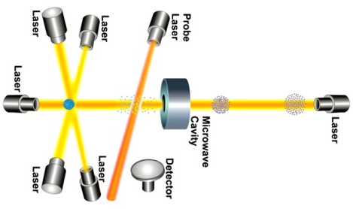
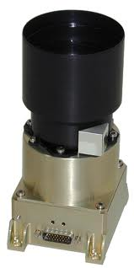
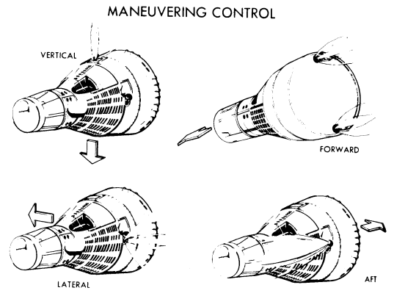
USML – Spacecraft-Related Articles
Proposed Category XV – Parts and Components
Antennas with dia >25m
Actively scanned antennas
Adaptive beam forming antennas
Interferometric radar antennas
Space qualified optics including coating with active porpoerties
Space qualified optics including coating with largest lateral dimension >0.35 m
Space qualified FPAs having peak response wavelength >900nm and associated ROICs
Space qualified mechanical cryocooler, active coldfinger, and associated control electronics
Space qualified active vibration suppression, including isolation and dampening, and associated electronics
Optical bench assemblies and control electronics for satellites on previous page
Control moment gyroscopes
Certain space qualified MIMICs, oscillators for radar, star trackers
Secondary or hosted payloads that perform any function listed on previous page
DoD funded payloads
Classified components
Non-communication space-qualified directed energy designed for spacecraft on previous page
Space-based kinetic energy systems
Charged particle energy systems
Attitude Determination and Control Systems with ground location points better than or equal to 5m (LEO), 30m (MEO), 150m (GEO), or 225m (HEO)
Thrusters for orbit adjustment with .150lbf vacuum thrust
Space qualified cesium, rubidium, hydrogen Master, or Quantum atomics clocks
Space based thermoionic or non-nuclear thermoionic converters or generators
Illustrative list only

