Slide 1

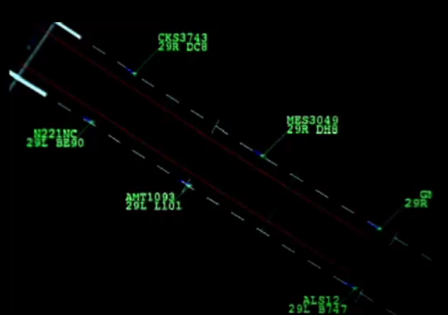
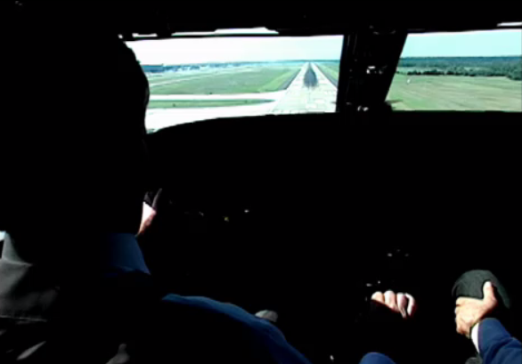

Precision Runway Monitor (PRM)
Pilot Procedures
Original Date: September 20, 2017
Contact: 9-awa.avs-afs-400-flight-technologies-procedures@faa.gov
REV 1: Graphics enhanced pages 6, 7, 12, 14, 15, 16 3/15/2018
REV 2: Replaced 3000’ with 2500’, pages 1, 12 5/5/2020

Slide 2
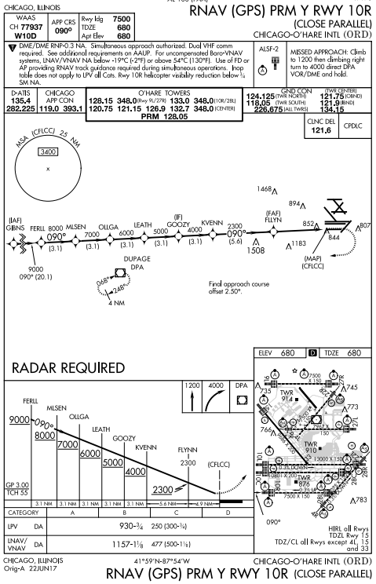
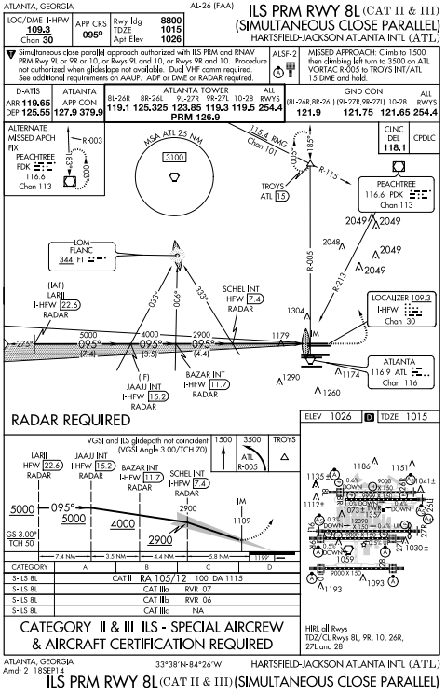

PRM Approaches to
Closely Spaced Runways
PRM approaches are independent,
simultaneous operations to runways
spaced between 2500 and less than
4300 feet apart. The approach courses
are normally parallel but may be offset
by between 2.5 and 3.0 degrees
depending on the runway separation.
Chart examples
not current
1

Slide 3
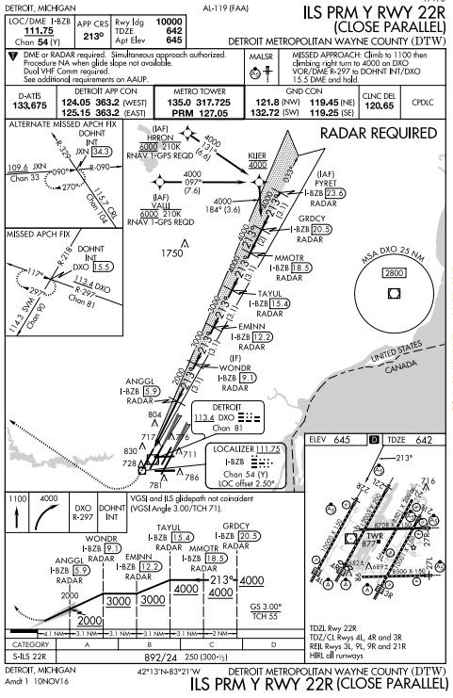
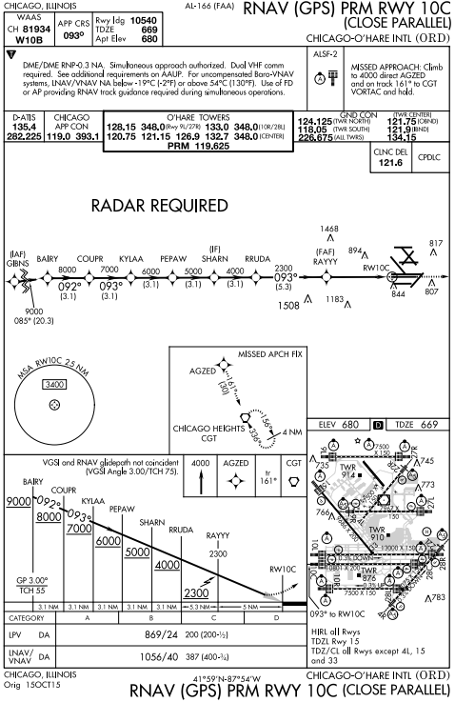
In the FMC, select ILS Y 22R
to conduct the ILS PRM Y Rwy 22R;
select RNAV (GPS) 10C to conduct
the RNAV (GPS) PRM 10C.
PRM approaches require specific pilot
training. Refer to company
requirements or, for general
aviation, the Aeronautical
Information Manual (AIM).
Chart examples
not current
2

Slide 4
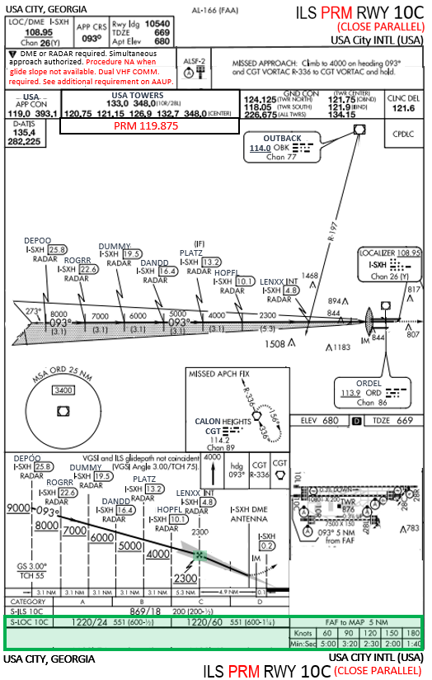
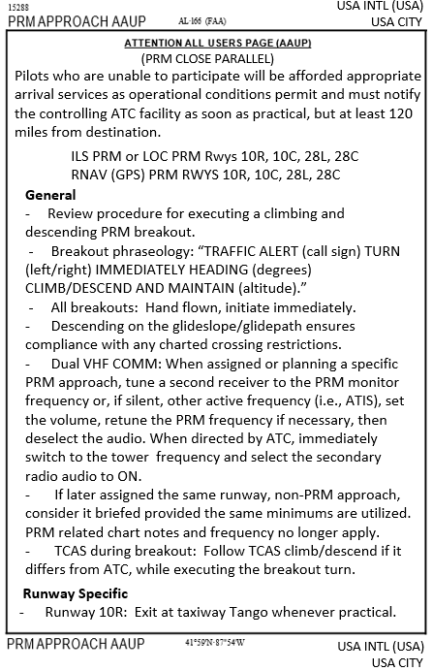

The chart at the left combines all of the text
and symbols that appear on both an ILS and
ILS PRM chart.
Procedure NA when glide slope not
available. Dual VHF COMM required.
See additional requirements on AAUP.
2. Text in red appears only on the PRM chart.
4. One Attention All Users Page (AAUP) is
published for each airport where PRM
approaches are conducted.
5. It is required to brief the General airport
procedures and those Runway Specific
applicable to the approach that is to
be conducted.
3

Slide 5


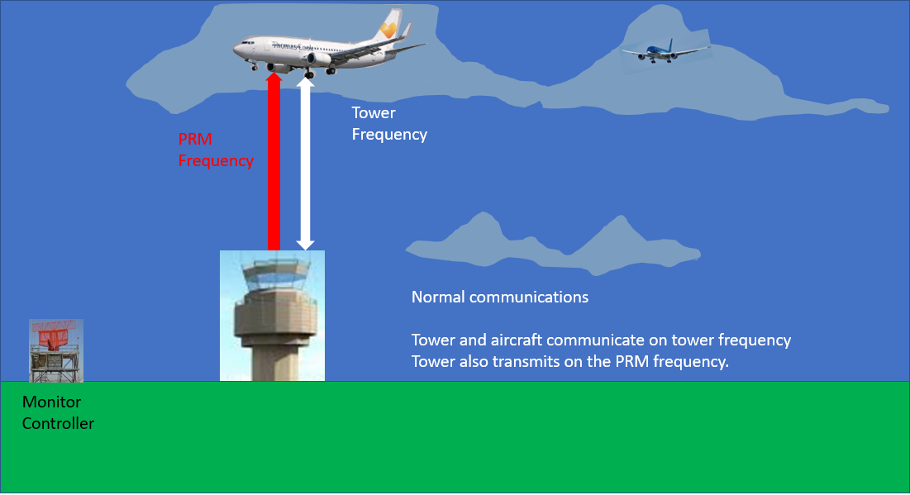
The chart note “Dual VHF comm. required” refers to use of the Tower frequency and concurrently a secondary PRM Monitor frequency to protect against a blocked “breakout” instruction. The tower transmits on both. The aircraft transmits only on the tower frequency but listens to both.
Jeppesen depiction
FAA depiction
4

Slide 6
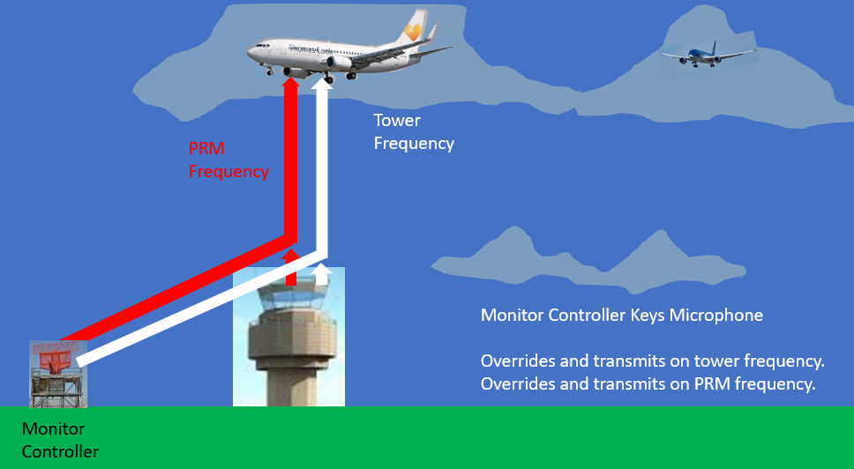
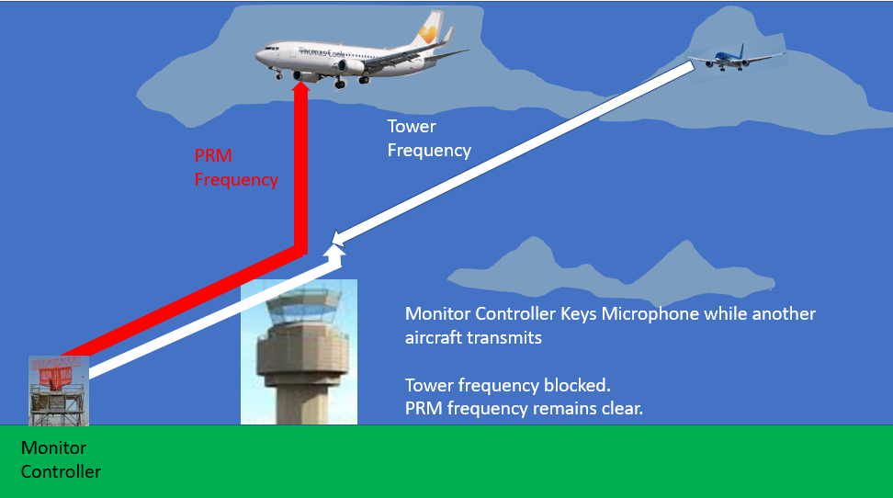
Tune a secondary communication radio to the PRM frequency (or, if silent, to another, e.g. ATIS), set the volume as desired,
retune if necessary to the PRM frequency, then deselect the secondary audio. When switched to the tower, re-select the
secondary radio audio.
If the monitor controller’s breakout instruction is blocked on the tower frequency, it can still be heard on the PRM frequency.
Monitor controller overrides both the tower and PRM frequencies.
5

Slide 7
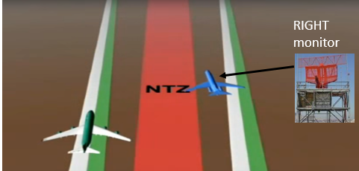
One No Transgression Zone (NTZ) Monitor Controller and one Tower Controller are assigned to each PRM runway. The monitors watch for off course deviations, especially those toward the NTZ.
If an aircraft strays off course , the Right Monitor’ will attempt to return the aircraft to the final approach
course.
“West Central 1502 turn right return to the localizer course”
02L 02R
6

Slide 8
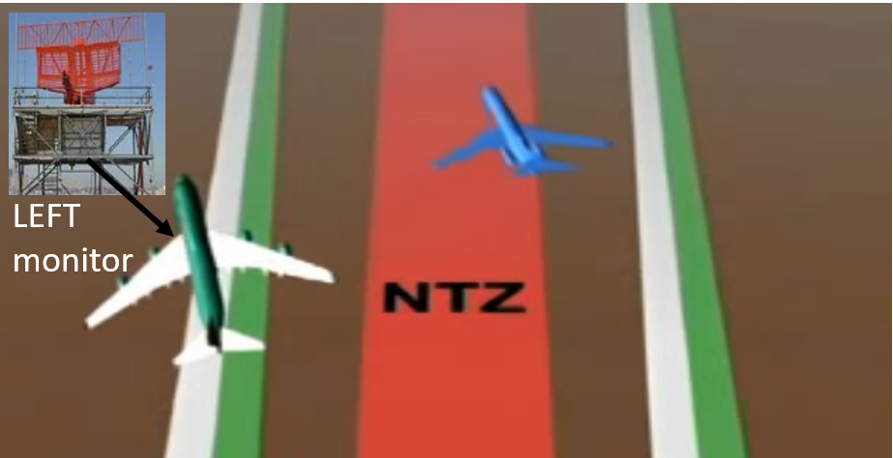
Though issuance is rare, the “breakout” instruction will begin with the words “Traffic Alert,”
  followed by:
- aircraft call sign
- a turn
- climb (normally) or descend (rarely).
Climb
“Traffic Alert Trans Global 574 heavy turn left
immediately heading 340 climb and maintain 4000”
Descend
“Traffic Alert Trans Global 574 heavy turn left
immediately heading 340 descend and maintain 1900”
02L 02R
Pilots must assume that a conflict is developing and
execute this instruction without delay. Thus, ALL
“breakouts’’ are Hand Flown.
Because “breakouts” are rare, before conducting a
PRM approach, the AAUP reminds pilots to brief their
aircraft specific procedures, covering such topics as
Autopilot, Flight Director, pitch, roll and power.
7

Slide 9
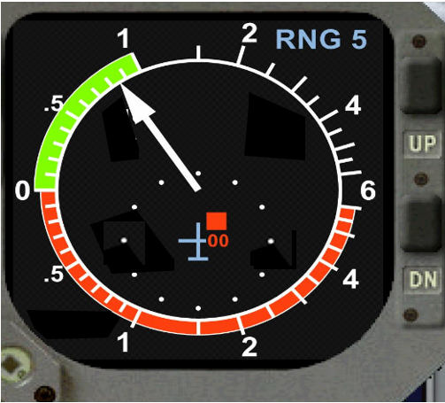
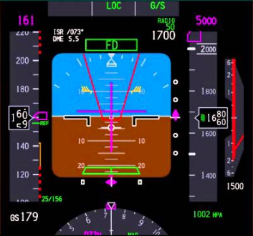
If, during a “breakout,” TCAS issues a climb or descend Resolution Advisory (RA) opposite to the
controller’s instruction, follow the TCAS RA while executing the turn portion of controller’s instruction.
Monitor Controller:
“…turn left heading 340
descend and maintain 1900”
Monitor Controller:
“…turn left heading 340,
climb and maintain 4000”
8

Slide 10
PRM Questions
(Answers at the bottom of the page)
Question 1 When conducting closely spaced PRM approaches, the secondary monitor frequency is:
a. always used by the pilot to transmit to ATC
b. sometimes used by the pilot to transmit to ATC
c. never used by the pilot to transmit to ATC
Question 2 Pilots may fly a PRM approach:
a. using the Autopilot or Flight Director throughout
b. using the Autopilot or Flight Director, but a “breakout” must be hand flown
c. only be hand flown throughout
Answer 1: c. Pilots never transmit on the monitor frequency, they only receive transmissions on it.
Answer 2: b. The approach itself is to be flown using the flight director or the autopilot, but a
“breakout” must always be hand flown.
9

Slide 11
Question 3 You briefed an ILS PRM approach and as ATC vectors your aircraft, you are informed that PRM approaches are no longer being conducted, expect the ILS approach to the same runway. You should?
a. request a delaying vector in order to brief the ILS approach
b. request an RNAV (GPS) approach
c. continue the approach, because, having briefed the ILS PRM approach, you have completed the requirements
to conduct the ILS approach to the same runway
Question 4 During a “breakout,” a pilot should follow a TCAS RA even if it is opposite the climb/descend ATC clearance:
a. false
b. true
c. at the pilot’s discretion
Answer 3: c: Briefing a PRM approach also briefs the same runway ILS or RNAV (GPS) approach, provided the same vertically guided minimums are utilized. The chart notes that apply to PRM operations may be ignored.
Answer 4: b: If an RA is received, its instruction supersedes the controller’s climb/descend clearance. However, the pilot should still follow the ATC turn instruction and inform ATC of the deviation.
10

Slide 12
Question 5. At an airport where the PRM runway ILS glideslope is reported out of service, you can still conduct
a PRM approach if you are approved to:
a. conduct a PAR or other ATC radar directed approach to that runway
b. conduct an RNAV (GPS) PRM approach to LNAV/VNAV or LPV minimums to that runway
c. cannot accept a PRM approach of any kind to that runway
Question 6. Briefing a climbing and descending “breakout” procedure for your aircraft before conducting
a PRM is required and noted on the AAUP because:
a. the closeness of the runways makes it essential that a “breakout” be properly executed
b. a “breakout” is an extremely rare event and hence pilots are not often required to execute one
c. a “breakout” is an unexpected ATC clearance, and pilot’s should know ahead of time how they should
conduct it
Answer 5 b. You can conduct an RNAV (GPS) PRM approach to that runway if you are approved for vertically
guided RNAV approaches (LNAV/VNAV or LPV).
Answer 6 a., b., c. Because pilots do not perform a “breakout” with regularity either in actual flight or in
a flight simulator, it is critical to preplan the maneuver so that it can be executed
correctly, in a timely manner…just in case!
End PRM Approaches to Closely Spaced Runways
11

Slide 13
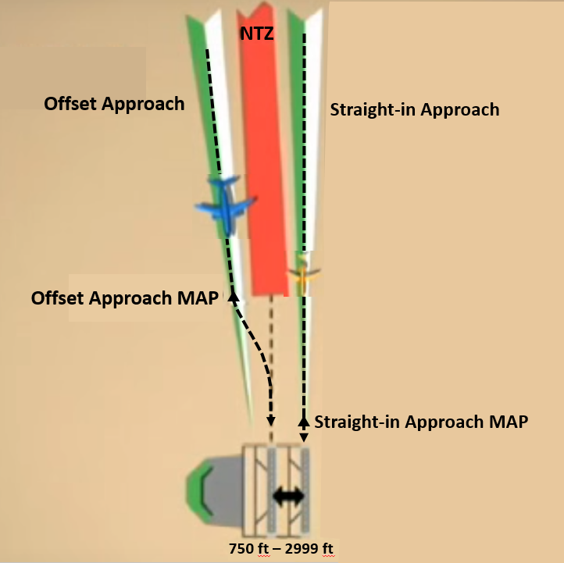
Simultaneous Offset Instrument Approach (SOIA)
Simultaneous Offset Instrument Approaches (SOIA) can be authorized when parallel runway separation is less than 2500 feet
and at least 750 feet. SOIA approaches use one straight-in and one offset approach.
12

Slide 14
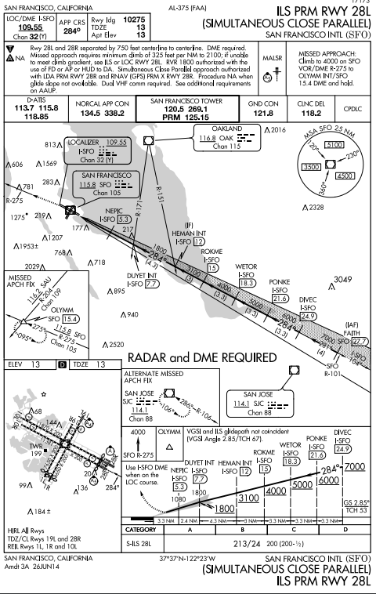
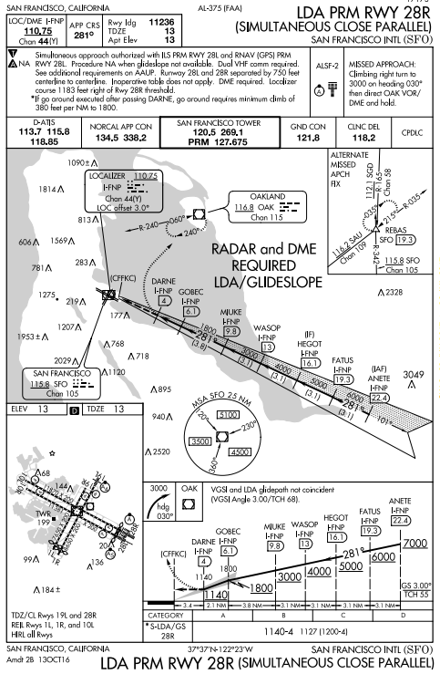
Straight-In
Approach
Offset
Approach
At the offset approach missed approach
point (MAP), aircraft leave the final
approach course, and proceed visually
to the airport. Normal maneuvering
will establish the aircraft on the
extended runway centerline about
500 feet Above Ground Level (AGL).
Chart examples
not current
13

Slide 15
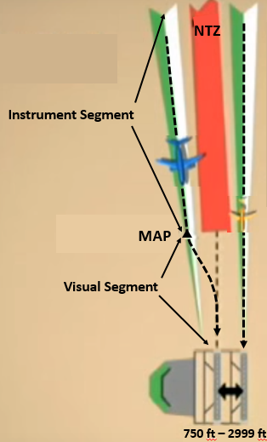
The offset MAP establishes the end point of both the NTZ and instrument segment
and the beginning of the visual segment.
Prior to reaching the offset MAP, the pilot must:
- make visual contact with the straight-in aircraft.
- report to ATC that the traffic is in sight (ATC is NOT required to respond
to this transmission).
- have visual contact with the landing runway.
Otherwise a missed approach must be executed at the offset MAP.
Only vertically guided minimums (ILS, LDA with glideslope, LNAV/VNAV, or LPV) are
published for flyability and wake mitigation purposes.
14

Slide 16
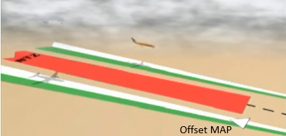
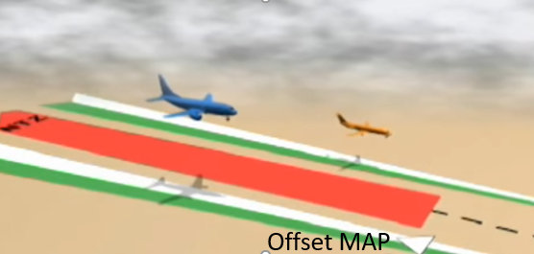
ATC will space the offset aircraft slightly behind to aid in visual contact of the straight-in aircraft. A minimum cloud ceiling is required so that the offset aircraft will exit the overcast about 25 seconds or more prior to reaching the offset MAP.
.
.
ATC: traffic report request
“Coastal 221 traffic at 10 o’clock less than a mile a DC9 report that traffic in sight”
.
Aircraft: traffic report
.
.
“Coastal 221 traffic in sight”
15

Slide 17
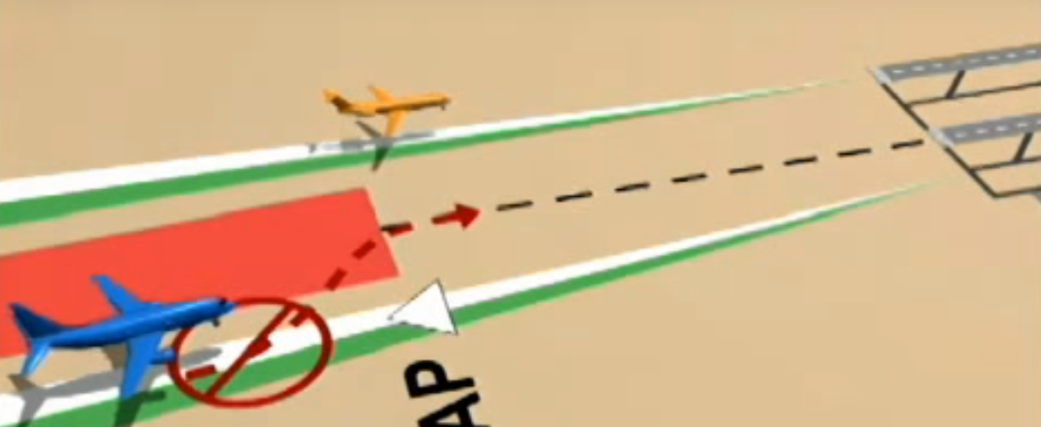
Pilots conducting the offset approach are cautioned not to prematurely turn off the offset approach and accidently enter the NTZ.
.
.
Inside the offset MAP, pilots are responsible for wake turbulence and collision mitigation. If wake mitigation is an issue, (large aircraft following a heavy for example), pilots are encouraged to begin developing a wake avoidance strategy as soon as practical.
Inside the offset MAP, if the aircraft loses visual contact with the leading straight-in aircraft, the pilot should inform ATC and execute the published missed approach unless otherwise instructed by ATC.
16

Slide 18
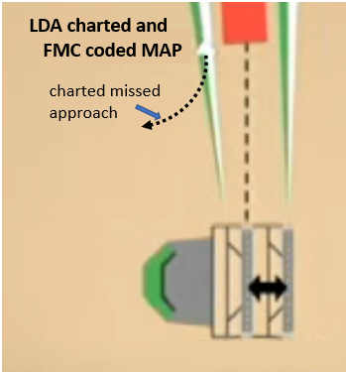
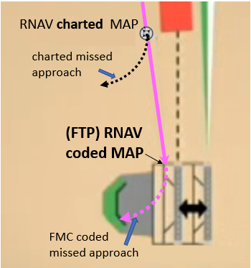
Offset Approach Missed Approach Considerations
Offset LDA Approach
The LDA charted and LDA FMC coded MAPs are co-located.
Offset RNAV approach
The offset RNAV charted and RNAV FMC coded MAPs are
not co-located so as to provide vertical guidance to the threshold.
NTZ
NTZ
Pilots must always conduct the charted missed approach.
Heading mode must be initially used for the RNAV missed approach. Course information, if depicted inside the RNAV charted MAP, is not part of the authorized missed approach procedure.
17

Slide 19
Question 1. The SOIA offset PRM approach procedure can be thought of as:
a. an instrument approach with a visual segment
b. an instrument approach
c. a visual approach
Question 2 When conducting SOIA procedures, the aircraft are paired. Prior to reaching the offset approach MAP,
the aircraft conducting the offset approach will always be positioned by ATC:
a. slightly to the rear of the straight-in aircraft
b. slightly ahead of the straight-in aircraft
c. either ahead of behind the straight-in aircraft
Answer 1: a. The SOIA offset approach procedure is an instrument approach with a visual segment from
the offset MAP to the runway threshold.
Answer 2 a. The offset aircraft will always be slightly to the rear so as to be in the best position to
visually acquire the straight-in aircraft.
SOIA Questions
(Answers at the bottom of the page)
18

Slide 20
Question 3 If ATC advises the aircraft conducting the SOIA offset approach that there is traffic on the adjacent straight-in final, the offset aircraft is authorized to continue past the MAP for a landing if:
a. the straight-in aircraft is in sight
b. the straight-in aircraft and the runway threshold are in sight
c. the straight-in aircraft and the runway threshold are in sight, the pilot reports to ATC that
traffic is in sight
Question 4. Your FMS map display depicts the RNAV (GPS) PRM missed approach begins at about the
runway threshold:
a. there is an error in the coding
b. the coding is correct but the map depiction does not initially represent the charted missed
approach procedure
c. the coding is correct and a pilot can follow the course as depicted on the map display
Answer 3 c. All three are required. Remember that ATC is not required to acknowledge the aircraft’s
“traffic in sight” transmission.
Answer 4: b. The coding is correct, but the depiction of the missed approach beginning near the
runway threshold does not initially represent the charted missed approach procedure.
Always execute the charted missed approach.
19

Slide 21
Question 5 Why is the RNAV approach coded in the FMC so that the missed approach does not begin
at the charted MAP:
a. To assist ATC in providing traffic avoidance in the visual segment.
b. To assist ATC in providing wake separation in the visual segment.
c. To provide vertical guidance to the threshold.
Question 6. After passing the MAP you lose sight of either the traffic you are following or the runway
threshold:
a. continue the approach because it is a visual segment.
b. execute a missed approach and inform ATC of that fact.
c. report to ATC that you have lost sight of the aircraft or the runway.
Answer 5 c. Pilots will have a vertical reference to the runway threshold, for maneuvering and wake
avoidance purposes.
Answer 6: b. Inform ATC you are executing a missed approach. Follow the published missed approach
unless otherwise instructed by ATC.
End Simultaneous Offset Instrument Approach (SOIA)
20

Slide 22
Recap (Review is Optional)
PRM Approach
The AAUP brief includes:
reviewing the procedure for executing a breakout.
reviewing the breakout phraseology: “Traffic alert (call sign) turn (L/R) immediately climb/descend and maintain (altitude).”
noting that all breakouts are hand flown, initiate immediately.
noting that descending on the glideslope/glidepath meets any charted crossing restrictions.
noting that later assignment of the non-PRM approach to the same runway, consider it briefed if the same vertically guided
minima are utilized. PRM related notes may be disregarded.
follow a TCAS RA climb/descend during a breakout, even if it differs from ATC, while executing the breakout turn.
using dual communications to tune a secondary radio to the PRM monitor frequency, set the volume, then deselect the audio.
When directed by ATC, immediately switch to the tower frequency and select the secondary radio audio to ON.
Simultaneous Offset Instrument Approach (SOIA)
One straight-in and one offset approach
Straight-In Approach: Normal PRM procedures.
Offset Approach:
- Normal PRM procedures up to the Missed Approach Point (MAP). Report traffic in sight prior to MAP.
In the visual segment from the MAP to the runway threshold, collision and wake mitigation are pilot responsibilities.
* Do not pass.
Glideslope or VNAV vertical path provided to the runway threshold.
RNAV FMC coded MAP not co-located with the charted MAP. Unless otherwise instructed always fly the charted missed
approach.
21

