Slide 1
Challenges in Commercial Space Research and Development
Challenges in Commercial Space Research and Development
Presented by
Brian Rushforth
Manager
Innovation Division (ASZ-300)
September 21, 2022

Slide 2
AGENDA
Authorities
Stakeholder Challenges
Scope of AST R&D
R&D Focus Areas
Integration into the NAS
Centers of Excellence
Meeting the challenges

Slide 3
Authorities
Focused on Safety of the Uninvolved Public
Statutory Encourage, Facilitate, and Promote
Human Spaceflight Moratorium – Ends 2023?
Licenses, Not Certificates for ALL U.S. Companies
Safety Standards – 1 X 10⁻⁶
Outer Space Treaty of 1967 – Ambiguities

Slide 4
Stakeholder challenges
Congress
Industry
Fail Forward Fast
Proprietary Research
Academia

Slide 5
THE SCOPE OF AST R&D
FAA AST’s mission goals:
Safety of uninvolved public
Encourage, facilitate, and promote industry
Continuous improvement of human space flight safety

Slide 6
Current R&D Focus areas
LOX/Methane (Complimentary with NASA & USSF)
Human Space Flight
Orbital Debris Mitigation
Vehicle/Occupant Safety

Slide 7
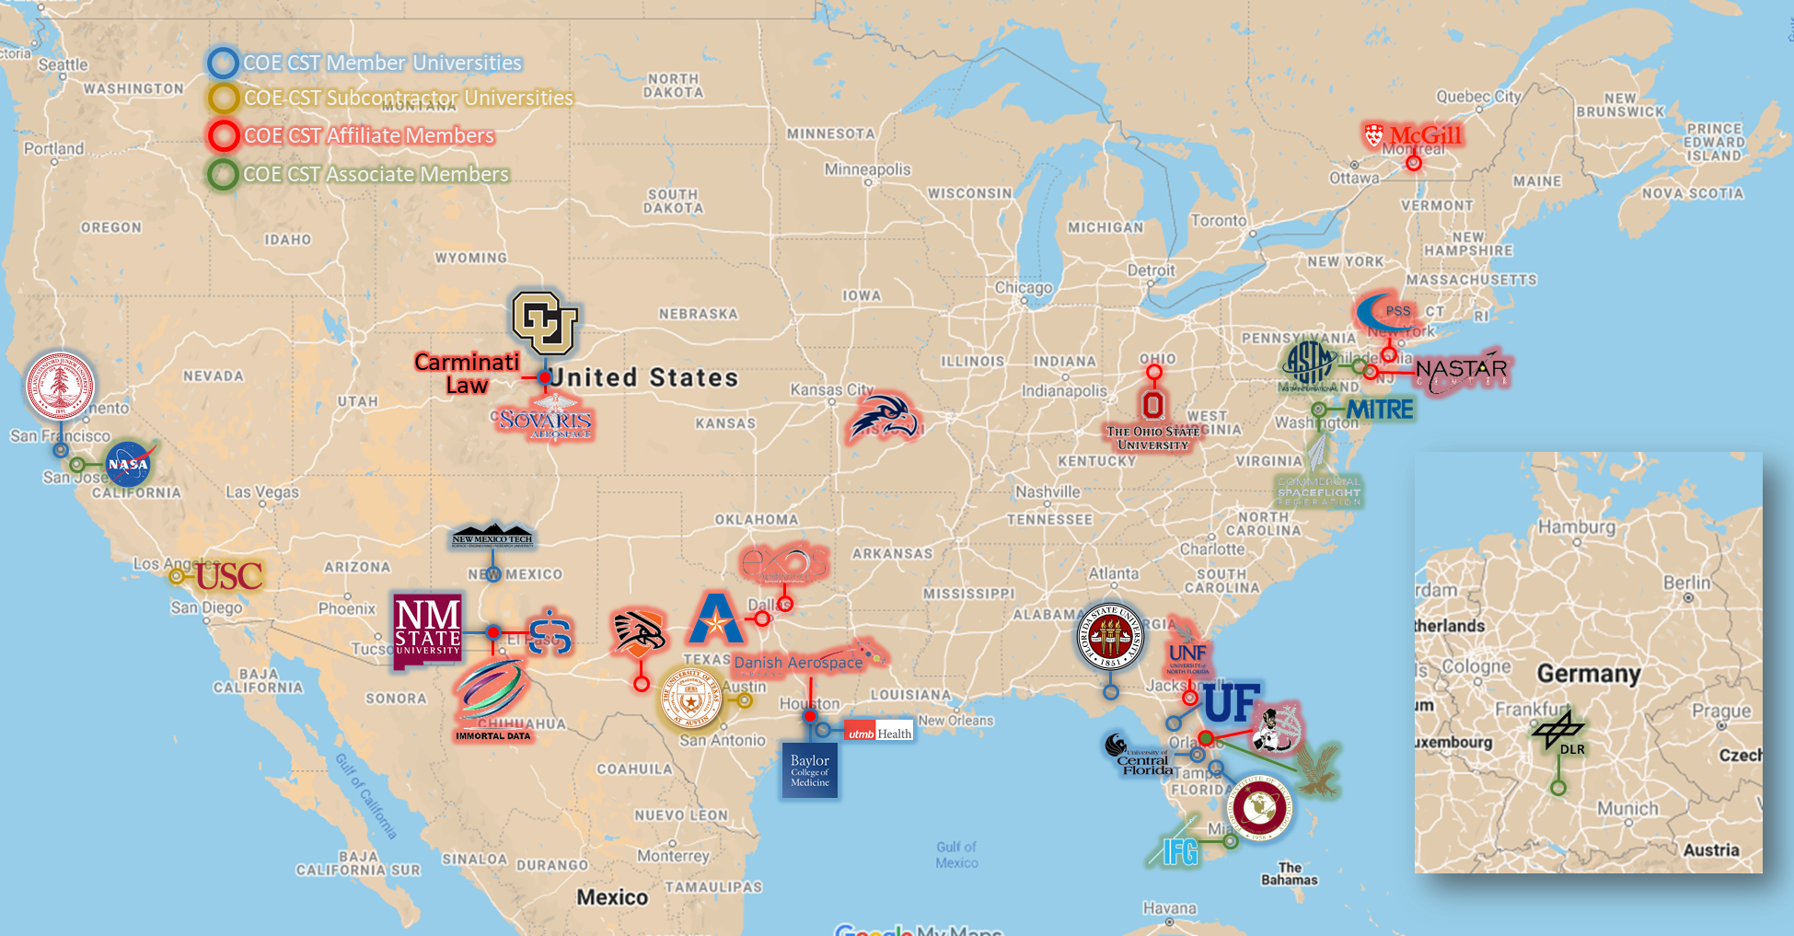
Center of Excellence for Commercial Space Transportation
CLOSED
As of 19 Aug 2022

Slide 8
Integration into the Nas
Commercial space launches cause less than 0.5 percent of delays
Space Data Integrator Prototype
No longer AST focus
Coordinating with ATO

Slide 9
Meeting the Challenges
Developing regulations, standards, and guidance
Formalizing internal processes
Research Alliance
Communication, Communication, Communication

