Slide 1
Title Slide
Frameworks and Measures for Dynamic Innovation with Rigor
FAA V&V Summit
September 21-22, 2022
William D. Miller
School of Systems and Enterprises
Stevens Institute of Technology

Slide 2
Topics
Bottom Line Up Front (BLUF)
Challenges
Digital Engineering, Digital Threads, Digital Twins, Digital Artifacts
Velocity
Rigor
Frameworks and Measures
Summary
Relevant Reads

Slide 3
Bottom Line Up Front
BLUF
Dynamic innovation is a multi-faceted approach with concrete action plans to accelerate synergistic innovation across multiple fields towards a balanced set of dynamic, evolving complex objectives.
  The Next Generation Air Transportation System (NextGen) is the FAA’s ongoing infrastructure program implementing major new technologies and capabilities, leading to a new way of managing air traffic using Trajectory Based Operations.
  NextGen is a series of interlinked programs, portfolios, systems, policies, and procedures that are fundamentally changing aviation communications, navigation, and surveillance. Within its scope are airport infrastructure improvements, new air traffic management technologies and procedures, and environmental, safety, and security-related enhancements.
Rigor is defined as “the quality or state of being very exact, careful, or strict” (Merriam-Webster, 2017).
  “Scrupulous adherence to established standards for conduct of work” (NASA Final Report of the Return to Flight Task Group, Appendix A.2, 2005).
  We need to be mindful of precision as a key characteristic of rigor. What level of precision is acceptable to stakeholders?
Frameworks and measures assess the question of “how are we doing”?
  Quality, velocity/agility, user experience, knowledge transfer, and adoption (Systems Engineering Research Center SERC 2020).
  Product quality/functional correctness; process effectiveness, efficiency, speed; technology effectiveness/performance (PSM Digital Engineering Measurement Framework 2022).
V&V is at the affect of these pain points for dynamic innovation and rigor with needed assessment frameworks and measures.

Slide 4
Complexity Awareness
Challenges
Wilson N. Felder, Addressing the Complexity Challenge with Adaptive Verification and Validation, 2017 FAA V&V Summit, September 13
Too many system states
Don’t have enough bandwidth to cover them all
Fat tailed probabilities
Dynamic, asynchronous ad hoc exchange of digital data among constituents
Surprises

Slide 5
FAA Leadership in Adaptive V&V
Challenges
Wilson N. Felder, Addressing the Complexity Challenge with Adaptive Verification and Validation, 2017 FAA V&V Summit, September 13
Early recognition of the problem (2005)
Early application of all the adaptive V&V techniques
Productive collaboration with
  DoD (JMETC)
  NASA/MITRE (AvSimNet)

Slide 6
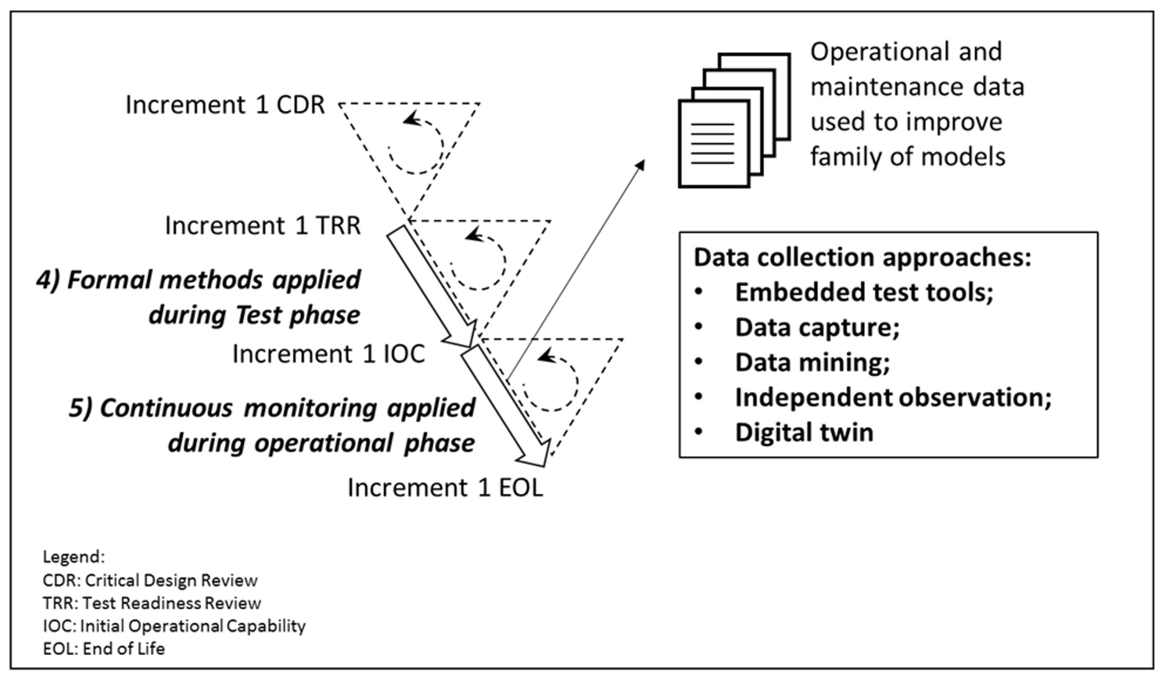
Formal Methods and Recurrent Surveillance
Challenges
Wilson N. Felder, Addressing the Complexity Challenge with Adaptive Verification and Validation, 2017 FAA V&V Summit, September 13

Slide 7
Is it Time to Revamp Systems Engineering?
Challenges
Graham Warwick and Guy Norris, Aviation Week & Space Technology, 2010
citing Michael Griffin, undersecretary of defense for research & engineering and former NASA
administrator; Paul Eremenko, former DARPA program manager; and Jeff Wilcox,
Lockheed vice president for engineering
“… systems engineering processes that have served the aerospace and defense community since pre-Apollo days are no longer adequate for the large and complex systems industry is now developing.
The issues typically lie with unintended and unanticipated interactions between elements that are only uncovered during integration, testing or, worse still, in service. And they are only getting more serious as systems become more interactive.
Failures usually occur at the interfaces between system elements, many times between elements thought to be separate. “There are two exponential trends, in software and network communications, that mean a lot of elements of a system can now impact each other. The result is incredible complexity: millions of lines of software and hundreds of nodes.
Historically, systems engineering has been successful in bringing order to the development of systems as they have become increasingly complicated. But there is a big difference between complicated and complex. Complicated is decomposable, which is what systems engineering is based on. Complex systems are no longer strictly decomposable, and systems engineering has to adapt.
Adding processes is not the right answer, ... What is needed is a new view that the core systems engineering function “is not primarily concerned with characterizing the interactions between elements and verifying that they are as intended. What’s more important, …, is understanding the dynamic behavior of those interactions.”

Slide 8
Elegant Design
Challenges
Michael Griffin, “How do we fix system engineering?”, 61st International Astronautical Congress, Prague, Czech Republic, 27 September – 1 October 2010
The system actually works: the system produces the anticipated behavior, the expected output, over the expected range of input conditions, and control variations.
The system is robust/resilient: the system should not produce radical departures from expected behavior in response to small changes to operating inputs, internal states, or external environment.
  Advocating that engineered systems be loosely coupled (rather than tightly coupled) with simple interfaces is too simplistic.
  Tightly coupled systems are difficult to avoid with system constraints such as weight & power, and real-time latencies.
  Simple interfaces do not address propagation of faults across and among interfaces.
An elegant system is efficient: it produces desired results for a lower expenditure of resources than competing alternatives.
An elegant system accomplishes its intended purposes while minimizing unintended actions, side effects, and consequences.

Slide 9
21st Century Engineering: Challenges & Opportunities
Challenges
Remarks by Stephen P. Welby, Deputy Assistant Secretary of Defense for Systems Engineering, 2013 INCOSE International Symposium, Philadelphia, 24 June 2013
“Systems Engineering focuses on the creative application of scientific and engineering principles:
To design, develop, construct, and operate complex systems
To forecast their behavior and interaction under specific operating conditions
To deliver their intended function while addressing economic efficiency, environmental stewardship, and safety of life and property.
The key gaps in our current engineering practice, as I see them, are threefold:
Dealing with Complexity at Scale
Quantifying Risk
Predicting the Impact of Engineering Decisions in the Product Context
I would argue that our engineering tools today often lack the power to adequately model and predict the interactions within these systems of systems, and this regularly results in unplanned and undesired systemic consequences.
Our tools are even less adequate when we need to think about systems of systems, with complex interactions that can lead to unplanned and often unwanted emergent behaviors.
Another major gap in our systems engineering toolkit is our ability to co-design and co-develop software and hardware.”

Slide 10
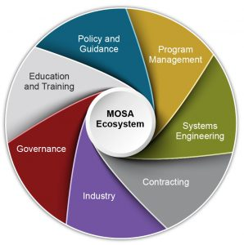
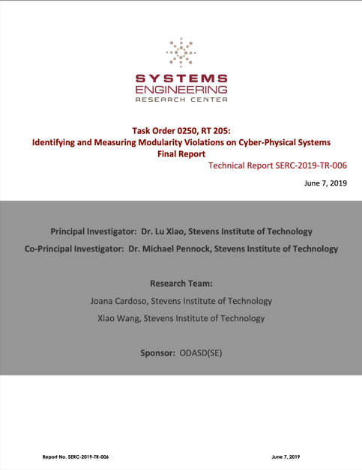
Modular Open Systems Architecture (MOSA)
Challenges
Principles
Cohesive (contain well-focused and well-defined functionality)
Encapsulated (hide the internal workings of a module's behavior and its data)
Self-contained (do not constrain other modules)
Highly binned (use broad modular definitions to enable commonality and reuse)
Pitfalls
Overreaching (trying to solve too many problems at once)
Identifying interfaces for standardization not relevant to goals
Assuming or selecting implementation technologies too early
Believing a technology will solve integration problems, as opposed to discipline in architecture, interface definitions & verifiable agreements
Allowing unconstrained options, or loopholes – lessens interoperability
Not involving practitioners (SMEs), or ignoring existing standards
Ambiguity, lack of clarity, conflicts, under or over specification
Not maturing specifications, letting users find problems
Selection of technologies inappropriate to the environment / use case
Not executing due diligence (validation/maturation, compliance tests, etc.)
Intended Benefits
Enhance competition. open architecture with severable modules, allowing components to be openly competed.
Facilitate technology refresh. ...
Incorporate innovation. ...
Enable cost savings/cost avoidance. ...
Improve interoperability
Support composability
Rapid integration and deployment
Identifying and Measuring Modularity Violations on Cyber‐Physical Systems

Slide 11
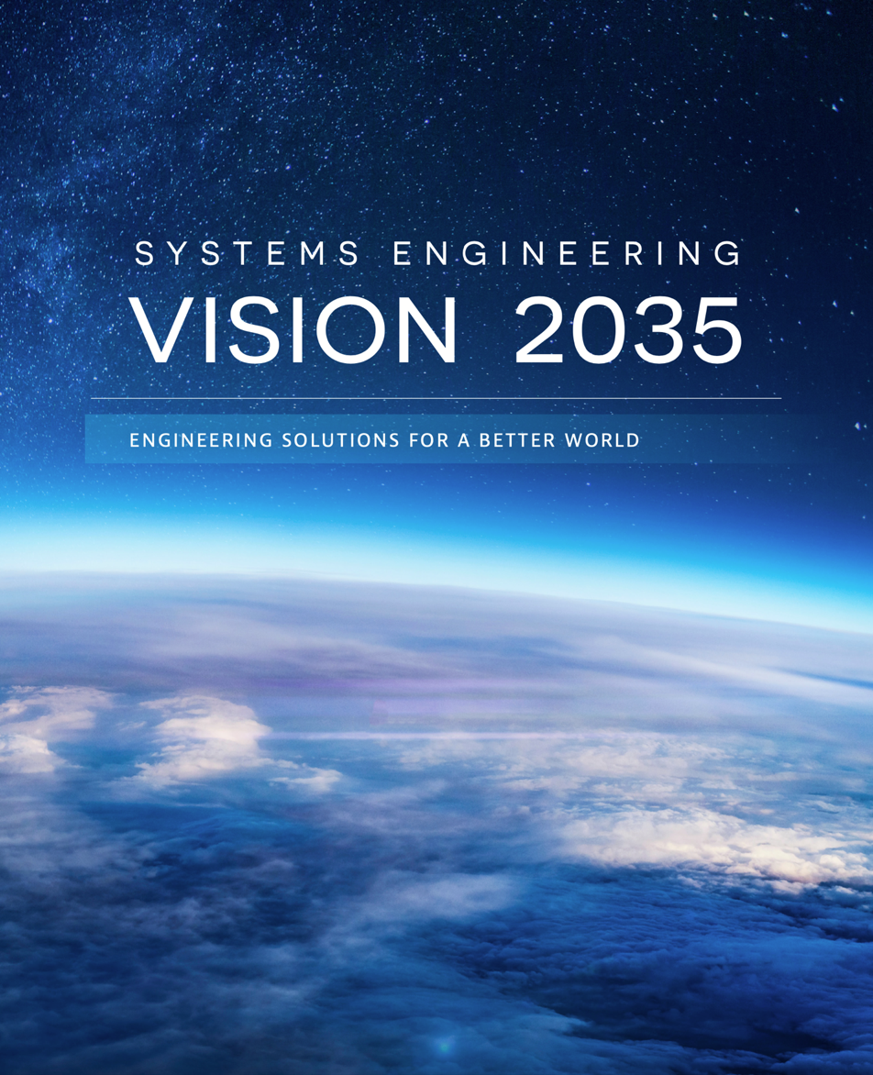
Systems Engineering Vision 2035
Challenges
Executive Summary
The Global Context for Systems Engineering
The Current State of Systems Engineering
The Future State of Systems Engineering
Realizing the Vision
Summary of Systems Engineering by 2035
https://www.incose.org/about-systems-engineering/se-vision-2035
Copyright 2021 – INCOSE

Slide 12
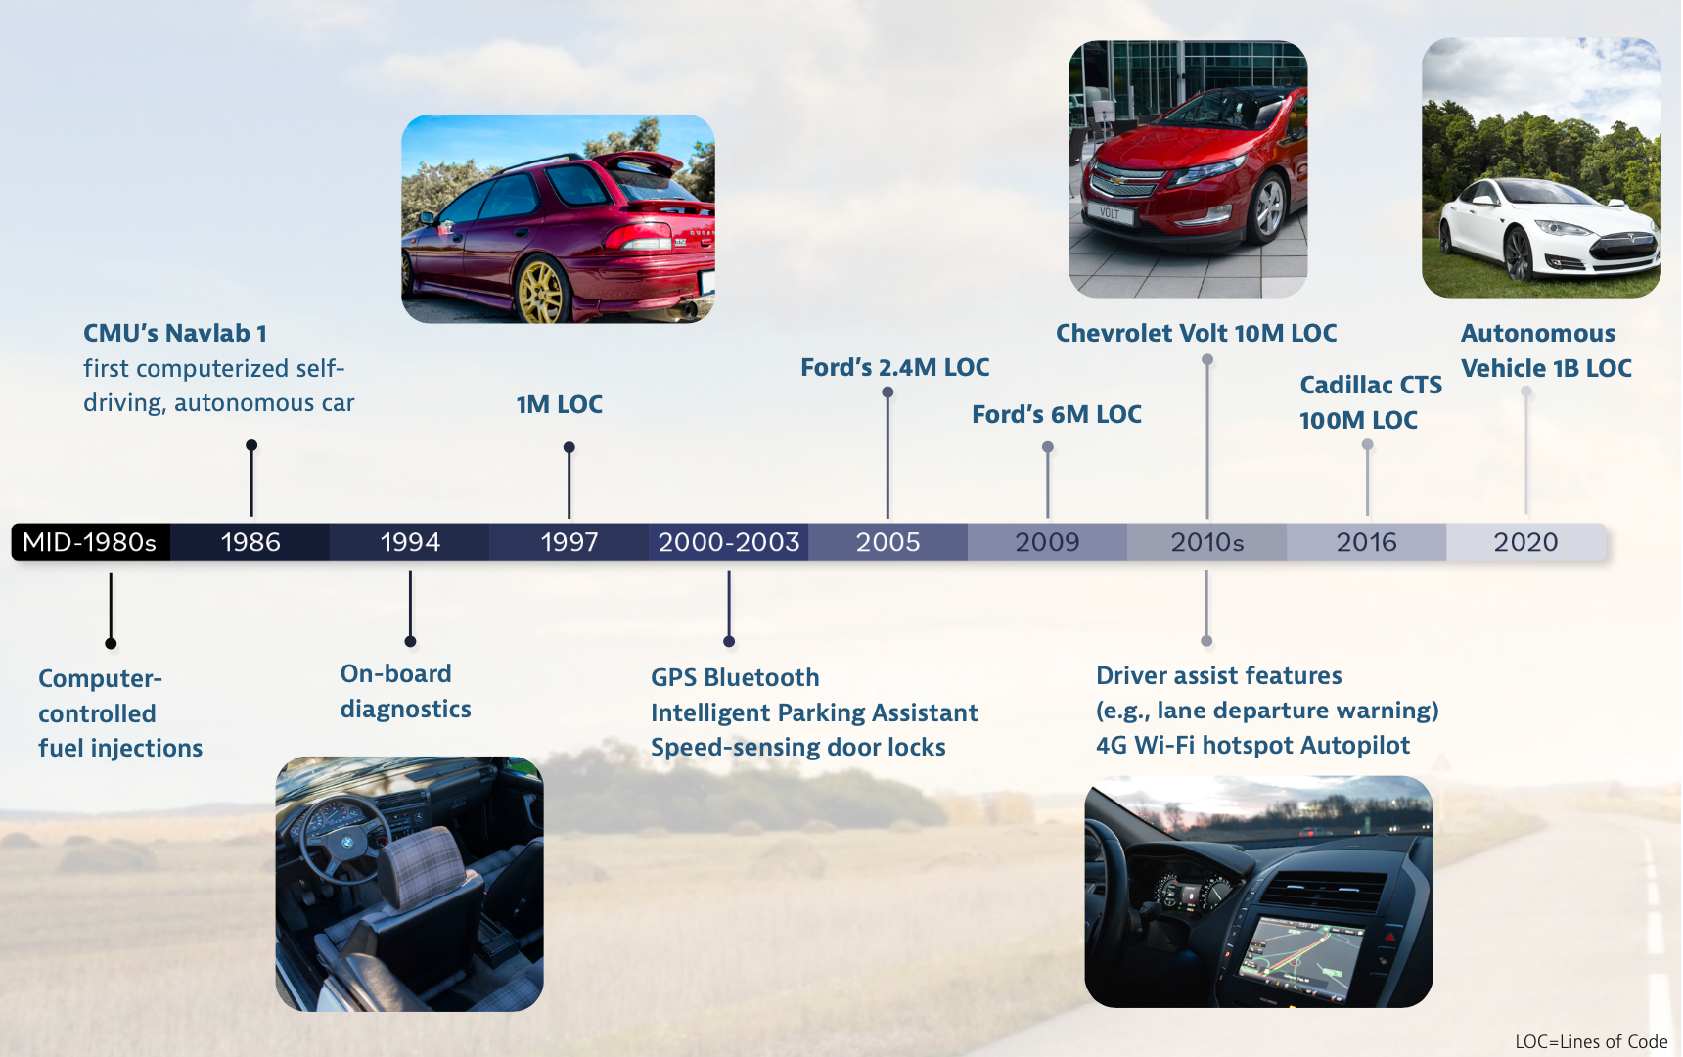
Systems Engineering Vision 2035 – Challenges
Challenges
Today’s Cyber-Physical Systems are Computer & Software Centric
Tools & Data Integration
Software Complexity
Agility
Velocity
Scale
Non-determinism
Impact of Additive Manufacturing
Impact of AI & Autonomous Systems
Copyright 2021 – INCOSE
The curse of dimensionality

Slide 13
Technology Advances Shape the Nature of Systems
Challenges
Advances in Materials and Manufacturing
Advanced Modeling and Simulation
Autonomy and Artificial Intelligence
Big Data and Analytics
Bio/Life Science and Nano Technologies
Communications Technologies
Edge Computing
Geospatial Technologies
Power Generation, Storage, and Conversion
Quantum Information Science
Technology advances are all concurrently in play
Systems Engineering Vision 2035

Slide 14

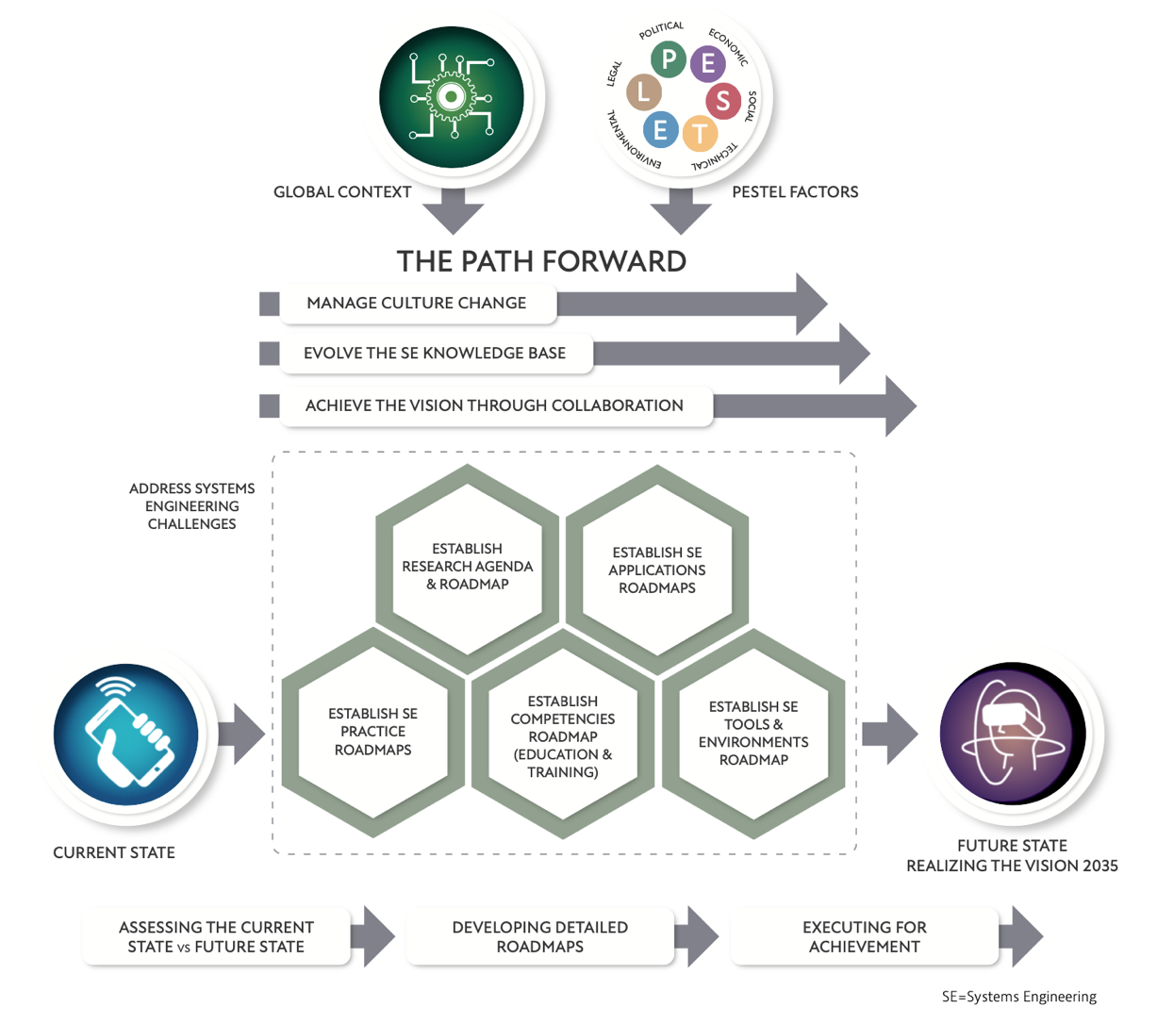
Systems Engineering Vision 2035 – Path Forward
Challenges
https://www.youtube.com/watch?v=szmdO2tm4vU
Our situation is not comparable to anything in the past. It is impossible, therefore, to apply methods and measures which at an earlier age might have been sufficient. We must revolutionize our thinking, revolutionize our actions ….
Albert Einstein (1948) in “A Message to Intellectuals”
Roadmapping:
Where are we today?
Where could we go?
(future scenarios)
Where should we go?
(enterprise competencies)
Where are we actually going?
Examples at https://roadmaps.mit.edu/index.php/Main_Page
Copyright 2021 – INCOSE

Slide 15
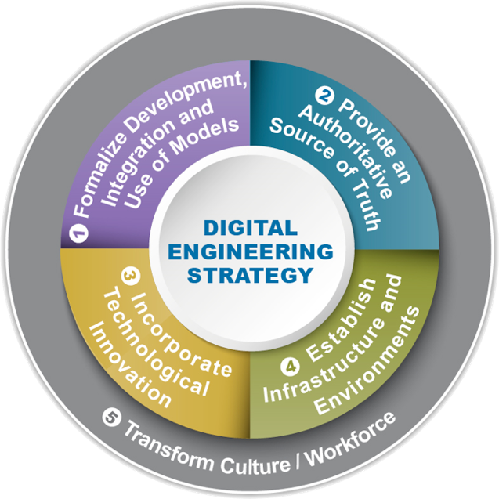
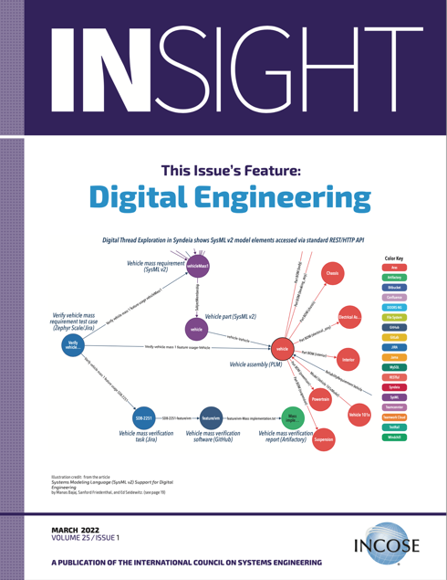
Digital Engineering, Digital Threads, Digital Twins,
Digital Artifacts
Digital Engineering
Digital Engineering – An integrated digital approach that uses authoritative sources of systems' data and models as a continuum across disciplines to support life cycle activities from concept through disposal. (Defense Acquisition University (DAU) Glossary) Model-based systems engineering (MBSE) is considered a subset of digital engineering.
Digital Thread – An extensible, configurable, and component enterprise-level analytical framework that seamlessly expedites the controlled interplay of authoritative technical data, software, information, and knowledge in the enterprise data-information-knowledge systems, based on the Digital System Model template, to inform decision makers throughout a system's life cycle by providing the capability to access, integrate, and transform disparate data into actionable information. (DAU Glossary)
Digital Twin – An integrated multi-physics, multiscale, probabilistic simulation of an as-built system, enabled by Digital Thread, that uses the best available models, sensor information, and input data to mirror and predict activities/performance over the life of its corresponding physical twin. (DAU Glossary)
Digital Artifact – The artifacts produced within, or generated from, the digital engineering ecosystem. These artifacts provide data for alternative views to visualize, communicate, and deliver data, information, and knowledge to stakeholders. (DAU Glossary)
The curse of dimensionality

Slide 16
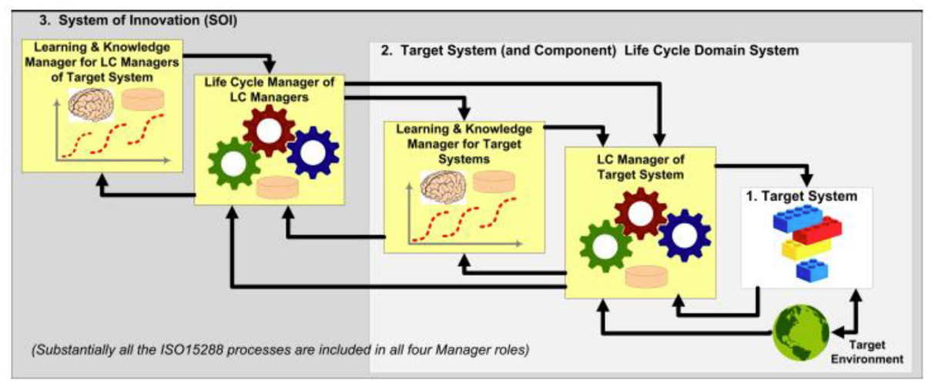
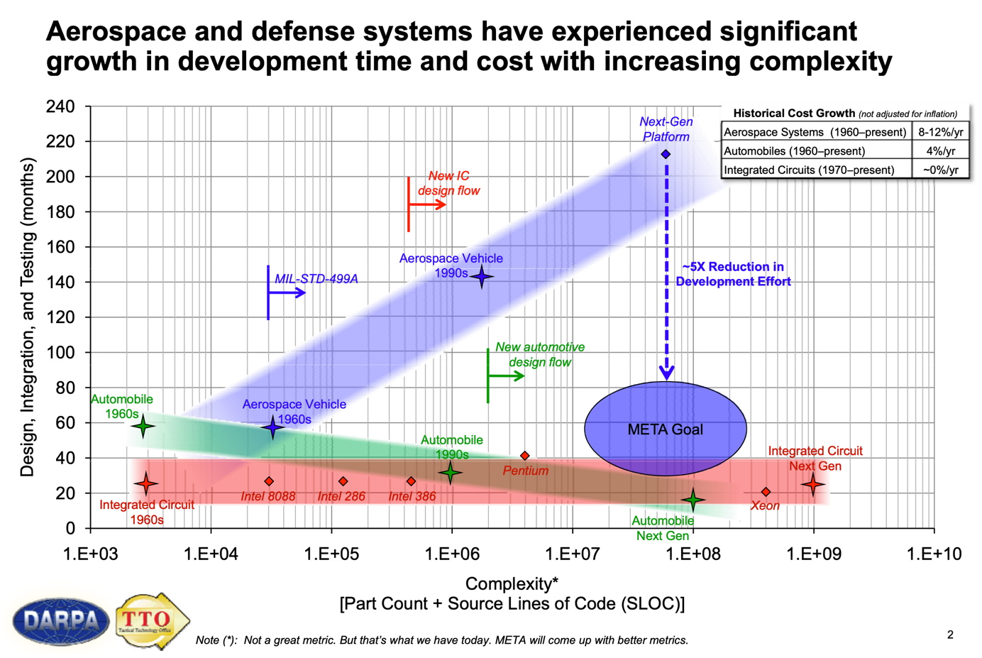
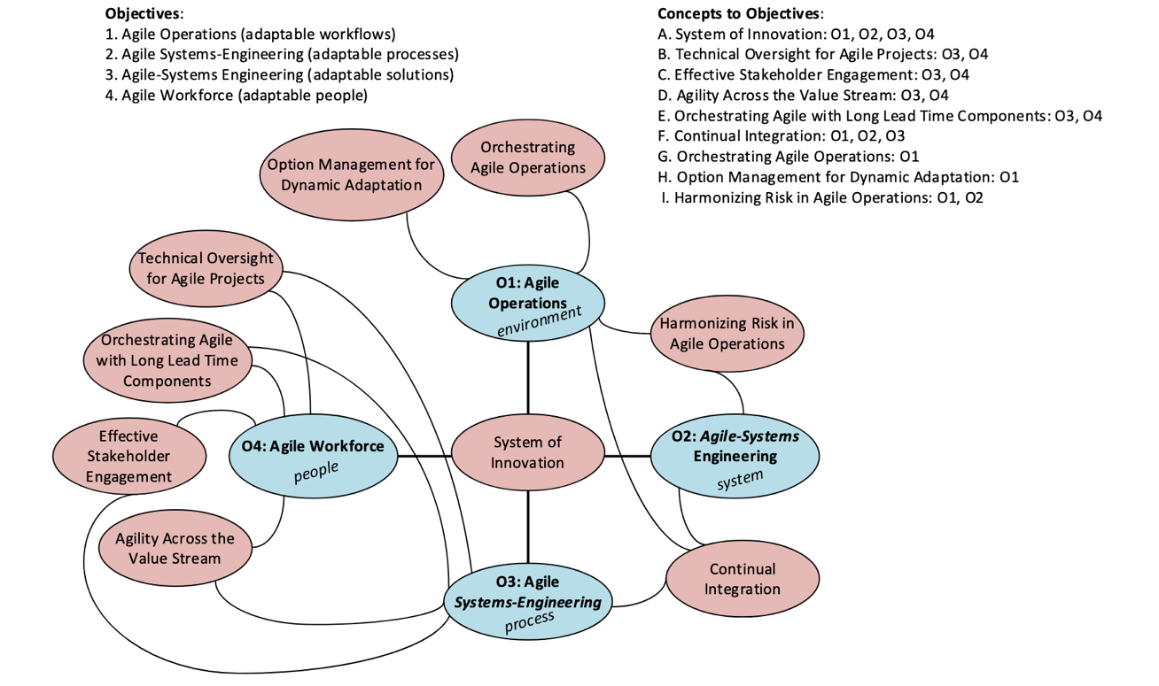
Legacy DARPA META Program and Future of System Agility
Velocity
DARPA META Program Industry Day 2009
Willett et al, Agility in the Future of Systems Engineering (FuSE) -
A Roadmap of Foundational Concepts, INCOSE Intl Symp, 2021.

Slide 17
Themes for Engineering Design of Systems
Rigor
Mathematical and heuristic representations of the design problem assist in evaluating the design problem so that it is well defined for completeness, consistent, correct, and attainable. Mathematical foundations include the discrete mathematics of Boolean logic, set theory, relations and functions; and graph theory. Category theory is emerging as foundational.
Dynamic Stakeholder preferences are used to compare feasible designs against each other.
The design problem addresses every relevant phase of the system’s life cycle in order to be well defined.
Scenarios (use cases) defining how the system is to be used are elaborated in detail, with the interactions among the system and other systems are defined, in order to understand and meet stakeholders’ objectives. This is a dynamic activity as both stakeholders’ and developers’ thinking evolve over a journey of discovery.
Integration requires a well-defined design, including a design of the qualification process for verification, validation, and acceptance. A systematic process of design provides all of the necessary inputs for defining the qualification process.
Early validation of the evolution of the definition of the design problem needs to be pursued vigorously to ensure that the definition of the design problem does not change as the problem is defined in greater detail, whilst at the same time keeping everything in synch as changes occur..
Qualification of the system is the key issue in integration. Qualification includes verification and validation of both the requirements and the system design, followed by the stakeholders’ acceptance. There are many methods for qualifying the system; these methods must be chosen judiciously.
Successful qualification also requires that decisions about what should be tested be made in a systematic way that balances the two conflicting objectives of not wasting resources and obtaining stakeholder acceptance.
D. M. Buede and W. D. Miller, The Engineering Design of Systems: Models and Methods, 3rd ed, Wiley, 2016

Slide 18
Foundations for Engineering Design of Systems
Rigor
Stakeholder Foundations
Dynamic Preferences: Cost, Schedule, Performance, Qualities, Policies, Constraints
Domains Business/Mission Engineering Technology Tracking Stakeholder Requirements
Engineering Foundations
Requirements, Design, Integration, V&V
~ Certainty out of Uncertainty
Heuristics
Principles, Design, Communication
Processes & Methods
Necessary for System Modeling Rigor
Structure
Data/Material/Energy Flows
Behavior
Control Flow
Dynamics
Context
Laws of conservation: Inputs, Outputs
Engineering Analytics
Science Foundations
Chemistry, Physics
Laws of conservation: Force, Energy, Entropy
Necessary for Assuring ~ Certainty out of Uncertainty
Mathematical Foundations
Probability
Graph Theory
Boolean Logic
Category Theory
Algebra, Geometry, Trigonometry, Calculus
Necessary for Effective System & Software Engineering Interface
Discrete Mathematics: Sets, Relations, Functions
D. M. Buede and W. D. Miller, The Engineering Design of Systems: Models and Methods, 3rd ed, Wiley, 2016

Slide 19
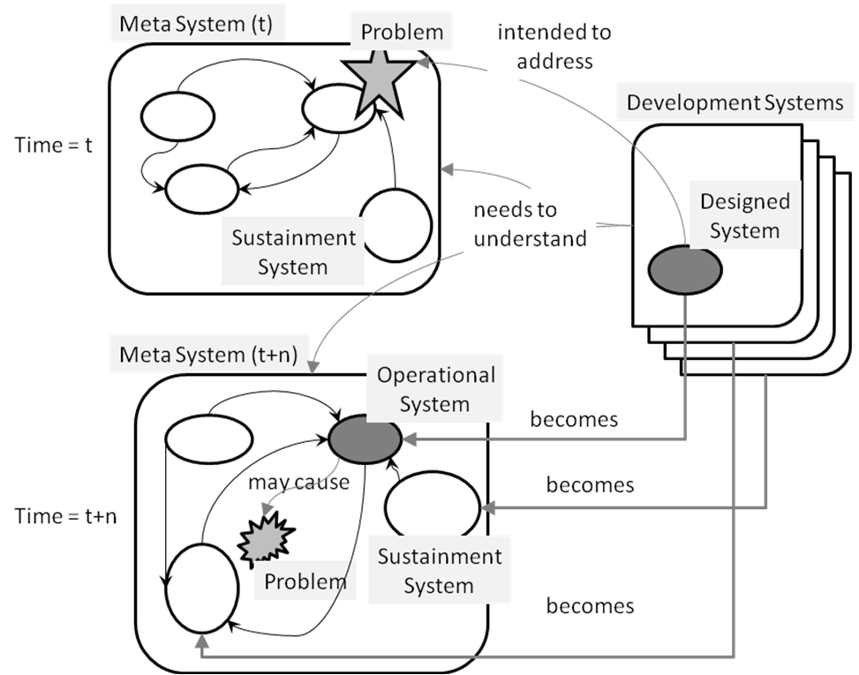
Dynamic External and Enabling Systems & Context
Rigor
Characterize and predict the context / meta system over the life cycle: structure, behavior, dynamics
Unmanageable, or Manageable? Static or Dynamic?
Context is critical!!!
External and Enabling Systems
Cooperative Uncooperative
System
D. M. Buede and W. D. Miller, The Engineering Design of Systems: Models and Methods, 3rd ed, Wiley, 2016

Slide 20
Key Domain Drivers of Organization Characterized by Regulatory Constraints, and Time (T), Cost (C), Quality (Q)
Rigor
Order of Importance for the Domain
Q-C-T: Quality 1st, Cost 2nd, Time 3rd
C-Q-T: Cost 1st, Quality 2nd, Time 3rd
C-T/Q: Cost 1st, Time & Quality Equal Priority
T-Q-C: Time 1st, Quality 2nd, Cost 3rd
Integration and Test Planning Approach
Regulated approach focused on removing all risk as soon as possible; test phases planned after each development & assembly action; prescribes specific test cases performed in a specific test phase; optimization of test phase done only within the test phase itself.
Flexible approach focused on maximal integration process; test phases planned after some of development & assembly actions; allows optimization of test phases by moving test cases from one phase to another
Adapted from Jan Tretmans, editor, Tangram: Model-Based Integration and Testing of Complex High-Tech Systems, Embedded Systems Institute, The Netherlands, 2007
https://esi.nl/tangram

Slide 21
System Life Cycle
Rigor
Development
Pre-Initial Operational Capability
All systems address a recognized need, deficiency, or opportunity:
Acquisition System (not explicitly shown in graphic)
System ABC
System ABC Model(s) as a system
Development System (including Qualification System for Integration and V&V)
Manufacturing System
Deployment System
Training System
Refinement System
Retirement System
Operational Use and Refinement
Retirement
D. M. Buede and W. D. Miller, The Engineering Design of Systems: Models and Methods, 3rd ed, Wiley, 2016

Slide 22
System Scenarios/Use Cases for Each Life Cycle Phase
Rigor
Development
Pre-Initial Operational Capability
Use Cases:
• Primary Actor:
• Scope:
• Level:
• Stakeholders and Interests:
• Preconditions:
• Minimal Guarantee:
• Success Guarantee:
• Main Success Scenario
1.
2.
…
n.
• Extensions:
m1.
m2.
…
mk.
• Variations:
• Postconditions:
Alistair Cockburn, Writing Effective Use Cases. Addison Wesley, 2001.
Large number of scenarios/ use cases
Operational Use and Refinement
Retirement
D. M. Buede and W. D. Miller, The Engineering Design of Systems: Models and Methods, 3rd ed, Wiley, 2016

Slide 23
System Life Cycle Decisions
Rigor
Decision-Rich Ecosystem!!
Acquisition System
System ABC
System ABC Model(s) as a system
Development System (including Qualification System for Integration, and V&V)
Manufacturing System
Deployment System
Training System
Refinement System
Retirement System
D. M. Buede and W. D. Miller, The Engineering Design of Systems: Models and Methods, 3rd ed, Wiley, 2016

Slide 24
Systems Engineering Cycle Model
Rigor
Design and Integration Cycles
1. Core cycle: Realization of stakeholder needs, followed by requirements development, design, manufacturing and product delivery
2. Verification cycle: Analysis, simulation, prototyping, integration, and testing
Management Cycles
3. Technologies and external resources cycle: Insertion of the appropriate technologies and resources into the systems engineering process
4. Controlling cycle: Configuration management of the design process and multiple product releases and updates
5. Strategic check cycle: Management assessment and approval of product development
D. M. Buede and W. D. Miller, The Engineering Design of Systems: Models and Methods, 3rd ed, Wiley, 2016

Slide 25
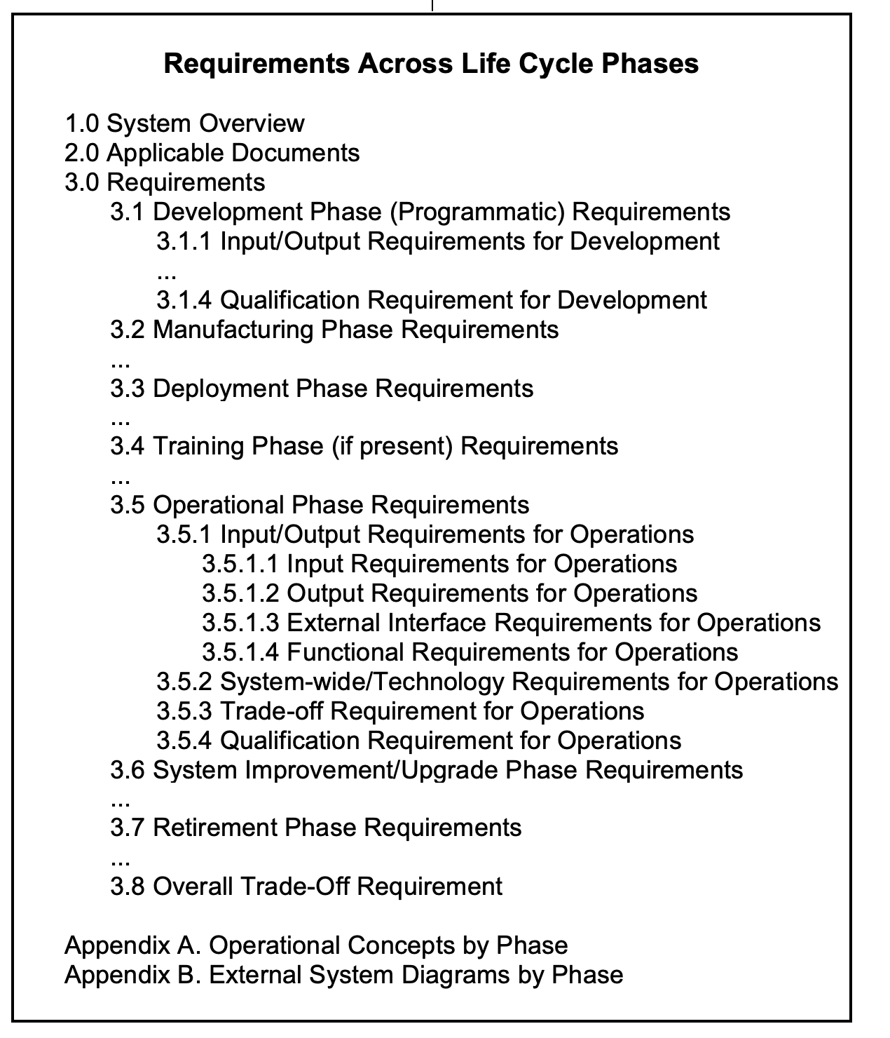
Requirements
Rigor
Requirements are derived from and validated by models
D. M. Buede and W. D. Miller, The Engineering Design of Systems: Models and Methods, 3rd ed, Wiley, 2016

Slide 26
System-Level Design Activities – External Systems View
Rigor
/”Environmentals”
Outputs of Stakeholders/”Environmentals”
V&V the V&V System
incl V&V
IDEF0 provides structural integrity and preservation of flows of controls (C), inputs (I), outputs (O) through functions/ activities/processes/tasks as performed by mechanisms (M)
Inputs, outputs, controls can be data, material, or energy
Mechanisms provide consumable and non-consumable resources to transform inputs and controls into outputs
IDEF0 does not represent control flows and is therefore not executable
Control flow models are executable
D. M. Buede and W. D. Miller, The Engineering Design of Systems: Models and Methods, 3rd ed, Wiley, 2016

Slide 27
System-Level Design Activities:
Rigor
Perform System-Level
Design Activities
Next Slide
/Environmentals
IDEF0 provides structural integrity and preservation of flows of controls (C), inputs (I), outputs (O) through functions/ activities/processes/tasks as performed by mechanisms (M).
Inputs, outputs, controls can be data, material, or energy
Mechanisms provide consumable and non-consumable resources to transform inputs and controls into outputs
IDEF0 does not represent control flows and is therefore not executable
Control flow models are executable
V&V
D. M. Buede and W. D. Miller, The Engineering Design of Systems: Models and Methods, 3rd ed, Wiley, 2016

Slide 28
System-Level Design Activities:
Rigor
Define System-Level
Design Problem
V&V
IDEF0 provides structural integrity and preservation of flows of controls (C), inputs (I), outputs (O) through functions/ activities/processes/tasks as performed by mechanisms (M).
Inputs, outputs, controls can be data, material, or energy
Mechanisms provide consumable and non-consumable resources to transform inputs and controls into outputs
IDEF0 does not represent control flows and is therefore not executable
Control flow models are executable
D. M. Buede and W. D. Miller, The Engineering Design of Systems: Models and Methods, 3rd ed, Wiley, 2016

Slide 29
System-Level Design Activities – Develop Qualification System: Structural Model
Rigor
IDEF0 provides structural integrity and preservation of flows of controls (C), inputs (I), outputs (O) through functions/ activities/processes/tasks as performed by mechanisms (M) as well for development of the qualification system.
Inputs, outputs, controls can be data, material, or energy
Mechanisms provide consumable and non-consumable resources to transform inputs and controls into outputs
IDEF0 does not represent control flows and is therefore not executable
Control flow models are executable
D. M. Buede and W. D. Miller, The Engineering Design of Systems: Models and Methods, 3rd ed, Wiley, 2016

Slide 30
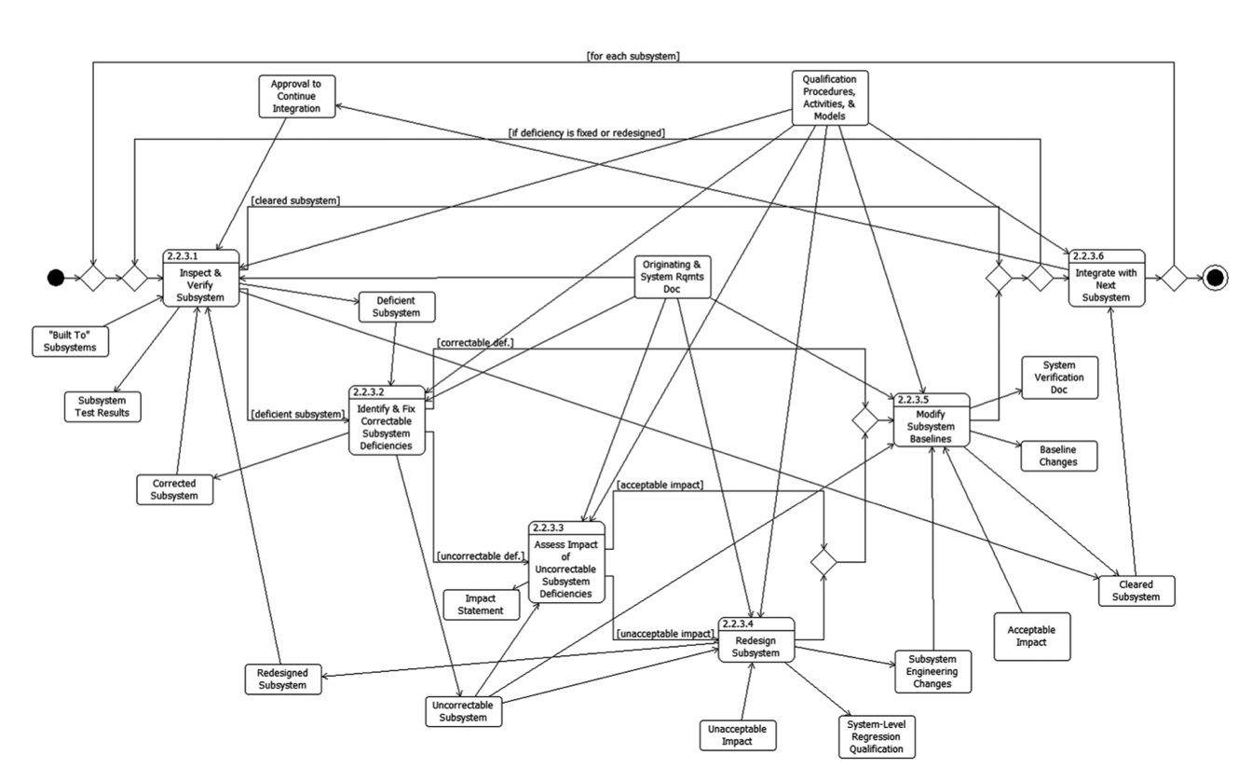
Qualification System: Structural and Dynamic Executable Control Flow Views
Rigor
Scenario-driven Assurance of Structural Integrity, Behavior, and Dynamic Performance Engineered Out on the Tails of Uncertainty Distributions to Achieve ~Certainty
SysML Activity Diagram Representing Data/Material/Energy Flows AND Control Flows Performed by Mechanisms and Constrained by Consumable and Non-consumable Resources
IDEF0 Structural Representation of Controls, Inputs, Functions, and Outputs
D. M. Buede and W. D. Miller, The Engineering Design of Systems: Models and Methods, 3rd ed, Wiley, 2016

Slide 31
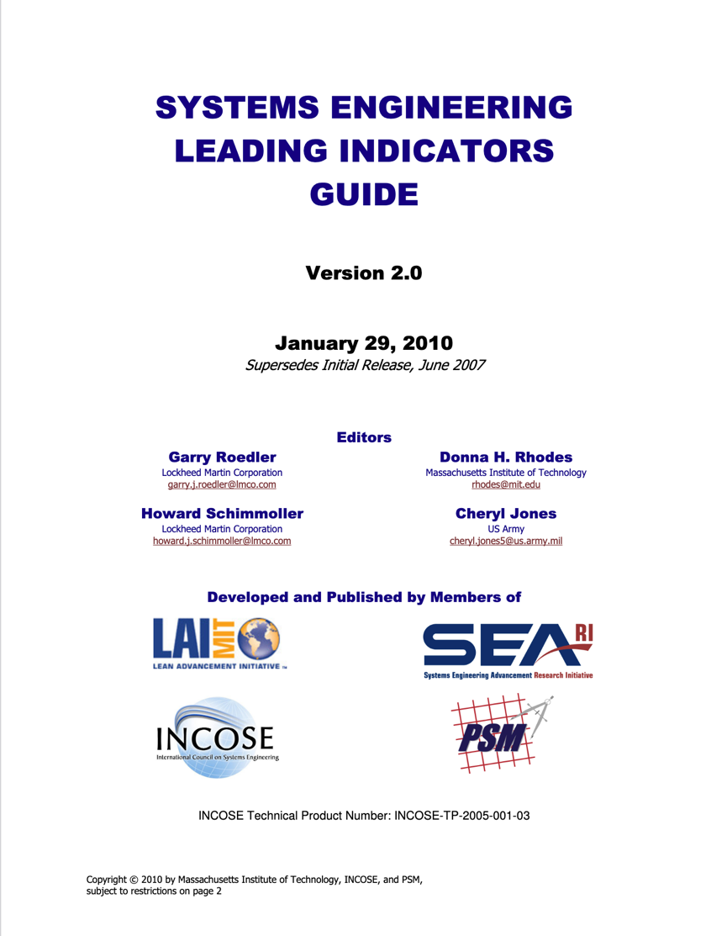
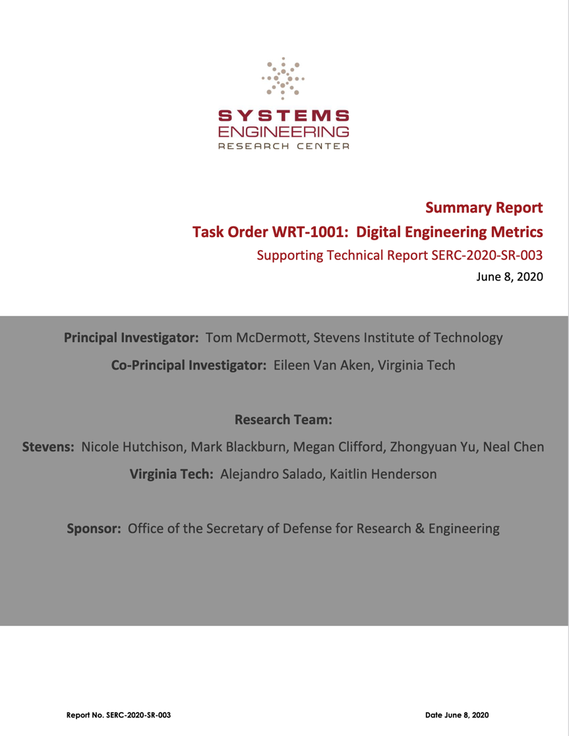
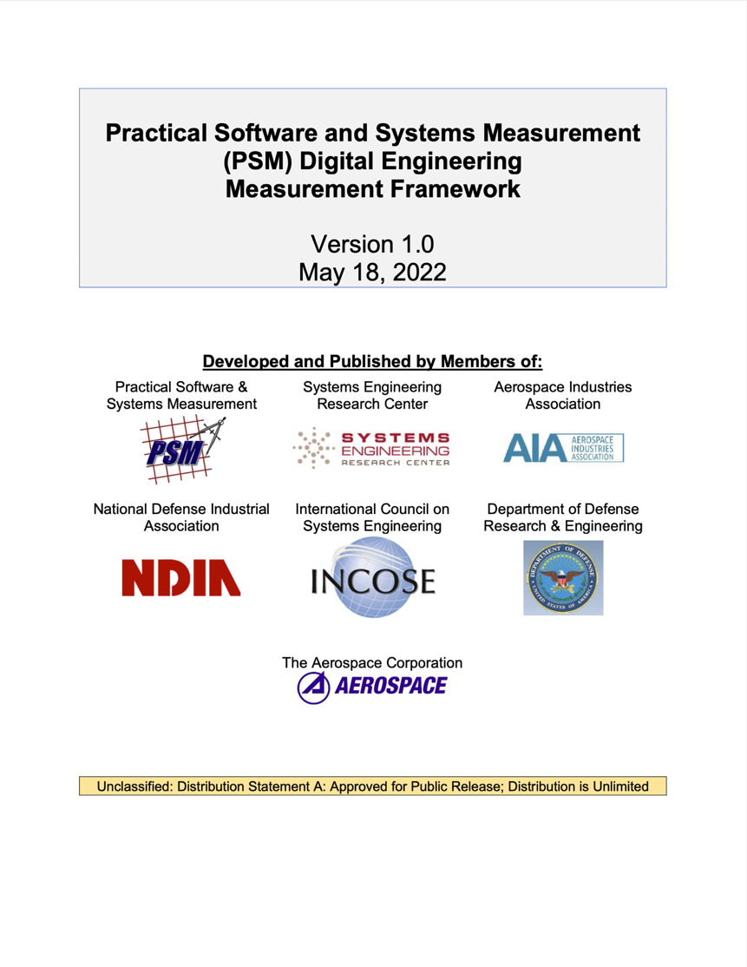
Frameworks and Measures – 1
Frameworks and Measures
2010
2020
2022

Slide 32
Frameworks and Measures – 2
Frameworks and Measures
Systems Engineering Leading Indicators v2 2010 | Systems Engineering Research Center (SERC) Digital Engineering Metrics 2020 |  | Practical Software and Systems Measurement (PSM) Digital Engineering Measurement Framework 2022
Requirements Trends Sys Definition Change Backlog Trend Interface Trends Requirements Validation Trends Requirements Verification Trends Work Product Approval Trends Review Action Closure Trends Risk Exposure Trends Risk Treatment Trends Technology Maturity Trends Technical Measurement Trends SE Staffing & Skills Trends Process Compliance Trends Facility/Equipment Availability Trends Defect/Error Trends System Affordability Trends Architecture Trends Schedule and Cost Pressure | Quality: ⬆️ Increased Traceability ⬇️ Cost ⬆️ System Quality ⬇️ Risk ⬇️ Defects/Errors ⬆️ System Design ⬆️ Requirements Generation ⬆️ Deliverable Quality ⬆️ SE Effectiveness ⬆️ Risk Analysis ⬆️ Analysis Capability ⬆️ Strengthened Testing ⬆️ Rigor, Predictability ⬆️ Stakeholder Involvement Velocity/Agility: ⬆️ Improved Consistency ⬇️ Reduced Time ⬆️ Capacity for Reuse ⬆️ Efficiency ⬆️ Productivity ⬆️ Reduce Rework ⬆️ Early V&V ⬇️ Reduce Ambiguity ⬆️ Increased Uniformity ⬆️ Easy to Make Changes ⬇️ Reduce Waste ⬆️ Requirements Mgmt ⬆️ Support for Integration | Velocity/Agility (continued): ⬆️ Increased Precision ⬆️ Increased Flexibility User Experience: ⬆️ System Understanding ⬆️ Better Manage Complexity ⬆️ Support for Automation ⬆️ Data Management/Capture ⬆️ Better Decision Making ⬇️ Reduce Burden of SE Tasks ⬇️ Reduce Effort Knowledge Transfer: ⬆️ Communication / Info Sharing ⬆️ Accessibility of Info ⬆️ Improved Collaboration ⬆️ Knowledge Management/Capture ⬆️ Architecture/Multiple Model Viewpoints Adoption: ⬆️ Leadership Support/Commitment ⬆️ Workforce Knowledge Skills ⬆️ DE/MBSE Methods & Processes ⬆️ Training ⬆️ DE/MBSE Tools ⬆️ Demonstrating Benefits/Results ⬆️ Change Mgmt Process Design ⬆️ DE/MBSE Implementation Resources ⬆️ Willingness to Use MBSE Tools ⬆️ MBSE Alignment with Customer Requiremnts | Product Quality/Functional Correctness: ⬇️ Anomalies, ⬆️ Adequate (in phase); ⬇️ Rework Effort; ⬇️ Traceability Gaps/Defects; ⬆️ Traceability Support Impact Assessment Process Performance/Effectiveness: ⬇️ Approved Elements Returned for Rework; ⬆️ Containing Defects in Early Phases Process Performance/Automation Efficiency: ⬆️ % Artifacts Automatically Generated from Digital Models; ⬆️ Artifacts Facilitating Program Reviews Process Performance/Efficiency Speed: ⬇️ Time to Deploy Feature/Capability; ⬇️ Time from Request to Operationally Deploy Viable Product; ⬇️ Localizing Deployment Bottleneck Process Performance/Efficiency: ⬆️ Productivity Improving over Time; ⬆️ Number of Model Elements/Artifacts Produced/Release; ⬆️ Expected Number Produced Next Release Technology Effectiveness/Performance: ⬇️ Capability/System Runtime; ⬆️ Likelihood Runtime Performance Will Meet Operational Requirements; ⬇️ Runtime Performance Bottlenecks, Optimization

Slide 33
Frameworks and Measures – 3
Frameworks and Measures
Primary Benefits and Secondary Benefit Measures from Causal Analysis
Primary Benefits | Description | Secondary Benefits and Measures
Higher Level Support for Automation | Use of tools and methods that automate previously manual tasks and decisions | 8.6 Product Automation 8.7 Deployment Lead Time
Early V&V | Moving tasks into earlier developmental phases that would have required effort in later phases | 8.4 Digital Engineering Anomalies 8.5 Adaptability and Rework 8.7 Deployment Lead Time
Reusability | Reusing existing data, models, and knowledge in new development | 8.4 Digital Engineering Anomalies 8.5 Adaptability and Rework 8.7 Deployment Lead Time
Increased Traceability | Formally linking requirements, design, test, etc. via models | 8.7 Deployment Lead Time 8.8 Runtime Performance
Strengthened Testing | Using data and models to increase test coverage in any phase | 8.1 Architecture Completeness and Volatility 8.2 Model Traceability 8.3 Product Size
Better Accessibility of Information (ASoT) | Leveraging an Authoritative Source of Truth (ASoT) to increase access to digital data and models to increase the involvement of stakeholders in program decisions | 8.7 Deployment Lead Time 8.8 Runtime Performance
Higher Level of Support for Automation | Using data and models to support integration of information and to support system integration tasks | 8.6 Product Automation 8.2 Model Traceability
Multiple Model Viewpoints | Viewpoints Presentation of data and models in the language and context of those that need access | 8.1 Architecture Completeness and Volatility 8.7 Deployment Lead Time
2022

Slide 34
Summary
Summary
We characterize dynamic innovation such as stated for the FAA NextGen as a multi-faceted approach with concrete action plans to accelerate synergistic innovation across multiple fields towards a balanced set of dynamic, evolving complex objectives.
We face significant challenges in concurrent technology advances, complexity, scale, interconnectedness, and uncertainty.
Digital engineering poses a significant change in systems infrastructure and culture.
We define rigor as “the quality or state of being very exact, careful, or strict,” and we need to be mindful of the level of precision acceptable to stakeholders as a key characteristic in the engineering and operations of systems.
We describe frameworks and measures for technology effectiveness/performance, systems quality, process effectiveness/efficiency, velocity/agility, user experience, knowledge transfer, and adoption.
V&V is at the affect of the pain points for dynamic innovation and rigor with needed assessment frameworks and measures.

Slide 35
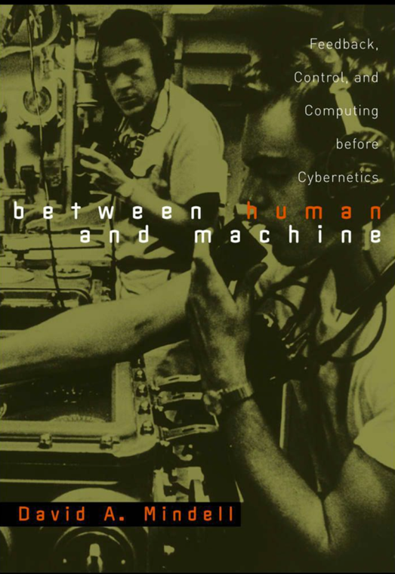
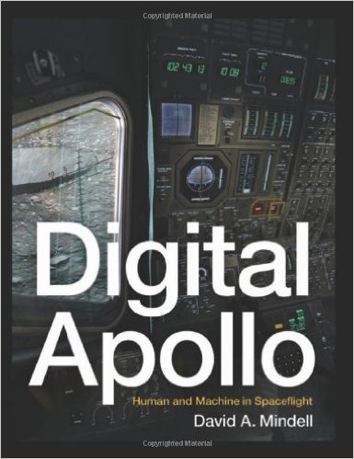
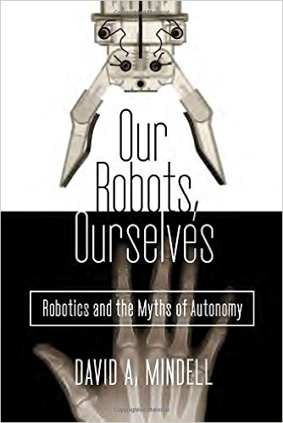
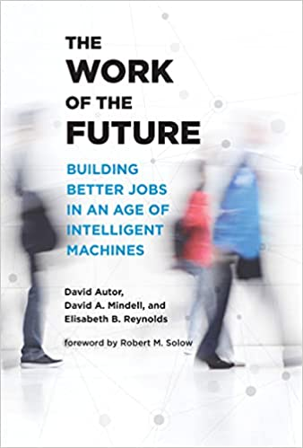
Case Study Books by David Mindell that Address Dynamic Innovation & Rigor
Relevant Reads
"Datum for its own annihilation" : feedback, control, and computing, 1916-1945
David A. Mindell, PhD Dissertation, MIT 1996
https://dspace.mit.edu/handle/1721.1/10807
https://sts-program.mit.edu/people/sts-faculty/david-a-mindell/

Slide 36
Stevens Institute of Technology
William D. Miller
wmiller@stevens.edu
1.908.759.7110

