Slide 1
Incrementally Assuring the Viability of Critical Software Systems
Will Hayes
September 2022

Slide 2
Copyright 2022 Carnegie Mellon University.
This material is based upon work funded and supported by the Department of Defense under Contract No. FA8702-15-D-0002 with Carnegie Mellon University for the operation of the Software Engineering Institute, a federally funded research and development center.
The view, opinions, and/or findings contained in this material are those of the author(s) and should not be construed as an official Government position, policy, or decision, unless designated by other documentation.
NO WARRANTY. THIS CARNEGIE MELLON UNIVERSITY AND SOFTWARE ENGINEERING INSTITUTE MATERIAL IS FURNISHED ON AN "AS-IS" BASIS. CARNEGIE MELLON UNIVERSITY MAKES NO WARRANTIES OF ANY KIND, EITHER EXPRESSED OR IMPLIED, AS TO ANY MATTER INCLUDING, BUT NOT LIMITED TO, WARRANTY OF FITNESS FOR PURPOSE OR MERCHANTABILITY, EXCLUSIVITY, OR RESULTS OBTAINED FROM USE OF THE MATERIAL. CARNEGIE MELLON UNIVERSITY DOES NOT MAKE ANY WARRANTY OF ANY KIND WITH RESPECT TO FREEDOM FROM PATENT, TRADEMARK, OR COPYRIGHT INFRINGEMENT.
[DISTRIBUTION STATEMENT A] This material has been approved for public release and unlimited distribution. Please see Copyright notice for non-US Government use and distribution.
This material may be reproduced in its entirety, without modification, and freely distributed in written or electronic form without requesting formal permission. Permission is required for any other use. Requests for permission should be directed to the Software Engineering Institute at permission@sei.cmu.edu.
DM22-0753

Slide 3
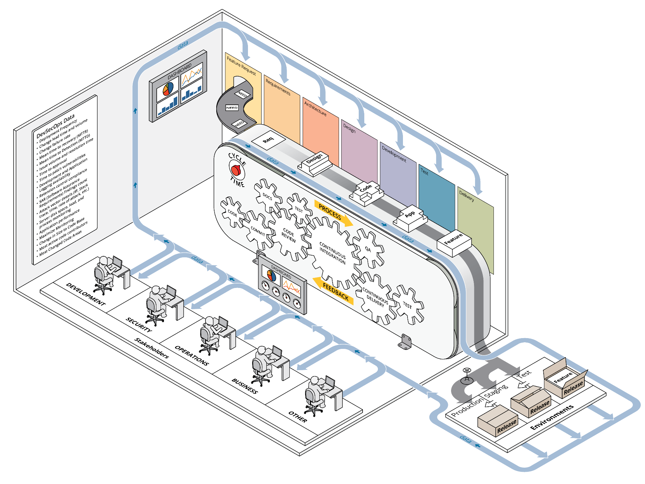
DevSecOps
Factory
Concept

Slide 4
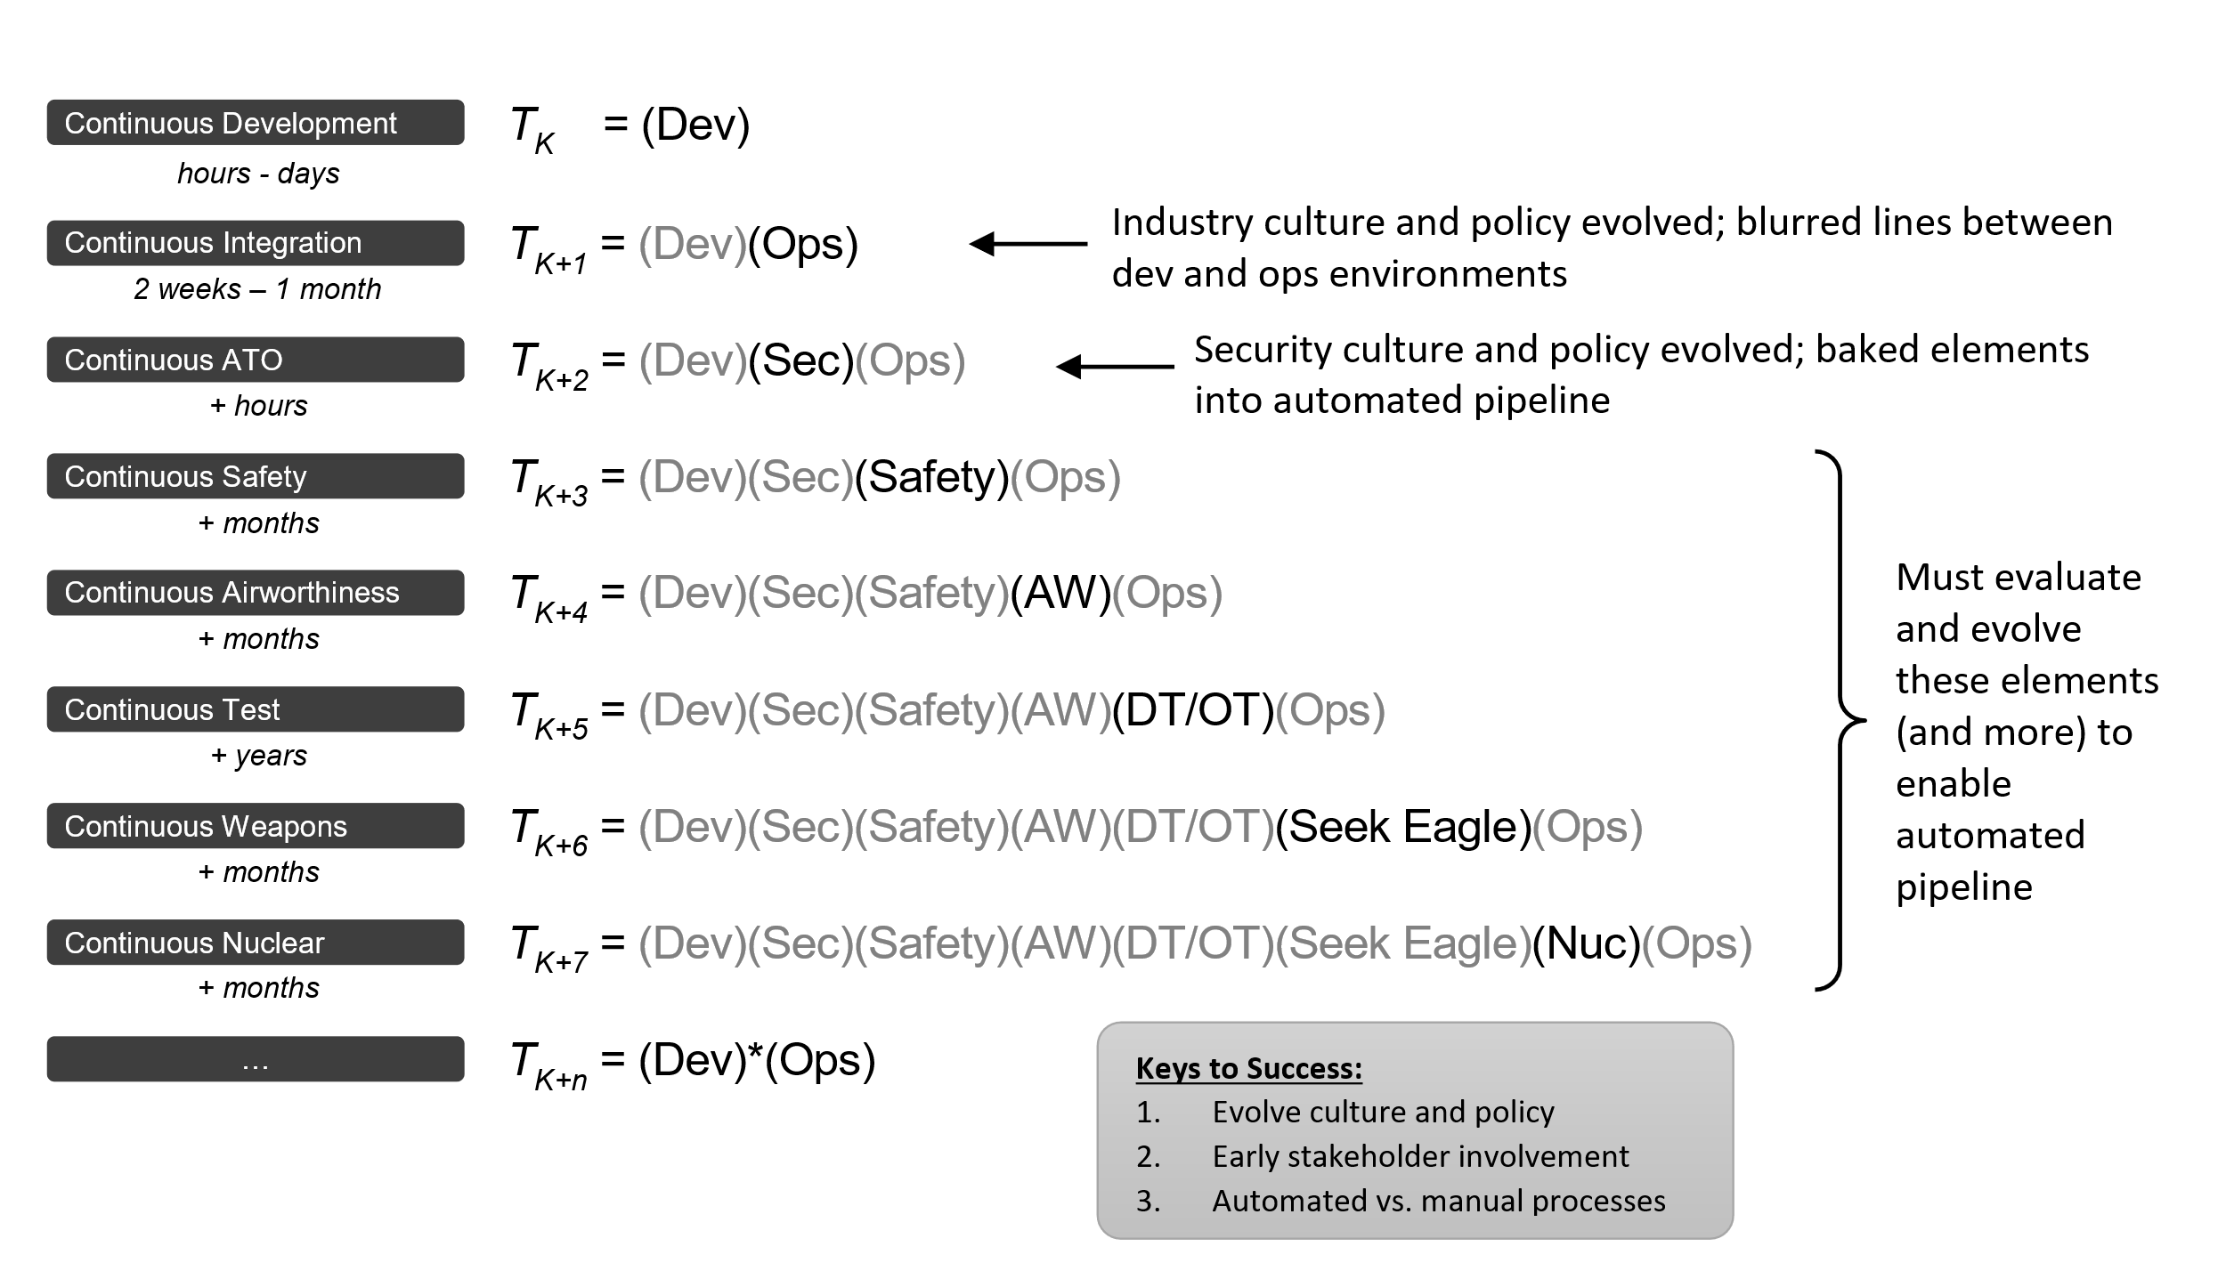
The DevStar Concept
Dr. Michael Tanner • SAF/AQ
https://software.af.mil/dsop/dsop-devstar/

Slide 5

The Focus on
Process/Workflow

Slide 6
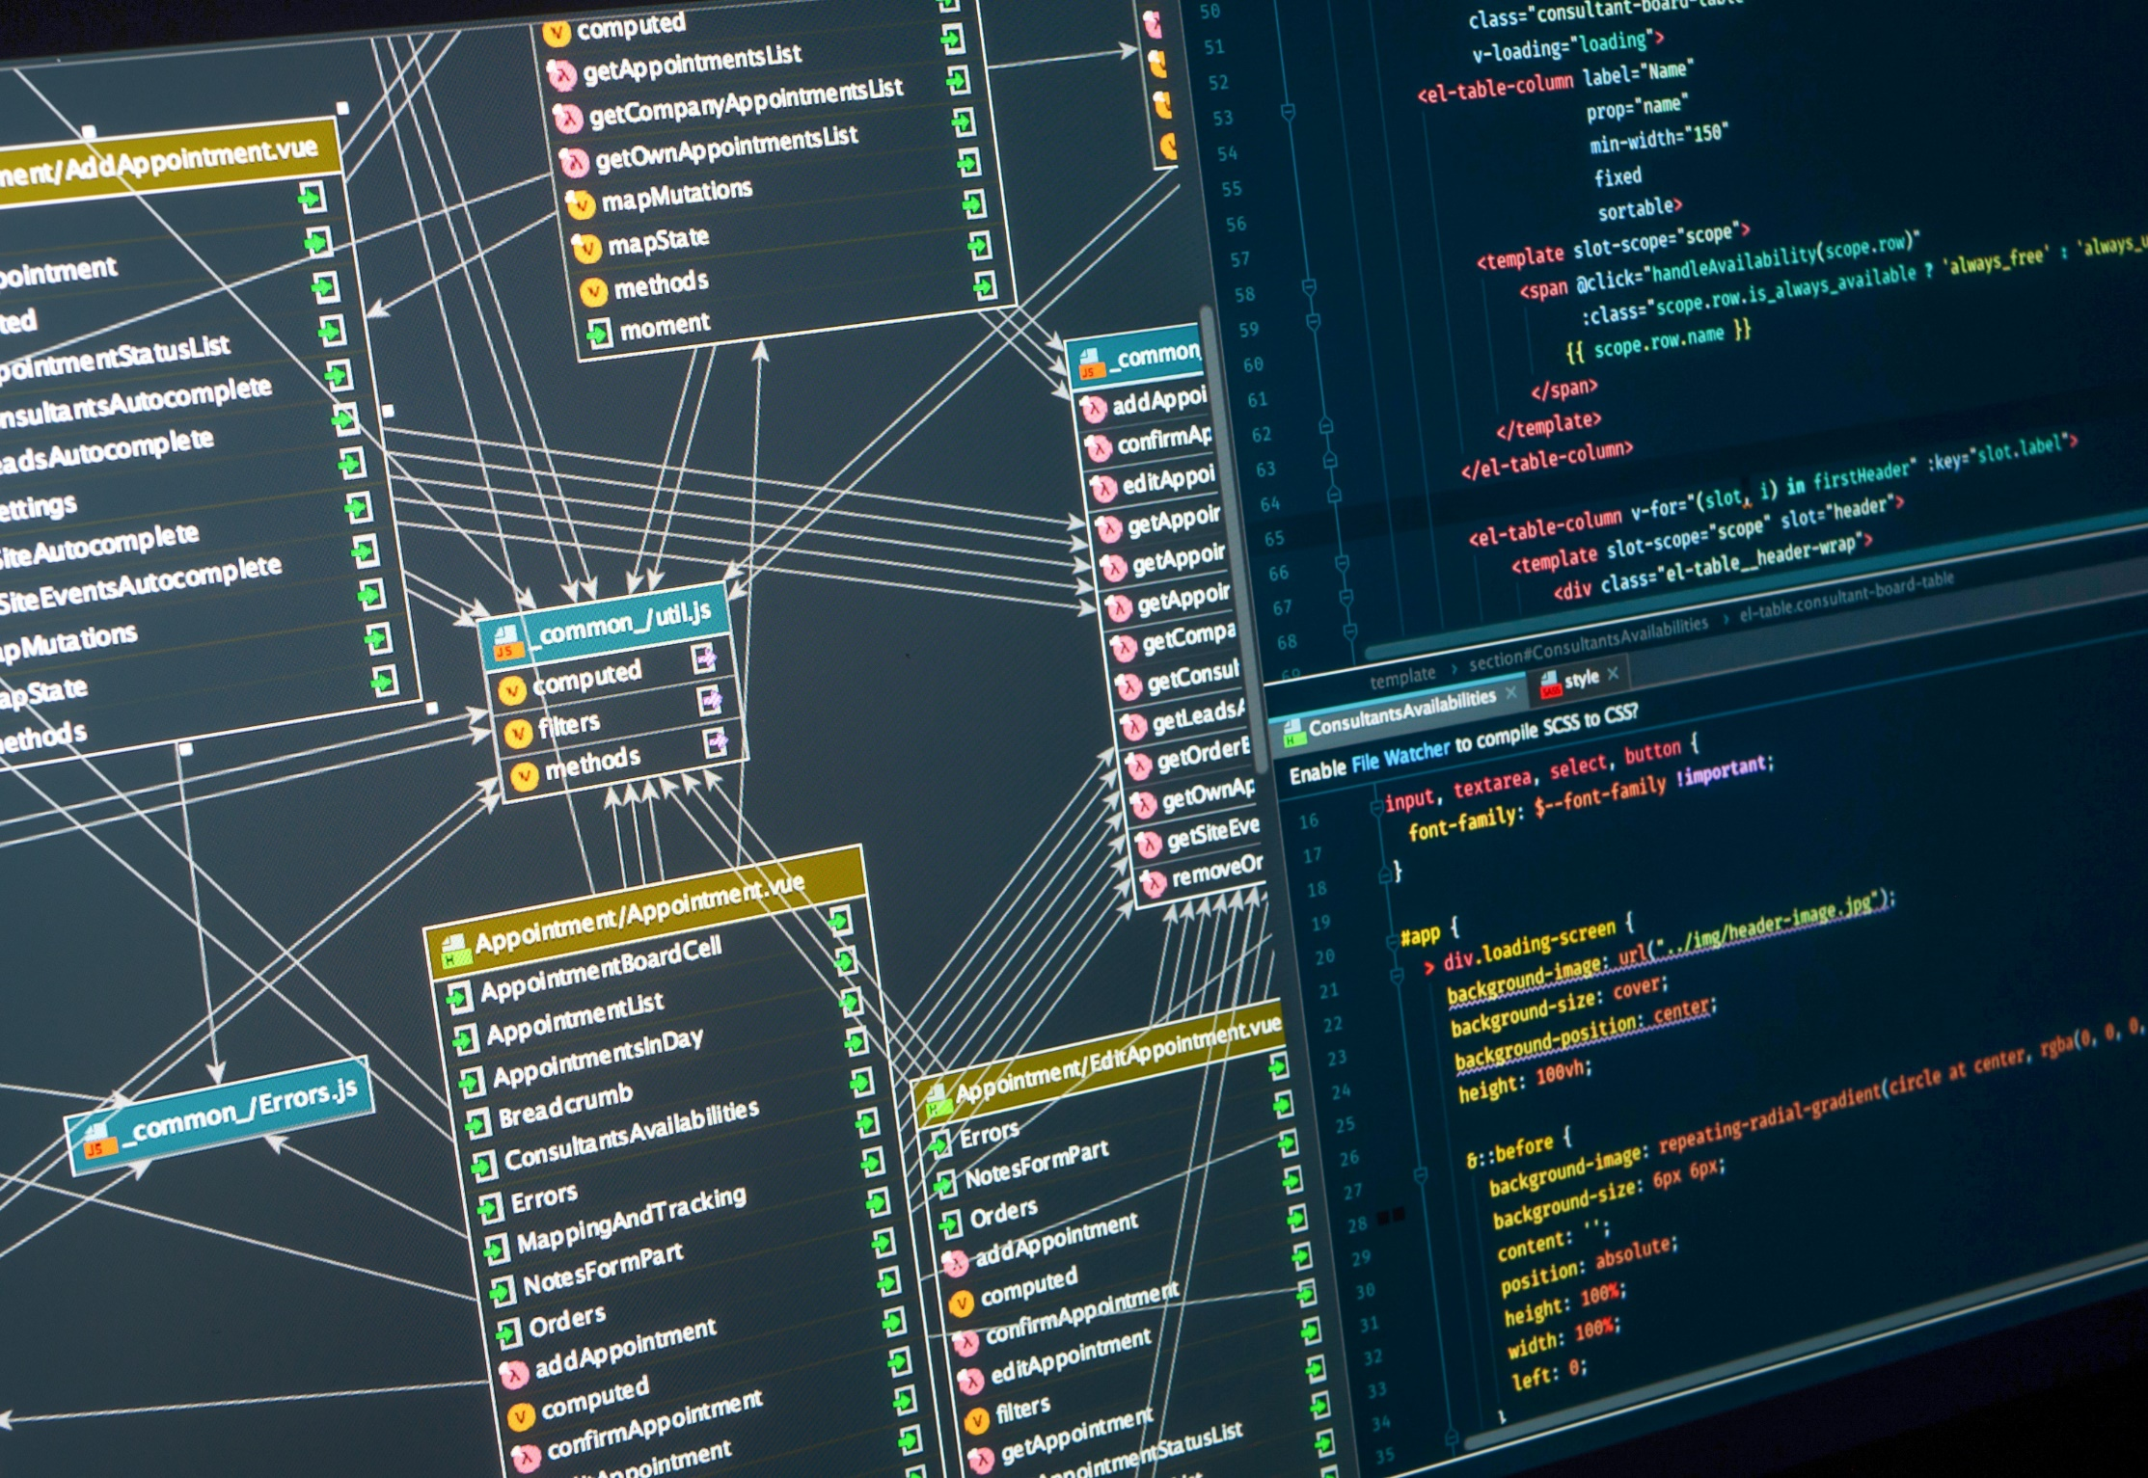
The Focus on
Product

Slide 7
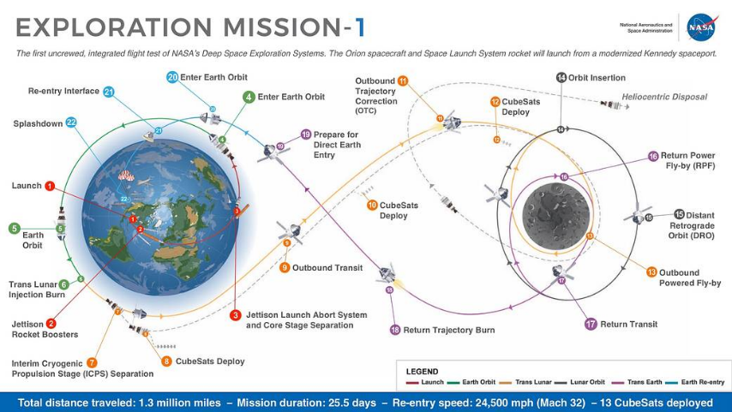
The Focus on Mission
Excerpted from: Justin Smith, John Bradbury & Will Hayes
2018 Trilateral Safety and Mission Assurance Conference

Slide 8
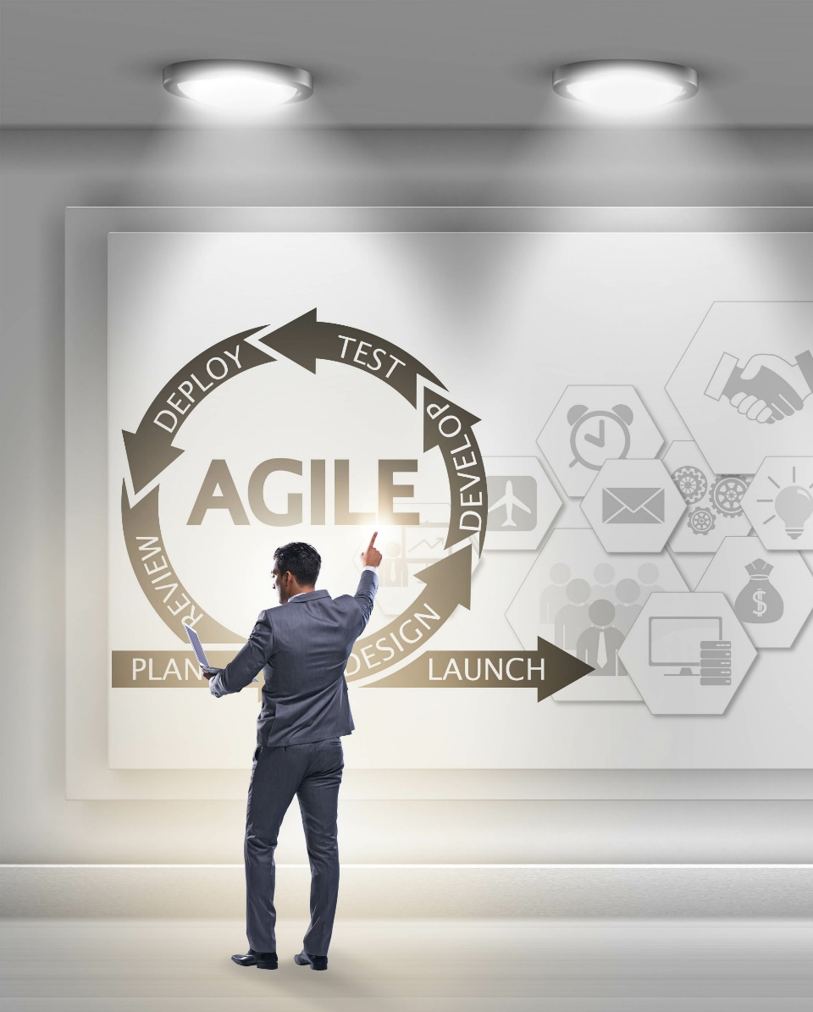
Lessons on Iterative Realization of Value
Abstractions of the product may not all be deliverable components
Iterations of process design may be paired with product increments
Not all iterative processes need to execute on the same cadence
Product demonstrations don’t have to all be a ‘run for score’
Mission and Product Vision drive process optimization – not the other way around

