Slide 1
Research Roadmap and the UML-3 Operational Integration Assessment Theory and Practice for Evolving Complex Enterprise Systems
Dr. Ian Levitt, NASA
V&V Summit
Sep 8, 2022

Slide 2
Theory
Research Roadmap and Digital Engineering

Slide 3
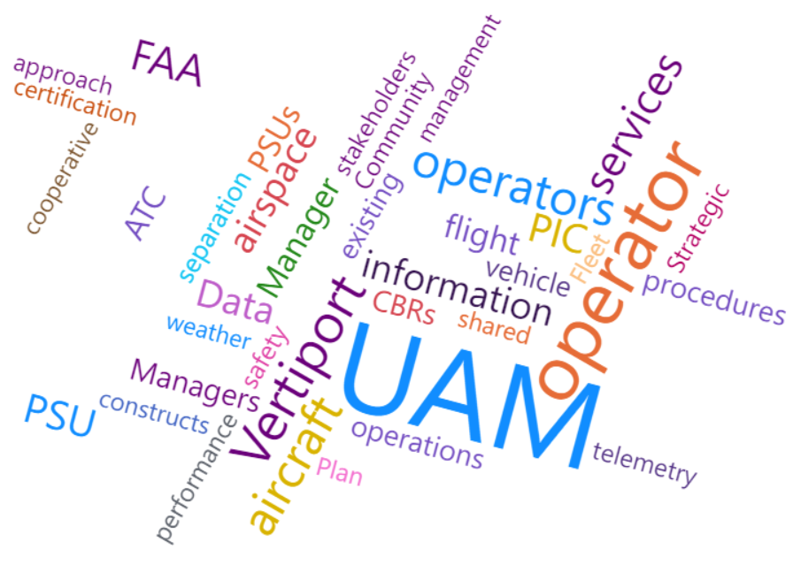
What is a Research Roadmap?
A living document that describes how research informs the progression of complex system capabilities
By way of high-level…
Requirements
Assumptions
Constraints
Notes:
Would benefit from the COP rules/COP practices
A living document that describes what research tells us about the progression of UAM airspace capabilities”. May want to consider- “A living document that describes how research informs the progression of UAM airspace capability maturity”. The word ‘informs’ is already supported on this same slide. I presume the tense neutral word “tells us” or “informs”- is because it can describe both past and future progression. If that is the case, then I think it is the right tense

Slide 4
What is a Research Roadmap?
A living document that describes how research informs the progression of complex system capabilities
By way of high-level…
Requirements
Assumptions
Constraints
Not really a Roadmap!
Does not use timeframes
Includes contradictions found in research
Roadmaps can be extracted
Notes:
Would benefit from the COP rules/COP practices
A living document that describes what research tells us about the progression of UAM airspace capabilities”. May want to consider- “A living document that describes how research informs the progression of UAM airspace capability maturity”. The word ‘informs’ is already supported on this same slide. I presume the tense neutral word “tells us” or “informs”- is because it can describe both past and future progression. If that is the case, then I think it is the right tense

Slide 5
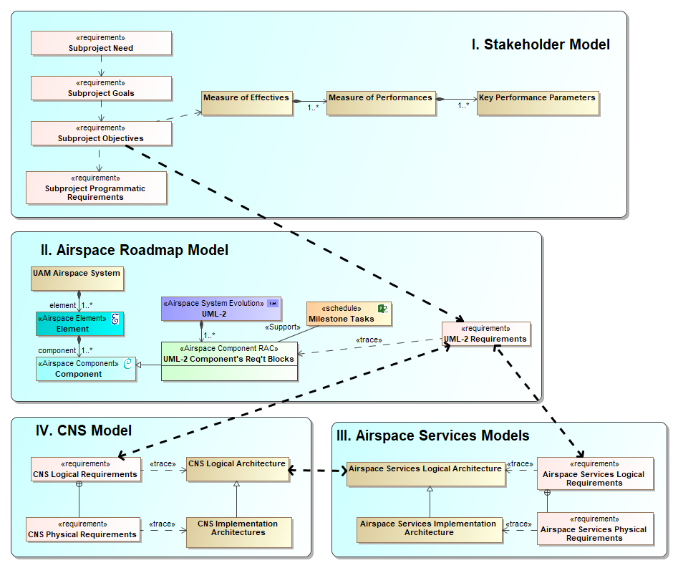
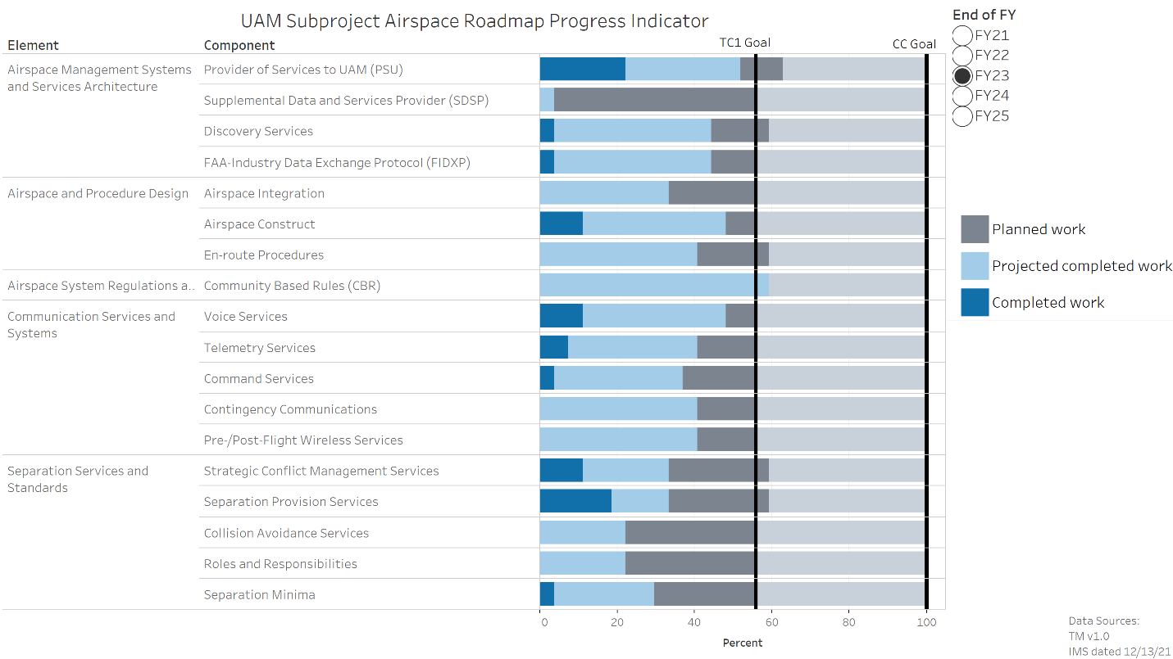
Under-the-hood System Engineering
Digital Engineering methodology
Traces to research through requirements hierarchy
Analyzes requirements for research insights
Provides dashboard reports for program management
CNS = Communication, Navigation, and Surveillance
UML = UAM Maturity Level
Notes:
Phojanamongkolkij, N., Levitt, I., Barnes, P. “Overview of Model-Based Systems Engineering Efforts to Evolve the Airspace Research System Roadmap,” 2022 AIAA Aviation Forum, June 2022
Cheng, A., Witzberger, K., Phojanamongkolkij, N., and Levitt, I., " Urban Air Mobility (UAM) Airspace Research Roadmap Systems Engineering Approach to Managing Airspace Evolution Towards UML-4," 2022 AIAA Aviation Forum, June 2022

Slide 6
Practice
UAM Airspace Research Roadmap v1.2

Slide 7
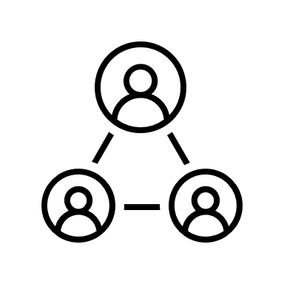
UAM Airspace Research Roadmap Development
Oct 2020 | Jan 2021 | Apr 2021 | June 2021 | Oct 2021 | Jan 2022 | Apr 2022 | June 2022 | Oct 2022 | Jan 2023+
Started
V1.0
NASA Technical Memo
NASA-Informed
Notes:
Would benefit from the COP rules/COP practices
A living document that describes what research tells us about the progression of UAM airspace capabilities”. May want to consider- “A living document that describes how research informs the progression of UAM airspace capability maturity”. The word ‘informs’ is already supported on this same slide. I presume the tense neutral word “tells us” or “informs”- is because it can describe both past and future progression. If that is the case, then I think it is the right tense

Slide 8
UAM Airspace Research Roadmap Development
Oct 2020 | Jan 2021 | Apr 2021 | June 2021 | Oct 2021 | Jan 2022 | Apr 2022 | June 2022 | Oct 2022 | Jan 2023+
Started
V1.0
NASA Technical Memo
V1.1
NASA-FAA review
NASA-Informed
FAA-Informed
Notes:
Would benefit from the COP rules/COP practices
A living document that describes what research tells us about the progression of UAM airspace capabilities”. May want to consider- “A living document that describes how research informs the progression of UAM airspace capability maturity”. The word ‘informs’ is already supported on this same slide. I presume the tense neutral word “tells us” or “informs”- is because it can describe both past and future progression. If that is the case, then I think it is the right tense

Slide 9
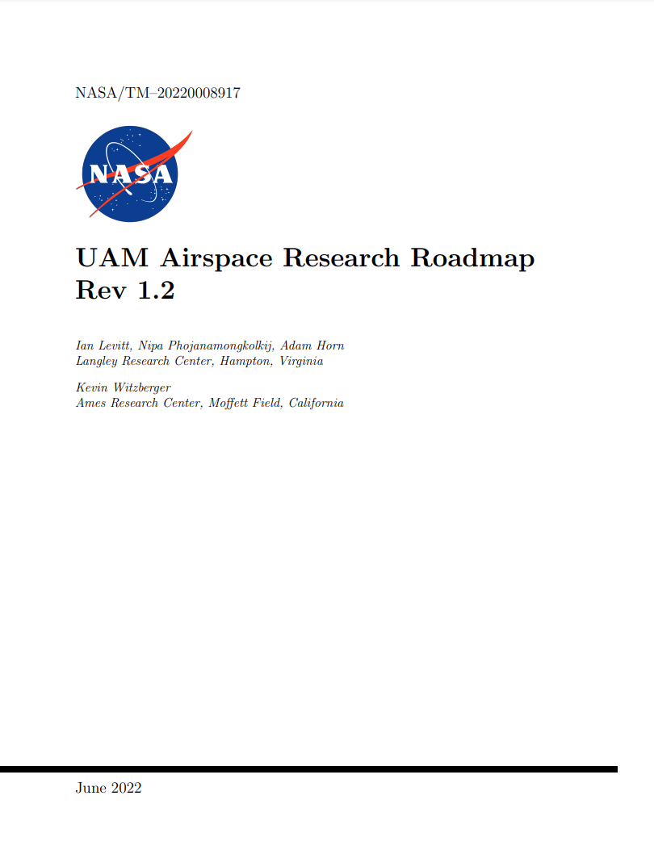
UAM Airspace Research Roadmap Development
§1 Introduction
§2 UAM Airspace System Definition
§3 UAM Airspace System Progression
§4 System Engineering Methodology
§5 Roadmap Requirements Tables
§6 Conclusions and Next Steps
References
Appendix A: Acronyms
Appendix B: Glossary
https://nari.arc.nasa.gov/uam-research-roadmap
Oct 2020 | Jan 2021 | Apr 2021 | June 2021 | Oct 2021 | Jan 2022 | Apr 2022 | June 2022 | Oct 2022 | Jan 2023+
Started
V1.0
NASA Technical Memo
V1.1
NASA-FAA review
V1.2
NASA Technical Memo
Community-Informed
NASA-Informed
FAA-Informed
Notes:
Would benefit from the COP rules/COP practices
A living document that describes what research tells us about the progression of UAM airspace capabilities”. May want to consider- “A living document that describes how research informs the progression of UAM airspace capability maturity”. The word ‘informs’ is already supported on this same slide. I presume the tense neutral word “tells us” or “informs”- is because it can describe both past and future progression. If that is the case, then I think it is the right tense

Slide 10
UAM Airspace Research Roadmap Development
§1 Introduction
§2 UAM Airspace System Definition
§3 UAM Airspace System Progression
§4 System Engineering Methodology
§5 Roadmap Requirements Tables
§6 Conclusions and Next Steps
References
Appendix A: Acronyms
Appendix B: Glossary
https://nari.arc.nasa.gov/uam-research-roadmap
Oct 2020 | Jan 2021 | Apr 2021 | June 2021 | Oct 2021 | Jan 2022 | Apr 2022 | June 2022 | Oct 2022 | Jan 2023+
Started
V1.0
NASA Technical Memo
V1.1
NASA-FAA review
V1.2
NASA Technical Memo
V2.0
Baseline
Community-Informed
NASA-Informed
FAA-Informed
Notes:
Would benefit from the COP rules/COP practices
A living document that describes what research tells us about the progression of UAM airspace capabilities”. May want to consider- “A living document that describes how research informs the progression of UAM airspace capability maturity”. The word ‘informs’ is already supported on this same slide. I presume the tense neutral word “tells us” or “informs”- is because it can describe both past and future progression. If that is the case, then I think it is the right tense

Slide 11
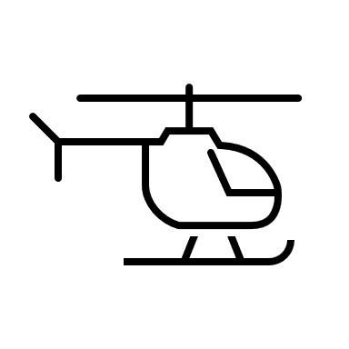
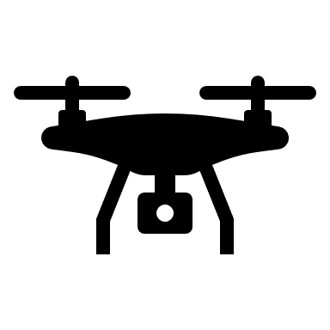
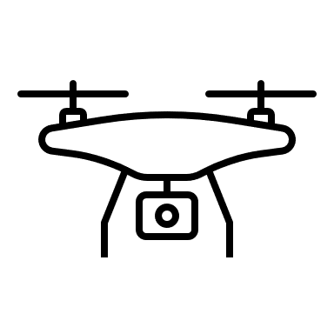
System Engineering Methodology
UAM System of Systems
partially decomposed into
capabilities that cover
the airspace system
Notes:
Roadmap requirements
Roadmap assumptions
Should/Shall/Will
TBR

Slide 12
System Engineering Methodology
UML-1: Pre-Operational
UML-2: Initial
eVTOL introduced
Initial Data Collection
UAM System of Systems
Capabilities evolve over time
UML-3: Transition and Growth
Vertiports, PSUs new airspace constructs
Extensive data collection
UML-4: New Predetermined Separator
New mode of operation
ATC is not the separator
Notes:
Roadmap requirements
Roadmap assumptions
Should/Shall/Will
TBR

Slide 13
System Engineering Methodology
Airspace Mgmt
Airspace Design
Regulations & Policies
Communications
Navigation
Secured Airspace
Separation Services
Surveillance
Vertiport Operations
Weather
UAM System of Systems
Enterprise decomposed into
capabilities that cover
the airspace system
Notes:
Roadmap requirements
Roadmap assumptions
Should/Shall/Will
TBR

Slide 14
System Engineering Methodology
Airspace Mgmt
Airspace Design
Regulations & Policies
Communications
Navigation
Secured Airspace
Separation Services
Surveillance
Vertiport Operations
Weather
UAM System of Systems
Enterprise decomposed into
capabilities that cover
the airspace system
Notes:
Roadmap requirements
Roadmap assumptions
Should/Shall/Will
TBR

Slide 15
System Engineering Methodology
Progress of Time
Airspace Mgmt
Airspace Design
Regulations & Policies
Communications
Navigation
Secured Airspace
Separation Services
Surveillance
Vertiport Operations
Weather
Research Assumptions
will
UAM System of Systems
Enterprise decomposed into
capabilities that cover
the airspace system
Notes:
Roadmap requirements
Roadmap assumptions
Should/Shall/Will
TBR

Slide 16
System Engineering Methodology
Progress of Time
Airspace Mgmt
Airspace Design
Regulations & Policies
Communications
Navigation
Secured Airspace
Separation Services
Surveillance
Vertiport Operations
Weather
Research Assumptions
will
Research Requirements
shall/should
Operational and
Functional
UAM System of Systems
Enterprise decomposed into
capabilities that cover
the airspace system
Notes:
Roadmap requirements
Roadmap assumptions
Should/Shall/Will
TBR

Slide 17
System Engineering Methodology
Progress of Time
Airspace Mgmt
Airspace Design
Regulations & Policies
Communications
Navigation
Secured Airspace
Separation Services
Surveillance
Vertiport Operations
Weather
Research Assumptions
will
Research Requirements
shall/should
Operational and
Functional
TBR
UAM System of Systems
Enterprise decomposed into
capabilities that cover
the airspace system
Notes:
Roadmap requirements
Roadmap assumptions
Should/Shall/Will
TBR

Slide 18
§4 System Engineering Methodology
Progress of Time
Airspace Mgmt
Airspace Design
Regulations & Policies
Communications
Navigation
Secured Airspace
Separation Services
Surveillance
Vertiport Operations
Weather
Research Assumptions
will
Research Requirements
shall/should
Operational and
Functional
TBR
UAM System of Systems
Enterprise decomposed into
capabilities that cover
the airspace system
Tables
Notes:
Roadmap requirements
Roadmap assumptions
Should/Shall/Will
TBR

Slide 19
Theory
Digital Engineering for Research

Slide 20
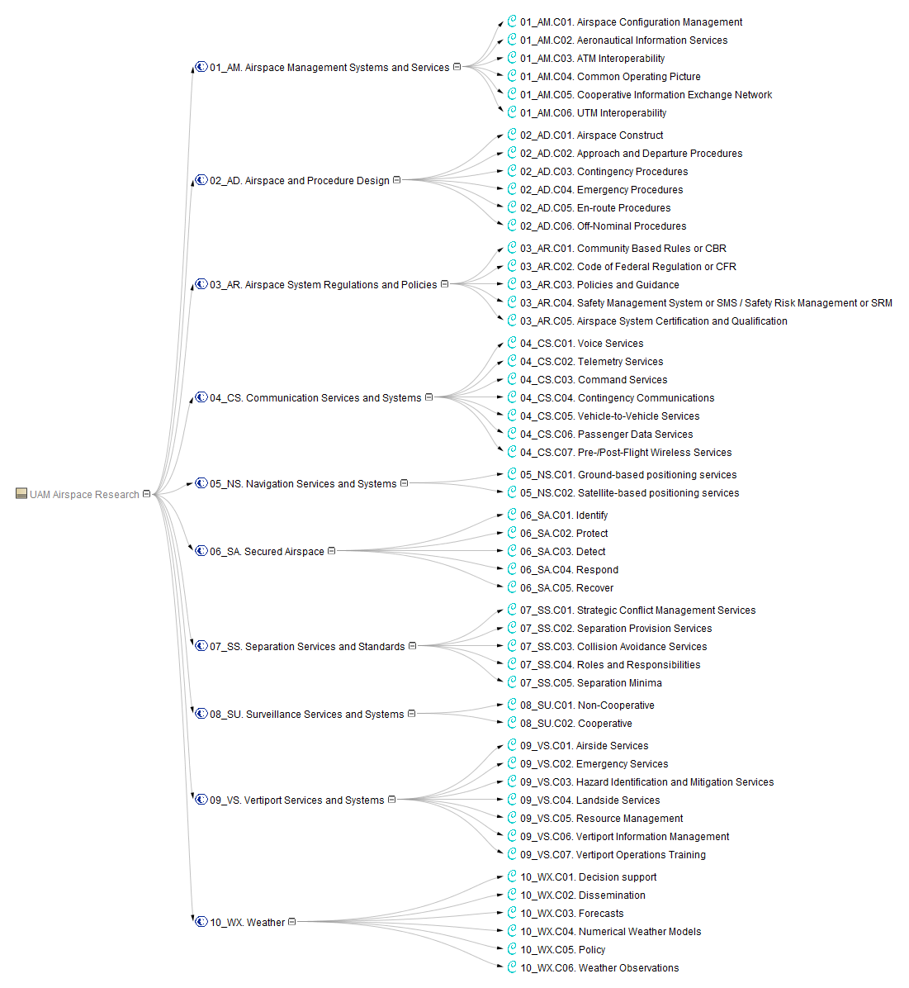
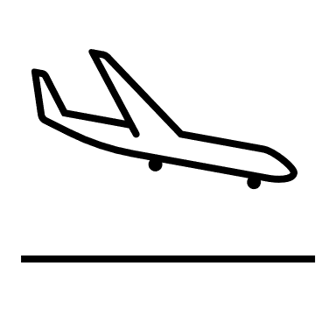
Development of a Research System
Identify/Discover requirements and flow-down to implementation of research system
Helps identify:
comprehensive set of capabilities
dependencies and interoperability

Slide 21
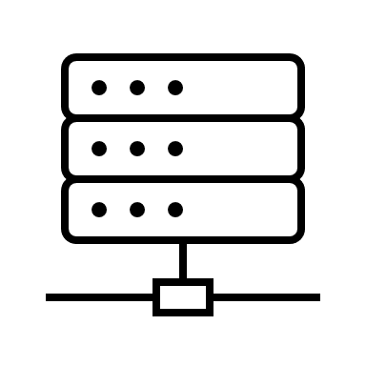
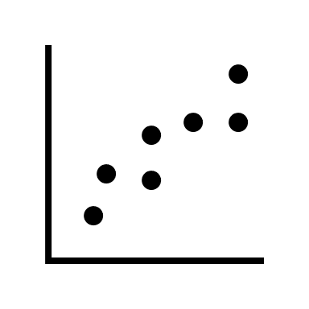
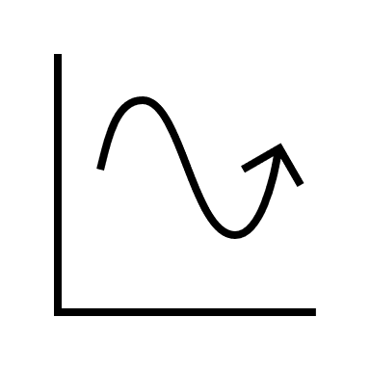
Integration of Research Results
Execute research to identify new requirements, and refine existing requirements
Research results validate and mature the requirements
Notes:
Expect this to lead to both improved research results, but also an improved model reflecting more about what we know

Slide 22
Practice
X5 & UML-3 Operational integration assessment (OIA)

Slide 23
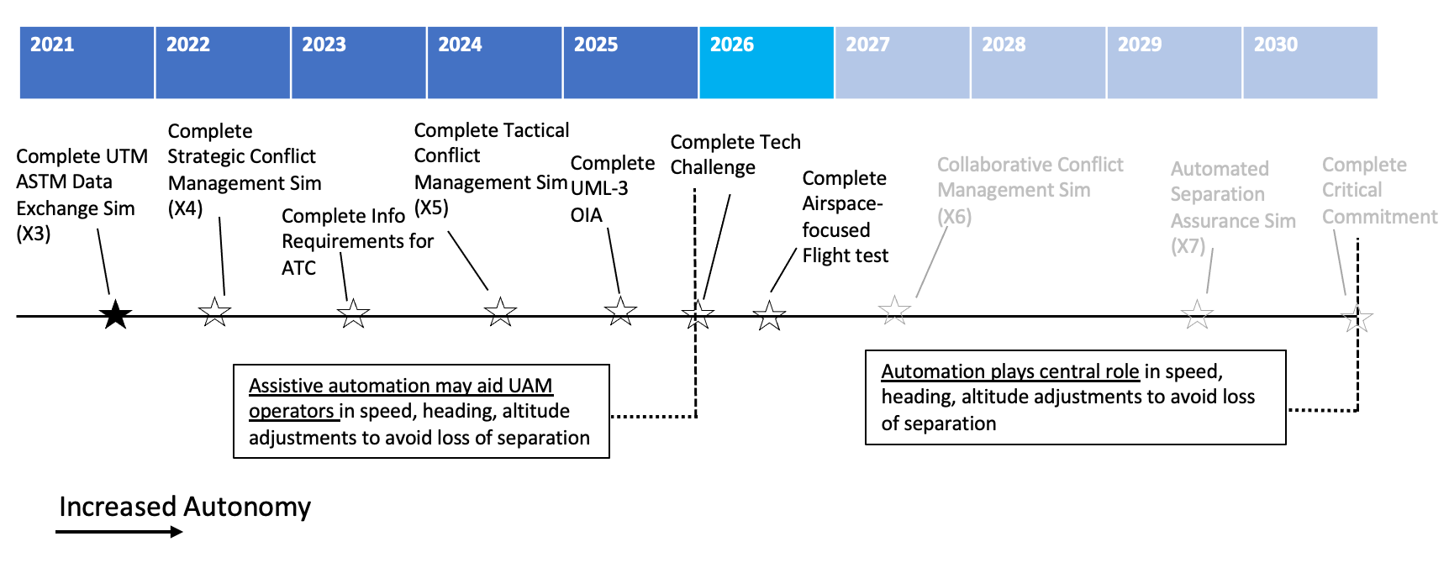
UAM Airspace Subproject’s Future Efforts
Ongoing/Upcoming
Applications
Notes:
Take a learning by doing approach, well suited to roadmap process.

Slide 24
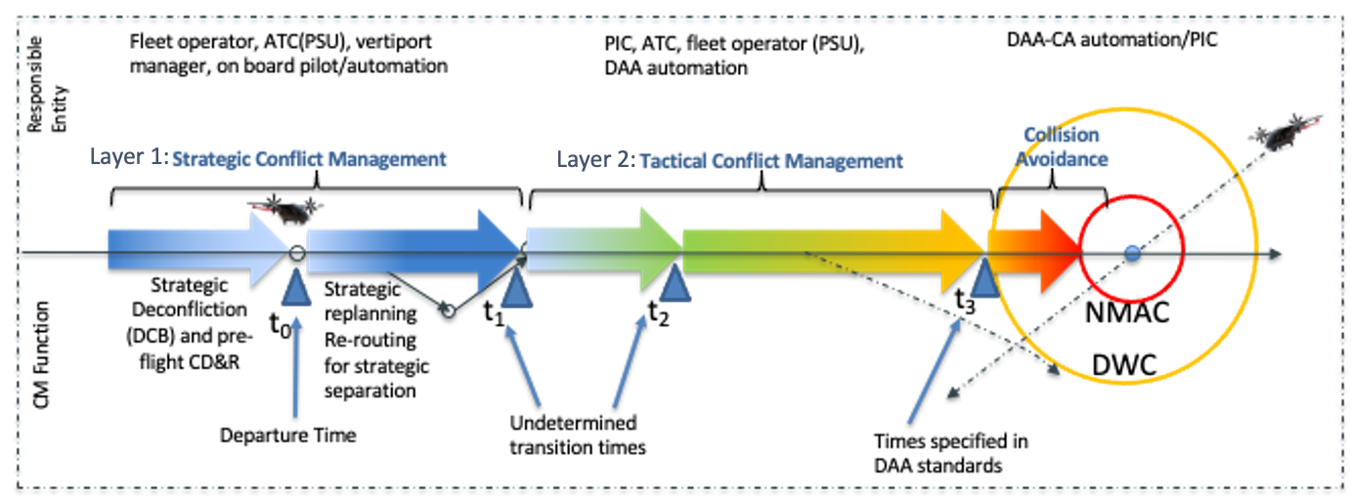
UML-3 Cooperative Conflict Management (CCM) Concept
Cooperative Conflict Management addresses scalability through new ATM paradigms that distribute the responsibility for Conflict Management amongst cooperative actors
Relies on common situation awareness, common operating picture
UML-3 will be in IFR or VFR, with novel procedures enabling increased tempo
Notional Conflict Management Diagram
Developed by NASA/Maria Consiglio
Notes:
Learning quickly, already in need of update

Slide 25
UML-3 Cooperative Conflict Management (CCM) Concept
VFR: managed flow of UAM traffic for increased throughput, extending below VMC, with acceptable pilot workload
Cooperative Conflict Management addresses scalability through new ATM paradigms that distribute the responsibility for Conflict Management amongst cooperative actors
Relies on common situation awareness, common operating picture
UML-3 will be in IFR or VFR, with novel procedures enabling increased tempo
Notional Conflict Management Diagram
Developed by NASA/Maria Consiglio

Slide 26
UML-3 Cooperative Conflict Management (CCM) Concept
VFR: managed flow of UAM traffic for increased throughput, extending below VMC, with acceptable pilot workload
IFR: efficient and predictable flow of UAM operations, with acceptable ATC workload at sustained tempos
Cooperative Conflict Management addresses scalability through new ATM paradigms that distribute the responsibility for Conflict Management amongst cooperative actors
Relies on common situation awareness, common operating picture
UML-3 will be in IFR or VFR, with novel procedures enabling increased tempo
Notional Conflict Management Diagram
Developed by NASA/Maria Consiglio

Slide 27
UML-3 Technical and Operational R&D
Tactical Conflict Management (X5)
Implement automation to support Cooperative Conflict Management
Strategic and Tactical for UML-3
Interoperability tested through simulation and analysis
Assess the effectiveness of the total system

Slide 28
UML-3 Technical and Operational R&D
Tactical Conflict Management (X5)
Implement automation to support Cooperative Conflict Management
Strategic and Tactical for UML-3
Interoperability tested through simulation and analysis
Assess the effectiveness of the total system
UML-3 Operational Integration Assessment (OIA)
Integrate X5 capabilities into a higher-TRL operational environment
Joint NASA/FAA integrated LVC
Most system actors represented
Integrate UAM and non-UAM traffic
Novel airspace constructs
Off-nominal scenarios
Key objectives
Accelerate UML-3 Operationalization
Evaluate innovative solutions for operational integration
Evaluate and explore ATM, Flight Crew, and Operator functions
Identify barriers associated with progressing operations from VMC to IMC

Slide 29
UML-3 Technical and Operational R&D
Tactical Conflict Management (X5)
Implement automation to support Cooperative Conflict Management
Strategic and Tactical for UML-3
Interoperability tested through simulation and analysis
Assess the effectiveness of the total system
UML-3 Operational Integration Assessment (OIA)
Integrate X5 capabilities into a higher-TRL operational environment
Joint NASA/FAA integrated LVC
Most system actors represented
Integrate UAM and non-UAM traffic
Novel airspace constructs
Off-nominal scenarios
Key objectives
Accelerate UML-3 Operationalization
Evaluate innovative solutions for operational integration
Evaluate and explore ATM, Flight Crew, and Operator functions
Identify barriers associated with progressing operations from VMC to IMC
Traces to broad set of research requirements and assumptions

Slide 30
Requirements Development
X5 / OIA research requirements

Slide 31
Integration of Research Results
X5 / OIA research results
Notes:
Expect this to lead to both improved research results, but also an improved model reflecting more about what we know

Slide 32
Agile Requirements Development
Continuous process of requirements discovery and research system test & evaluation
X5 / OIA research requirements
X5 / OIA research results

Slide 33
Next Steps
Practice
Baseline UAM Airspace Research Roadmap v2.0 in Jan 2023
Build out database of research results
Apply AI/ML techniques to increase efficiency of the researcher, program manager, and system engineer
Apply process to next 5-8 years of ATM-X UAM Subproject research
Theory
Develop concept of operations for Knowledge-based Digital Platform
Study transportation system enterprise and its sectors

